Slide 1
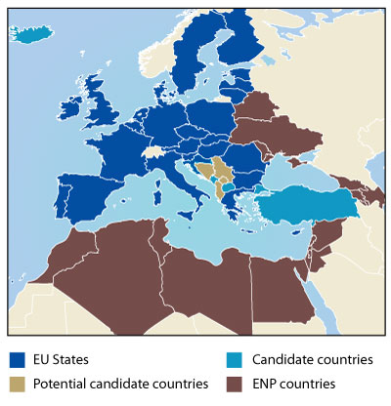
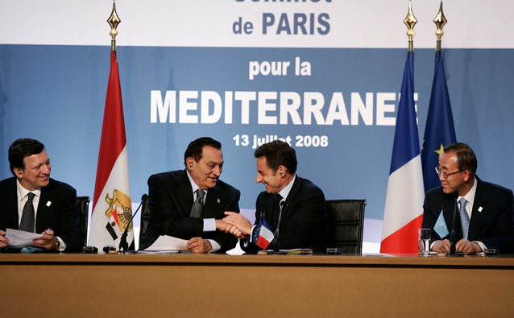
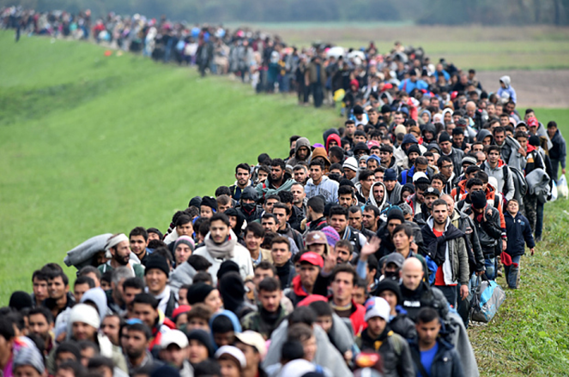
EU AND the Middle East
Mgr. Eva Taterová, M.A., Ph.D.
Politics and Society in the Middle East

Slide 2
CONCEPT OF SOFT POWER
Term opposed to „hard power“ (power to coerce).
EU tries to spread its own values and ideas (democracy, human rights) in the world.
Crucial for close neighbours because of stability.
Some EU states disagreed with US intervention to Iraq.

Slide 3
COPENHAGEN CRITERIA
Set of conditions the candidate states would have to fulfil to become members:
  Political – democracy, stable institutions, rule of law, respect to human rights.
  Economic – market economy, ability to sustain competition in the internal market.
  Aquis communitaire– to transport all EU law into national legal orders (including EMU).

Slide 4
MEMBERSHIP CONDITIONALITY
For many countries EU membership is very attractive.
“Power of attraction“ can turn soft power into a power of coercion.
The possibility of membership has to be credible.
For many European countries nowadays EU membership is a “far shot“.

Slide 5
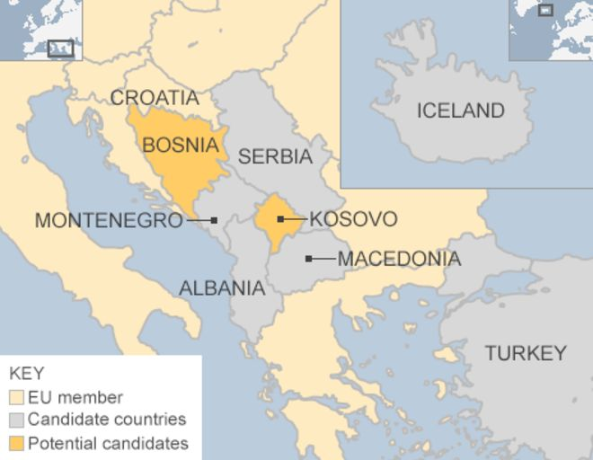
EU CANDIDATE COUNTRIES
Turkey
Nothern Macedonia
Montenegro
Serbia
Island (stopped)
Since 2014 Albania

Slide 6
POSITION OF TURKEY
Associate member since 1963.
Partner country in NATO.
Application in 1987, candidate country since 1999.
Negotiations opened in 2004, but are very slow.
Poor country (but with huge GDP growth), large agriculture.
Does it lie in Europe?
Common history.
Current political problems in Turkey.

Slide 7
EUROPEAN NEIGHBOURHOOD POLICY
Established in 2004 as a framework of relations with neighbouring countries.
First idea was to capitalize on the relations of the new member states with EECs.
The southern countries wanted to include also Mediterrean countries.
Includes altogether 16 countries.
In fact bilateral relations between the EU and a given country.

Slide 8
EUROPEAN NEIGHBOURHOOD POLICY
Action Plans are the most important tools – program of concreate reforms in the area of democracy, access to EU markets.
Monitoring of progress.
ENP as a main financial instrument of cooperation.

Slide 9
EU AND MEDITERRANEAN
One of the first regions where the then EC established deeper ties.
1995 as a breaking point – Barcelona Process signed.
Multilateral platform of cooperation.
Political, security, economic, cultural and social level of cooperation.

Slide 10

UNION FOR MEDITERRANEAN
Follows the former Barcelona Process established in 1995.
Was created in 2008, idea of Nicolas Sarkozy – at first it should have been a much closer union of states.
Turkey opposed – no alternative to EU membership.

Slide 11
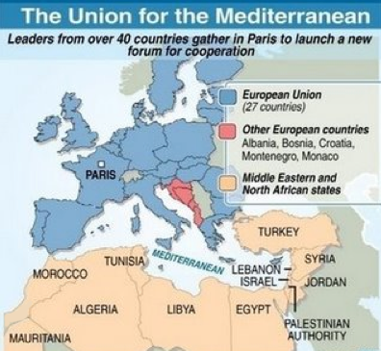
UNION FOR MEDITERRANEAN
Contains EU countries, Maghreb and Mashriq countries, Bosna, Montenegro, Albania, and Mauritania.
Ambitious goals: cooperation in education, industry, science, transport, energy security, water resources, development
of rural areas, and many others.

Slide 12
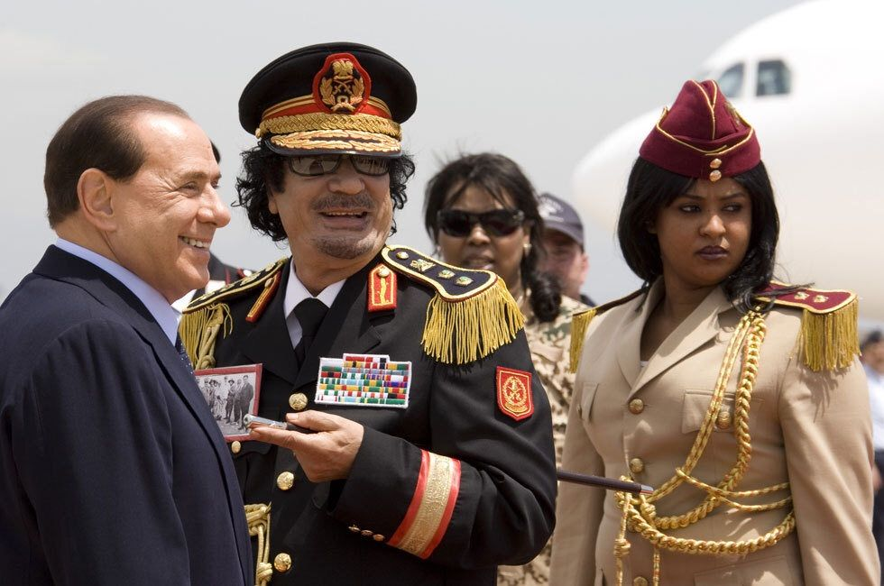
EU AND MAGHREB
Countries that are important for EU countries as regards resources: Lybian oil (25% for Italy in 2009) and gas from Algeria (ITA 42%)
Cooperation in migration crisis.
Cooperation on terrorism – potentialy problematic countries.

Slide 13
EU AND ARAB-ISRAELI CONFLICT
EU supports the idea of two states.
Since 1967, most of western European countries rather support Arab side.
EU criticizes Israeli settlements.
EU part of the Quartet (together with U.S., Russia and UN).
Member states divided on recognition of Palestine (CZE against,
UK and DE abstained).

Slide 14
EU AND THE ARAB SPRING
EU supports democratic changes in the region.
Substantional amounts of money have been provided through the Support to Partnership, Reform and Inclusive Growth Policy (SPRING).
Syria – EU was only able to agree on sanctions – lowest common denominator.

Slide 15
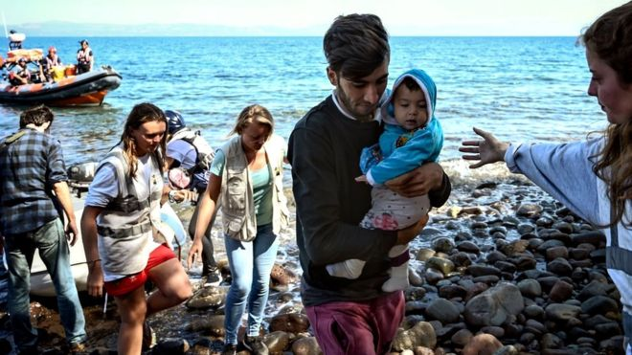

EU AND MIGRATION CRISIS
Cooperation of neighbouring countries is crucial
for tackling illegal migration.
These countries should protect their border and
not to let transit.
Existence of readmission treaties.
Most problematic border is Turkey-Greece – FRONTEX action needed – Treaty with Turkey.

Slide 16
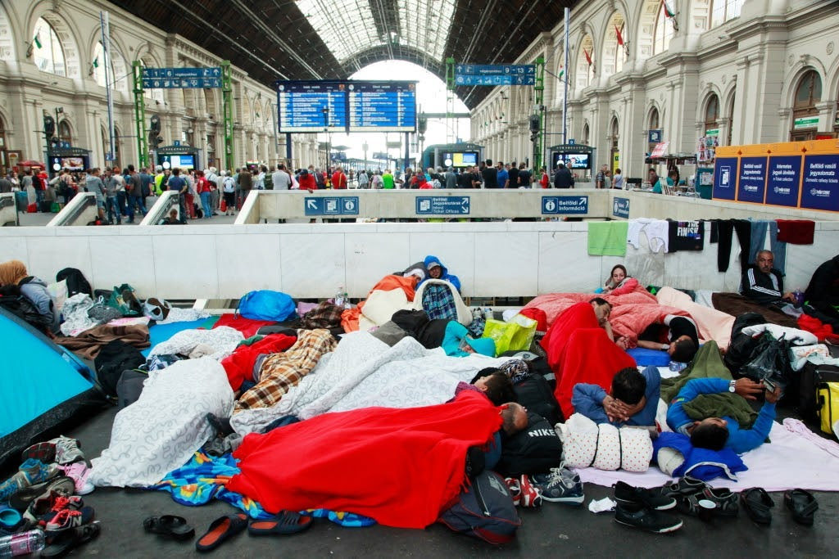
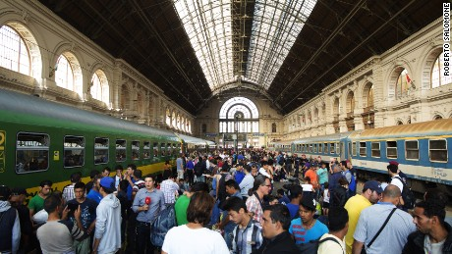
MIGRATION CRISIS
Start in 2015 – sharp increase
in the number of migrants – over
a million people came.
EU response was quite slow.
Treaty with Greece sealed the Mediterranean route.
Pressure moved to Italy – cooperation with Libya.
Currently most people come through Spain, but the numbers
are much smaller.

Slide 17
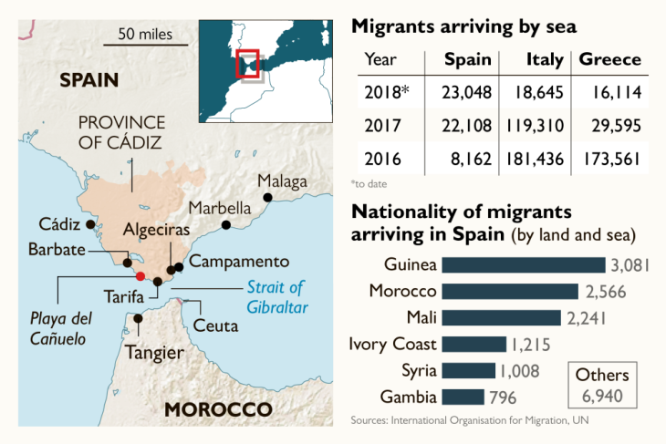
MIGRATION CRISIS: STATISTICS

Slide 18
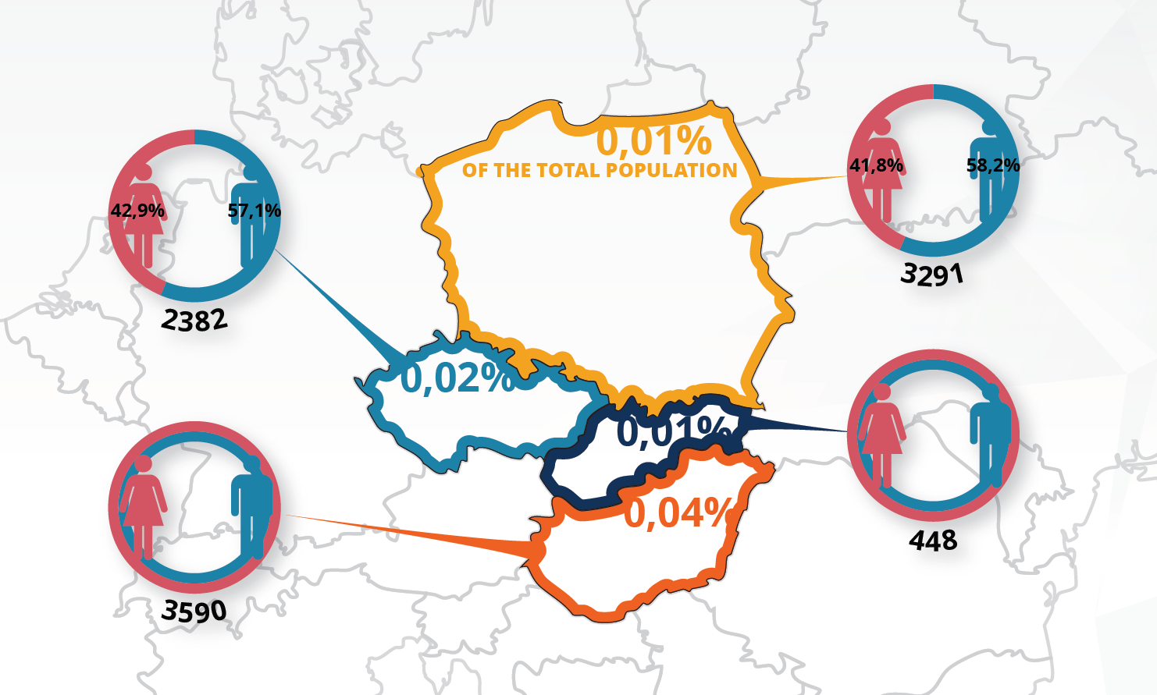
APPROACH OF VISEGRAD COUNTRIES
In general, there are not many refugees in V4 countries (most of them come from former USSR).
V4 countries deny quota system suggested by EU.
Solidarity within EU?

Slide 19
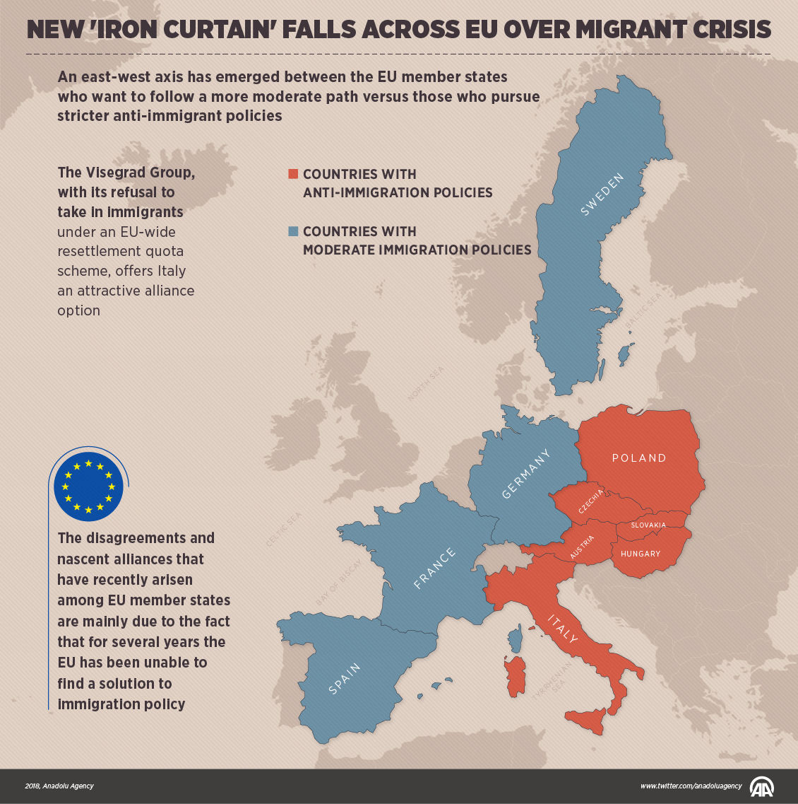

Slide 20
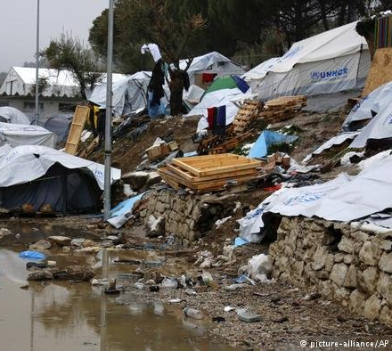
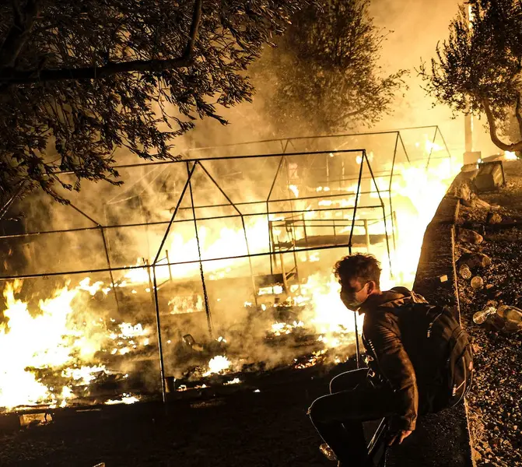
MORIA CAMP, GREECE

Slide 21
SOLUTIONS?
New rules?
Current rules put burden at some particular states.
Difficult to find consensus in Europe.
Asylum quotas?
Cooperation with African/Northern African states??
Migration/development nexus?

Slide 22
THANK YOU FOR YOUR ATTENTION

