Slide 1
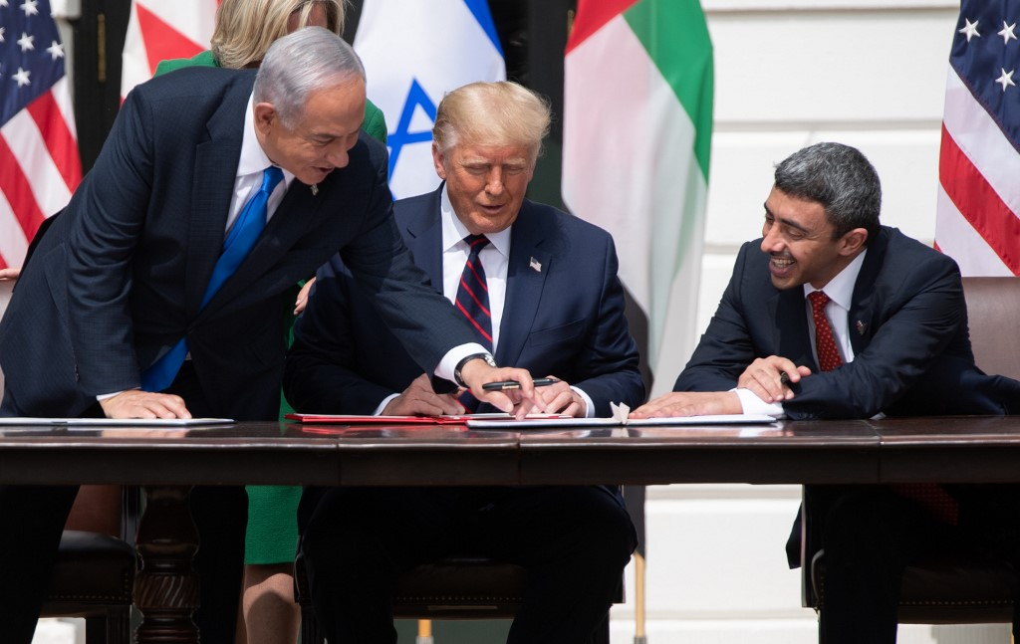
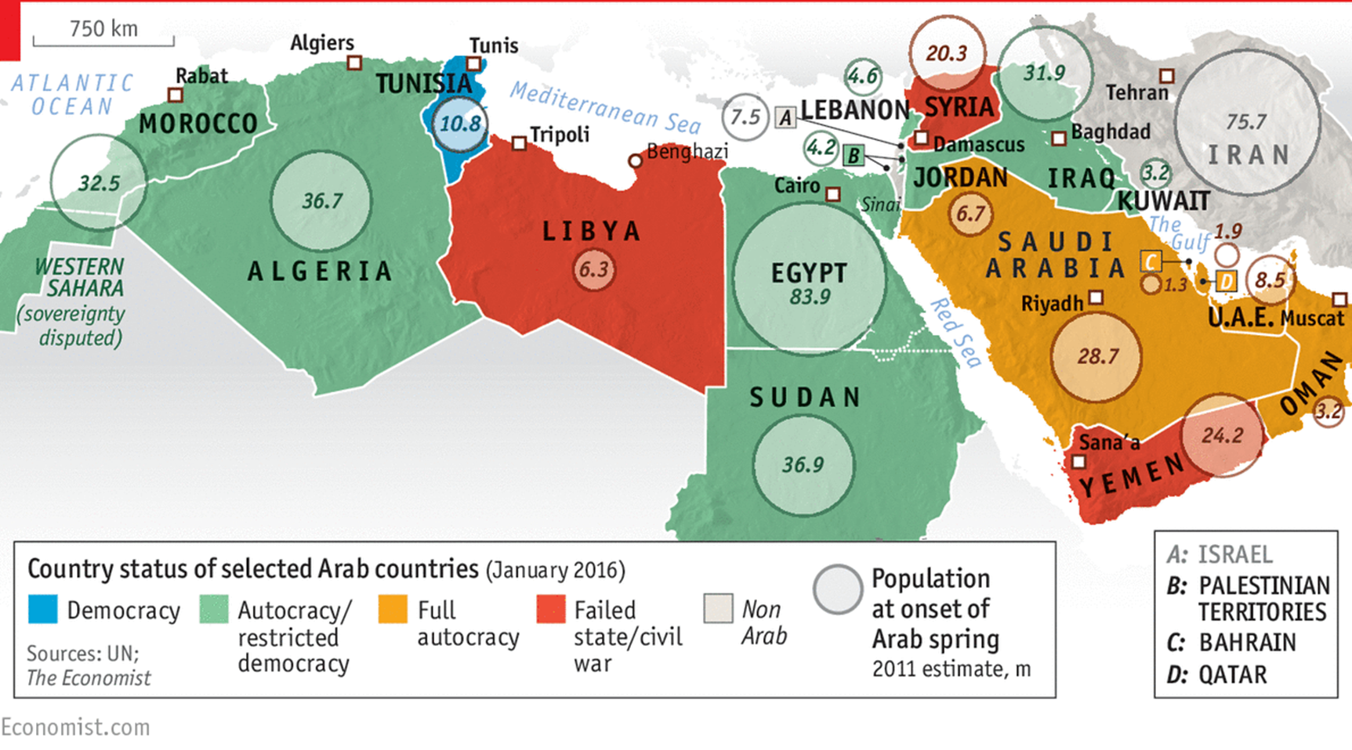
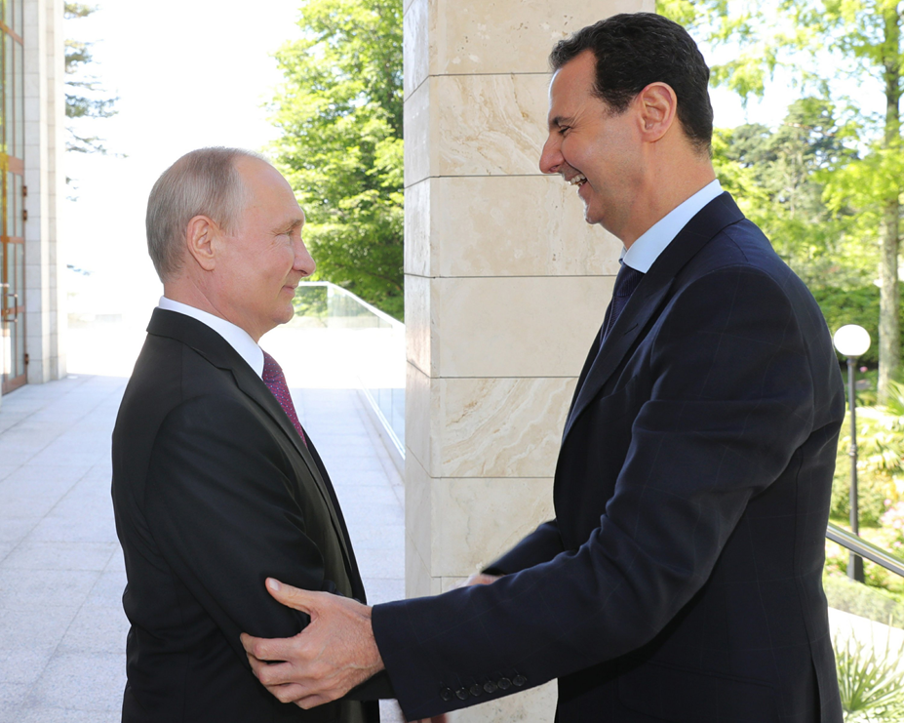
CURRENT ISSUES IN THE MIDDLE EAST
Mgr. Eva Taterova, M.A., Ph.D.
Faculty of Social Studies
Masaryk University

Slide 2
FINAL EXAM
Final Exam: January 14, January 28, February 11 (12 CET)
6 open questions sent by e-mail (cover lectures and readings from the whole semester)
Time: 1 hour
Submission: Information System of Masaryk University
Total: 60 points

Slide 3
GRADES
A 92 - 100
B 84 - 91
C 76 - 83
D 68 - 75
E 60 - 67
F less than 60 points

Slide 4
Ambiguous (and still open) consequences of the Arab Spring
A stable but often very brutal autocracy sinks into chaos (Syria, Yemen, Libya) or the resurgence of autocracy (Egypt).
In the ongoing chaos, radicals of all kinds are strengthening - from secularists (clan warlords in Syria or Kurdish militias) to religious extremists (ISIS, An-Nusra).
Weakening US power, slightly strengthening influence of Russia (Syria), China, regional power Turkey is trying to become a local hegemon.

Slide 5
Ambiguous (and still open) consequences of the Arab Spring
Intra-Islamic religious disputes are politicized and sharpened (Saudis and their allies versus Iran and its allies), the Israeli-Arab conflict (but not the Israeli-Palestinian conflict) is de-escalating.
Giant refugee waves, humanitarian disasters, devastation or stagnation of economies, rising inequality and poverty.
Abdel Fattah el-Sisi

Slide 6
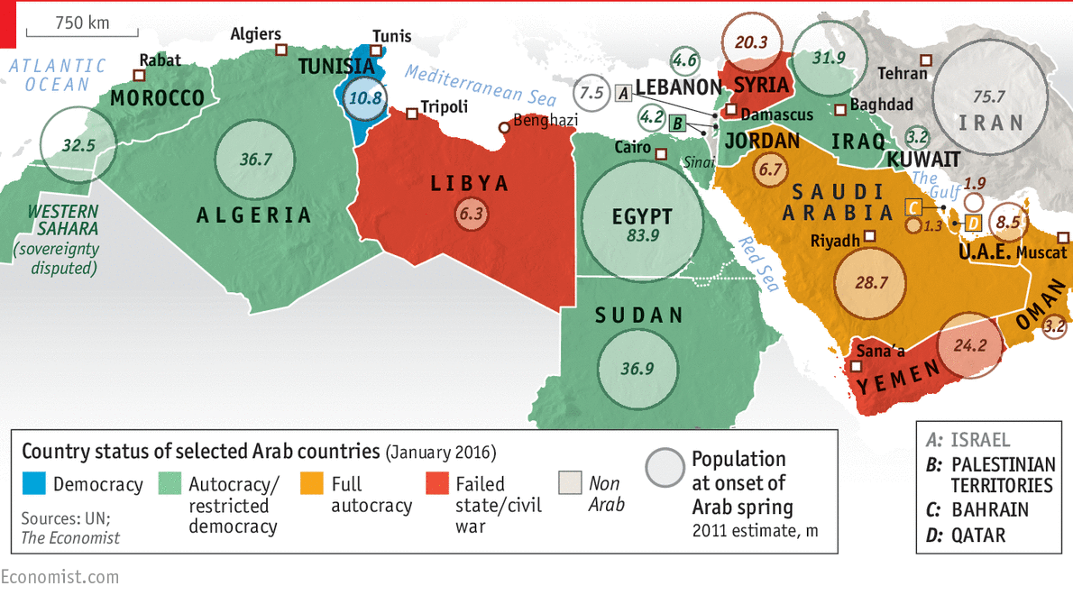
Situation after the Arab Spring

Slide 7
The Arab Spring led to the strengthening of three alliances:
1. "Saudi" - inaccurately "Sunni" bloc
maintaining the conservative regimes of the Middle East (mainly Saudis, UAE + Bahrain, Egypt) + Israel
2. "Iranian" - inaccurately "Shiite" bloc
Iran, Syria, Lebanese Hezbollah, largely the government in Iraq
3. Qatar and Turkey
Proxy Wars - Iraq, Syria, Yemen, etc.

Slide 10
POSITION OF ISRAEL
Normalization of the diplomatic relations with selected Muslim countries in 2020:
United Arab Emirates.
Bahrain.
Sudan.
Morroco.
Israeli prime minister Benjamin Netanyahu, US President Donald Trump, and UAE Foreign Minister Abdullah bin Zayed Al-Nahyan

Slide 11
2019 and Turkey as a new key player
Member of NATO (2nd strongest army).
Fighting Kurds (YPG / PKK).
It benefits from the problems of Syria.
An important role in the context of the migration crisis.
Increasing domestic and foreign influence of President Erdogan.
Business partner of the United States.
Recep Tayyip Erdoğan

Slide 12
CURRENT POLITICAL CHALLENGES
Change in US foreign policy - gradual abandonment of the Middle East.
High unemployment in post-war states (Iraq, Syria).
High debt and corruption.
Political and religious instability.
Missing and insufficient infrastructure.
Consequences of covid-19 pandemy for the region.

Slide 13
THANK YOU FOR YOUR ATTENTION

