Slide 1
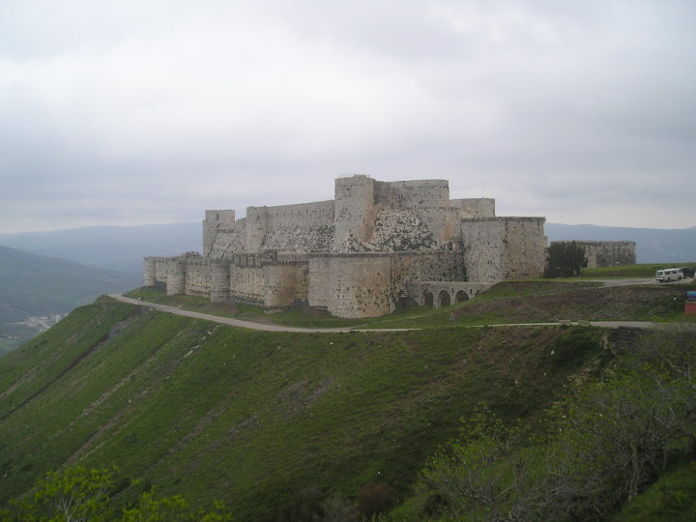
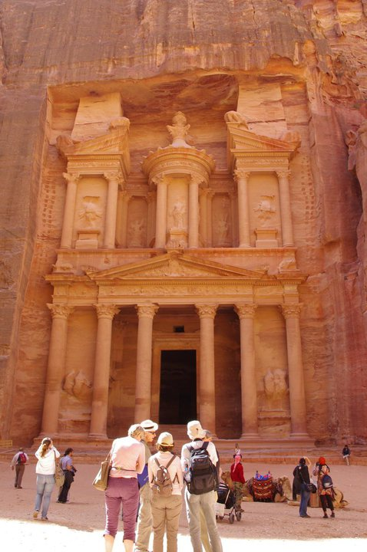
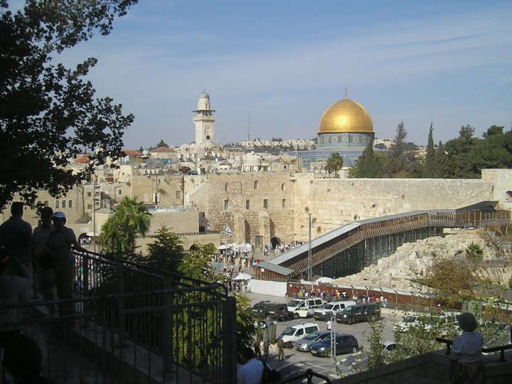
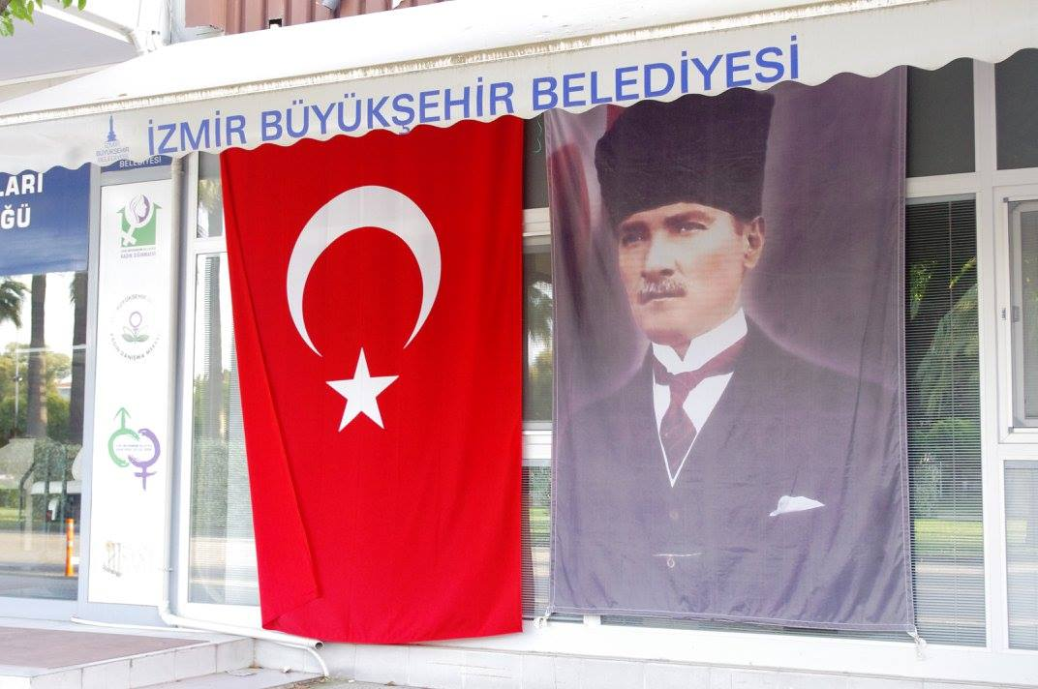
POLITICS AND SOCIETY IN THE MIDDLE EAST
Mgr. Eva Taterova, M.A., Ph.D.
Faculty of Social Studies
Masaryk University

Slide 2
COURSE OVERVIEW
Online MS Teams: https://teams.microsoft.com/l/team/19%3ab0d0b5ab9fcd4ed3b2c1db19838a9892%40thread.tacv2/conversations?groupId=c05d8366-4960-4f80-90d6-8a51da33eec2&tenantId=11904f23-f0db-4cdc-96f7-390bd55fcee8
Credits: 4 ECTS
Lecturer: Mgr. Eva Taterova, M.A., Ph.D. (evataterova@gmail.com)

Slide 3
COURSE SCHEDULE
October 8: Introduction. scope of the course, organization of the course, and course requirements
October 15: Middle East: the basic terminology, geography, demography
October 22: History of Middle East before 1945
October 29: Arab-Israeli Conflict I
November 5: Arab-Israeli conflict II
November 12: Iran: From Western Ally to Islamic Republic

Slide 4
COURSE SCHEDULE
November 19: Midterm, movie
November 26: Political Development of Lebanon
December 3: Post Cold War Conflicts in the Middle East
December 10: War in Syria
December 17: EU and the Mediterranean region
January 7: Current Events in the Middle East
January 14: Final Exam

Slide 5
COURSE ACTIVITIES
Midterm: November 19, 5 open questions, 40 points
Final Exam: January 14, 6 open questions, 60 points

Slide 6
GRADES
A 92 - 100
B 84 - 91
C 76 - 83
D 68 - 75
E 60 - 67
F less than 60 points

Slide 7
LEBANON

Slide 9
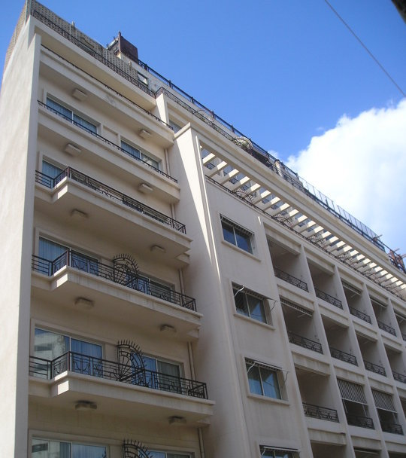
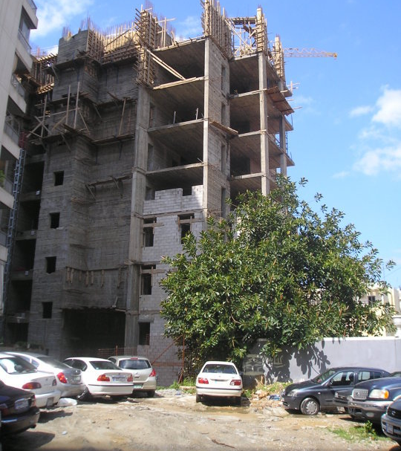

Slide 10
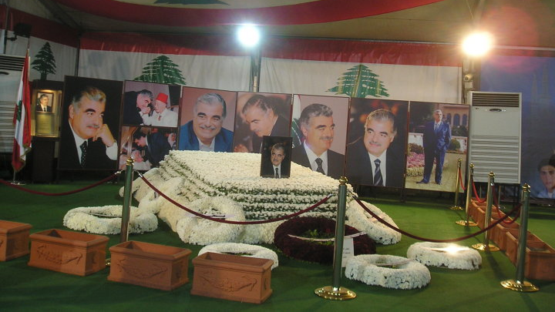

Slide 11
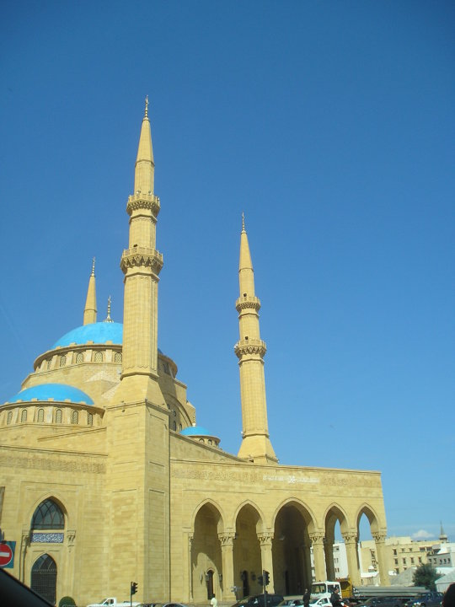
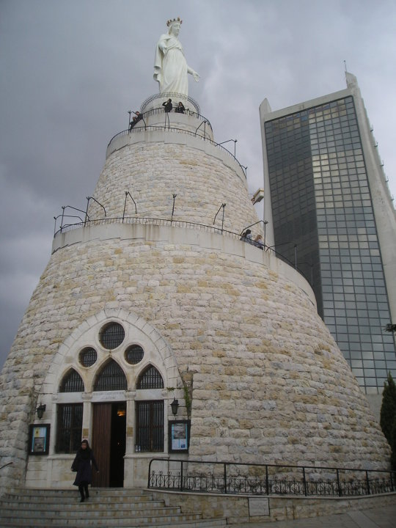

Slide 12
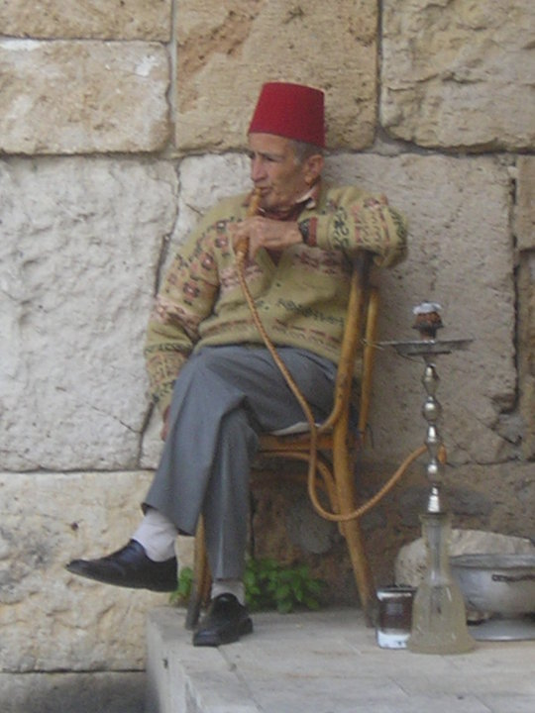
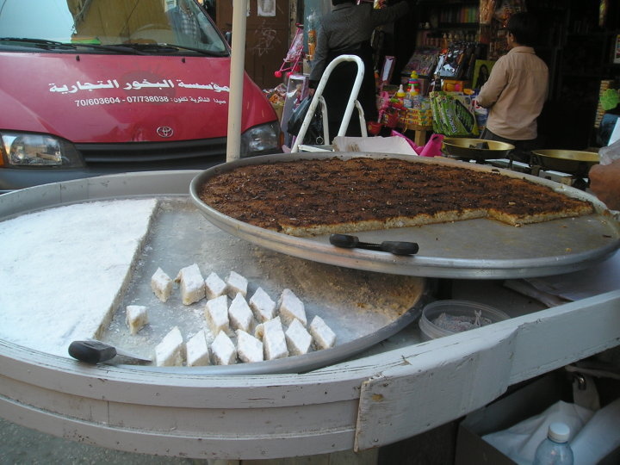

Slide 13
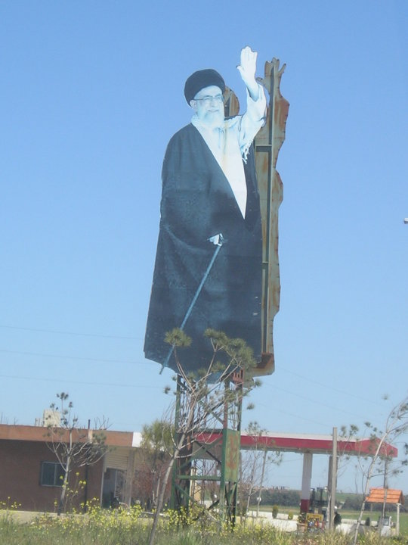
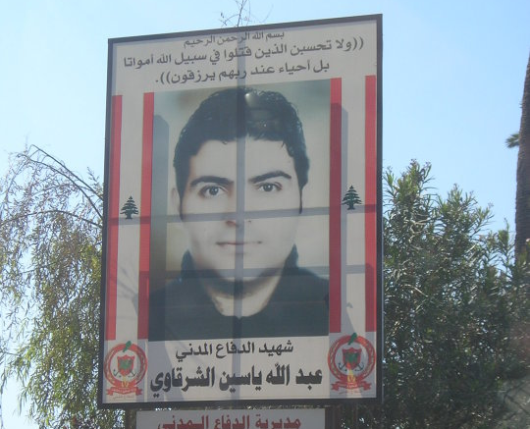

Slide 14
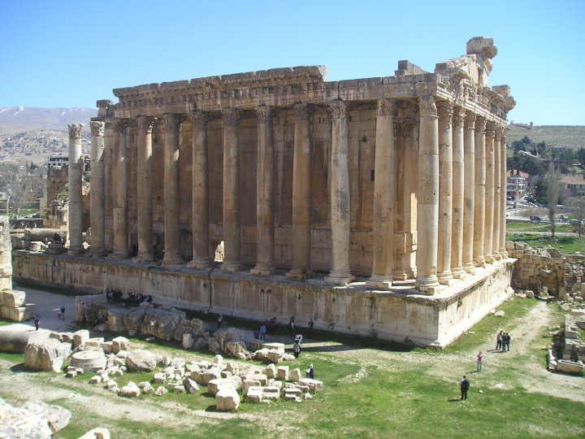

Slide 15
SYRIA

Slide 17
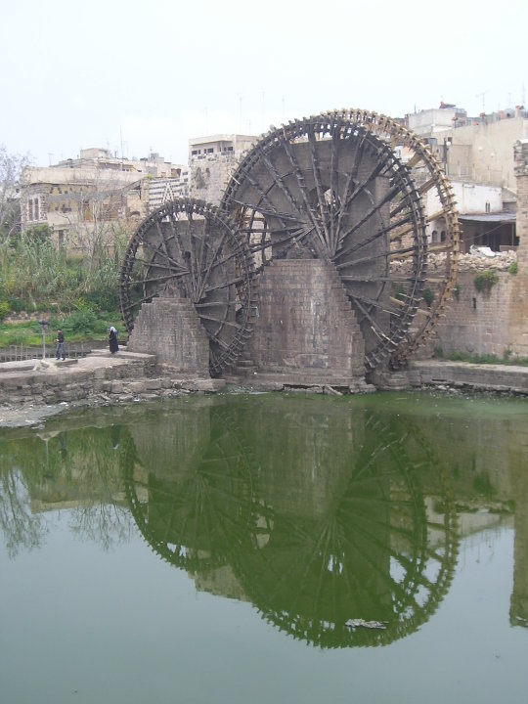
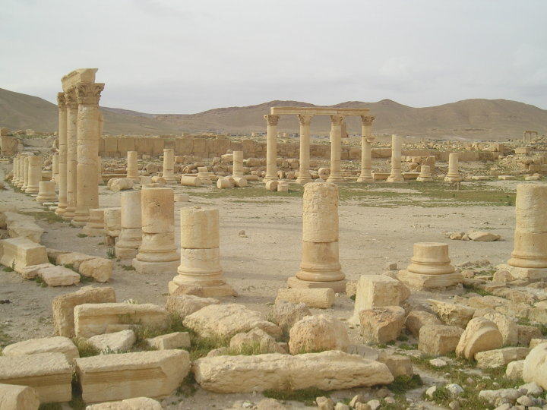

Slide 18
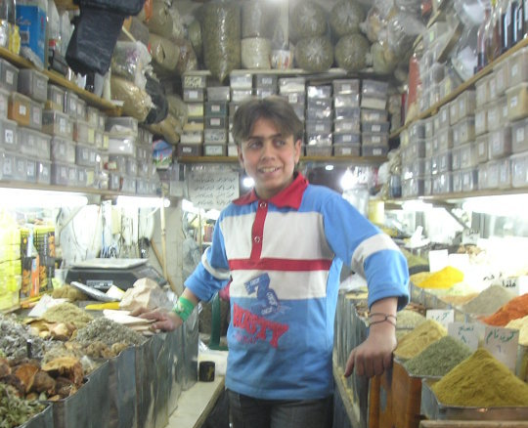
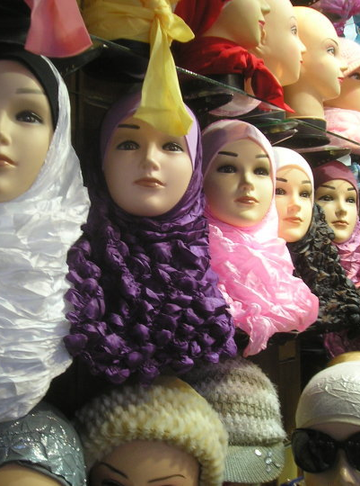

Slide 19
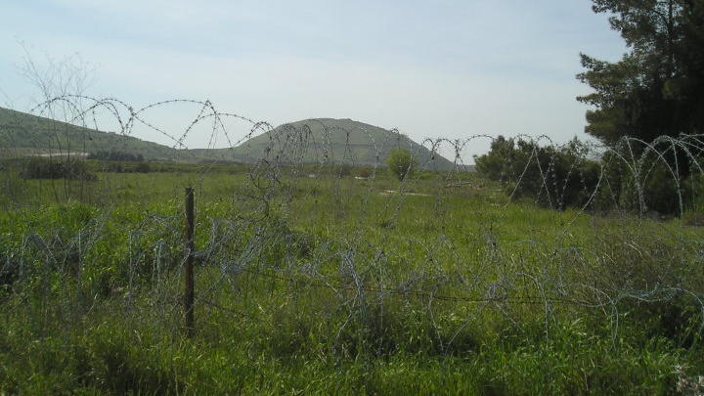

Slide 20
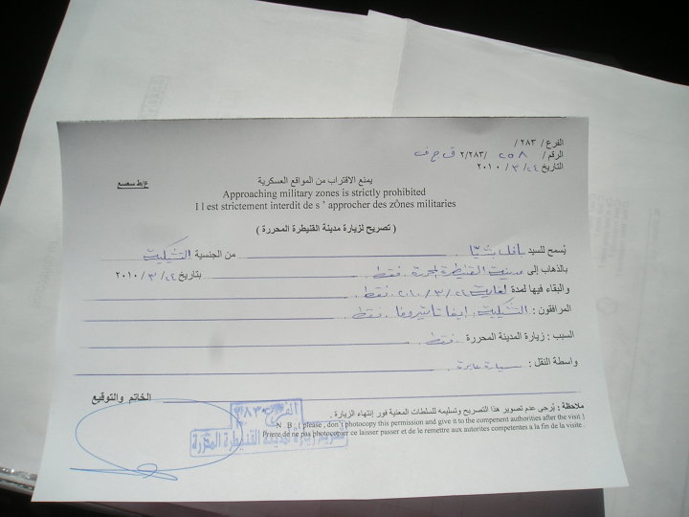
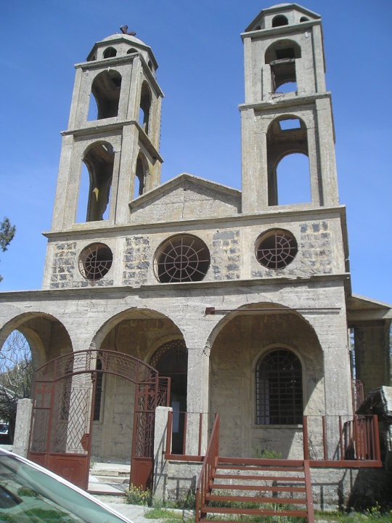

Slide 21
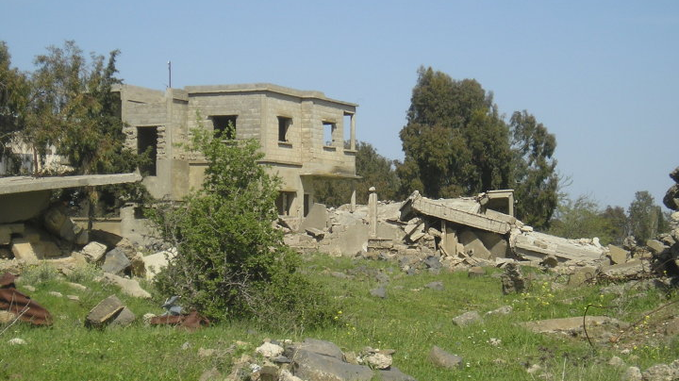

Slide 22
JORDAN

Slide 25
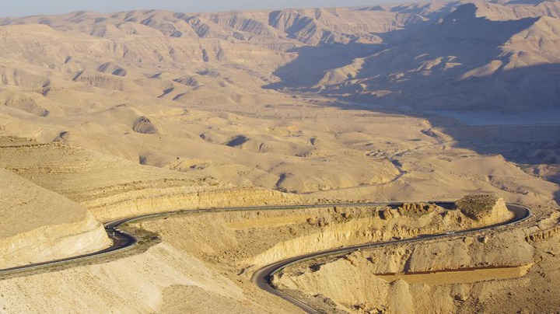

Slide 26
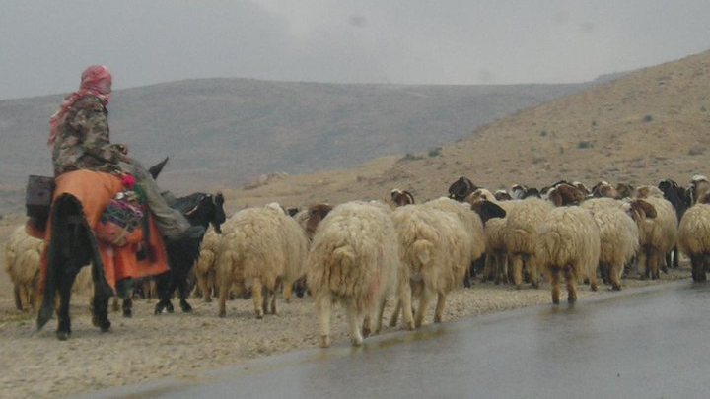

Slide 27
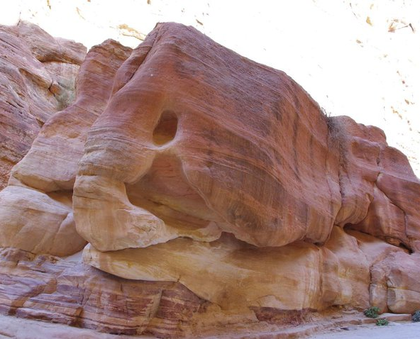

Slide 28
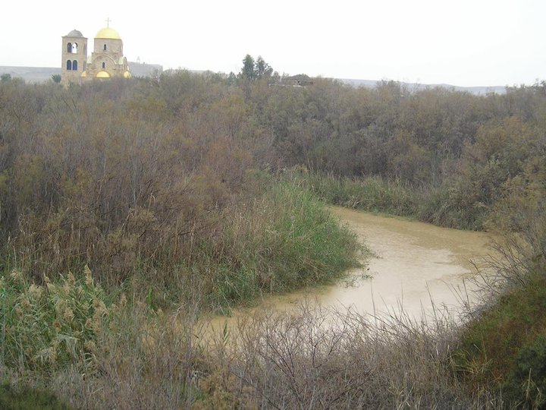

Slide 29
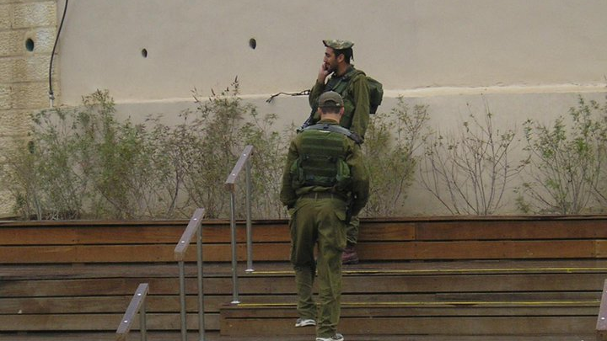

Slide 30
ISRAEL/PALESTINIAN TERRITORIES

Slide 31
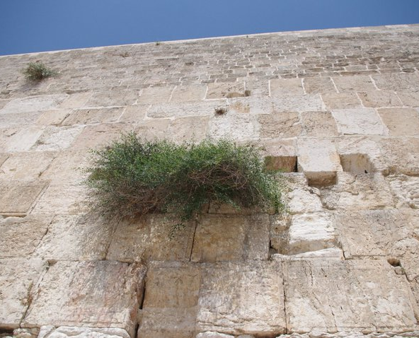

Slide 32
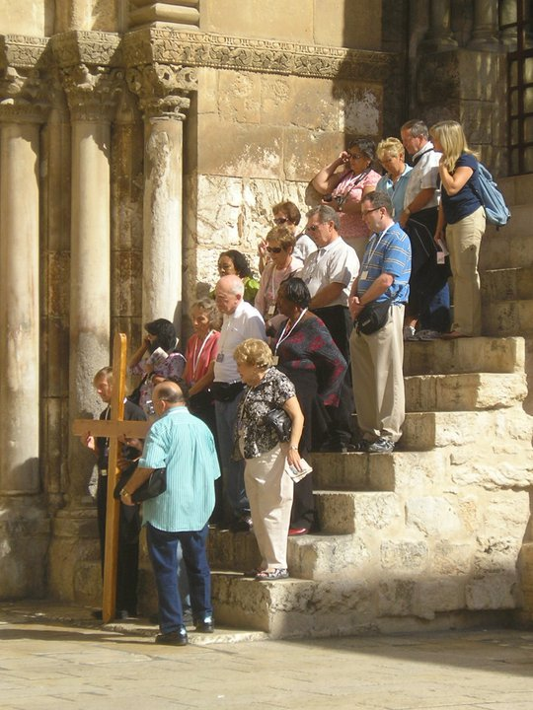
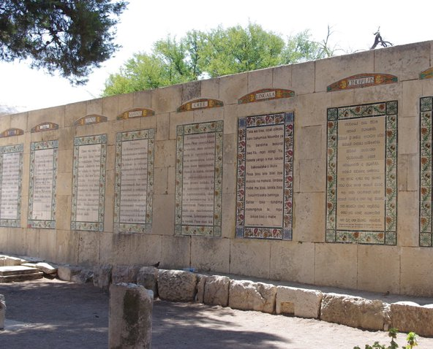

Slide 33
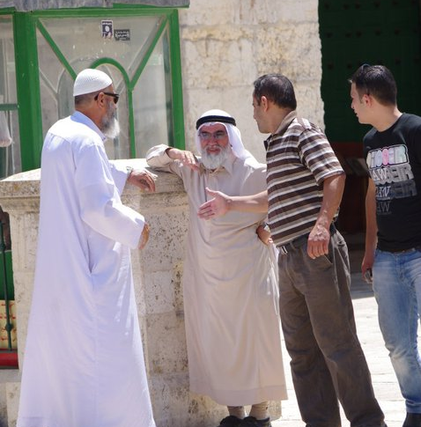
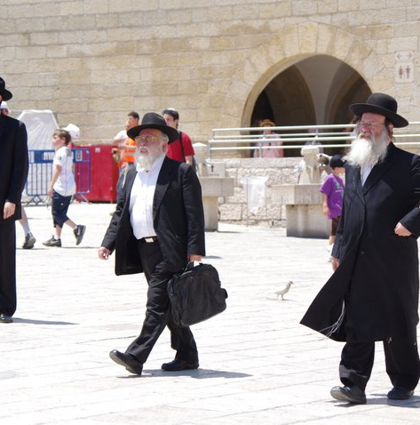

Slide 34
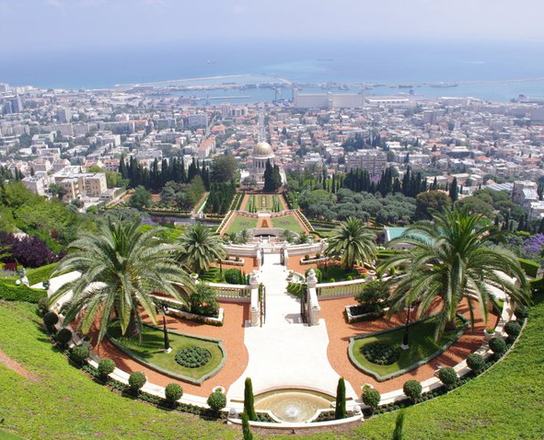
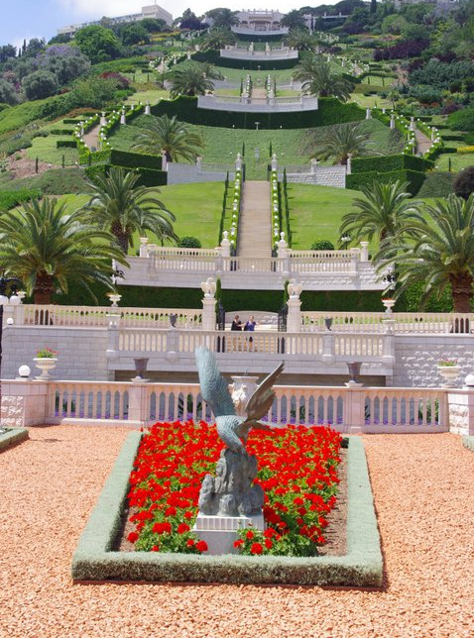

Slide 35
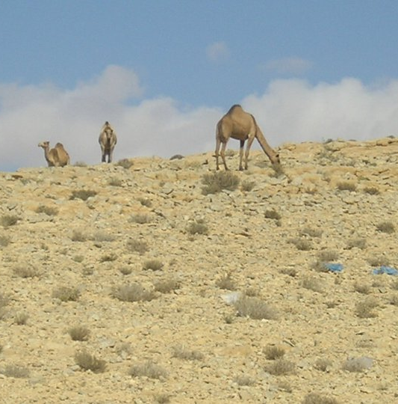
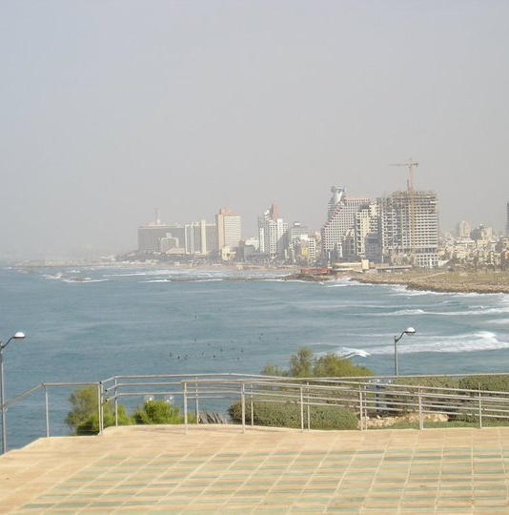

Slide 36
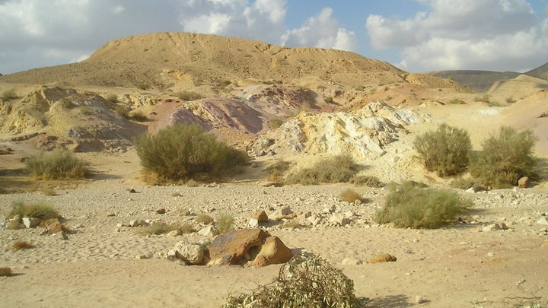

Slide 37
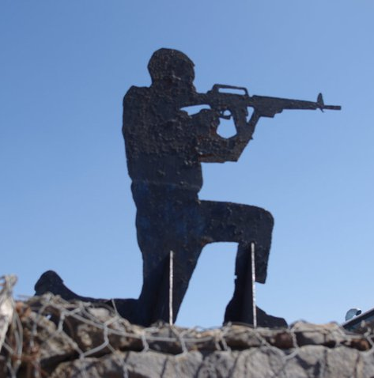

Slide 38
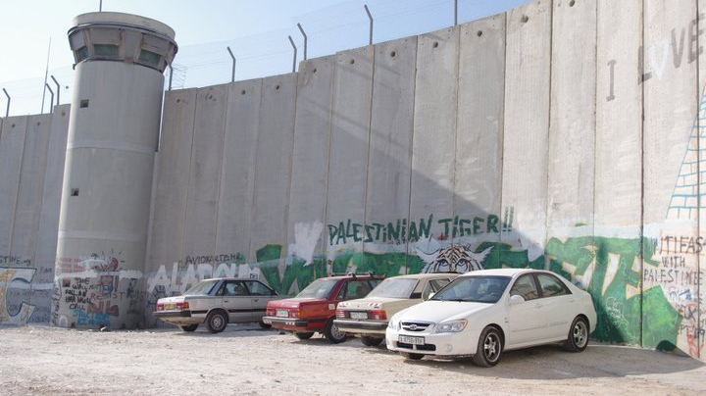

Slide 39
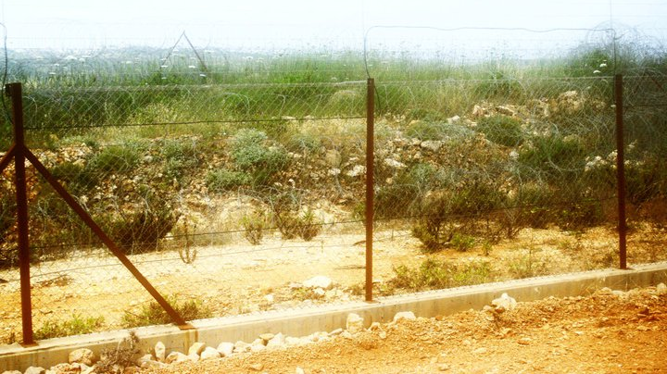

Slide 40
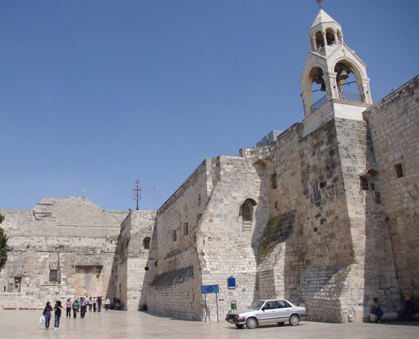

Slide 41
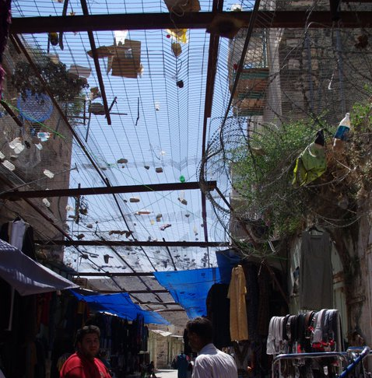
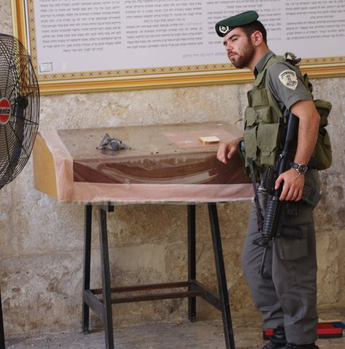

Slide 42
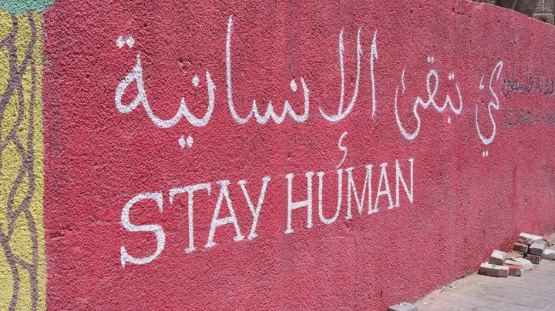

Slide 43
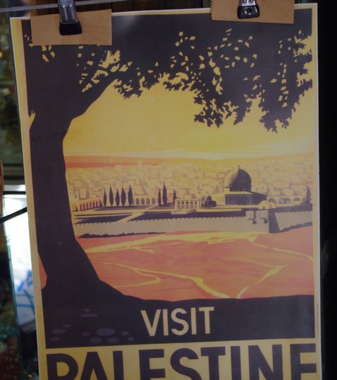
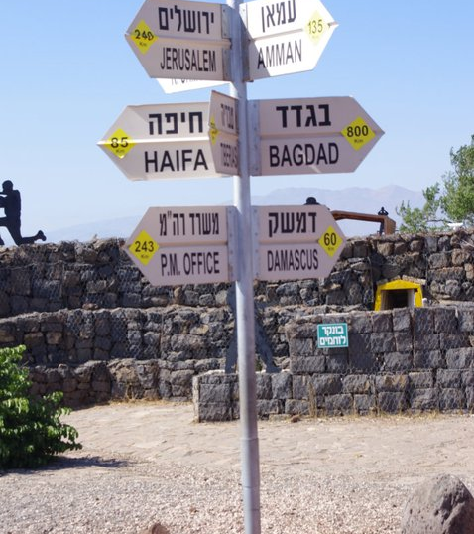

Slide 44
THANK YOU FOR YOUR ATTENTION

