Slide 1
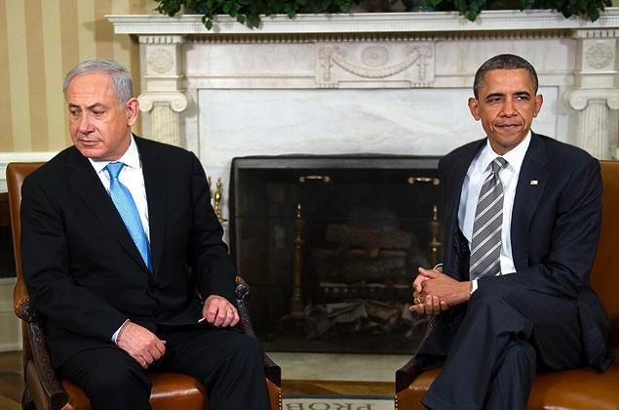
Asset or Liability
U.S and Israeli relationship

Slide 2
Background
America’s commitment to Israel is motivated by morality and ethics
  the Holocaust, to Western anti-Semitism and to American public apathy before and during World War II that left European Jews to be killed by the Nazis.
Second, Israel is a democracy with the same values as the United States.
Third, the United States will never abandon Israel, and will help it keep its military edge over its neighbors.
Since 2010, arguably earlier, questions as to Israel being a liability or an asset has been asked.

Slide 3
Asset
Shared values and moral responsibility remain unshakable foundations of U.S.-Israel relations,"
    Robert D. Blackwill and Walter B. Slocombe Israel: A Strategic Asset for the United States.
"But the relationship stands equally on an underappreciated third leg: common national interests and collaborative action to advance those interests."

Slide 4
Asset
It is to America’s advantage to have in Israel an economy that is so closely associated with the USA.
  innovator in the information and technology field,
  high-tech medicine, and in
  green technologies like the electric car.
The Obama administration made the economic health and well-being of the United States the pillar of its National Security Strategy.
  Clinton administration, James D. Boys Clinton Grand Strategy

Slide 5
Asset
The peace process has been a vehicle for American influence throughout the broad Middle Eastern region.
An excuse for Arab declarations of friendship with the United States,
    regardless if Americans remain devoted to Israel.
    Helped eliminate what might be a zero-sum game

Slide 6
Asset
A long list of military-related advantages.
Israel—through its intelligence, its technology, and the lessons learned from its own experience in counterterrorism and asymmetric warfare
Israel’s unique counterproliferation efforts—destroying nuclear reactors in Iraq (1981) and Syria (2007) Israel’s contribution to Western security is greater.
Bottom line: do a cost-benefit analysis of the U.S. relationship with Israel over the past thirty-plus years and the U.S. relationship with its Arab friends in the Gulf.
  To secure its interests in the Arab-Israeli arena, the United States has spent about $100 billion in military and economic assistance to Israel, plus another $30 billion to Egypt and relatively small amount to other Arab nations.
  On a state-to-state basis, investment in Israel has paid off in terms of regional stability. pre-2011.

Slide 7
Reversal
We had an arms embargo on Israel until Lyndon Johnson 1964.
In 1973, for reasons of the Cold War, rescues Israel as it battled Egypt.
  values only to values + (strategic) relationship
The resulting Arab oil embargo cost the U.S. And also there is all the time we’ve put into the perpetually ineffectual and now long defunct “peace process.”

Slide 8
Liability
U.S. domestic partisan politics (2012, 2014)
  payback ? (1996, 2001, 2005)
Strategic ally?
  Turkey (geopolitical ally)
  Saudi Arabia (U.S. Armed Forces)
  Bahrain (U.S. navy)

Slide 9
Liability
Political costs to the U.S. internationally of having to spend our political capital this way are huge.
Protecting ally (Israel) from continual and increased international indignation about Israel’s behavior
  grave damage to U.S. global and regional standing.
Severely impaired U.S. ties with the world’s 1.6 billion Muslims not only in the Middle East.
But it has also cost us much of our followership in international organizations.
  U.N.

Slide 10
Liability specifics
The conflict foments anti-American sentiment, due to a perception of U.S. favoritism for Israel.
Arab anger over the Palestinian question limits the strength and depth of U.S. partnerships with governments and peoples in the AOR and weakens the legitimacy of moderate regimes in the Arab world.
Meanwhile, al-Qaeda and other militant groups exploit that anger to mobilize support.
The conflict also gives Iran influence in the Arab world through its clients, Lebanese Hizballah and Hamas.
      Gen. Petraeus (2010)

Slide 11
Interests
Israel and AIPAC have long been pushing the bounds of a relationship: a patron and a supplicant.
Division of Jewish support and lobby
  J-Street vs. AIPAC

Slide 12
Future
Strength remains in value (special) and security (strategic) strengths.
Obama and Netanyahu era (2009-2016) showed both sides that other options were available for potential allies in the region.
  Iran
  Saudi Arabia
Dialogue driven (media vs. politicians) and policy orientated.
  Israeli-Palestinian peace
  role of U.S. in Middle East = 2050?

Slide 13
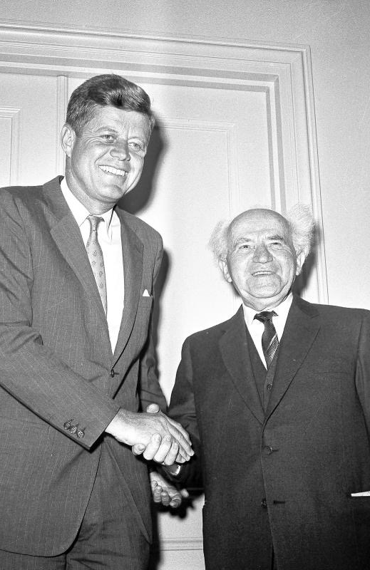
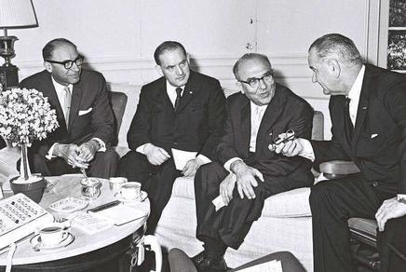
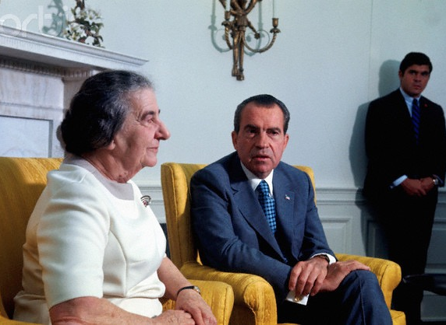

Slide 14
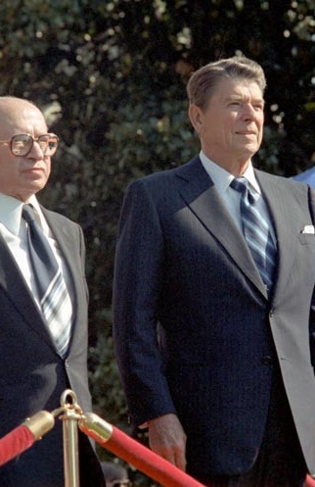

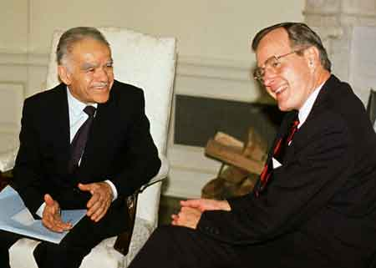

Slide 15
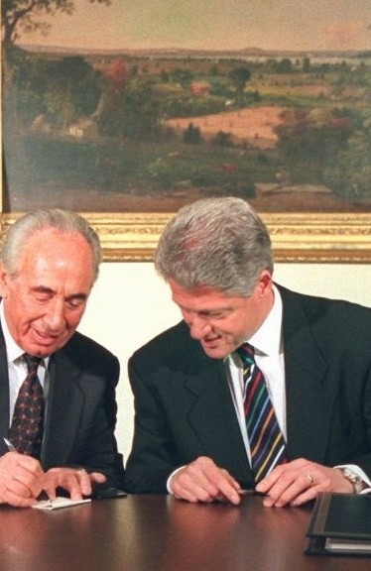
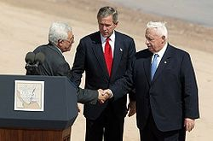
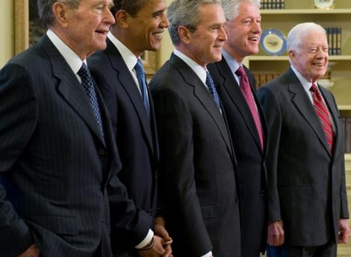

Slide 16
Readings
Josh Rogan: http://foreignpolicy.com/2010/07/21/is-israel-an-asset-or-a-liability-satloff-vs-freeman/
Robert Satloff: http://www.washingtoninstitute.org/uploads/Documents/pubs/SatloffDebate.pdf
Efraim Inbar, “Israel: An Enduring Union,” Journal of International Security Affairs, No. 11 (Fall 2006), pp. 7-13. http://www.biu.ac.il/Besa/efraim_inbar/enduring.pdf
Robert D. Blackwill and Walter B. Slocombe, Israel: A Strategic Asset for the United States, The Washington Institute for Near East Policy, Nov. 2011. http://www.washingtoninstitute.org/ uploads/Documents/pubs/Blackwill-Slocombe_Report.pdf
Israel: Asset or Liability? A Debate on the Value of the US-Israel Relationship, Robert Satloff vs. Chas Freeman,” The Washington Institute for Near East Policy, http:// www.washingtoninstitute.org/uploads/Documents/pubs/SatloffDebate.pdf
Anthony Cordesman: http://csis.org/publication/israel-strategic-liability
Dov Waxman, “The Real Problem in US-Israeli Relations,” The Washington Quarterly, Vol. 35, No. 2 (Spring 2012), pp. 71-87. http://csis.org/files/publication/twq12springwaxman.pdf

