Slide 1
The Lobby
U.S. Foreign Policy and an Interest Group

Slide 2
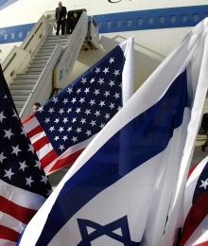
Influence?
Foreign aid
  $3 billion to Israel
Democracy promotion
  Support of Iraq war
  Anti-Iranian nuclear deal
Peace process
  inflamed Arab and Islamic opinion
  jeopardized U.S. security

Slide 3
Balance?
Debate within academia
  observe employment and prior published work
Arguments supported by ideological preference
  neoClassical realism
  Zakaria (1998: 42) “principal actors and their perceptions are crucial.”

Slide 4
Real-time
Paper from 2006.
Book published in 2007.
Sources from early 2000s or prior
Discussion on regional events since 2011

Slide 5
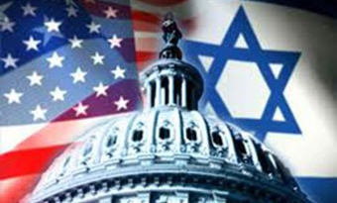
A real lobby?
Is argument sustainable when compared

Slide 6
