Slide 1
1967 & 1973
Crisis of Their Own Making

Slide 2
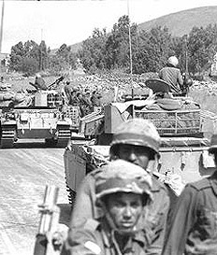
A National Crisis
Victory brought invincibility complex (1967)
Invincibility complex brought surprise attack (1973)

Slide 3
Background
Israeli national security policy has been predicated on a broad national consensus, which holds that Israel faces a realistic threat of genocide, or at a minimum, of politicide.
Israel faces numerous and complex national security “environments” — diplomatic, political, economic, technological, and military.

Slide 4
Experience has demonstrated that national security decisions contain the potential for transforming the nation’s
  future course and
  fundamental character,
    This was the case following the 1967 Six Day War and 1973 Yom Kipper War

Slide 5
Background
On June 5, 1967, after three weeks of tension, the Israeli Air Force attacked air bases in Egypt, Syria, and Jordan, and destroyed approximately 80% of the warplanes of these states on the ground.
During the military operations Israeli troops swiftly occupied the Sinai peninsula, the Gaza Strip, the West Bank of Jordan, and the Golan Heights.

Slide 6
Justification
The official Israeli government decision was drafted by Defense Minister Moshe Dayan and gave the outlines of pre-emption:
  “After hearing reports on the military and diplomatic situation from the prime minister, the defense minister, the chief of staff and the head of IDF, the government has determined that the armies of Egypt, Syria, and Jordan are deployed for a multi-front attack that threatens Israel’s existence. It is therefore decided to launch a military strike aimed at liberating Israel from encirclement and preventing assault by the United Arab Command.”
  (Oren, Six Days of War, p. 158)

Slide 7
Background
“locus classicus of the right of self-defense”
Factors point to support the view that the June 1967 War was a pre-emptive war.
Deployment of some 80,000 Egyptian troops on the Sinai peninsula, agitation of the Arab opinion with calls for the destruction of Israel, the ensuing fear and alarm among the Israeli public, and
Also most importantly, conclusion of a defense treaty that comprised all of Israel’s neighbors with the exception of Lebanon just before the war,
All this easily gave the impression of an imminent attack by the Arab states and thus open up the way for the interpretation of the Israeli first strike as a pre-emption of that attack.

Slide 8
Decision-type
Bureaucratic
  Bureaucratic politics is often offered as a counterpoint to realist or rationalist conceptions of policy decision making.
  Also, policies are guided by, even resulting from, previously established bureaucratic procedures. This leaves little room for autonomous action by high-level decision makers. (pre-emption?)
  In comparison the bureaucratic politics model represents a significant and distinctive strain of organization- and state-level theory in international relations.
    Graham T. Allison’s 1969 article in The American Political Science Review, “Conceptual Models and the Cuban Missile Crisis,”

Slide 9
Decision-type
Poliheuristic
PH postulates a two-stage decision process.
First, a set of possible options is reduced by applying a "noncompensatory principle" to eliminate any alternative with an unacceptable return on a critical, typically political, decision dimension.
Once the choice set has been reduced to alternatives that are acceptable to the decision maker, the process moves to a second stage, where the decision maker uses more analytic processing in an attempt to minimize risks and maximize benefits.
  Alex Mintz 1999 article in The Journal of Conflict Resolution, How Do Leaders Make Decisions?: A Poliheuristic Perspective.

Slide 10
Choice
Surrounded by enemies.
Recommendations by ‘expert’ advisors
National security = nation at risk

Slide 11
Pre-emption?
The conceptualization of the 1967 War as an “inadvertent war” (i.e. an unwanted war which is the outcome of miscalculations, misperceptions, and misunderstandings) is adopted by many scholars writing on the June 1967 War.
It is a “recurring theme in both revisionist and traditionalist accounts of Six Day War.”
  (Roland Popp, “Stumbling Decidedly into the Six Day War,” The Middle East Journal, Vol. 60, No. 2 (Spring 2006), pp. 282-.)
Scholars writing on the nuclear strategic thinking of the Cold War era tend to regard pre-emptive war either as a sub-species of inadvertent war or they treat both terms as synonyms.

Slide 12
Pre-emptive Types
Williams and Williams describe “pre- emptive attack” as “an attack provoked by an imminent and certain attack.”
  Geoffrey Lee Williams and Alan Lee Williams, Crisis in European Defence: The Next Ten Years (London: Charles Knight & Co Ltd, 1974), p. 19.
Betts maintains that there are three types of first strike: “preemptive;” “aggressive;” and “preventive;” and “a preemptive attack is one made in immediate anticipation of enemy attack.”
  Richard K. Betts, Nuclear Blackmail and Nuclear Balance (Washington, DC: The Brookings Institution, 1987), p. 161.
Schelling and Halperin define pre-emptive war as a “war initiated in the expectation that attack is imminent.”
  Schelling and Halperin quoted in Daniel Frei, Risks of Unintentional Nuclear War (London: Croom Helm, 198), p.3.

Slide 13
Certain conditions emanate, what Brecher calls “the external operative environment” function as “inputs” for decision-making. (Brecher, Decisions in Israel’ s Foreign Policy, pp. 6-7).
It is possible to presume that in the case of a decision to strike pre-emptively, these conditions should give rationality to, or constitute the basis for, such a decision.
If not, then the strike in question is, in the least aggressive case, an erroneous decision that starts “an unintentional war.” In such a situation, the inputs of the decision may be traced back to the “internal operative environment” or the “psychological environment.” (Brecher, Decisions in Israel’ s Foreign Policy, pp. 6-7).
Second, and more importantly, pre-emption of an imminent attack is the outcome of a conjunction between decision-making and material circumstances.
It is not possible to identify a pre-emptive strike only on the basis of decision-making, because this would blur the crucial distinction between a pre-emptive war, which is launched in order to neutralize a forthcoming attack, and an unintentional war, which is caused by an incorrect perception on the part of decision-makers that there is such an imminent attack.

Slide 14
The difference between these two types of wars is by no means purely terminological:
  Good quality intelligence may precipitate a pre-emptive war while being a decisive factor in avoiding an unintentional war.
  Concentration on decision-making is also problematic due to the methodological difficulties mentioned above and because of the incentive on the part of decision-makers to resort to deception by exploiting the defensive connotations of the word “pre-emptive war.”

Slide 15
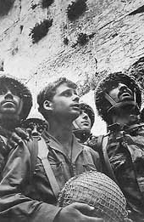
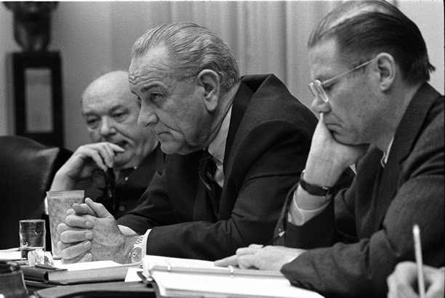
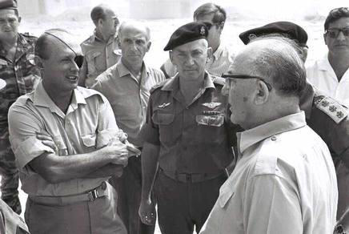

Slide 16
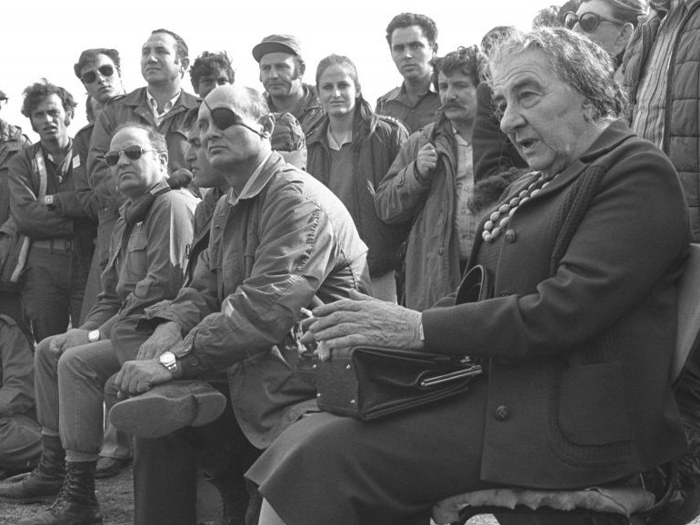

Slide 17
Background
Israel’s failure to detect the war plans in Cairo and Damascus was due to a combination of intelligence breakdown and political misperception.
The roots of the Israeli psyche which led to the October 1973 surprise can be traced to a large extent to their victory in the 1967 Six Day War.
Rhetoric coming from Arab capitals did not help to alter Israeli’s perception of isolation and rejection in the Middle East.
If Israel thought strategically in terms of defending herself from an absolute war aimed at her destruction, President Sadat planed with his Syrian allies a much more limited war in order to shake Israeli complacency and intransigence.

Slide 18
Background
A feeling of Israeli vulnerability and a dominant ‘Ben-Gurionist’ view of the Arabs created a climate of suspicion and, crucially, of fear in Israel in 1967.
Dan Reiter puts forward that this climate of fear was a key element in Israel’s decision to launch a pre-emptive strike: “the essence of preemption […] is that is motivated by fear, not by greed”
  Dan Reiter, ’Exploding the Powder Keg Myth: Preemptive Wars Almost Never Happen’, International Security, Vol. 20, No. 2 (1995), pp. 5-34.

Slide 19
Background
By October 1973, Israel’s perception of itself and its neighbors was different.
  The rapid, decisive military victory of 1967 led to an overwhelming feeling of confidence in Israel’s military capability.
Micheal Brecher and Mordechai Raz stress the feeling of invulnerability in Israeli society at the time,
  the “unshakeable self confidence that, even if by some remote contingency, the Arabs attempted to attack, Israel’s second strike capacity and its post-1967 hinterland would ensure a quick military victory”.
    Beecher and Raz, ’Images and Behaviour: Israel’s Yom Kippur Crisis 1973’, International Journal, Vol. 32, No. 3 (Summer 1977), pp. 475-500.

Slide 20
(Mis)calculation?
The fact that Israel no longer felt its survival threatened due to its vulnerable borders allowed Israeli policy makers to redefine defense priorities.
Deciding whether to accept General El-Azar’s proposition to strike pre-emptively, PM Meir outlined her prioritys – First, Israel’s survival.
  It was decided that Israel could easily absorb an attack without hampering its security in the long run.
  A predominant idea that any land lost to the Arabs would be quickly regained.
Second PM Meir turned to second and third priorities – world public opinion, and the compelling need not to alienate the US – which ultimately led her to opt against a pre-emptive attack.

Slide 21
No pre-emption
The re-definition of Israeli borders and prevailing sense of Israeli strength changed the strategic reality of Israel.
With its survival no longer at stake, Israeli leaders considered the longer-term, political impacts of a pre-emptive strike.
Sacrifice a short-term, fleeting military advantage in favor of a long-term strategy aimed at protecting Israel’s international reputation and alliances.

Slide 22
The War
Massive and successful Egyptian crossing the Suez Canal. After crossing the 1967 cease-fire lines, Egyptian forces advanced into the Sinai Peninsula .
  After three days, Israel had mobilized most of its forces and managed to halt the Egyptian offensive, settling into a stalemate.
The Syrians coordinated their attack on the Golan Heights to coincide with the Egyptian offensive and initially made threatening gains into Israeli-held territory.
  Within three days, Israeli forces had managed to push the Syrians back to the pre-war ceasefire lines.

Slide 23
Outcome
No war left the Israeli society more traumatized and in search of leadership and guidance than the October War
  resignation of Golda Meir = Yitzhak Rabin
Israel was caught by complete surprise, the lead up to this became known is as the “fiasco”.
The war shattered the perceptions of the Israeli decision making elite regarding their neighbors’ intentions and capabilities, and led to question of how to best guarantee the long term security of the country.
Israeli society lost its confidence in her leadership, and this loss would eventually end the dominance of the Labor party in Israeli politics.
  Likud electoral victory 1977

Slide 24
The U.S. Response
In 1967, U.S. sent missiles and 6th Fleet.
  despite USS Liberty incident.
  USSR threatened war.
In 1973, major airlift over 32 days (Operation Nickel Grass) deliver weapons and supplies, over 22,325 tons. The U.S. support helped Israel survive the coordinated and surprise attack by Egypt and Syria.
  Cold War considerations
Staunch ally.

Slide 25
