Slide 1
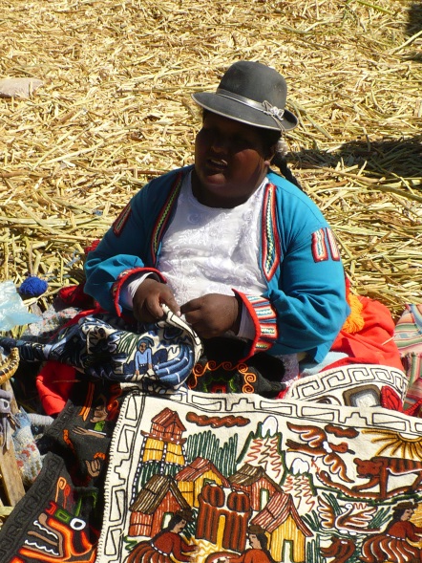
Populism in Latin America
POL333 Populism and political parties

Slide 2
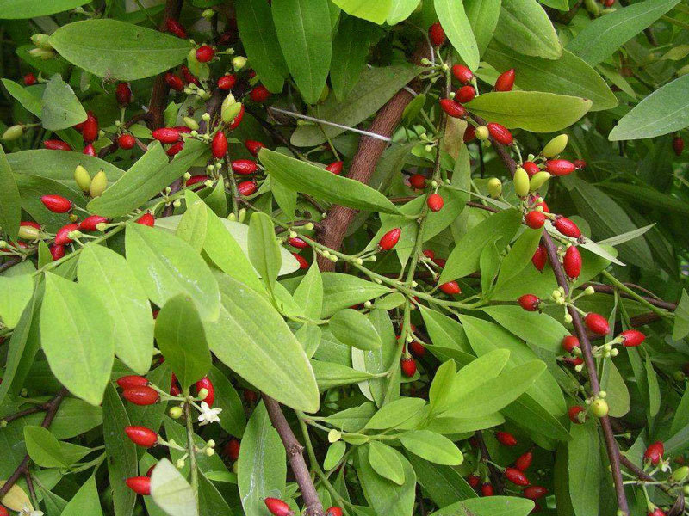

Slide 3
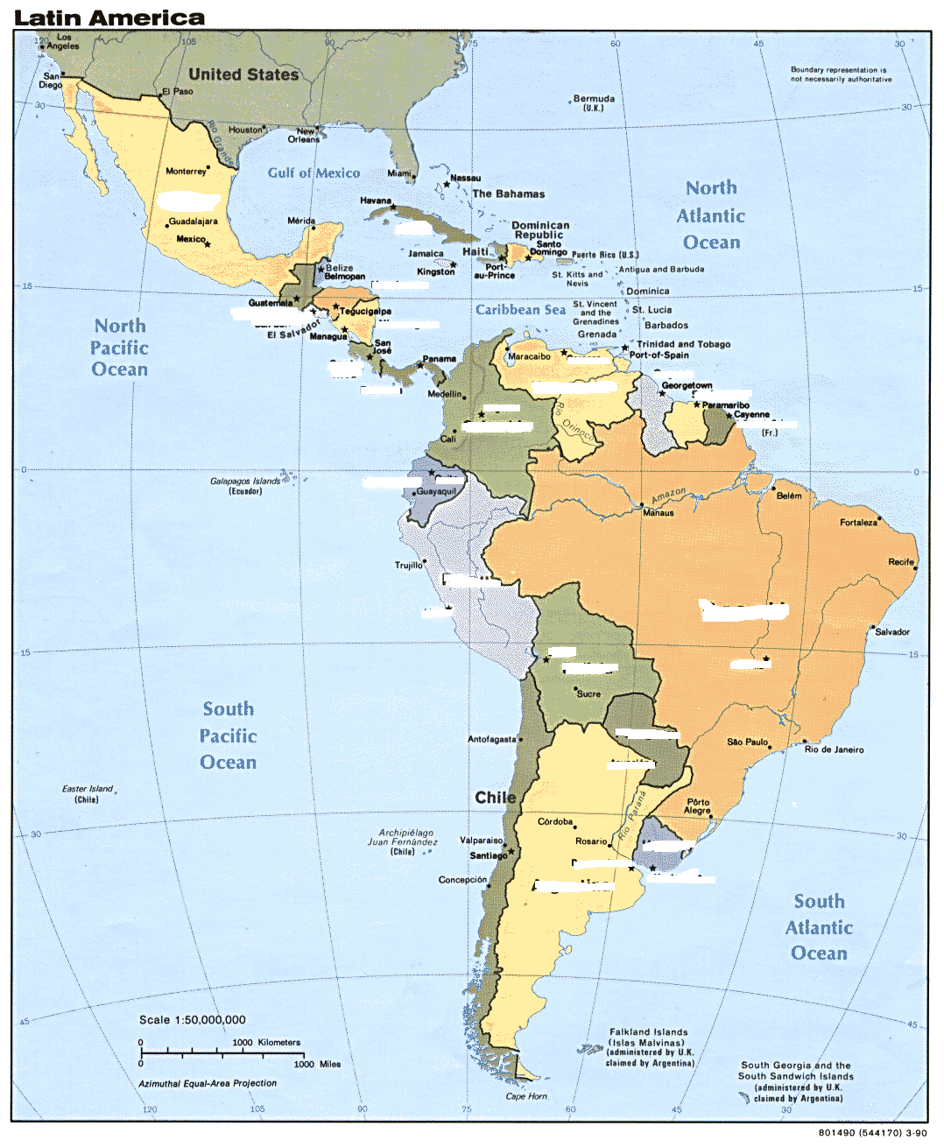

Slide 4
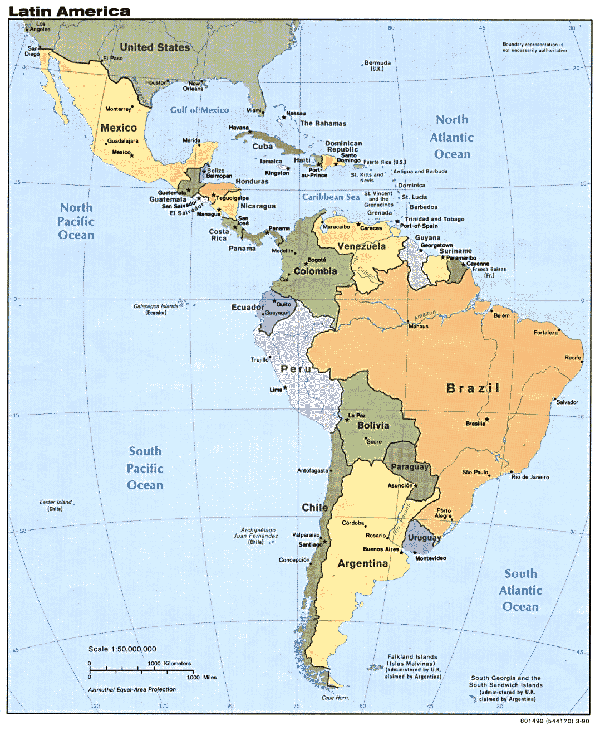

Slide 5
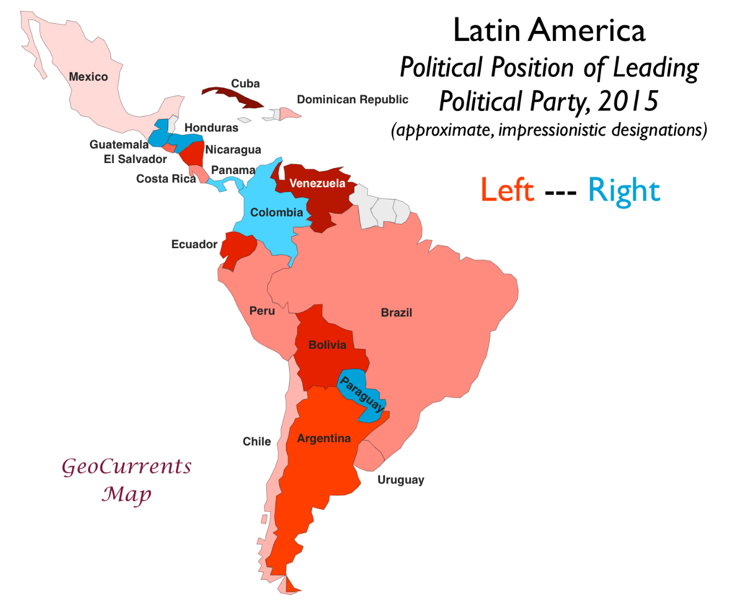
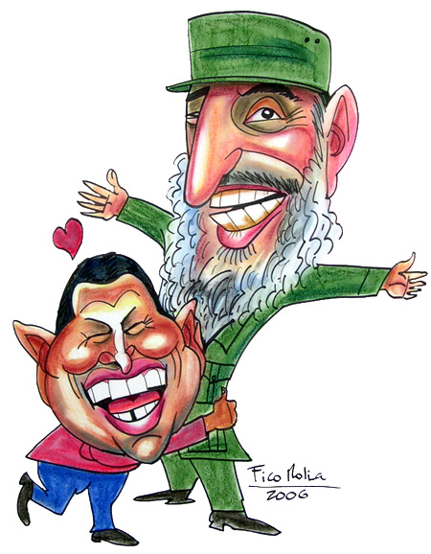
LA Political spectrum

Slide 6
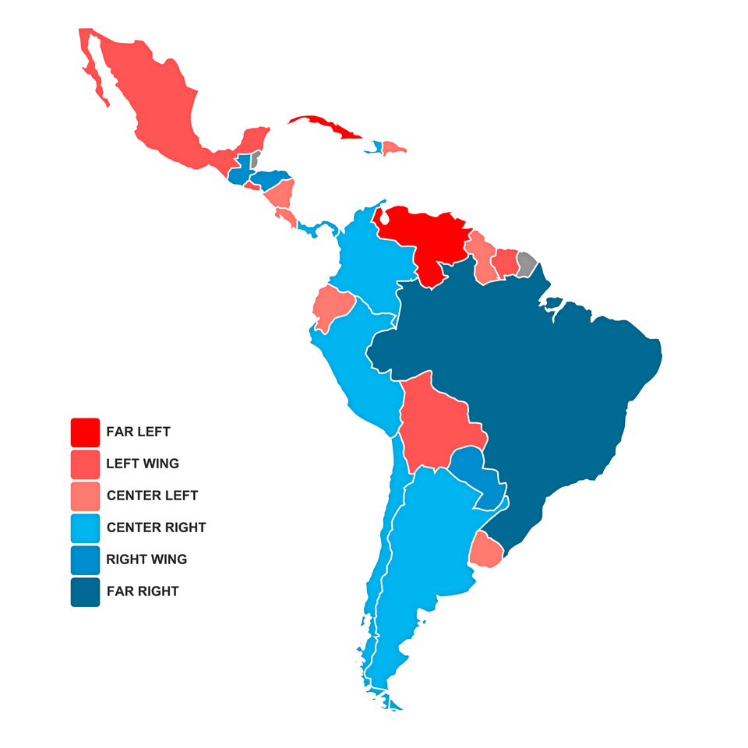
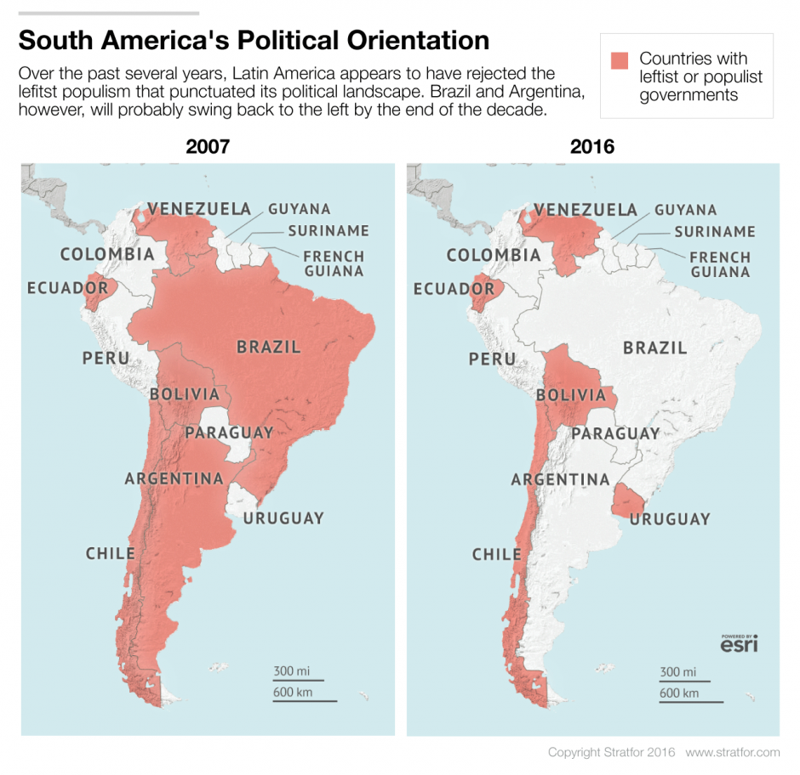
LA 2007-2019

Slide 7
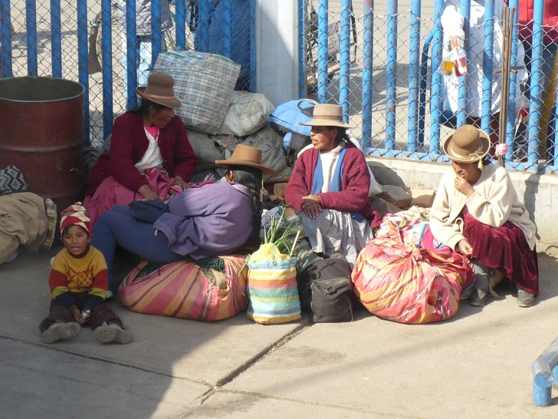
Waves of LA populism
1. „Classical LA populists: created mass-based party or labor organisations linked to the state to incorporate their followers, national populism
  Peru: Haya de la Torre 1978-79
  Argentina: Juan Perón, 1945-55
  Chile: Popular Front, 1938-41
  Mexico: Lázaro Cárdenas, 1934-40
  Brazil: Getulio Vargas, 1937-45 (Estado Novo period)
2. „Neo-populists“ - more pluralistic or individualized form of representation, neoliberalism and populism
Peru: Alberto Fujimori 1990-2000
Argentina: Carlos Menem 1989-99
3. Left-wing populism,socialism and indigenism:
Venezuela: Hugo Chavez 1999-2013
Bolivia: Evo Morales since 2006
Argentina: Nestor Kirchner 2003-2007, Christina Fernandez de Kirchner since 2007
Ecuador: Raffael Correa since 2007
4. Far right populism in Brazil : Bolsonaro

Slide 8
LA Populism
more voters – workers as well as firm owners, poorest part of society
nationalism or indigenism
charismatic leader
Sentiments, strong leadership, rapid solutions,
Always men with exception of Eva Perón – LA machismo
origins are quite different from traditional while elite
High public support
Mostly presidential systems without checks and balances
Fragile party system
Aim to create“new type of democracy“
Notes:
(“The Turk” was the nickname of Carlos Menem (Syrian in origin), while Alberto Fujimori was “The Chinaman”, Evo Morales is indigenous, while Hugo Chávez is said to have the native physique of the Venezuelan people, former president of Ecuador, Abdalá Bucaram (parents were Lebanese) Néstor Kirchner (origins are Swiss and Chilean)

Slide 9
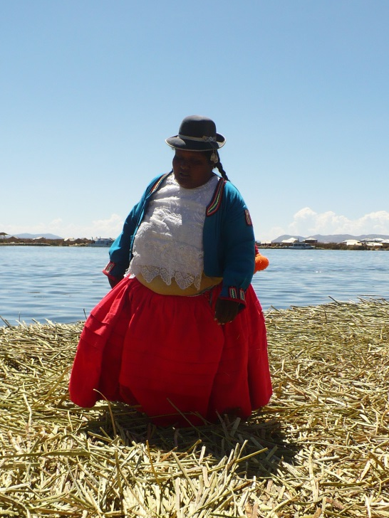
Populist mobilisation
Hard where party system is strong and inclusive and where strong civil society exists
Easy for weak, fragile and exclusive party system and weak civil society

Slide 10
Different forms
use of established political party as Menem in Argentina/
create new one against established existing party system as e.g. Chavez in Venezuela
Property in state hands, nationalisation – Chavez, vs. Neoliberalism e.g. Fujimori
Polarisation of society and support from low class in Chavez Venezuela vs. Multi-class coalitions in Fujimori regime
Most of them critiques of partidocracias but unable to fill the political vacuum with new representative institutions
Peronismo, fujimorismo, chavismo…..

Slide 11
Populism as challenge to democracy
Promoted democracy eventhough they did not always behave in democratic ways
Exhibit authocratic tendencies
Show little respect for the rule of law, political pluralism and democratic checks and balances

Slide 12
Populism as challenge to democracy
Voice to the excluded and marginalized ones – workers in the classical populism or indigenismo in the neo-populist one
End up ruling with decrees, changing constitutions, launching military backed up presidential coups, disregarding division of power, shutting down congress, legitimizing power by new elections or referenda

Slide 13
Populism as challenge to democracy
Rely on armed forces so politicisation of army and weakening of civilian representative institutions
Skirt institutional checks and balances
Promise to be more efficient but usually end up similarly as their predecessors with administrative failures and inefficiency
„bait-and-switch“ tactics

Slide 14
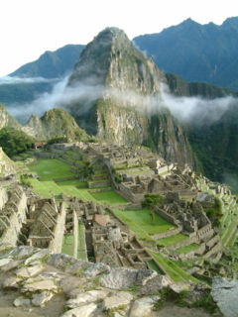
LA neo-populists: Fujimori in Peru
1914-1979 military governments alternate with weak democracy
Transition to democracy in Peru only from 1979
1979 new constitution – suffrage for illiterates and indigenas (30% increase in electorate)
Democracy very weak
Marked by hyperinflation
Social tensions, rise of Shining Path, terrorism
Notes:
In 1906, Finland became the second country in the world, and the first in Europe, to grant universal active suffrage to its citizens and the first in the world to grant universal full suffrage (active and passive suffrage) by being the first country in the world to grant women full political rights.^{[13][14]} So Finland was the first country in the world to give all (adult) citizens full suffrage, in other words the right to vote and to run for office (in 1906). The last Latin American country to give women the right to vote was Paraguay in 1961.^{[15][16]} Women were guaranteed equal voting rights by The constitution of the Czechoslovak Republic in 1920.^{[93]} In Liechtenstein, women's suffrage was granted via referendum in 1984.^{[104]} Switzerland was the last Western republic to grant women's suffrage; they gained the right to vote in federal elections in 1971 after a second referendum that year.^{[127]} In 1991 following a decision by the Federal Supreme Court of Switzerland, Appenzell Innerrhoden became the last Swiss canton to grant women the vote on local issues.^{[129]}

Slide 15
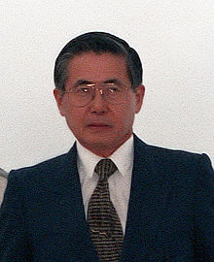
LA neo-populists: Fujimori in Peru
Capitalized from disenchantment with the government of Alan Garcia, beating Mario Vargas Llosa with the political party „Cambio 90“ in 1990
Exploited political distrust, Llosa ties with previous establishment and won much support from the poor
El Chino – first LA head od government with East Asian decent
Controversial figure
Restoring macroeconomic stability
Authoritarian way of ruling
Violation of human rights and consequent imprisonment after he seeked refugee in Japan

Slide 16
LA neo-populists: Fujimori in Peru
implemented measures that caused inflation to drop from 7,650% in 1990 to 139% in 1991.
disolved Congress in the auto-golpe of 5th April 1992
The poutsch was perceived positively because congress was seen as the corrupted institution
He then revised the constitution; called new congressional elections; and implemented substantial economic reform, including privatization of numerous state-owned companies, creation of an investment-friendly climate, and sound management of the economy.

Slide 17
Fujimori against terrorism and the end of Fujimorismo
Sendero Luminoso (Shining Path)
Successful but marred with HR violations
1996, Japanese embassy taking 72 people hostage.
Fujimori's seek a third term in 2000 brought political and economic turmoil

Slide 18

LA 3rd wave of populism: Bolivia before Morales
1935- 1952 new ideologies
1952 Revolution, universal adult suffrage, sweeping land reform, rural education, nationalized the country's largest tin mines.
for the first time in Republican history, the State attempted to incorporate into national life and Aymara and Quechua peasants that together constituted no less than 65 percent of the total population.
1964-85 junta, coups, counter coups, hyperinflation,
1985 -2005 transition to (weak) democracy

Slide 19
Social conflict in Bolivia before Morales
Bolivia is South America's poorest country, with 60 percent of the population living below the poverty line, and 38 percent in extreme poverty,"
Bolivia is 2nd after Venezuela with the natural reserves
30% Quechua, 30% Mestizo, 25% Aymara, 15% White
Exploitation of gas resources: capitalisation vs nationalisation
Coca eradication/cultivation
Military responses towards strikes

Slide 20
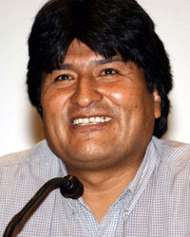
Bolivia: Evo Morales
loose confederation of indigenous social movements (MAS) with Evo Morales as leader
2005 -2019
Evo Morales and MAS - 54% of the electorate's votes, becoming the first Native Bolivian president in history
announced the increase of the minimum wage by 50%
nationalizing most of Bolivia's natural gas fields

Slide 21
Bolivia: Evo Morales administration
"We want to be an exemplary country in Latin America with the participation of the people“.
nationalised the oil and gas industries, begun redistributing land, cut public sector salaries and hopes to promote some legal uses of coca leaves.
Some have called the changes in Bolivia a democratic revolution.
close ties to governments in Venezuela and Cuba

Slide 22
Bolivia: New constitution introduced by Evo Morales
Re-election: Allows Mr Morales to stand for re-election in Dec 2009
Indigenous rights: Stresses importance of ethnicity in Bolivia's make-up. A whole chapter devoted to indigenous rights
Autonomy: Power decentralised, four levels of autonomy - departmental, regional, municipal and indigenous
Resources: Sets out state control over key economic sectors, state sovereignty over vast natural gas fields, redistribution of revenues to poorer parts of the nation
Judiciary: Indigenous systems of justice same status as official existing system. Judges will be elected, and no longer appointed by Congress.
Land: New limit on ownership 5,000 hectares (12,355). But measure not retroactive.

Slide 23
Evo Morales administration
Rise of tensions against redistribution
Anti-imperialism
national protests after cutting government subsidies to gasoline and so increase of petrol price. Morales responded by annuling the decree, saying that he was complying with his promise to "listen to the people".
2019 political crisis
2020 election and victory of MAS

Slide 24


Venezuela before Hugo Chavez
1820s-1935 caudillismo
1935-58 democratisation however interrupted by junta regime, universal suffrage, political parties,
1958-1998 transition towards democracy
Agreement from Punto Fijo – power in hands of two parties AD and COPEI, corporativism,nepotism, high oil revenues flowing through the government, corruption
1992 unsuccessful coup d etat, Chavez inprisoned and becomes national hero

Slide 25
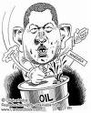
Venezuela: Hugo Chavez 1998-2013
Bolivarian revolution
New constitution 1999: Reform of the judiciary power, More opportunities for referenda, Stronger presidential power, The role of the state in economy stronger, President can issue the decrees which have the power of law without consultation of approval by the parliament
The president term was extended to 6 years (5 before) with the right of re-election

Slide 26
Chavez
Firstly popularity
Since 2001 increase in the opposition due to the nepotism, aggressive style, revolutionary extremist rhetoric
2002 unsuccessful coup d´etat organized by the opposition with the cooperation of oil company PDVSA, businessmen and USA

Slide 27
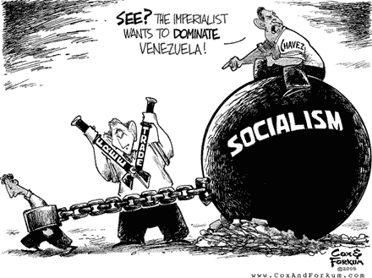
Venezuela under Hugo Chavez
Chavez very clever in PR – soap novellas about the young couple (she is for Chavez fighting for the life of poor, he is undecided and at the end decides for president)
2006 Chavez reelected in the president office (being for the 3rd time president – the election according to the old constitution does not count☺
The Constitution designates three additional powers of the federal government--the judicial, citizen, and electoral branches.

Slide 28
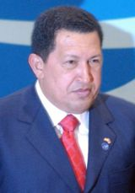
Venezuela under Chavez:Constitution 2007
POLITICS
* Lifts the existing two-term limit for presidents and extends the term from six to seven years.
* Lowers the voting age to 16 from 18.
* Allows the president to create and eliminate provinces, districts and "communal cities" via decree and name the authorities in charge of them.
ECONOMY
* Ends the central bank's autonomy and gives the president direct control over foreign currency reserves.
* Prioritizes collective interests over individual interests in constitutional goal of creating a socialist economy.
* Reduces the work day to six hours from eight.
* Extends social security to some self-employed workers.
RIGHTS
* Allows security forces to arrest citizens without charge and opens the way to censoring media during natural disasters or political "emergencies" declared by the president.

Slide 29
Venezuela under Hugo Chavez
New Constitution severely limits checks and balances
High government spending on populist policies
Maintained fixed exchange rate for a long time
Expanded role of the military
Nepotism and corruption
Stronger OPEC relationships → oil prices
Growing tensions: poverty, crime & corruption

Slide 30
https://www.youtube.com/watch?v=Wsxmod0TSAo (hugo chavez at un assembly, devil)
https://www.youtube.com/watch?v=JzQCQm77GK4 (last speech 18 min)

Slide 31

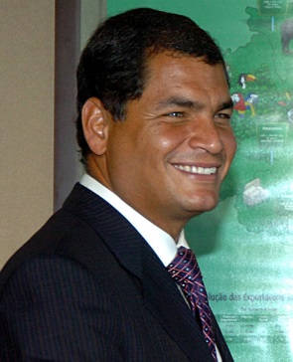
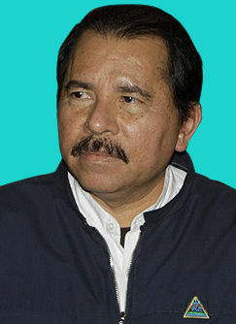
Hugo Chavez and his friends
LA integration against US power
„Bolivarian Alliance of the American People" (ALBA) –Castro in Cuba, Morales in Bolivia, Raffael Correa in Ecuador and Daniel Ortega in Nicaragua.
OPEC relationships (Iraq, Libya & Iran) and the ability to control oil prices
Russia

Slide 32
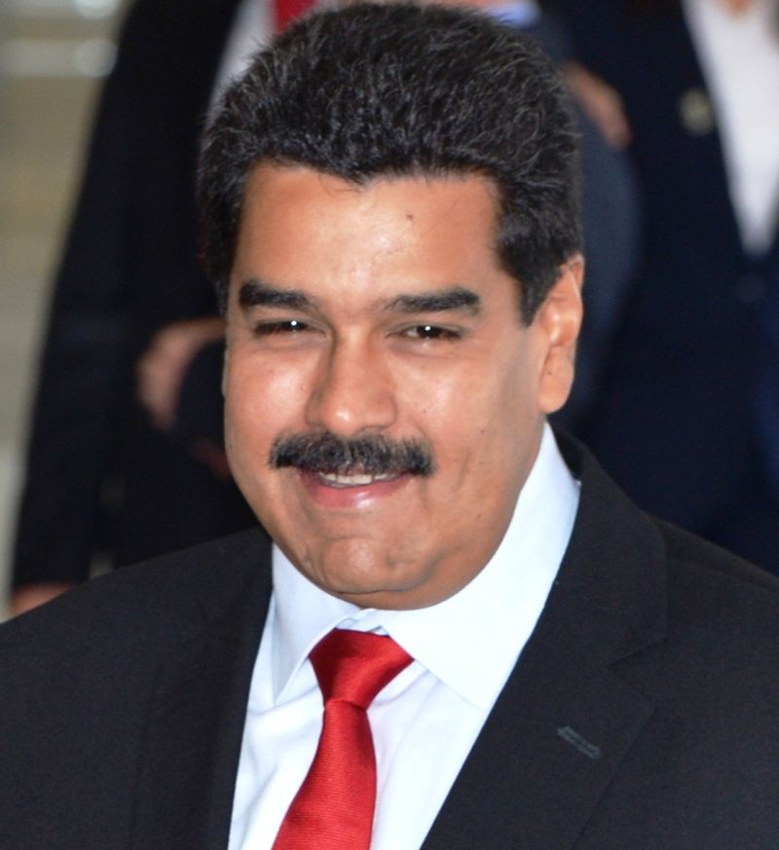
Nicola maduro since 2013
Protests
Supported by police and army
Authoritarian
Decree ruling
9 000 executions
5 mil flee out
Crimes against humanity
Conspiracy theories
homophobia

Slide 33
Ecuador before Rafael Correa
1978 towards democracy
Weak democracy, permanent crisis
Correa since 2006- 2017
Hugo Chavez his mentor

Slide 34
Ecuador: Rafael Correa
(1) a constitutional and democratic revolution, including a deep reform of state institutions,
(2) a moral revolution through a media campaign and tougher penalties against those guilty of corruption,
(3) an economic and productive revolution against the interests of big business,
(4) an education and health revolution through the creation of new social programmes, and
(5) a revolution for dignity, sovereignty and Latin American integration.

Slide 35
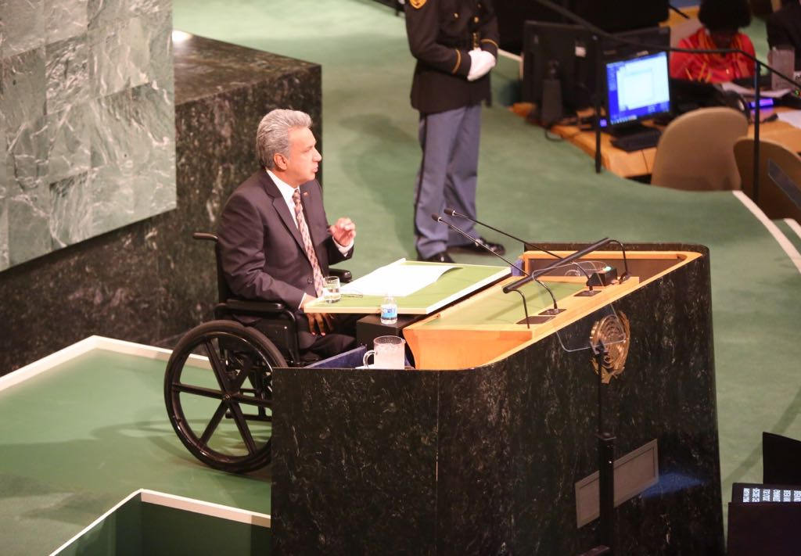
Lenin Moreno – Ecuador 2017 switching sides and decorreisation reversed several key legislation pieces passed by Correa´s administration, that targeted wealthy individuals and banks, also reversed a previous referendum allowing indefinite re-election unstable policies fuel subsidies, poverty, - political crisis

Slide 36
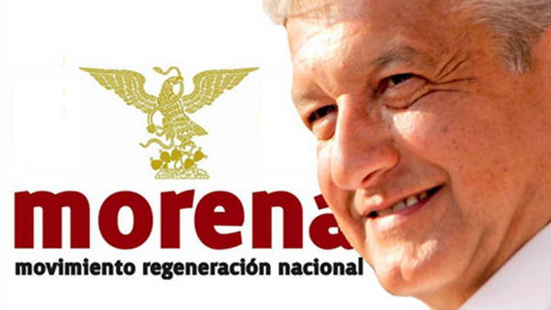
MORENA
Since 2015 in Mexican politics
Andres Manuel Lopez Obrador
Anti-establishment
opponent to the neoliberal economic policies
fair wages
stop the privatization of Pemex
no land to foreign mining companies
better treatment of the Indigenous peoples
to carry out the 1996 San Andrés Accords
Legalisation of marihuana
Against US engagement in Mexico
Mexicanismo

Slide 37
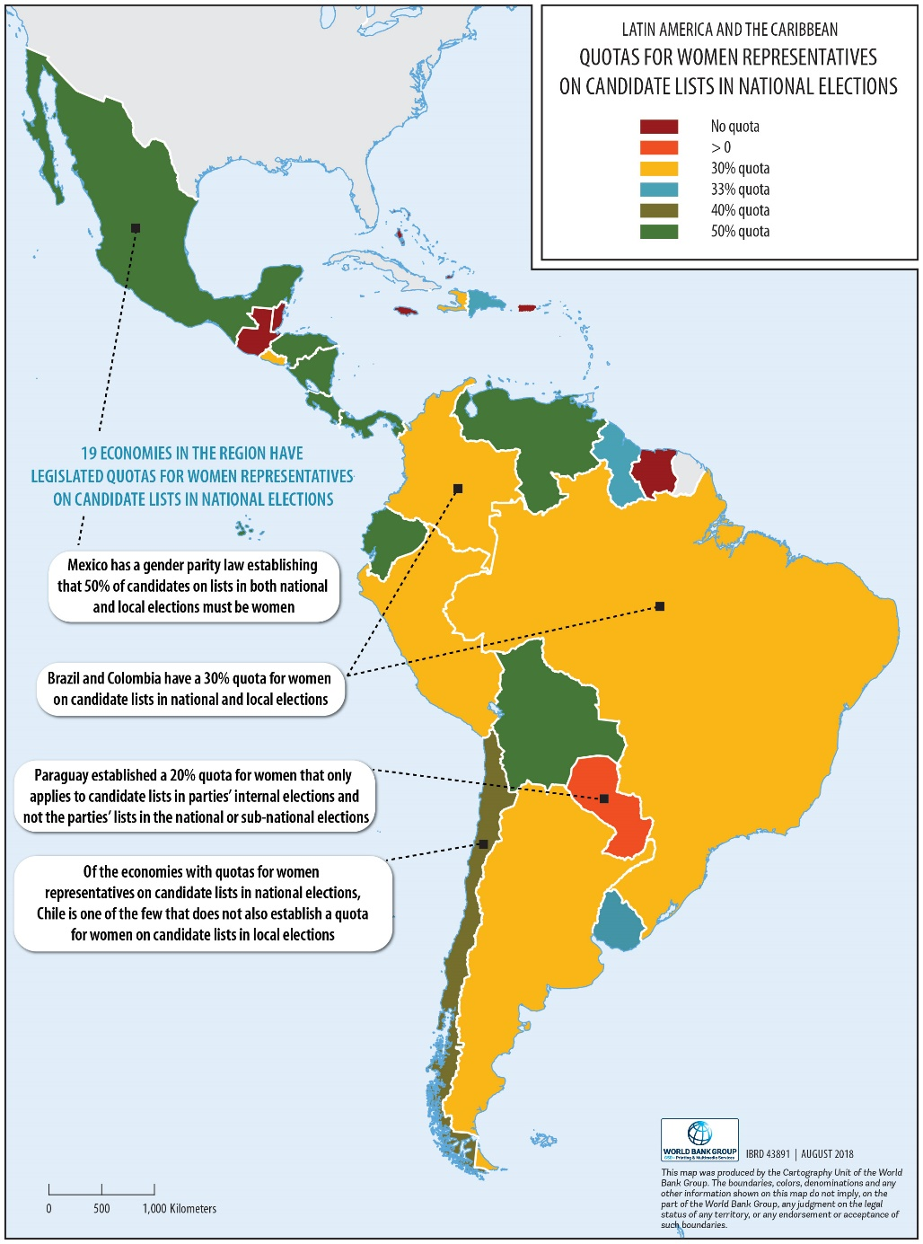
In the name of women in LA

Slide 38
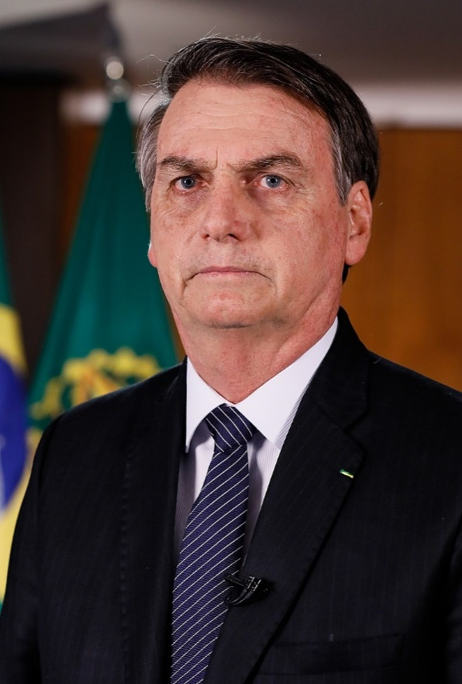
Brazil: far right populism?
Jair Messias Bolsonaro
Nationalist, populist
Pro-gun
Misogyny, homophobia
vocal opponent of same-sex marriage, environmental regulations, abortion,[affirmative action , drug liberalization, land reforms, and secularism at the federal level
statements in defense of the Brazilian military regime
torture is a "legitimate practice"
introduction of life imprisonment to the Brazilian penal code
supports the privatization of state-owned companies and advocates free market policies

Slide 39
LA populism as a result of these factors:
Unequality and exclusion
weak states which provide virtually no services to their citizens
elitist governments that have failed to create representative and inclusive democracy
Drugs
Gas
US backyard

Slide 40
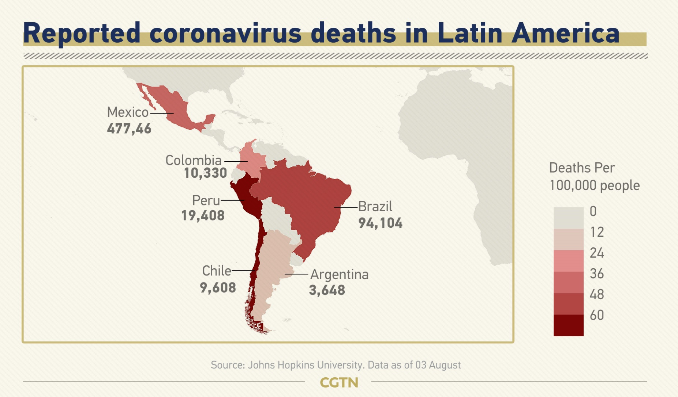

Slide 41
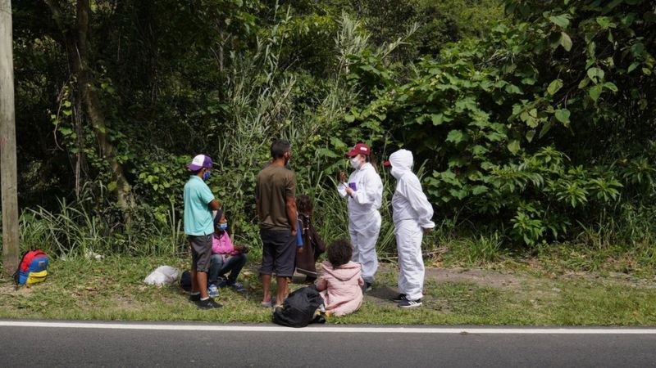
Covid-19 – worse than 1981/2008 crises?
Basic education
economies, exports, tourism
OC, underground economy
Migrants
Democracy
Authoritarian drift
Conflicts
political violence
https://reliefweb.int/report/colombia/covid-19-disorder-tracker-two-month-review-latin-america-22-mar-16-may-2020

Slide 42
