Slide 1
Social Stratification
What is social stratification?
  Systematic inequality between groups of people
Why social?
  SS concerns the groups of people
  Systems of inequality are organized around groups with a shared characteristic.
Criteria delimit the inequality
  wealth, income, prestige, power, gender, education, age
Rankings of groups change only very slowly
Contemporary European societies are stratified societies

Slide 2
On what dimensions does stratification exist?
Assets, wealth, money (“class” views) = Labour market
Prestige, respect (“status” views)
Education, occupation, income (“socioeconomic status” view)
Power and influence (“power” view)
The debate is over which is the most important or most basic
Three main dimensions of stratification are: power, economic capital, prestige
Basic Social Stratification Cube: 3 dimensions

Slide 3
Two concepts of social stratification
Inequality of conditions
  unequal distribution of income to people
  differencens in wealth and material conditions
  different incomes means different chances to get different goods
Inequality of opportunity
  unequal start positions
  different start positions means different chances to get different levels of education, jobs and incomes
3
Notes:
Historically speaking, there are three major types of systems of social stratification: slavery, caste, and class. Let me briefly describe each type.
1. In slave systems, some peoples are considered less than human and are owned as property. Their legal rights are limited, certain relationships are prohibited, and as you might imagine, and social power is essentially nonexistent.
2. In caste systems, societal groupings are based on deeply held cultural ideals and boundaries. The Indian caste system exemplifies this societal form of stratification, having both cultural and economic impacts. Caste systems are rigidly based. They are characterized by hereditary status, endogamy, and social barriers and are sanctioned by custom, law, and religion.
3. Class systems are the stratification system we are familiar with. People are divided according to economic markers such as income, wealth, ownership, and so on. There are many different characterizations of what constitutes class, and we will be talking about these characterizations today.

Slide 4
Inequality of conditions vs. inequality of opportunity
Inequality of conditions and inequality of opportunity are connected in empirical reality
Analytically they are two concepts that describe differences among people
Inequality of conditions result from social classes in empirical reality
Inequality of opportunity result from social movements/social mobility

Slide 5
Inequality of material conditions
indicated by Lorenz curve in empirical reality
  curve not number, it shows the shape of material inequality not the size
the size of material inequality is indicated by GINI coefficient
  it is number, it shows the size of material inequality

Slide 6
Lorenz curve I.
Max O. Lorenz (1876-1959), American economist
description of concentration of incomes/wealth in societies
graphical presentation of inequality of conditions
  it is cumulative distribution function
Lorenz curve is utilized in social sciences as:
  economy
  sociology
  demography
  statistics

Slide 7
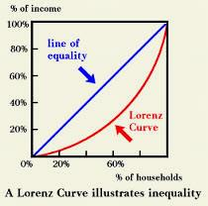
Lorenz curve II.
it is based on the comparison of cumulative distribution of incomes to cumulative distribution of population
higher distance between hypothetical and real Lorenz curve means higher inequality in incomes in society

Slide 8
Trends in Lorenz curve in the CR

Slide 9
Gini index I.
Corrado Gini (1884-1965), Italian sociologist, statistician and demograph
the Gini coefficient is also known as the Gini index or Gini ratio
a measure of the income inequality
it is one number that represents the income distribution in society
the coefficient varies between 0, which reflects complete equality and 1, which indicates complete inequality (one person has all the income or consumption, all others have none).

Slide 10
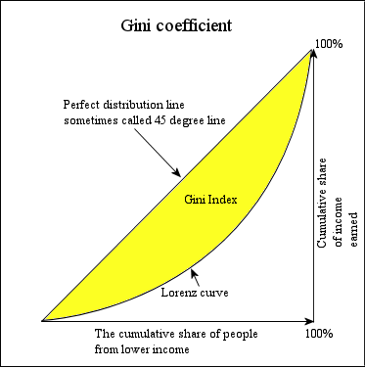
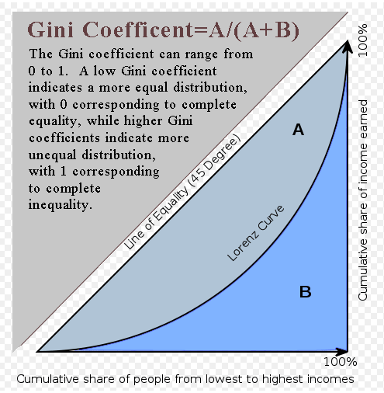
Gini index II.
GI is derived from Lorenz curve
  it shows the relationship between the Lorenz curve area and the total area under ideal Lorenz curve area

Slide 11
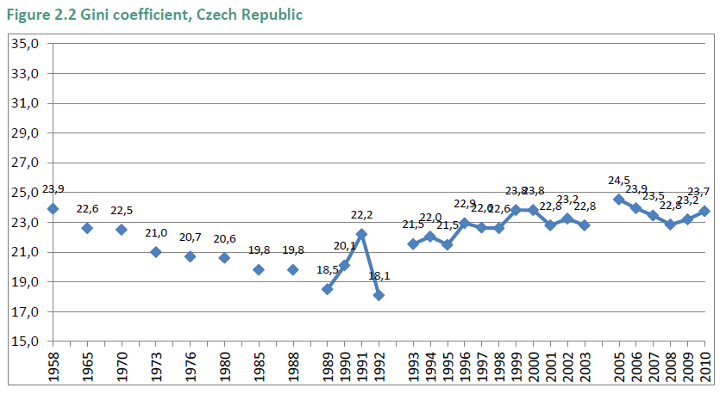
Trend in GINI in the Czech Republic

Slide 12
Advantages and disadvantages of Lorenz curve and GINI coefficient
advantages of GINI
  it is a number suitable for comparison of many historical periods or countries
disadvantages of GINI
  it does not show the shape of inequality, different shapes but one GINI coefficient
advantages of Lorenz curve
  it shows the shape of inequality, it means that it makes differences among various types of inequalities
disadvantages of Lorenz curve
  but Lorenz curve is not very suitable for huge comparisons
  many curves means chaos

Slide 14
Inequality of opportunity
indicated by social mobility
  SM is the movement of people up or down the stratification system
trends in European countries
  from agriculture to industry: industrial societies
  from industry to services: post-industrial societies
    these trends are reflected in structural social mobility trends
but no changes in social fluidity (relative social mobility)
  odds ratios are the same
14
Notes:
An important characteristic of class systems, as opposed to slave or caste systems, is that in class-based systems of stratification, there is the opportunity for social mobility. This means that people and groups can, potentially, move up or down in the rankings, and this is seen by many as a significant benefit of class systems.
In reality, however, such mobility is less common than our national mythology suggests. Typically, those who arrive at high positions have families who either had high positions themselves or the resources to provide the appropriate education for advancement. Achieving upward mobility is very difficult, and the wonderful stories we’ve all heard and seen (think, for example, of the movie The Pursuit of Happyness) are so very moving because they are the exception, not the norm. If such stories were common, they would not get our attention in nearly the same way.

Slide 15
Ascription versus Achivement
What is ascription?
  How does acriptive society work?
What is achivement?
  How does meritocratic society work?
Why we should strive for meritocratic societies?
  Discussion

Slide 16
Three basic models of social stratification
Slavery—ownership of certain people
Caste—status for life
Class—positions based on economics
16
Notes:
Historically speaking, there are three major types of systems of social stratification: slavery, caste, and class. Let me briefly describe each type.
1. In slave systems, some peoples are considered less than human and are owned as property. Their legal rights are limited, certain relationships are prohibited, and as you might imagine, and social power is essentially nonexistent.
2. In caste systems, societal groupings are based on deeply held cultural ideals and boundaries. The Indian caste system exemplifies this societal form of stratification, having both cultural and economic impacts. Caste systems are rigidly based. They are characterized by hereditary status, endogamy, and social barriers and are sanctioned by custom, law, and religion.
3. Class systems are the stratification system we are familiar with. People are divided according to economic markers such as income, wealth, ownership, and so on. There are many different characterizations of what constitutes class, and we will be talking about these characterizations today.

Slide 17
Fathers of social classes are Karl Marx and Max Weber
Karl Marx (1818–1883), German philosopher, economist, sociologist.
Two classes in modern society: class antagonisms under capitalism between the bourgeoisie and proletariat
Classes are defined by the relationship to production
  Bourgeoisie owns means of production
  Proletariat owns just labour power
This is the problem of modern society
Max Weber (1864–1920), German sociologist, philosopher, and political economist
Class position means the labour market position
Jobs
Many classes and specific behaviour (explanation!)

Slide 18
Standards of Equality – what should be the goal?
Ontological equality - everyone is created equal. Goal is equal respect and status within the culture.
Equality of Condition – “level playing field,” same starting point for everyone. Goals may include increasing diversity & using affirmative action.
Equality of Opportunity - inequality of condition is acceptable as long as everyone has the same opportunities for advancement and is judged by the same standards
  Fits most closely with modern capitalist society
Notes:
Photo Courtesy of AP Photo.

