Slide 1
What is base of social classes in moder societies I
Generally: social classes are connected to modern society
The labour market is the axis of modern life
Job = money that are necessary for life in society = the level of quality of life
  living conditions
Jobs (and labour markets in nation states) mean the organization of life, time and individual biographies

Slide 2
What is base of social classes in moder societies II
Socio-economic inequalities in the labour market
Differences among jobs
What are jobs? Can we order them?
  The result 1: social classes – categorical perception of social reality
  The result 2: ISEI (international socioeconomic index) – hierarchical perception of social reality
What are the differences between these two approaches?

Slide 3
What is base of social classes in moder societies
Social classes are groups of people in the same labour market position
People with the same labour market chances
  The same odds to get certain type of work
  The same odds to get the similar salary
  The same odds to do certain type of paid activity
Are social classes the social groups today?
  Is job/employment so important that makes social class?

Slide 4
Socio-economic inequalities in the labour market
Differences among jobs
What are jobs? Can we order them?
  The result 1: social classes – categorical perception of social reality
  The result 2: ISEI (international socioeconomic index) – hierarchical perception of social reality
What are the differences between these two approaches?

Slide 5
Up to 1980’s huge distance between class theory and empirical indication of class differences
A lot of authors wrote about class differences in the modern labour markets but the problem was how to indicate them
Empirical indication of class differences = operational definition
  Operationalization
Theory is a base of concept of social classes
Why social classes cannot be derived from empirical reality???

Slide 6
Theory of social classes must answer two key questions:
What criteria and why these criteria differentiate positions in the labour market?
  How many social classes?
Who belongs to which social class?
  Does the social class exist as a social group? What have social class representants similar?

Slide 7
EGP and ESeC => ESeG
  The most popular social class empirical indications today
EGP (Erikson, Goldthorpe and Portocarero)
  Origins in 1980s
  It was developed for occupational structure for Great Britain in 1980s.
ESeC is updated EGP
ESeC is developed for contemporary european countries

Slide 9
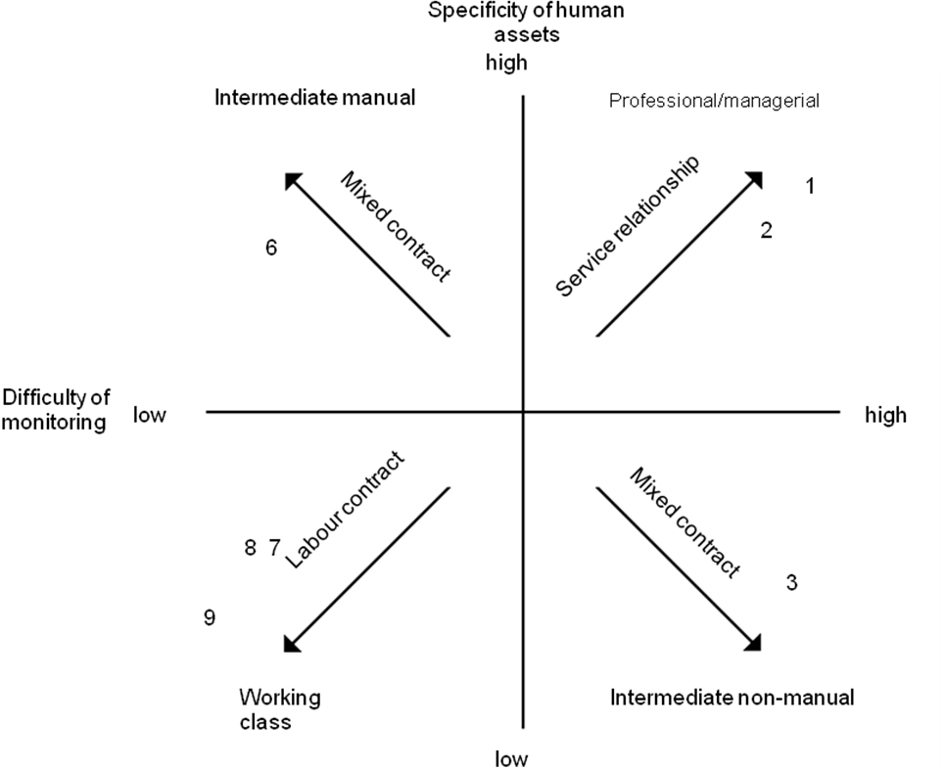

Slide 11
Empirical variables for identification ESeC position
ISCO_88, ISCO_08, demonstration
Questions for questionnaire, demonstration, p. 42 (questions F21, F22, F25-F26, F33-F34 ISCO) from questionnaire ESS

Slide 12
Proportion of ESeC and EGP in the Czech Republic (6 class version, 2012)

Slide 13
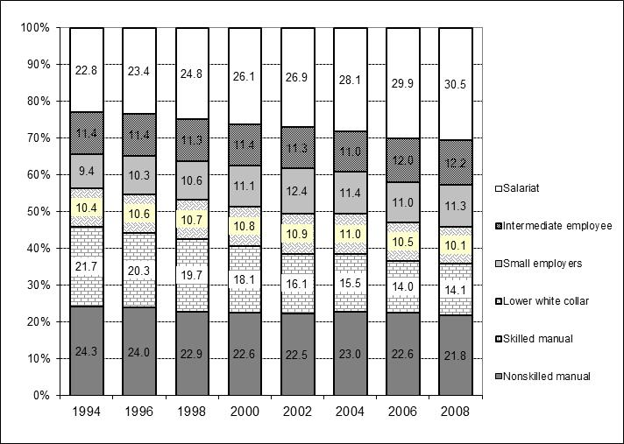
Trends in ESeC in the Czech Republic (6 class version of ESeC)

