Slide 1
Postmodernism
Week 9

Slide 2
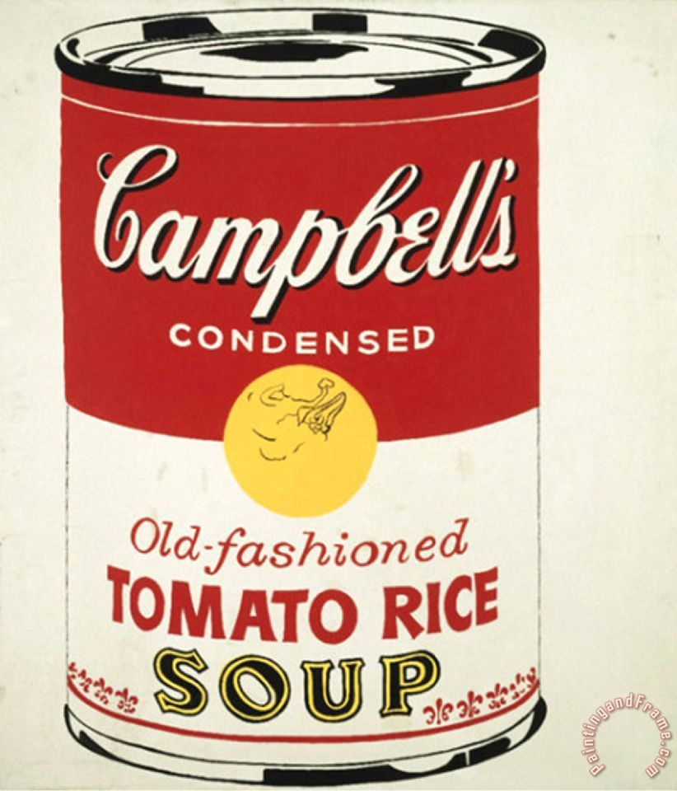
Origins
Around since 1870’s; comes to fruition in 1960’s
Collapse of distinction between high and low culture
Confrontations with the canonic
shocking, scandalous, ugly, dissonant, immoral, anti-social, is acceptable
a culture of kitsch -- artwork marked by sentimental or pretentious
Western culture = a state of decline
Pomo = a celebration of that decline, mass art = commercial culture
Andy Warhol - no distinction between real/mass art
Only context defines it (art gallery, museum)

Slide 3
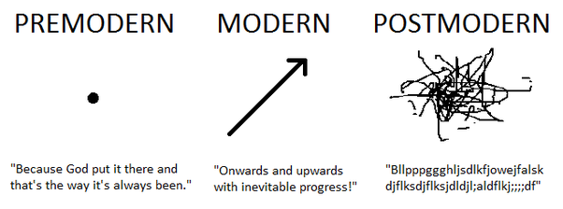
Jean-Francis Lyotard
Pomo = crisis in the status of knowledge in Western societies.
Collapse of metanarratives which explain and order our existence and mark the voices, narratives, and structure of everyday life (christianity, science) creating the privileged truth
What will religion give to me?
What can I get from knowing science?
Cultural diversity over homogenization
The intellectual’s privilege to explain and distribute knowledge is threatened, his authority, dispersed.
Creates new intellectuals, voices from the margins
- blacks, women, homosexual, minority or working class -

Slide 4
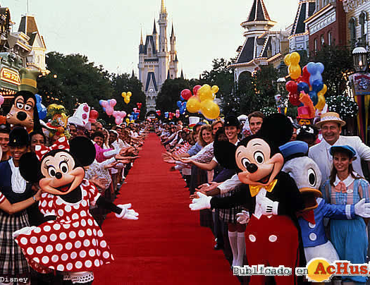
Jean Baudrillard
A culture of the simulacrum
No original = no distinction between copy/original
The hyperreal: real without origins or reality
Real and simulation continually collapse; no such thing as authentic/truth
Disneyland
Watergate
Gulf War
Collapse of metanarratives of authority, as centers of authenticity and truth
The collapse of meaning and representation

Slide 5
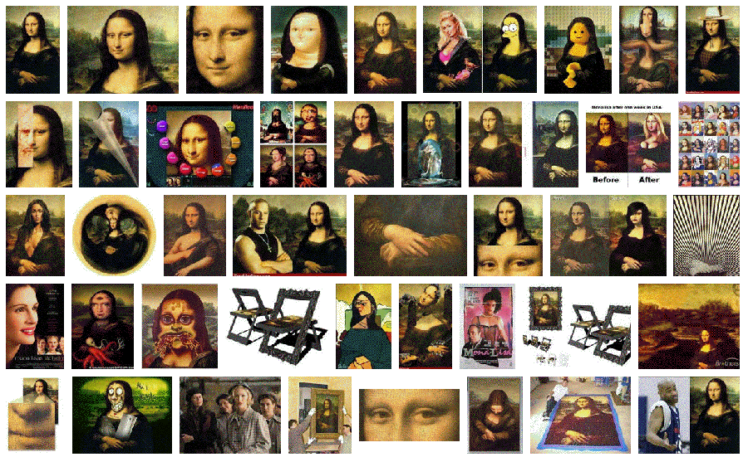
Frederic Jameson
Culture of pastiche - an open imitation of the works of other artists
Pomo culture is a culture of quotations, a culture of intertextuality, flatness/depthlessness = the waning of affect
A separation between affect and meaning; a loss of temporality; a schizophrenic experience
Pomo = hopelessly commercial culture;
collapse of culture into commerce = representation as a form of power
metanarratives replaced by micronarratives
Co-optation and incorporation make no sense -- we are already from the start

Slide 6
Characteristics of Postmodernism
The elevation/commodification of the ordinary
Infinite signification and insatiable desire
Irony
Plurality of Value
Globalization
Convergence Culture
Logics of Late Capitalism
Q = who determines significance, and who has the right to interpret?
Pessimists = multinational capital, the decisions of the market and marketing
Optimists = consumers themselves, stylists who take the goods on offer and make their own marks with them

Slide 7
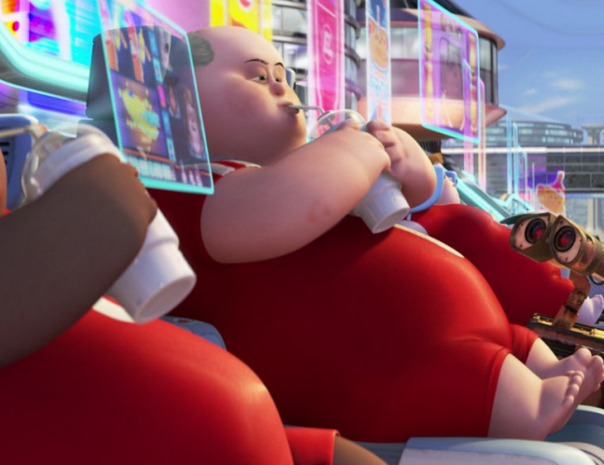
Debord
Spectacle – Commodities have supplanted human relationships
Obfuscates history/past – the ever-present
Yesterday’s religion is today’s advertising
Quality of life, knowledge, critical thinking is degraded; “what was lived is now represented”
Mass media stimulating consumer culture and commodity fetishism serve to stupefy public
What binds the spectators together is the very center which maintains their isolation. The spectacle reunites the separate, but reunites it as separate" (29) With people trying to understand themselves through a representation, they in fact lose all hope of coherently and unitarily living their own life. "This is why the spectator feels at home nowhere, because the spectacle is everywhere" with representation ruling over "the society of the spectacle", the unified direct human relations are replaced with the fragmented adherence to the spectacle which isolates us
A society which no longer needs a developing economy for its survival, but rather one which has to provide for the survival of the ever-developing economy

Slide 8
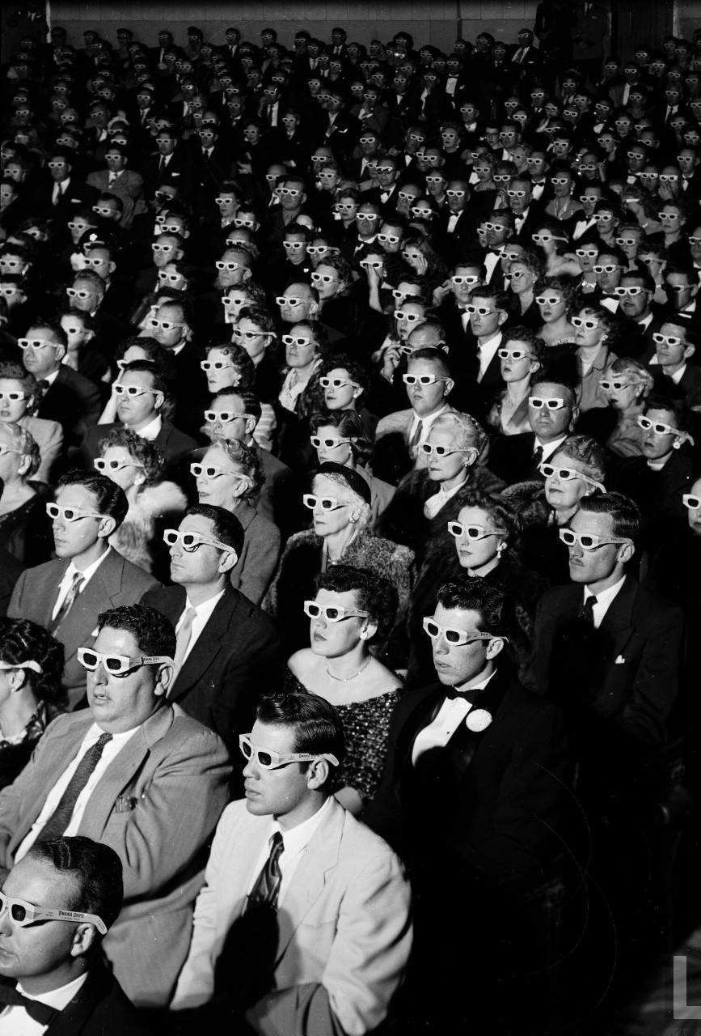
Debord: Society of the Spectacle (1967)
Deeply distressed by the hegemony of governments and media over everyday life through mass production and consumption.
Criticized both the capitalism of the West and the dictatorial communism of the Eastern bloc for the lack of autonomy allowed to individuals by both types of governmental structure.
Postulated that Alienation had gained a new relevance through the invasive forces of the 'spectacle = a social relation between people that is mediated by images" consisting of mass media, advertisement, and popular culture
a self-fulfilling control mechanism for society
probed the historical, economic, and psychological roots of the media and popular culture
alienation is a consequence of the mercantile form of social organization that has reached its climax in capitalism

Slide 9
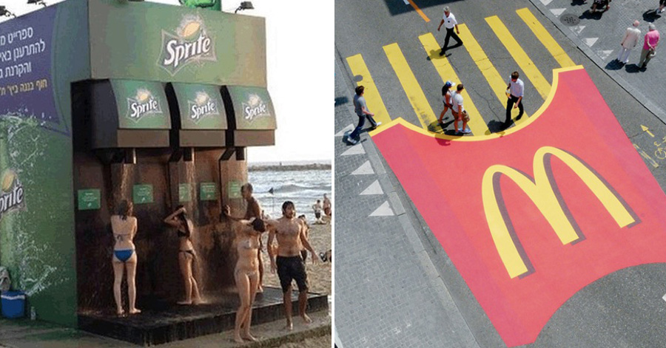
Advertising And Commercial Culture
History and Discourse: Transition to Consumer Society: Pros and Cons
Shift in Techniques: Shift in Experience: “Values” promoted
Shift to Visual Culture: Target Marketing; Cultural Differentiation
Ad Agencies (prime movers): Size, Structure (demographics, lifestyle brands, produser incentives)
Techniques: snob-appeal, bandwagon, hidden-fear, irritation, association principle
Stereotypes, myths and stories, product placement
Limitations (?): Children, Schools, Health, Politics

Slide 10
Transformations
https://www.youtube.com/watch?v=AKlVyUJw3TM
https://www.youtube.com/watch?v=vjO4hf7Byhw

Slide 11
Transformations ?

Slide 12
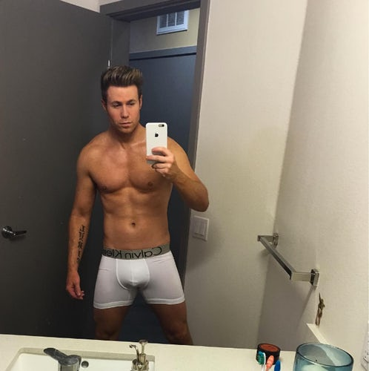
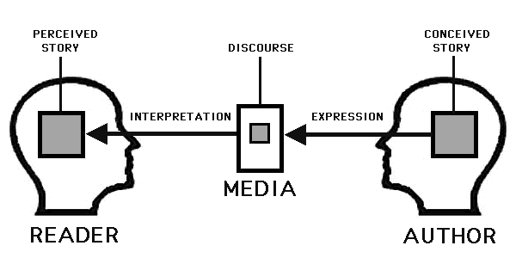
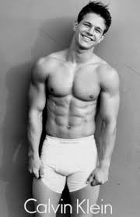
Media Narratives: STorytelling

Slide 13
The Branded Self
Self as Something Produced Discursively
Different form of exploitative labour: “If we see the self as both a product and a reflexively-constituted brand subject to a transaction and exchange, we see a notion of self deeply marked by the discourse and practices of post-fordist modes of capitalist production”
Brand = ultimate image-commodity; value-generating (internalized logics of capitalist accumulation); empty signifiers (flexible meanings)
Sits as the nexus of discourses related to neoliberalism, flexible accumulation, radical individualism, and spectacular promotion
Entrepreneur of the self; whole way of life
Reality TV: Media Life

Slide 14
Discussion Prompts
Consider the tenets of Postmodernismm: The collapse of 1) Metanarratives, 2) Authenticity/Truth, 3) Affect (waning); what are the positives and negatives of these developments for society?
The ascendancy of the Spectacle (and its logics) has, according to Debord, brought powerful changes to how culture operates.
What are those changes?
What role does the media and advertising (and their logics) play in this development?
Is it better or worse for culture? The ways we communicate?
What is your role in this (consider this question in relation to your thoughts on The Branded Self)

