Slide 1

Big Data and Security
Moderní technologie a bezpečnost (BSSn4411)
Modern technologies and conflict (CDSn4003)
Jan Kleiner
20.10.2021

Slide 2
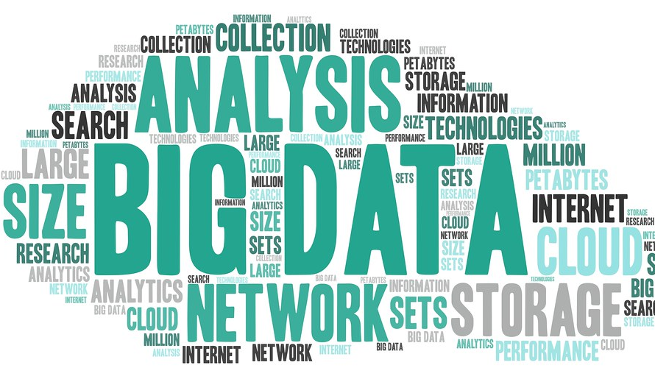
Presentation outline
Big Data – theoretical and methodological prism.
Legitimate ways of use.
Problematic ways of use.

Slide 3

Manyika et al. (2011, 1):
„Big Data refers to datasets, whose size is beyond the ability of typical database software tools to capture, store, manage, and analyse.“

Slide 4

Manyika et al. (2011, 1):
Definition intentionally subjective and moving.
It also depends on a software tools and usual data size in a given sector.
„… as technology advances over time, size of datasets that qualify as big data will also increase.“

Slide 5


Are data more valuable than oil?

Slide 6
Three approaches (PWC, 2019)
Market:
  Active markets for data are rare, mostly illegal.
  Shutterstock, Flicker.
Cost:
  Straight-forward, how much does the data currently cost (e.g. CPC).
  Fails to capture future revenues a holder can get from the data.
Income:
Measure of cash flows the data are expected to generate.
Around 2017 – Amazon, Google, Facebook – biggest net profits (mainly from advertising).

Slide 7
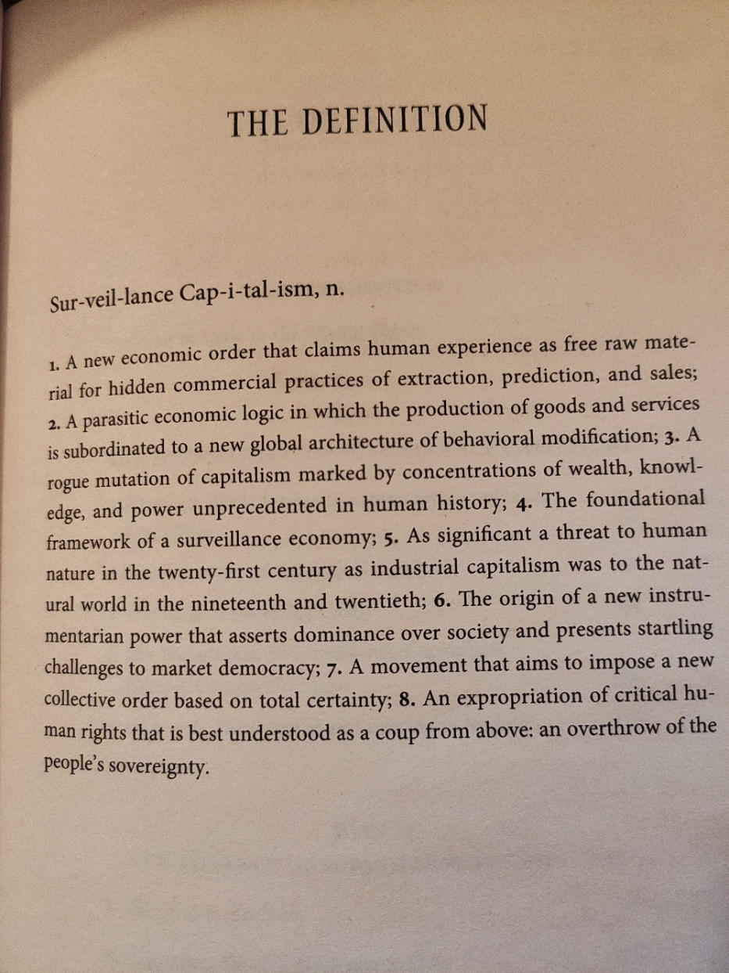

Surveillance Capitalism (Zuboff, 2019)

Slide 8
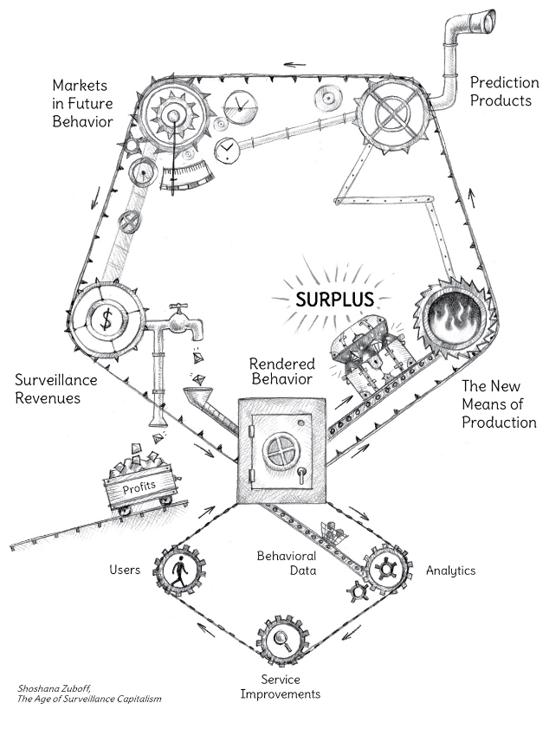
Behavioural Surpluss (Zuboff, 2019: 97)

Slide 9
How to do research with Big Data?
The distinction from „normal“ research is in the data collection.
→ How to collect „Big Data“?
  Google – Trends, Keyword Planner, 3rd parties – SEMRush, Keywordtool
  Social media – Twitter API, scrapers (Octoparse), Facepager
  Wikileaks
  Pastebin
  Cyber security – Shodan (academic licence, shodan trends)
  Open science repositories
    https://openscience.muni.cz/
European legislation on open data and the re-use of public sector information
  https://ec.europa.eu/digital-single-market/en/european-legislation-reuse-public-sector-information

Slide 10
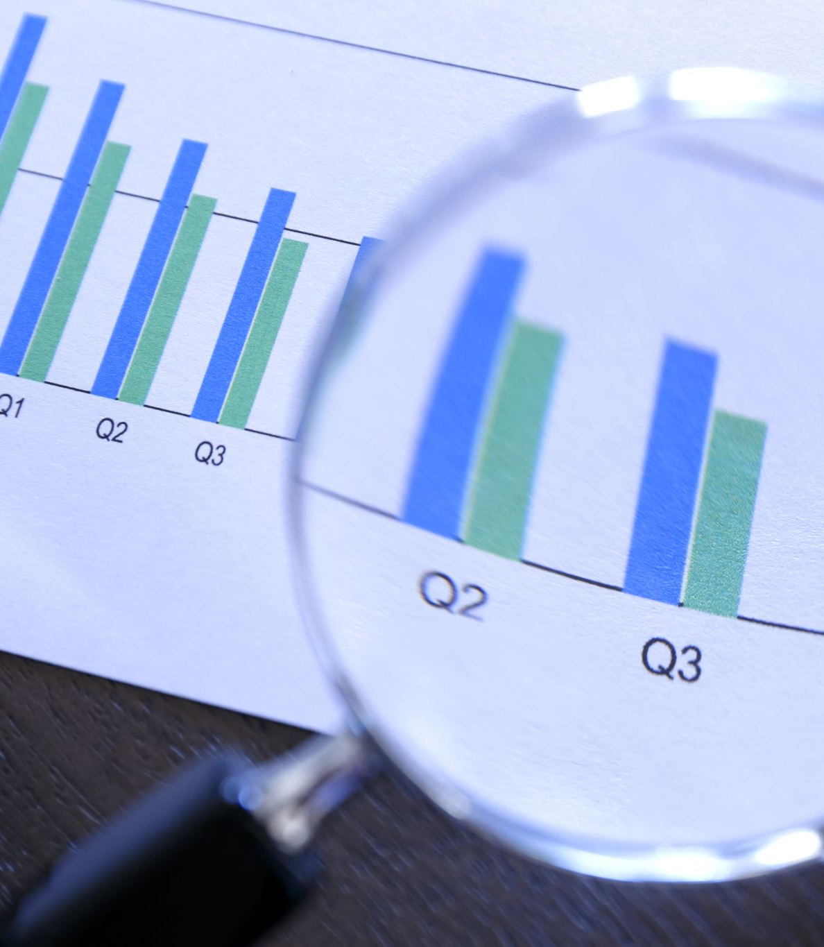
How is Big Data (e.g. searches from Google) different from „conventional“ survey/interview/experiment etc. data?

Slide 11

There are pros as well as cons (Davidowitz, 2015)
Overcome respondent bias (social desirability).
Efficiency. Wider and deeper insight.
Representativeness?
Population of searchers? How big is it?
Misformulated seed words.
We need to intepret results with explicit limits and deliberation in the relation with quantitative and qualitative methodologies.

Slide 12

6 principles of scientific method
Empirically testable (through observations, data etc.)
Replicability.
Objectivity.
Transparency.
Falsifiability.
Logical consistency/coherency.

Slide 13
Challenges (Chen, 2018: 19-23)
Complexity
  There is never too little data, only too little processing and analytical power.
  Social media – complex language issues (e.g., sentiment analysis), enormous scale of data.
  Data integrity? Not reliable due to lack of accessibility.
  Transparency? Black-box data algorithms.

Slide 14
Big Data search
  Keywords return too many results.
  The need of post-processing, indexing strategies.
Lack of theoretical or scientific foundations for Big Data use in research → the need for huge justification (see next slides).
Other risks (caveats):
  Fake news, disinformation campaigns/psyops tarnishing.
  Technology as a catalyst for human behaviour.

Slide 15
„Big data do not constitute a panacea, and their dark side should never be ignored.“ (Chen, 2018: 22)

Slide 16

How to check for Big Data validity and reliability?

Slide 17
Measurement (construct) validity
  Covergent validity
    Measures of the same trait using different methods show agreement.
  Discriminant validity
    Different traits measured by the same method do not agree (any issues here?).
Multi-trait Multi-method Matrix
Test-retest reliability (repetition).
 | Propaganda perception experiment | from Facebook discussion | Pizza perception experiment | Pizza Facebook
Propaganda perception experiment | = | +++ | +/0 | 0
from Facebook discussion |  | = | 0 | +/0
Pizza perception experiment |  |  | = | +++
Pizza Facebook |  |  |  | =

Slide 18
Legitimate ways of use
Army and law enforcement recruitment (see Jahedi, Wenger and Yeung, 2016).
Studies on public perception (Kostakos, 2018).
And others…

Slide 19
Problematic ways of use
Cambridge Analytica (see Isaak and Hanna, 2018) – Facebook data.
Bulk surveillance (privacy vs. security debate) – e.g. PRISM programme exposed by Edward Snowden.
Wikileaks.

Slide 20
References
Manyika, J. et al. (2011). Executive summary: Big data: The next frontier for innovation, competition, and productivity. McKinsey Global Institute. Available from: https://www.mckinsey.com/business-functions/mckinsey-digital/our-insights/big-data-the-next-frontier-for-Innovation.
PWC. (2019). Putting a value on data. Available from: https://www.pwc.co.uk/data-analytics/documents/putting-value-on-data.pdf.
Jahedi, S., Wenger, J. W. a Yeung, D. (2016). Searching for Information online: Using Big Data to Identify the Concerns of Potential Army Recruits. RAND Corp. ISBN: 978-0-8330-9414-8. Available from: https://www.rand.org/pubs/research_reports/RR1197.html.
Isaak, J. and Hanna, M. J. (2018). User Data Privacy: Facebook, Cambridge Analytica, and Privacy Protection. Computer 51(8), pp. 56-59. DOI: 10.1109/MC.2018.3191268. Available from: https://ieeexplore.ieee.org/abstract/document/8436400
Davidowitz, S. S. a Varian, H. (2015). A Hands-on Guide to Google Data. pp. 9-25. (via Google Scholar).
Kostakos, P. (2018). Public Perceptions on Organised Crime, Mafia,and Terrorism: A Big Data Analysis based onTwitter and Google Trends. International Journal of Cyber Criminology. 12(1). pp. 282-289. DOI: 10.5281/zenodo.1467919.
Chen, S. (2018). Big Data in Computational Social Science and Humanities. Springer. DOI: 10.1007/978-3-319-95465-3.
Zuboff, S. (2019). The Age of Surveillance Capitalism: The Fight For a Human Future at the New Frontier of Power. London: Profile Books.

Slide 21

Thank you for the attention. Questions and your presentations.

