Slide 1
MUNI
Faculty
Of Social
Studies
The Caucasus Mini-Region:
Does it even exist?
Notes:
Determinants of the region in general terms – what is Caucasus?
You had all the presentations, so I will focus only on one specific topic – Illustration of the “complexity” of the complex on the example of Nagorno-Karabakh dispute.
The question is whether there is – nowadays – a security complex in the Caucasus? Answer this question yourselves throughout the lesson.
Very brief lecture, but I will send you literature.

Slide 2
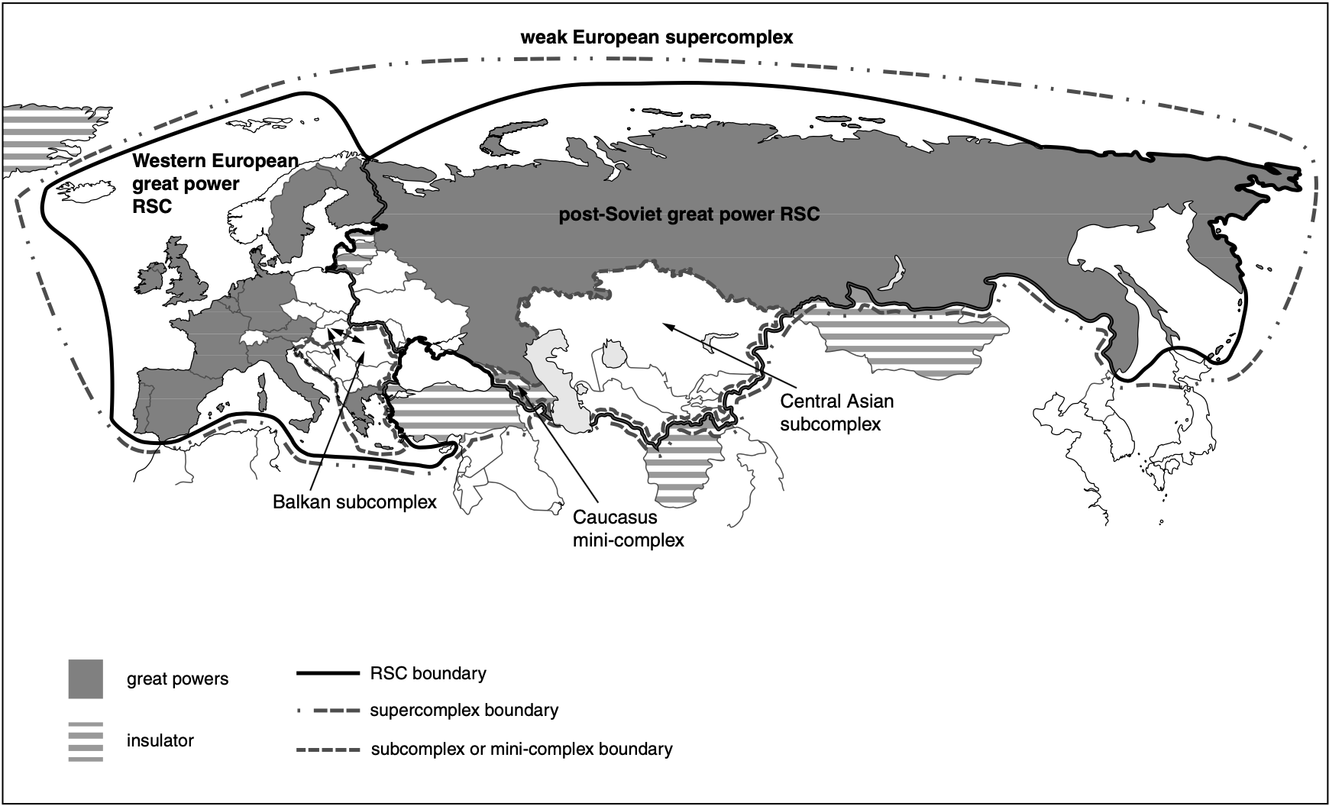

Slide 3
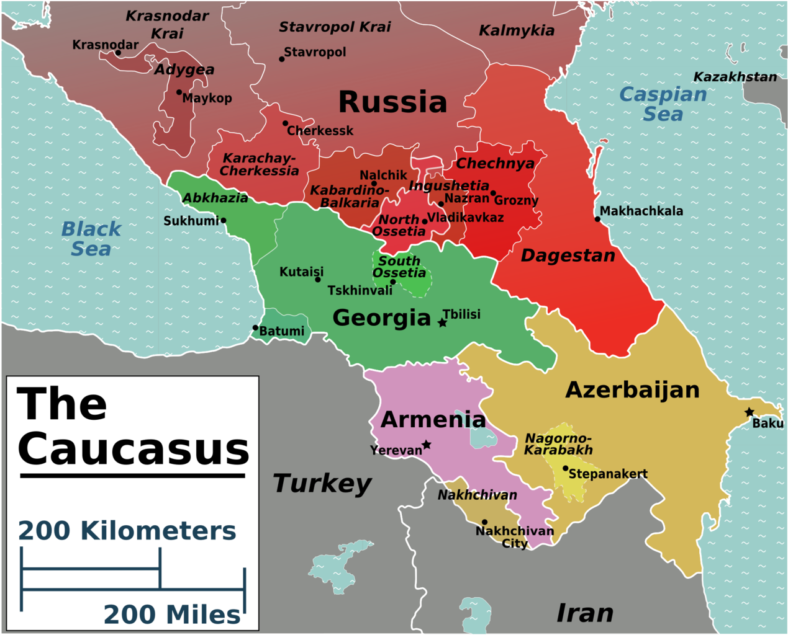

Slide 4
“The ethnic relations in Caucasus are so complicated that the Balkans and Afghanistan become simple and clear in comparison”.
The most complicated pattern in terms of different ethnic groups is in the republic of Dagestan.
Chechnya is in a sense simpler than most of the other conflicts in the area.

Slide 5
South Caucasus or Trans-Caucasus is defined by a complicated interplay between issues internal to the region on the one hand (Georgia or Nagorno-Karabakh) and the issue of alignments out of the region (foreign influence) on the other hand.
Abkhazia, South Ossetia, and Adzharia.
Nagorno-Karabakh used later as an illustration of complex‘s complexity.

Slide 6
Is the Caucasus a real Security Complex (be it ‘mini’, ‘sub’ or whatever else)?
Is there a common regional identity?
Are there patterns of cooperation?
What is the level of influence / interference / interest of ‘third powers’?
What about centrifugal tendencies and overall heterogeneity of the region?

Slide 7
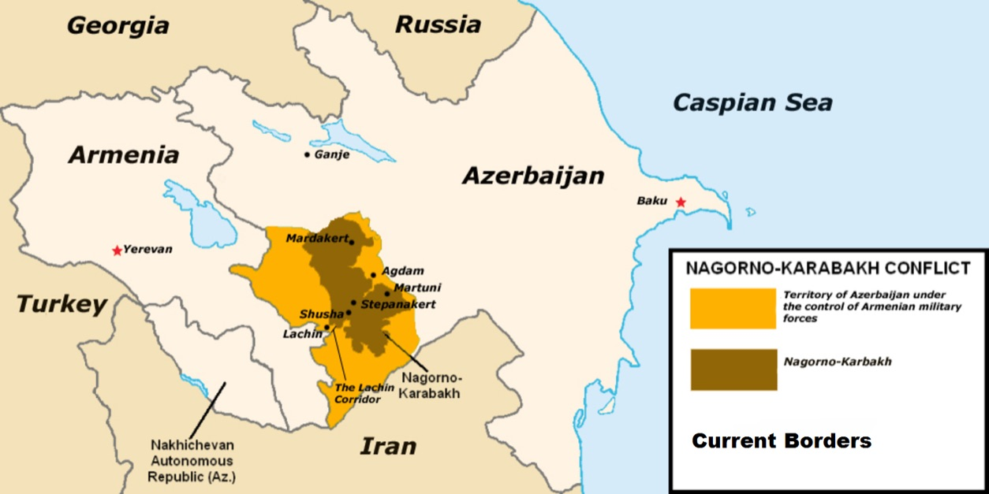
S

Slide 8
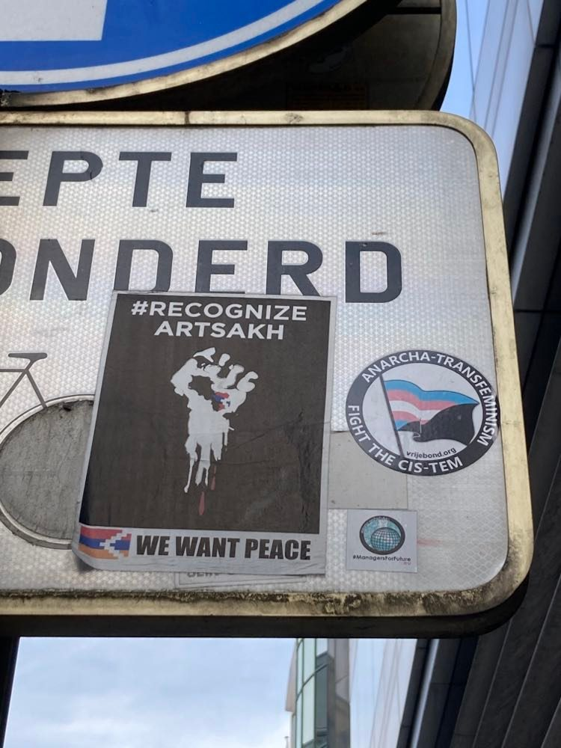
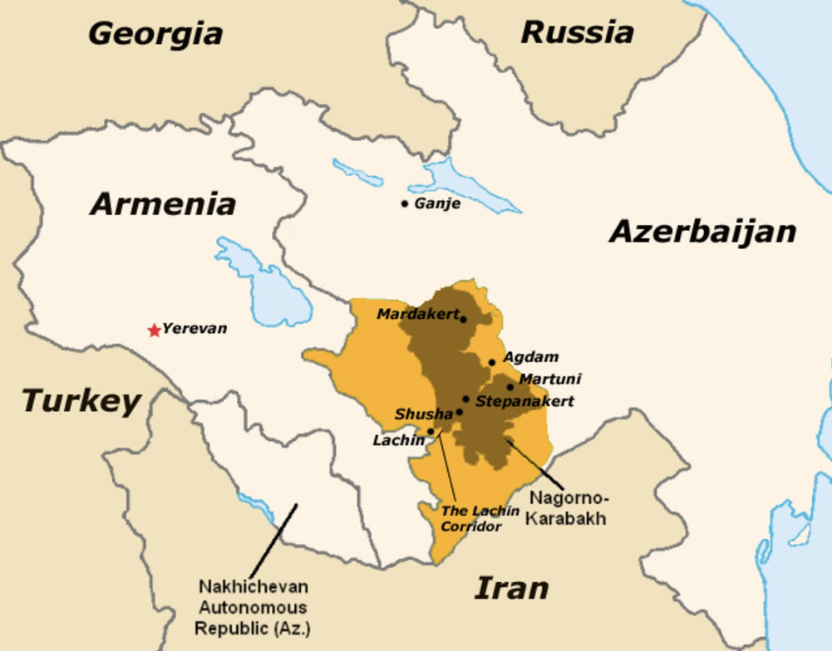
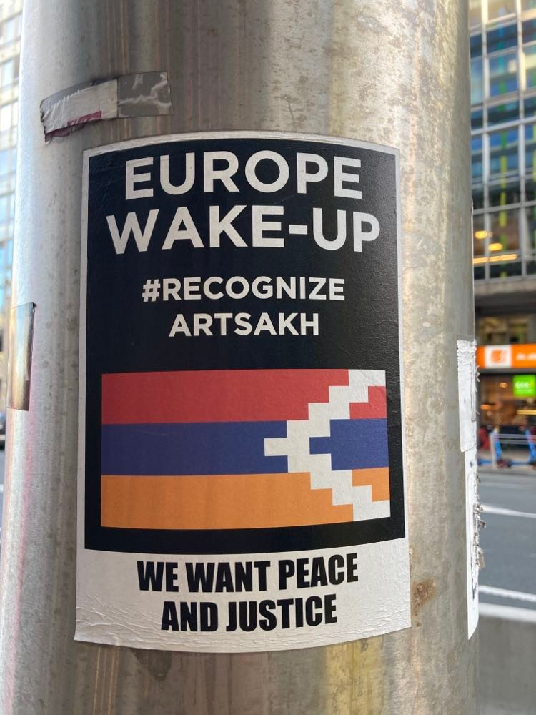

Slide 9
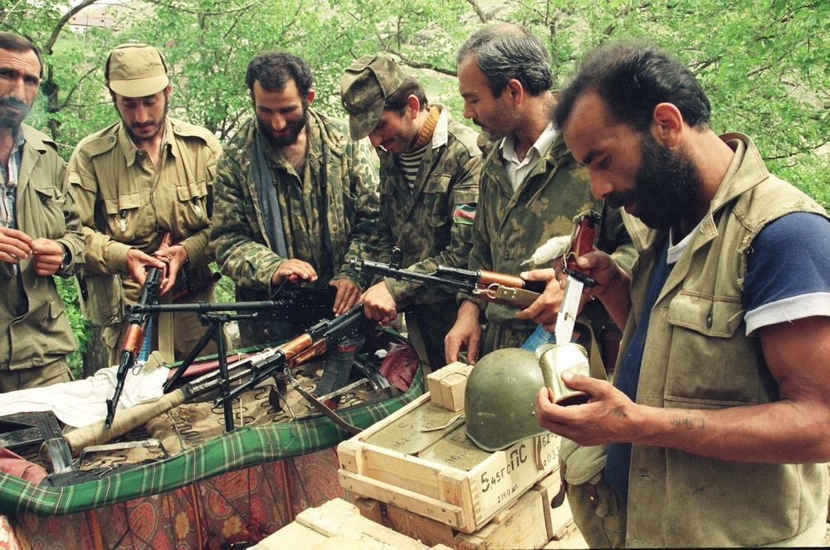
First issue: geography (previous slide)
Region on ethno-religious crossroads
Heavy foreign interest – triadic relations in multiple layers?

Slide 10
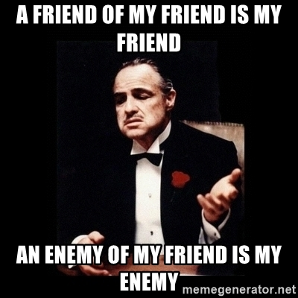
… or not?

Slide 11
Solutions of Nagorno-Karabakh conflict? -> Krzysztof’s presentation.
Ethno-religious situation in Northern Caucasus? -> Maud’s presentation.
Abkhazia and Southern Ossetia? -> Vojtěch’s presentation.
Notes:
Daniel Pechanec – nice paper on NKR!

Slide 12
MUNI
Faculty
Of Social
Studies
Thank you for your attention!
25. November, International day for the Elimination of Sexual violence
against Women.

