Slide 1
MUNI
Faculty
Of Social
Studies
A FRAMEWORK OF SECURITY DYNAMIC IN AFRICA
+
Central AfricaN RSC

Slide 2
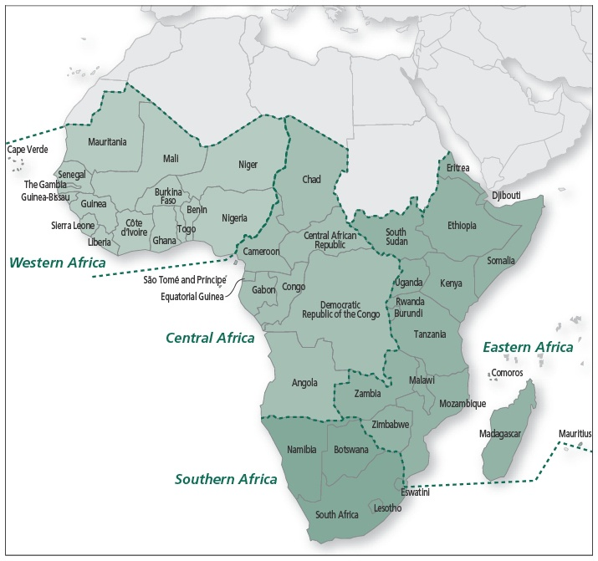
Securitisation of the whole African
continent on some levels of analysis.
Central and East African RSC
CAR is not in CA RSC
Buzan & Weaver, 2003.

Slide 3
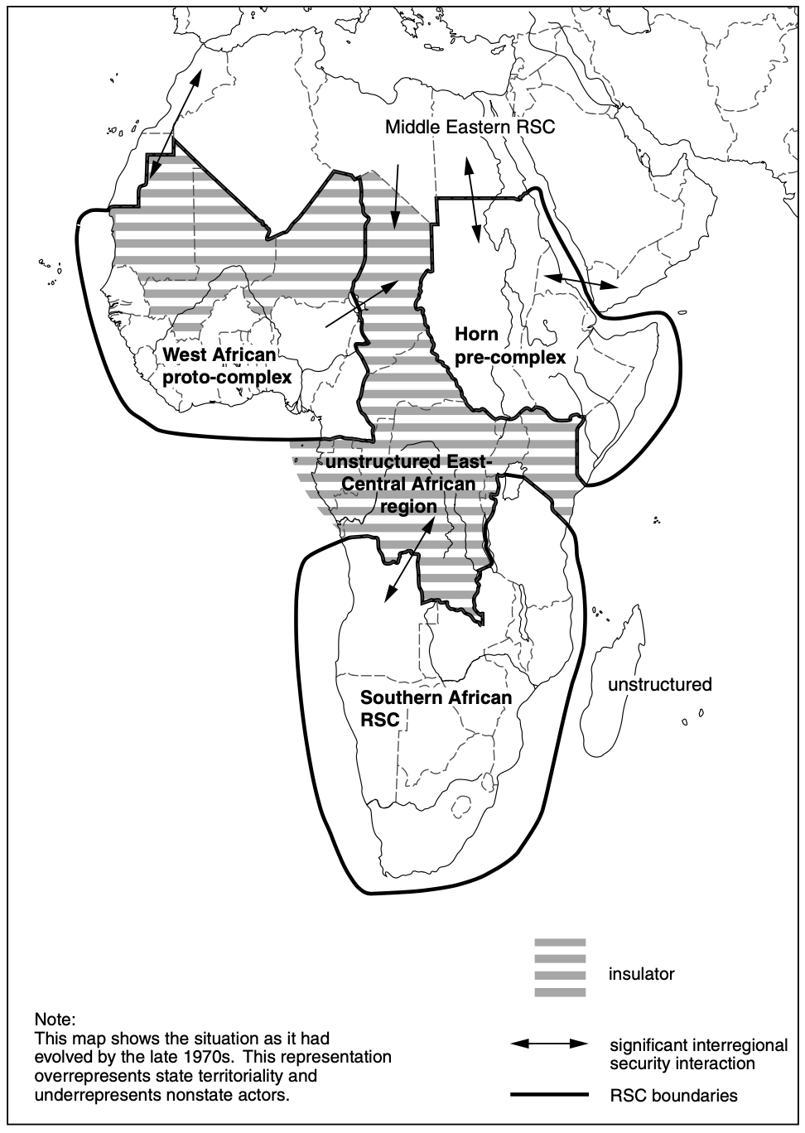
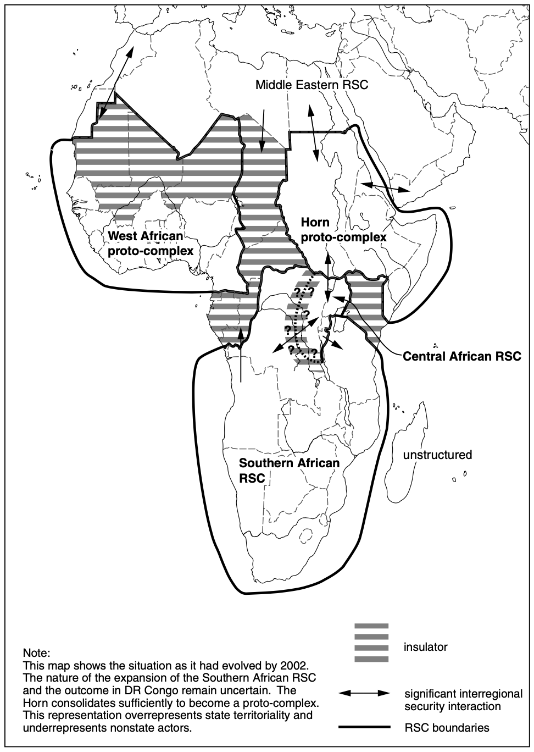

Slide 4
Domestic level of security dynamics in Africa
The vital problem of African security is the post-colonial state.
Weak both as a state (social cohesion) and in power (econ., polit., or military).
Rapid decolonisation produced anything but consolidation of modern state.
Variety of non-state actors ruling over the “state affairs”.

Slide 5
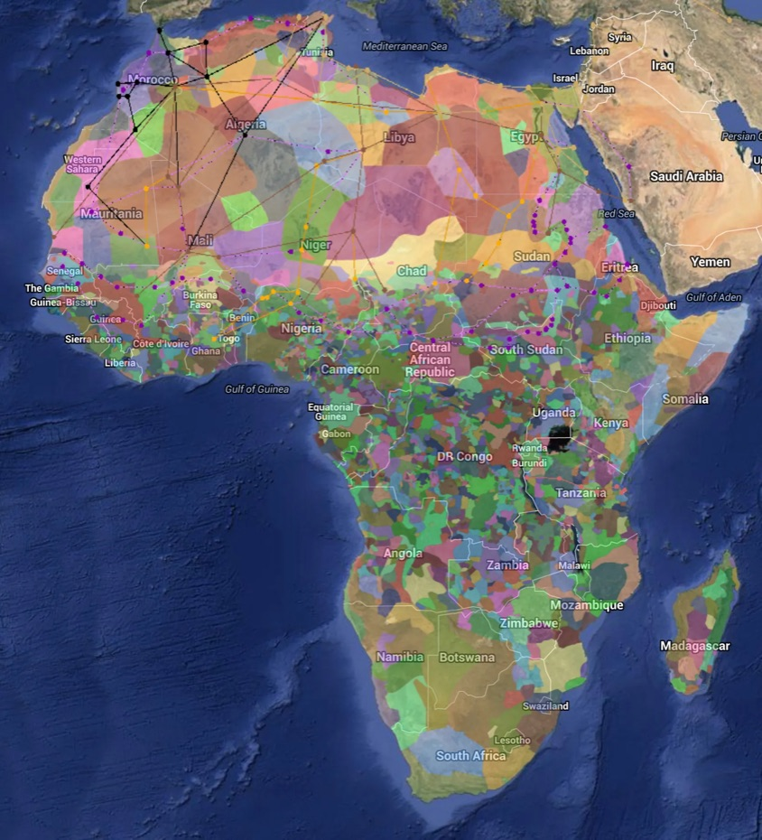

Slide 6
Domestic level of security dynamics in Africa
Somehow stateless configuration is articulated on the basis of primordial and patronage attachments.
Empirical versus Juridical Sovereignty are adopted in opposite direction.
Result is an unique mix of post-traditional, modern and post-modern state features.

Slide 7
Domestic level of security dynamics in Africa
The above-mentioned results in two arguments leading us to the assumption that “domestic” is not the right level of analysis for us:
    Existence of “nonstatist” African state
    Nonstate rivals to the African state (whatever the state is)

Slide 8
Regional level of security dynamics in Africa
RSC depends on existence of significant levels of security interdependence among a group of states – is there any such feature?
Interstate security dynamics in Africa are often simply spillovers of domestic dynamics, particularly refugee flows, expulsions of foreigners, and civil wars.
Rare to find African states engaging in vital security interactions with actors other than their immediate neighbours.

Slide 9
Regional level of security dynamics in Africa
“Close Neighbourhood” pattern of security interactions.

Slide 10
Central African Regional Security complex
Uganda, Rwanda, Burundi
+ part of DRC (how big part?).
What about Kenya (insulator) and Tanzania (SA RSC)?

Slide 11
Central African Regional Security complex
No evidence of even pre-complexes so far.
De facto only insulator area up till late 1990s.
Main security dynamic oscillates between dictatorship and civil war.

Slide 12
Central African Regional Security complex
Four major civil wars (DRC, Rwanda, Burundi, Uganda).
Two major inter-state wars.
Mutual cross-border interventions (everyone vs. everyone).
International interventions.

Slide 13
Central African Regional Security complex
Grounds for centration of the RSC on the Great Lakes region.
DRC may be restored as pure insulator but not in near future.
Probably bigger partition of Central and Eastern African RSC, but these two will remain unstable and turbulent.
Full integration together (according to RSCT) is unlikely.

Slide 14
Inter-Regional and Global Levels of security dynamics in Africa
Buzan, Barry, and Ole Waever. 2003. Regions and Powers: The Structure of International Security. 1st ed. Cambridge: Cambridge University Press.
PP 248-252.

Slide 15
MUNI
Faculty
Of Social
Studies
Thank you for your attention!
9. December, International Day of
Commemoration and Dignity of the victims of the Crime of Genocide

