Slide 1
Development II
Comparative Perspectives
Marek Rybář, PhD.

Slide 2
Institutional explanations
Good institutions favor self-realization, innovations, freedom of expression, equality before the law, and protect political and economic competition
North America: English colonizers first tried the strategies first used by Spaniards in South America, but the local conditions were not conducive to their strategy
Representative institutions were introduced only as a “plan B”

Slide 3
Institutional explanations
Acemoglu a Robinson Why Nations Fail (2012):
short video AKA 500 pages in 5 minutes:
https://www.youtube.com/watch?v=2z5RAZlv2UQ

Slide 4
Questions
HOW EXACTLY do decisions in the past influence today’s political and social reality?
“classical geography”: fixed geographical factors (ecology, climate, resources) have the same impact today as in the past – directly on people
More sophisticated explanations emphasize the mediating role of institutions
Acemoglu et al work with broadly conceived sets of institutions
however, a precise mechanism of their influence is unclear (how and why do institutions persist)

Slide 5
Inequality as a direct consequence of the past
the importance of Africa’s slave trades in shaping subsequent economic development:
a robust negative relationship between the number of slaves taken from a country and its subsequent economic development
the slave trades impeded the formation of broader ethnic groups, leading to ethnic fractionalization, and the slave trades resulted in a weakening and underdevelopment of political structures: colonial origins of trust?

Slide 6
Transport as Development
Global South: poorly maintained infrastructure, unreliable, labor-intensive and high-cost transport,
A majority of population lives in spatially circumscribed local socio-economic systems where poverty and immobility are linked

Slide 7
Transport as Development
Hilling (1996):
“revolution in transport” in the developed world:
Cheap mass air travel
High and rising levels of personal mobility
Internationalization in industry and commerce → “Global village”
situations, when development followed after transport infrastructure: new railroads paved the way for increases in production and export

Slide 8
Transport as Development
Transport infrastructure in Amazonia ➔ expansion of agriculture, forestry and mining industry
Transport and infrastructure often link to non-economic factors: military, ideological and political considerations (control over territory)
Consequences of new transport infrastructure:
For users (reduced costs, reliability, …)
For non-users (cheaper products, greater selection, changing land values, )
For wider regions (shifts from non-monetary to monetary economy, from isolation to incorporation, from rural to urban etc. )

Slide 9
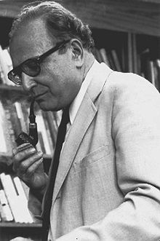
Modernization
Economic factors lead to modernity, to economic and political progress
S.M. Lipset (1959): GDP per capita fosters democratization and strengthens democracy
Income is strongly linked to other phenomena that influence democratization

Slide 10
Modernization
the literature on modernization and democracy has offered three explanations of the emergence of democracy
1) a functional match between democracy and social modernization
2) extension of pluralistic values associated with economic development
3) transformation of economic and social structures

Slide 11
A functional match between democracy and modernization
market economy is sustained by a free flow of information,
markets can prosper only when embedded in a political framework characterized by the recognition of political rights and constitutional liberties
there is a lack of causal direction in this line of argument, consequently, a second explanation has been put forward:

Slide 12
Extension of values associated with economic development 1/2
rising education levels AND an autonomous labor force generate a public opinion tolerating multiplicity of values and opinions, thus paving the way for accepting liberal democracy as the mechanism to settle disagreements
however, what makes the practice of toleration relatively easier and less costly?

Slide 13
Extension of values associated with economic development 2/2
either a shift in religious and cultural values
OR a change in the structure of material or economic relations
however, the link between religious practices and democratization seems to be weak: (many countries had democratized before a widespread process of secularization)

Slide 14
Transformation of economic and social structures
modernization results in reduction of the level of inequality (which is a source of political conflict)
AND in the growth of a middle class who acts as a moderating force
the causal mechanisms linking economic development and democracy are underspecified - what is missing is the role of political agency

Slide 15
Przeworski et al (2000) Democracy and Development 1/2
Economic growth does not explain the occurrence of democracy, only whether it will survive once it appears
In poor countries, neither type of régime (democracy, autocracy) can produce growth more effectively than the other, while democracies grow faster among wealthier countries
Dictatorships have higher fertility rates and lower life expectancies, why?

Slide 16
Przeworski et al (2000) Democracy and Development 2/2
since democracies find it easier to credibly commit to taking care of you, parents are less concerned about having many children
democracies can credibly commit to assist the elderly, dictatorships cannot
even if the economy is good this year and you're getting your pension, the dictator may cut your benefits off if the economy falls

Slide 17
Boix and Stokes (2003)
when the Przeworski et al dataset is divided by time periods, economic development is an extremely important predictor of transition prior to 1950, but has only a small (though statistically significant) effect in the post-1950 period
Selection bias: Przeworski focuses on the cases after WWII, if cases from the earlier periods are added, a link between economic development and democracy is stronger

Slide 18
Boix a Stokes (2003)
Why is it that rich countries were already democratic and poor countries were dictatorships after 1950?
democratization in 1850-1940: strong link between GDP per capita and democracy
Development CAUSES democracy but the link is less visible after 1950 because rich countries are already democratic at that time

Slide 19
Boix (2003)
the core assumption is that democratization is driven by conflict between the rich and the poor
increasing levels of economic equality bolster the chances of democracy: redistributive pressures from the poorest social strata on the rich diminish
since the tax rich would pay under democracy becomes smaller than the costs of repression, they accept the introduction of democracy

Slide 20
Boix (2003)
the importance of capital mobility: as it increases (i.e. owners can transfer it abroad), tax rates also decline;
similarly, when capital can be hidden from the state or can be used only by the owner, the temptation to confiscate it also declines
e.g. in South Africa opposition to democracy was high among the Afrikaner farmers, it barely existed among financial and industrial elites (who could move their capital abroad)

Slide 21
Why does development underpin democracy?
Inglehart (2000): material conditions influence how individuals perceive social and economic reality
Development influences our subjectively perceived well-being which in turn shapes the legitimacy of democratic institution
high level of well-being supports democracy, a strong link between the type of regime and subjective well-being
(despite anecdotic evidence suggesting the opposite, people in rich countries are more satisfied with their lives)

Slide 22
Modernization and demography 1
Dyson:
Demographic transition has been central to the creation of the modern world – independently of economic aspects of modernization
Sustained mortality decline causes both urbanization and fertility decline

Slide 23
Modernization and demography 2
Urbanization leads to an increased division of labor, dependence upon monetary exchange, and the wider distribution of political power (“organized democracy is the product of urban life”)
Fertility and mortality decline contribute to reduced gender differentiation (“women become more like men”)
Population ageing probably contributes to the rise of modern democracy

Slide 24
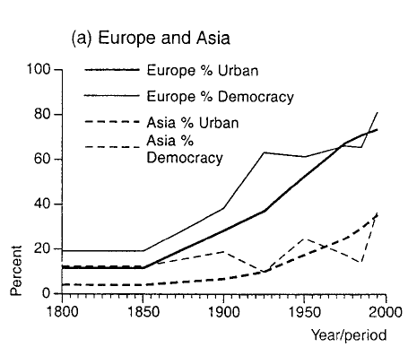
Urbanization and Democracy 1

Slide 25
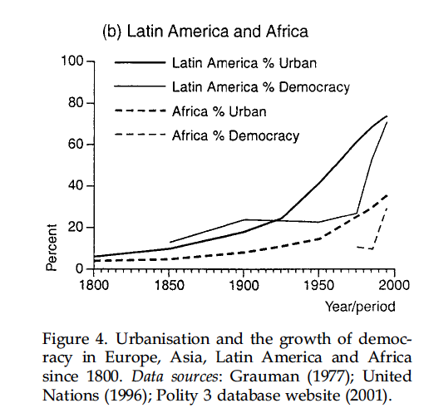
Urbanization and Democracy 2

Slide 26
State Institutions and Economic Growth
Weber: bureaucracy as one of the institutional foundations of capitalist growth
public administrative organizations characterized by meritocratic recruitment and predictable, long-term career rewards will be more effective at facilitating growth than other forms of state organization

Slide 27
Professional Bureaucracy and Economic Growth
Evans and Rauch: a strong and significant correlation between score on the “Weberianness” Scale and total growth of real GDP per capita during the 1970-1990 period (r = .67; p < .001)
Because the data refer primarily to core economic agencies, the implication is not that the entire bureaucratic apparatus must be structured in this way to have positive effects on growth

