Slide 1
Research Basics and Research Design II
Methodology of Conflict and Democracy Studies
September 27

Slide 2
Aim of this lecture
Empirical part of the research
Research design – main components
How to present your design

Slide 3

Step by Step
1. Topic and goals (+ reading)
2. Research questions (+ reading)
3. Hypotheses (+ reading)
4. Methods (+ reading)
5. Data collection
6. Data analysis
7. Results

Slide 4
After the Planning is Done
What comes next:
  Data collection
  Data analysis
Applies to both qualitative and quantitative research
Data and methods link your ambitions with your results

Slide 5
Before we Start
Validity
  We measure what we aim and are supposed to measure
  Invalid measure – measuring something different than originally intended
  Importance of operationalization
  Any thoughts of bad examples?
Reliability
  A measure of a concept is reliable to the extent that it is repeatable
  If we use same measurement under same conditions, we should gain identical results
  Important for checking and repeating previous research
  Importance of transparency

Slide 6
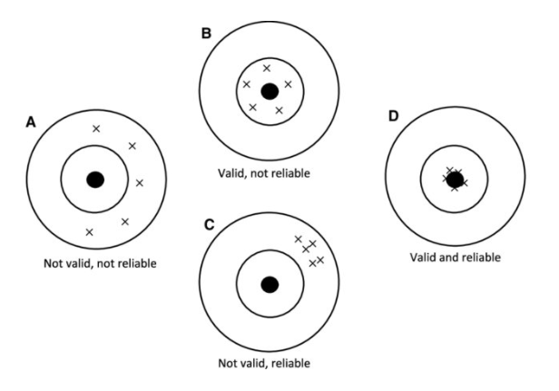
Validity and Reliability
Irvine (2019)

Slide 7
Strategy of Your Research
How to search for causality?
Methods always depend on your aims and ambitions
Two main strategies:
  Experiments
  Observational studies

Slide 8
Experiment
Consider the following:
  You own a media and PR company. You made a contract with a clothing producer that hires you to increase its sales. You prepare four different commercials. What should the clothing producer do to maximize its profit?
The answer – the producer should run an experiment

Slide 9
Experiment
Estimation of effect of IV on DV by effective controlling for effects of all other confounding variables
The researcher manipulates with the independent variable
Experimental group (at least one) and control group
Random assignment as a necessity
Random assignment vs. random sampling

Slide 10
Experiment
Does corruption lower trust in elected representatives?
Laboratory experiment, 2 groups (experimental and control)
  Exp Grp: Video with corruption of a political official
  Ctrl Grp: Video with the political official in daily duties
Sample of 100 people
How to divide the sample into groups?

Slide 11
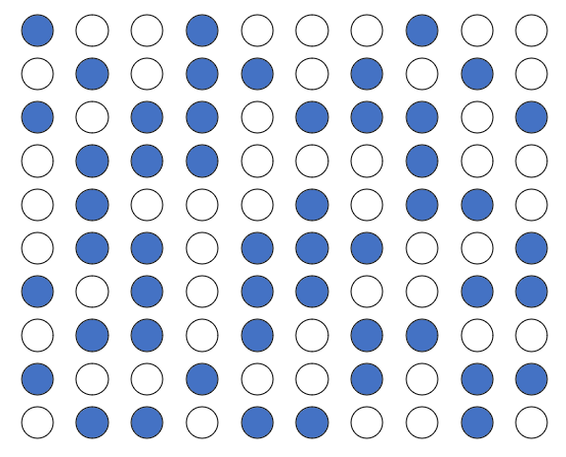
50 men (blue dots), 50 women (white dots)

Slide 12


Wrong Solution
Experimental group: Control group:
50 M, 0 W 0 M, 50 W

Slide 13
Post experimental questionnaire
On a scale from 0 to 10 how do you trust the political official?
Experimental group (50 M, 0 W):
  Result: 4.2
Control group (0 M, 50 W):
  Result 6.7
The result – watching a video with corrupt practices lowers trust to political officials

Slide 14
Post experimental questionnaire
On a scale from 0 to 10 how do you trust the political official?
Experimental group (50 M, 0 W):
  Result: 4.2
Control group (0 M, 50 W):
  Result 6.7
The result – watching a video with corrupt practices lowers trust to political officials
What if the video has no effect but
men simply have lower trust in politicians?

Slide 15
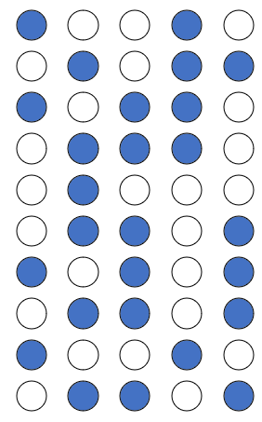
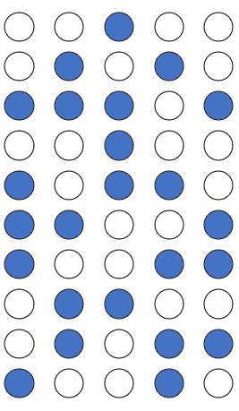
Correct Solution
Experimental group: Control group:
26 M, 24 W 24 M, 26 W

Slide 16
Correct Solution
All differences (that can affect the results, e.g. age, income, education) are eliminated.
The only difference between the groups is our treatment (the video).
If the video has an effect, we will see it in different scores of groups and vice versa.
Experimental group: Control group:
26 M, 24 W 24 M, 26 W

Slide 17
Experiment
Estimation of effect of IV on DV by effective controlling for effects of all other confounding variables
The researcher manipulates with the independent variable
Experimental group (at least one) and control group
Random assignment as a necessity
Random assignment vs. random sampling

Slide 18
Experiment
Several types:
  Laboratory experiment
  Field experiment
  Natural experiment (quasi-experiment)
Strengths:
  Effective isolation of other variables
  Reliability, internal validity
Weaknesses:
  External validity (vs. experiments based on population sample)
  Not always applicable in social sciences
  Not all independent variables are subject of manipulation
  Need of replication

Slide 19
Transparency at the Local Level
Topic: Reactive provision of information by local governments
Effect of Freedom of Information (FOI) requests on responsiveness of local governments compared to less formal requests
Experimental study on 2,926 municipalities in Slovakia
Requests on information about local elections

Slide 20
Preparation of Experiment
Random assignment of municipalities into three groups
All municipalities obtained an information request
Control group – baseline version
Exp group 1 – baseline + moral paragraph
Exp group 2 – baseline + FOI paragraph
All requests sent via e-mail on Monday

Slide 21
Results
FOI requests double responsiveness of municipalities
Higher response rate found among larger towns and towns with independents and female mayors
The effect of content of requests strongly moderated by population size

Slide 22
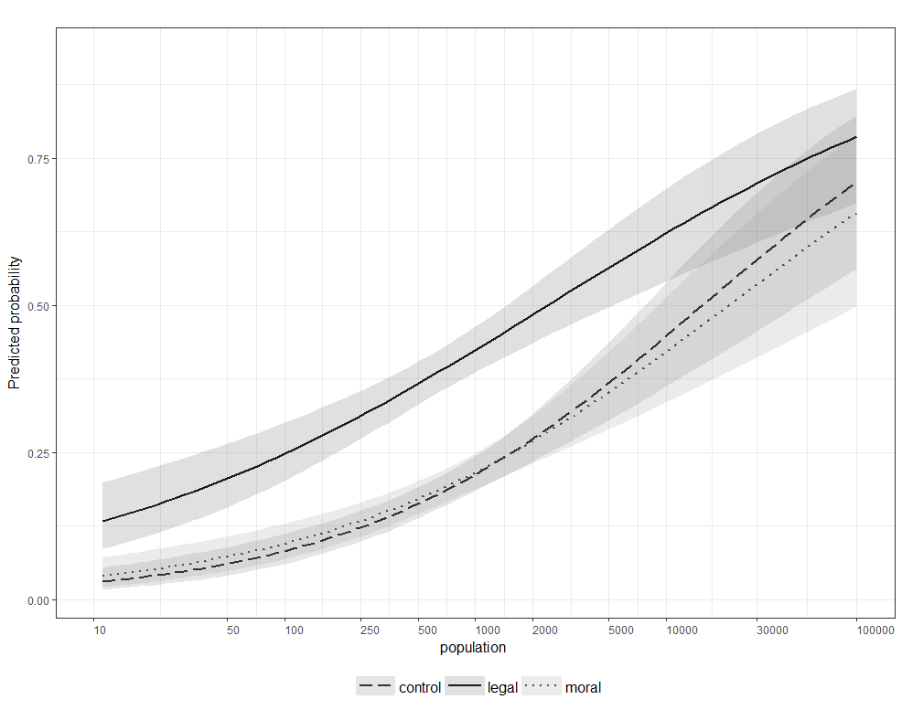

Slide 23




Experiment with Oranges and Discrimination

Slide 24
Observational studies
It does not mean that the researcher stands and physically observes the research object with a binocular
Researchers observe the reality as it is - they do not manipulate with any variables and they have no control over the values of variables
Lesser control over other confounding variables (compared to experiment)
Time-series and cross-sectional studies

Slide 25
Qualitative and Quantitative Research
Both have their strengths and weaknesses
None is superior to the other (although opinions vary)
Different methods and approaches, but the same aims

Slide 26
Qualitative and Quantitative Research
Case study:
  Typically a study of a single case
  Aim is to gain deep and detailed knowledge of the phenomena
Statistical Analysis:
  Large N studies
  A variety of techniques that allow testing hypotheses on relations between variables
Comparative Method:
  Somewhere in between, when you lack enough cases for a statistical analysis
  Example - QCA

Slide 27
Work with Data
Large number of techniques and approaches
The choice depends on research aims and data availability
Interview vs. survey:
  Deep understanding vs. standardized questionnaire
  Number of cases
  Length of data collection
  Differences in data analysis
Content analysis, discourse analysis, QCA, regression analysis (linear, logistic, multilevel, polynomial…)

Slide 28
Research Ethics
Always be aware of potential problems with ethics
Milgram’s experiment with false electricity shocks
Character of questions in a questionnaire
Informed consent of research participants

Slide 29
Limits of Your Research
There is no “one research to rule them all”
Every research contains limits:
  What cannot be analyzed
  Is the found relationship between variables important in the real world?
  Are there any obstacles that limit your research?
Be transparent on limits

Slide 30
Research Design
Basic points:
  Selection of the topic and your aims
  Previous theory
    What is already known
    Gaps in the literature
  Questions (and hypotheses)
  Data and Methods
  Ethics and limits
Always explain – Why do you have such a research question? Why is it important to study your case? What is the added value of your research?

