Slide 1
Propaganda:
Case studies
CDSn4104 HYBRID WARFARE

Slide 2
What is propaganda?
“Propaganda is neutrally defined as a systematic form of purposeful persuasion that attempts to influence the emotions, attitudes, opinions, and actions of specified target audiences for ideological, political or commercial purposes through the controlled transmission of one-sided messages (which may or may not be factual) via mass and direct media channels.”
Wide-spread and multifaced phenomenon
Related with modernity – Importance of mass culture

Slide 3
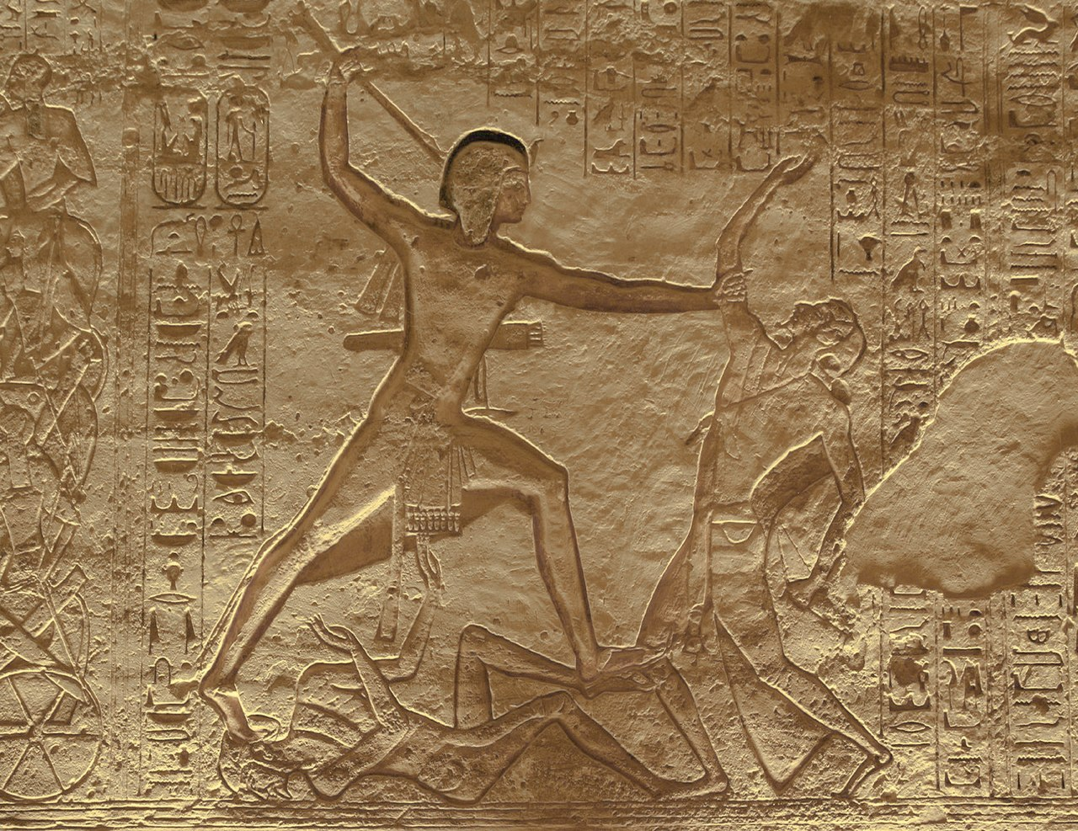
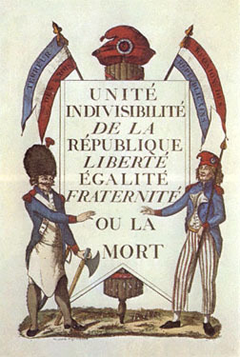
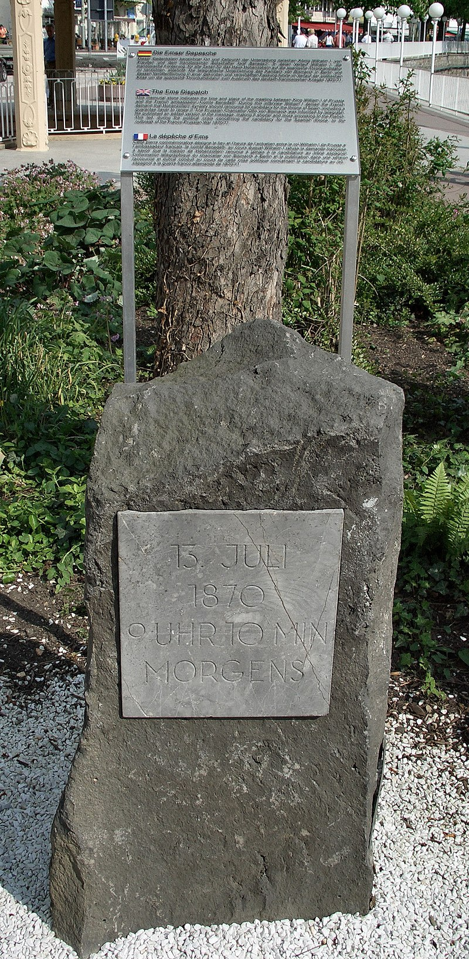
Pre-modern Era
Heroic poems, legends, hymnus
  Battle of Kadesh (1274 BC)
Importance of print and increasing mobility and literacy
French revolution and Napoleonic Wars
  Caricatures and bulletins
  La Marseillaise
Franco-Prussian War (1870)
  Ems Dispatch

Slide 4
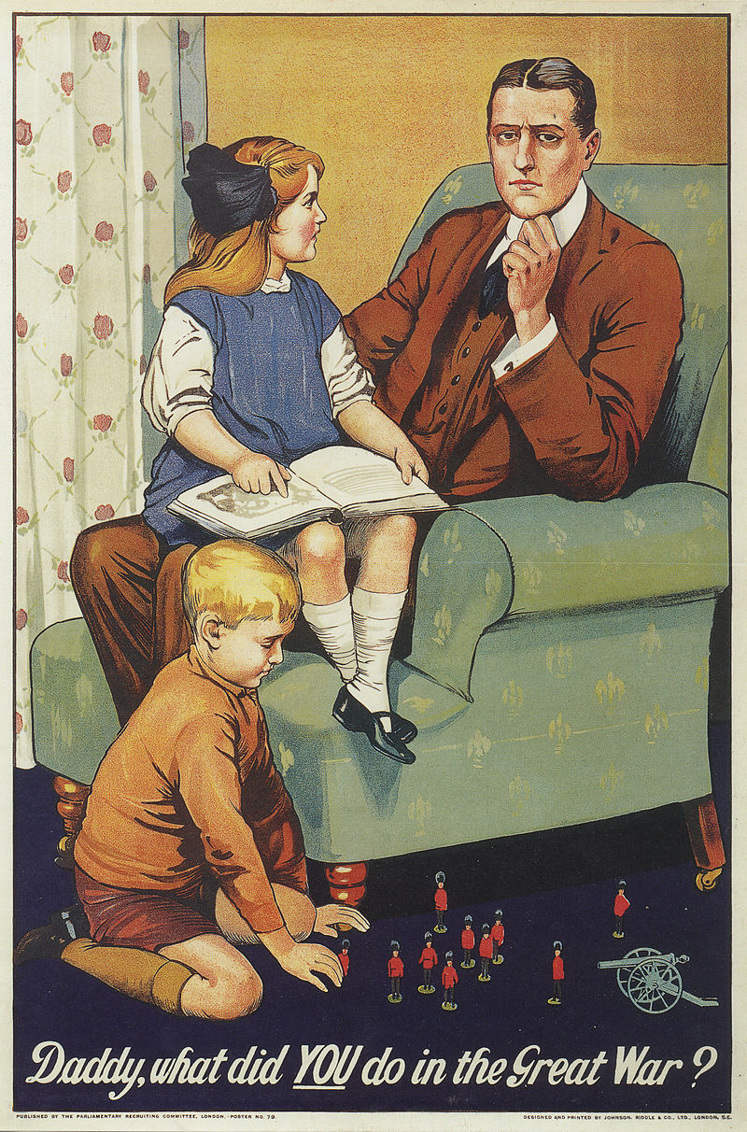
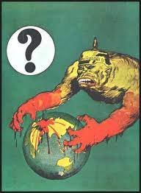
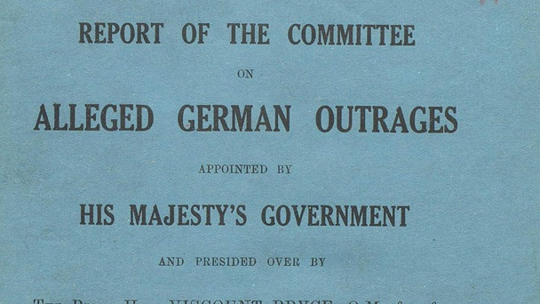
First World War
Need for mass mobilization and consistent war effort (home front)
  Motivation of fighting forces and population
  Demonizing enemy
  Communicate key messages
United Kingdom as leading country
  Centralization under the Foreign Office (1916) and Ministry of Information (1918)
  Report of the Committee on Alleged German Outrages (1915)
  Inspiration for Nazi Germany

Slide 5
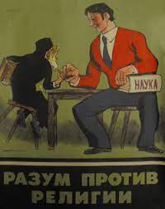
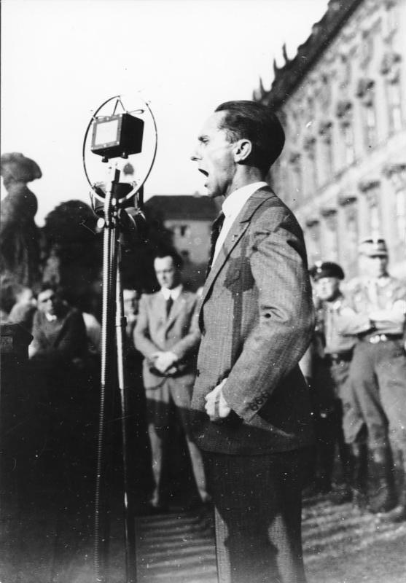
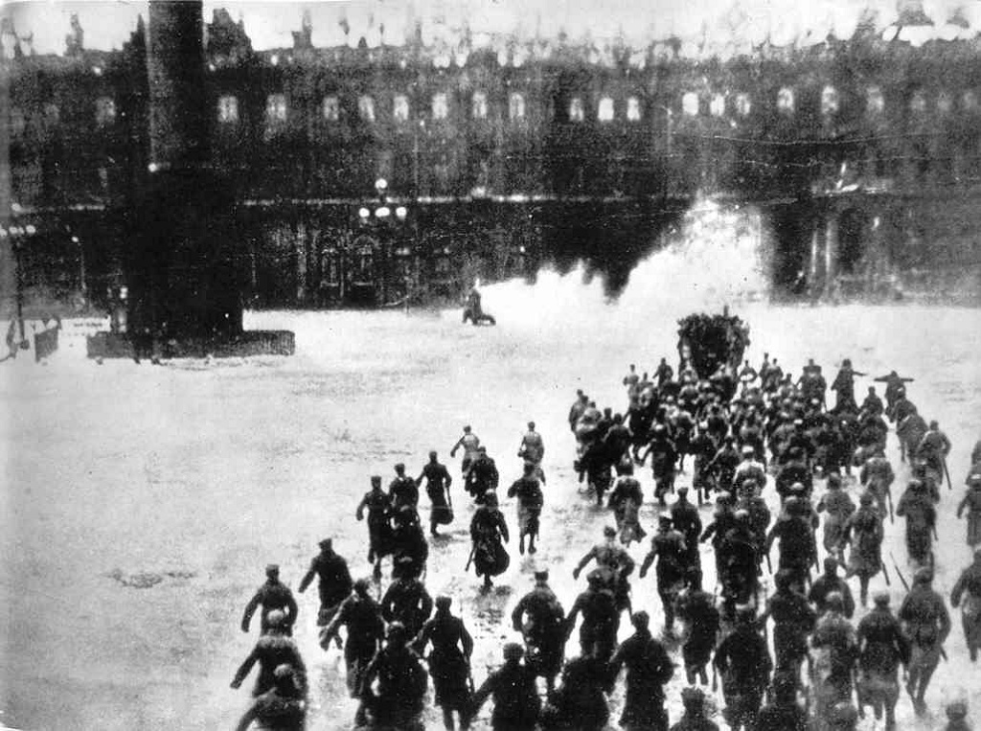
Totalitarian regimes
Third Reich and Soviet Union as a new type of regimes
  Constant mass mobilization of population as key feature of regime
  Ambition to create new man
New means of communication
  Movies (Leni Riefenstahl, Sergei Eisenstein)
  Radio
Special institutions
  Reich Ministry of Propaganda (1933)

Slide 6
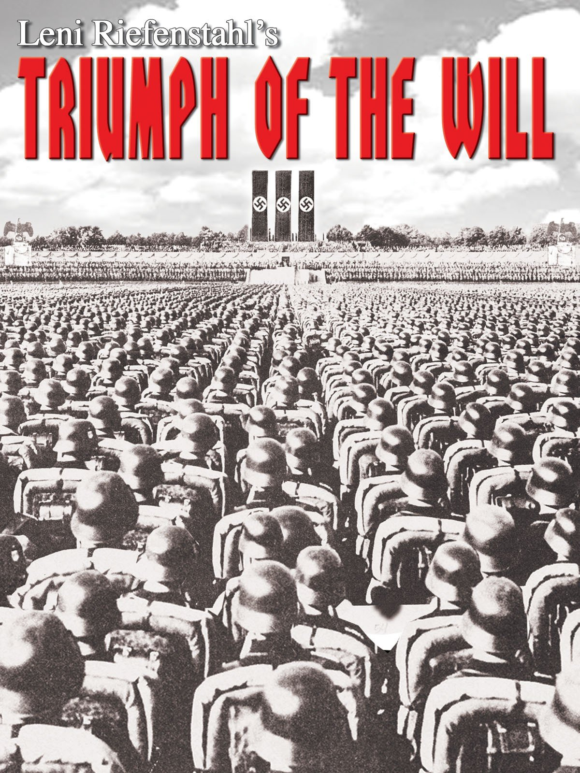
Totalitarian regimes

Slide 7
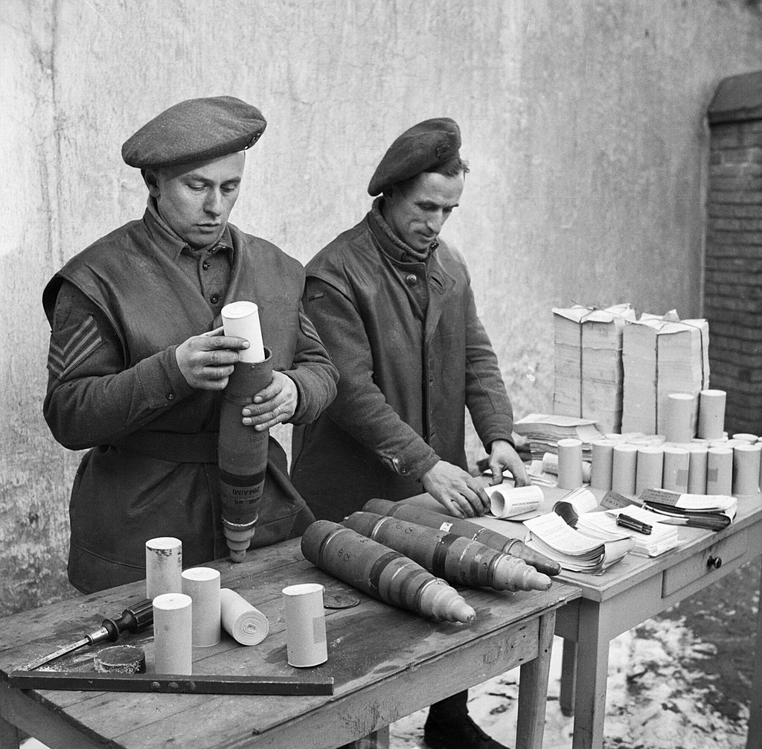
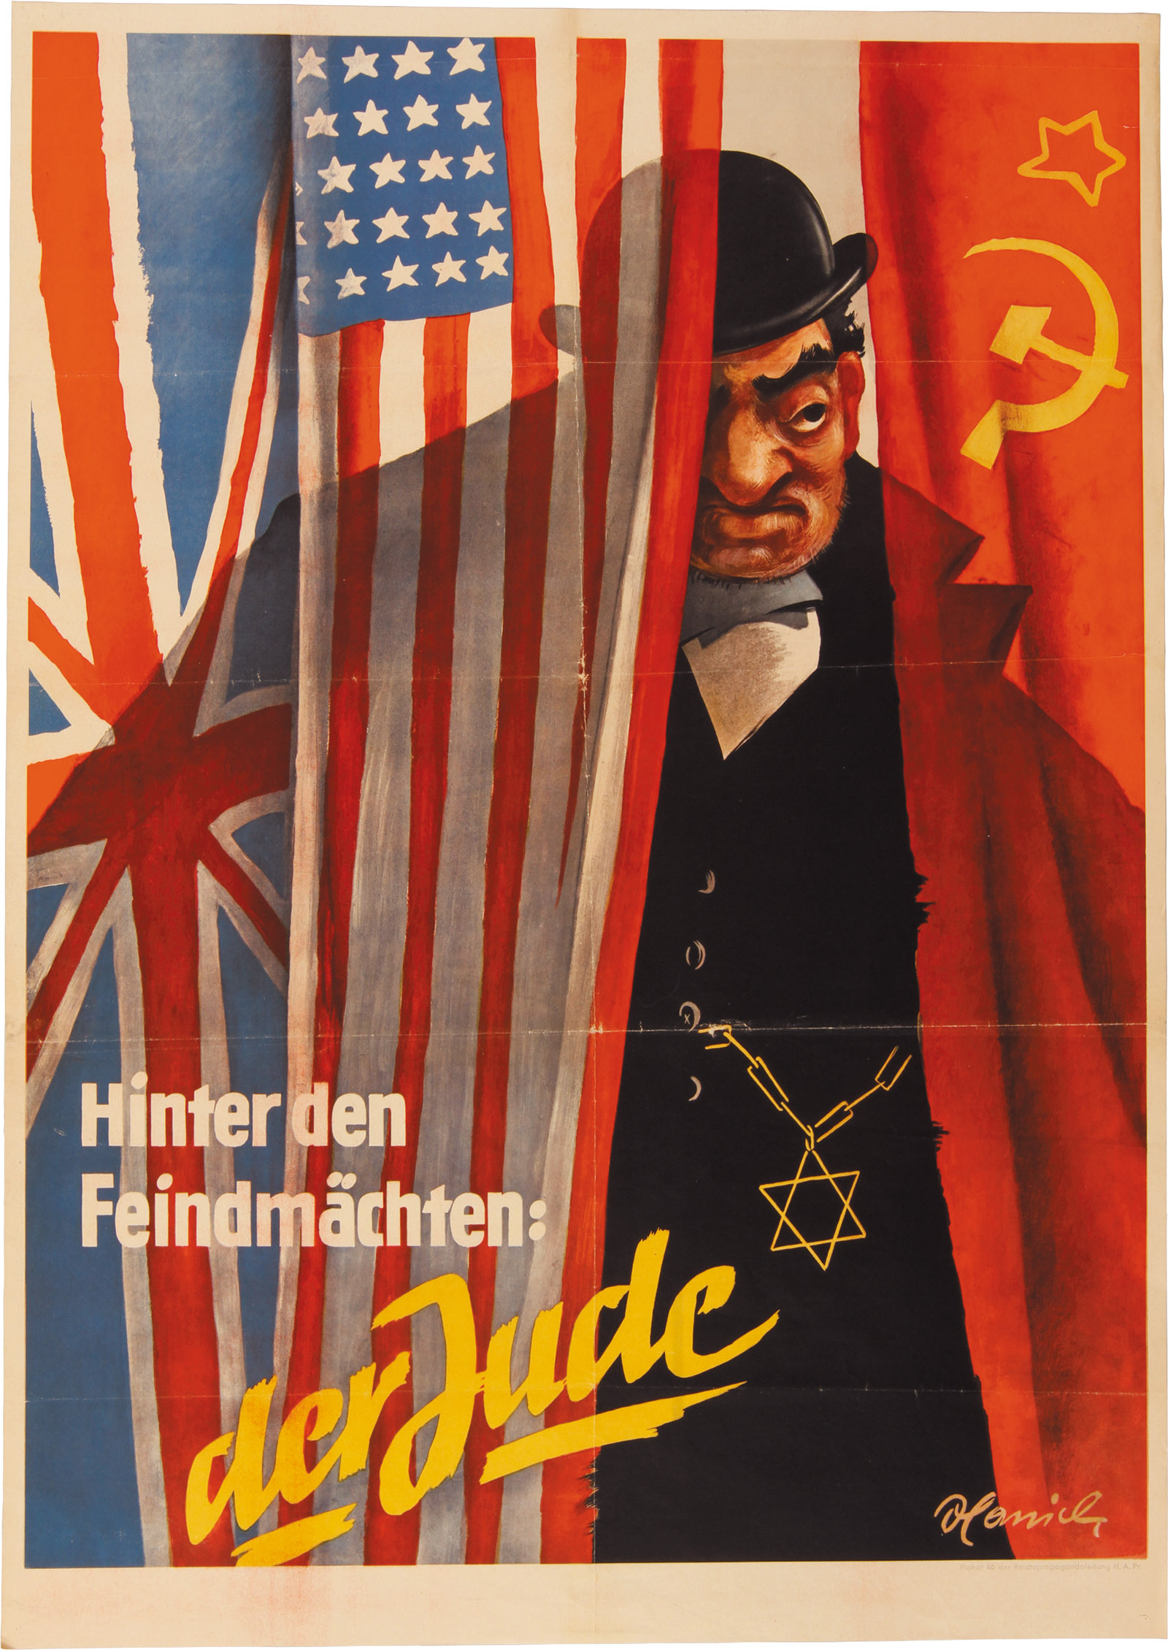
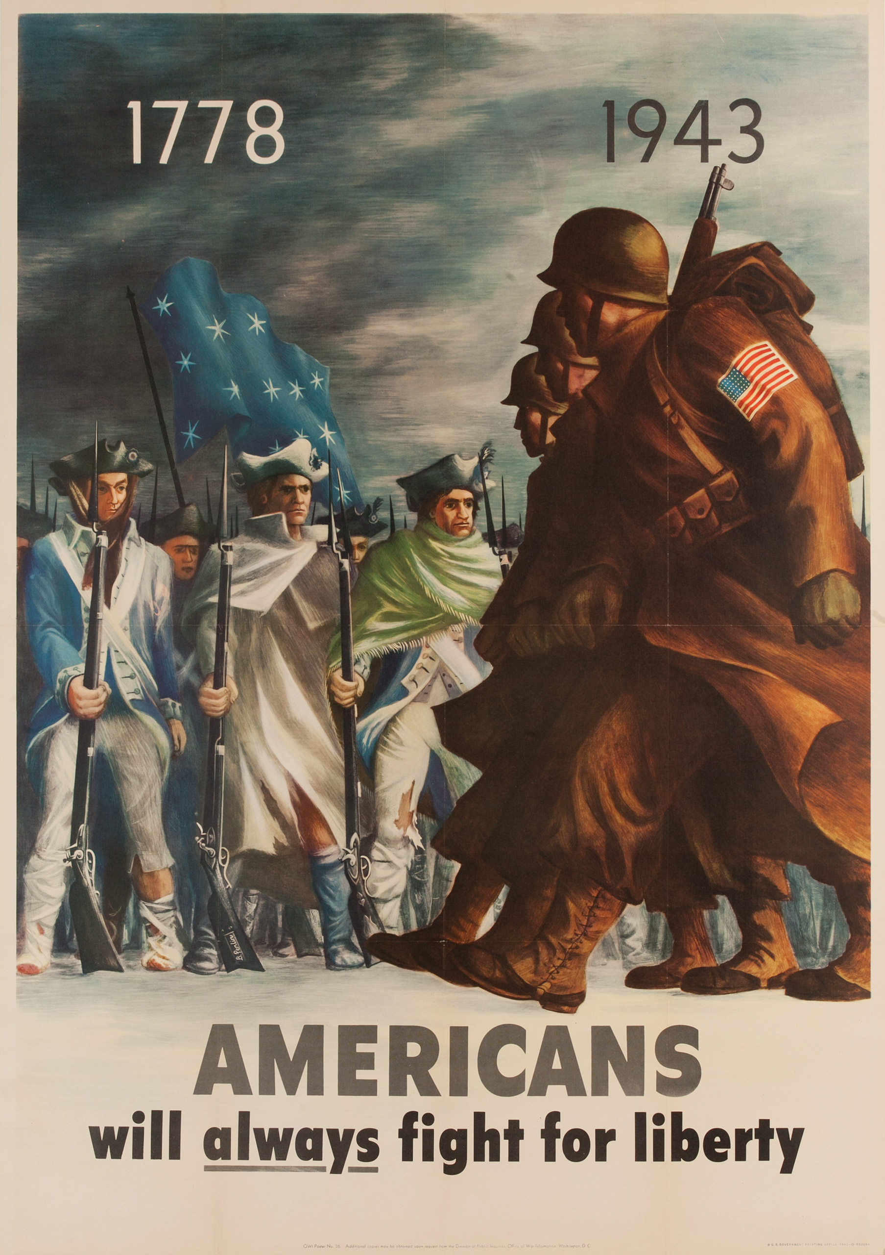
World War II
Propaganda as indispensable part of war effort
  Present in all spheres of public life – posters, songs, movies, radio broadcast
  Important role of public speaking
Important component of ideology
  Judeo-Bolshevism x Democracies

Slide 8
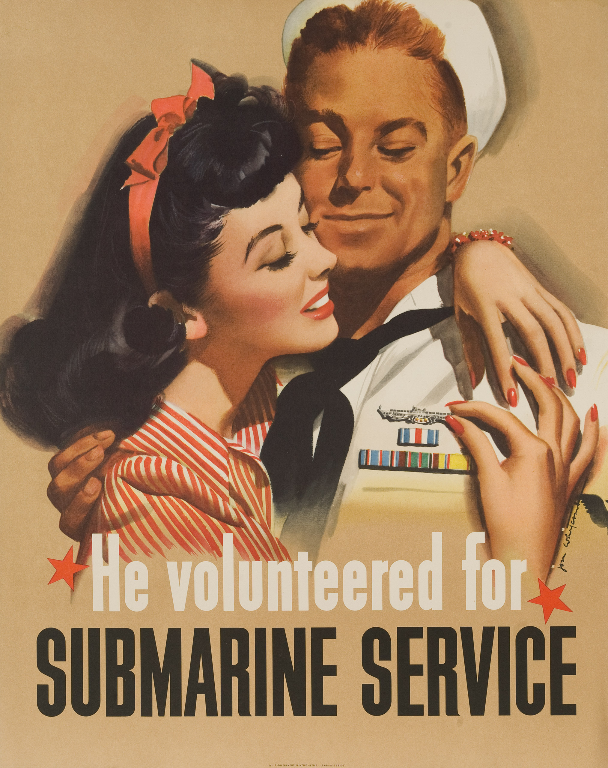

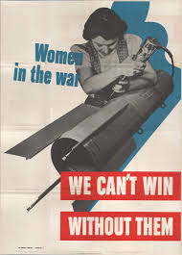
World War II
But at the same time use of everyday problems and themes

Slide 9
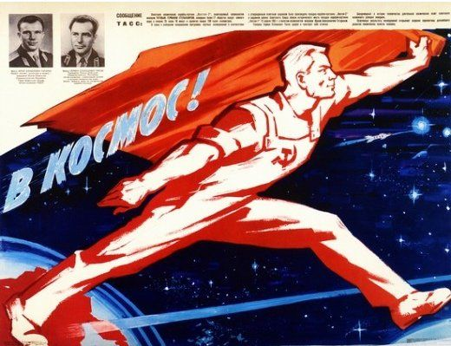
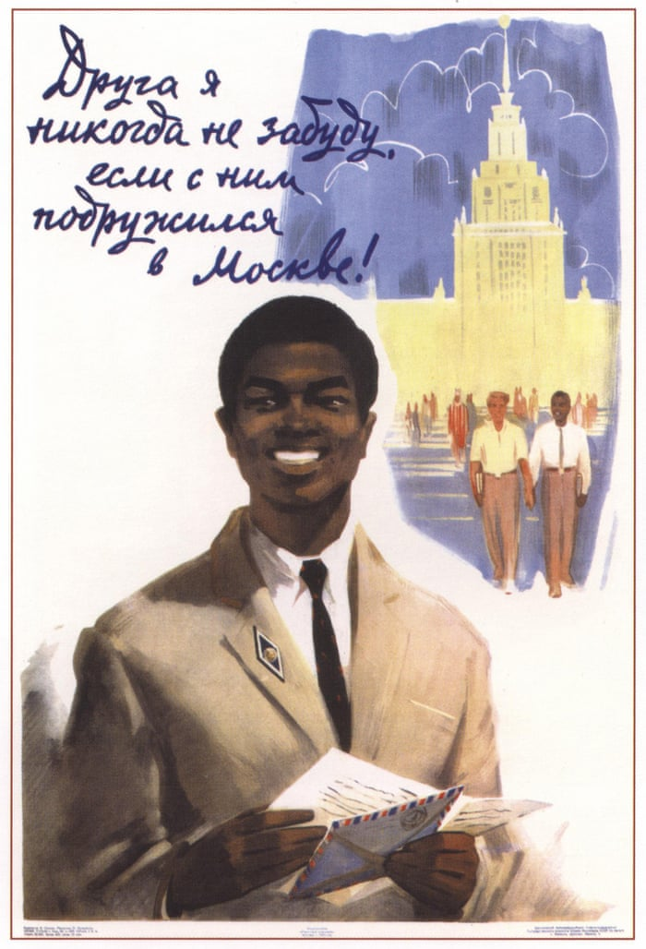
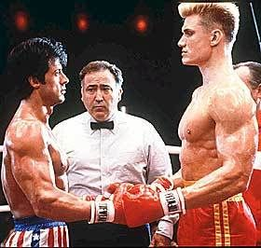
Cold War
Ideological contestation with limited kinetic component – propaganda as the main tool
  Appeal to values represented by each system
  Blurring lines between propaganda and culture
  Every component of politics as venue for propaganda (Space race, decolonization)
Importance of information component
  Radio Free Europe/Radio Liberty
  Operation Infektion (1983)

Slide 10

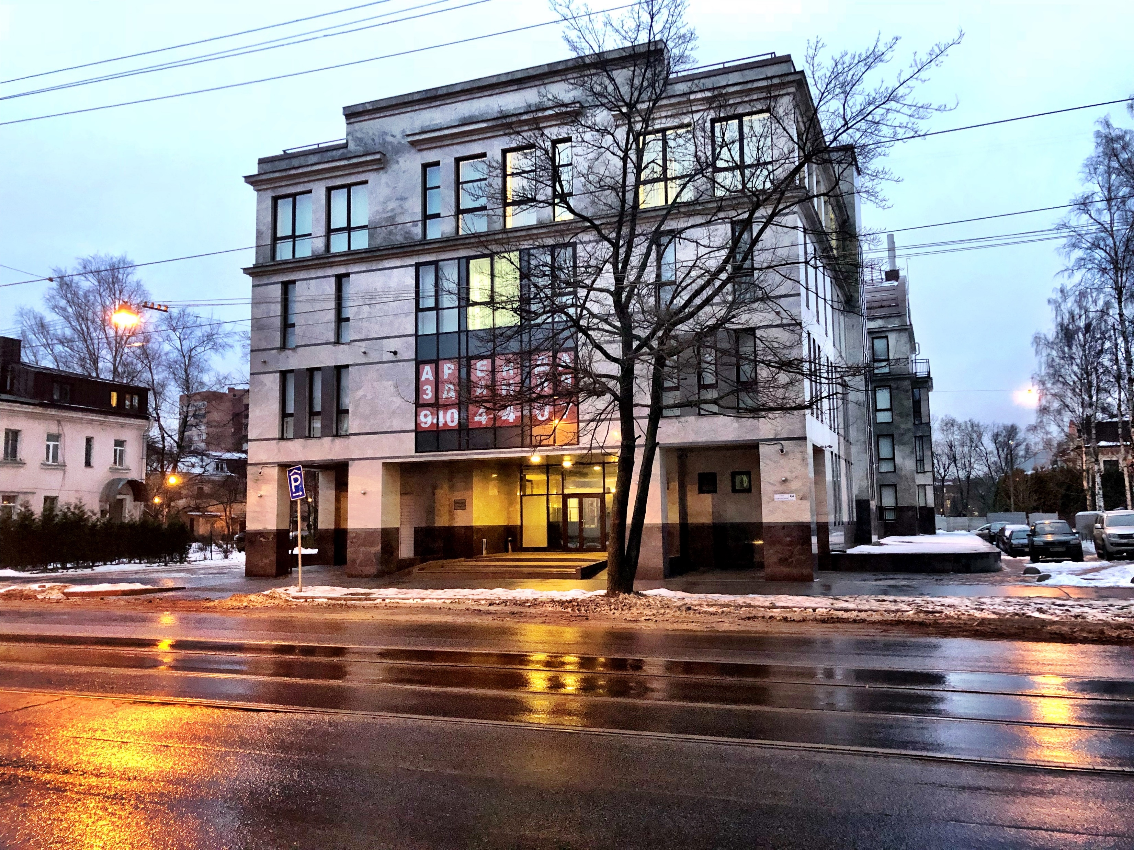
Modern days
Geopolitical contestation is back as well as propaganda
  RT, Sputnik, Confucius Institutes
  Use of internet – trolls (Internet Research Agency)
  MH17 (2014) or COVID-19 (Chinese virus)
Open information space as opportunity
  Non-state actors
  Private companies
  Profiteers
Different context but same goals

Slide 11
Thank you for attention

