Slide 1
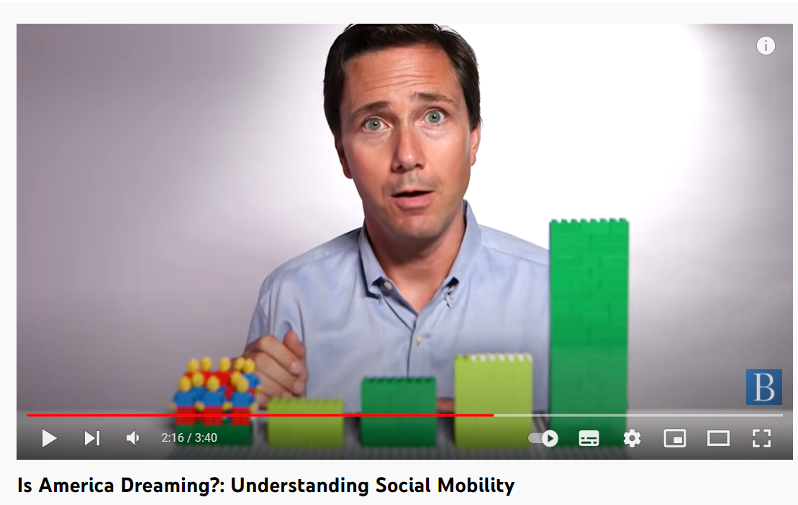
Is America Dreaming?: Understanding Social Mobility
YT: https://www.youtube.com/watch?v=t2XFh_tD2RA

Slide 2
Social mobility
Social mobility is the movement of people up or down the stratification system.
Class systems allow for more movement than slave or caste systems.
Intragenerational and intergenerational social mobility.
While class systems do allow for social mobility, opportunities are not evenly distributed across social groups.
Social origin class/actual social class position have a significant impact on many aspects of life, including education, occupation, place of residence, marriage partner, and more
2
Notes:
An important characteristic of class systems, as opposed to slave or caste systems, is that in class-based systems of stratification, there is the opportunity for social mobility. This means that people and groups can, potentially, move up or down in the rankings, and this is seen by many as a significant benefit of class systems.
In reality, however, such mobility is less common than our national mythology suggests. Typically, those who arrive at high positions have families who either had high positions themselves or the resources to provide the appropriate education for advancement. Achieving upward mobility is very difficult, and the wonderful stories we’ve all heard and seen (think, for example, of the movie The Pursuit of Happyness) are so very moving because they are the exception, not the norm. If such stories were common, they would not get our attention in nearly the same way.

Slide 3
Social mobility - politicians
“I want to see social mobility rising once again,” said prime minister Tony Blair in 2004
“We can unleash the biggest wave of social mobility since the second world war,” said prime minister Gordon Brown in 2010.
“I want to see a more socially mobile Britain,” said David Cameron in 2013.
“I want Britain to be the world’s great meritocracy,” said Theresa May in 2016.

Slide 4
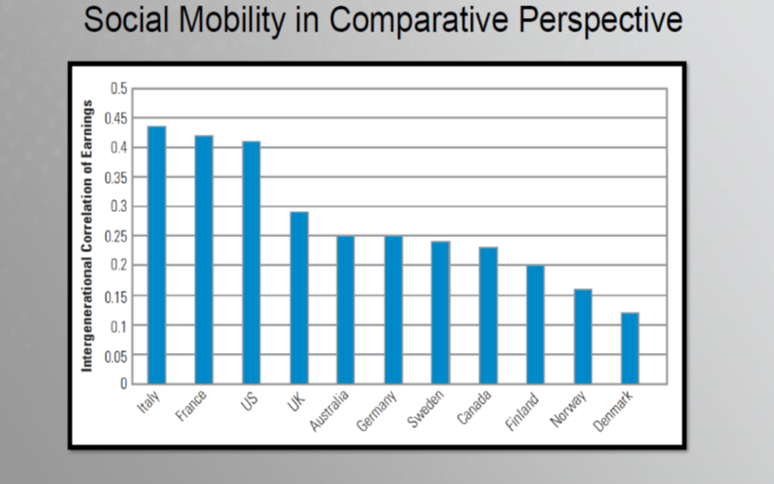

Slide 5
Absolute and relative social mobility
  Social mobility indicates „societal openness“
  Distinctions between structural and exchange mobility
  It is not possible to measure structural and exchange mobility in data ex post
  Structural and Exchange mobility are replaced by concepts absolute and relative mobility
    explanation
      Contingency table: Father, Son and The Holy Ghost (the core of mobility table) (R. Erikson, J. Golthorpe: Constant Flux, 1992)

Slide 6
Absolute and relative social mobility
  Absolute mobility is your chance of ending up in a different social class from the one you were born into.
    That is around 80% and has been remarkably consistent for at least a century
    But the movement is often small: from class 2 to 1, say, or from class 5 to 6.
  Relative mobility is different. That is your chance, if you started in, say, class 6 or 7, of making it to, say, class 1 or 2 compared with those who started at the top.
    Here, if you start at the bottom, you are many times less likely to make it to the top than somebody born there.

Slide 7
Trends in social mobility in European countries
trends in social mobility in European countries
  from agriculture to industry: industrial societies
  from industry to services: post-industrial societies
    these trends are reflected in structural social mobility trends
but no changes in social fluidity (relative social mobility)
  odds ratios are the same
7
Notes:
An important characteristic of class systems, as opposed to slave or caste systems, is that in class-based systems of stratification, there is the opportunity for social mobility. This means that people and groups can, potentially, move up or down in the rankings, and this is seen by many as a significant benefit of class systems.
In reality, however, such mobility is less common than our national mythology suggests. Typically, those who arrive at high positions have families who either had high positions themselves or the resources to provide the appropriate education for advancement. Achieving upward mobility is very difficult, and the wonderful stories we’ve all heard and seen (think, for example, of the movie The Pursuit of Happyness) are so very moving because they are the exception, not the norm. If such stories were common, they would not get our attention in nearly the same way.

Slide 8
Great Gatsby Curve - GGC
What is the relatioship between inequality and social mobilty?
in aggregated level higer economic inequality means lower social mobility and vice versa
Great Gatsby curve
How does it work in individual level?
8
Notes:
An important characteristic of class systems, as opposed to slave or caste systems, is that in class-based systems of stratification, there is the opportunity for social mobility. This means that people and groups can, potentially, move up or down in the rankings, and this is seen by many as a significant benefit of class systems.
In reality, however, such mobility is less common than our national mythology suggests. Typically, those who arrive at high positions have families who either had high positions themselves or the resources to provide the appropriate education for advancement. Achieving upward mobility is very difficult, and the wonderful stories we’ve all heard and seen (think, for example, of the movie The Pursuit of Happyness) are so very moving because they are the exception, not the norm. If such stories were common, they would not get our attention in nearly the same way.

Slide 9
COLEMAN’S BOAT APPLIED TO INEQUALITY
SOCIETAL
INEQUALITY
LOW
SOCIAL
MOBILITY
INDIVIDUAL
EDUCATION,
INCOME
INDIVIDUAL
CHANCES
Coleman, ‘Microfoundations and macrosocial behavior’, 1987, page 165

Slide 10
Explanation of social mobility I
Social mobility research is very sophisticated from statistical point of view
  theory and explanation of social mobility is weak point in SSR
Two basic questions of mobility research:
    Why does increase social mobility happen?
      answer: theory of industrialization, technological and economic trends in modern societies (Kerr, Dunlop, Harbison, Myers, 1960; Treiman, 1970; Kerr, 1983), key role of education, from ascription to achievement (meritocracy)
    Why there is reproduction of labour market position from one generation to other?
      answer 1: theory of rational action (Goldthorpe, 1996; 2000), the aim is to avoid of social decrease, because of that strong orientation for social reproduction, especially in educational aspiration that are stratified according to social origin
      answer 2: cultural capital is a tool for reproduction of class position via educational system (Bourdieu, Passeron, 1964; 1977)
10

Slide 11
Explanation of social mobility II
Birth cohort replacement, education, equalization and compositional effect in social mobility development (Breen, Johnson, 2007)
  Labour market is composed of birth cohort
  Cohort replacement influences trends in social mobility
    Argument: in each younger cohort we can measure higher social fluidity (lower OD association)
      Why? Connections: O - E - D
      Equalization effect:
      Compositional effect
  This argument is relevant for stable democratic society „under normal circumstances“
11

Slide 12
OED triangle as a core of social mobility process
E
a b
O D
c
OD connection via E, indirect
OD connection, direct (via ownership, property, aspirations, access to occupations
What we can expect in European states? Links a? b? c?
a) transition to school from family (equalization effect)
b) transition to labour market from educational systém (compositional effect)
c) transition to labour market from family

Slide 14
Educational expansion in the CR in last 20 years I
14

Slide 15
Educational expansion in the CR in last 20 years II
What does educational expansion mean for transition to labour market?
  Can we talk about the inflation of diploma/certificates?
  If yes, is it good strategy to invest to education and increase number of young people in universities?
What happens with returns to higher education?
  In status consistency society they should be higher and increase
  Yes, returns to higher education increase
15

Slide 16
Cultural capital: definition
Pierre Bourdieu and Jean-Claude Passeron (1966, 1970, 1977)
  Analysis of French society (1960s and 1970s)
  Formulation of concept of cultural capital as a part of family origin of students
Cultural capital is ‘skill’ acquired from parents
    Cultural knowledge (orientation in dominant culture)
    Linguistic abilities (ways of self-expressions)
    Social knowledge (orientation in social relationships)
Cultural capital exists in three ways
  incorporated (personal dispositions acquired during socialization process)
  objectivized (cultural artefacts connected with family of origin, pictures, books, sculptures)
  institutionalized (academic titles, scientific degrees)
16

Slide 17
Cultural capital: explanation of class inequalities in education
Educational system evaluates the level of cultural capital
  Transformation of cultural capital to individual merit of children
  Children with high level of cultural capital are better in school and leave educational system later
  Children with low level of cultural capital are not so good, their school results are worse and leave educational system very soon
Parents from higher social classes are connected with school via dominant culture, which means the success of their children in educational system
Differences in cultural capital generate social class differences in education attainment
17

Slide 18


Pierre Bourdieu on social reproduction
La Sociologie est un sport de combat
YT: https://youtu.be/js_fVKBL5NA

