Slide 1
Peace of Westphalia and the Westphalia System
Zdeněk Kříž
Masaryk University

Slide 2
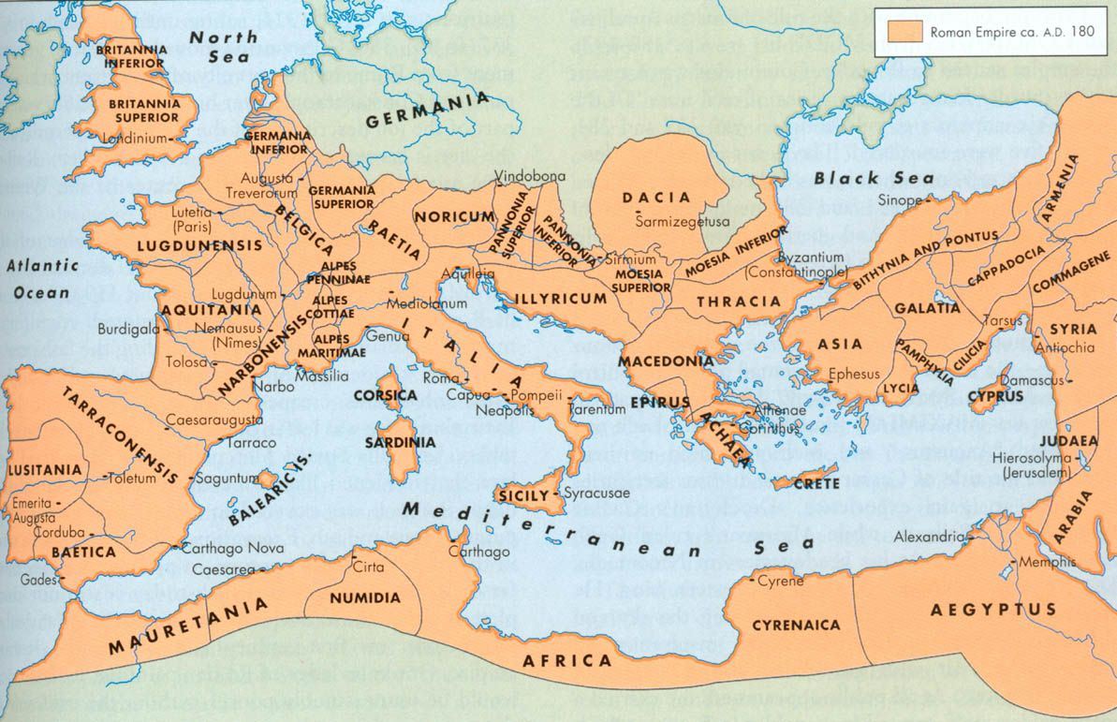
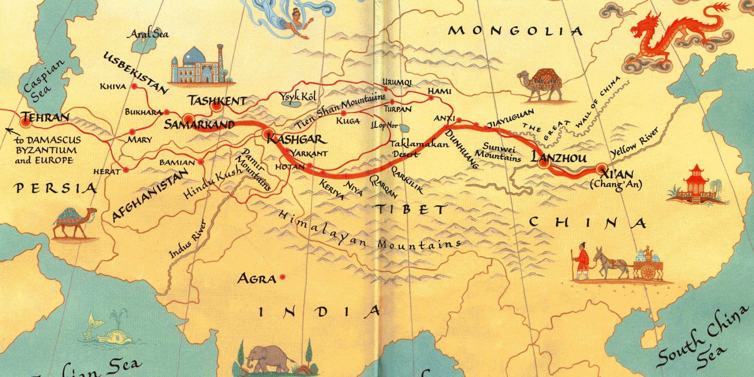
Variables of International System
System - (a) a set or assemblage of things connected, associated, or interdependent, so as to form a complex unity, or (b) a whole composed of parts in orderly arrangement according to some scheme or plan.“
(The Oxford English Dictionary)
System - elements and patterns of interactions.
Pax Romana, Pax Mongolica etc.
Main general variables of International system
Nature of the actors in the system (state-actors: empires, nation-states, city-states, and non state actors - international organizations, corporations, churches or denominations etc.)
Stratification – distribution of power.
Patterns of interactions.
Norms of behavior and rules through which the system is operated.
The present – Westphalia system of IR - Peace of Westphalia in 1648 – traditionally highly Eurocentric.
Concept of Westphalia Sovereignty
(https://www.youtube.com/watch?v=vxqeG-QEe84)
Post Westphalia order?

Slide 3
State Actors
States – traditional and most important actors/agents in IR. Modern state – a product of Enlightenment (Francis Bacon, René Descartes, John Locke and Baruch Spinoza)
State - a political and geopolitical entity. Nation – cultural entity!
Sovereign state - permanent population, defined territory, one government, and the capacity to enter into relations with other sovereign states.
Internal and External Sovereignty
More types of states: national state, feudal state, empire, city state.
1. Nation states
Germany, Japan, Finland, Sweden, Australia.
2. Feudal states
Liechtenstein, Andorra, Monaco,
3. Empires
Austrian Empire, Kingdom of France, the Russian Empire, the Ottoman Empire or China.
4. City states
Rome, Athens, Brunei or Kuwait.

Slide 4
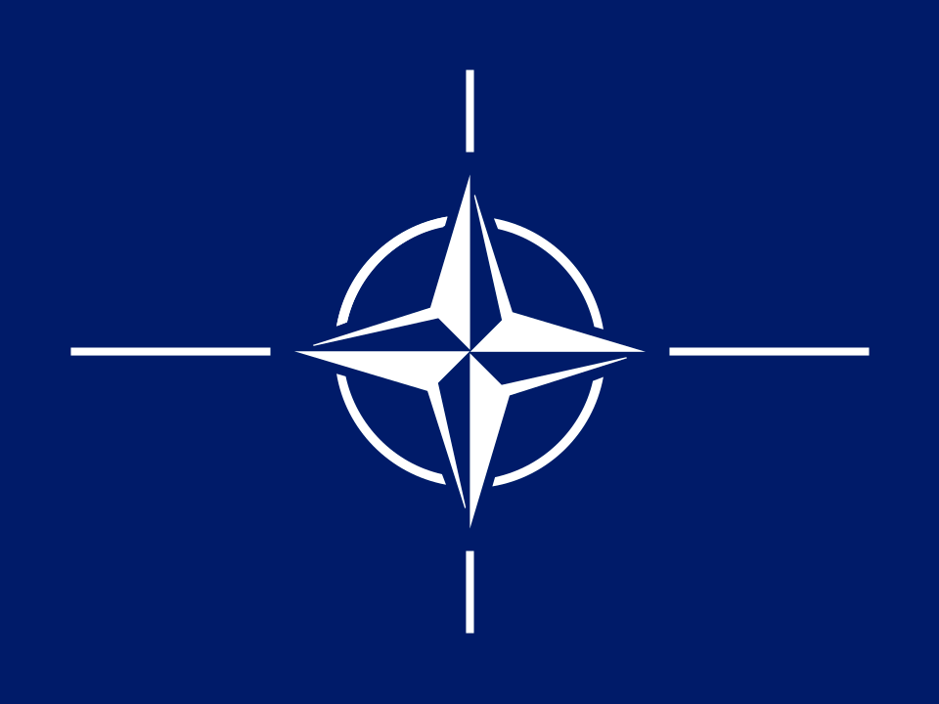




Non-state Actors
Non-states actors
1. International organizations
1a) Intergovernmental organizations
The Central Commission for Navigation on the Rhine - 1815 - Congress of Vienna. UN, OSCE, NATO etc.
1b) International non-governmental organizations
International Committee of the Red Cross, Greenpeace
2. Corporations
Dutch East India Company (VOC), East India Company of London etc.

Slide 5
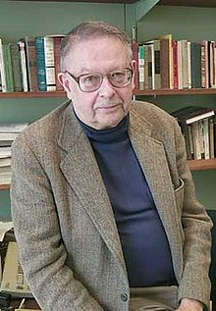
Stratification, structure and distribution of Power
Stratification = polarity of power
Kenneth Waltz - Theory of International Politics (1979).
Power in IR - actor's ability to exercise influence over other actors within the international system
Different types of influence (power): coercive, attractive, cooperative, or competitive
Problems of measurement – only sources of power are measurable – population GDP, military power.
Distribution of power varies between multipolarity and monopolarity
Unipolarity (1), bipolarity (2), tripolarity (3), and multipolarity (4 and more)
Problem of categories of power

Slide 6
Stratification - Categories of Power
Superpower
State with a dominant position, which is typical of its extensive ability to exert influence or project power on a global scale.
William T. R. Fox - "great power plus great mobility of power“.
Great power
State that has strong political, cultural and economical influence over nations around them and across the world.
Middle Power
Not great or small, being able to act in global affairs.
Regional Power
Exercises influence and power within a region.
Small Power

Slide 7
The patterns of interactions
Realist scholars of IR see International System as full of conflict and violence.
Thomas Hobbes – The State of Nature Concept.
State of Nature – time of anarchy (Hobbes) or time of innocence (Rousseau).
Many IR Scholars believe in Hobbes.
Most interactions between states are peaceful and cooperative.
IR are not norm less, rule less, nor lawless.
This is typical of the entire period of the Westphalian system.

Slide 8
The norms of behavior and rules
1. A government is supreme within its own territory.
2. External sovereign government is accountable but no superior authority.
3. No other international actor has the authority to interfere in the internal affairs of another state.
4. All sovereign states are equal in a legal sense despite obvious disparities in terms of power.
Norms are addressed by two general approaches to the study of IR: constructivism and rationalism.
Diffusion mechanisms in international system:
Coercion - founded on power, strong states are norm promoters.
Competition - states race from the bottom up, keeping up with the others.
Emulation - states are merely copying the behavior of more prestigious states like them.
Learning - states have a desire to fix a problem, and they look to the population for ideas about which policy to adopt.

Slide 9
Thirty Years' War
The Thirty Years’ War (1618-48)
Major European Powers involved - Sweden, France, Spain and Austria.
Protestants versus Catholics? Religious war – highly disputable!
Albrecht von Wallenstein overran most of Protestant Germany and much of Denmark by 1629.
Reaction - the Swedish intervention
1634 – Spanish intervention
1635 – France declared war on Spain and Hapsburgs (1636)
1648 - Peace of Westphalia.

Slide 10
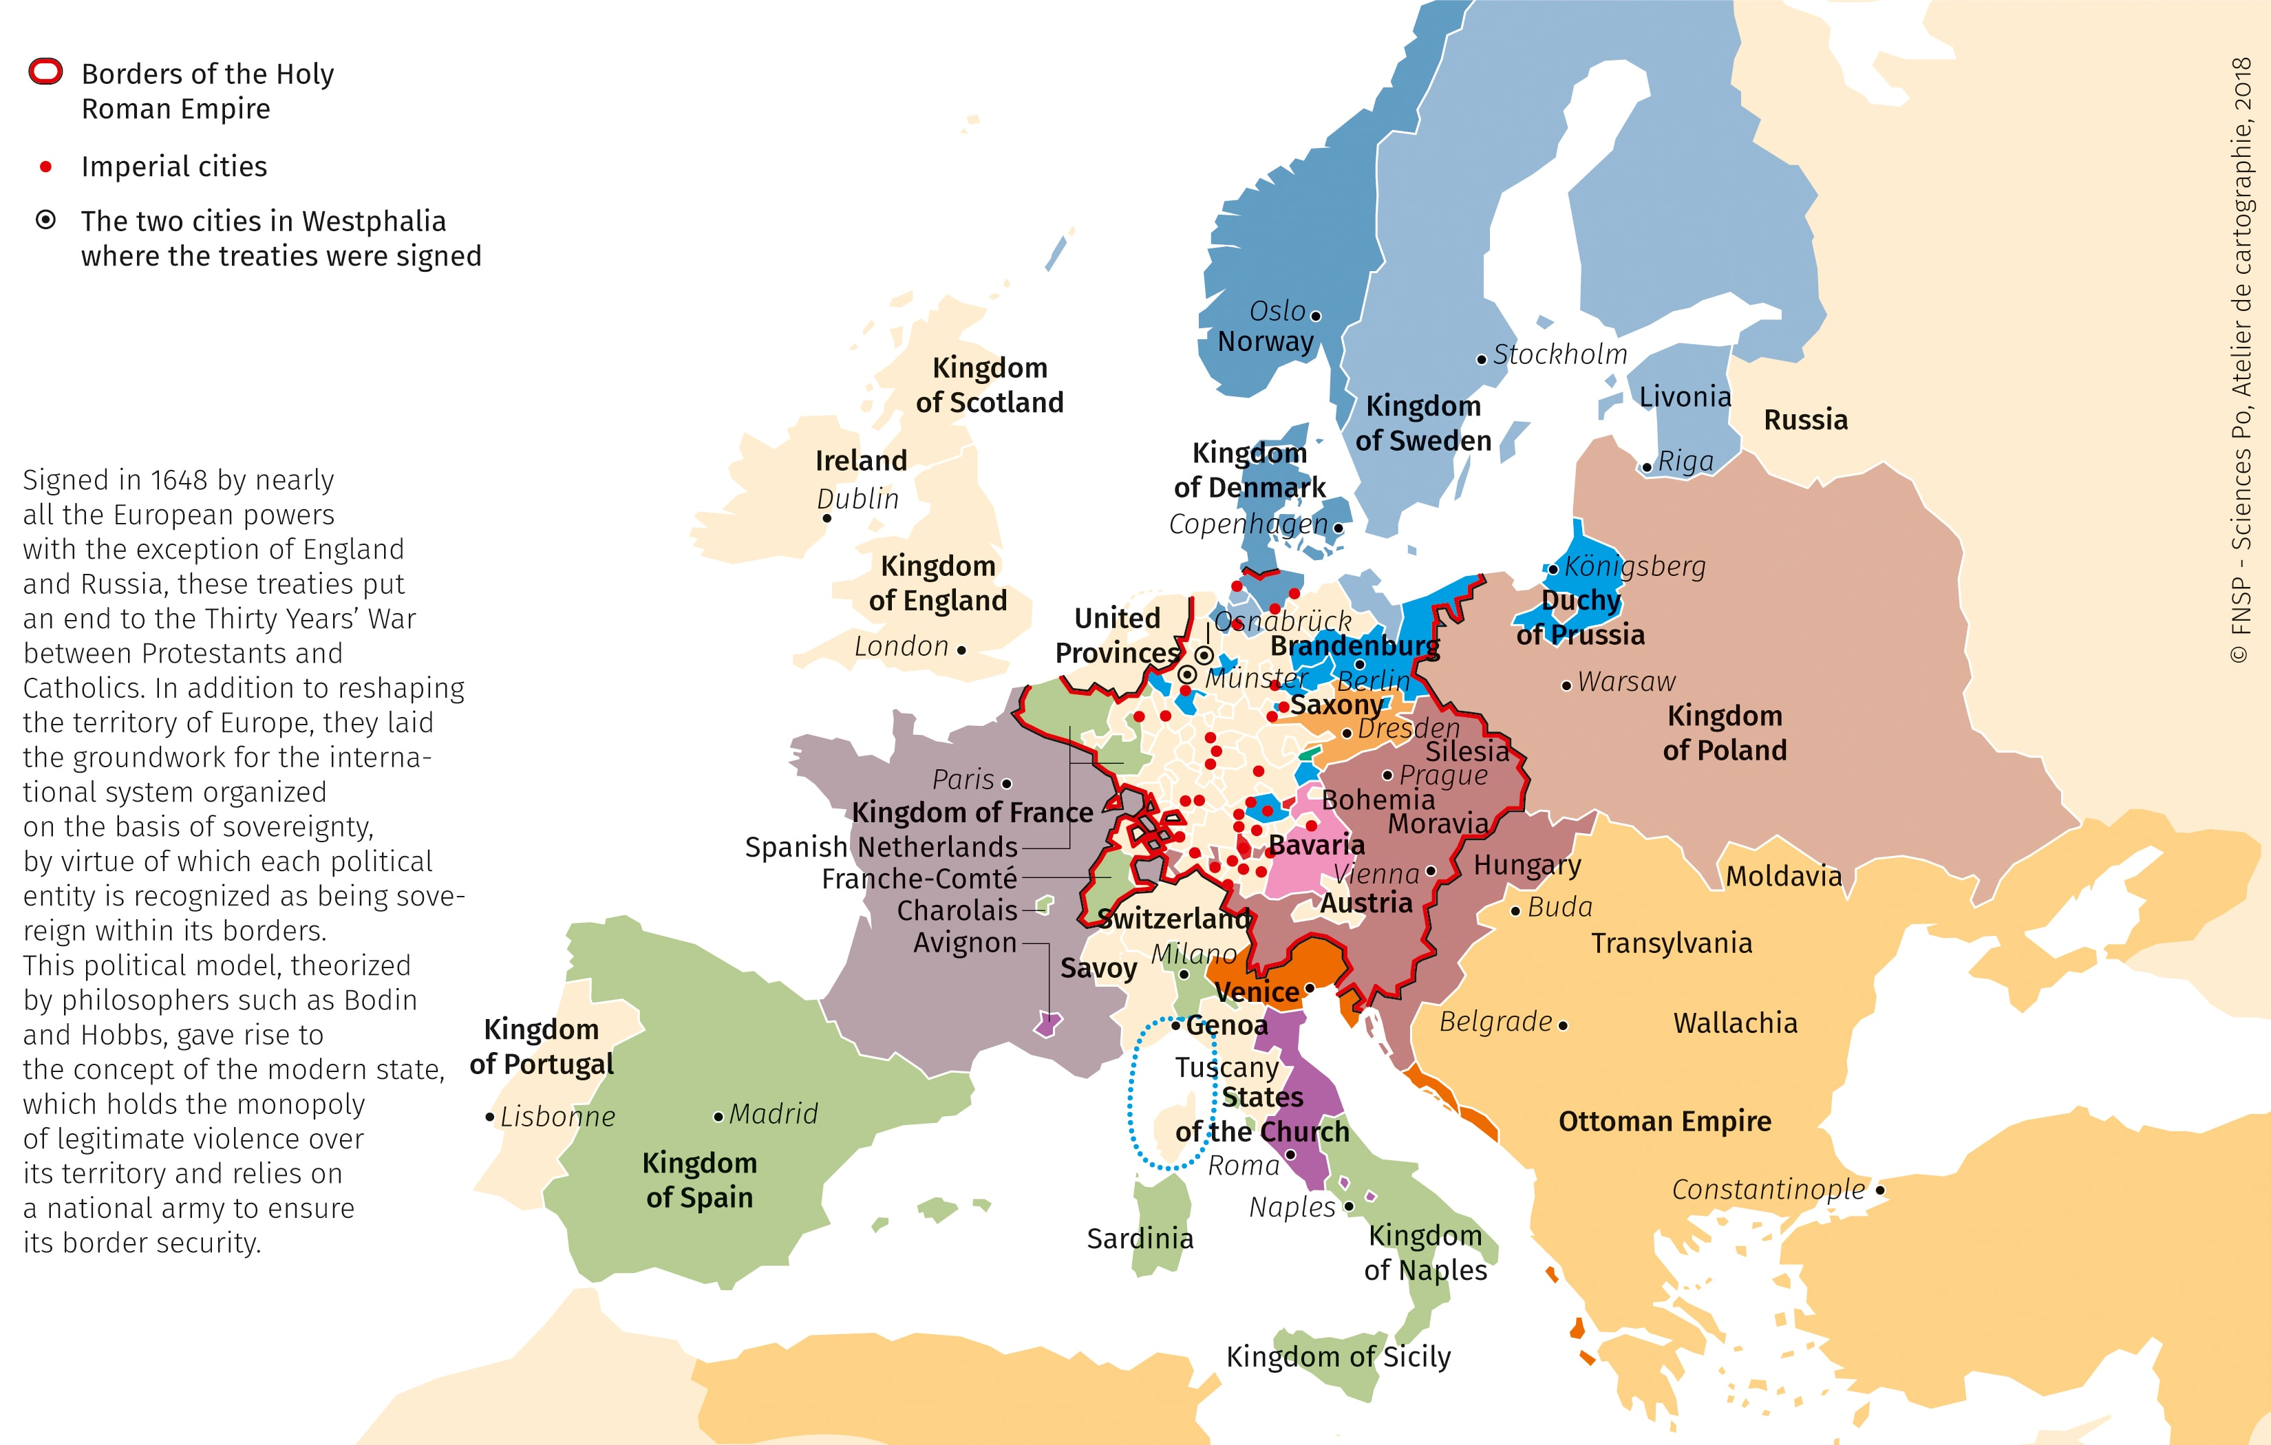
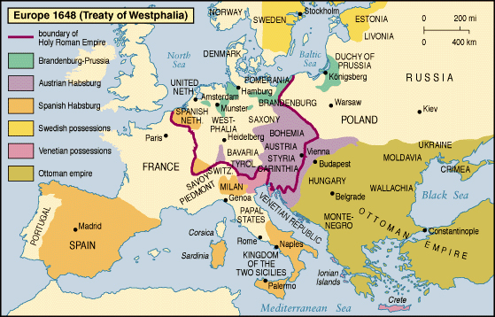
Peace of Westphalia I.
Peace negotiations - Münster and Osnabrück – all major powers involved.
Reaffirming Peace of Augsburg of 1555.
There were also territorial adjustments.
Around 20 percent of Germany’s total population was lost, 50% in some regions (Pomerania).
Beginning of the modern era - end of Religious Wars in Europe.
Beginning of the modern International System – independent and self-determined states.
Anarchy in the European IR - the power of the Holy Roman Emperor was weakened.
Congress diplomacy.

Slide 11
Westphalian system
1. Westphalian sovereignty - based upon the concept of co-existing sovereign states.
2. Principle of (legal) equality between states
3. Non-interference in another state's domestic affairs.
Westphalia principles expanded all over the globe – the effect of European expansionism, imperialism and colonialism.
The principles developed at Westphalia – central for the contemporary IR.
Central for IR theory – realism and neorealism.

Slide 12
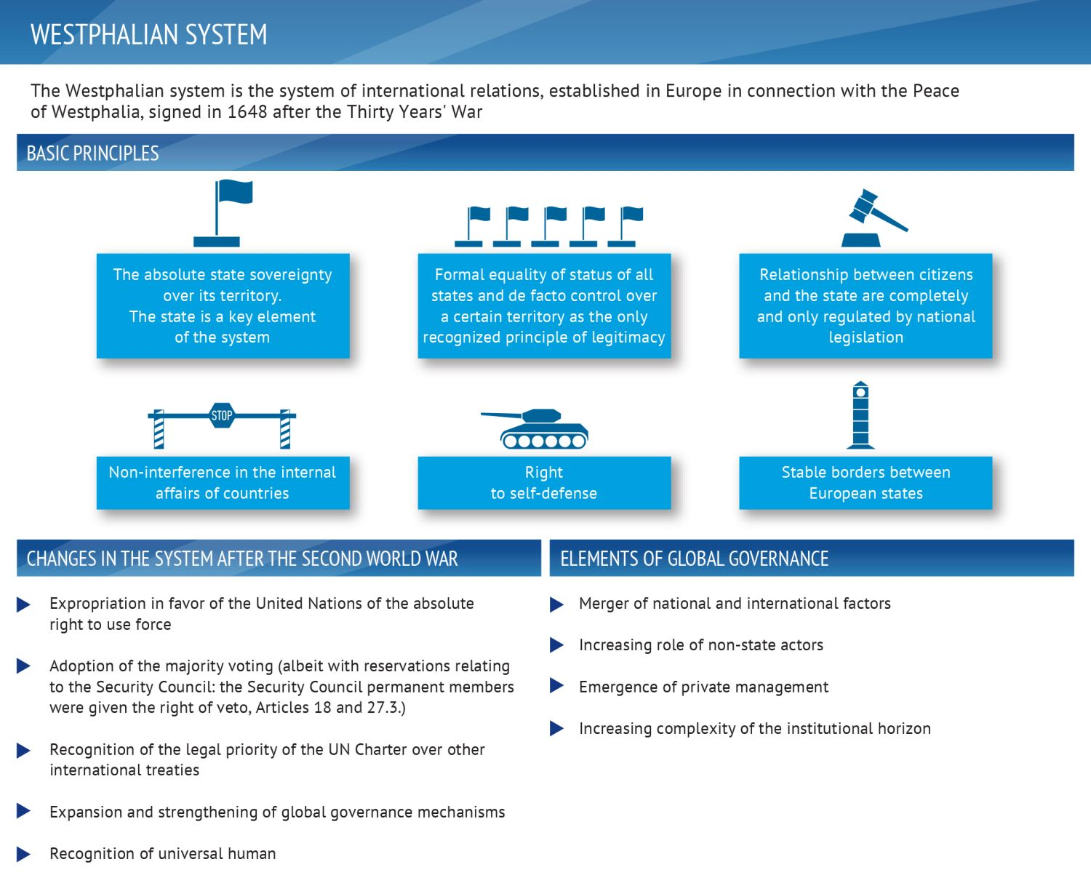
Westphalian system

Slide 13
Literature
Hocking, Brian – Smith, Michael. 1990. World Politics. An Introduction to International Relations. Harlow: Prentice Hall, pp. 50-73.

