Slide 1
Second World War
Zdeněk Kříž

Slide 2
World War II
Causes of WWII
General overview of the War
The Soviet role in the War
Correlation of Forces
Milestones of diplomatic history of WWII
WWII effects

Slide 3
Causes WW II
International system
1. Carthaginian peace set up in Versailles Treaty leading German revanchist policy.
2. The distribution of power did not correspond the distribution of obligations.
3. League of Nations was not able to fulfill its tasks and prevent wars.
4. The 1929 Great Depression.
State level
5. Three totalitarian states, the USSR, Italy and Germany among the Great Powers - able to mobilize resources in favor of war and build huge militaries.
6. Instability in French internal affairs.
7. Polish – Czechoslovak antagonism in Central Europe.
Individual level
8. Western politicians’ wrong assessment of Hitler's final goals.
9. Miscalculation of Adolf Hitler's regarding the Western security guaranties to Poland.

Slide 4
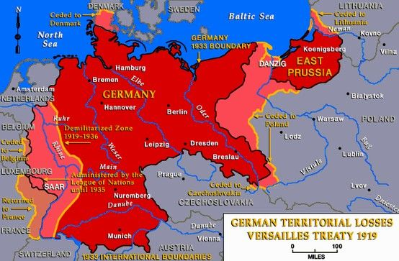
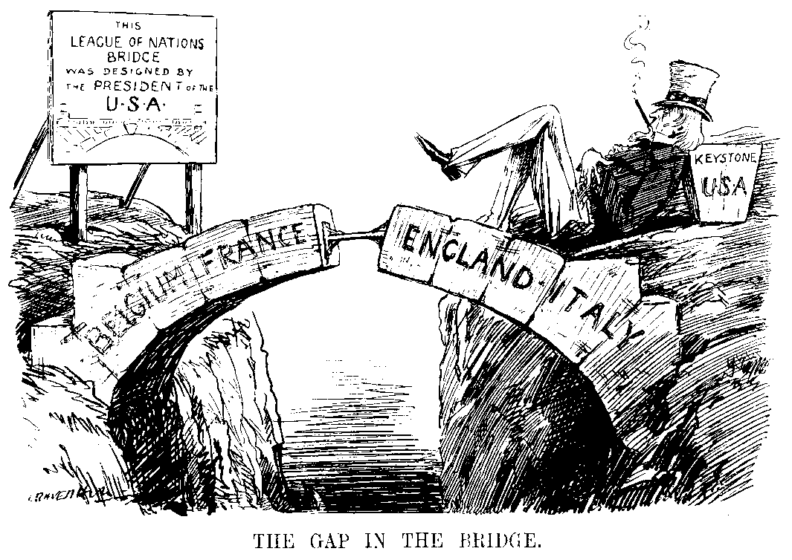
Causes WW II – International System Level
1. The punitive Treaty of Versailles and the German desire for revenge
1919 - John Maynard Keynes - The Economic Consequences of the Peace.
1961 – A. J. P. Taylor - The Origins of the Second World War.
2. The distribution of power did not correspond the distribution of obligations.
3. League of Nations was not able to fulfill its tasks and prevent wars.
4. The 1929 Great Depression.

Slide 5
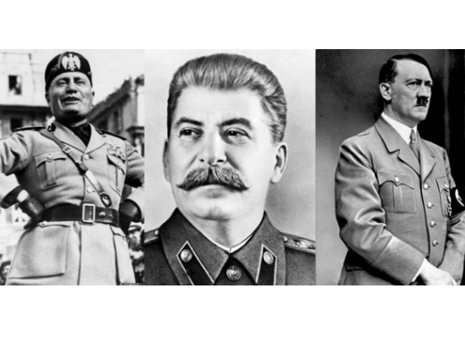
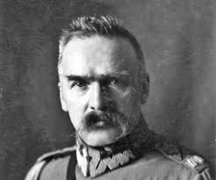
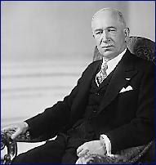
Causes WW II – state level
4. Three totalitarian states among the Great Powers
the USSR – industrialization, militarization and dream about worldwide communist revolutions
First Five Year Plan (1928–1932) – heavy and arms industry – Western assistance.
Italy – dissatisfaction with territorial gains in WW I
Germany – revisionism and expansionism.
They were able to mobilize resources in favor of war and build huge militaries.
5. Instability in French internal affairs.
Division on the axis far left-far right
6. Polish – Czechoslovak antagonism in Central Europe.
Territorial disputes – Cieszyn, Silesia, Orava Territory and Spiš.
Disagreement about cooperation with USSR.

Slide 6
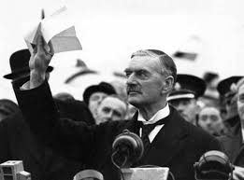
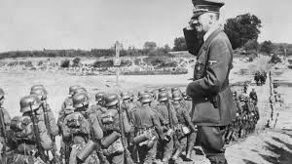
Causes WW II –individual level
Individual miscalculations
Appeasement - symbol - British Prime Minister Neville Chamberlain
Appeasement - seeking to compromise on German territorial demands so as avoid conflict.
Not to sacrifice another generations of Western menhood because of disputes in Central and Eastern Europe
Not to start a war, which would only serve the Stalin’s policy of expanding the Soviet empire.
Adolf Hitler
Convinced that the British and French would not seriously start war in order to defend Poland.

Slide 7
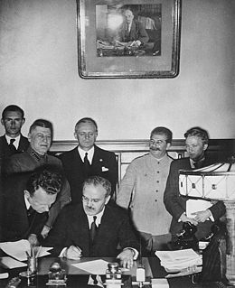
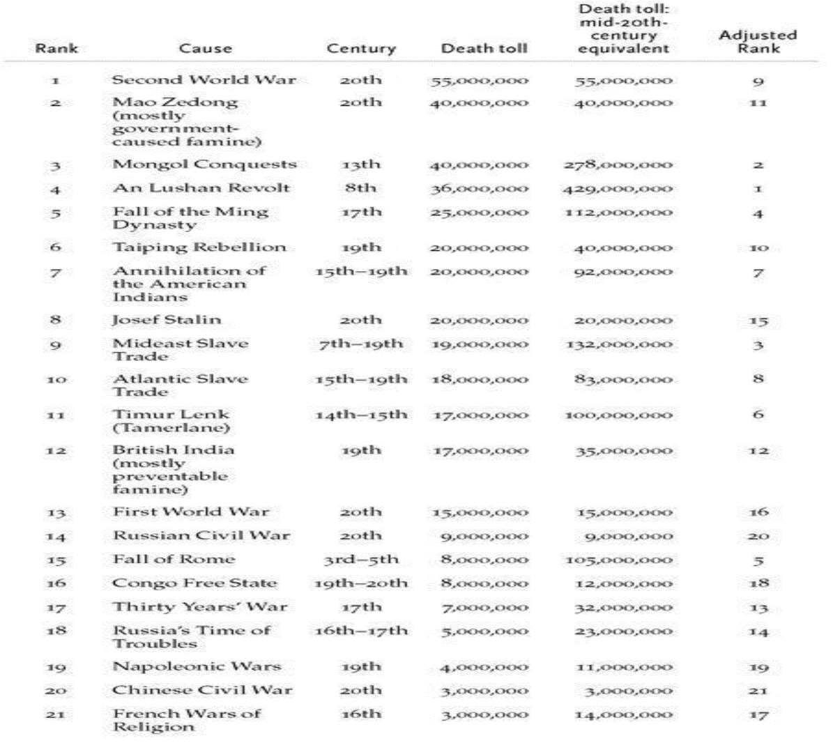
General Overview of World War II
Second World War - a global war 1939 to 1945.
1937 – Japan invaded China.
The Allies (France in fact till 1940, UK, USA and China, versus the Axis (Germany, Italy, Japan).
The USSR supported the Axis till 1941, then alliance with the UK and USA (1942).
Involved more than 100 million people from over 30 countries.
A total war - fought to final victory or defeat and used almost all military means including nuclear weapons.
In absolute numbers with its 50-60 million fatalities it was the deadliest conflict in human history.
In relative numbers - the 9th most deadliest war in human history.
Steven Pinker: The Better Angels of Our Nature: Why Violence Has Declined?

Slide 8
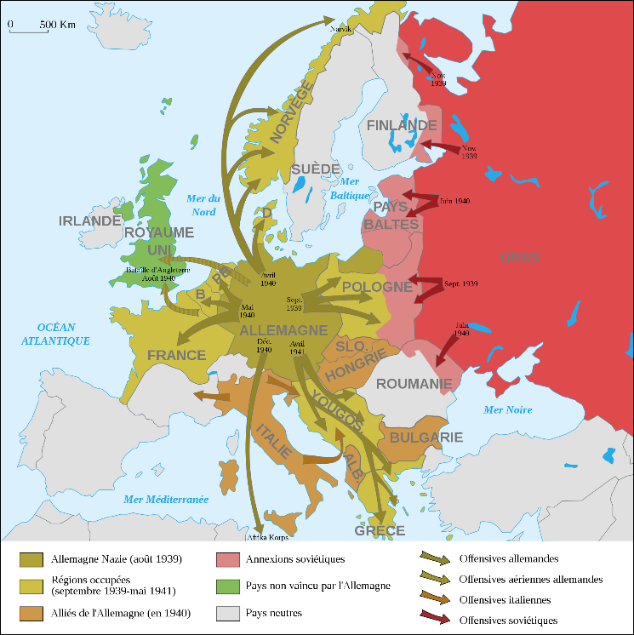
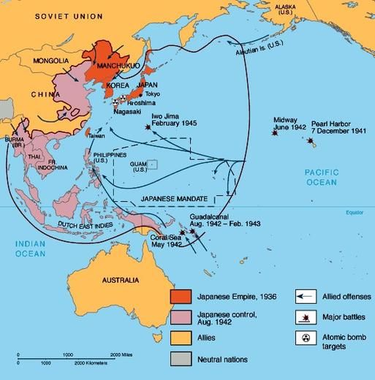
Main military turning points
WW II - the most complex War in Human history.
Three continents – Europe, Africa, Asia.
1939 – German and Soviet invasion of Poland.
Spring and Summer 1940 – Germany defeated France and the UK in the North and the West.
Spring 1941 – Germany invasion of Balkan
Summer 1941 – invasion of USSR
Winter 1941 - the USA entry to War after Pearl Harbor.
The end of European war.
Turning point – 1942 - Germany suffered defeat at Stalingrad and El Alamein.
1943 – invasion of Italy – capitulation.
1944 - the Western Allies invaded German-occupied France.
1945 – USSR captured Berlin.
September 1945 – Hiroshima, Nagasaki and the Soviet invasion of Manchuria.

Slide 9
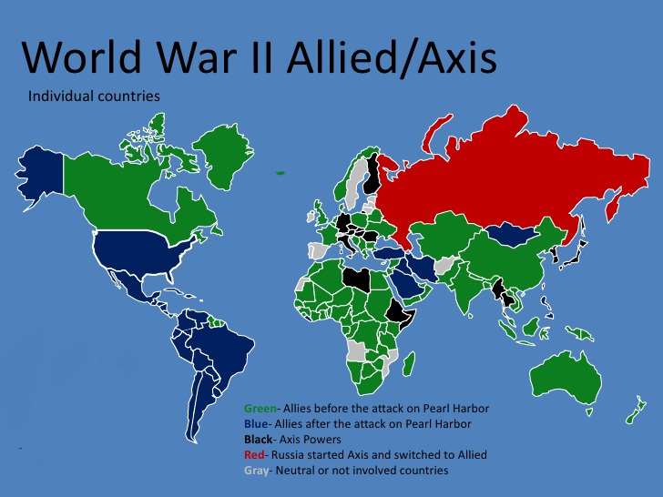
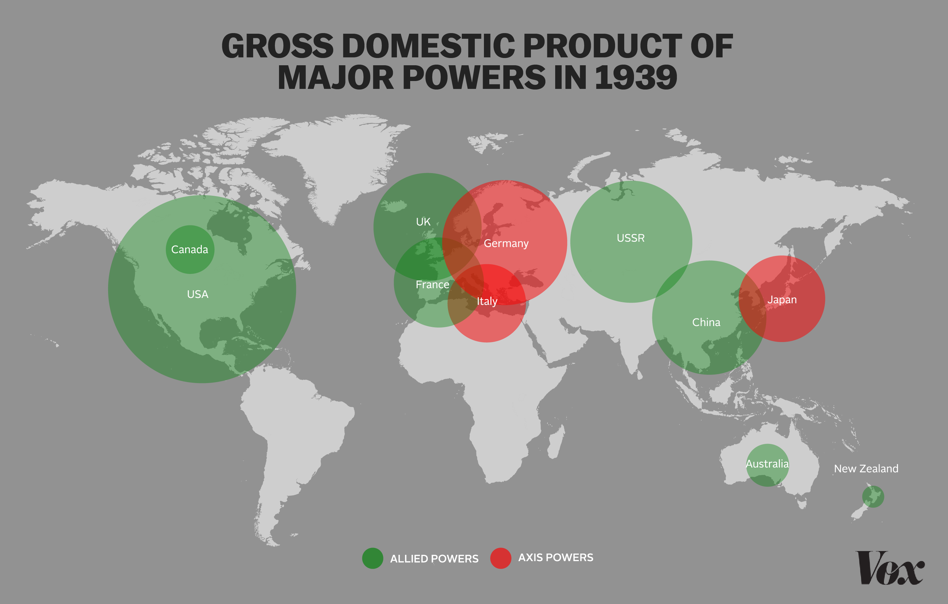
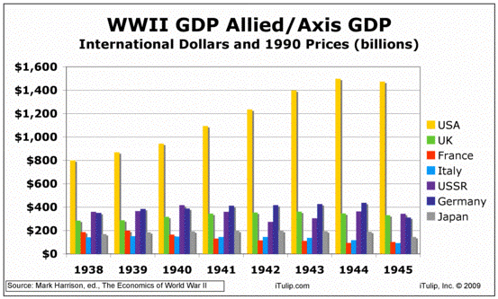
WWII and correlation of forces
The correlation of forces between Axis power and Allied was unequal - was in favor of Allied powers.
The Axis population in 1938 was 259 million,
The Allied population – much higher!
The United Kingdom (excluding its colonies) had a population of 47.5 million and France (excluding its colonies) 42 million.
USSR population was around 180 mil in 1941 (included occupied territories).
USA –population was around 134 mil
Italy and Japan lacked industrial capacity; their economies were small, dependent on international trade, external sources of fuel and other industrial resources.
All Axis powers did not have enough strategic resources necessary for conducting modern war, especially oil.
The USA was the leading world industrial power capable of producing modern arms in huge numbers.
The USSR invested enormous resources in a very rapid industrialization and militarization in the 1930s .
In 1939 it produced 40%-50% of the worlds production of weapons.

Slide 10
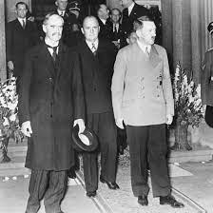
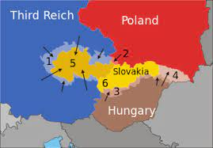
Munich 1938 Security Conference
Spring 1938 – Anschluss of Austria – weak Stresa Front protests (Italy, France, Britain).
Autumn 1938 - Munich Agreement - annexation of the "Sudetenland", a region of western Czechoslovakia inhabited by 1 mil people, mainly German speakers.
Top leaders of Germany, France, Great Britain, and Italy – USSR and Czechoslovakia were not invited.
Followed by the First Vienna Award (November 2, 1938) - new border between Czechoslovakia and Hungary, while Poland also annexed territories from Czechoslovakia.
March 1939 - Czechoslovakia disappeared.
The creation of the Protectorate of Bohemia and Moravia
Result: Germany took full control of the Czech parts.
West came to the conclusion that appeasement is not working.

Slide 11
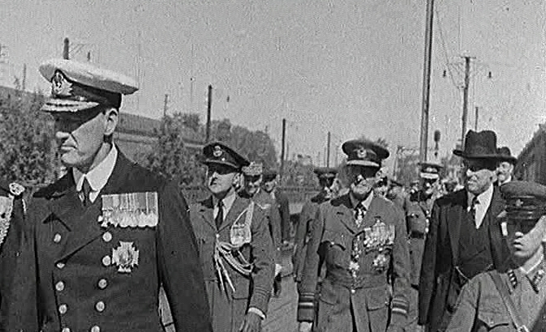
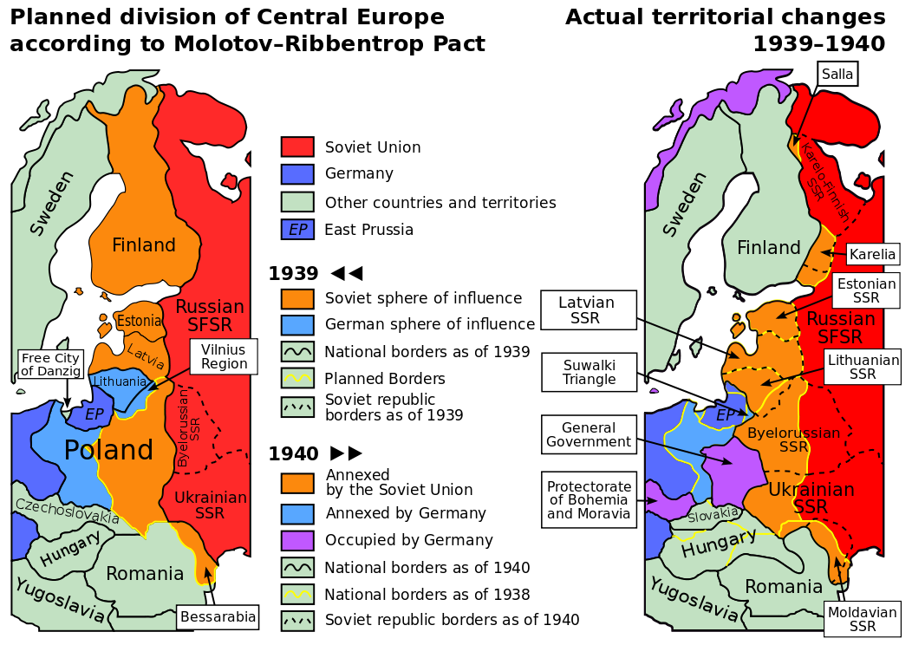
Anglo-French Talks with USSS and Mollotov – Ribbentrop Pact in 1939
Mid-March 1939, the Soviet Union, Britain and France negotiations of a potential political and military agreement.
April 17, 1939 - the Soviet outline of a French–British–Soviet mutual assistance pact for 5 to 10 years.
Negotiations failed
The Soviet explanations – West wanted to pave the way for German – Soviet war.
The ongoing explanation based on archive materials (Western):
1. Britain and France would not agree on a key Soviet demand, namely that Soviet troops be allowed free passage across Poland and stationing troops in Poland.
2. Britain and France did not believe that the USSR military can provide a significant contribution to the war against Hitler after huge purges in the Soviet military.
Molotov-Ribbentrop Pact on August 23, 1939.
Public and secret parts.

Slide 12
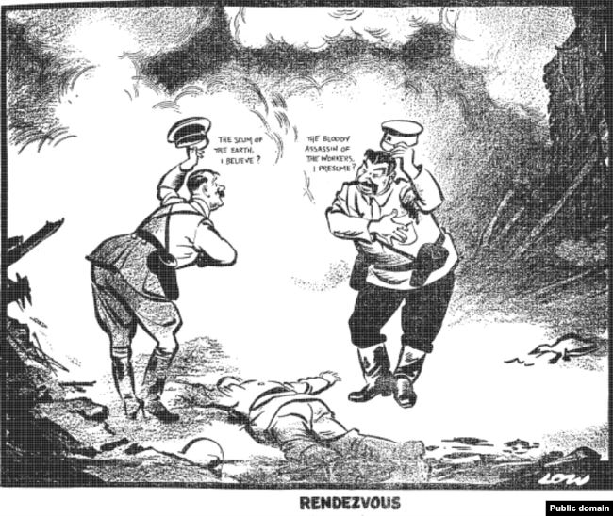
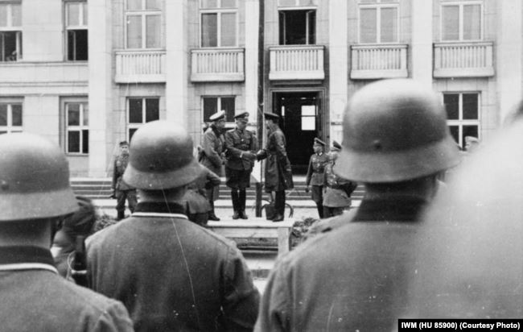
M-R pact explanations
1. The Soviet traditional explanation of the M-R pact (supported by many West liberal intellectuals)
Allowed the USSR to delay the onset of war with Nazi Germany.
Allowed the Soviet border to be moved 200km or more to the west.
Allowed the USSR to take under its defense the "blood-brother peoples" - the Ukrainians and Belarussians.
Prevented an "anti-Soviet alliance" between the West and Nazi Germany.
2. The Icebreaker explanation – Victor Suvorov.
Stalin wanted to set the scene for European war in order to create conditions for Marxist revolution in the West.
Politburo meeting held on 19 August 1939 - war with Germany could be avoided, should the USSR form an anti-Nazi alliance with Britain and France but the subsequent development of events after that would be unfavorable to the Soviet Union!
“Special Archive of the USSR”, Folder 7, Set 1, Doc. 1223. It is also reproduced from Dimitrov`s diary in T.S. Bushuyev`s “Proklinaya – Probuite Ponyat” (“Curse It but Try to Understand”), “Novyi Mir”, no. 12, 1994; pp. 232-233.

Slide 13
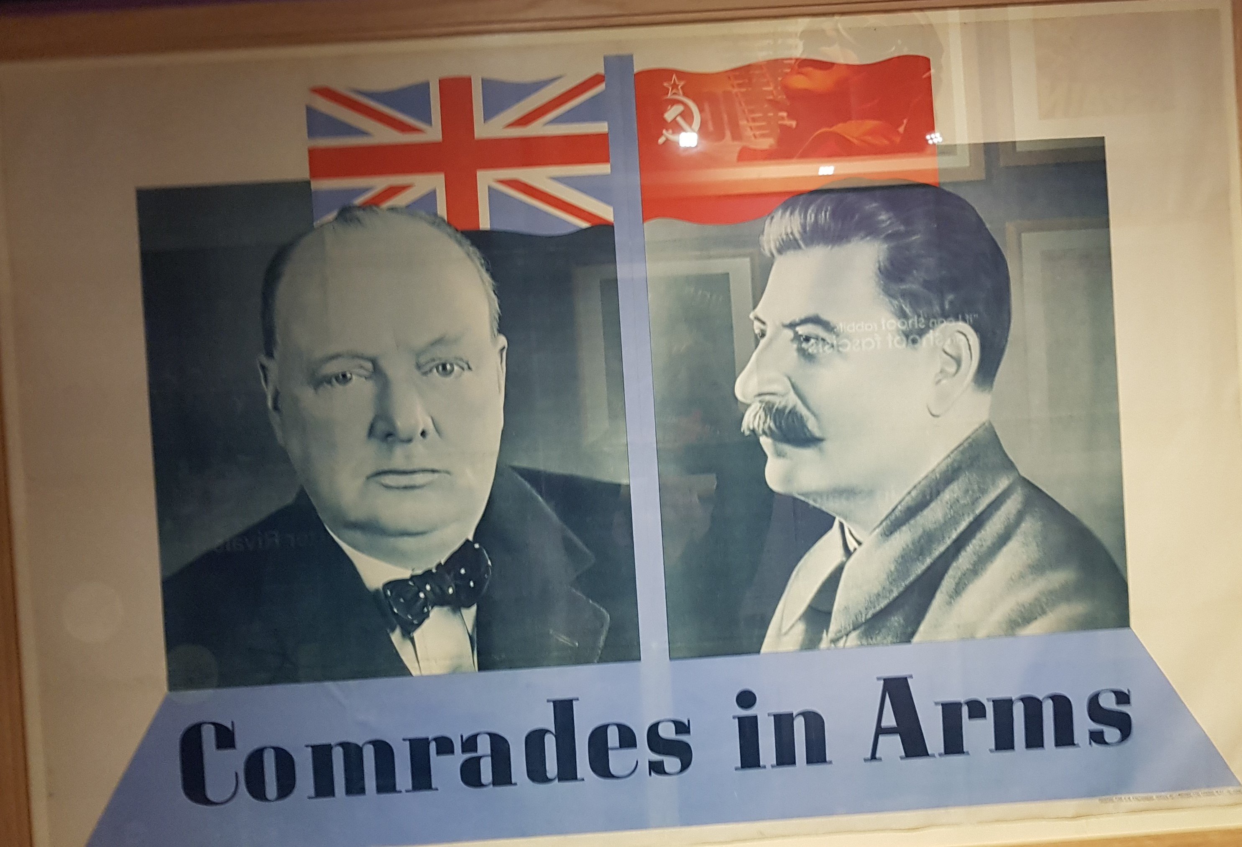
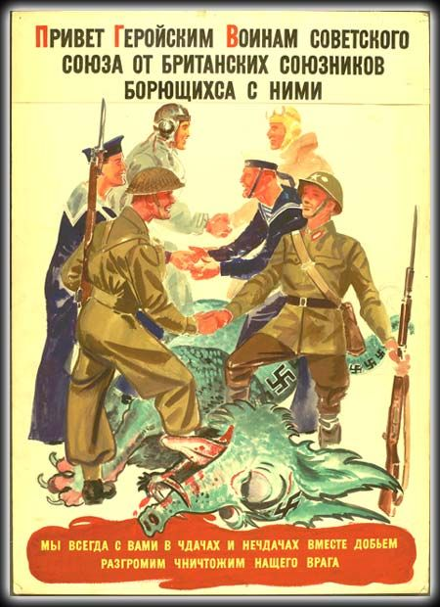
The Soviet role in WW II
The Soviet role in WWII is complex.
In the 1930 the USSR rhetoric was typical of a very strong anti-German and anti-Nazi attitude.
1934 – the League of Nations Member.
Huge Soviet military build-up in the 1930s – USSR the World leading military power in late 1930s.
In August 1939- Molotov–Ribbentrop Pact - with a secret protocol – division of Europe.
The German–Soviet Treaty of Friendship, Cooperation and Demarcation in 1939 – USSR - the German strategic resources supplier.
1939-1940 – Winter War against Finland. The USSR was expelled from the LoN.
1940 – annexation of Baltic States.
June 22, 1941 - by the German invasion, the USSR was put in the anti-Nazi camp again.
1942 - USSR forged Alliance with Anglo-Saxon powers.
June 1941 – May 1945 – decisive role in German military defeat and recipient of very significant Western economic assistance.

Slide 14
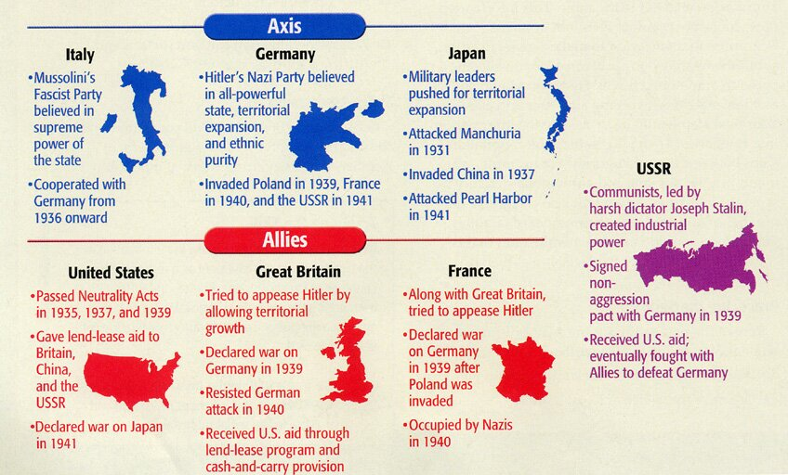
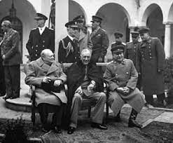
WWII diplomatic history 1941-1945 I.
1939-1941 – there was widespread opposition to American military intervention in European affairs in the USA.
1939 - "cash and carry" legislation - paved the way for Lend-Lease.
March 11, 1941 - American program to defeat Germany, Japan and Italy by distributing food, oil, and materiel between 1941 and August 1945.
The aid went to the United Kingdom, China, and later the Soviet Union, Free France, and other Allied nations – in fact the End of the U.S. neutrality.
August 1941 - Atlantic Charter – the USA and the UK
no territorial gains were to be sought by the United States or the United Kingdom;
territorial adjustments must be in accord with the wishes of the peoples concerned;
all people had a right to self-determination;
trade barriers were to be lowered;
there was to be global economic cooperation and advancement of social welfare;
the participants would work for a world free of want and fear;
the participants would work for freedom of the seas;
there was to be disarmament of aggressor nations, and a common disarmament after the war.

Slide 15
WWII diplomatic history 1941-1945 II.
Tehran Conference in Iran from 28 November to 1 December 1943
an invasion of France in 1944
way of dealing with Turkey, Iran, Yugoslavia
the war against Japan
the post-war settlement
The Yalta Conference, the Crimea, February 4–11, 1945 - Declaration of Liberated Europe.
promise that allowed the people of Europe "to create democratic institutions of their own choice"
unconditional surrender of Nazi Germany
postwar plans for European boundaries
the Polish destiny - agreed to reorganize the pro-soviet communist Provisional Government of the Republic of Poland and incorporate members from the Polish government in the UK – free elections in Poland
Stalin agreed to enter the war against Japan three months after the defeat of Germany
the USSR would be a member of the United Nations Security Council, with a veto right
4 Occupation zones in Germany
The Potsdam Conference, July 17-Aug. 2, 1945
- demanded "unconditional surrender" from Japan.
- finalized arrangements for Germany to be occupied and controlled by the Allied Control Commission.

Slide 16
WW II Effects
50 - 60 million of people were dead and millions homeless. Millions of people were expelled from their homes.
The European economy had collapsed, and much of the European industrial infrastructure had been destroyed.
The Soviet Union, Germany and Poland had been the most affected countries.
WWII - the power bipolarity – USA and USSR.
The British empire, one of the winner of the war, was economically exhausted: 1946 - Anglo-American Loan Agreement .
Absolute defeat of Germany and Japan
WWII was the end of the period of European dominance in world politics.
United Nations

