Slide 1
World after Second World War
Zdeněk Kříž

Slide 2
World War II and its effects
WWII effects
Distribution of power
United Nations
Bipolarity
New Economic order
Hotspots after WWII
Marshall Plan
U.S. security guaranties to Europe
Cold War system

Slide 3
WW II Effects
60 million of people were dead. Millions of people were expelled from their homes.
The European economy collapsed as industrial infrastructure and agriculture were destroyed.
Year Zero
The Soviet Union, Germany and Poland - the most affected countries.
WWII - the power bipolarity – USA and USSR – superpowers.
Absolute defeat of Italy, Germany and Japan.
WWII was the end of the period of European supremacy in world politics.
The British empire, one of the winner of the war, was economically exhausted.
End of U.S. isolationism.
Marxism as viable alternative to liberal order.

Slide 4
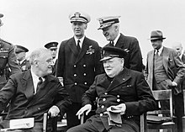
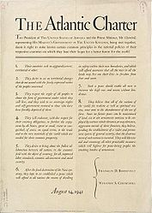
Road to United Nations
President Franklin D. Roosevelt and British Prime Minister Winston Churchill.
Atlantic Charter in August 1941.
On January 1, 1942, 26 countries signed the Declaration by United Nations, which made clear the war aims of the Allied powers.
The United States, the United Kingdom, and the Soviet Union took the lead in designing the new organization.
Disputes
The Soviet Union demanded individual membership and voting rights for its constituent republics.
Britain wanted assurances that its colonies would not be placed under UN control.
Veto problem.

Slide 5
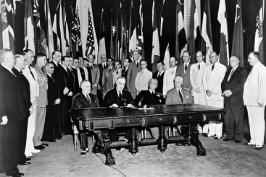
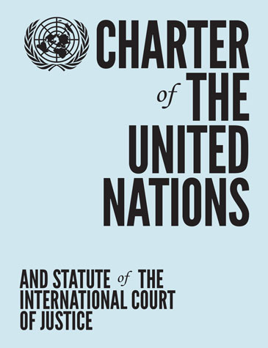
United Nations and management of international system
April 1945 – United Nations – Charter of the UN - replaced the non-functional League of Nations.
The aim of preventing future wars - collective security.
Attempt to decrease the anarchic character of international relations by introducing a collective security system protecting peace.
At its founding, the UN had 51 members; there are now 193, representing the vast majority of the world's sovereign states.
USA, USSR, Great Britain, France and China Republic - permanent membership in the UN Security Council.
The UN security system was very often dysfunctional.
WWII promoted the institutionalization of management tools to discipline international financial affairs.
International Monetary Fund (IMF) – 1945.
International Bank for Reconstruction and Development (IBRD) (popularly known as the World Bank) – 1947.
General Agreement on Tariffs and Trade (GATT) – 1948.
Universal Declaration of Human Rights - 1948.
Charter of the United Nations - call for the maintenance of peace and international security and respect for human rights.

Slide 6
United Nations collective security
United Nation’s Four Main Goals
Maintain international peace and security;
Develop friendly relations among nations;
Achieve international cooperation in solving international problems; and
Be a center for harmonizing the actions of nations in the attainment of these common ends.
Article 2
„All Members shall settle their international disputes by peaceful means in such a manner that international peace and security, and justice, are not endangered. All Members shall refrain in their international relations from the threat or use of force against the territorial integrity or political independence of any state, or in any other manner inconsistent with the Purposes of the United Nations.“
War is not a legitimate tool of foreign policy!
The Security Council - maintaining peace and security among countries.
1971 – PRC replaced Chinese Republic (Taiwan).
UNSC – often paralyzed during Cold War
Authorized military interventions in the Korean War and the Congo Crisis.

Slide 7
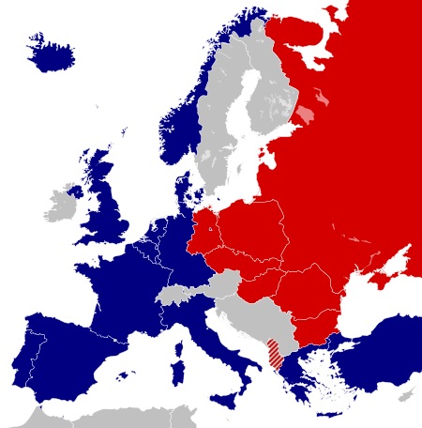
Bipolar Distribution of Power
USA
During WWII, the USA had doubled the U.S. economic power.
The USA produced just over half of the world's products and launched a new industrial revolution.
Nuclear weapons monopoly plus means of delivery.
Enormous increase of public debt in the USA.
1939 – 39,7 billion USD (43% GDP) versus 251 billion USD (112% GDP) in 1945.
United States became one of the first members of the United Nations.
USA promoted decolonization.
Monopoly on atomic bomb till 1949 – atomic diplomacy.
Management of Bretton Wood institutions.

Slide 8
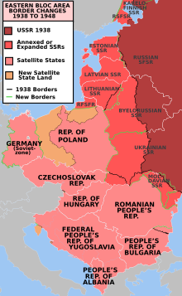
Bipolar Distribution of Power
USSR
The Soviet Union had become the dominant continental power.
Soviet economy was to a dollar equivalent of approximately 10 – 15 % of the US level.
Shortage of labor force:20 - 28 million causalities during WWII.
The Soviet Union did not have the military strength needed to fight and win a global war against the United States.
Strong enough to conquer Europe.

Slide 9
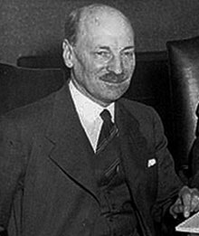
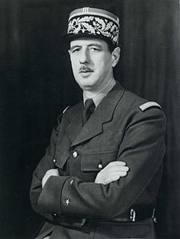
Great Britain and France after WWII
Devastation of Europe after WWII. European Great powers were exhausted.
Great Britain
Clement Attlee, prime minister - the disintegration of Britain's empire transformed global politics.
Great Britain - dependant on the USA. Great Britain could not afford financing British Empire – Keynes estimation - £2 billions per year.
1947 – India and Pakistan became independent.
1949 – GB helped to establish NATO.
France
Devastated by WWII + inflation
France became one of the largest recipients of U.S. Marshall Plan aid.
Imprisonment of Vichy France leaders + Charles de Gaulle in lead
1946 – new constitution
France was a founding member of the six-state European Coal and Steel Community in 1951.
France tried to preserve its colonial Empire in Africa and regain its colonies in Indochina.

Slide 10
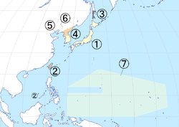
Italy and Japan after WWII
Italy
In May 1946 King Victor Emmanuel III finally formally abdicated.
Constituent Assembly was elected: the Christian Democrats, Socialists, and Communists—took 75% of seats.
Strong communist party
Italy participated in Marshall plan – economic miracle in the 1950s and 1960s.
Incorporated in Western institutions – 1949 NATO member, 1957 European Common Market.
Japan
Emperor Hirohito remained on the throne.
U.S. occupation of Japan.
Liberalization and democratization.
Peace Clouse – article 9 of Constitution.
1952 – Treaty of San Francisco – end of occupation.
Japan – part/allied of the West.
1. Map of Japan under Allied occupation Japanese archipelago, placed under the authority of the Supreme Commander of the Allie Powers, effective 1945–1952 (with the exceptions of Iwo Jima, under US authority until 1968, and Okinawa, under US authority until 1972)
2. Japanese Taiwan and the Spratly Islands, placed under the authority of China
3. Karafuto Prefecture and the Kuril Islands, placed under the authority of the Soviet Union
4. Japanese Korea south of the 38th parallel north, placed under the authority of the United States Army Military Government in Korea, granted independence in 1948 as South Korea
5. Japanese Korea north of the 38th parallel north, placed under the authority of the Soviet Civil Administration, granted independence in 1948 as North Korea
6. Kwantung Leased Territory, occupied by the Soviet Union 1945–1955, returned to China in 1955
7. South Pacific Mandate, occupied by the United States 1945–1947, converted into the Trust Territory of the Pacific Islands in 1947

Slide 11
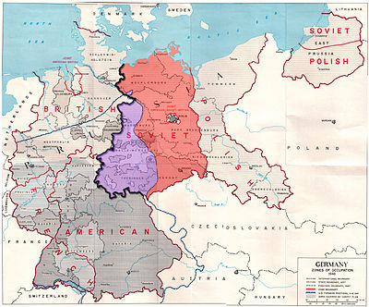
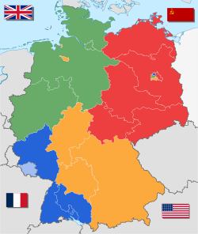
Germany after WWII
This division of Germany was agreed at Yalta conference (February) ratified at the Potsdam Conference (1945).
Allied Control Council broke down in 1946–1947 due to growing tensions between the Allies.
Absorption of post-war expellees.
Berlin Blockade that was enforced from June 1948 to May 1949.
Federal Republic of Germany – 1949
German Democratic Republic - 1949
5 May 1955, when the General Treaty (German: Deutschlandvertrag) entered into force.

Slide 12
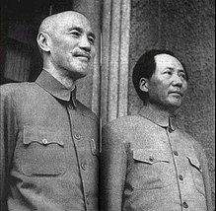
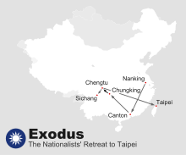
China after WWII
1911 – Chinese Revolution
1921 - Chinese Communist Party was founded in Shanghai.
1931 – Japanese invaded Manchuria.
1930s - Government of the Republic of China (ROC) faced the triple threat of Japanese invasion, Communist uprising, and warlord insurrections.
During World War II, popular support for the Communists increased.
1946 - 1949 the two sides were fighting a full scale civil war.
1949 - creation of the People’s Republic of China (PRC).
PRC – under late 1950s – under the influence of USSR.
USA versus PRC in Korean war
Chiang Kai-shek and Mao Zedong met in Chongqing in 1945.
The Nationalists' retreat to Taipei: after the Nationalists lost Nanking they next moved to Canton) then to Chungking, Chengtu and finally, (Sichang) before arriving in Taipei.

Slide 13
New Economic Order
WWII promoted the institutionalization of management tools to discipline international financial affairs.
Avoid economic crisis similar to the 1930 crisis leading to WWII.
Formed in 1944 at the Bretton Woods Conference.
International Monetary Fund (IMF) – 1945 - primarily by the ideas of Harry Dexter White and John Maynard Keynes
IMF goal: reconstructing and keeping the international payment system.
International Bank for Reconstruction and Development (IBRD) (popularly known as the World Bank)
1944 - along with the International Monetary Fund (IMF)
Goal: provide temporary loans to low-income countries which were unable to obtain loans commercially. The Bank may also make loans and demand policy reforms from recipients
General Agreement on Tariffs and Trade (GATT) – Geneva – 1948 (in effect)
"substantial reduction of tariffs and other trade barriers and the elimination of preferences, on a reciprocal and mutually advantageous basis."

Slide 14
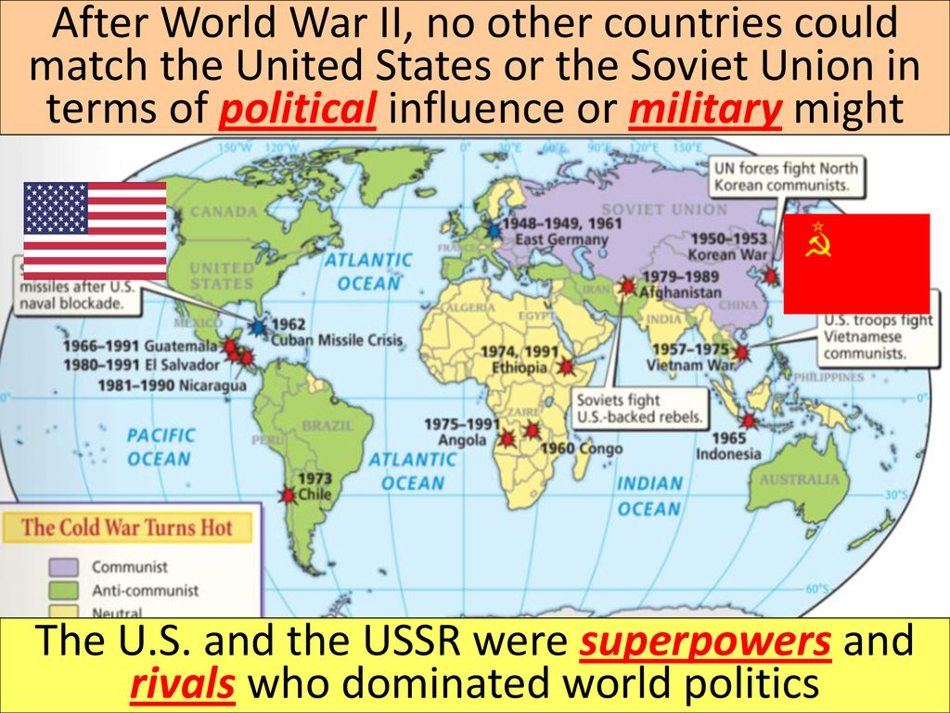
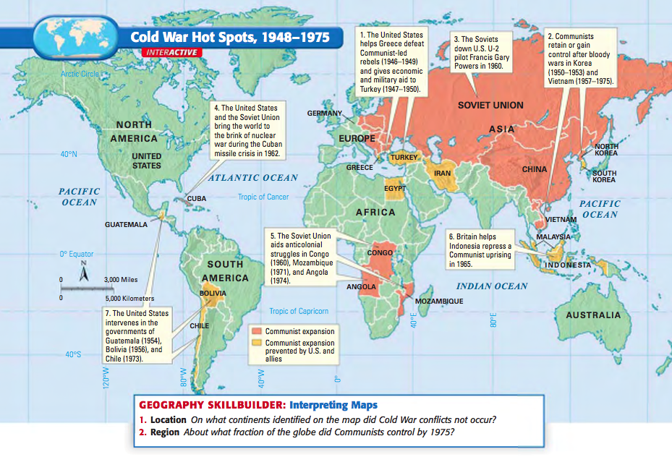
Flashpoints after WWII
Flashpoints: control over Germany, future of Poland, Greece and Turkey, reparations and the USSR role in Central and Eastern Europe.
Long Telegram and The Sources of Soviet Conduct - George F. Kennan.
Cold War beginning?
Main disputes in late 1940s
The Soviets’ failure to withdraw their troops from northern Iran in early 1946 (as per the terms of the Tehran Declaration of 1943);
Soviet attempts to pressure the Iranian Government into granting them oil concessions while at the same time forming irredentism by Azerbaijani separatists in northern Iran;
Soviet efforts to force the Turkish Government into granting them base and transit rights through the Turkish Straits;
The USSR rejection of the Baruch plan for international control over nuclear energy and weapons in June 1946.
The Soviet behavior in Central and Eastern Europe
1947 - The Truman Doctrine – end of the US isolationism.
The European Recovery Program announced in July 1947 - the Marshall Plan.

Slide 15
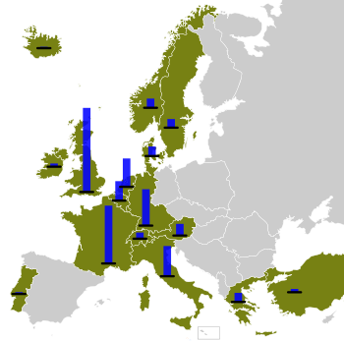
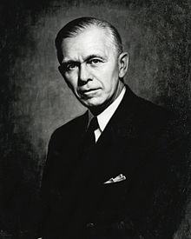
Marshall Plan
European Recovery Program (ERP) - the Marshall Plan
1948 – 1951
16 European Nations, including Germany
Great Britain – 26%, France - 18% and FRG – 11%
Goals
Reduction of interstate barriers
Dropping of many regulations
Encouraged an increase in productivity
Adoption of modern business procedures
1948 to 1952 saw the fastest period of growth in European history.
Marshall Plan sped the European recovery, but did not initiate it.
Paved the way for further economic and security cooperation.
European Recovery Program expenditures by country
George Marshall, the U.S. Secretary of State

Slide 16
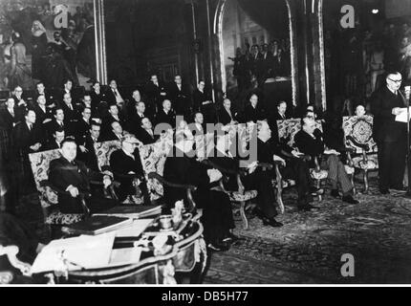
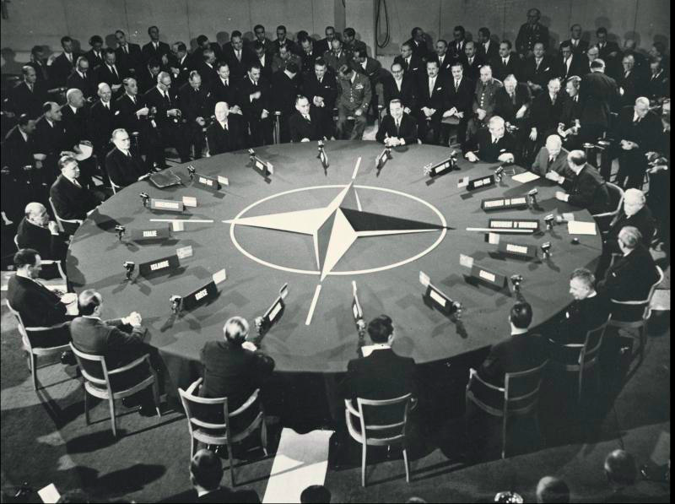
The U.S. security guaranties to West Europe
Brussels Treaty was established in March 1948.
Berlin Crisis in 1948 accelerated the NATO founding.
WWII bound the US and European security – 1949 – NATO.
NATO was initiated by European states!
12 countries - USA, Canada, Belgium, France, Luxembourg, the Netherlands, the United Kingdom, Denmark, Iceland, Italy, Norway and Portugal.
The US leadership - NATO is an association of sovereign states.
The decision-making process is based on consensus of all NATO members.
Four purposes: deterring Soviet expansionism, forbidding the revival of nationalist militarism in Europe, keeping a strong U.S. presence on the continent, and encouraging European political integration.

Slide 17
Cold War system 1945-1989/1990
(Hocking and Smith, p .55, changes by ZK) | Cold War system 1945-1990/91
Actors | Emergence of a global international system. Rapid expansion of both state and non-state actors. Ideological division decreases level of homogeneity in international system.
Stratification and structure | Emergence of two superpowers. Emerging tripolar system in economic relations in late 1960s (USA, Western Europe, Japan) Military stratification increases with development of nuclear weapons. North-South divide.
Patterns of interaction | No major war between superpowers. Nuclear weapons increase the cost of war. Division into block in international trade and commerce. Growth of summit and multilateral diplomacy. Diplomacy is challenged by ideological division. Rigid alliance systems based on ideology.
Rules and practices | A managed superpower system based on self-restraint. Balance of power replaced by balance of terror due to nuclear weapons. Use of superpower conferences and summits to resolve disputes.

