Slide 1
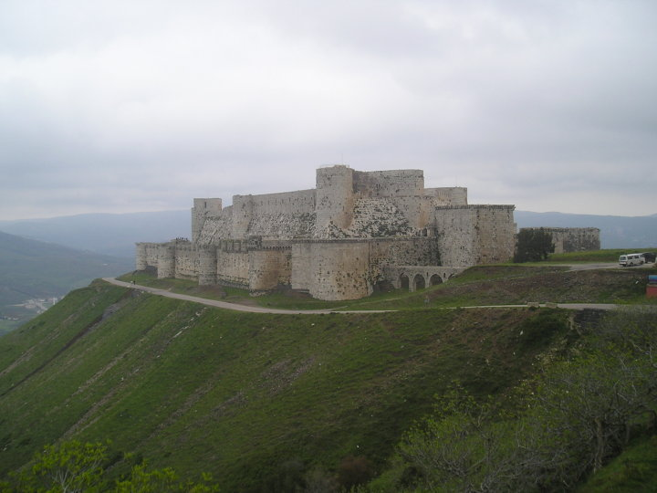
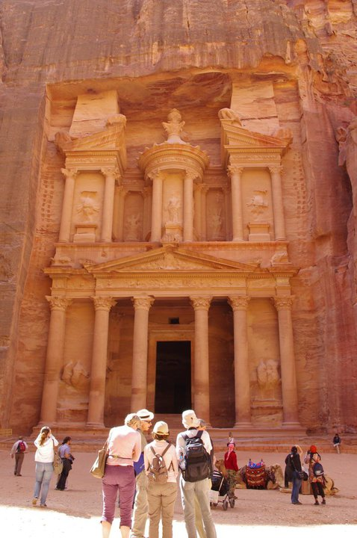
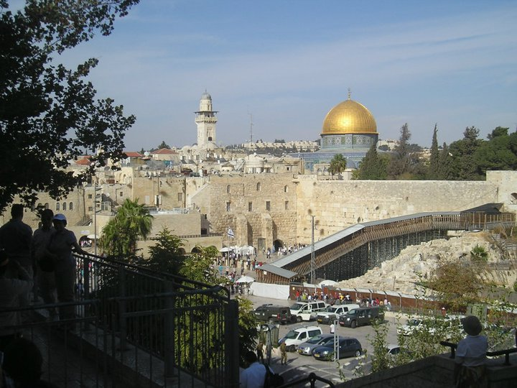
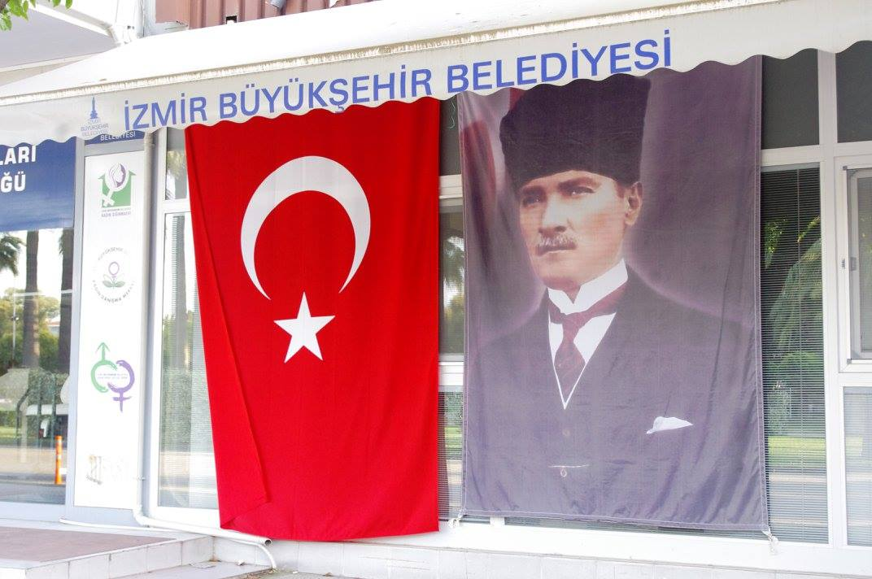
POLITICS AND SOCIETY
IN THE MIDDLE EAST
Mgr. Eva Taterova, M.A., Ph.D.
Faculty of Social Studies
Masaryk University

Slide 2
COURSE OVERVIEW
Credits: 4 ECTS
Lecturer: Mgr. Eva Taterova, M.A., Ph.D. (evataterova@gmail.com)

Slide 3
COURSE SCHEDULE
September 16: Introduction: scope of the course, organization of the course, and course requirements
September 23: Middle East: the basic terminology, geography, demography
September 30: History of Middle East before 1945
October 7: Arab-Israeli Conflict I
October 14: Arab-Israeli conflict II
October 21: Iran: From Western Ally to Islamic Republic
October 28: National holiday – no class

Slide 4
COURSE SCHEDULE
November 4: Midterm essay
November 11: Political Development of Lebanon
November 18: Post-Cold War Conflicts in the Middle East
November 25: War in Syria
December 2: Current events in the Middle East
December 9: Final exam

Slide 5
COURSE ACTIVITIES
Midterm essay: November 4, 40 points
The students shall provide critical assessment of the perspectives to the given topic based on classes and readings. The students are expected to integrate the readings in a thoughtful way, not just summarize them. The detailed instructions will follow before the essay.
Final exam: December-January, 6 open questions, 60 points

Slide 6
GRADES
A 92 - 100
B 84 - 91
C 76 - 83
D 68 - 75
E 60 - 67
F less than 60 points

Slide 7
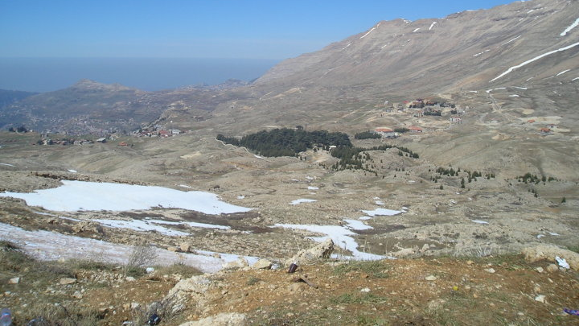
LEBANON

Slide 8
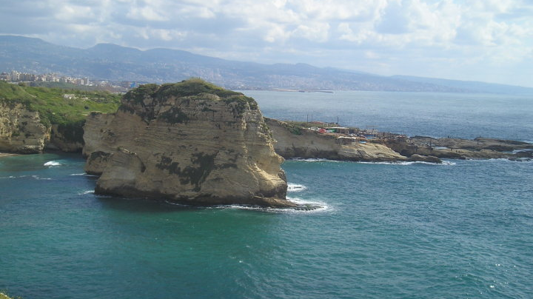

Slide 9
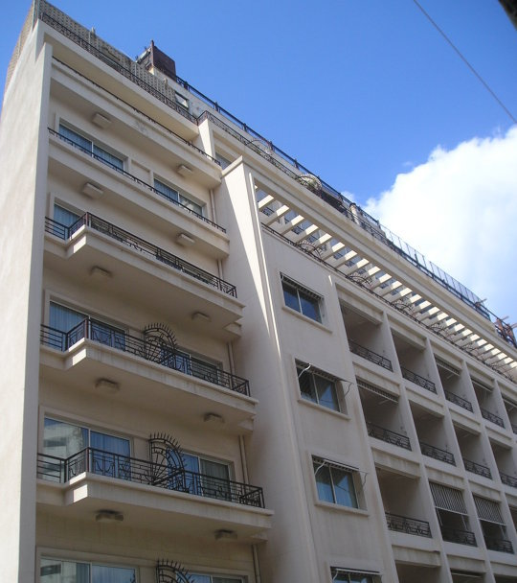
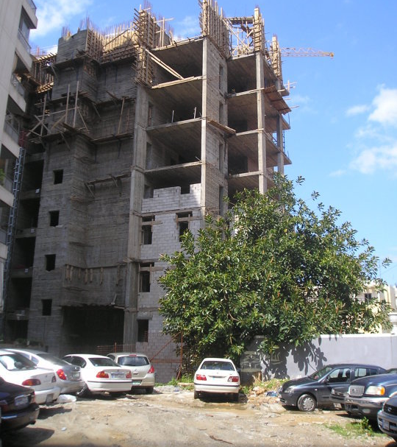

Slide 10
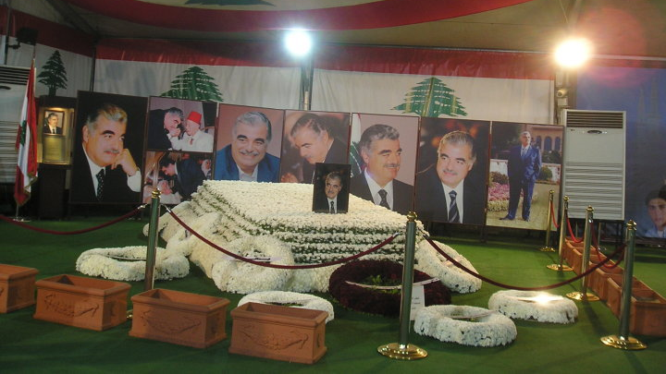

Slide 11
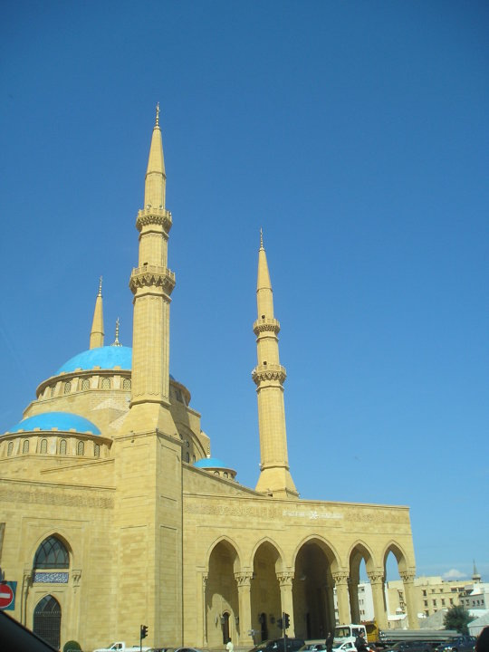
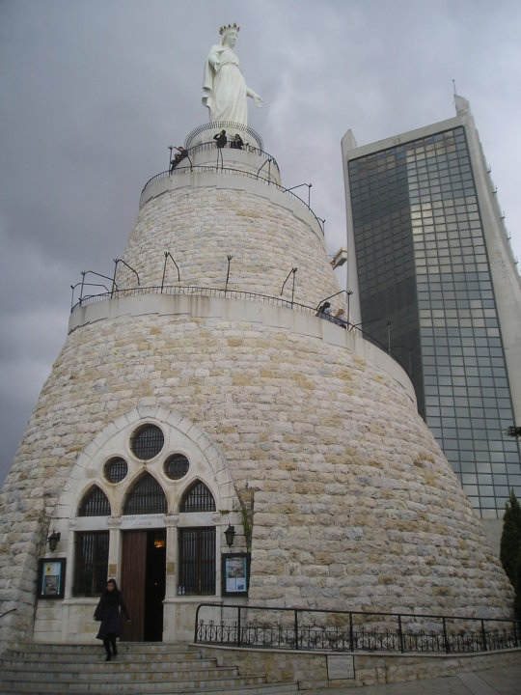

Slide 12
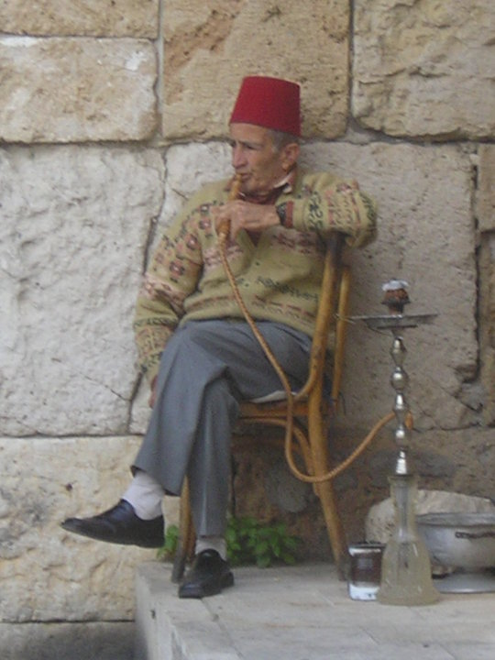
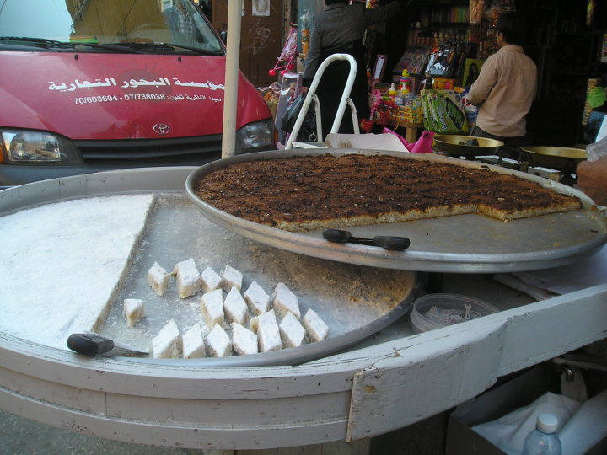

Slide 13
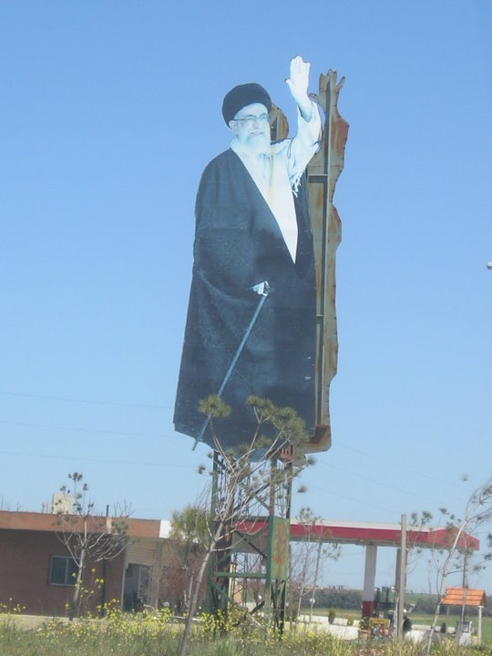
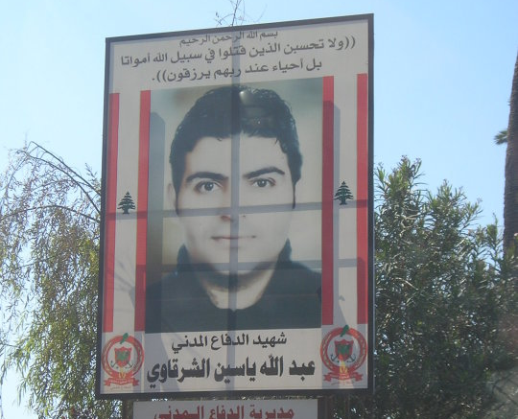

Slide 14
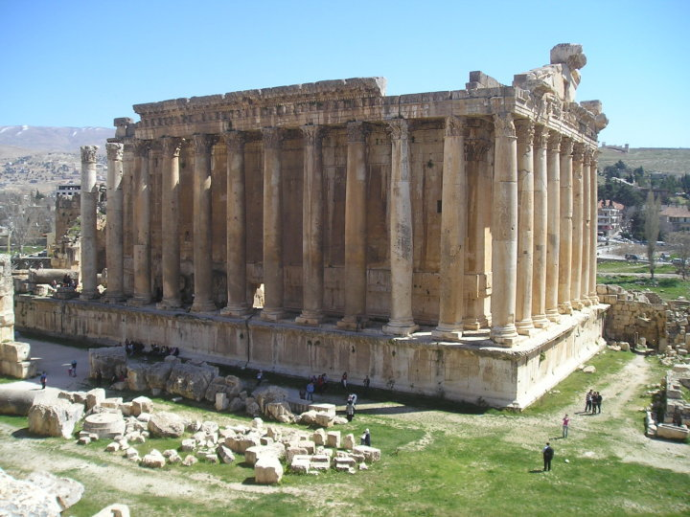

Slide 15
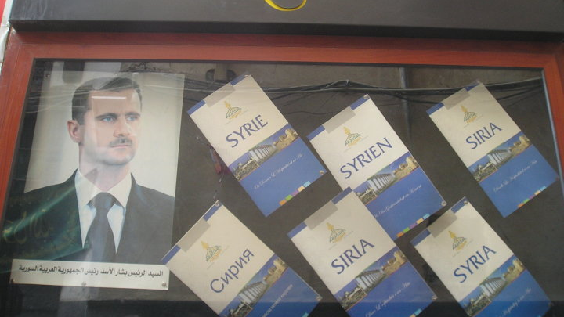
SYRIA

Slide 17
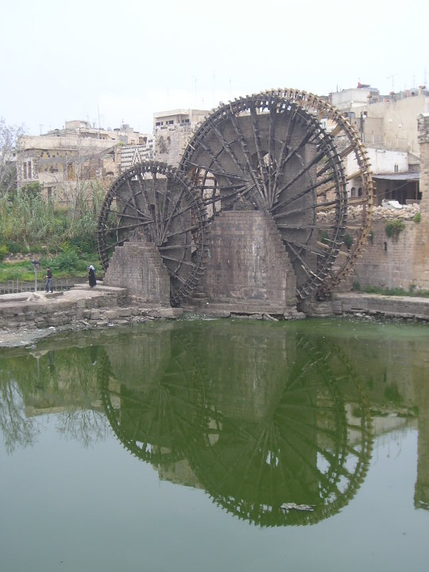
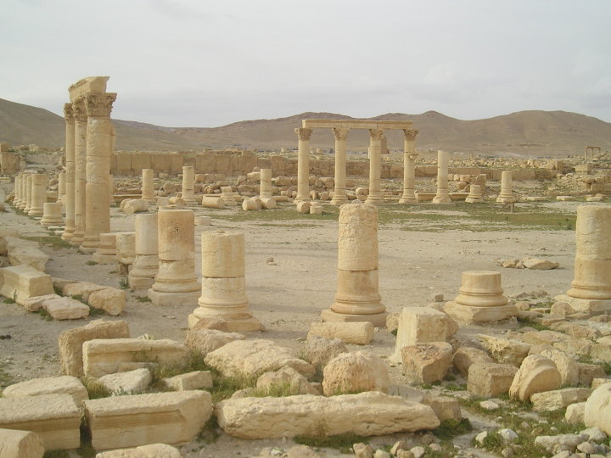

Slide 18
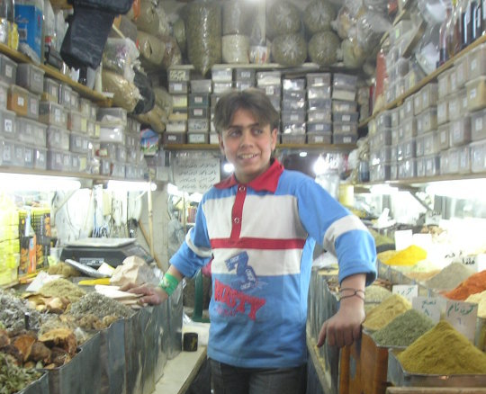
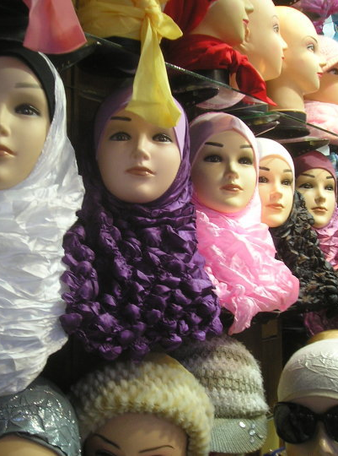

Slide 19
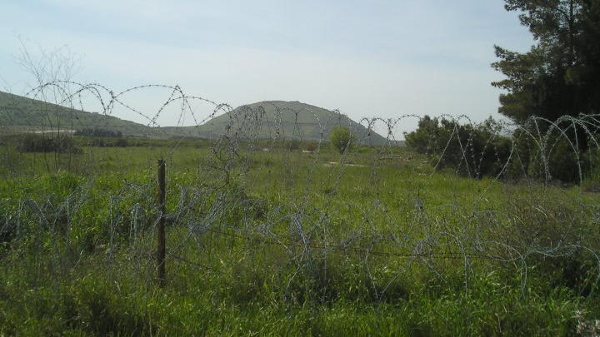

Slide 20
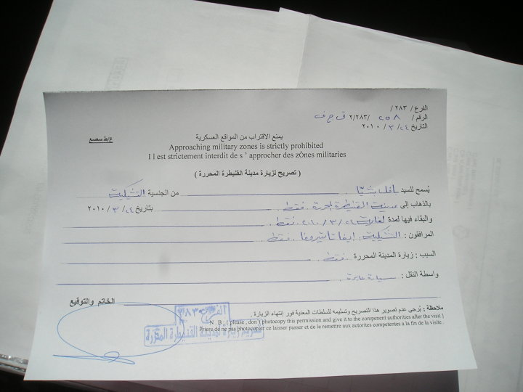
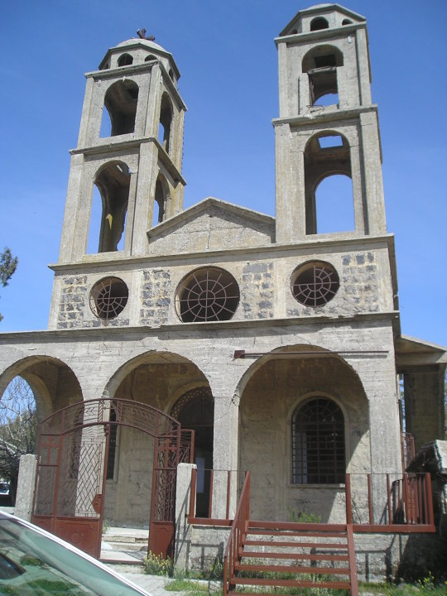

Slide 21
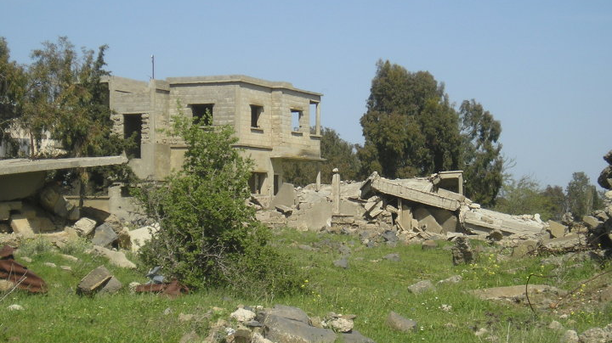

Slide 22
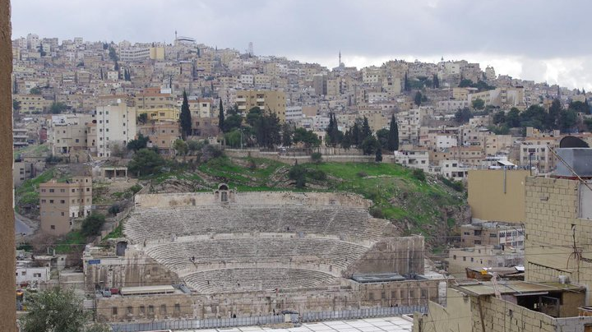
JORDAN

Slide 23
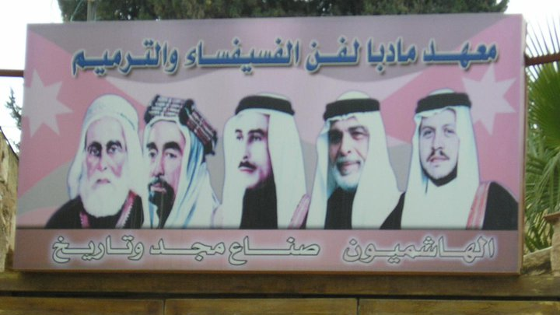

Slide 24
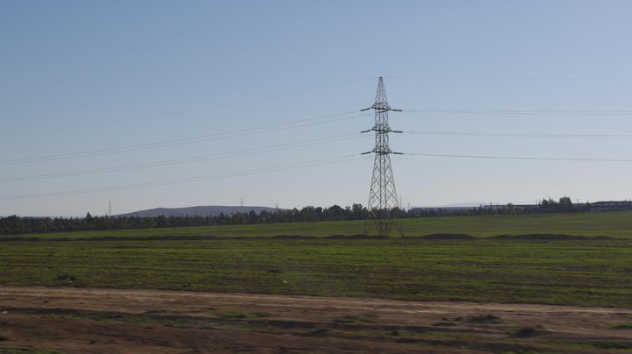

Slide 25
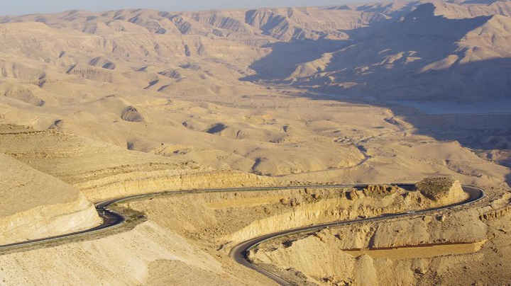

Slide 26
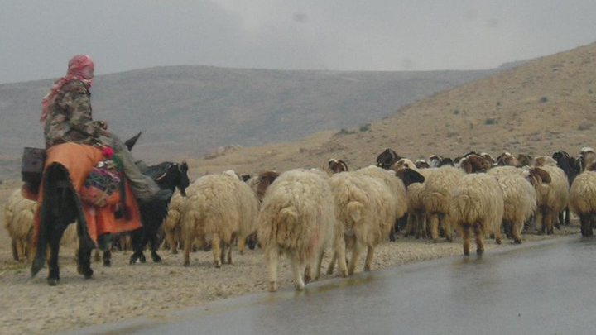

Slide 27
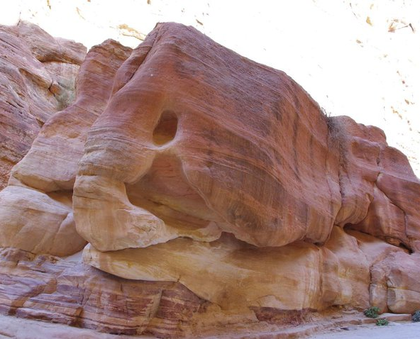

Slide 28
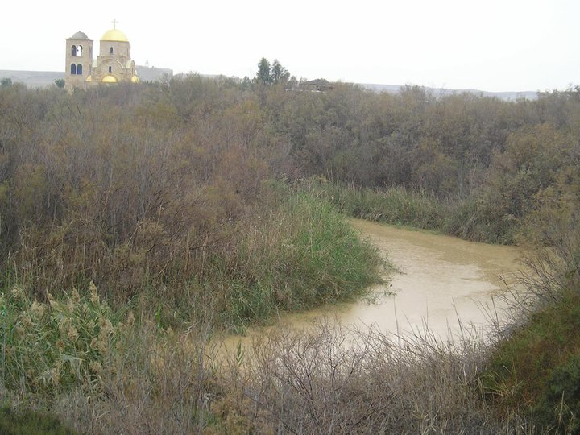

Slide 29
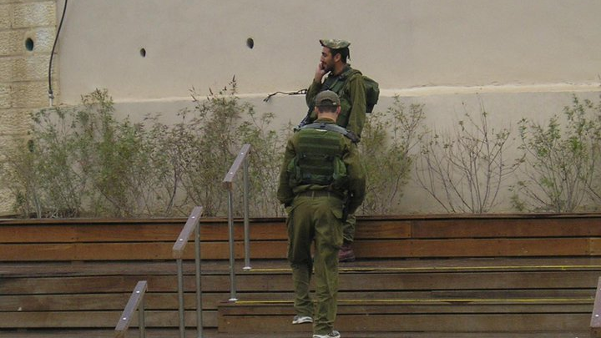

Slide 30
ISRAEL/PALESTINIAN TERRITORIES

Slide 31
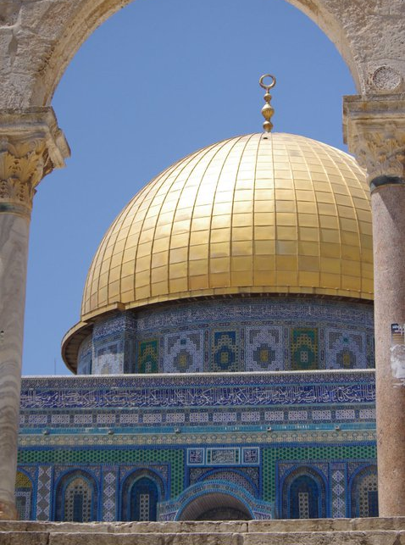
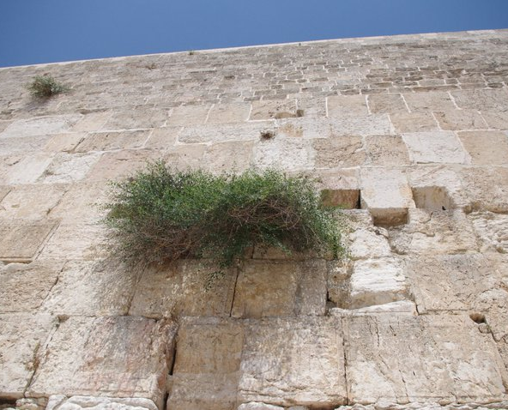

Slide 32
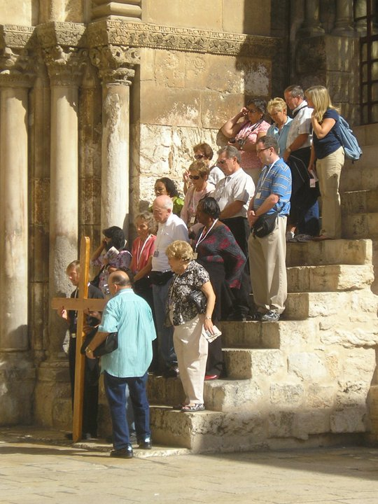
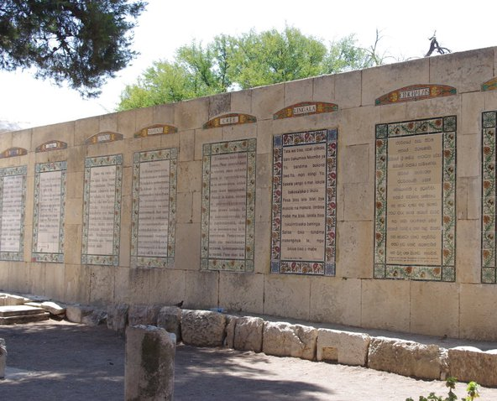

Slide 33
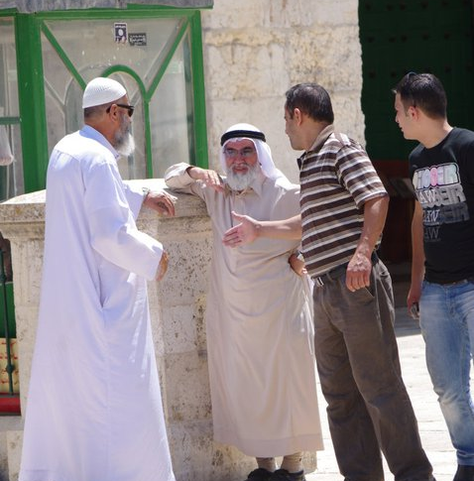
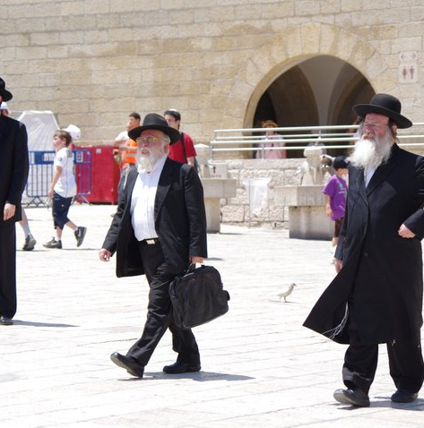

Slide 34
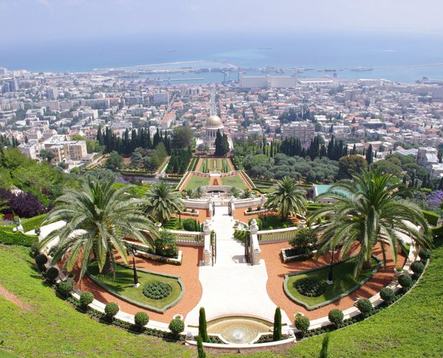
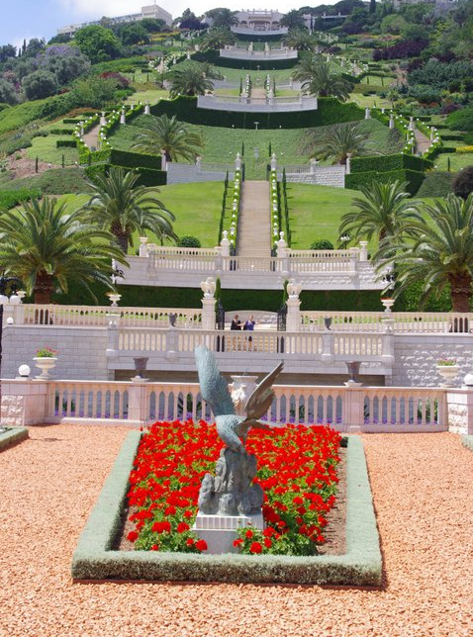

Slide 35
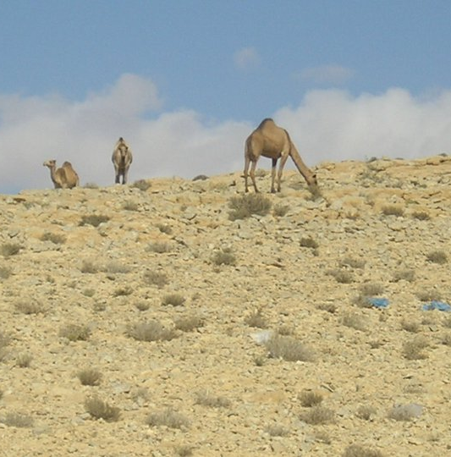
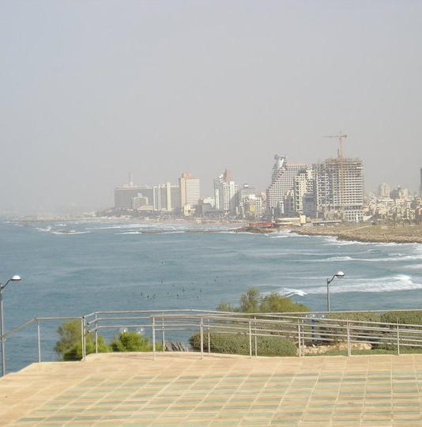

Slide 36
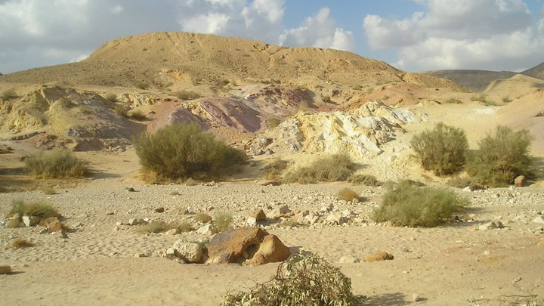

Slide 37
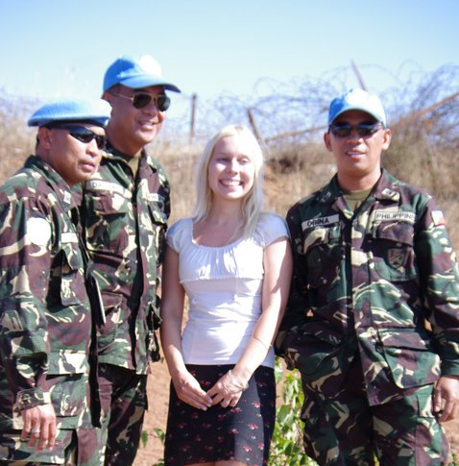
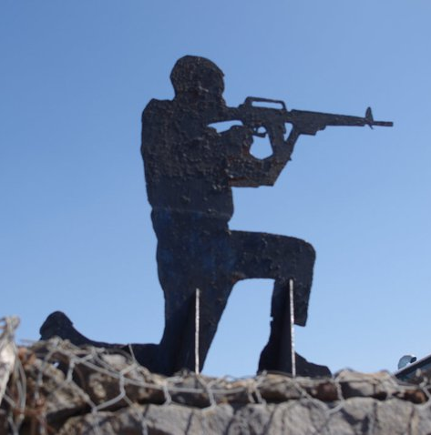

Slide 38
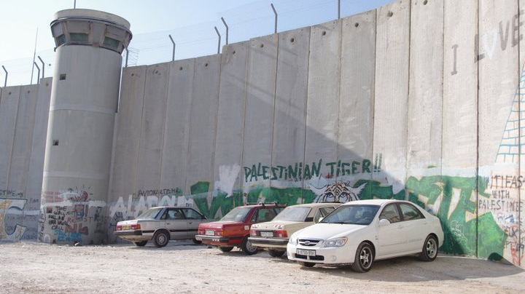

Slide 39
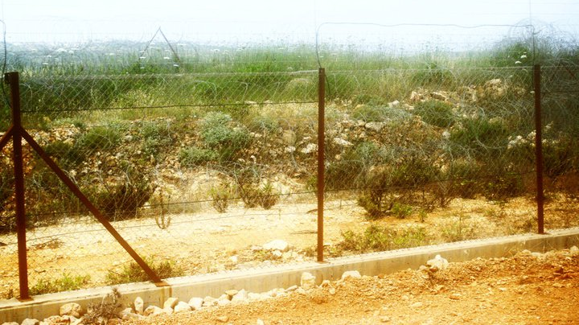

Slide 40
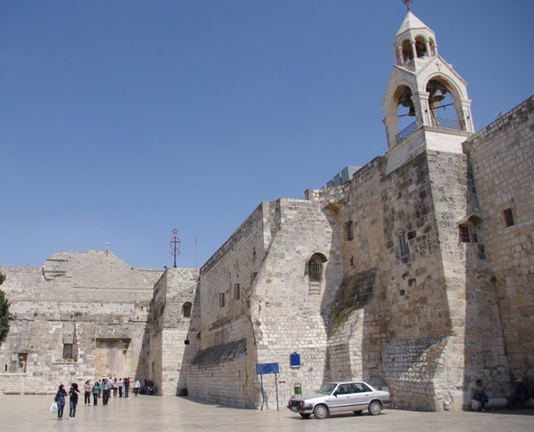

Slide 41
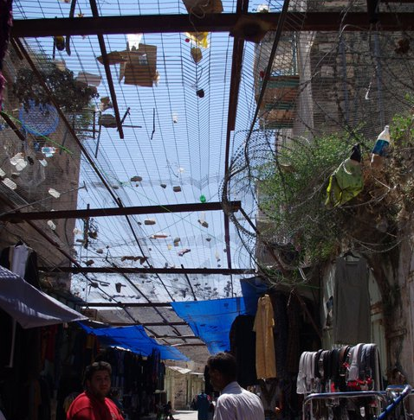


Slide 42


Slide 43



Slide 44
THANK YOU FOR YOUR ATTENTION

