Slide 1
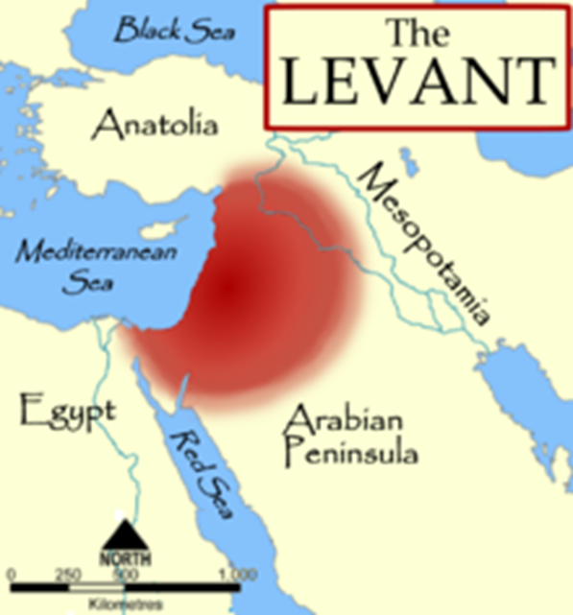
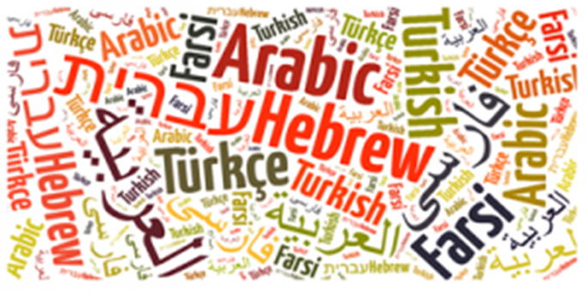
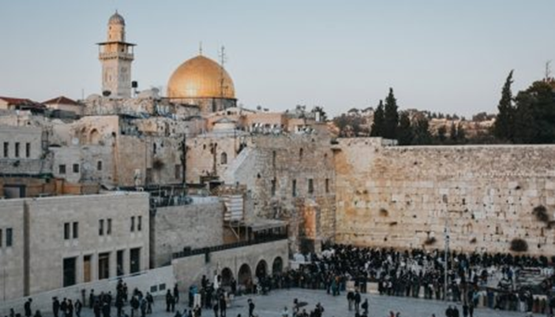
Middle East: the basic terminology, geography, demography
Mgr. Eva Taterova, M.A., Ph.D.

Slide 2
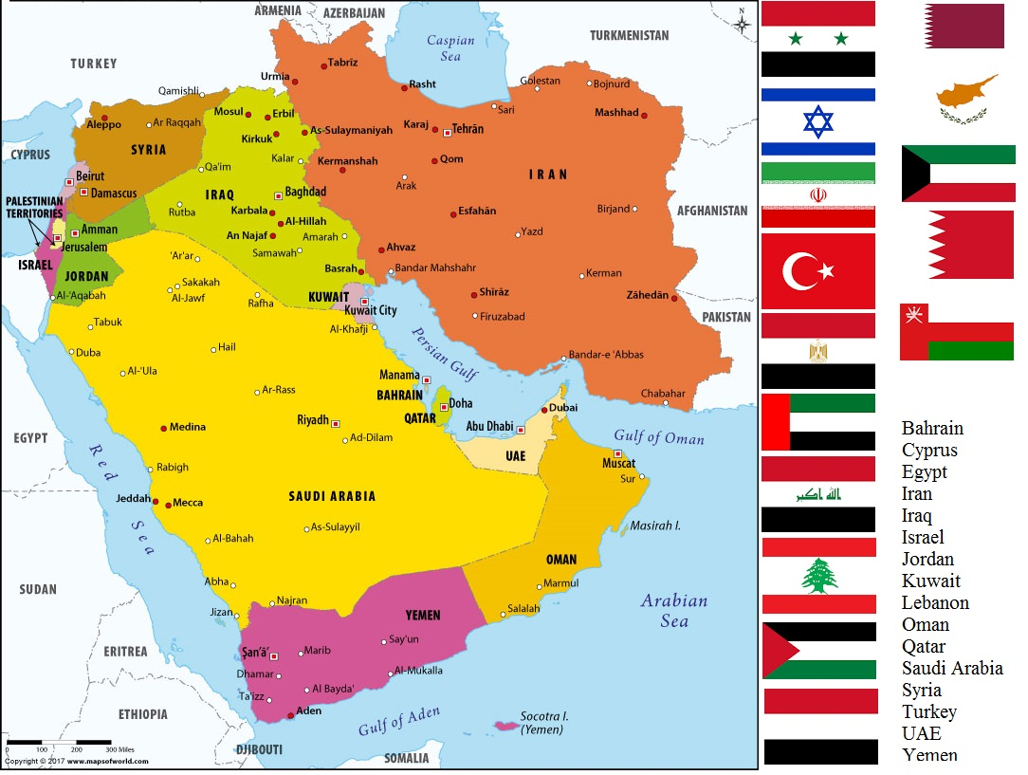

Slide 3
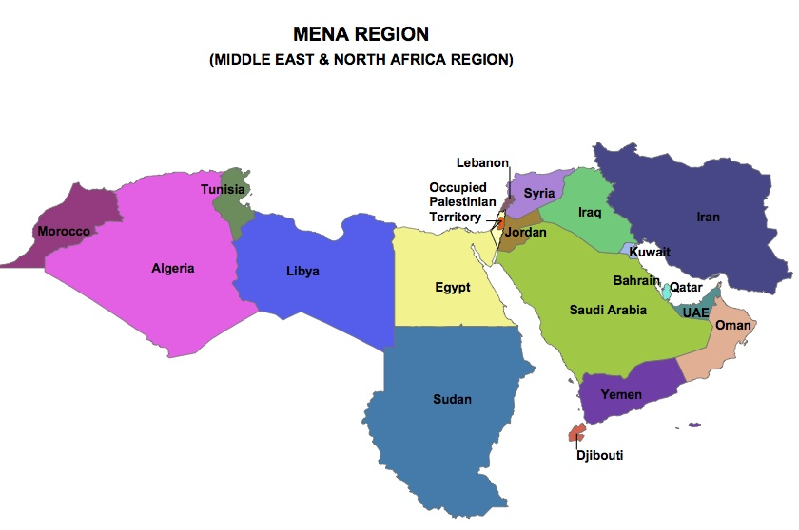

Slide 4
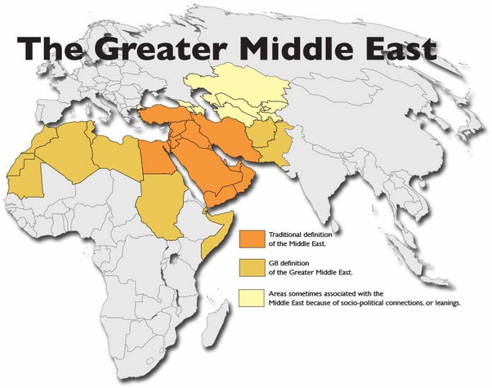
GREATER MIDDLE EAST
A new term developed by George W. Bush.

Slide 5
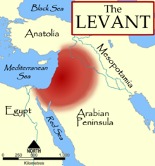
BASIC TERMINOLOGY
No consensus about the terminology.
Historically, Near East referred to the territory of whole Ottoman Empire while Middle East was used for the whole region of Arab peninsula, Afghanistan + the countries of southern and central Asia.
Orient – a label for countries of Near, Middle and Far East – today quite negative connotations (book „Orientalism“ by Edward Said from 1978).
The Levant – eastern Mediterranean (Israel/Palestine, Lebanon, Syria, Jordan, northern Iraq).

Slide 6

BASIC TERMINOLOGY
Nowadays the prevailing definition says that "it is a region located on the border between southwest Asia, northern Africa, and Europe".
The terms Near and Middle East are usually used simultaneously.
The unifying factors: similar historical development, religion, culture, language.

Slide 7

DEMOGRAPHY OF MIDDLE EAST
Estimated population in 2018: 411 million people.
Great diversity regarding ethnicity, languages, religion.
Main ethnic groups: Arab, Turks, Kurds, Jews, Berbers.
Main languages: Arabic (different slangs), Turkish, Kurdish, Persian, Hebrew.
Countries with biggest populations: Iran, Turkey, Iraq, Saudi Arabia, Yemen
Main religions: Islam, Christianity, Judaism.

Slide 8
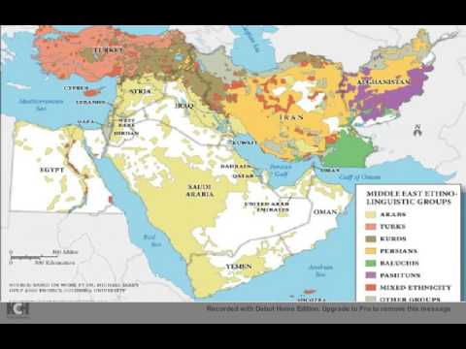

Slide 9
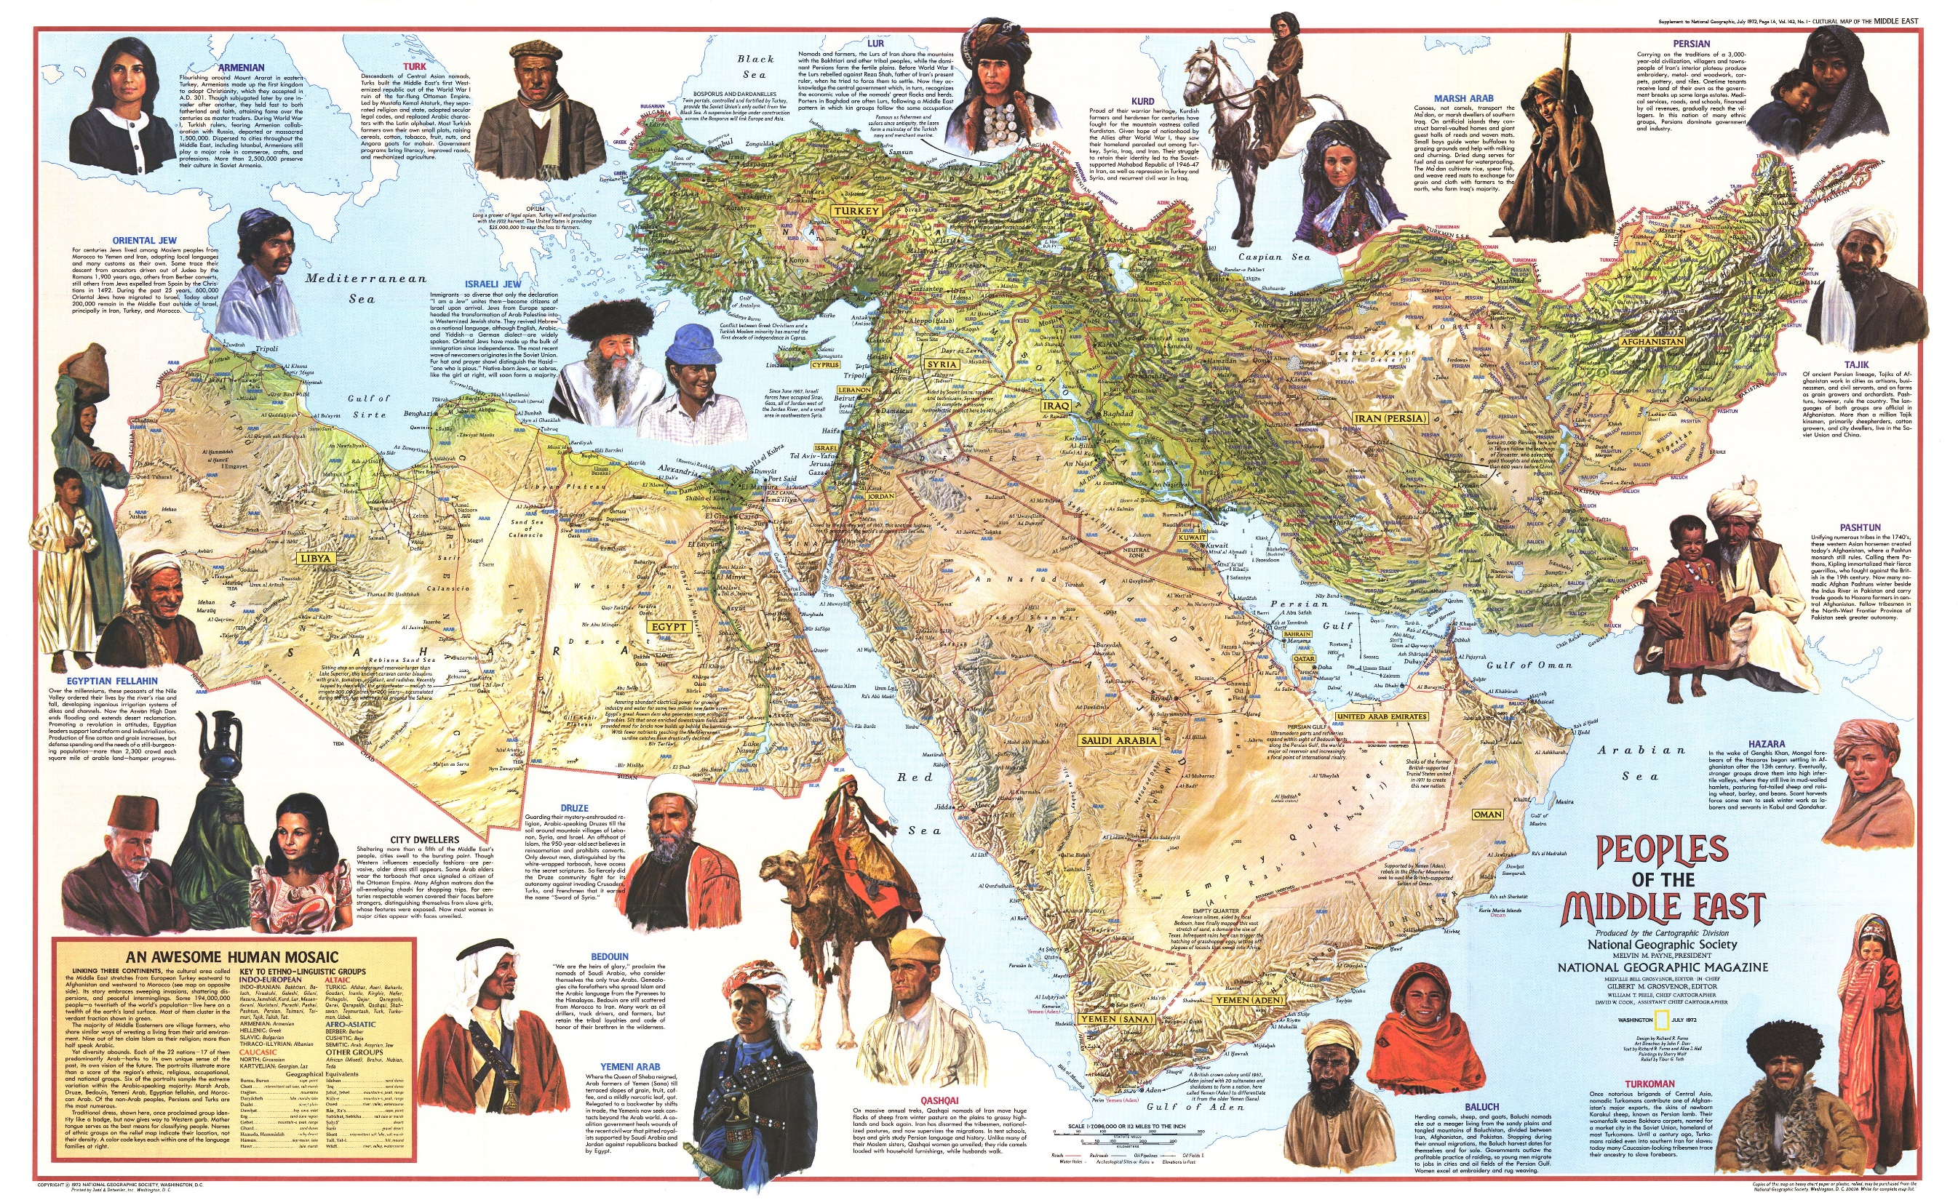

Slide 10
MIDDLE EAST: INTRODUCTORY STATISTICS
Countries with biggest population
Iran | 81,824,270
Turkey | 79,414,269
Iraq | 37,056,169
Saudi Arabia | 27,752,316
Yemen | 26,737,317
Major religious groups
Islam | 317,070,000
Christianity | 12,710,000
Judaism | 5,630,000
Unaffilliated | 2,100,000
Hinduism | 1,720,000
Richest Countries of the Middle East (GDP)
Qatar | 124,900 USD
Kuwait | 69,700 USD
United Arab Emirates | 68,200 USD
Saudi Arabia | 55,300 USD
Bahrain | 51,800 USD
Poorest Countries of the Middle East (GDP)
Afghanistan | 1,900
Yemen | 2,300
Syria | 2,900
Pakistan | 5,400
Jordan | 12,500

Slide 11
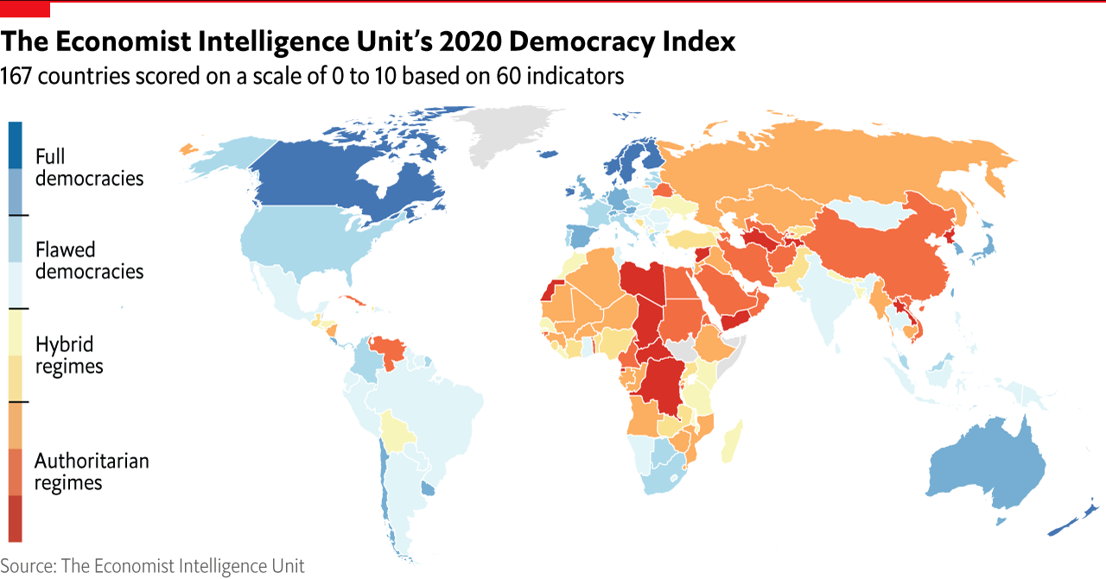
DEMOCRACY IN THE MIDDLE EAST 2020

Slide 12

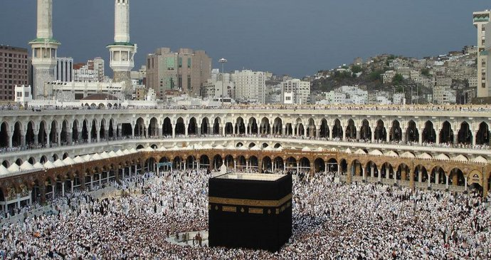
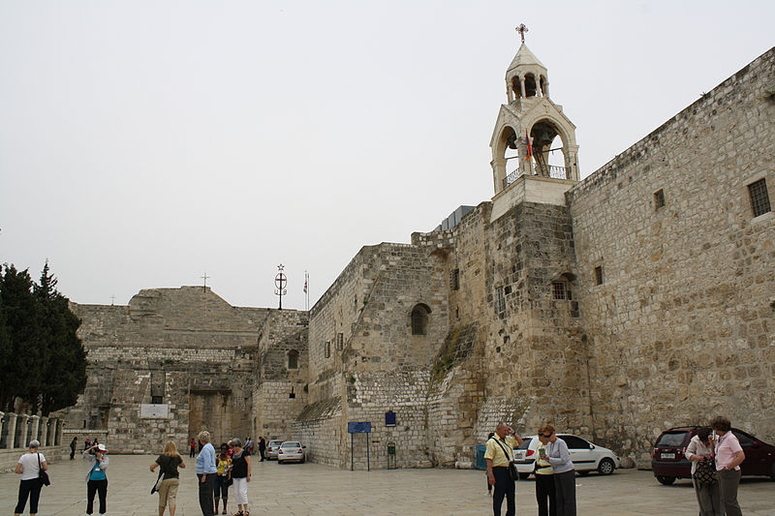
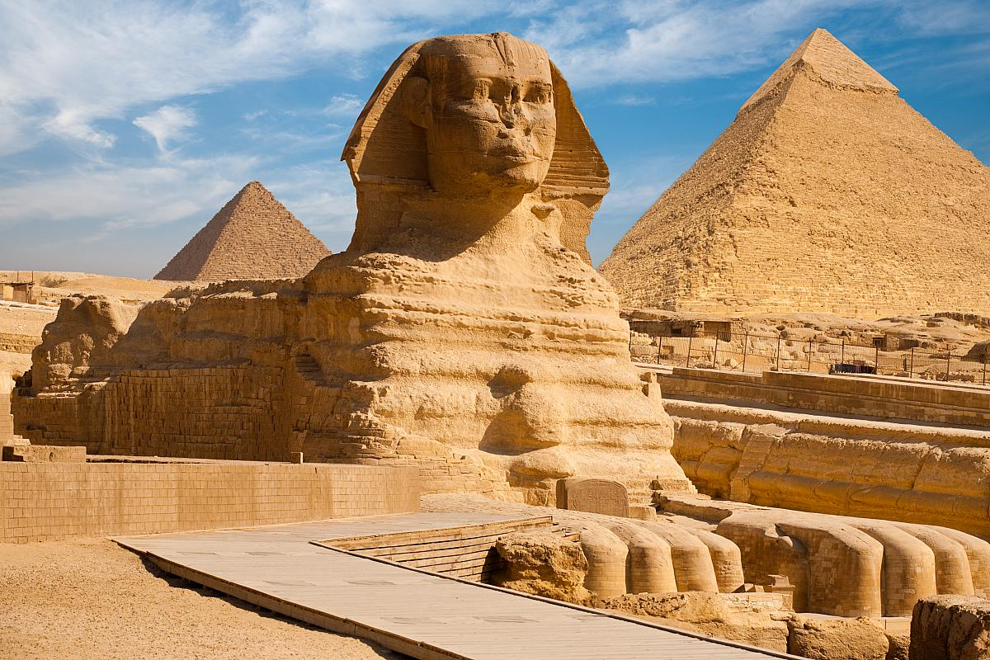
RELIGIONS OF THE MIDDLE EAST

Slide 13
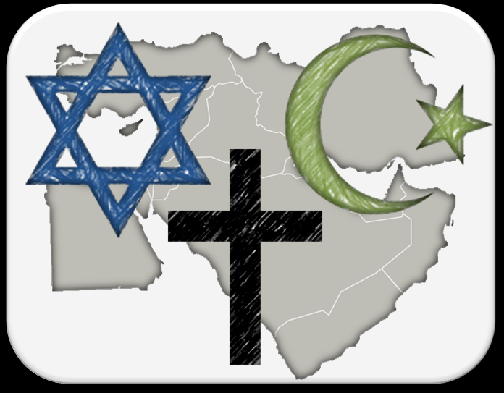
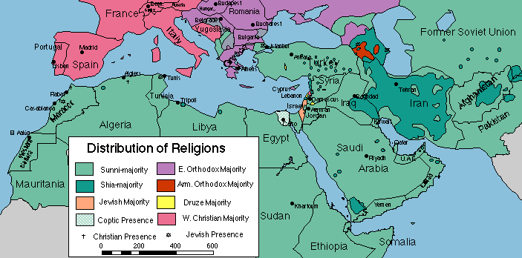
RELIGIONS OF THE MIDDLE EAST
Many religions have got their origins in the Middle East.
Religions of the book: Judaism, Christianity, Islam – three monoteistic religions.
In the past there was a lot of religious tolerance, nowadays religion is often a source of conflict.

Slide 14
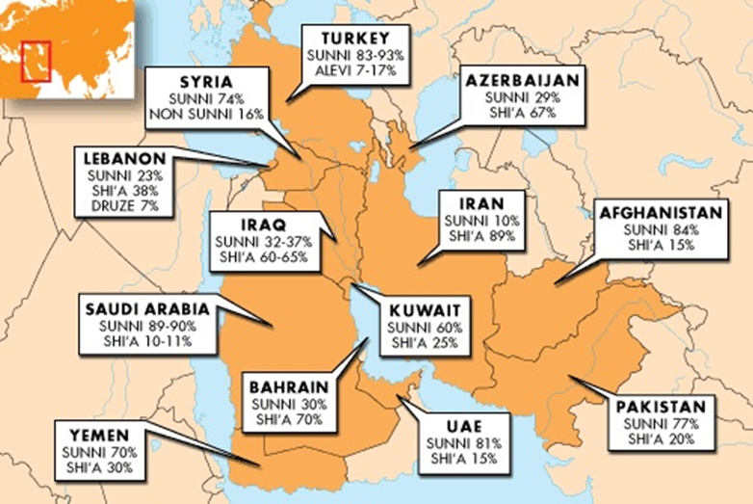

Slide 15
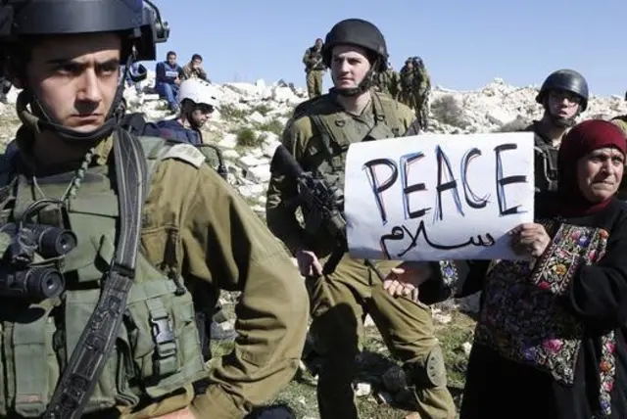
CONFLICTS IN THE MIDDLE EAST
Israeli-Arab (since 1948).
Israeli-Palestinian (since 1948 respectively since
the immigration of Jews to Palestine).
Wars in Persian Gulf (1990, since 2003).
Civil war in Lebanon (1975-1990).
Inter-Muslim countries conflicts (Iraq-Iran, Iraq-Kuwait, Yemen).
Conflicts in Afghanistan (since 1980s).
Kurdish issue.

Slide 16
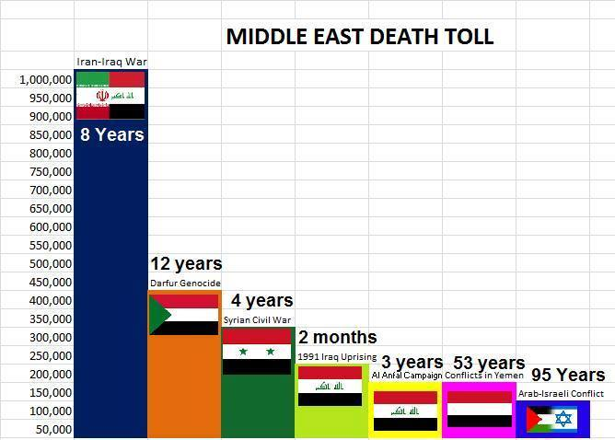
VICTIMS OF THE CONFLICTS IN THE MIDDLE EAST

Slide 17
THANK YOU FOR YOUR ATTENTION

