Slide 1
Definitions and trends of different types of internal armed conflict
IREn5019 No War, No Peace: Frozen Conflicts in the Caucasus
Mgr. Zinaida Bechná, Ph.D.
22. september 2021

Slide 2
Structure
Introduction
A taxonomy of conflict
Conflict typology
Ethnic conflict
Where do we stand now and what is next?

Slide 3
Introduction
International violence is becoming less problematic than it was during the last century – more intrastate conflicts, than interstate struggles.
From 1989 to 1996 there were 69 armed conflicts, of which only five have been between states.

Slide 4
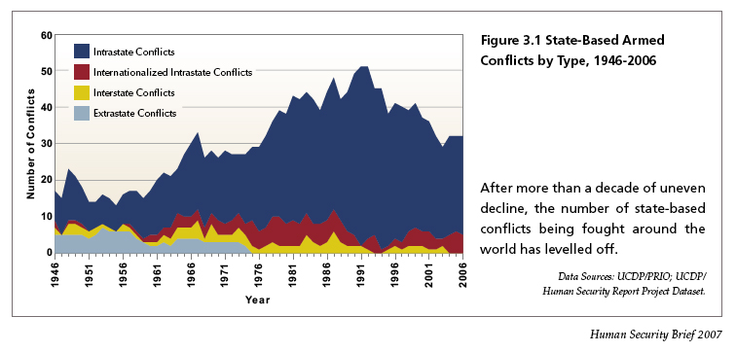
Trends in conflict I

Slide 5
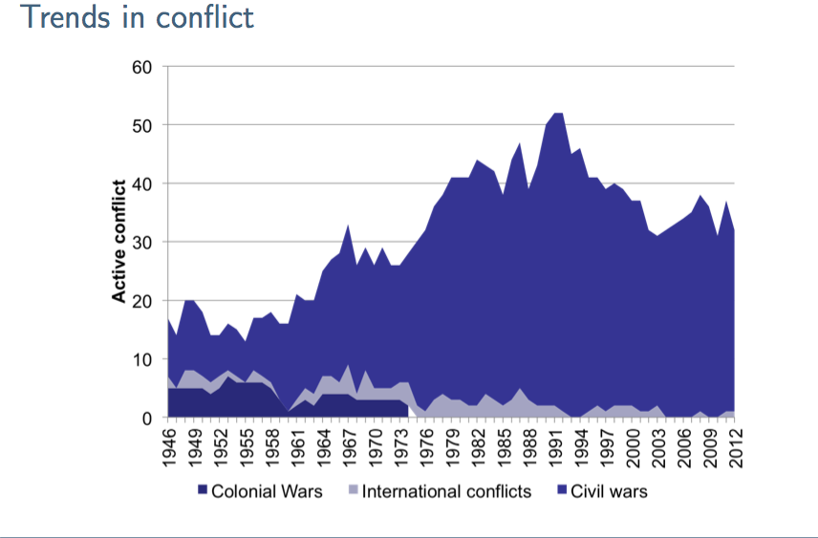
Trends in conflict II

Slide 6
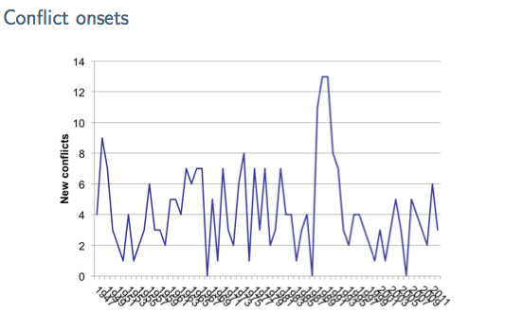
Trends in conflict III

Slide 7
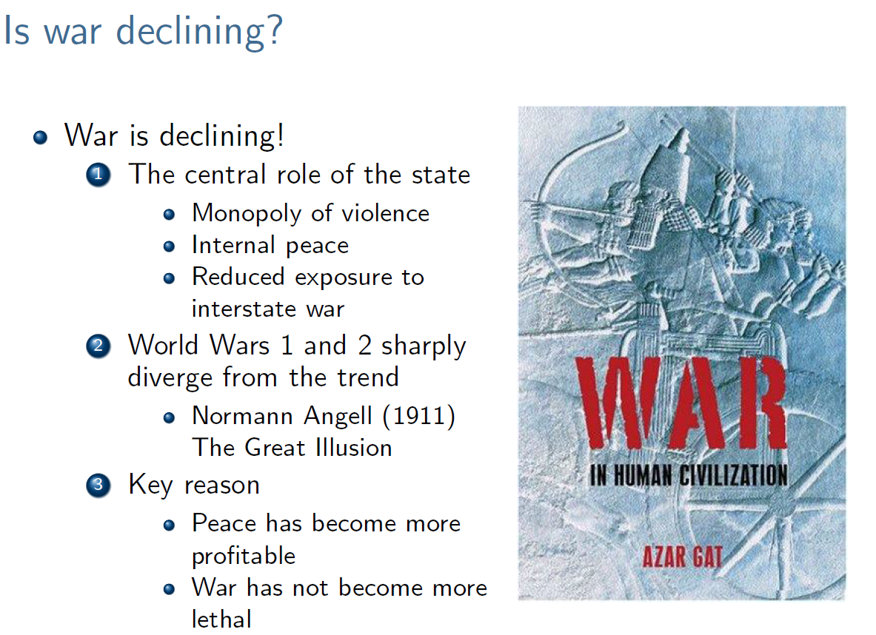

Slide 8
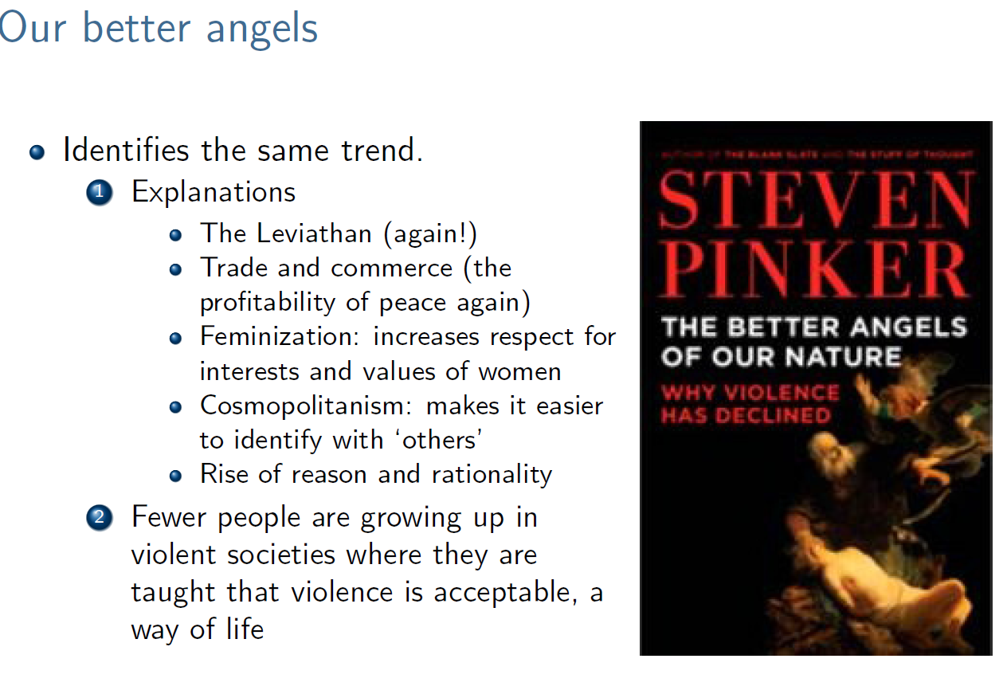

Slide 9
A taxonomy of conflict
Who fights?
  Governments
  Organizations
  Individuals
Why do they fight?
  Politics?
  Economics?
  Insanity?
Where do they fight
  Home or away?
Consequences of conflict
  How many were killed?
  What is the time frame?

Slide 10
The concept of conflict
This word is derived from the Latin “con-fligo” which means strife.
“Conflict is a struggle in which the aim is to gain objectives and simultaneously to neutralize, injure, or eliminate rivals”.
Conflict is “a social situation in which minimum of two actors (parties) strive to acquire at same moment in time an available set of scarce resources.”
Conflict is a situation in which “actors use conflict behavior against each other to attain incompatible goals and/or express their hostility”.
In general, conflict is understood in terms of aspirations of conflicting parties to achieve incompatible goals simultaneously.

Slide 11
The concept of Conflict
Goals are incompatible when the action of one party threatens the interests of another party.
The complexity of conflict depends whether tangible issues (like recognition, security, territory, money) are more significant than intangible aspects like symbolic meanings that shape values and ideologies, legitimizing a certain conflict behavior.

Slide 12
The concept of conflict
Donald Horowitz: “conflict is a struggle in which the aim is to gain objectives and simultaneously to neutralize, injure, or eliminate rivals” (Horowitz 1985: 95).
The Heidelberg Institute for International Conflict Research defines conflict as “the clashing interests (political differences) on national values of some duration and magnitude between at least two parties (organized groups, states, groups of states, organization) that are determined to pursue their interests and win their cases.“

Slide 13
Towards conceptual clarity
Peter Wallensteen:
In order to understand and provide conflict analysis, we have to focus on three major components of the phenomenon:
1) actors,
2) process (action), and
3) incompatibility (issues at stake).

Slide 14
The concept of conflict
By combining these aspects, we arrive at a most comprehensive analysis of all possible kinds of conflict, which is a “social situation in which a minimum of two actors (parties) strive to acquire at the same moment in time an available set of scarce resources” (Wallensteen 2009: 15).

Slide 15
Typology according to actors
(1) Extrasystemic armed conflict, which takes place between a state and a non-state group outside its own territory. In the Correlates of War (COW) project, this category is further divided into colonial wars and imperial wars;
(2) interstate armed conflict, which occurs between two or more states;
(3) internal armed conflict, in which the government of a state is in conflict with internal opposition groups without intervention from another state; and
(4) internationalized internal armed conflict, when conflict occurs between the government of a state and internal groups in opposition to and with intervention from an outside state (Havard, Wilhelmsen, Gleditsch 2004: 11).

Slide 16
Typology according to actors
Civil war–affected states are states in which “it is almost the case that significant elements of actual or potential military power exist outside the control of the central state apparatus” (Giddens 1987).
Violence is a central feature of such a conflict and the only way to establish the authority of one or the other conflicting party. Under this condition a state uses its military power to suppress rebellions challenging its authority and legitimacy. As a result civil conflict is brutish and nasty, accompanied by killing, which is “to a great extent a matter of national pride” (Misra 2008: 45).

Slide 17
Typology according to actors
Emergence of new non-state actors
Trends that have increased a range of worldwide arms trades expanded the power of multinational corporations and the growth of trans-border exchange of weapons, drugs, and people, which in turn has contributed to the formation of coalitions that have acquired the capacity to form armies.

Slide 18
Typology according to actors
first, between states;
second, between a state and non-state actors outside of the state;
third, between a state and non-state actors within a state; and
fourth, between non-state actors taking place outside of the state.

Slide 19
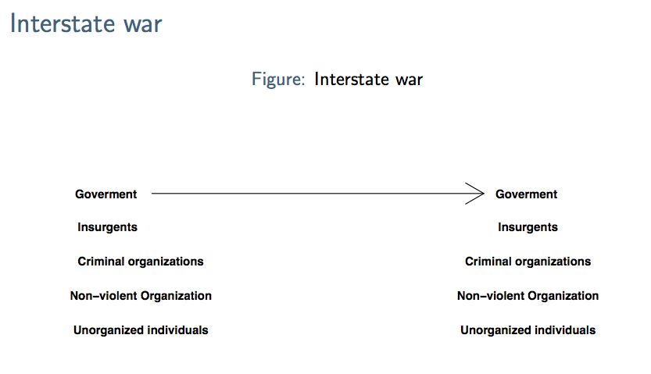
A taxonomy of conflict

Slide 20
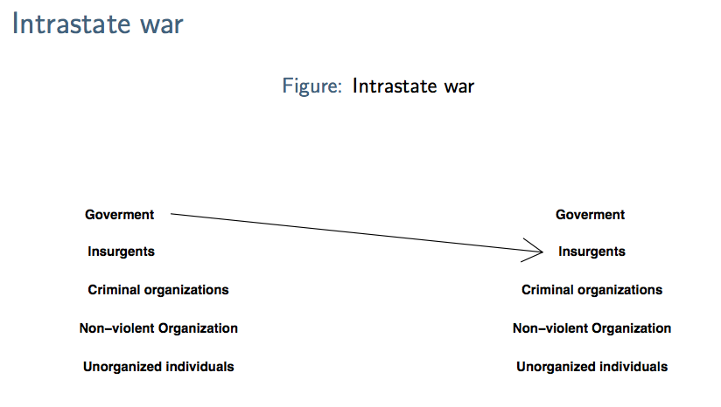
A taxonomy of conflict

Slide 21
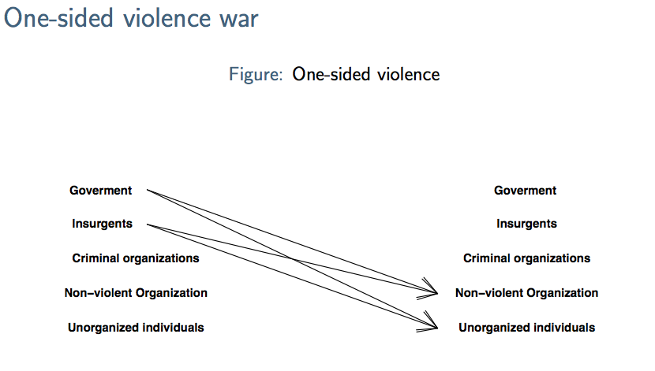
A taxonomy of conflict

Slide 22
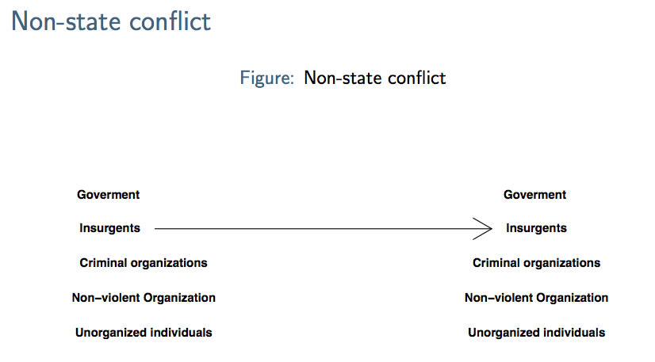
A taxonomy of conflict

Slide 23
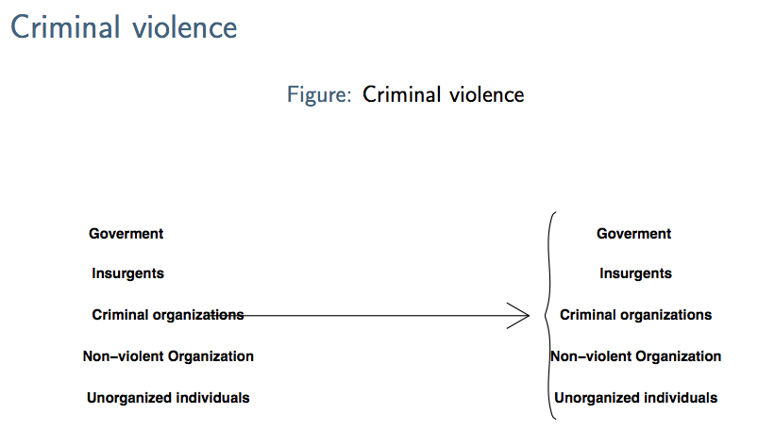
A taxonomy of conflict

Slide 24
Conflict typology by Process—Violence Intensity
The COSIMO (Conflict Simulation Model) conflict categorization belongs among the most prominent classifications; it has been developed by the Heidelberg Institute for International Conflict Research (HIIK), aiming to grasp armed conflict from non-violent, latent conflict to violent war phases.

Slide 25
Conflict typology by Process—Violence Intensity
Dennis Sandole (1998):
Non-violent conflict is a manifestation of conflict processes during which one party seeks to undermine the goal-seeking capabilities of another conflicting party by non-violent means, as i.e. economic sanctions, exclusion of some groups from access to power, and so on.

Slide 26
Conflict typology by Process—Violence Intensity
According to The Uppsala Conflict Data Program:
Minor armed conflicts - conflicts with more than 25 deaths but fewer than 1000 for the year and for the duration of the conflict.
Intermediate armed conflicts - conflicts with more than 25 deaths and fewer than 1000 for a year, but more than 1000 for the duration of the conflict.
Wars - conflicts with more than 1000 battle-related deaths in one year.

Slide 27
Conflict typology by Process—Violence Intensity
Hedley Bull’s definition, which has guided research within the field of IR, defines war as “organized violence carried on by political units against each other” (Bull 1977: 184).
Significant assumptions made by this definition elucidate the following aspects of war: first, it is fought by political organizations (not by any other collective actors, as for example economic corporations); second, war is organized violence with its own rules and norms; and third, war is collective, not individual (Vasquez 1993: 35).
As the most well-known definition by famous military theorist Carl von Clausewitz claims “war is merely the continuation of policy by other means” (Clausewitz 2008).

Slide 28
Conflict typology by Process—Violence Intensity
The concept of war has been based on two primary criteria: (1) a certain magnitude of battle related fatalities (initially including only soldiers and military staff) and (2) the status of the conflicting actors. According to these scholars, the threshold of 1,000 battle-related deaths caused by sustainable organized armed forces differentiate war from other types of conflict (Singer, Small 1972: 8).

Slide 29
Conflict dynamics
Latent conflict,
Manifestation of the conflict,
Escalation,
Dead-point,
De-escalation,
Resolution and
Post conflict arrangement of relations (peace building).

Slide 30
Conflict dynamics
During the phase of latent conflict divergence of interests are perceived, but the actors are unwilling or unable to clearly articulate the existence of conflict.
During the manifestation of the conflict at least one of the actors articulates its incompatible interests and intention to protect them at the expense of other party.
During the escalation of the conflict both conflict parties try to achieve their goals. This phase has four sub-phases: 1. Discussion, 2. Polarization, 3. Isolation and 4. Destruction.

Slide 31
Conflict dynamics
Dead-point is a situation when neither conflict party is able to end conflict in his favor.
De-escalation –decreasing the destructive power of conflict, a greater willingness to search compromise solutions.
Resolution and post conflict arrangement, peace building restore relation between the parties, the objective is to restore cooperation and peace.

Slide 32
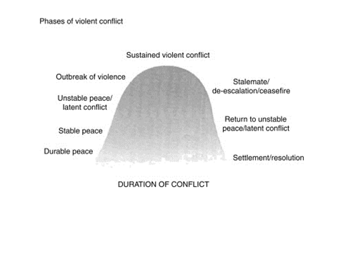
Phases of violent conflict

Slide 33
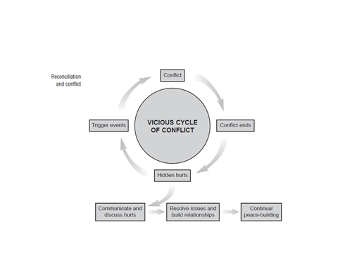
Frozen conflict

Slide 34
Frozen conflict
Michal Smentana and Jan Ludvik: “a protracted, post-war conflict process, characterized by the absence of stable peace between the opposing sides”.
Four criteria: “it must be (a) international and (b) protracted post-war, it must have (c) core unresolved issues, and it (d) lacks stable peace.
Under influence of internal and external factors, a frozen conflict undergoes a periodical “thawing” : toward diplomatic negotiations - “peaceful thawing” or re-escalation toward use of armed force - “violent thawing”.

Slide 35
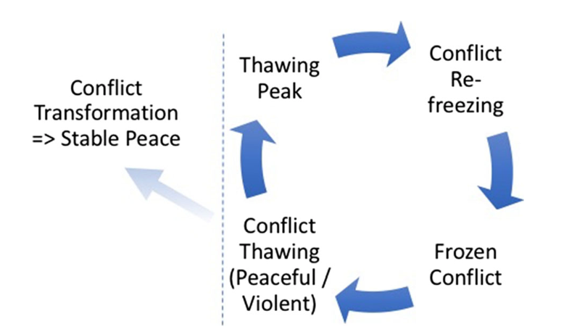
Frozen conflict

Slide 36
Competing goals: typology of issues at stake in armed conflicts
Academic research focuses on such aspects as religion, ideology, language, ethnicity, resources and markets, dominance, equality, and territory.
(1) ethnic conflict, (2) conflict over political arrangements, (3) ideological, (4) economic, and (5) territorial cross-border conflict.

Slide 37
Competing goals: typology of issues at stake in armed conflicts
Each conflict differs on a range of dimension and may include ethnicity, religion, political, economic, and territorial aspirations.
The question is how these dimensions interrelate in the whole process of conflict dynamics and how far each contributes to armed conflict?

Slide 38
Ethnic conflict
Ethnic conflict is a conflict in which the key causes of confrontation run along ethnic lines, which involve some elements of ethnic identity, the status of ethnic groups, and the opportunity to mobilize violent confrontation. At the outset of a conflict, ethnic conflict could be identified by the observable pattern of rebel recruitment, while ethnicity by itself could be a motivation to mobilize forces.

Slide 39
Conflict over political arrangements
The long-term political relationship becomes increasingly conflictive and hostile when
(1) political change is used as a tool to mobilize masses,
(2) there are conflicting visions about the political arrangement of a state, and
(3) incompatibility of goals rests upon a change of political regime.

Slide 40
Ideological confrontation
Religion can tur into armed confrontation if
(1) the religious make-up of a state involves different religious groups,
(2) there are conflict-prone religious structures, and
(3) religion is a politicized issue and serves as a tool in the hands of political leaders.

Slide 41
Economic conflict
Economic aspects of conflict are operationalized as follows: (1) economic decline and inequality in the economic development of different regions,
(2) the shadow economy (smuggling, drug trafficking, illegal trade activities), and
(3) interest to control key economic resources.

Slide 42
Irredentism is not a state-based process; it is a movement that seeks to attain the external support and territory of the group across the existing border. The goal of this group is to add territory and population into an existing state by reason of common affinities, such as ethnic, cultural, historical, or linguistic ties (Wolff 2007).
Secession, which is a process at the end of which a population group inhabiting a defined territory within an existing state has succeeded in splittin itself and its territory off from a titular state. As a result it has established an independent state of its own (Wolff 2004). Secession is a process of political divorce and the formation of at least one new sovereign unit through a formal declaration of independence.

Slide 43
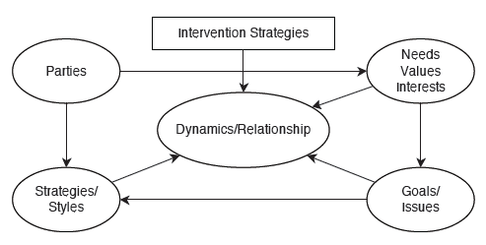
Conflict mapping

Slide 44
Underlying and Proximate Causes
Main question: Do ethnic cleavages matter for a conflict, and how?
Main point: Ethnic cleavages matter in combination with relative inequality between groups.
Underlying causes
Necessary but not sufficient conditions for conflict.
Four types of factor:
  structural;
  political;
  economic and social;
  cultural and perceptual.
Can contribute to mobilisation of ethnic groups and impact on development of the conflict.
(See Wolff 2006, chpt. 3)

Slide 45
Underlying and Proximate Causes (2)
Proximate causes
Factors increasing likelihood of conflict where there are underlying conditions.
Internal and external factors at mass and elite level.
  Internal elite-level: ‘bad leaders’.
  External elite-level: ‘bad neighbours’.
  Internal mass-level: ‘serious domestic problems.’
  External mass-level: ‘bad neighbourhoods’.
Many situations of ethnic tension share similar underlying causes but not all lead to civil war because not all share significant proximate causes (Wolff 2006, chpt. 3).

Slide 46
Context
A very popular claim that ethnic cleavages generate internal armed conict
Very popular in the 1990s (Bosnia, Rwanda etc.)
Robert D. Kaplan`s `The Coming Anarchy' article, 1993
Samuel Huntington`s `Clash of Civilizations'
Still extremely widespread (e.g right-wing immigration sceptics)
Main ideas:
a) Many conflicts are driven by `ancient hatreds' between groups !
b) ethnic cleavages generate inter-group antagonisms !
c) ethnic heterogeneity will lead to conflict !
This lecture will show that these claims must either be:
Rejected, or (more likely)...
qualied: Ethnic cleavages matter in combination with political and economic context

Slide 47
Concepts: Ethnic group
What is ethnicity?
What is an ethnic group?
First, an ethnic group needs a common marker
Religion (i.e Alawites in Syria)
Language (i.e French-Quebequouis in Canada)
Common origin or nationality (i.e Indians in South Africa)
Second, a group needs a common identity
The members of the group must actively identify themselves as members
Shared sense of belonging to that group
Often also common narratives relating to history etc.
Ethnic groups are \imagined communities" (e.g Benedict Anderson) (BUT, not epistemically subjective! Ethnic groups exist)
External attribution is often also mentioned (others must also identify the group as a group)

Slide 48
Concepts: Ethnic group
What constitutes ethnic conflict?
The definition most of the studies stick to:
`Internal conflict between a government and an organized interna challenger (Uppsala definition!) in which the challenger is defined (and defines itself) along ethnic lines.'
Another common definition (from the MAR project)
`Episodes of violent conflict between governments and national, ethnic, religious, or other communal minorities (ethnic challengers) in which the challengers seek major changes in their status'

Slide 49
Why ethnic conflict: ancient hatred and the security
Why do groups fight? (`onset' of conflict)
1 Ancient hatreds (Kaplan)
Historical rivalries,
Retribution and revenge
Almost tautological!
2 Security dilemmas (Posen)
Since groups (where the state is weak or predatory) cannot be sure that other groups are benign, and vice versa. This leads to a security dilemma where groups attack each other pre-emptively (offense is the best defense)

Slide 50
Ancient hatreds
Ethnic appeals may lead to violent escalation only if a group fears that its existence threatened: myths justifying ethnic hostility.
What matters is the ability to evoke vertical escalation “our group is in danger” – ethnic fear.
The next condition, is political opportunity. This consist of two elements,
first, there must be sufficient political space (weakening or state breakdown, or support from external power)
second, a territorial base (for successful mobilization, ethnic groups are either territorially concentrated in some region or they have a territorial base in neighboring country).

Slide 51
Ancient hatreds
Ethnic conflict involves three dynamics:
- mass hostility,
chauvinist political mobilization
a security dilemma.
The combination and interaction of those aspects creates the spiral of escalation, if the preconditions mentioned above are present.

Slide 52
Ancient hatreds
Mechanisms:
Extreme hostility has a popular mass support. The probability of conflict increases with the ethnic group’s relative demographic size.
The ethnic group glorifies its history through a one sided interpretation of its own victories and blames losses on traitors or weak leaders. Nourishing calls for revenge contributed to creating organizational structures and culture of violence.
Elites uses ethnic appeals, promoting fear and mass hostility and mobilization for conflict.
A security dilemma arises, in which the hostile ax by the leadership on one side leads to the radicalization of the leadership on the other.

Slide 53
Ancient hatreds
Ethnic symbolism – combines ancient hatreds, manipulative elites and rivalry.
Without perceived conflicts of interest, people have no reason to mobilize.
Without emotional commitment based on hostile feelings, they lack sufficient imputes to do so.
Without leadership, they typically lack the organization to act.

Slide 54
Ethnic Security Dilemma
Security dilemmas as result of ‘fear-producing environments’:
  government breakdown;
  geographical isolation or vulnerability of a minority within a larger group;
  shifts in political power balance between groups;
  changes in access to or control over economic resources;
  forced or voluntary demobilisation of partisan armies;
  changes in external patronage or balance of power between rival patrons.

Slide 55
Ethnic Security Dilemma (2)
Increased security of one group seen as coming at expense of insecurity of another; incentive for group to use force pre-emptively.
How elites and masses respond to the ethnic security dilemma determines the outcome.
Physical security, political security, economic and social security, cultural security, and environmental security.
For leaders to mobilise followers to violence there must be ‘credible evidence’ of other groups’ hostile intentions.
(Wolff (2006, chpt. 3), gives an overview of the ethnic security dilemma; Barry Posen (1993) was the first to introduce this. See Lake and Rothchild (1996) for wider strategic dilemmas argument.)

Slide 56
State institutions
The Lijphart-Horowitz debate
Lijphart: Majoritarian `winner-take-all' institutions lead to ethnic conflict
Horowitz: Lijphartian power sharing institutions `reify' and harden ethnic cleavages, leading to more conflict
Note: Przeworski's argument about the fundamental un-democratic nature of power sharing
4 Relative deprivation (Gurr)
`Why Men Rebel'
Frustrations relating to relative deprivation generate conflict
Relative deprivation: a discrepancy between `the goods and conditions of life to which people believe they are rightfully entitled' and the `goods and conditions they think they are capable of attaining or maintaining, given the social means available to them'.
This is the most developed theoretical framework

Slide 57
Opportunity theory
Opposing framework: Opportunity theory (`ethnic-grievance skepticism')
Tilly (and Skocpol): Grievances are ubiquitous : what is needed is a minimum level of resources and organization
Ethnic (and other) antagonisms are endemic, opportunities for conflict are not
Ethnic grievances not important
Focus on economic opportunities for conflict (e.g Collier and Hoeer 2004) or feasibility (e.g Fearon and Laitin 2003)

Slide 58
The Economic Debate: Greed vs. Grievance
Recent body of work developed argument about ethnic and other civil conflicts being the result of economic ‘greed’.
Largely developed by economists working for bodies like the World Bank.
Most well known are Paul Collier and Anke Hoeffler (1998 and 2000), arguing that ethnic conflict happens if the incentive for rebellion is sufficiently large relative to its costs and that contemporary civil wars are largely motivated by economic greed rather than by political grievances.

Slide 59
Three „waves“ of research
1. The skeptics:
Seminal studies (on armed conflict) are Collier and Hoeer (2004) and Fearon and Laitin (2003)
Country-level studies, looking at civil conflict
Using Ethnolinguistic Fractionalization (ELF) as a measure of country-level ethnic heterogeneity
General finding: Ethnic heterogeneity does not increase risk of civil war.
2. The horizontal-inequality wave:
Ostby (2008), and Cederman and colleagues
Finds that substantive inequalities (political and economic) between groups lead to more conflict
Most research here is at the group level, using the Ethnic Power Relations (EPR) dataset.
3. Micro-research
For example the contributions of Lyall
Less interested in whether ethnic grievances matter, and more in how they matter

Slide 60
A prominent representative of grievance-skepticism": Professor Paul Collier

Slide 61
New York Times coverage of Fearon and Laitin

Slide 62
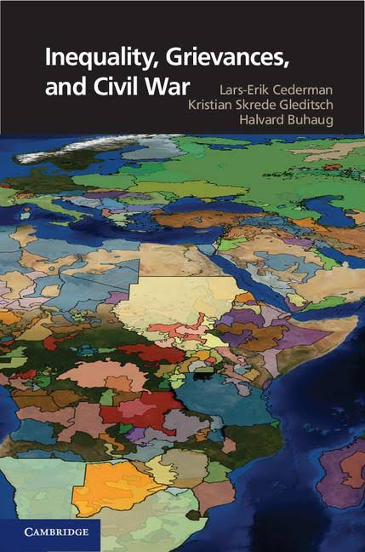
Empirical research: The horizontal inequality wave
The horizontal inequality wave
Argues against looking at ELF at the country-level
Not enough to count number of ethnic groups!
We should look at substantive (economic and political) inequalities between groups
Note: two crucial recent papers:
Cederman, Wimmer and Min 2010: `Why Do Ethnic Groups Rebel?'
Cederman, Weidmann, Gleditsch 2011: `Horizontal Inequalities and Ethno-Nationalist Civil War: A Global Comparison'

Slide 63
Empirical research: The horizontal inequality wave
Why do Ethnic Groups Rebel?
Core question: Does political exclusion/inclusion increase the risk of ethnic conflict
Introduces the EPR (Ethnic Power Relations dataset)
Codes all `politically relevant' ethnic groups in the world, 1946-2005.
Rely on theories of relative deprivation
The `polity model':
A government versus several contenders
Excluded versus included groups

Slide 64
Empirical research: Why do Ethnic groups Rebel?

Slide 65
Why do ethnic groups rebel
Independent variables:
Political exclusion (not being included in government, or regional autonomy)
Political `downgrading'
Dependent variable:
Ethnic Armed Conflict onset: UCDP internal conflicts, where challenger \pursued ethnonationalist aim"

Slide 66
Why do ethnic group rebel
Cederman and colleagues show that politically excluded groups are more prone to conflict
And that groups who lose power are also more likely to rebel
Discussion:
The `politically relevant ethnic group' criterion
The dependent `ethnic conflict' variable
Coding `power status'
The endogeneity of inclusion/exclusion (this is affected by nocflict-potential!)

Slide 67
Why do ethnic group rebel
Core question: Does economic inequality between groups lead to conflict?
They look at horizontal inequality (overlapping cleavages in Rokkan`s terminology)
Test a `grievance' argument: Relative inequality between groups lead to conflict

Slide 68
Cederman and colleagues find that groups that are poorer or richer than country average are more prone to rebel
Discussion:
This shows strong support for `grievance explanations'
Potential measurement problems?
Causal mechanisms

Slide 69
Summary: Where are we now?
Summary: What do we know about ethnic cleavages and conflict?
Ethnic heterogeneity might not matter much in itself
Ethnic cleavages matter in combination with horizontal inequalities
Groups that are somehow aggrieved are more likely to rebel
This supports the „grievance explanation" for conflict
Denny and Walter present arguments for why cleavages that are ethnic are so potent
The emerging micro-literature can tell us more about mechanisms

Slide 70
What next?
We know more about correlations, less about causality
Huge endogeneity problems, almost never dealt with
Ethnic groups are treated as `black boxes'
Ethnicity treated as `static'
More work needed to establish mechanisms
We know little about what drives horizontal inequality

Slide 71
Challenges in conflict research
It is critically significant to think about the dialog between the conceptual and operational level of our analysis.
The problem remains how to assess the causal impact of one factor in relation to others. One of the possible ways for establishing the relation between operationalization and measurement lies in the case-oriented view.
The challenge for further research is to explore not only the combination of issues at stake in armed conflict, but also the correlation and causal relationships among these aspects.

Slide 72
Conflict research
Study of each conflict requires the research of:
1. Background of the conflict (history of mutual relations),
2. Type of actors,
3. Character and nature of involved parties,
4. Reasons of conflict and
5. Context (the role of external actor).

Slide 73
Useful Sources in Conflict Research
News databases
BBC Summary of World Broadcasts (www.monitor .bbc.co.uk)
Factiva (www.factiva.com)
Open Source Center (www.opensource.gov)
Keesing’s Record of World Event (www.keesings.com)
LexisNexis (academic.lexisnexis.com)
Reports issues by specialized NGOs and IGOs
Global Witness (www.globalwitness.org)
Human Rights Watch (www.hrw.org )
International Crisis Group (www.crisisgroup.org)
Integrated Regional Information Network (www.irinnews.org)

Slide 74
Useful Sources in Conflict Research
Surveys
Afrobarometer (www.afrobarometer.org)
Households in Conflict Network – HiCV (www.hinc.org)
World Values Survey (www.worldvaluessurvey.org)
General country information
World Development Indicators (data.worldbank.org)
UN Data (data.un.org)
The Quality of Government Institute, Goteborg University (www.qog.pol.gu.se)
Gapminder (www.gapminder.org)
Conflict data programs
Center for International Development and Conflict Management, University of Maryland (www.cidcm.umd.edu)
Correlated of War (www.correlatesofwar.org)
Uppsala Conflict Data Program (www.ucdp.uu.se)

Slide 75
Literature:
Bartos, O. J., Wehr, P. (2002): Using Conflict Theory, Cambridge University Press.
Tesar, F. (2007): Etnicke konflikty, Praha, Portal.
Waisová, Šárka (2005): Řešení konfliktů v mezinárodních vztazích. Praha: Portál.
Wallensteen, P. (2007): Understanding Conflict Resolution, War, Peace and Global System, SAGE, London.
Wolff, S. (2006): Ethnic Conflict A Global Perspective, Oxford University Press.
Cederman, Lars-Erik, Wimmer, Andreas and Min, Brian. “Why Do Ethnic Groups Rebel? New Data and Analysis.” World Politics 62, no. 01 (2010): 87–119. doi:10.1017/S0043887109990219.
Ceckel, Jeffrey T. Transnational Dynamics of Civil War. Cambridge University Press, 2014.
Collier, Paul, and Anke Hoeffler. “Greed and Grievance in Civil War.” Oxford Economic Papers 56, no. 4 (October 1, 2004): 563–95. doi:10.1093/oep/gpf064.
Eck, Kristine. “From Armed Conflict to War: Ethnic Mobilization and Conflict Intensification.” International Studies Quarterly 53, no. 2 (June 1, 2009): 369–88. doi:10.1111/j.1468-2478.2009.00538.x.
Fearon, James D., and David D. Laitin. “Explaining Interethnic Cooperation.” The American Political Science Review 90, no. 4 (December 1, 1996): 715–35. doi:10.2307/2945838.
Gleditsch, Nils Petter, Peter Wallensteen, Mikael Eriksson, Margareta Sollenberg, and Håvard Strand. “Armed Conflict 1946-2001: A New Dataset.” Journal of Peace Research 39, no. 5 (September 1, 2002): 615–37. doi:10.1177/0022343302039005007.

Slide 76
Literature
Gurr, Ted Robert. Handbook of Political Conflict: Theory and Research. Free Press, 1980.
Horowitz, Donald L. Ethnic Groups in Conflict. University of California Press, 1985.
———. Ethnic Groups in Conflict, Updated Edition With a New Preface. 2nd edition. Berkeley, Calif.; London: University of California Press, 2000.
———. The Deadly Ethnic Riot. Berkeley: University of California Press, 2003.
Hutchinson, John, and Anthony D. Smith. Ethnicity. Oxford ; New York: Oxford University Press, 1996.
Jeong, Ho-Won. Understanding Conflict and Conflict Analysis. Los Angeles ; London: SAGE Publications Ltd, 2008.
Kaufman, Stuart J. Modern Hatreds: The Symbolic Politics of Ethnic War. 1 edition. New York: Cornell University Press, 2001.
Lake, David A., Donald Rothchild, Timur Kuran, James D. Fearon, Stephen M. Saideman, and Sandra Halperin. The International Spread of Ethnic Conflict: Fear, Diffusion, and Escalation. Princeton, N.J: Princeton University Press, 1998.

