Slide 1
Maoism and central planning

Slide 2
Questions from last lecture
What was the tributary system and which states were involved in it?

Slide 3
Questions from last lecture
What was the tributary system and which states were involved in it?
What was demanded of China in the „unequal treaties“?

Slide 4
Questions from last lecture
What was the tributary system and which states were involved in it?
What was demanded of China in the „unequal treaties“?
Who were China‘s last dynasty? When were they overthrown?

Slide 5
Questions from last lecture
What was the tributary system and which states were involved in it?
What was demanded of China in the „unequal treaties“?
Who were China‘s last dynasty? When were they overthrown?
What was (and is) the Kuomintang? Who was its first leader?

Slide 6
Questions from last lecture
What was the tributary system and which states were involved in it?
What was demanded of China in the „unequal treaties“?
Who were China‘s last dynasty? When were they overthrown?
What was (and is) the Kuomintang? Who was its first leader?
What was the Northern expedition?

Slide 7
Questions from last lecture
What was the tributary system and which states were involved in it?
What was demanded of China in the „unequal treaties“?
Who were China‘s last dynasty? When were they overthrown?
What was (and is) the Kuomintang? Who was its first leader?
What was the Northern expedition?
Which city was China‘s capital before WWII?

Slide 8
Questions from last lecture
What was the tributary system and which states were involved in it?
What was demanded of China in the „unequal treaties“?
Who were China‘s last dynasty? When were they overthrown?
What was (and is) the Kuomintang? Who was its first leader?
What was the Northern expedition?
Which city was China‘s capital before WWII?
When did the Communist party came to power?

Slide 9
Today
The intellectual journey of Marxism thought from Karl Marx to Mao Zedong
Maoist rule of China (1949 – 1976)

Slide 10
Karl Marx
„A ………….. is haunting Europe—the ………… of communism“

Slide 11
Karl Marx
„A specter is haunting Europe—the specter of communism“

Slide 12
Karl Marx
Philosophy of history – teleological development towards more advanced modes of society

Slide 13
Karl Marx
Philosophy of history – teleological development towards more advanced modes of society
Deterministic – the path is inevitable
Historical materialism – structure and superstructure

Slide 14
Karl Marx
„Theory of two revolutions“

Slide 15
Karl Marx
„Theory of two revolutions“ (or two-stage revolution)
Feudal system – land as the most important resource > landowners as the ruling class
Exploitative and inefficient, almost no sustained economic growth

Slide 16
Karl Marx
„Theory of two revolutions“ (or two-stage revolution)
= feudal system – land as the most important resource > landowners as the ruling class
Exploitative and inefficient, almost no sustained economic growth
Rich bourgeois entrepreneurs will eventually overthrow the monarchy and aristocracy
= at first a change in the economic structure, than a change in the political superstructure

Slide 17
Karl Marx
„Theory of two revolutions“ (or two-stage revolution)
= feudal system – land as the most important resource > landowners as the ruling class
Exploitative and inefficient, almost no sustained economic growth
Rich bourgeois entrepreneurs will eventually overthrow the monarchy and aristocracy
= at first a change in the economic structure, than a change in the political superstructure
= French Revolution 1789, Revolutions of 1848

Slide 18
Karl Marx
French Revolution 1789, Revolutions of 1848
= „first revolution“ = transition from feudalism to capitalism

Slide 19
Karl Marx
Is this good or not?

Slide 20
Karl Marx
Is this good or not?
Yes!

Slide 21
Karl Marx
Capitalism = improvement – technological progress and accumulation of wealth

Slide 22
Karl Marx
Capitalism = improvement – technological progress and accumulation of wealth
Capitalists compete to effectively use labor and new technologies to serve their customers

Slide 23
Karl Marx
Capitalism = improvement – technological progress and accumulation of wealth
Capitalists compete to effectively use labor and new technologies to serve their customers
Significantly more efficient than feudalism

Slide 24
Karl Marx
Capitalism = improvement – technological progress and accumulation of wealth
Capitalists compete to effectively use labor and new technologies to serve their customers
Significantly more efficient than feudalism
But also even more exploitative – humans have no other value than as workers

Slide 25
Karl Marx
> accumulation of wealth in the hands of the elite, impoverishment of everyone else

Slide 26
Karl Marx
> accumulation of wealth in the hands of the elite, impoverishment of everyone else
Ruthless competition will bankrupt most capitalists
In the end, workers will overthrow the capitalists and establish communism

Slide 27
Karl Marx
> accumulation of wealth in the hands of the elite, impoverishment of everyone else
Ruthless competition will bankrupt most capitalists
In the end, workers will overthrow the capitalists and establish communism
= „second revolution“ > transition from capitalism to communism
In the future, not in Marx‘ lifetime!

Slide 28
Karl Marx
„Dictatorship of the proletariat“ – the many will overthrow the few
= majority rule!

Slide 29
Karl Marx
Why cannot a society go from pre-modern agricultural state straight to communism?

Slide 30
Karl Marx
Why cannot a society go from pre-modern agricultural state straight to communism?
Because there would be no wealth to redistribute!

Slide 31
Karl Marx
Capitalism is a necessary stage through which every human society must pass
Therefore, every society must at first have the liberal, bourgeois revolution

Slide 32
Karl Marx
Communist revolutions will happen in the richest, most advanced societies on Earth, as the next step of civilization
> Germany, Britain, or the United States

Slide 33
Lenin and Trotsky
Active politicians who expected to personally lead the revolution

Slide 34
Lenin and Trotsky
Active politicians who expected to personally lead the revolution
Russia – Europe‘s economic periphery, still at the feudal stage > „How can we have a communist revolution here?“

Slide 35
Lenin and Trotsky
Active politicians who expected to personally lead the revolution
Russia – Europe‘s economic periphery, still at the feudal stage > „How can we have a communist revolution here?“
Poorer countries follow a different path (x Marx)

Slide 36
Lenin and Trotsky
Active politicians who expected to personally lead the revolution
Russia – Europe‘s economic periphery, still at the feudal stage > „How can we have a communist revolution here?“
Poorer countries follow a different path (x Marx)
> investment comes from foreign capitalists and the state

Slide 37
Lenin and Trotsky
Active politicians who expected to personally lead the revolution
Russia – Europe‘s economic periphery, still at the feudal stage > „How can we have a communist revolution here?“
Poorer countries follow a different path (x Marx)
> investment comes from foreign capitalists and the state
> there is no bourgeoisie to establish capitalism and liberal democracy!

Slide 38
Lenin and Trotsky
Exchange with rich countries will only enrich the traditional, conservative elite
For example, aristocratic landowners in Russia will export food to rich countries > they will make money and hold power indefinitely

Slide 39
Lenin and Trotsky
> poor countries don‘t follow the same path as the West
They are not going to transition to Western-style capitalism

Slide 40
Lenin and Trotsky
> poor countries don‘t follow the same path as the West
They are not going to transition to Western-style capitalism
The capitalist and democratic stage must be bypassed – straight from feudalism into communism

Slide 41


Slide 42
Lenin and Trotsky
Russia (and China!) – urban workers in the few existing modern industries are a minority

Slide 43
Lenin and Trotsky
Russia (and China!) – urban workers in the few existing modern industries are a minority
Who made up the bulk of the population?

Slide 44
Lenin and Trotsky
Russia (and China!) – urban workers in the few existing modern industries are a minority
Who made up the bulk of the population? > peasants – who are conservative and will never rise up

Slide 45
Lenin and Trotsky
Russia (and China!) – urban workers in the few existing modern industries are a minority
Who made up the bulk of the population? > peasants – who are conservative and will never rise up
Socialism cannot come via a popular revolt
> workers must become organized and carry out a coup d‘etat

Slide 46
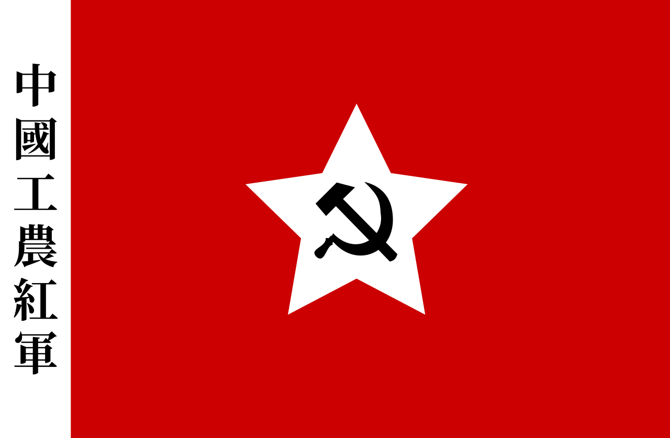

Slide 47
Lenin and Trotsky
Communist party – extremely important – it will unify the workers and carry out the coup
„Leninism“, „party vanguardism“

Slide 48
Lenin and Trotsky
Communist party – extremely important – it will unify the workers and carry out the coup
„Leninism“, „party vanguardism“
The party must be disciplined and centrally led = „democratic centralism“

Slide 49
Lenin and Trotsky
Communist party – extremely important – it will unify the workers and carry out the coup
„Leninism“, „party vanguardism“
The party must be disciplined and centrally led = „democratic centralism“
= decision inside the party are made democratically, but once they are made, they are binding

Slide 50
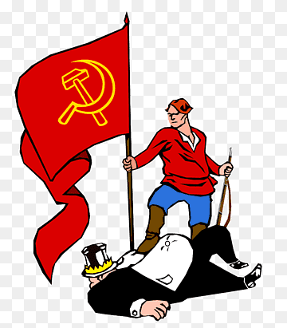
Lenin and Trotsky
„Dictatorship of the proletariat“

Slide 51
Lenin and Trotsky
„Dictatorship of the proletariat“
– Marx though that almost everyone will be a worker at this stage, so the revolution will simply mean majority rule

Slide 52
Lenin and Trotsky
„Dictatorship of the proletariat“
– Marx though that almost everyone will be a worker at this stage, so the revolution will simply mean majority rule
x Lenin: „nothing other than power which is totally unlimited by any laws, totally unrestrained by absolutely any rules, and based directly on force.”

Slide 53
Central planning
Then the Party must stay in power and oversee the industrialization = the state will do what capitalists did in the West

Slide 54
Central planning
Then the Party must stay in power and oversee the industrialization = the state will do what capitalists did in the West
> central planning

Slide 55
Central planning
Then the Party must stay in power and oversee the industrialization = the state will do what capitalists did in the West
> central planning
> totalitarianism – total control of economy, culture etc.

Slide 56
Central planning
„Where is the capital necessary for investment going to come from?“

Slide 57
Central planning
„Where is the capital necessary for investment going to come from?“
Wealth must be extracted from peasants and invested into developing modern industry

Slide 58
Central planning
„Where is the capital necessary for investment going to come from?“
Wealth must be extracted from peasants and invested into developing modern industry
> regulated prices – artificially low prices for agricultural products, high prices for agricultural equipment
Outright confiscation of harvest

Slide 59
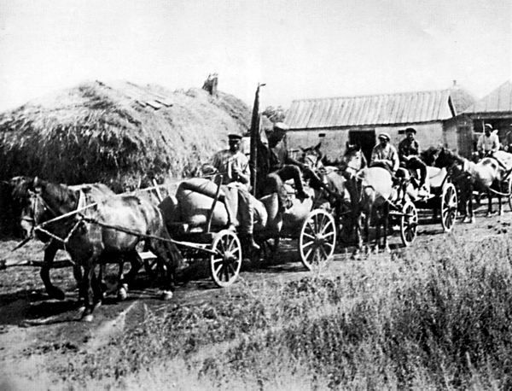

Slide 60
Central planning
„Where is the capital necessary for investment going to come from?“
Wealth must be extracted from peasants and invested into developing modern industry
> regulated prices – artificially low prices for agricultural products, high prices for agricultural equipment
Outright confiscation of harvest
> black market, peasant uprisings > harsh punishments

Slide 61
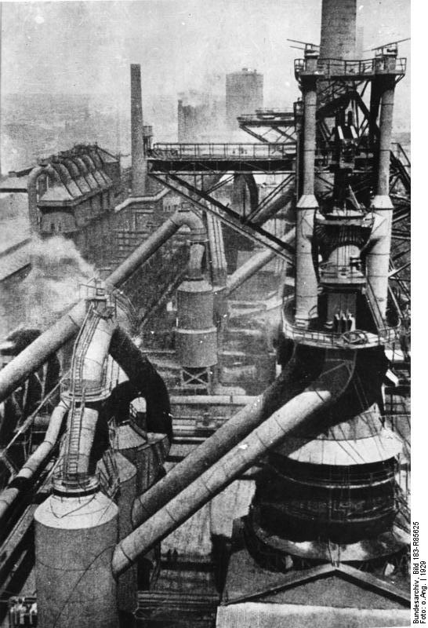

Slide 62
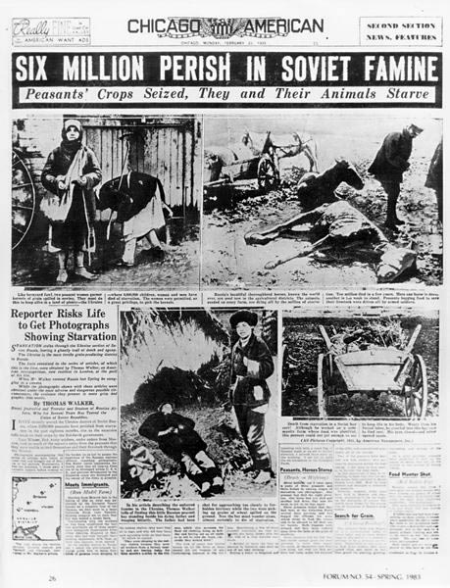

Slide 63
„Foreign tourists in Russia stand in silent amazement before the gigantic enterprises created there, as they stand before the pyramids, for example. Only seldom does the thought occur to them what enslavement, what lowering of human self-esteem was connected with the construction of those gigantic establishments.“
- Karl Kautsky

Slide 64
Central planning
A believe that central planning will outcome capitalism

Slide 65
Central planning
A believe that central planning will outcome capitalism
Capitalists behave in a way that is individually rational but collectively irrational

Slide 66
Central planning
A believe that central planning will outcome capitalism
Capitalists behave in a way that is individually rational but collectively irrational
= they spend money on advertising their product and making it more attractive than the competition
= „race to the bottom“ situations

Slide 67
Central planning
A believe that central planning will outcome capitalism
Capitalists behave in a way that is individually rational but collectively irrational
= they spend money on advertising their product and making it more attractive than the competition
= „race to the bottom“ situations
In a communist society, all these resources would be invested more productively ☺

Slide 68
Central planning
NEP

Slide 69
Central planning
Russian Civil War (1917-1921) > War Communism
= Attempt to stamp out money and all private transactions
Allowed Bolsheviks to mobilize resources and defeat Whites, but unpopular > peasant uprisings
> New Economic Policy (NEP, 1923-1928) = market-oriented reform > small business allowed!
1928 – Stalin – end of NEP, start of Five Year plans
= blueprint for China and other communist countries

Slide 70
Central planning
NEP proved that it‘s possible for a Communist party to stay in power in a market economy and even to turn back the reforms if it wishes to

Slide 71
Central planning
NEP proved that it‘s possible for a Communist party to stay in power in a market economy and even to turn back the reforms if it wishes to
x „Fukuyamist neoliberalism“

Slide 72
The Chinese Communist Party
1921
Initially – a smaller sibling of the Kuomintang

Slide 73
The Chinese Communist Party
1921
Initially – a smaller sibling of the Kuomintang
Theory of two revolutions
„1911 was the first revolution, the Kuomintang is the party of the Chinese bourgeoisie“
„we must help the Kuomintang to develop capitalism first“

Slide 74
Maoism
Mao Zedong (*1893) – unorthodox theory

Slide 75
Maoism
Mao Zedong (*1893) – unorthodox theory
> the Party should organize peasants instead of urban workers

Slide 76
Maoism
Mao Zedong (*1893) – unorthodox theory
> the Party should organize peasants instead of urban workers
> a prolonged rural guerilla war against landlords and the KMT

Slide 77
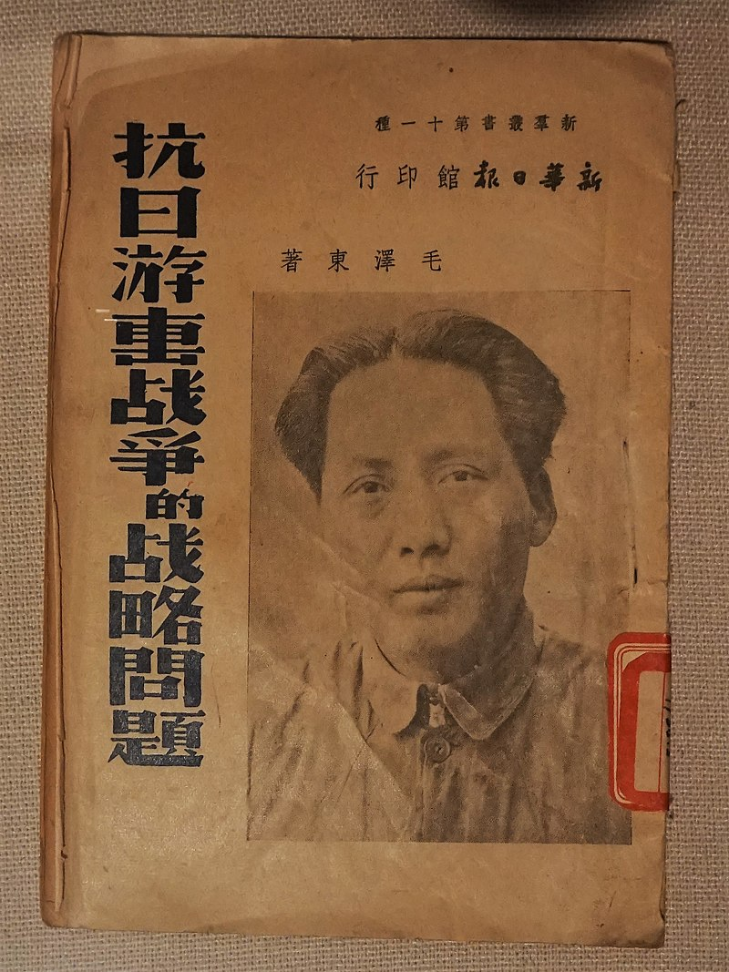

Slide 78
Maoism
Mao Zedong (*1893) – unorthodox theory
> the Party should organize peasants instead of urban workers
> a prolonged rural guerilla war against landlords and the KMT
= „Maoism“

Slide 79
Maoism
Mao Zedong (*1893) – unorthodox theory
> the Party should organize peasants instead of urban workers
> a prolonged rural guerilla war against landlords and the KMT
= „Maoism“
At first seen as a fringe position

Slide 80
Marx – short mass revolution by workers – who are the majority
Lenin – short armed insurrection by workers, who are a minority
Mao – long armed insurrection by peasants, who are the majority

Slide 81
The Chinese Communist Party
CCP – compliant at first, the KMT turned against them after the Northern Expedition (1927)

Slide 82
The Chinese Communist Party
CCP – compliant at first, the KMT turned against them after the Northern Expedition (1927)
> asymmetric guerilla warfare
> Mao‘s position vindicated

Slide 83
The Chinese Communist Party
CCP – compliant at first, the KMT turned against them after the Northern Expedition (1927)
> asymmetric guerilla warfare
> Mao‘s position vindicated
> a rural guerilla is actually necessary – cities (with workers) are controlled by the KMT

Slide 84
The Chinese Communist Party
Long March (1934-1935)

Slide 85
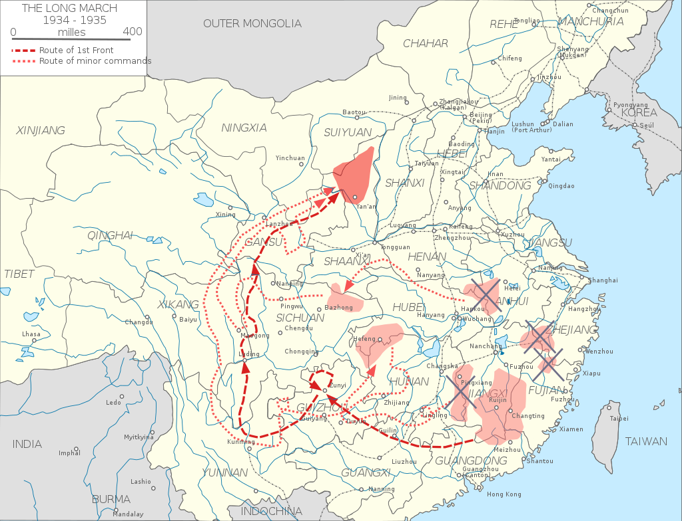

Slide 86
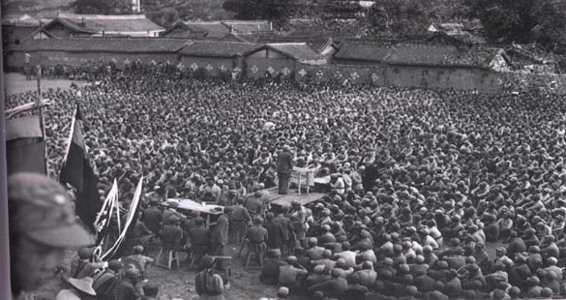

Slide 87
The Chinese Communist Party
Long March (1934-1935) > to the north of China where the KMT was less powerful

Slide 88
The Chinese Communist Party
Long March (1934-1935) > to the north of China where the KMT was less powerful
Most leaders of the CCP died during the KMT crackdown, or during the march
> Mao emerged as the undisputed leader

Slide 89
WWII
Communists patiently built their movement, avoided major battles with the Japanese

Slide 90
WWII
Communists patiently built their movement, avoided major battles with the Japanese
„Long struggle“ – „It is necessary to preserve our strength for the final showdown against the Nationalists“
> this will be the fight that really matters

Slide 91
WWII
Communists patiently built their movement, avoided major battles with the Japanese
„Long struggle“ – „It is necessary to preserve our strength for the final showdown against the Nationalists“
> this will be the fight that really matters
x Nationalists – „Japan is our mortal enemy, we must spare no effort to kick them out“
> the KMT bore the brunt of the war

Slide 92
WWII
The Japanese could only control large cities, not the Chinese countryside > the Party could probably operate easier than under KMT rule

Slide 93
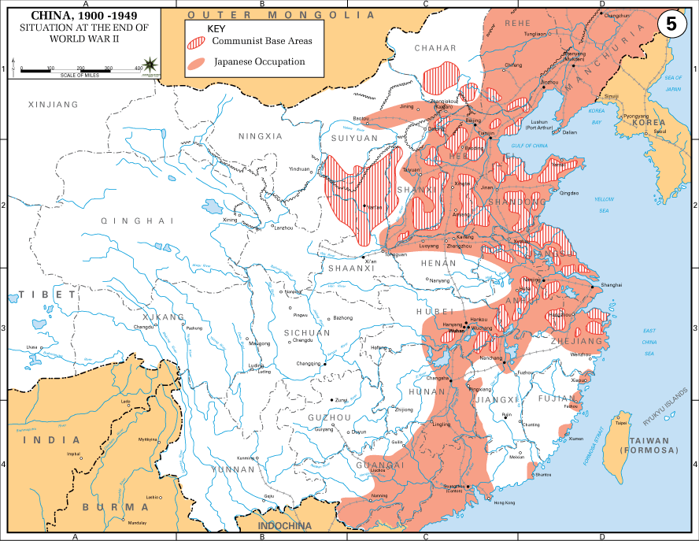

Slide 94
WWII
Seat of the party – Yan‘an – far away from any danger

Slide 95
WWII
Seat of the party – Yan‘an – far away from any danger
„Yan'an Rectification Movement“ – 1942-45 – Mao‘s cult of personality, suppression of dissent within the party, Maoism as the official ideology

Slide 96
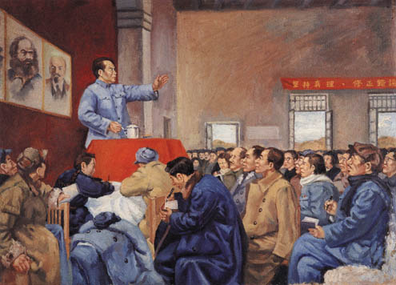

Slide 97
WWII
Seat of the party – Yan‘an – far away from any danger
„Yan'an Rectification Movement“ – 1942-45 – Mao‘s cult of personality, suppression of dissent within the party, Maoism as the official ideology
= blueprint for future purges

Slide 98
WWII
„thought reform“, „though realignment“

Slide 99
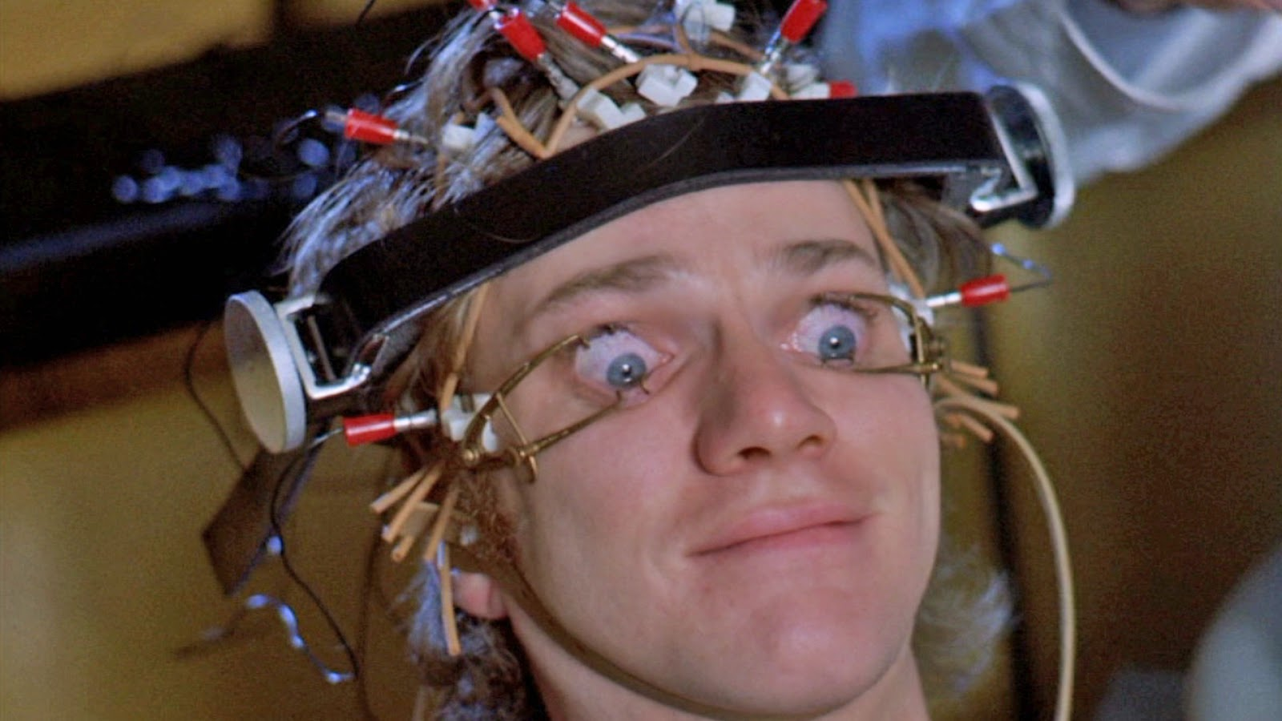
WWII
„thought reform“, „though realignment“

Slide 100
WWII
„thought reform“, „though realignment“
= confession of one‘s mistakes during combative sessions > opponents driven to suicide

Slide 101
Communist victory
1946-1949 – Civil war – communist victory over the exhausted, overextended and corrupt KMT in 1949

Slide 102
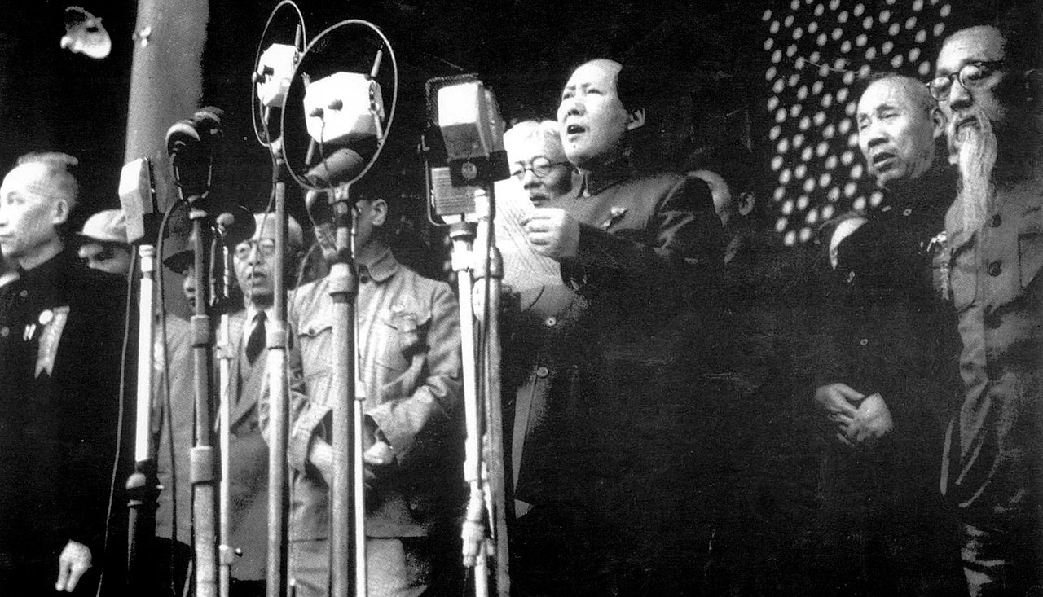

Slide 103
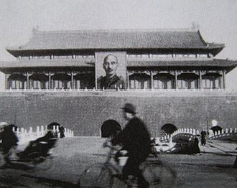

Slide 104
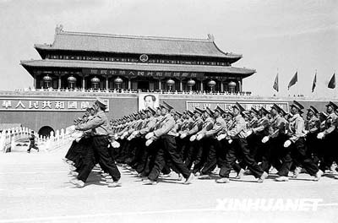

Slide 105
Communist victory
Communist promises: to carry out a land reform

Slide 106
Communist victory
Inequality of land ownership – the main problem in all of East Asia
Brutal exploitation of peasants > poverty and resentment
KMT – allied itself with the landlords

Slide 107
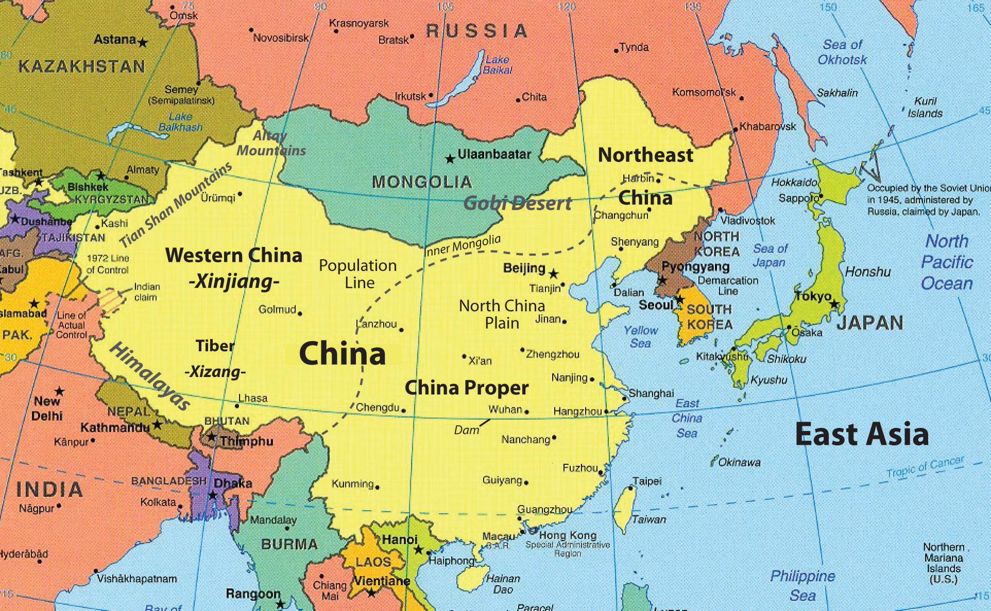

Slide 108
Korea, Japan, Taiwan – land reforms „from above“ – carried out by the conservative regimes to avoid revolution – US pressure!
> „blank slate“ > start of a successful capitalist development!

Slide 109
Communist victory
Communist promises
1) Carry out a land reform

Slide 110
Communist victory
Communist promises
1) Carry out a land reform
2) Entrepreneurship is going to remain allowed

Slide 111
Communist victory
Communist promises
1) Carry out a land reform
2) Entrepreneurship is going to remain allowed
3) Create democracy and pluralism! – CCP will lead a broad coalition of progressive parties and movements

Slide 112
Communist victory
Communist promises
1) Carry out a land reform
2) Entrepreneurship is going to remain allowed
3) Create democracy and pluralism! – CCP will lead a broad coation of progressive parties and movements
CCP will thus finish what was started in 1911, Mao is the true heir of Sun Yat Sen!

Slide 113
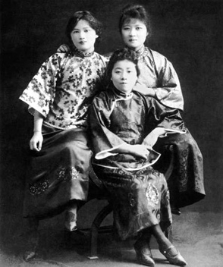

Slide 114
Compare this with: communists in Czechoslovakia

Slide 115
Compare this with: communists in Czechoslovakia
- land reform ✔️

Slide 116
Compare this with: communists in Czechoslovakia
- land reform ✔️
- socialism different from the Soviet model – gradual path, no threat for small businesses ✔️

Slide 117
Compare this with: communists in Czechoslovakia
- land reform ✔️
- socialism different from the Soviet model – gradual path, no threat for small businesses ✔️
- democracy – „National Front“ coalition ✔️

Slide 118
Compare this with: communists in Czechoslovakia
- land reform ✔️
- socialism different from the Soviet model – gradual path, no threat for small businesses ✔️
- democracy – „National Front“ coalition ✔️
= fulfillment of the dream of the republic from 1918! ✔️

Slide 119
First years of the PRC - 1949-1953
Massacre of landlords > circa 2 million victims

Slide 120
First years of the PRC - 1949-1953
Massacre of landlords > circa 2 million victims
Redistribution of land, formation of cooperatives of small farmers – not collective ownership

Slide 121
First years of the PRC - 1949-1953
Massacre of landlords > circa 2 million victims
Redistribution of land, formation of cooperatives of small farmers – not collective ownership
Initially more or less as promised, but…

Slide 122
First years of the PRC - 1949-1953
Purge of former KMT officials; „third way“ intellectuals, entrepreneurs – thought reform campaigns, re-education through labor

Slide 123
First years of the PRC - 1949-1953
Not full central planning yet!

Slide 124
First years of the PRC - 1949-1953
Not full central planning yet!
Industry – slow nationalization of companies
Agriculture – independent farmers – pressure to form cooperatives

Slide 125
First years of the PRC - 1949-1953
Not full central planning yet!
Industry – slow nationalization of companies
Agriculture – independent farmers – pressure to form cooperatives
Recovery from all the wars, participation in Korea > the CCP was not strong enough to control all of the economy

Slide 126
First Five Year Plan (1953-1957)

Slide 127
First Five Year Plan (1953-1957)
Soviet model, Soviet equipment, Soviet advisors

Slide 128
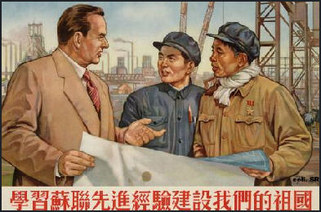
First Five Year Plan (1953-1957)
Soviet model, Soviet equipment, Soviet advisors

Slide 129
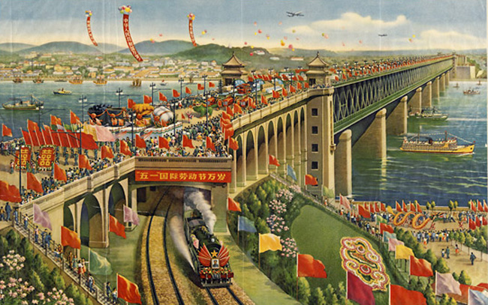

Slide 130
First Five Year Plan (1953-1957)
Soviet model, Soviet equipment, Soviet advisors
Centralized, hierarchical, technocratic

Slide 131
First Five Year Plan (1953-1957)
Soviet model, Soviet equipment, Soviet advisors
Centralized, hierarchical, technocratic
Main point – develop modern industry at the expense of agriculture

Slide 132
First Five Year Plan (1953-1957)
Soviet model, Soviet equipment, Soviet advisors
Centralized, hierarchical, technocratic
Main point – develop modern industry at the expense of agriculture
Full nationalization of industry, collective farming

Slide 133
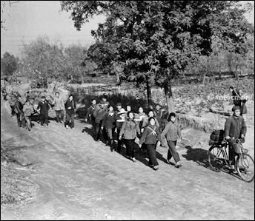

Slide 134
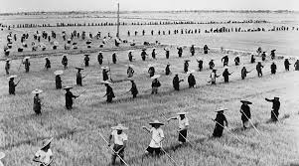

Slide 135
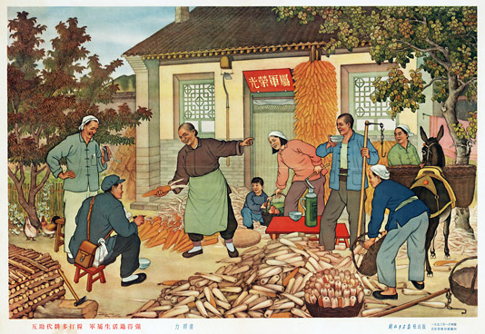

Slide 136
First Five Year Plan (1953-1957)
Progress in industry, but stagnation in agriculture

Slide 137
First Five Year Plan (1953-1957)
Progress in industry, but stagnation in agriculture
Mao – that‘s not good enough!

Slide 138
First Five Year Plan (1953-1957)
Progress in industry, but stagnation in agriculture
Mao – that‘s not good enough!
1957 – turn in a more radical direction

Slide 139
First Five Year Plan (1953-1957)
Progress in industry, but stagnation in agriculture
Mao – that‘s not good enough!
1957 – turn in a more radical direction
Hundred Flowers Campaign – „you can criticize us without fear“
Anti-Rightist Campaign – another purge; full one-party state; led by Deng Xiaoping!

Slide 140
„Great Leap Forward“ (1958-1962)
Basic idea – simultaneous progress in cities and the countryside

Slide 141
„Great Leap Forward“ (1958-1962)
Basic idea – simultaneous progress in cities and the countryside
Local patriotic and ideological enthusiasm will replace Soviet-style centralized technocracy

Slide 142
„Great Leap Forward“ (1958-1962)
Basic idea – simultaneous progress in cities and the countryside
Local patriotic and ideological enthusiasm will replace Soviet-style centralized technocracy
Local party leaders should heroically struggle to achieve great results

Slide 143
„Great Leap Forward“ (1958-1962)
Basic idea – simultaneous progress in cities and the countryside
Local patriotic and ideological enthusiasm will replace Soviet-style centralized technocracy
Local party leaders should heroically struggle to achieve great results
Abolition of private land ownership, farms to be fused into large scale „village communes“

Slide 144
„Great Leap Forward“ (1958-1962)
Basic idea – simultaneous progress in cities and the countryside
Local patriotic and ideological enthusiasm will replace Soviet-style centralized technocracy
Local party leaders should heroically struggle to achieve great results
Abolition of private land ownership, farms to be fused into large scale „village communes“
Small industrialization carried out by these village communes

Slide 145
„Great Leap Forward“ (1958-1962)
Communes were supposed to produce their own steel

Slide 146
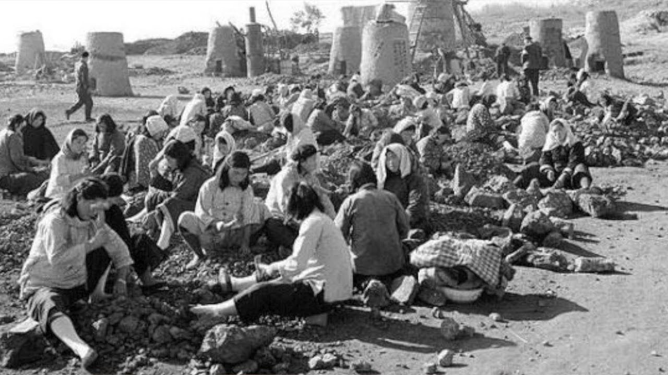

Slide 147
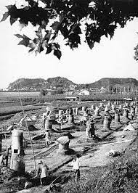

Slide 148
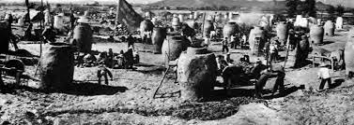

Slide 149
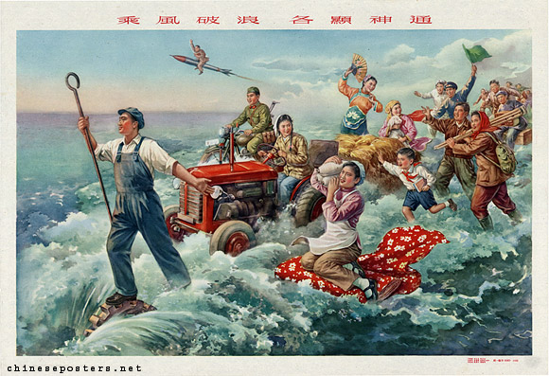

Slide 150
„Great Leap Forward“ (1958-1962)
Communes were supposed to produce their own steel
„They probably have a lot of spare workers who aren‘t doing anything valuable, let‘s force them to work in manufacturing“

Slide 151
„Great Leap Forward“ (1958-1962)
Communes were supposed to produce their own steel
People fulfilled their quotas by melting down tools and reforging them into useless, low-quality iron

Slide 152
„Great Leap Forward“ (1958-1962)
Communes were supposed to produce their own steel
People fulfilled their quotas by melting down tools and reforging them into useless, low quality iron
Unrealistic production quotas > all the food was forcibly confiscated

Slide 153
„Great Leap Forward“ (1958-1962)
Communes were supposed to produce their own steel
People fulfilled their quotas by melting down tools and reforging them into useless, low quality iron
Unrealistic production quotas > all the food was forcibly confiscated
Biggest famine in China‘s history – 30 million deaths

Slide 154
„Great Leap Forward“ (1958-1962)
The program had to be called off in 1962

Slide 155
Lysenkoism

Slide 156
Lysenkoism – Soviet attempt to discredit genetics as bourgeois pseudoscience and replace it with Marxist-Leninist biological theory

Slide 157
Lysenkoism – Soviet attempt to discredit genetics as bourgeois pseudoscience and replace it with Marxist-Leninist biological theory
Seeds of wheat should be placed deep underground and close together > they will form a collectivist spirit and grow together…

Slide 158
Lysenkoism – Soviet attempt to discredit genetics as bourgeois pseudoscience and replace it with Marxist-Leninist biological theory
Seeds of wheat should be placed deep underground and close together > they will form a collectivist spirit and grow together…
Both USSR and China actually attempted to implement this (!)

Slide 159
„Agriculture first“ (1962-1966)
Intermezzo - more pragmatic policies aimed at repairing the damage

Slide 160
„Agriculture first“ (1962-1966)
Intermezzo - more pragmatic policies aimed at repairing the damage
Less ideology, more management
Material rewards

Slide 161
„Agriculture first“ (1962-1966)
Intermezzo - more pragmatic policies aimed at repairing the damage
Less ideology, more management
Material rewards
> alleviate the hunger and poverty of rural villages > higher prices for agricultural products

Slide 162
„Agriculture first“ (1962-1966)
Intermezzo - more pragmatic policies aimed at repairing the damage
Less ideology, more management
Material rewards
> alleviate the hunger and poverty of rural villages > higher prices for agricultural products
Industrial firms – mostly remained under local control, but run in a more professional manner

Slide 163
„Agriculture first“ (1962-1966)
Intermezzo - more pragmatic policies aimed at repairing the damage
Less ideology, more management
Material rewards
> alleviate the hunger and poverty of rural villages > higher prices for agricultural products
Industrial firms – mostly remained under local control, but run in a more professional manner
Basic economic model until 1978

Slide 164
„Agriculture first“ (1962-1966)
Except for the first Five Year plan, China never had true Soviet-style central planning

Slide 165
„Agriculture first“ (1962-1966)
Except for the first Five Year plan, China never had true Soviet-style central planning
Decision making was divided between different levers of party and government

Slide 166
„Agriculture first“ (1962-1966)
Except for the first Five Year plan, China never had true Soviet-style central planning
Decision making was divided between different levers of party and government
Typically, many enterprises were controlled on the provincial level etc.

Slide 167
„Agriculture first“ (1962-1966)
Except for the first Five Year plan, China never had true Soviet-style central planning
Decision making was divided between different levers of party and government
Typically, many enterprises were controlled on the provincial level etc.
> opaque system, it is difficult to say who is in charge of what

Slide 168
Cultural Revolution (1966-1976)
Mao was partially discredited by the Great Leap Forward and faced opposition inside the party (Deng Xiaoping)

Slide 169
Cultural Revolution (1966-1976)
Mao was partially discredited by the Great Leap Forward and faced opposition inside the party (Deng Xiaoping)
Attempt to turn Mao into a mere figurehead and create a more technocratic and collective leadership

Slide 170
Cultural Revolution (1966-1976)
Mao was partially discredited by the Great Leap Forward and faced opposition inside the party (Deng Xiaoping)
Attempt to turn Mao into a mere figurehead and create a more technocratic and collective leadership
Cultural Revolution – attack on intellectuals and party bureaucrats – Mao‘s opponents

Slide 171
Cultural Revolution (1966-1976)
Mao was partially discredited by the Great Leap Forward and faced opposition inside the party (Deng Xiaoping)
Attempt to turn Mao into a mere figurehead and create a more technocratic and collective leadership
Cultural Revolution – attack on intellectuals and party bureaucrats – Mao‘s opponents
Officially: attempt to prevent the Communist party from becoming a new elite – permanent revolution

Slide 172
Cultural Revolution (1966-1976)
Red Brigades – groups of fanatical young comrades

Slide 173
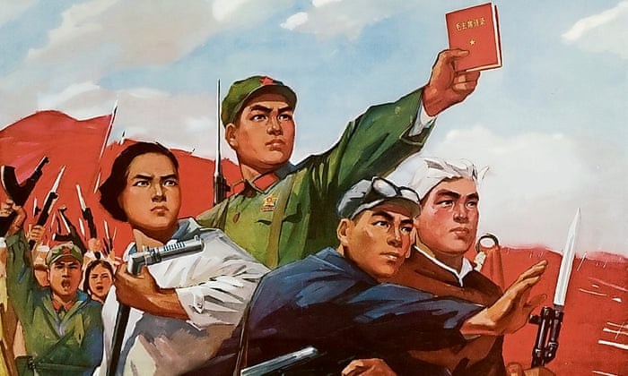

Slide 174
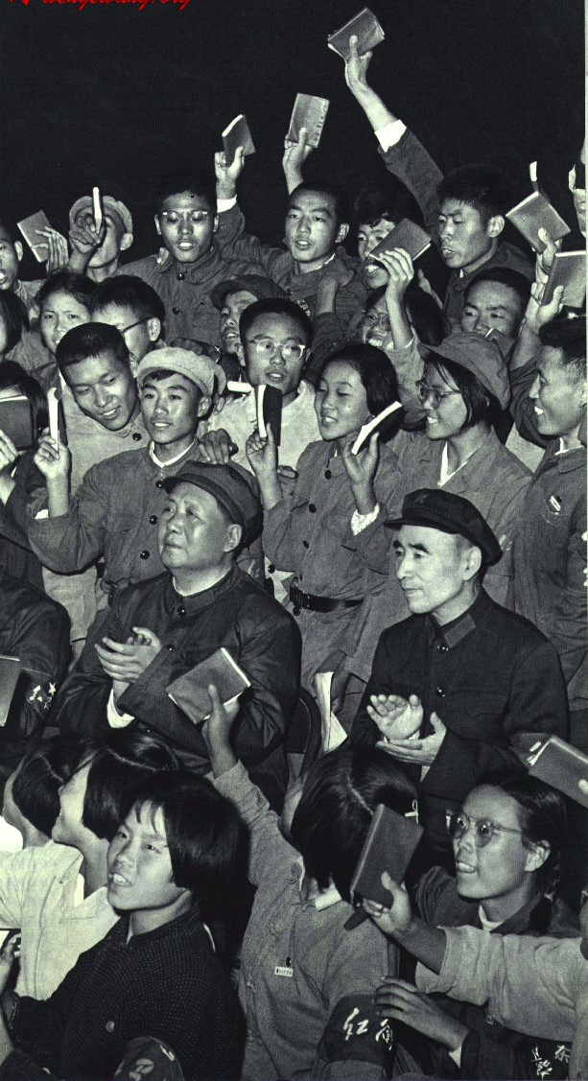

Slide 175
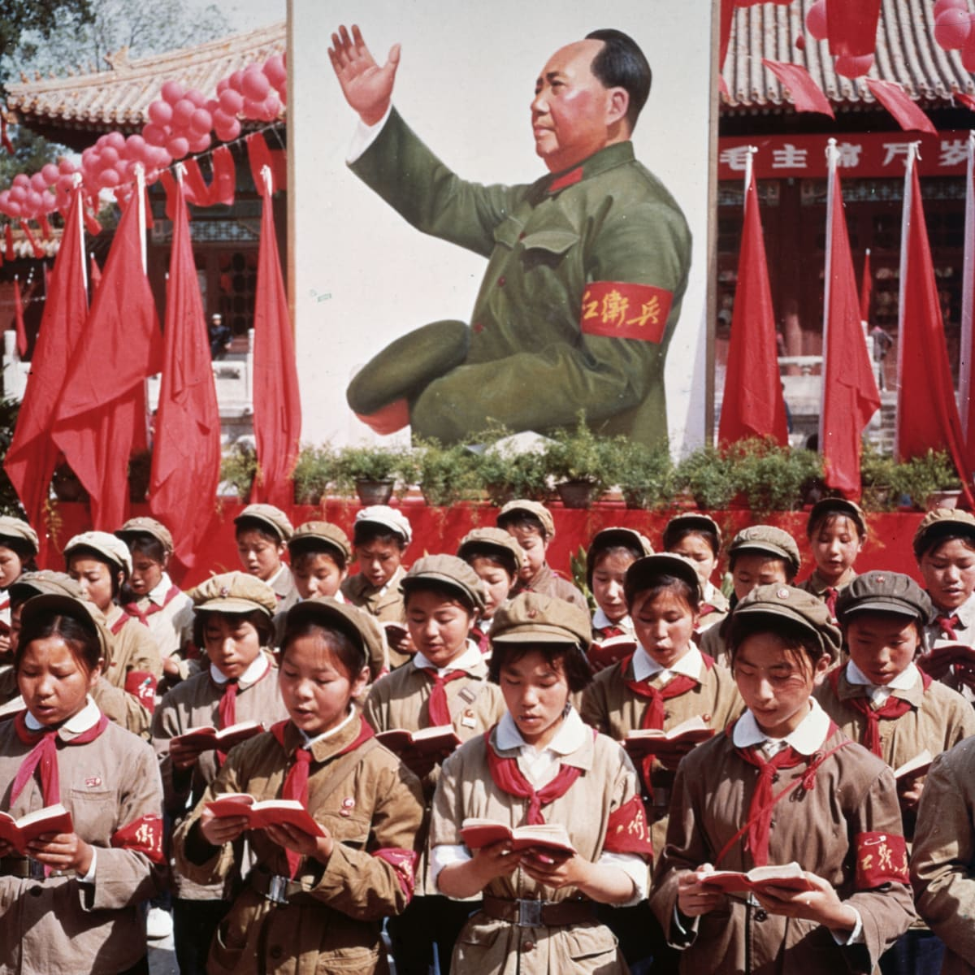

Slide 176
Cultural Revolution (1966-1976)
Red Brigades – groups of fanatical young comrades > attacks on „bourgeois elements“ etc., taking over of factories

Slide 177
Cultural Revolution (1966-1976)
Red Brigades – groups of fanatical young comrades > attacks on „bourgeois elements“ etc., taking over of factories
Destruction of Chinese cultural heritage („old thinking“)

Slide 178
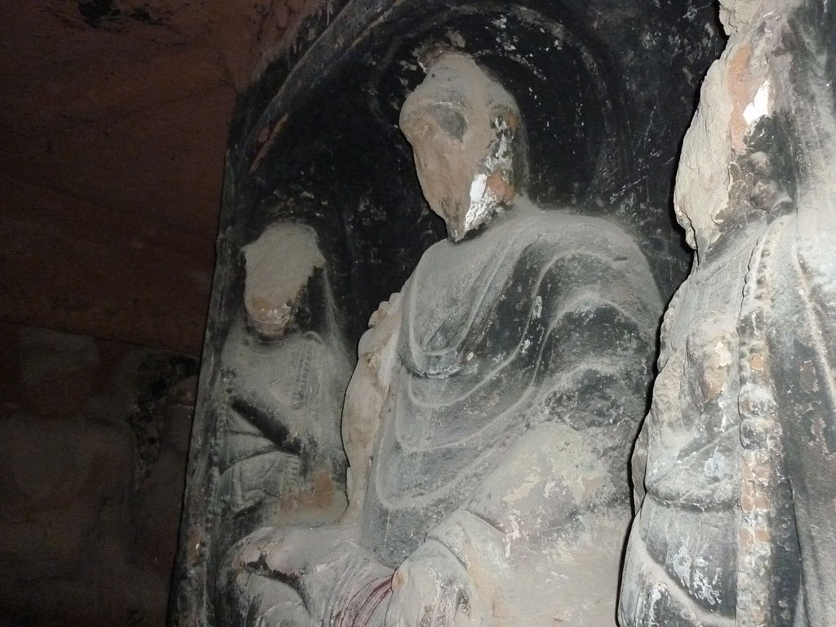

Slide 179
Cultural Revolution (1966-1976)
Red Brigades – groups of fanatical young comrades > attacks on „bourgeois elements“ etc., taking over of factories
Destruction of Chinese cultural heritage („old thinking“)
„Sending down“ – young intellectuals sent to work in villages > waste of talent and potential

Slide 180
Cultural Revolution (1966-1976)
Red Brigades – groups of fanatical young comrades > attacks on „bourgeois elements“ etc., taking over of factories
Destruction of Chinese cultural heritage („old thinking“)
„Sending down“ – young intellectuals sent to work in villages > waste of talent and potential
„Self-criticism“ – public humiliation and torture

Slide 181
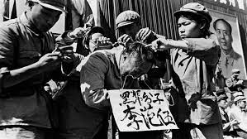

Slide 182
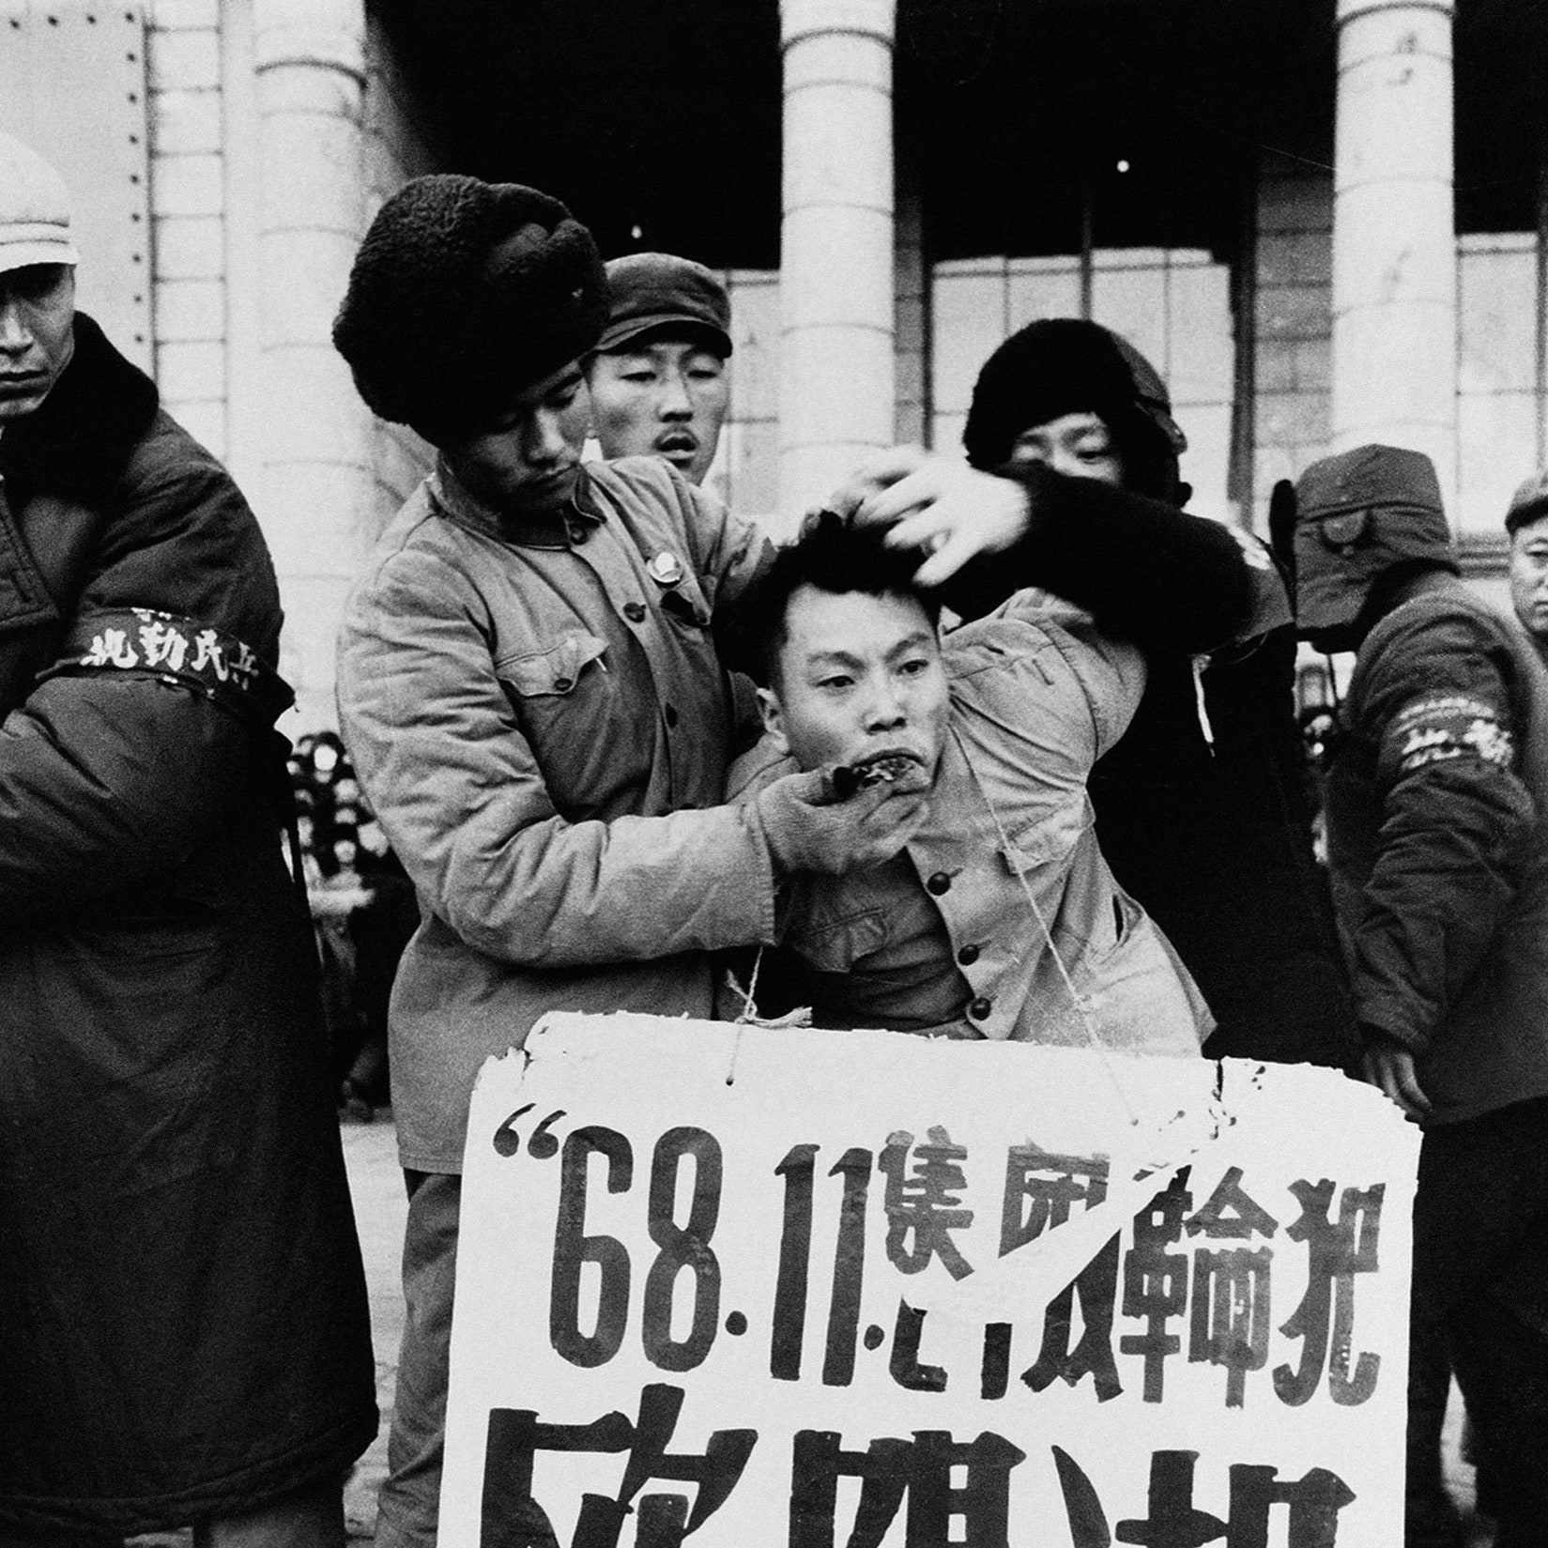

Slide 183
Cultural Revolution (1966-1976)
1968 – the army had to move in to rein in the Red Brigades

Slide 184
Cultural Revolution (1966-1976)
Officially no major change to the economic model – but omnipresent chaos and radicalism

Slide 185
Cultural Revolution (1966-1976)
Officially no major change to the economic model – but omnipresent chaos and radicalism
Mao‘s final years (1970-76) – the situation slowly calmed down

Slide 186
“Had Mao died in 1956, his achievements would have been immortal. Had he died in 1966, he would still have been a great man but flawed. But he died in 1976. Alas, what can one say?”

Slide 187
Mao‘s final years
Power struggle between pragmatists (Deng and Zhou Enlai) and hardcore Maoists (Gang of Four – Mao‘s wife)

Slide 188
Mao‘s final years
Power struggle between pragmatists (Deng and Zhou Enlai) and hardcore Maoists (Gang of Four – Mao‘s wife)
Material incentives and focus on economic performance vs. ideological purity and revolutionary zeal

Slide 189
Mao‘s final years
Power struggle between pragmatists (Deng and Zhou Enlai) and hardcore Maoists (Gang of Four – Mao‘s wife)
Material incentives and focus on economic performance vs. ideological purity and revolutionary zeal
Both Mao and Zhou died in 1976

Slide 190
Mao‘s final years
Power struggle between pragmatists (Deng and Zhou Enlai) and hardcore Maoists (Gang of Four – Mao‘s wife)
Material incentives and focus on economic performance vs. ideological purity and revolutionary zeal
Both Mao and Zhou died in 1976
Brief interregnum, Deng‘s faction emerged victorious in 1978

Slide 191
Mao‘s final years
Power struggle between pragmatists (Deng and Zhou Enlai) and hardcore Maoists (Gang of Four – Mao‘s wife)
Material incentives and focus on economic performance vs. ideological purity and revolutionary zeal
Both Mao and Zhou died in 1976
Brief interregnum, Deng‘s faction emerged victorious in 1978
„Gang of Four“ – blamed for the excesses of the Cultural Revolution so that Mao himself could be absolved of all responsibility

Slide 192
Pros and cons of central planning

Slide 193
Pros and cons of central planning
Difficulty of finding out what‘s valuable in absence of prices

Slide 194
Pros and cons of central planning
Difficulty of finding out what‘s valuable in absence of prices
> focus on tangible targets – tons of fertilizer, steel, concrete
> neglect of things which are harder to measure (services etc.)

Slide 195
Pros and cons of central planning
Difficulty of finding out what‘s valuable in absence of prices
> focus on tangible targets – tons of fertilizer, steel, concrete
> neglect of things which are harder to measure (services etc.)
Bad management of resources > environmental damage!

Slide 196
Pros and cons of central planning
Difficulty of finding out what‘s valuable in absence of prices
> focus on tangible targets – tons of fertilizer, steel, concrete
> neglect of things which are harder to measure (services etc.)
Bad management of resources > environmental damage!
No competition and no bankruptcies > no pressure to make products and services attractive to buyers > low quality + little choice

Slide 197
Pros and cons of central planning
Good at adopting existing techniques and replicating them throughout the economy > catching up

Slide 198
Pros and cons of central planning
Good at adopting existing techniques and replicating them throughout the economy > catching up
Bad at independent innovation

Slide 199
Pros and cons of central planning
Good at adopting existing techniques and replicating them throughout the economy > catching up
Bad at independent innovation
> as communist countries neared the technological frontier, growth stalled
> problem for all state-dominated economies (China…?)

Slide 200
Results of Maoism
Success in decreasing extreme poverty, illiteracy, child mortality

Slide 201
Results of Maoism
Success in decreasing extreme poverty, illiteracy, child mortality
Growth from a very low starting point + ability to mobilize and direct resources > some basic industrialization

Slide 202
Results of Maoism
Success in decreasing extreme poverty, illiteracy, child mortality
Growth from a very low starting point + ability to mobilize and direct resources > some basic industrialization
Great power status abroad

Slide 203
Results of Maoism
Success in decreasing extreme poverty, illiteracy, child mortality
Growth from a very low starting point + ability to mobilize and direct resources > some basic industrialization
Great power status abroad
But, obviously, also famine and death, trauma, destruction of institutions…

Slide 204
Next time – economic reforms after 1978

