Slide 1
Reforms after 1978
China in the World Economy, autumn 2021

Slide 2
Questions from last time
How was Maoism distinctive from Marxism and Leninism?

Slide 3
Questions from last time
How was Maoism distinctive from Marxism and Leninism?
Which sector of the economy did the Communists try to develop at the expense of which other sector?

Slide 4
Questions from last time
How was Maoism distinctive from Marxism and Leninism?
Which sector of the economy did the Communists try to develop at the expense of which other sector?
When did China attempt to copy the Soviet model with Soviet aid? What happened to their relations then?

Slide 5
Questions from last time
How was Maoism distinctive from Marxism and Leninism?
Which sector of the economy did the Communists try to develop at the expense of which other sector?
When did China attempt to copy the Soviet model with Soviet aid? What happened to their relations then?
Was the Great Leap Forward an example of central planning?

Slide 6
Questions from last time
How was Maoism distinctive from Marxism and Leninism?
Which sector of the economy did the Communists try to develop at the expense of which other sector?
When did China attempt to copy the Soviet model with Soviet aid? What happened to their relations then?
Was the Great Leap Forward an example of central planning?
How did China‘s economic model in the 1960‘s and 1970‘s differ from the Soviet model?

Slide 7
Today
Reforms in the late 1970‘s and 1980‘s
The Tiananmen interlude
Continuing reforms in the 1990‘s and 2000s
Opening up to foreign trade, export-led growth
Until circa the Financial crisis

Slide 8
Literature

Slide 9
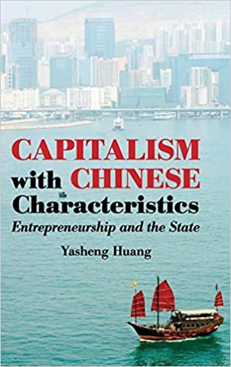

Slide 10
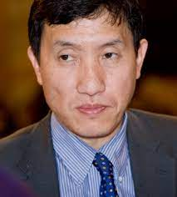

Slide 11
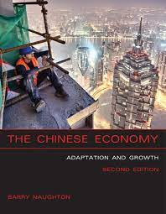

Slide 12
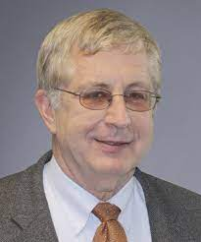

Slide 13
The end of Maoism
1976 – Mao dies > power vacuum
Prolonged struggle for power – intrigues, demonstrations!

Slide 14
The end of Maoism
1976 – Mao dies > power vacuum
Prolonged struggle for power – intrigues, demonstrations!
The faction around Deng Xiaoping emerges victorious two years later and announces a series of economic reforms
Gang of Four condemned, Mao kept as a symbol

Slide 15
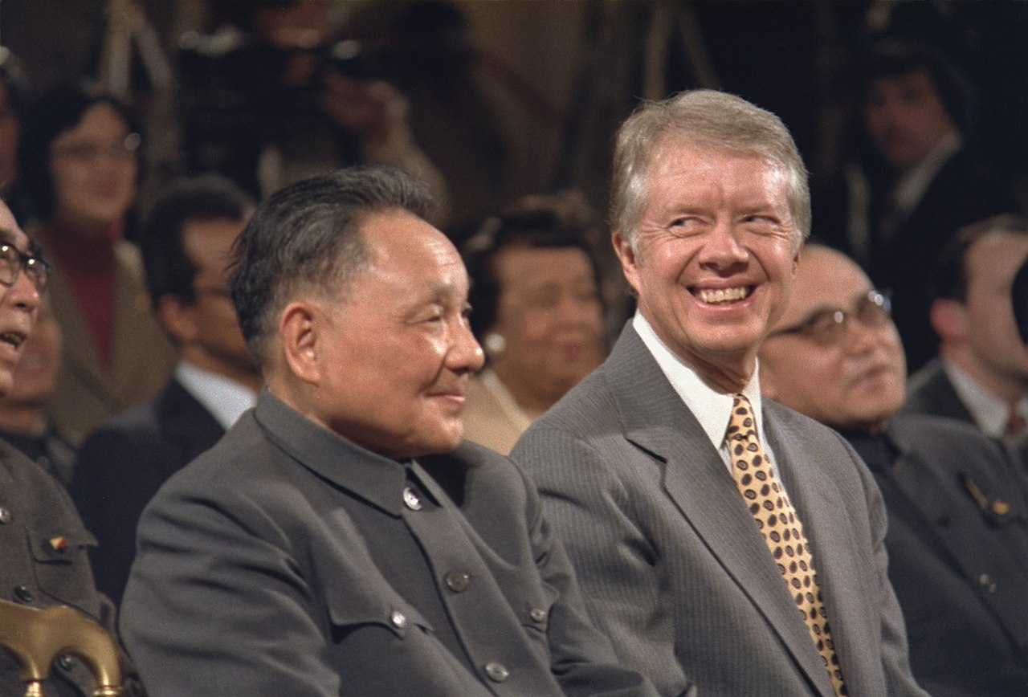

Slide 16
China‘s situation in 1978
GDP per capita – similar to India and sub-Saharan Africa
Overpopulation

Slide 17
China‘s situation in 1978
GDP per capita – similar to India and sub-Saharan Africa
Overpopulation
The Party itself was ravaged by years of purges
> bad economic data!
Some excellent centers of learning and science – but small, isolated, decimated by the Cultural Revolution

Slide 18
China‘s situation in 1978
Unhealthy focus on heavy industry and military technologies

Slide 19
China‘s situation in 1978
Unhealthy focus on heavy industry and military technologies
Cities – complete state ownership, zero room for enterprise
= not centers of commerce but bastions of the Party

Slide 20
China‘s situation in 1978
Unhealthy focus on heavy industry and military technologies
Cities – complete state ownership, zero room for enterprise
= not centers of commerce but bastions of the Party
Rural areas – somewhat looser rule, farmers were sometimes allowed to de facto own plots of land
Most of the land was still collective, though

Slide 21
China‘s situation in 1978
Foreign trade – extreme isolation, focus on autarky

Slide 22
China‘s situation in 1978
Foreign trade – extreme isolation, focus on autarky
Result of the break with the USSR

Slide 23
China‘s situation in 1978
Foreign trade – extreme isolation, focus on autarky
Result of the break with the USSR in the 1960s

Slide 24
China‘s situation in 1978
Foreign trade – extreme isolation, focus on autarky
Result of the break with the USSR in the 1960s
„Double air-lock“ – tight control of both currency and the movement of goods

Slide 25
China‘s situation in 1978
Foreign trade – extreme isolation, focus on autarky
Result of the break with the USSR in the 1960s
„Double air-lock“ – tight control of both currency and the movement of goods
12 monopoly state trading-enterprises – bridges between China‘s regulated prices and the world market

Slide 26
China‘s situation in 1978
Need to import technology
= machines and the know-how embodied in them (= capital goods)

Slide 27
China‘s situation in 1978
Need to import technology
= machines and the know-how embodied in them (= capital goods)
> reverse engineering

Slide 28
China‘s situation in 1978
Need to import technology
= machines and the know-how embodied in them (= capital goods)
> reverse engineering
It would be ideal to purchase whole assembly lines etc.

Slide 29
China‘s situation in 1978
Need to import technology
= machines and the know-how embodied in them (= capital goods)
> reverse engineering
It would be ideal to purchase whole assembly lines etc.
Problem – need for foreign exchange (dollars, yens, pounds)

Slide 30
China‘s situation in 1978
How does a country gain foreign exchange?

Slide 31
China‘s situation in 1978
How does a country gain foreign exchange?
Export!

Slide 32
China‘s situation in 1978
How does a country gain foreign exchange?
Export!
Developing countries – food, natural resources, textiles

Slide 33
China‘s situation in 1978
How does a country gain foreign exchange?
Export!
Developing countries – food, natural resources, textiles
China – barely above subsistence > „What can we export?“

Slide 34
China‘s situation in 1978
How does a country gain foreign exchange?
Export!
Developing countries – food, natural resources, textiles
China – barely above subsistence > „What can we export?“
Oil (!)

Slide 35
China‘s situation in 1978
How does a country gain foreign exchange?
Export!
Developing countries – food, natural resources, textiles
China – barely above subsistence > „What can we export?“
Oil (!) > then we can afford to purchase equipment from Western Europe and Japan

Slide 36
China‘s situation in 1978
How does a country gain foreign exchange?
Export!
Developing countries – food, natural resources, textiles
China – barely above subsistence > „What can we export?“
Oil (!) > then we can afford to purchase equipment from Western Europe and Japan
Oil production didn‘t work out > need boost other exports

Slide 37
China‘s situation in 1978
„averted oil curse“ – lack of oil production forced China into reforms that led to far more significant growth than oil could ever deliver

Slide 38
Reforms - agriculture
Major overhaul of the rural economy
Huang – the most significant and drastic reform

Slide 39
Reforms - agriculture
Major overhaul of the rural economy
Most collective land was distributed back among the peasants (= what they hoped for in 1949!)

Slide 40
Reforms - agriculture
Major overhaul of the rural economy
Most collective land was distributed back among the peasants (= what they hoped for in 1949!)
Legalization of enterprise > farmers can further process their products – turn cotton into clothes, or milk into yogurt, etc.

Slide 41
Reforms - agriculture
Major overhaul of the rural economy
Most collective land was distributed back among the peasants (= what they hoped for in 1949!)
Legalization of enterprise > farmers can further process their products – turn cotton into clothes, or milk into yogurt, etc.
> „township and village enterprises“ (TVEs) – formally public, de facto usually private

Slide 42
Reforms - agriculture
Major overhaul of the rural economy
Most collective land was distributed back among the peasants (= what they hoped for in 1949!)
Legalization of enterprise > farmers can further process their products – turn cotton into clothes, or milk into yogurt, etc.
> „township and village enterprises“ (TVEs) – formally public, de facto usually private
Local banks and funds – collection of savings, investment

Slide 43
Reforms - agriculture
Rural sector – became far more commercial than the cities during the 1980‘s!
Poverty alleviation, lifting people out of agriculture

Slide 44
Reforms - agriculture
Rural sector – became far more commercial than the cities during the 1980‘s!
Poverty alleviation, lifting people out of agriculture
Small-scale industrialization – (what the Great Leap Forward hoped for!)

Slide 45
Reforms - agriculture
Rural sector – became far more commercial than the cities during the 1980‘s!
Poverty alleviation, lifting people out of agriculture
Small-scale industrialization – (what the Great Leap Forward hoped for!)
Rural areas were no longer squeezed for cash by the state

Slide 46
Reforms - agriculture
Rural sector – became far more commercial than the cities during the 1980‘s!
Poverty alleviation, lifting people out of agriculture
Small-scale industrialization – (what the Great Leap Forward hoped for!)
Rural areas were no longer squeezed for cash by the state
Some successful entrepreneurs moved into the cities

Slide 47
Reforms – urban areas
„Dual-prices“

Slide 48
Reforms – urban areas
„Dual-prices“ – state-owned enterprises (SOEs) must fulfill the plan, then they can sell any surplus products and keep the profits

Slide 49
Reforms – urban areas
„Dual-prices“ – state-owned enterprises (SOEs) must fulfill the plan, then they can sell any surplus products and keep the profits
> official prices within the plan + market prices

Slide 50
Reforms – urban areas
„Dual-prices“ – state-owned enterprises (SOEs) must fulfill the plan, then they can sell any surplus products and keep the profits
> official prices within the plan + market prices
Typical style of reforms – a university or research center can start an enterprises and commercialize some invention made there

Slide 51
Reforms – urban areas
„Dual-prices“ – state-owned enterprises (SOEs) must fulfill the plan, then they can sell any surplus products and keep the profits
> official prices within the plan + market prices
Typical style of reforms – a university or research center can start an enterprises and commercialize some invention made there
Far fewer true private enterprises than in the countryside!
Few privatizations – the private sector grew next to the state sector

Slide 52
Reforms – urban areas
Increased motivation and production
Significant corruption – typical result of intermingling of private and public resources and interests

Slide 53
Reforms – foreign trade
Special economic zones (SEZs)

Slide 54
Reforms – foreign trade
Special economic zones (SEZs)
– Goungdong and Fujien
= close to Hong Kong and Taiwan

Slide 55
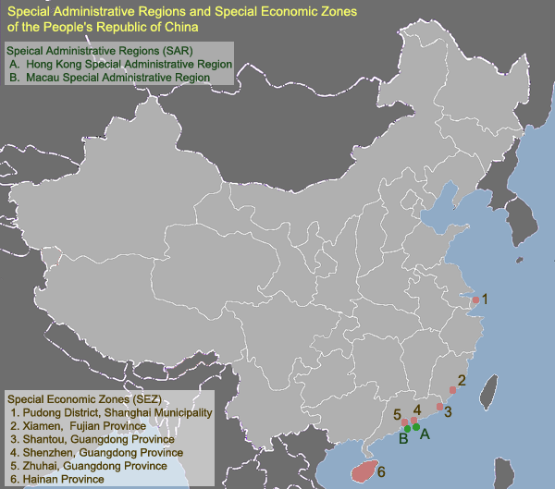

Slide 56
Reforms – foreign trade
Special economic zones (SEZs)
– Goungdong and Fujien
= close to Hong Kong and Taiwan
HK had bigger exports that all of China in 1978 (!)

Slide 57
Reforms – foreign trade
Special economic zones (SEZs)
= special legal regime allowing the use cheap Chinese labour force to work for Taiwanese and HK companies

Slide 58
Reforms – foreign trade
Special economic zones (SEZs)
= special legal regime allowing the use cheap Chinese labour force to work for Taiwanese and HK companies
Textile industry, later more sophisticated products – electronics

Slide 59
Reforms – foreign trade
Special economic zones (SEZs)
= special legal regime allowing the use cheap Chinese labour force to work for Taiwanese and HK companies
Textile industry, later more sophisticated products – electronics
FDI, export

Slide 60
Reforms – foreign trade
Not a major source of growth in the 1980s!
The economy was still relatively closed, most trade was domestic

Slide 61
Reforms – foreign trade
Not a major source of growth in the 1980s!
The economy was still relatively closed, most trade was domestic
Trade with HK and Taiwan raised revenue necessary to finance imports

Slide 62
Reforms – foreign trade
Not a major source of growth in the 1980s!
The economy was still relatively closed, most trade was domestic
Trade with HK and Taiwan raised revenue necessary to finance imports
„Export processing“ – all the stuff Taiwanese companies make in China has to be exported

Slide 63
Reforms – foreign trade
Not a major source of growth in the 1980s!
The economy was still relatively closed, most trade was domestic
Trade with HK and Taiwan raised revenue necessary to finance imports
„Export processing“ – all the stuff Taiwanese companies make in China has to be exported – so it does not compete with Chinese companies

Slide 64
The Tiananmen interlude
1980s- discussion about political reform
Deng – „party elder“ – informal influence
Desire to separate the Party and the state, introduce term-limits for officials

Slide 65
The Tiananmen interlude
1980s- discussion about political reform
Deng – „party elder“ – informal influence
Desire to separate the Party and the state, introduce term-limits for officials
Feud between reformists and „conservatives“ – unreconstructed Maoists over both economic and political reforms

Slide 66
The Tiananmen interlude
1980s- discussion about political reform
Deng – „party elder“ – informal influence
Desire to separate the Party and the state, introduce term-limits for officials
Feud between reformists and „conservatives“ – unreconstructed Maoists over both economic and political reforms
General Secretary – Hu Yaobang, followed by Zhao Ziyang – both favored some form of political liberalization

Slide 67
The Tiananmen interlude
Hu – dismissed because of pressure of conservatives in 1987
Died in early 1989
Demonstrations in large Chinese cities – calls for more political reforms (also economic demands – lower inequality etc.)

Slide 68
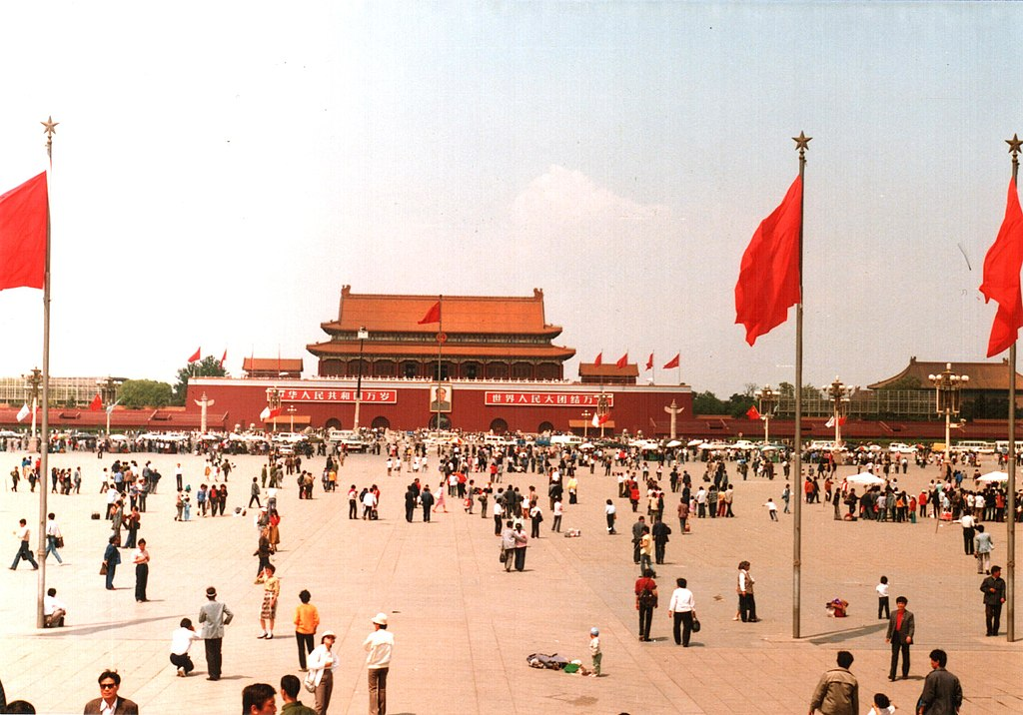

Slide 69
The Tiananmen interlude
CCP – more behind the scenes infighting

Slide 70
The Tiananmen interlude
CCP – more behind the scenes infighting
General Secretary Zhao – supported the protesters
Prime minister Li – favored a harsh crackdown

Slide 71
The Tiananmen interlude
CCP – more behind the scenes infighting
General Secretary Zhao – supported the protesters
Prime minister Li – favored a harsh crackdown
Deng (chairman of the military committee!) – undecided, in the end he reluctantly joined the conservatives

Slide 72
The Tiananmen interlude
CCP – more behind the scenes infighting
General Secretary Zhao – supported the protesters
Prime minister Li – favored a harsh crackdown
Deng (chairman of the military committee!) – undecided, in the end he reluctantly joined the conservatives
> martial law, army units gathered around Beijing
„June the 4th incident“ – massacre of protesters

Slide 73
The Tiananmen interlude
CCP – more behind the scenes infighting
General Secretary Zhao – supported the protesters
Prime minister Li – favored a harsh crackdown
Deng (chairman of the military committee!) – undecided, in the end he reluctantly joined the conservatives
> martial law, army units gathered around Beijing
„June the 4th incident“ – massacre of protesters
Followed by (less violent) crackdowns in other cities

Slide 74
The Tiananmen interlude
Party conservatives led by Li Peng seized power, Zhao dismissed – spent the rest of his life under house arrest
Attempt to overturn the economic reforms – central planning briefly reinstated!

Slide 75
Return to reform and opening up
1992 – Deng‘s Southern Tour > push for reviving the reforms

Slide 76
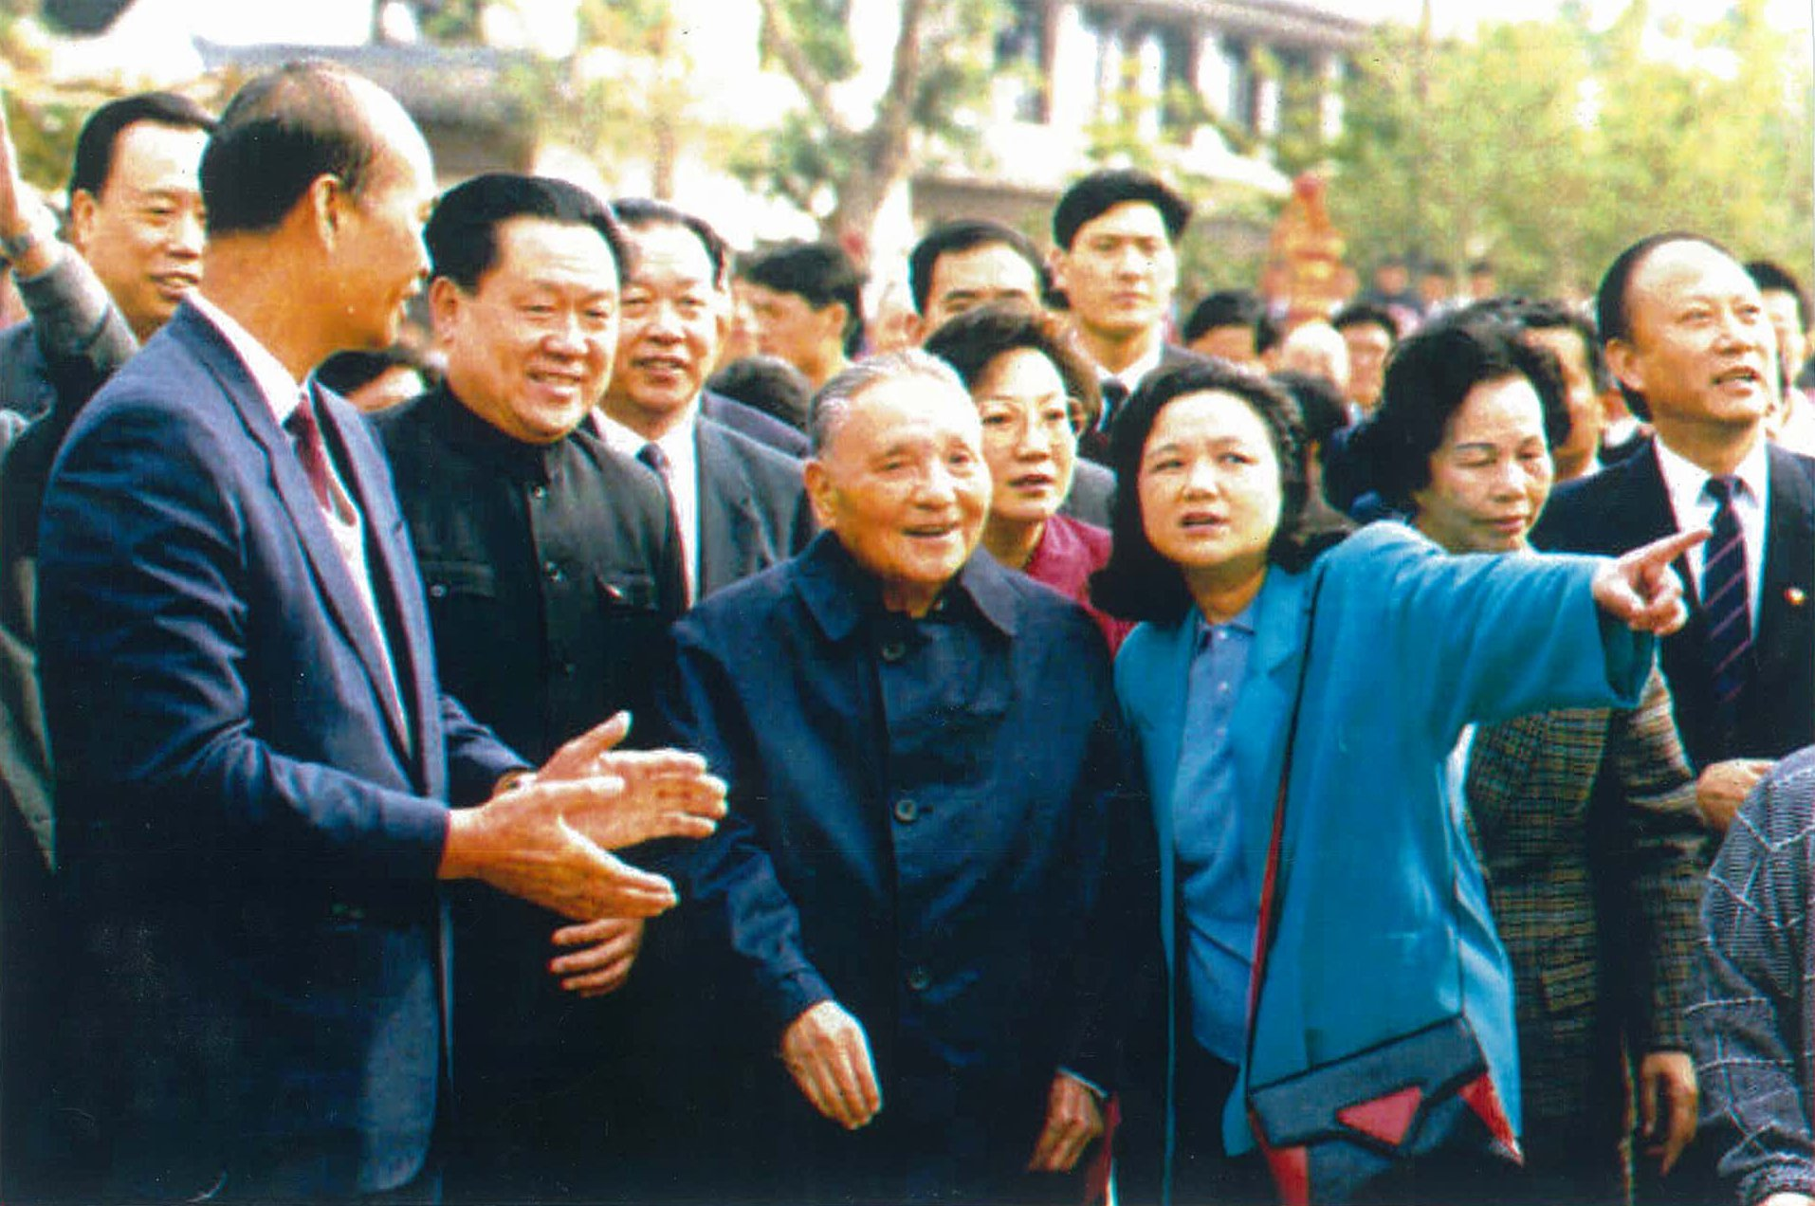

Slide 77
Return to reform and opening up
1992 – Deng‘s Southern Tour > push for reviving the reforms
New party leadership – Jiang Zenmin and Zhu Rongji – reliable party loyalists
Jiang and Zhu – from Shanghai – very conservative during the 1980s, almost no liberalization!

Slide 78
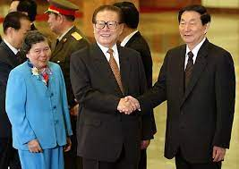

Slide 79
Return to reform and opening up
1992 – Deng‘s Southern Tour > push for reviving the reforms
New party leadership – Jiang Zenmin and Zhu Rongji – reliable party loyalists
Jiang and Zhu – from Shanghai – very conservative during the 1980s, almost no liberalization!
Return to a pro-market policy, but with more cautious approach than in the 1980s – fear of another Tiananmen

Slide 80
Return to reform and opening up
Focus on gradually reforming the urban economy – again at the expense of the countryside!

Slide 81
Return to reform and opening up
Focus on gradually reforming the urban economy – again at the expense of the countryside!
Higher taxes in for rural farmers and entrepreneurs > more inequality between cities and villages
Increased rural illiteracy!

Slide 82
Return to reform and opening up
Focus on gradually reforming the urban economy – again at the expense of the countryside!
Higher taxes in for rural farmers and entrepreneurs > more inequality between cities and villages
Increased rural illiteracy!
Resources invested in urban areas

Slide 83
Return to reform and opening up
Focus on advanced technologies and large projects

Slide 84
Return to reform and opening up
Focus on advanced technologies and large projects
Sophisticated infrastructure – high speed trains connecting major cities

Slide 85
Return to reform and opening up
Focus on advanced technologies and large projects
Sophisticated infrastructure – high speed trains connecting major cities
SOEs transformed into joint-stock companies, but the Party usually retains the controlling voting block

Slide 86
Return to reform and opening up
Focus on advanced technologies and large projects
Sophisticated infrastructure – high speed trains connecting major cities
SOEs transformed into joint-stock companies, but the Party usually retains the controlling voting block
Industrial policy –– „national champions“ – support of highly advanced companies such as Huawei – attempts to push them to the global cutting edge

Slide 87
Return to reform and opening up
„Letting go of the small“ – small companies can be privatized and left to their own devices
If they go bankrupt, who cares?

Slide 88
Return to reform and opening up
The state must nurture the big ones > economies of scale, export, prestige….

Slide 89
Return to reform and opening up
The state must nurture the big ones > economies of scale, export, prestige….
Largest firms – monopolistic construction companies (housing, infrastructure, electrical grid) - remained as SOEs

Slide 90
Return to reform and opening up
The state must nurture the big ones > economies of scale, export, prestige….
Largest firms – monopolistic construction companies (housing, infrastructure, electrical grid) - remained as SOEs
Financial sector (banks) – continues to be overwhelmingly state owned

Slide 91
Return to reform and opening up
The state must nurture the big ones > economies of scale, export, prestige….
Largest firms – monopolistic construction companies (housing, infrastructure, electrical grid) - remained as SOEs
Financial sector (banks) – continues to be overwhelmingly state owned
> Chinese foreign investment is based on state-owned capital!

Slide 92
Return to reform and opening up
Stunning growth of major cities
– shiny skyscrapers in downtown Shanghai etc
> overawed foreign visitors

Slide 93
Return to reform and opening up
Problems – large rate of investment, relatively small growth of consumption

Slide 94
Return to reform and opening up
Problems – large rate of investment, relatively small growth of consumption
= huge growth, but you can‘t enjoy its fruit, new wealth is immediately reinvested

Slide 95
Return to reform and opening up
Focus on foreign direct investment (FDI) and export – integrating China into the world economy

Slide 96
Return to reform and opening up
Focus on foreign direct investment (FDI) and export – integrating China into the world economy
x 1980s – mostly homegrown growth

Slide 97
Return to reform and opening up
Focus on foreign direct investment (FDI) and export – integrating China into the world economy
x 1980s – mostly homegrown growth
FDI = source of foreign technologies
Push to attract investors – financial incentives, offer of access to China‘s already huge market

Slide 98
Return to reform and opening up
Focus on foreign direct investment (FDI) and export – integrating China into the world economy
x 1980s – mostly homegrown growth
FDI = source of foreign technologies
Push to attract investors – financial incentives, offer of access to China‘s already huge market
Subcontractors, joint-ventures – investors need to commit themselves to transfer their know-how to Chinese counterparts

Slide 99
Return to reform and opening up
Focus on foreign direct investment (FDI) and export – integrating China into the world economy
x 1980s – mostly homegrown growth
FDI = source of foreign technologies
Push to attract investors – financial incentives, offer of access to China‘s already huge market
Subcontractors, joint-ventures – investors need to commit themselves to transfer their know-how to Chinese counterparts
Sometimes outright IP theft

Slide 100
Return to reform and opening up
> support for large, semi-state companies + foreign capital; indifference to small businesses

Slide 101
Return to reform and opening up
> support for large, semi-state companies + foreign capital; indifference to small businesses
> best strategy for Chinese companies – get incorporated in Hong Kong, then do business in China as a foreign company

Slide 102
Next time
Xi Jinping, China‘s technological ambitions

