Slide 1
The Xi Jinping era
China in the World Economy, autumn 2021

Slide 2
Repetition from last time
1) How does a country finance its imports?
2) What is the role of banks in an economy?
3) What happened with rural land during the 1980s?
4) What was the system of „dual prices“?
5) Where did FDI come from in the 1980s? Which areas were opened to it?
6) What happened to most SOEs during the 1990s?
7) Did China‘s private sector originate is a program of privatization?
8) What was the purpose of the obligation of foreign investors to form joint ventures?
9) What is the meaning of the phrase „national champions“?

Slide 3
Today
China‘s growing strength in the 2000s
The fallout from the 2008 Financial crisis
The rise of Xi Jinping and China‘s technological ambitions

Slide 4
The 2000s – export-led growth
Slow, gradual liberalization continued into the new millennium

Slide 5
The 2000s – export-led growth
Slow, gradual liberalization continued into the new millennium
China‘s most capitalist moment – after entering the WTO in 2001

Slide 6
The 2000s – export-led growth
Exports and imports – 5 % of GDP each in 1978
World average is about 20 % for each

Slide 7
The 2000s – export-led growth
Exports and imports – 5 % of GDP each in 1978
World average is about 20 % for each
China reached this level by 2001, its exports continued to soar after entering the WTO

Slide 8
The 2000s – export-led growth
Exports and imports – 5 % of GDP each in 1978
World average is about 20 % for each
China reached this level by 2001, its exports continued to soar after entering the WTO
2006 – exports stood at 35 % of GDP, imports at 30 % > 65 % together

Slide 9
The 2000s – export-led growth
Exports and imports – 5 % of GDP each in 1978
World average is about 20 % for each
China reached this level by 2001, its exports continued to soar after entering the WTO
2006 – exports stood at 35 % of GDP, imports at 30 % > 65 % together
In the United States, the sum is around 20 %!
= China was far more opened than the world average or comparably large countries!

Slide 10
The 2000s – export-led growth
2009 – largest exporter in the world
2011 – largest manufacturer
2012 – largest GDP by purchasing power parity

Slide 11
The 2000s – export-led growth
Huge growth of export, current account surplus (5 % of GDP in 2006)

Slide 12
The 2000s – export-led growth
Huge growth of export, current account surplus (5 % of GDP in 2006) = China finally overcame its problem of financing imports

Slide 13
The 2000s – export-led growth
Huge growth of export, current account surplus (5 % of GDP in 2006) = China finally overcame its problem of financing imports
> accumulation of foreign exchange (mostly dollars)

Slide 14
The 2000s – export-led growth
What is China going to do with all this foreign exchange?

Slide 15
The 2000s – export-led growth
What is China going to do with all this foreign exchange?
Keep it as a reserve – a precaution against a monetary crisis

Slide 16
The 2000s – export-led growth
What is China going to do with all this foreign exchange?
Keep it as a reserve – a precaution against a monetary crisis
Anxiety after the Asian monetary crisis of 1997

Slide 17
How a monetary crisis works
A country has a fixed exchange rate
- China does have a fixed exchange rate – the yuan was first tied to the US dollar, since 2005, it is pegged to a basket of currencies

Slide 18
How a monetary crisis works
A country has a fixed exchange rate
Markets (banks etc.) think that the rate is overvalued and unsustainable > they start to sell the currency

Slide 19
How a monetary crisis works
A country has a fixed exchange rate
Markets (banks etc.) think that the rate is overvalued and unsustainable > they start to sell the currency
> pressure for devaluation

Slide 20
How a monetary crisis works
A country has a fixed exchange rate
Markets (banks etc.) think that the rate is overvalued and unsustainable > they start to sell the currency
> pressure for devaluation
The central bank needs to start buying the currency to keep the same rate – they need foreign currencies to do this!

Slide 21
How a monetary crisis works
A country has a fixed exchange rate
Markets (banks etc.) think that the rate is overvalued and unsustainable > they start to sell the currency
> pressure for devaluation
The central bank needs to start buying the currency to keep the same rate – they need foreign currencies to do this!
If they fail > increased interest rates to stop the capital flight > drop of domestic credit > domestic recession

Slide 22
How a monetary crisis works
= in the end, the Central bank usually freezes the creation of money, which stops capital flight, but creates recession

Slide 23
How a monetary crisis works
= in the end, the Central bank usually freezes the creation of money, which stops capital flight, but creates recession
Did anything like this ever happen here?
Yes, in 1997! (like the Asian crisis!)

Slide 24
How a monetary crisis works
= in the end, the Central bank usually freezes the creation of money, which stops capital flight, but creates recession

Slide 25
How a monetary crisis works
China fears this scenario, so it keeps large reserves of foreign currency
> if you sit upon a huge pile of dollars, you can defeat a speculative attack
Actually, you can deter it

Slide 26
The 2000s – export-led growth
What else can you do with foreign exchange?
= you don‘t use it to buy imports, you don‘t want to keep it as reserves

Slide 27
The 2000s – export-led growth
What else can you do with foreign exchange?
= you don‘t use it to buy imports, you don‘t want to keep it as reserves
Foreign investment – purchases of Western companies; Belt and Road Initiative

Slide 28
The 2000s – export-led growth
Major exporter of advanced technology products already by 2005!
= laptops, mobile phones, scanners, cameras, medical equipment

Slide 29
The 2000s – export-led growth
Major exporter of advanced technology products already by 2005!
= laptops, mobile phones, scanners, cameras, medical equipment
Growth continued at breakneck speed – over 10 % a year – even though the base was already quite large

Slide 30
The 2000s – export-led growth
Major exporter of advanced technology products already by 2005!
= laptops, mobile phones, scanners, cameras, medical equipment
Growth continued at breakneck speed – over 10 % a year – even though the base was already quite large
= biggest story of the decade; the West overlooked it

Slide 31
The 2000s – export-led growth
2002 – change in Party leadership – Hu Jintao and Wen Jiabao
Only transfer of power without a purge in PRC‘s history!

Slide 32
The 2000s – export-led growth
2002 – change in Party leadership – Hu Jintao and Wen Jiabao
Only transfer of power without a purge in PRC‘s history!
Theoretically – generations of party leadership – change every 10 years (1992-2002-2012-2022)

Slide 33
The 2000s – export-led growth
2002 – change in Party leadership – Hu Jintao and Wen Jiabao
Only transfer of power without a purge in PRC‘s history!
Theoretically – generations of party leadership – change every 10 years (1992-2002-2012-2022)
Hu leadership – continuation of previous policies
More resources devoted to social spending – healthcare, education, alleviation of rural poverty

Slide 34
The 2000s – export-led growth
Fears that China will fall into a „middle income trap“

Slide 35
Averting a middle-income trap
Fears that China will fall into a „middle income trap“
China continues to specialize on low-value added activities within global value chains

Slide 36
Averting a middle-income trap
Fears that China will fall into a „middle income trap“
China continues to specialize on low-value added activities within global value chains
= it takes part in the production of sophisticated products organized by multinational companies, who keep the most lucrative work elsewhere

Slide 37
Averting a middle-income trap
Fears that China will fall into a „middle income trap“
China continues to specialize on low-value added activities within global value chains
= it takes part in the production of sophisticated products organized by multinational companies, who keep the most lucrative work elsewhere
For example, China makes electronics, but cannot produce top notch semiconductors

Slide 38
Averting a middle-income trap
Warning story – Japanese stagnation after 1990 – after wages grew, export moved to cheaper locations like China

Slide 39
Averting a middle-income trap
Theory – the most value added processes are at the start of production (research and development, design) and at the end (marketing, retailing)
The physical work in between can be done by anyone (= China)
Smiley curve

Slide 40
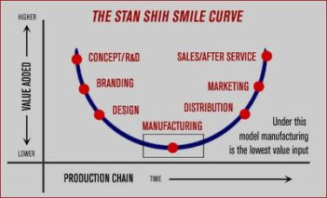
Averting a middle-income trap

Slide 41
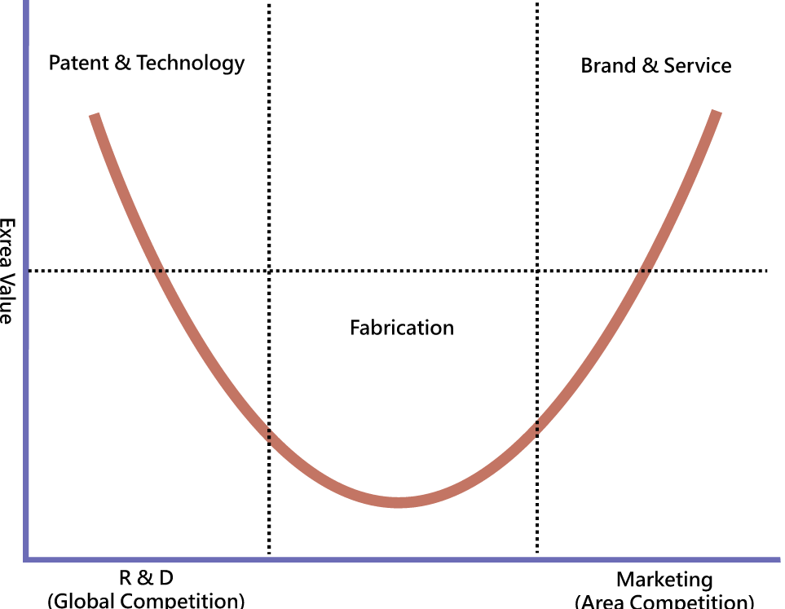
Averting a middle-income trap

Slide 42
Averting a middle-income trap
China needs to move up the value chains

Slide 43
Averting a middle-income trap
China needs to move up the value chains
Ideally to create its own brands which keep the best jobs in China

Slide 44
Averting a middle-income trap
China needs to move up the value chains
Ideally to create its own brands which keep the best jobs in China
Outsource cheap labor to poorer countries – Southeast Asia

Slide 45
Averting a middle-income trap
Kennedy and Lim – the innovation imperative
If a country wants to escape the middle-income trap, it must start to innovate (RaD)

Slide 46
Averting a middle-income trap
Kennedy and Lim – the innovation imperative
If a country wants to escape the middle-income trap, it must start to innovate (RaD)
Three types of possible actions:
1) Domestic innovation and research
2) Purchase of foreign technologies
3) Theft of foreign technologies

Slide 47
Averting a middle-income trap
Kennedy and Lim – the innovation imperative
If a country wants to escape the middle-income trap, it must start to innovate (RaD)
Three types of possible actions:
1) Domestic innovation and research
2) Purchase of foreign technologies
3) Theft of foreign technologies
> China practices all three at a large scale

Slide 48
Averting a middle-income trap
Technology will compensate for growing wages – China will remain a competitive exporter

Slide 49
Averting a middle-income trap
Technology will compensate for growing wages – China will remain a competitive exporter
How to do this? > industrial policy

Slide 50
„Industrial policy is defined as the strategic effort by the state to encourage economic transformation, i.e. the shift from lower to higher productivity activities, between or within sectors.“
x trade policy – attempts to influence import and export

Slide 51
Industrial policy - takes place within a country (subsidies, tax break, grants, privileged access to loans…)
Trade policy – takes place at the border – tariffs and non-tariff barriers to trade
> China is far more active in industrial policy

Slide 52
Return of industrial policy
Around 2000, China‘s central government did not directly attempt to develop specific sectors of the economy

Slide 53
Return of industrial policy
Around 2000, China‘s central government did not directly attempt to develop specific sectors of the economy
There were provincial programs + support for some SOEs and large corporations, but no central coordinated plan

Slide 54
MLP
2006 – Medium-Long Range Plan For Science and Technology (MLP) – 16 megaprojects

Slide 55
MLP
2006 – Medium-Long Range Plan For Science and Technology (MLP) – 16 megaprojects
- aircraft, semiconductors, intelligent computers, GMOs, novel drugs

Slide 56
MLP
Ambition to invest 2,5% of GDP into research and development by 2020
Almost achieved, RaD expenditures continue to grow quickly

Slide 57
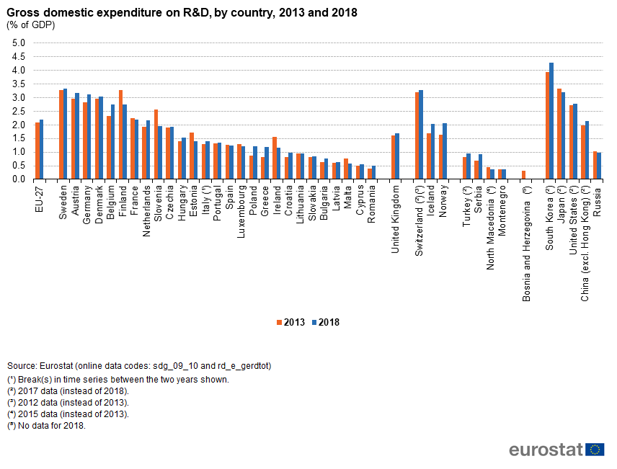

Slide 58
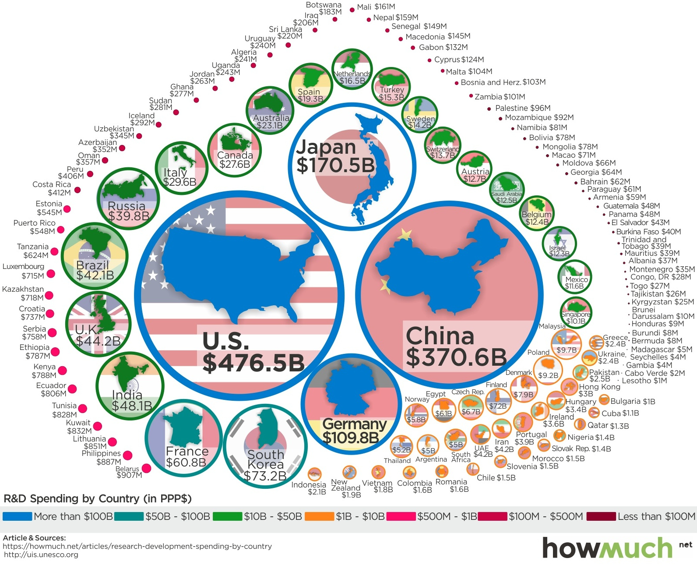

Slide 59
MLP
MLP – investments into science and research, not support for specifically chosen companies

Slide 60
MLP
Goal – to catch up with industry leaders

Slide 61
MLP
Goal – to catch up with industry leaders
= typical goal of industrial policy – use governmental incentives to learn and adopt foreign technologies
= similar to policies of other countries

Slide 62
2008 Financial crisis
> huge injections of state capital into the economy
Use of state banks and SOEs!

Slide 63
2008 Financial crisis
> huge injections of state capital into the economy
Use of state banks and SOEs!
Successful – return to growth as early as 2010
= positive experience with a large state intervention

Slide 64
2008 Financial crisis
> perception that the Western model of capitalism has failed

Slide 65
2008 Financial crisis
> perception that the Western model of capitalism has failed
> China should use the advantages of its state capitalist model more often and more forcefully

Slide 66
Strategic emerging industry (SEI)
Prime minister Wen – it is during periods of crisis when great technological revolutions take place

Slide 67
Strategic emerging industry (SEI)
Prime minister Wen – it is during periods of crisis when great technological revolutions take place
> this time, China is not going to miss it!

Slide 68
Strategic emerging industry (SEI)
Prime minister Wen – it is during periods of crisis when great technological revolutions take place
> this time, China is not going to miss it!
“Seize the commanding heights of the new technological revolution”

Slide 69
Strategic emerging industry (SEI)
2010 – new and more ambitious policy
Ambition to not just catch up with but to overtake leading countries and firms (=5G etc.)

Slide 70
Strategic emerging industry (SEI)
2010 – new and more ambitious policy
Ambition to not just catch up with but to overtake leading countries and firms (=5G etc.)
More direct – cooperation with specific firms

Slide 71
The Xi Jinping era
2012 – new leadership of the Party
Conservative, authoritarian turn

Slide 72
The Xi Jinping era
2012 – new leadership of the Party
Conservative, authoritarian turn
Limiting the autonomy of regional governments and collective bodies, cult of personality – president for life

Slide 73
The Xi Jinping era
2012 – new leadership of the Party
Conservative, authoritarian turn
Limiting the autonomy of regional governments and collective bodies, cult of personality – president for life
Ethnic nationalism, clampdown on minorities, upholding of traditional gender norms (ban on sissy boys etc.)

Slide 74
The Xi Jinping era
Economically – strengthening the role of the state/Party

Slide 75
The Xi Jinping era
Economically – strengthening the role of the state/Party
In the preceding era – the private sector grew faster than the public sector (in spite of policy!) and gradually overshadowed it

Slide 76
The Xi Jinping era
Private corporations:
1) May pose a threat to the Party

Slide 77
The Xi Jinping era
Private corporations:
1) May pose a threat to the Party
2) Behave according to their selfish motives = invest money according to what is most immediately profitable, not what is most beneficial for China in the long rung

Slide 78
The Xi Jinping era
Private corporations:
1) May pose a threat to the Party
2) Behave according to their selfish motives = invest money according to what is most immediately profitable, not what is most beneficial for China in the long rung
= they don‘t see the „big picture“= divert resources from more important causes

Slide 79
The Xi Jinping era
Private corporations:
1) May pose a threat to the Party
2) Behave according to their selfish motives = invest money according to what is most immediately profitable, not what is most beneficial for China in the long rung
= they don‘t see the „big picture“= divert resources from more important causes
> the Party must lead to overcome this coordination problem

Slide 80
The Xi Jinping era
Creeping nationalization > private companies are being forced to accept a role for the Party in decision making

Slide 81
The Xi Jinping era
Creeping nationalization > private companies are being forced to accept a role for the Party in decision making
Veto right, founding of new party cells inside of businesses

Slide 82
The Xi Jinping era
Creeping nationalization > private companies are being forced to accept a role for the Party in decision making
Veto right, founding of new party cells inside of businesses
Similar rules were often created in the 1990 for privatized SOEs, here this régime is extended to formally purely private companies

Slide 83
The Xi Jinping era
Creeping nationalization > private companies are being forced to accept a role for the Party in decision making
Veto right, founding of new party cells inside of businesses
Similar rules were often created in the 1990 for privatized SOEs, here this régime is extended to formally purely private companies
> even greater obfuscation of the already blurry line between the public and private sector!

Slide 84
Artificial intelligence
2016 – AlphaGo (Google) defeated professional Go players

Slide 85
Artificial intelligence
2016 – AlphaGo (Google) defeated professional Go players
- a traditional Asian game which is far more complex than chess
> „Sputnik moment“

Slide 86
Artificial intelligence
2016 – AlphaGo (Google) defeated professional Go players
- a traditional Asian game which is far more complex than chess
> „Sputnik moment“
„AI gap“ – like the missile gap during the Cold War

Slide 87
Prime minister Wen – it is during periods of crisis when great technological revolutions take place
> this time, China is not going to miss it!
“Seize the commanding heights of the new technological revolution”

Slide 88
Artificial intelligence
2016 – AlphaGo (Google) defeated professional Go players
- a traditional Asian game which is far more complex than chess
> „Sputnik moment“
„AI gap“ – like the missile gap during the Cold War
> „AI is the new groundbreaking technology we are looking for!“
A new economic era is beginning, China must take the lead

Slide 89
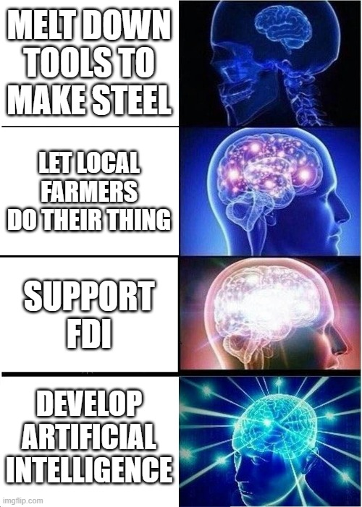

Slide 90
The AI triad
1) Collection of data – sensors, cameras with facial recognition etc.
2) Quick transfer of data – next generation Internet
3) Processing od data – algorithms, advanced hardware

Slide 91
The AI triad
1) Collection of data – sensors, cameras with facial recognition etc.
2) Quick transfer of data – next generation Internet
3) Processing od data – algorithms, advanced hardware
> a car driven by computer stops at a red light, which reacts to sensors observing transport, which automatically reacts to traffic jam

Slide 92
The AI triad
1) Collection of data – sensors, cameras with facial recognition etc.
2) Quick transfer of data – next generation Internet
3) Processing od data – algorithms, advanced hardware
> a car driven by computer stops at a red light, which reacts to sensors observing transport, which automatically reacts to traffic jam
> automatically operated factories or systems of transport

Slide 93
The AI triad
1) Collection of data – sensors, cameras with facial recognition etc.
2) Quick transfer of data – next generation Internet
3) Processing od data – algorithms, advanced hardware
> a car driven by computer stops at a red light, which reacts to sensors observing transport, which automatically reacts to traffic jam
> automatically operated factories or systems of transport
„Digital central planning“?

Slide 94
„New Era“
1949-1976 – Maoism – correct principles, but insufficient capacity to implement them

Slide 95
„New Era“
1949-1976 – Maoism – correct principles, but insufficient capacity to implement them
1978-2012 – Reform and Opening – attempt to build up wealth and strength at the cost of diverting from preferred values

Slide 96
„New Era“
1949-1976 – Maoism – correct principles, but insufficient capacity to implement them
1978-2012 – Reform and Opening – attempt to build up wealth and strength at the cost of diverting from preferred values
2012 -? – New Era – dialectical synthesis – now China has the means to go back to a much more statist economy and to do so efficiently = correct principles with capacity to implement them

Slide 97
Industrial revolutions

Slide 98
Industrial revolutions
1st – steam engine > textile industry, ships, trains

Slide 99
Industrial revolutions
1st – steam engine > textile industry, ships, trains
2nd – electricity and combustion engines > cars, planes; lighbulbs and domestic appliances

Slide 100
Industrial revolutions
1st – steam engine > textile industry, ships, trains
2nd – electricity and combustion engines > cars, planes; lighbulbs and domestic appliances
3rd – information technologies and electronics – computers, phones, GPS – human oversight!

Slide 101
Industrial revolutions
1st – steam engine > textile industry, ships, trains
2nd – electricity and combustion engines > cars, planes; lightbulbs and domestic appliances
3rd – information technologies and electronics – computers, phones, GPS – human oversight!
4th – AI – autonomous robots and machines, smart manufacturing etc.

Slide 102
China should seize the opportunity and become the leader in the 4th industrial revolution
> take a shortcut, bypass some stages of development and go to the top
> leapfrog advanced countries

Slide 103
At the same time – Brexit, Trump, terrorist attacks in France > even greater perception of Western decline

Slide 104
At the same time – Brexit, Trump, terrorist attacks in France > even greater perception of Western decline
> the West is weak and decadent, and cannot possibly withstand China‘s ability to mobilize resources and make sacrifices for its common future

Slide 105
China rediscovered its confidence after 40 years of basically uninterrupted growth and success

Slide 106
traditional anti-liberal worldview:
„Americans let their best minds focus on creating addictive social media; advertisement; financial services…“

Slide 107
traditional anti-liberal worldview:
„Americans let their best minds focus on creating addictive social media; advertisement; financial services…“
> „We will focus on things that are actually valuable and useful“ = high tech

Slide 108
„techno-nationalism“

Slide 109
Noah Smith – Why Is China Smashing Its Tech Industry?

Slide 110
Noah Smith – Why Is China Smashing Its Tech Industry?
What is called „tech“ in the West are mostly consumer-oriented services such as social media and financial apps

Slide 111
Noah Smith – Why Is China Smashing Its Tech Industry?
What is called „tech“ in the West are mostly consumer-oriented services such as social media and financial apps
China thinks this type of stuff is soft – true tech is advanced manufacturing, material science, AI…

Slide 112
Noah Smith – Why Is China Smashing Its Tech Industry?
What is called „tech“ in the West are mostly consumer-oriented services such as social media and financial apps
China thinks this type of stuff is soft – true tech is advanced manufacturing, material science, AI…
= things that have a high and measurable performance

Slide 113
Noah Smith – Why Is China Smashing Its Tech Industry?
What is called „tech“ in the West are mostly consumer-oriented services such as social media and financial apps
China thinks this type of stuff is soft – true tech is advanced manufacturing, material science, AI…
= things that have a high and measurable performance
Smith - would be useful in a war???

Slide 114
Liberal critique - Naughton, Huang – value does not necessarily come from technological prowess
Many things we value are quite rudimentary

Slide 115
Liberal critique - Naughton, Huang – value does not necessarily come from technological prowess
Many things we value are quite rudimentary
Krpec – a kilogram of integrated circuits vs. a kilogram of Parma ham

Slide 116
Made in China 2025
Announced in 2015
A truly large program of industrial policy – bigger, more concrete and more ambitious than SEI

Slide 117
Made in China 2025
Announced in 2015
A truly large program of industrial policy – bigger, more concrete and more ambitious than SEI
Supported sectors – advanced technology fields – AI, machine learning, internet of things, new materials, aerospace, biotechnology…

Slide 118
Innovation Driven Development Strategy
2016, meant as a more general framework for existing programs (MiC25, SEI, Internet Plus)

Slide 119
Innovation Driven Development Strategy
2016, meant as a more general framework for existing programs (MiC25, SEI, Internet Plus)
Main idea – AI is a general-purpose technology

Slide 120
Innovation Driven Development Strategy
2016, meant as a more general framework for existing programs (MiC25, SEI, Internet Plus)
Main idea – AI is a general-purpose technology
The goal is to 1) develop it and then 2) implement it in all sectors of the Chinese economy

Slide 121
Innovation Driven Development Strategy
2016, meant as a more general framework for existing programs (MiC25, SEI, Internet Plus)
Main idea – AI is a general-purpose technology
The goal is to 1) develop it and then 2) implement it in all sectors of the Chinese economy
> digitalization, smart cities, intelligent manufacturing

Slide 122
Innovation Driven Development Strategy
China now has a whole system of programs to develop new technologies and support their adoption

Slide 123
Industrial Guidance Funds
Key tool of industrial policy
The previous (MiC25 etc.) were programs laying out goals; this is about the means

Slide 124
Industrial Guidance Funds
Inspired by US venture capital firms
But funded by SOEs and banks – indirect state capital

Slide 125
Industrial Guidance Funds
Inspired by US venture capital firms
But funded by SOEs and banks – indirect state capital
„You have savings and profits? Give them to a designated fund!“

Slide 126
Industrial Guidance Funds
Inspired by US venture capital firms
But funded by SOEs and banks – indirect state capital
„You have savings and profits? Give them to a designated fund!“
2019 – total commitment 1,6 trillion USD – 11 % of Chinese GDP

Slide 127
Industrial Guidance Funds
Investment – both new startups and established firms

Slide 128
Biggest target of support – semiconductors
= chips
= brain of electronics, „DNA of technology“

Slide 129
Biggest target of support – semiconductors
= chips
= brain of electronics, „DNA of technology“
Necessary for China‘s technological goals

Slide 130
Biggest target of support – semiconductors
= chips
= brain of electronics, „DNA of technology“
Necessary for China‘s technological goals
China continues to be surprisingly weak and aims to improve its position

Slide 131
Biggest target of support – semiconductors
= chips
= brain of electronics, „DNA of technology“
Necessary for China‘s technological goals
China continues to be surprisingly weak and aims to improve its position
Next time!

Slide 132
Return of industrial policy
Bigger (even relatively) than policies of Japan, Taiwan, South Korea etc. in the post-war period
A qualitatively different goal – leadership

Slide 133
Return of industrial policy
Bigger (even relatively) than policies of Japan, Taiwan, South Korea etc. in the post-war period
A qualitatively different goal – leadership
Highly provocative – Naughton – breaking of unwritten international rules

Slide 134
Return of industrial policy
Bigger (even relatively) than policies of Japan, Taiwan, South Korea etc. in the post-war period
A qualitatively different goal – leadership
Highly provocative – Naughton – breaking of unwritten international rules
> backlash - end of Western complacency about China – US-China trade war

Slide 135
Return of industrial policy
Bigger (even relatively) than policies of Japan, Taiwan, South Korea etc. in the post-war period
A qualitatively different goal – leadership
Highly provocative – Naughton – breaking of unwritten international rules
> backlash - end of Western complacency about China – US-China trade war
Also next time

Slide 136
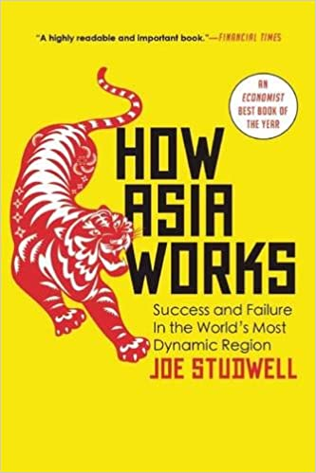
Asian developmental state
„How Asia works“ – Joe Studwell

Slide 137
Asian developmental state
„How Asia works“ – Joe Studwell
1) Land reform
2) Industrial policy > promotion of exports
3) State owned banks – also promotion of industry

Slide 138
Asian developmental state
New firms are not going to succeed on their own, they need protection and help from the state (x free trade)

Slide 139
Asian developmental state
New firms are not going to succeed on their own, they need protection and help from the state (x free trade)
But they must be tested so that they don‘t become complacent > „export discipline“ – they must be able to sell products abroad

Slide 140
Asian developmental state
New firms are not going to succeed on their own, they need protection and help from the state (x free trade)
But they must be tested so that they don‘t become complacent > „export discipline“ – they must be able to sell products abroad
Why abroad? Success in the closed domestic market doesn‘t prove anything

Slide 141
Asian developmental state
Undervalued currency – helps with export

Slide 142
Asian developmental state
China – somewhat similar, but even more statist
Most large enterprises continued to be state-owned (to this day)

Slide 143
Asian developmental state
China – somewhat similar, but even more statist
Most large enterprises continued to be state-owned (to this day)
No liberalization after successful growth

Slide 144
Asian developmental state
China – somewhat similar, but even more statist
Most large enterprises continued to be state-owned (to this day)
No liberalization after successful growth
J, K, T attempted to catch up, not to become the undisputed leader (x China‘s ambitions for next generation Internet, AI….)

Slide 145
Asian developmental state
J, K, T – developmental state as a necessary evil, a precursor to capitalism which isn‘t possible yet
= more or less in line with Western theorists of protectionism – Alexander Hamilton, Friedrich List

Slide 146
Asian developmental state
J, K, T – developmental state as a necessary evil, a precursor to capitalism which isn‘t possible yet
= more or less in line with Western theorists of protectionism – Alexander Hamilton, Friedrich List
CH – developmental state as a necessary evil, a precursor to socialism which isn‘t possible yet

Slide 147
Asian developmental state
J, K, T – developmental state as a necessary evil, a precursor to capitalism which isn‘t possible yet
= more or less in line with Western theorists of protectionism – Alexander Hamilton, Friedrich List
CH – developmental state as a necessary evil, a precursor to socialism which isn‘t possible yet
= China does not yet posses the capacity for planning and redistribution necessary to achieve socialism, so it has to accept markets

Slide 148
Asian developmental state
CCP – China‘s advantage continues to be the ability to mobilize resources

Slide 149
ISI
Import-substituting industrialization (ISI)
Not so important for us, but often discussed in IPE
Latin America, circa 1945-1980

Slide 150
ISI
Protectionism, state-owned banks and large enterprises – similar to Asia

Slide 151
ISI
But – no promotion of export! – closed economies

Slide 152
ISI
But – no promotion of export! – closed economies
> trade deficits > financed by debt

Slide 153
ISI
But – no promotion of export! – closed economies
> trade deficits > financed by debt
Overvalued currencies – to pay back the debt – but exacerbated the trade deficits

Slide 154
ISI
But – no promotion of export! – closed economies
> trade deficits > financed by debt
Overvalued currencies – to pay back the debt – but exacerbated the trade deficits
Also – no sweeping land-reform = surviving inequality, „old elite“

Slide 155
ISI
But – no promotion of export! – closed economies
> trade deficits > financed by debt
Overvalued currencies – to pay back the debt – but exacerbated the trade deficits
Also – no sweeping land-reform = surviving inequality, „old elite“
1980s – bankruptcies, transition to free trade (IMF, WB)

Slide 156
ISI
Economists – identification of ISI with protectionism and Asia with free markets
= misinterpretation

Slide 157
Shock therapy/Neoliberalism
Eastern Europe after 1989
= full transition towards free market capitalism
= privatization of enterprises, market prices, free trade

Slide 158
Shock therapy/Neoliberalism
Main idea – the Communist regimes have collapsed > there is no power capable of overseeing central planning

Slide 159
Shock therapy/Neoliberalism
Main idea – the Communist regimes have collapsed > there is no power capable of overseeing central planning
> we must move quickly towards markets, otherwise the managers of the SOE‘s will plunder the assets
= the need to dissolve public ownership relatively quickly, before it‘s completely hollowed out

Slide 160
Shock therapy/Neoliberalism
Derided and discredited today – collapse of Russia, Ukraine etc, poverty, rise of oligarchs

Slide 161
Shock therapy/Neoliberalism
Derided and discredited today – collapse of Russia, Ukraine etc, poverty, rise of oligarchs
But – Baltic countries, Poland, Czechia, Slovakia, Slovenia, Hungary…
> often reasonably successful!

Slide 162
Shock therapy/Neoliberalism
China – We don‘t want shock therapy, because:
1) we still basically believe that socialism will win in the end
2) doing so would drastically curtail the Party‘s power

Slide 163
Shock therapy/Neoliberalism
China – We don‘t want shock therapy, because:
1) we still basically believe that socialism will win in the end
2) doing so would drastically curtail the Party‘s power
Eastern Europe – We don‘t want Chinese-style mixed economy because:
1) we no longer believe in socialism
2) doing so would mean keeping the security apparatus to oversee the SOEs

