Slide 1
Deciding on the number of factors
PSY544 – Introduction to Factor Analysis
Week 11

Slide 2
Introduction
The objective of exploratory (unrestricted) factor analysis is to determine the number and nature of the common factors.
Deciding on the number of factors to extract is key, also because subsequent analyses (such as rotation) depend on this decision.
There’s a lot of literature out there on the how-many-factors problem. Unfortunately, most of this literature focuses on developing mechanistical rules that will indicate the “true” number of factors.

Slide 3
Introduction
This is very misguided.
First of all, there is no such thing as “the true number of factors”.
Second, mechanistical rules – while sometimes useful – do not work every time.

Slide 4
Introduction
We need to recognize that no parsimonious model will hold exactly.
We must use informed judgement and need to take into account various sources of information.
At times, the decision won’t be easy and all the available information will not clearly point us in either direction.

Slide 5
Introduction
A lot of researchers use the mechanistical rules or rules of thumb without careful judgement or understanding.
This is not effective and can result in misleading solutions or interpretations.
The mechanical rules can (and often do) provide useful information, but none can be effectively used by itself, without considering other information.

Slide 6
Introduction
There is a trade-off in what we do – we would like to find such a number of factors so that the model would fit reasonably well, but still provides a considerable degree of parsimony.
Ideal situation: to find a model that fits reasonably well, while a model with fewer factors fits significantly worse and a model with more factors doesn’t fit significantly better.
Also, the identified factors have to be meaningful and interpretable.

Slide 7
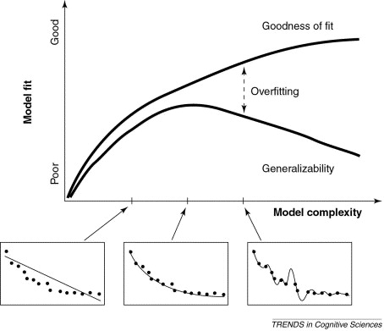
Pitt & Myung (2002)

Slide 8
Introduction
Nowadays, simply doing an EFA is not enough (oh, the old days…). So it is also important to view EFA as a step in the entire factor analysis process – it is very likely that you will subsequently perform a CFA on similar data, so EFA can work as a tool for limiting the space of potential models and identifying a couple of candidate models (with a reasonable number and interpretability of the common factors)

Slide 9
EFA, CFA, UFA, RFA…
I have been using the terms exploratory, confirmatory, restricted, unrestricted, …, in a pretty chaotic way sometimes, so let me explain.
Traditionally, people recognize EFA (exploratory) and CFA (confirmatory). But this sounds a bit more like it’s about the purpose and not about the model itself.
Better to use restricted (typically CFA) and unrestricted (typically EFA) factor analysis. This simply refers to whether there are any restrictions on Λ

Slide 10
Sources of error
When performing EFA (or most statistical analyses, actually), we face two sources of error:
Sampling error (our R is not our P)
Model error (even if we had P, it would not fit perfectly – all models are wrong)

Slide 11
Number of factors
OK, so, we established there is not such thing as the true number of factors
Our objective, then, is to identify the plausible number of major common factors
What kind of information is available?

Slide 12
Number of factors
Types of information available:
Rules of thumb (mostly based on eigenvalues)
Statistical tests
Common sense
Informed judgement

Slide 13
Rules of thumb
Number of eigenvalues greater than 1
Sometimes known as the Kaiser criterion or the Kaiser-Guttman criterion.
According to Guttman (1954), if the model holds exactly in the population, the number of eigenvalues greater than 1 provides a lower bound to the number of factors.

Slide 14
Rules of thumb
Number of eigenvalues greater than 1
Although there is theoretical justification for this rule at the population level and in the ideal case the model holds exactly, it is routinely used with sample correlation matrices.
People use this VERY often. It has been repeatedly demonstrated to be misleading.

Slide 15
Rules of thumb
Number of eigenvalues greater than 1
Furthermore, the theoretical justification only applies to the population correlation matrix, but most EFA software gives you the eigenvalues for the sample reduced correlation matrix.
It can serve you as a guide or a reference point, but dogmatic application will (probably) lead you nowhere.

Slide 16
Rules of thumb
Scree plot
Cattell (1966). Simply plot the eigenvalues of the sample correlation or reduced sample correlation matrix and look at the last large discontinuity.
Let’s look at an example.

Slide 17
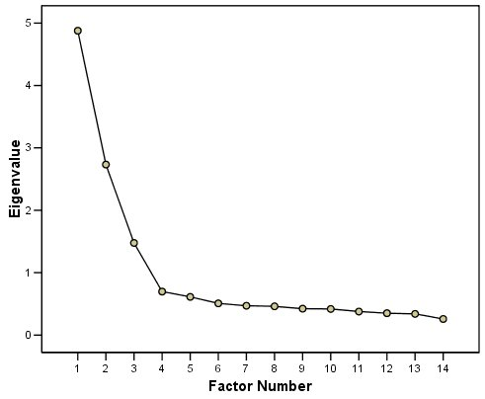
Rules of thumb

Slide 18
Rules of thumb
Scree plot
In this case, we would choose m = 3.
This procedure is very subjective and does not have any theoretical justification. Only an informal rationale is available – if there exists m factors, then there will be m relatively large eigenvalues. The rest of the eigenvalues (small) will only represent noise.

Slide 19
Rules of thumb
Scree plot
As before, this method can be informative to some extent, but should not be used exclusively.

Slide 20
Goodness of fit tests
Test of perfect fit
Using the likelihood-ratio test statistic to test a hypothesis that the model fits perfectly in the population.
We’ve covered this one already.
For a model with m factors, rejecting the null hypothesis means we need more factors. When we fail to reject the null, we should stop adding more factors.

Slide 21
Goodness of fit tests
Test of perfect fit
Problems!
The null hypothesis is not true, we know that, so what’s the point in testing it?
Sequential tests are not independent.
Functionally a test of sample size.
Mechanistical.

Slide 22
Fit indices
RMSEA
Selecting the number of factors (or selecting a couple of plausible numbers of factors) is fundamentally a problem of model fit.
We can sequentially estimate models with increasing numbers of factors and look at changes in model fit.
Encourages mechanistical use. Don’t rely too much on the suggested values for RMSEA.

Slide 23
Fit indices
Tucker-Lewis Index (TLI)
The TLI is a so-called incremental fit index. What does that mean?
The index is based on comparing the fit of a model with m factors to the fit of two reference models.
The first one is the „world’s worst model”, the so-called “null model”, with m = 0. This model implies zero correlation between the MVs in the population
The second one is the “world’s best model”, the so-called “ideal model”, which fits perfectly in the population.

Slide 24
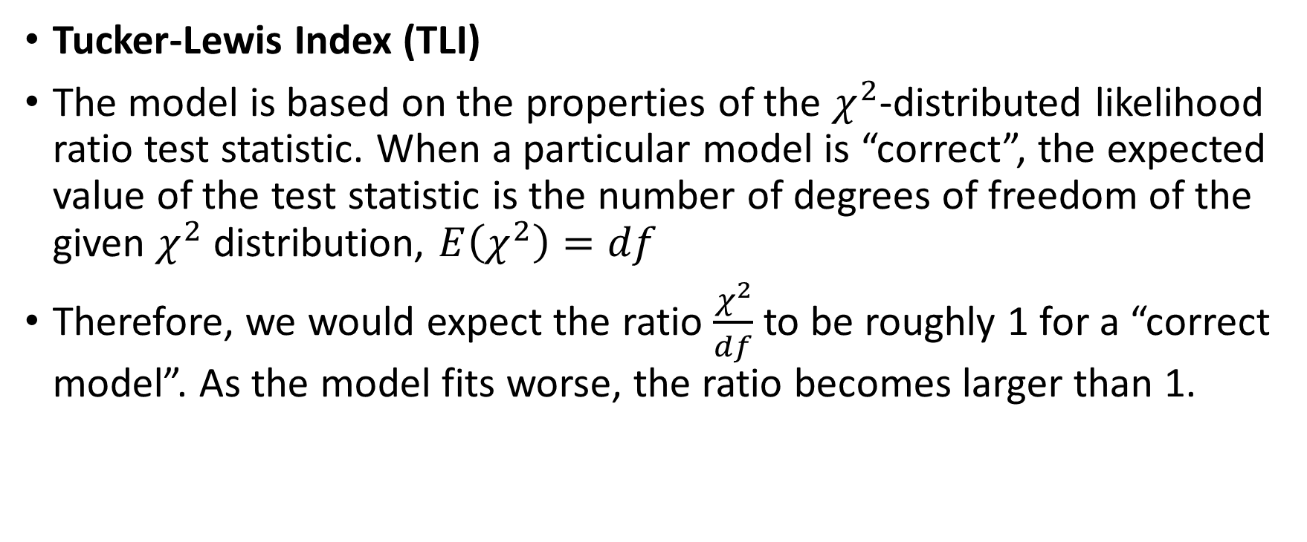
Fit indices
Tucker-Lewis Index (TLI)
The model is based on the properties of the $χ^{2}$-distributed likelihood ratio test statistic. When a particular model is “correct”, the expected value of the test statistic is the number of degrees of freedom of the given $χ^{2}$ distribution, $E\left(χ^{2}\right)=df$
Therefore, we would expect the ratio $\frac{χ^{2}}{df}$ to be roughly 1 for a “correct model”. As the model fits worse, the ratio becomes larger than 1.

Slide 25
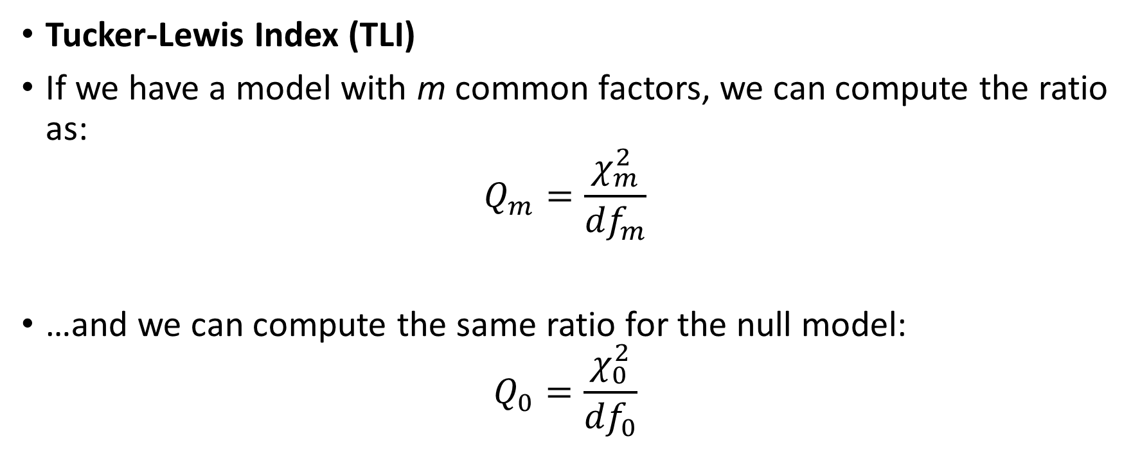
Fit indices
Tucker-Lewis Index (TLI)
If we have a model with m common factors, we can compute the ratio as:
$$Q_{m}=\frac{χ_{m}^{2}}{{df}_{m}}$$
…and we can compute the same ratio for the null model:
$$Q_{0}=\frac{χ_{0}^{2}}{{df}_{0}}$$

Slide 26
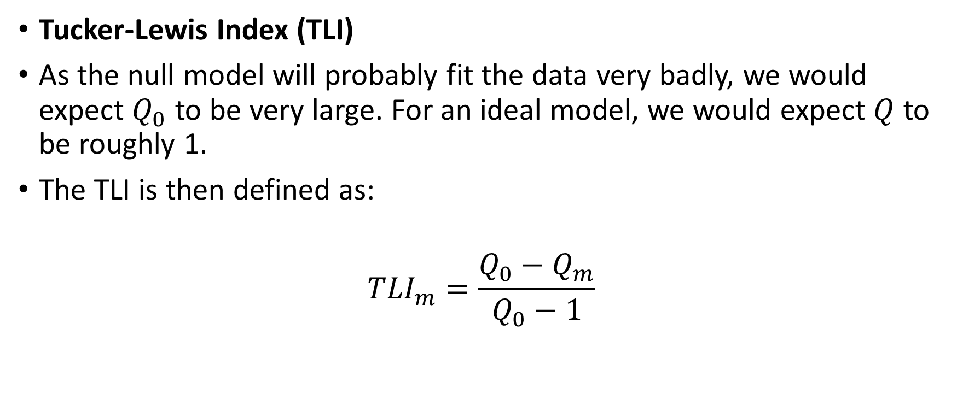
Fit indices
Tucker-Lewis Index (TLI)
As the null model will probably fit the data very badly, we would expect $Q_{0}$ to be very large. For an ideal model, we would expect $Q$ to be roughly 1.
The TLI is then defined as:
$${TLI}_{m}=\frac{Q_{0}−Q_{m}}{Q_{0}−1}$$

Slide 27
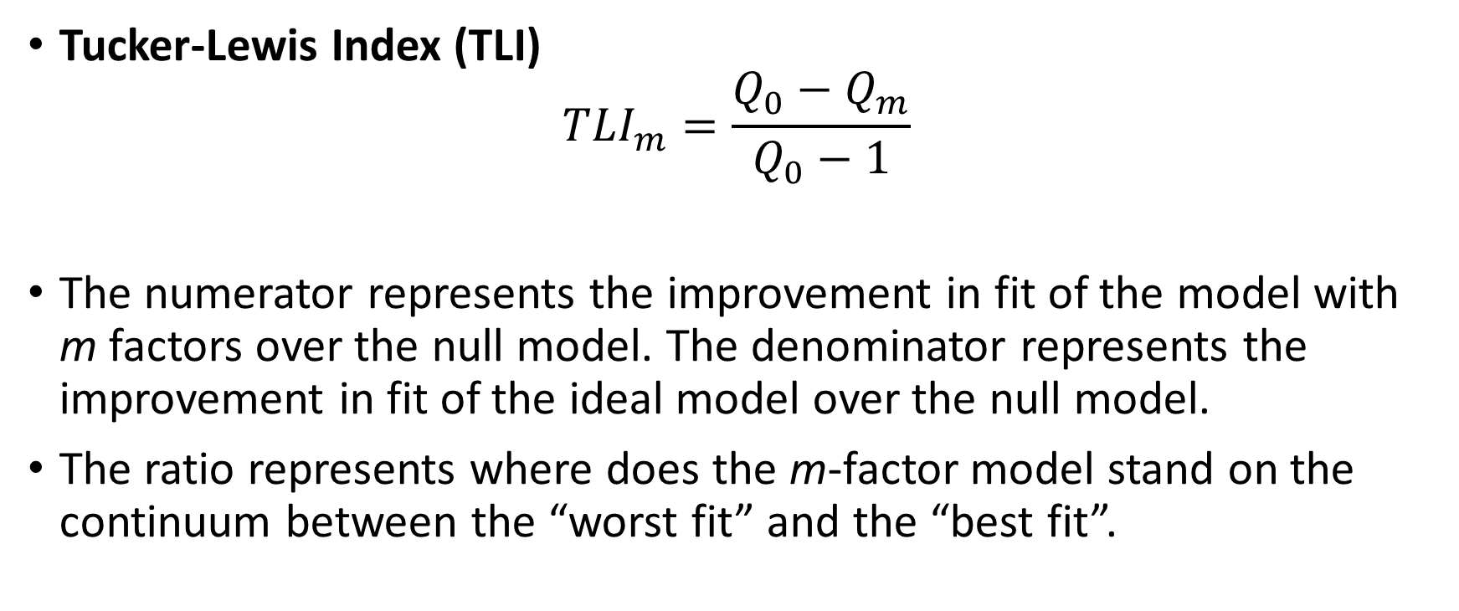
Fit indices
Tucker-Lewis Index (TLI)
$${TLI}_{m}=\frac{Q_{0}−Q_{m}}{Q_{0}−1}$$
The numerator represents the improvement in fit of the model with m factors over the null model. The denominator represents the improvement in fit of the ideal model over the null model.
The ratio represents where does the m-factor model stand on the continuum between the “worst fit” and the “best fit”.

Slide 28

Fit indices
Tucker-Lewis Index (TLI)
$${TLI}_{m}=\frac{Q_{0}−Q_{m}}{Q_{0}−1}$$
A value over .90 is desirable, preferably higher than that.

Slide 29
Selecting the number of factors
Consider prior hypotheses about the number of factors
There is no need for a single “right answer” at the exploratory phase of an analysis
Consider some rules-of-thumb as a source of guidance, but don’t rely on them blindly (scree plot, eigenvalues…)
Consider the results of goodness of fit tests and measures of fit, including RMSEA and TLI
Based on what you have observed, decide about the optimal number of factors, or a couple of alternatives

Slide 30
Selecting the number of factors
Go the extra mile and extract one or more additional factors, and see what happens – it’s better to “over-factor” than to “under-factor”
Look for converging evidence
Use your judgment and knowledge about the data. If someone says you are not allowed to, they are wrong.

Slide 31
What not to do
Use one piece of evidence or one mechanistical approach by itself
Not consider multiple sources of information

