Slide 1
Conceptual overview
PSYn5440 – Introduction to Factor Analysis
Week 1

Slide 2




Basic principles
Let’s begin with a little thought experiment
Imagine you gather a bunch of people in a room and let everyone secretly draw a number from a hat
Let’s call each person i’s drawn number their secret score, $s_{i}$
Person 3
$$s_{3}=−1$$
Person 1
$$s_{1}=3$$
Person 2
$$s_{2}=0.5$$

Slide 3
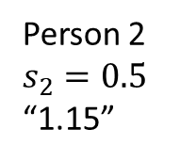
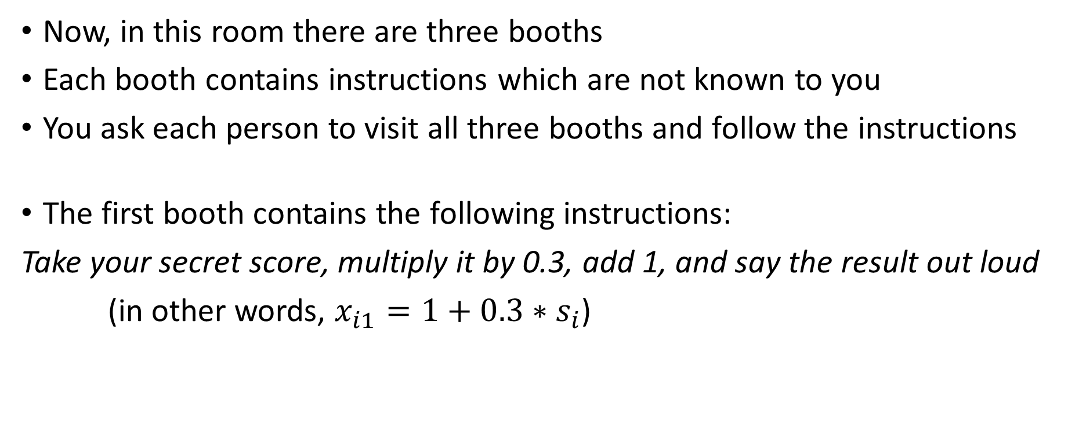
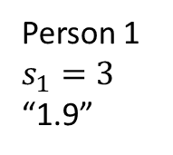
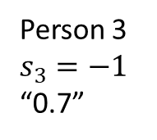
Basic principles
Now, in this room there are three booths
Each booth contains instructions which are not known to you
You ask each person to visit all three booths and follow the instructions
The first booth contains the following instructions:
Take your secret score, multiply it by 0.3, add 1, and say the result out loud
(in other words, $x_{i1}=1+0.3∗s_{i}$)
Person 1
$$s_{1}=3$$
“1.9”
Person 2
$$s_{2}=0.5$$
“1.15”
Person 3
$$s_{3}=−1$$
“0.7”

Slide 4
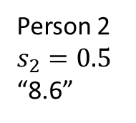

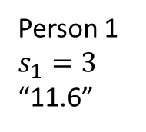
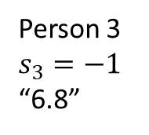
Basic principles
The second booth contains the following instructions:
Take your secret score, multiply it by 1.2, add 8, and say the result out loud
(in other words, $x_{i2}=8+1.2∗s_{i}$)
Person 1
$$s_{1}=3$$
“11.6”
Person 2
$$s_{2}=0.5$$
“8.6”
Person 3
$$s_{3}=−1$$
“6.8”

Slide 5
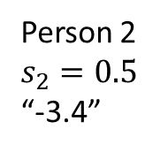

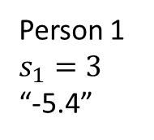
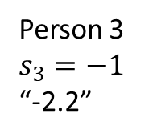
Basic principles
The third booth contains the following instructions:
Take your secret score, multiply it by -0.8, subtract 3, and
say the result out loud
(in other words, $x_{i3}=−3−0.8∗s_{i}$)
Person 1
$$s_{1}=3$$
“-5.4”
Person 2
$$s_{2}=0.5$$
“-3.4”
Person 3
$$s_{3}=−1$$
“-2.2”

Slide 6

Basic principles
As you can see, the numbers reported to us were always functions of each person’s secret score, $s_{i}$
Suppose we write this all down into a little data matrix
Person | Booth 1 | Booth 2 | Booth 3
1 | 1.9 | 11.6 | -5.4
2 | 1.15 | 8.6 | -3.4
3 | 0.7 | 6.8 | -2.2

Slide 7
Basic principles
This is an example of multivariate data – data for a sample of individuals on a number of variables
The data matrix contains scores on three variables we were able to directly observe (well, each person told us truthfully). In the world of factor analysis, we refer to these observable or measurable variables as manifest variables (MVs)
One column for each variable
Person | Booth 1 | Booth 2 | Booth 3
1 | 1.9 | 11.6 | -5.4
2 | 1.15 | 8.6 | -3.4
3 | 0.7 | 6.8 | -2.2
One row for each person

Slide 8
Basic principles
p columns (variables)
Data matrix:
X = N rows (individuals)
Score of person i on variable j
x₁₁ | x₁₂ |  | x_{1p}
 |  | x_{ij}
x_{N1} | x_{N2} |  | x_{Np}

Slide 9
Basic principles
What can we observe in these data?
Well, we can try to compare the persons
  Person 1 always seems to have the most extreme
  scores
  Person 3 kinda looks like they always have half the
  scores Person 1 has?
Person | Booth 1 | Booth 2 | Booth 3
1 | 1.9 | 11.6 | -5.4
2 | 1.15 | 8.6 | -3.4
3 | 0.7 | 6.8 | -2.2

Slide 10
Basic principles
What can we observe in these data?
We can also try to look at each variable
  Booth 2 seems to have the largest absolute values
  Booth 3 is always negative
  The sample range of Booth 1 is 1.2
  Maybe we could look at the variation of each variable over the sample? Like a standard deviation?
Person | Booth 1 | Booth 2 | Booth 3
1 | 1.9 | 11.6 | -5.4
2 | 1.15 | 8.6 | -3.4
3 | 0.7 | 6.8 | -2.2

Slide 11
Basic principles
What can we observe in these data?
We can also look at pairs of variables!
  How do the variables correlate / covary
  across our sample?
If we calculate correlations for each variable pair, we can arrange the correlation values into a correlation matrix
 | Booth 1 | Booth 2 | Booth 3
Booth 1 | 1 | r₁₂ | r₁₃
Booth 2 | r₂₁ | 1 | r₂₃
Booth 3 | r₃₁ | r₃₂ | 1

Slide 12
Basic principles
Correlation matrix:
R:
p manifest variables
1 | r₁₂ | r₁₃ |  |  |  | r_{1p}
r₂₁ | 1 | r₂₃ |  |  |  | r_{2p}
r₃₂ | r₃₂ | 1 |  |  |  | r_{3p}
 |  |  |  | r_{kj}
 |  |  | r_{jk}
r_{p1} | r_{p2} | r_{p3} |  |  |  | 1
p manifest variables

Slide 13
Basic principles
Now, it doesn’t make a lot of sense to calculate correlation of two variables with three observations each…
But if our thought experiment contained more people in our sample, we would be able to observe that the manifest variables do, in fact, correlate / covary
But why might that be? Why do the numbers or scores from the three booths correlate?

Slide 14
Basic principles
One reason for the observed correlations might be that the three manifest variables have a common cause
In other words, maybe they are all caused of affected by the same thing?
In fact, we know this is true. The variables were all functions of each person’s secret score

Slide 15
Basic principles
The secret score in our little thought experiment was something that is, in the world of factor analysis, referred to as a latent variable
Latent variables are “hidden” and unobserved (nobody told us their secret score), yet they affect the manifest variables in some systematic way

Slide 16
Basic principles
We might not be able to know what each person’s secret score was…
…but maybe we can try to indirectly infer on it if we study the relationships between the variables we have observed
(i.e., the manifest variables)

Slide 17
Basic principles
This is the fundamental idea behind factor analysis
Observed (manifest) variables that correlate do so because they share a common cause, some unseen, hidden, or latent variable
In factor analysis, latent variables are also called factors

Slide 18
Key terms and definitions
Manifest variable – variable that can be directly measured (or observed)
Latent variable – variable that cannot be directly measured (or observed) – a hypothetical construct. A latent variable is a factor in factor analysis. Thus, a factor is a variable and individuals have scores on those factors (hypothetically).
Population – The entire set of individuals of interest
Sample – A selected group of individuals from the population (N persons)

Slide 19
Basic principles – cont’d
In our thought experiment, we had everyone draw a secret score
Therefore, we could easily hypothesize that the answers from the booths varied because they had something to do with the (also varying) secret score
However, that was just a (silly) thought experiment. The world is, unfortunately, much more complicated and we are much less informed

Slide 20
Basic principles – cont’d
The fundamental principle still stands, though:
Observed (manifest) variables correlate because they are affected by the same unobserved (latent) variables, or factors.
In other words, the structure of the correlation (or covariance) matrix can be described or explained by the existence of latent variables.
Of course, this reasoning cannot be applied to just any correlation matrix. The hypothetical factor(s) must be theoretically justifiable.

Slide 21
Basic principles – cont’d
The objective of factor analysis, then, is to uncover and understand the structure that produces the correlations in the data
Assumption - there exists a small number of factors (within a particular domain) which influence the MVs and thus produce the correlations (covariances) between manifest variables. If this were not the case, we would gain very little by doing factor analysis.
e.g., it is assumed that a limited number of mental abilities will explain relationships between all ability tests. No MV single-handedly represents a distinct ability or trait.

Slide 22
Basic principles – cont’d
As said before, we assume that the factors influence or affect the MVs.
Our aim, then, is not only to uncover how many factors cause the observable correlation in our data, but also how each factor affects each manifest variable (in fact, these are two questions you can hardly separate)
The degree of a factor’s influence is represented by the so-called factor loading

Slide 23
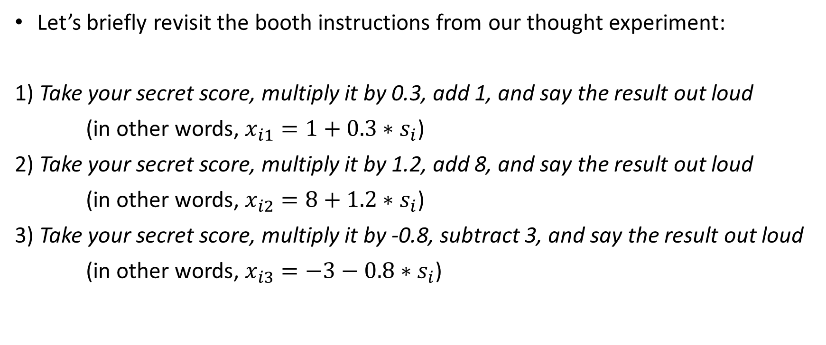
Basic principles – cont’d
Let’s briefly revisit the booth instructions from our thought experiment:
1) Take your secret score, multiply it by 0.3, add 1, and say the result out loud
(in other words, $x_{i1}=1+0.3∗s_{i}$)
2) Take your secret score, multiply it by 1.2, add 8, and say the result out loud
(in other words, $x_{i2}=8+1.2∗s_{i}$)
3) Take your secret score, multiply it by -0.8, subtract 3, and say the result out loud
(in other words, $x_{i3}=−3−0.8∗s_{i}$)

Slide 24
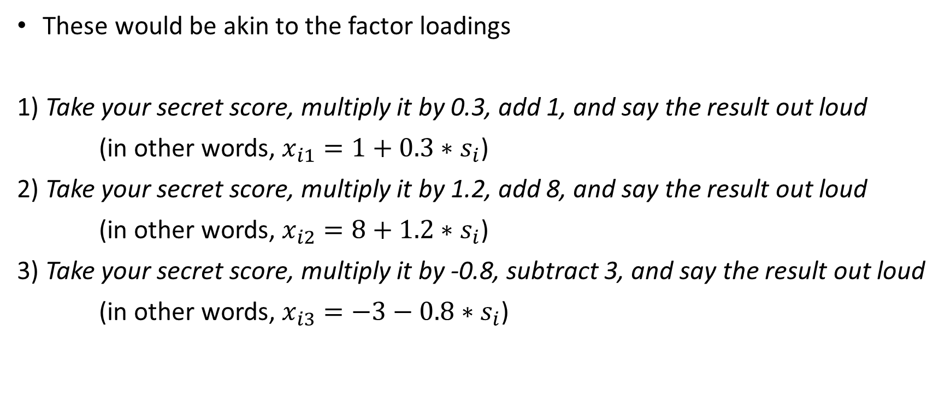
Basic principles – cont’d
These would be akin to the factor loadings
1) Take your secret score, multiply it by 0.3, add 1, and say the result out loud
(in other words, $x_{i1}=1+0.3∗s_{i}$)
2) Take your secret score, multiply it by 1.2, add 8, and say the result out loud
(in other words, $x_{i2}=8+1.2∗s_{i}$)
3) Take your secret score, multiply it by -0.8, subtract 3, and say the result out loud
(in other words, $x_{i3}=−3−0.8∗s_{i}$)

Slide 25
Basic principles – cont’d
The numerical values of factor loadings indicate the strength of the factor’s influence on the MV (a zero indicates no influence). Factor loadings are equivalent to regression coefficients, standing for the influence of a factor (independent variable) on a MV (dependent variable)
Let’s say that we have ‘discovered’ a factor which causes our MVs to correlate. We have somehow obtained the factor loadings. Now, how do we decide what is this factor?
What theoretical idea or construct does this factor / latent variable represent?
The pattern of factor loadings helps us determine the nature of a factor
…in other words, a factor is defined by the subset of MVs that it substantially influences

Slide 26
Example
Suppose we have scores from a sample of individuals on 4 performance measures: paragraph comprehension, vocabulary, arithmetic skills, and mathematical problem solving. We get the following correlation matrix:
 | PC | VO | AR | MPS
PC | 1
VO | .49 | 1
AR | .14 | .07 | 1
MPS | .48 | .42 | .48 | 1

Slide 27
Example
We would like to identify the underlying factors to explain the correlations. Thus, we employ factor analysis methods and obtain a factor loading matrix:
 | Factor 1 | Factor 2
PC | .70 | .10
VO | .70 | .00
AR | .10 | .70
MPS | .60 | .60

Slide 28
Example
 | Factor 1 | Factor 2
PC | .70 | .10
VO | .70 | .00
AR | .10 | .70
MPS | .60 | .60
Elements in the matrix represent the linear influence of each factor on each measure.

Slide 29
In this course, we will study methods that will allow us to obtain such interpretable factor loading matrices.
Keep in mind that we are using a model – a one which represents some hypothesized structure of observed data. Any mathematical model is – at least to some extent – wrong and does not perfectly correspond to reality.
A model that makes sense conceptually but does not fit reasonably well is useless.
A model that fits great but does not make sense is useless as well.
A factor analysis is not applicable to just any data.

Slide 30
In the world of factor analysis, situations differ regarding the existence of prior hypotheses / knowledge about the number and nature of the factors:
Exploratory (unrestricted) FA:
We have little prior idea of how many and what kind of factors there are.
Confirmatory (restricted) FA:
We do have a hypothesis (or hypotheses) about the number and nature of factors.
...the underlying theoretical model is the same!

Slide 31
A bit of history
Factor analysis began with the study of mental abilities
Charles Spearman proposed the first factor model in 1904:
  Performance on any test is a function of two factors – a general ability factor (Spearman’s g) common to all ability tests, and a specific ability factor relevant only to the specific test in question.
  → The two-factor theory of intelligence
  Ability tests correlate because they all depend on the general factor.

Slide 32
A bit of history
Burt and Vernon, on the other hand, proposed a hierarchical model of human abilities:
  The human mind is organized in a hierarchy of abilities.
  The general ability sits atop this hierarchy
  More specific abilities are located lower in the hierarchy

Slide 33
A bit of history
The Common Factor Model of L. L. Thurstone became the most prominent approach to FA since the 1940s. Thurstone disagreed with both the notion of g and a hierarchy of abilities.
According to Thurstone, MVs depend on two kinds of underlying factors:
  Common factors that are common to more than one MV
  Unique factors that influence only one MV. Unique factors do not explain correlations between MVs.
The p manifest variables depend on m common factors and p unique factors, where m < p

Slide 34
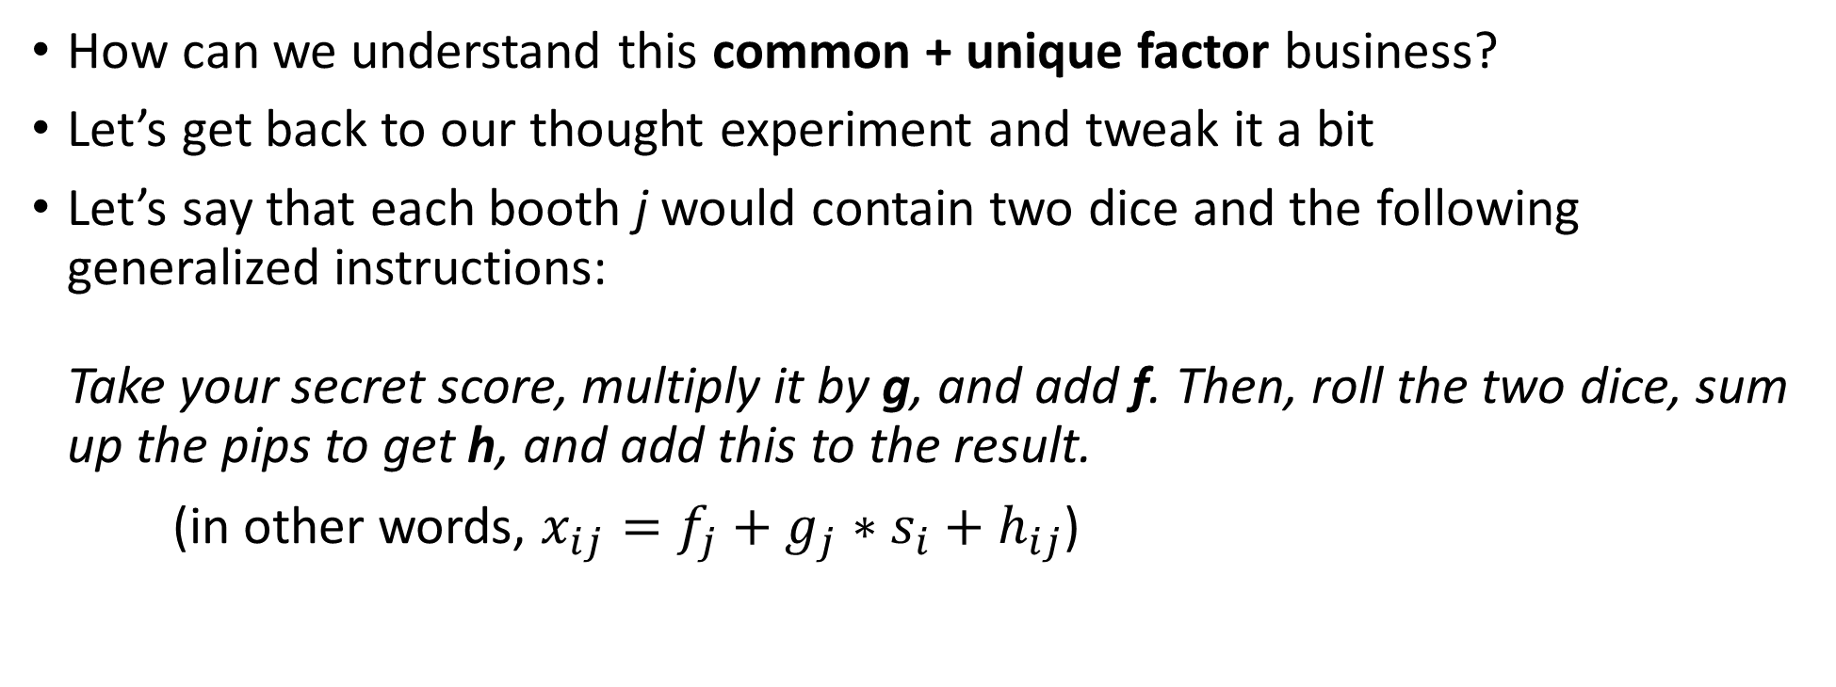
The Common Factor Model
How can we understand this common + unique factor business?
Let’s get back to our thought experiment and tweak it a bit
Let’s say that each booth j would contain two dice and the following generalized instructions:
Take your secret score, multiply it by g, and add f. Then, roll the two dice, sum up the pips to get h, and add this to the result.
(in other words, $x_{ij}=f_{j}+g_{j}∗s_{i}+h_{ij}$)

Slide 35
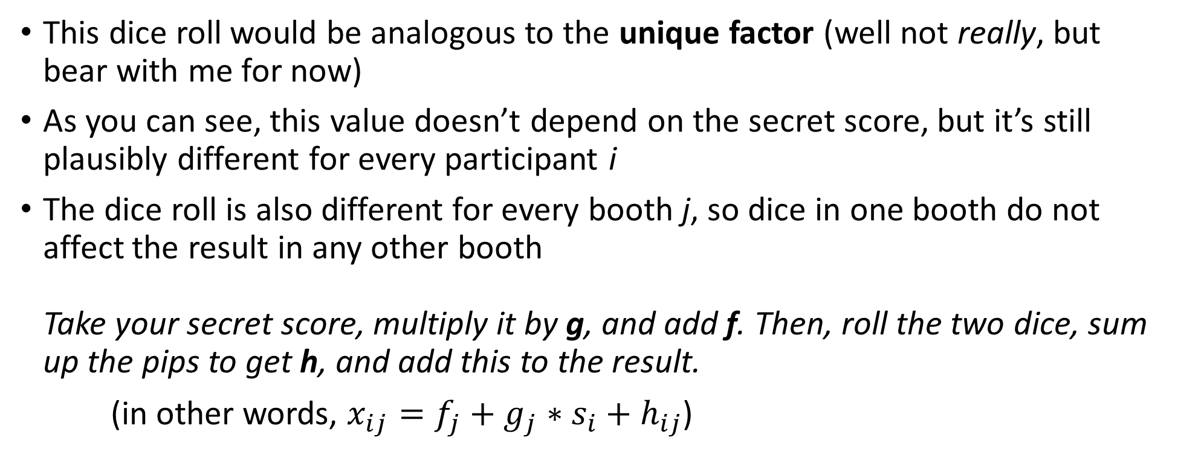
The Common Factor Model
This dice roll would be analogous to the unique factor (well not really, but bear with me for now)
As you can see, this value doesn’t depend on the secret score, but it’s still plausibly different for every participant i
The dice roll is also different for every booth j, so dice in one booth do not affect the result in any other booth
Take your secret score, multiply it by g, and add f. Then, roll the two dice, sum up the pips to get h, and add this to the result.
(in other words, $x_{ij}=f_{j}+g_{j}∗s_{i}+h_{ij}$)

Slide 36
The Common Factor Model
Dice rolls are purely random, so they represent random error
However, the unique factors are a bit more complicated – they do not represent only (unsystematic) random error
They also represent systematic effects that affect only the one particular MV in question – this is called the specific factor
Because the specific factor affects only one MV, we cannot disentangle it from the random error
Bottom line - each unique factor has two components:
  Specific factor
  Error of measurement

Slide 37
The Common Factor Model
We can break down the variance of a given MV in the following way:
Observed variance = Common variance + Unique variance
…and because:
Unique variance = Specific variance + Error variance
…then:
Observed variance = Common variance + Specific variance + Error variance

Slide 38
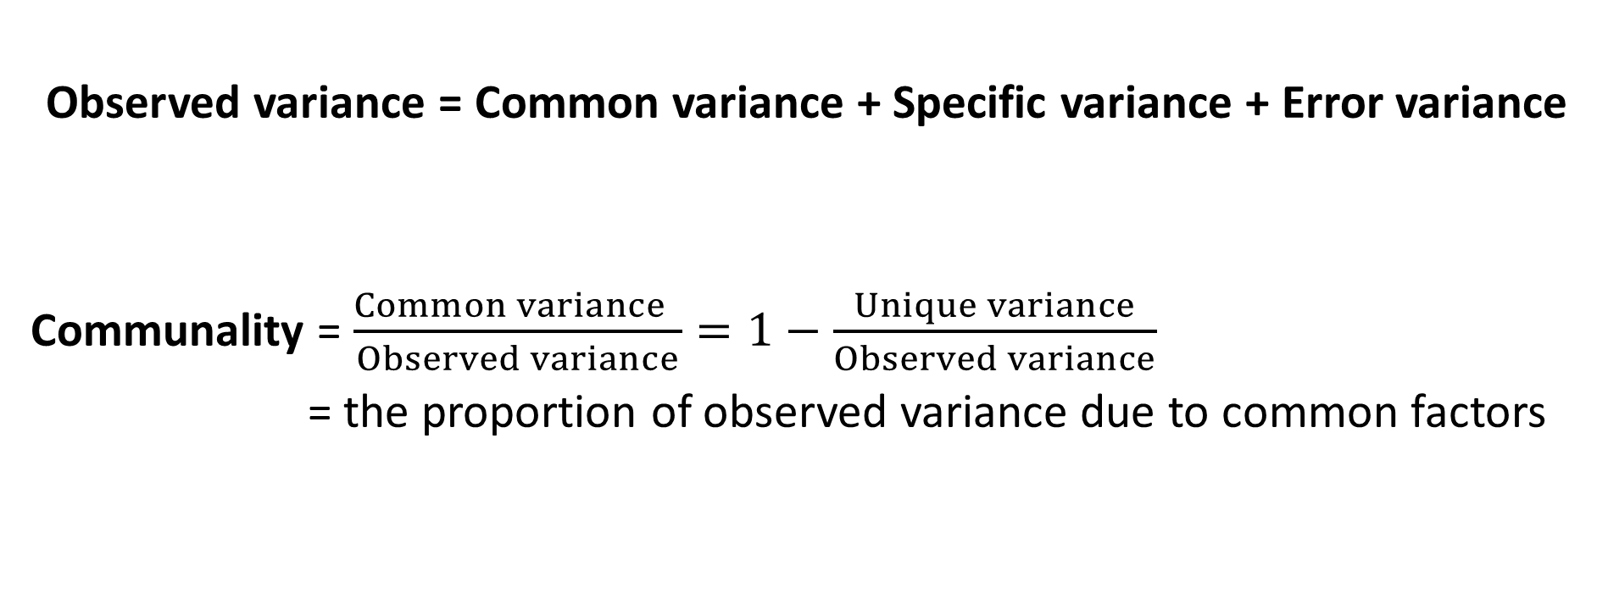
The Common Factor Model
Observed variance = Common variance + Specific variance + Error variance
Communality = $\frac{Common variance }{Observed variance}=1−\frac{Unique variance}{Observed variance}$
= the proportion of observed variance due to common factors

Slide 39
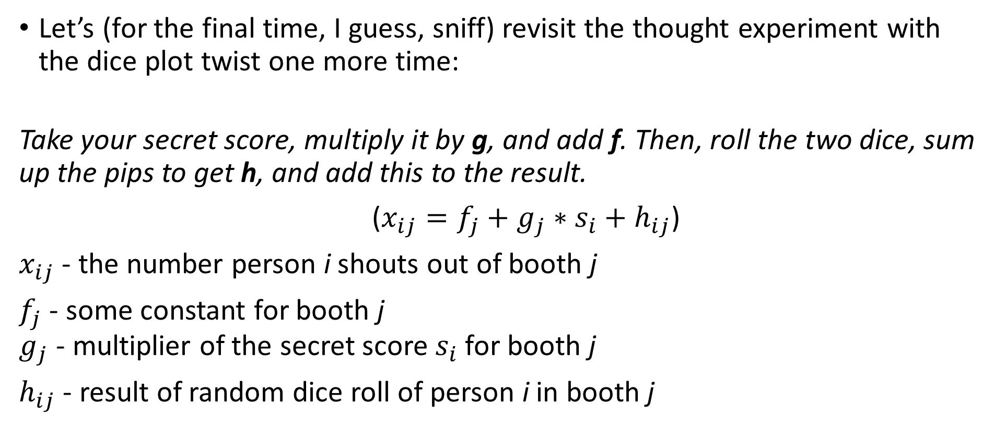
The Common Factor Model
Let’s (for the final time, I guess, sniff) revisit the thought experiment with the dice plot twist one more time:
Take your secret score, multiply it by g, and add f. Then, roll the two dice, sum up the pips to get h, and add this to the result.
($x_{ij}=f_{j}+g_{j}∗s_{i}+h_{ij}$)
$x_{ij}$ - the number person i shouts out of booth j
$f_{j}$ - some constant for booth j
$g_{j}$ - multiplier of the secret score $s_{i}$ for booth j
$h_{ij}$ - result of random dice roll of person i in booth j

Slide 40
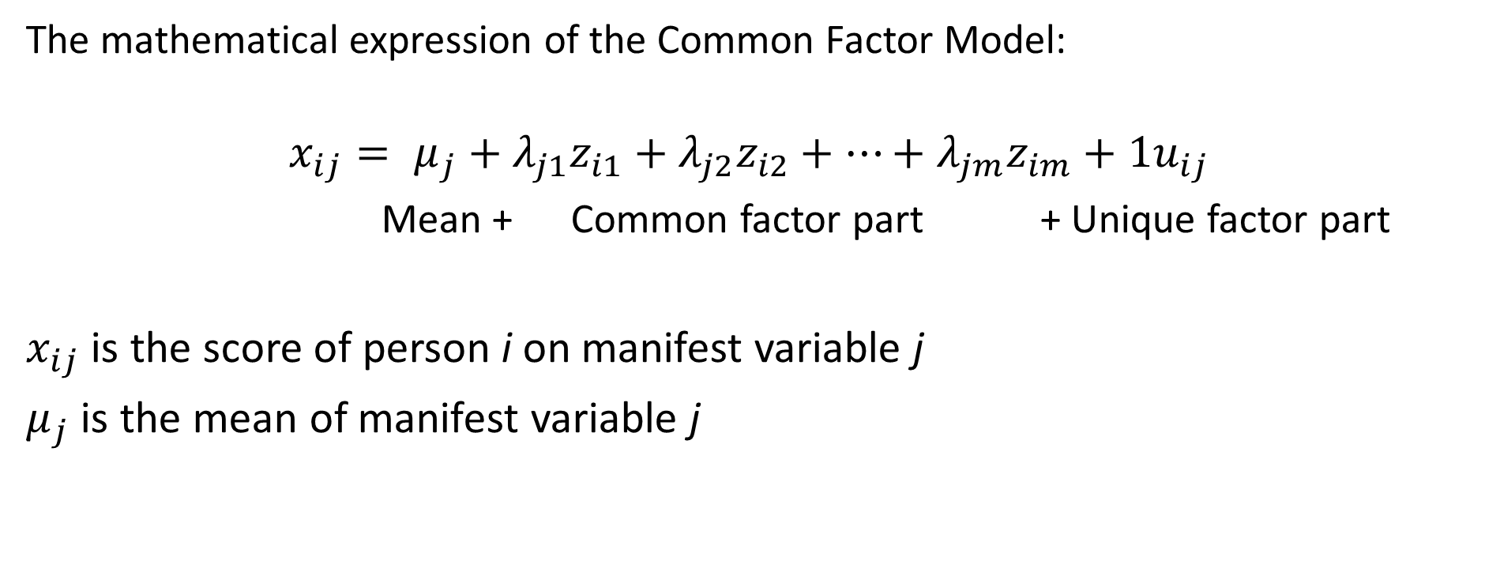
The Common Factor Model
The mathematical expression of the Common Factor Model:
$$x_{ij}= μ_{j}+λ_{j1}z_{i1}+λ_{j2}z_{i2}+…+λ_{jm}z_{im}+1u_{ij}$$
Mean + Common factor part + Unique factor part
$x_{ij}$ is the score of person i on manifest variable j
$μ_{j}$ is the mean of manifest variable j

Slide 41
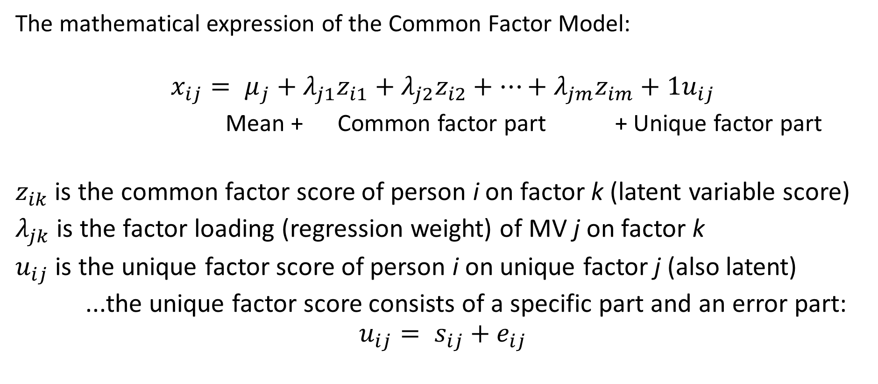
The Common Factor Model
The mathematical expression of the Common Factor Model:
$$x_{ij}= μ_{j}+λ_{j1}z_{i1}+λ_{j2}z_{i2}+…+λ_{jm}z_{im}+{1u}_{ij}$$
Mean + Common factor part + Unique factor part
$z_{ik}$ is the common factor score of person i on factor k (latent variable score)
$λ_{jk}$ is the factor loading (regression weight) of MV j on factor k
$u_{ij}$ is the unique factor score of person i on unique factor j (also latent)
...the unique factor score consists of a specific part and an error part:
$$u_{ij}= s_{ij}+e_{ij}$$

Slide 42
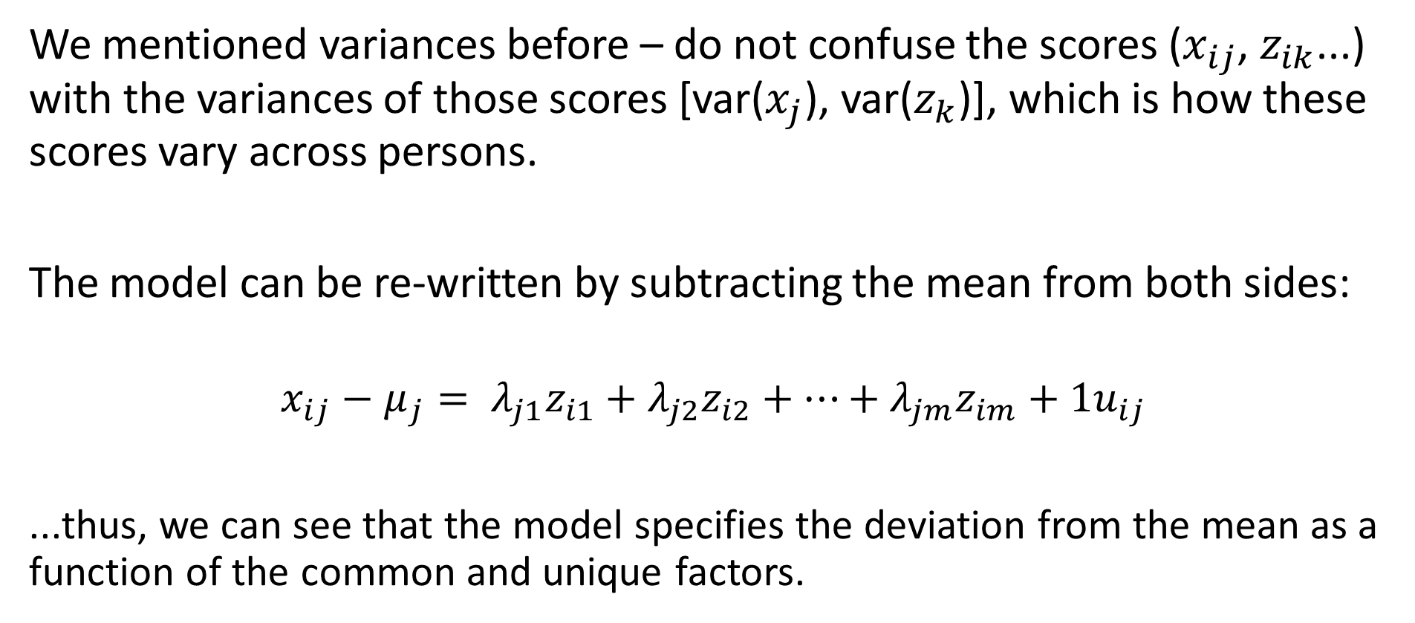
The Common Factor Model
We mentioned variances before – do not confuse the scores ($x_{ij}$, $z_{ik}$...) with the variances of those scores [var($x_{j}$), var($z_{k}$)], which is how these scores vary across persons.
The model can be re-written by subtracting the mean from both sides:
$$x_{ij}−μ_{j}= λ_{j1}z_{i1}+λ_{j2}z_{i2}+…+λ_{jm}z_{im}+{1u}_{ij}$$
...thus, we can see that the model specifies the deviation from the mean as a function of the common and unique factors.

Slide 43
The Common Factor Model
Important assumption: In the model, the unique factor scores for different MVs are assumed to be uncorrelated over all persons. Therefore, all partial correlations between MVs, controlling for the effect of the common factors, are assumed to be zero.
In other words, correlations between MVs are only due to the common factors (that’s why they’re called common)
This assumption refers to the population

Slide 44
The Common Factor Model
What factors are common and what factors are specific depends on the manifest variables in the dataset.
If we change the set of MVs by introducing new MVs or deleting MVs, we can potentially change specific factors into common factors, and so on.

Slide 45
The Common Factor Model
The model is will always be wrong to some degree (it’s a model after all). What are some of the ways the model could be wrong?
  1) The assumption of linearity – the MVs are specified as linear functions of factors. Nobody really thinks the real world is perfectly linear.
  2) The number of common factors is generally assumed to be small (m << p).
  In reality, there are probably many, many common influences on a score. However, we hope to identify the non-negligible ones.
We should recognize the common factors will not perfectly explain the variation and covariation of the manifest variables.

Slide 46
The Common Factor Model
The model equation looks like a multiple regression equation.
  The manifest variables are dependent variables
  The factors are independent variables
  The factor loadings are regression weights / coefficients
The factor analysis model is like a set of multiple linear regressions where the independent variables are unobservable.

