Slide 1
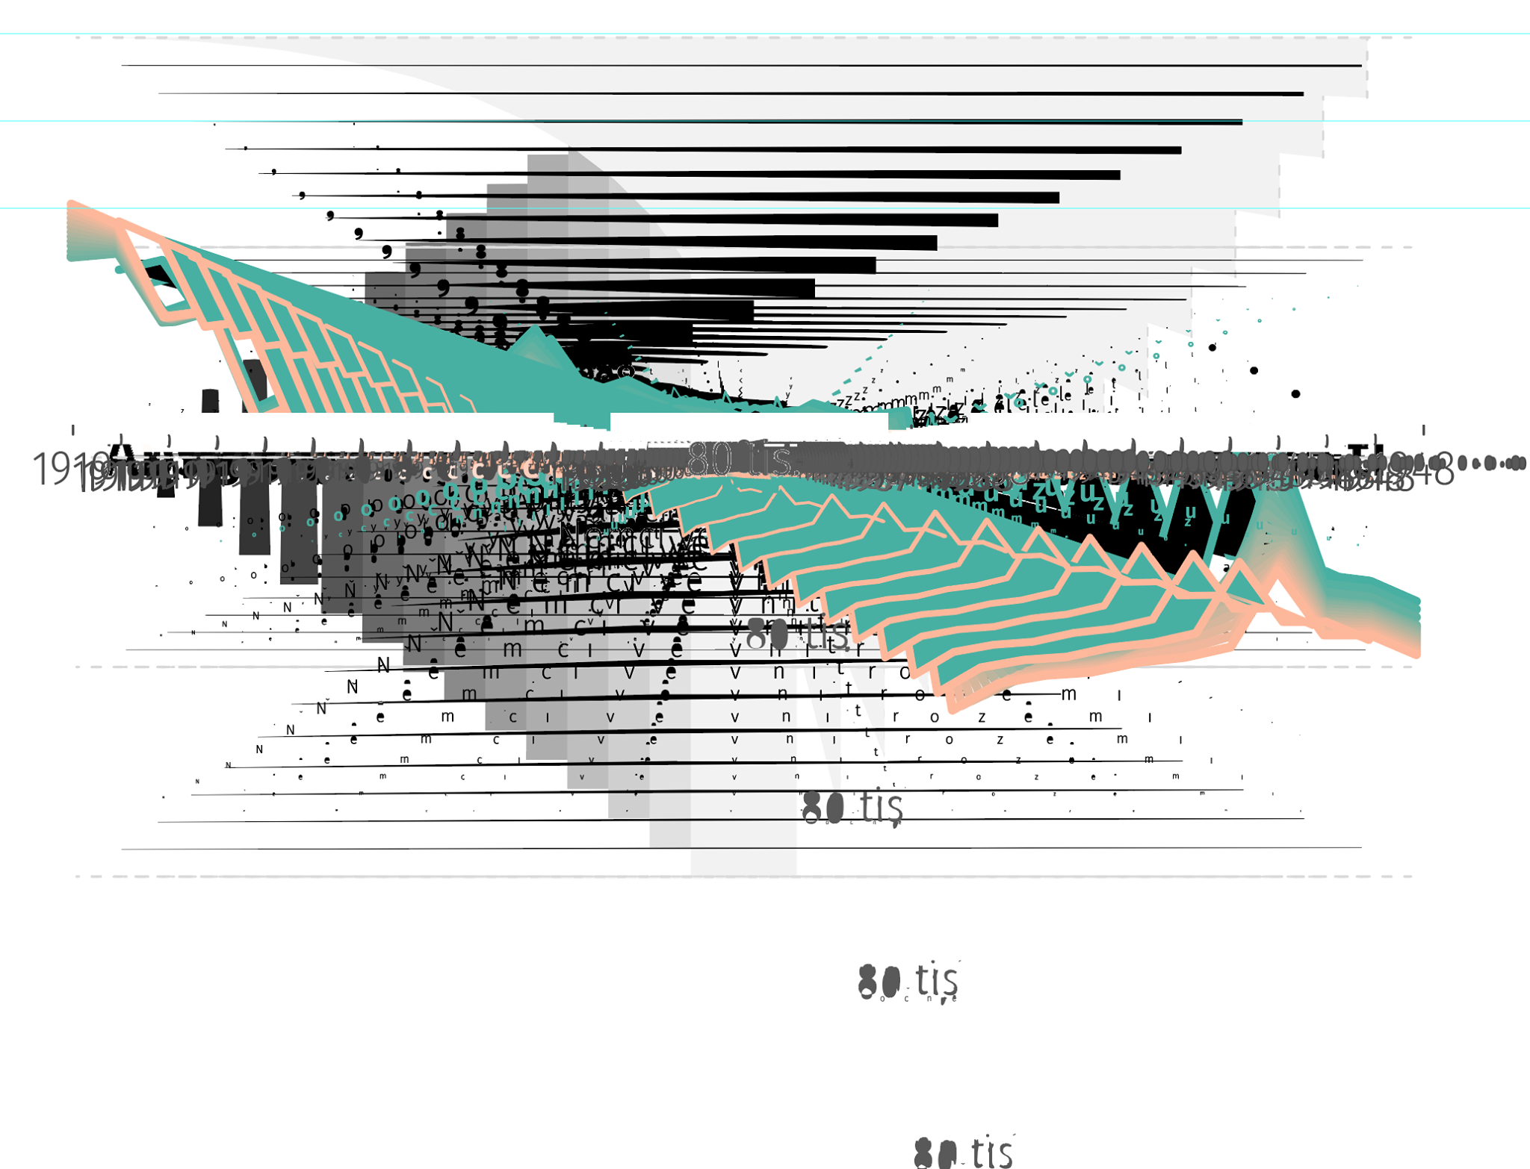
DATOVÁ ŽURNALISTIKA:
OD CHOLERY PO COVID

Slide 2
Notes:
https://www.irozhlas.cz/zpravy-domov/covid-priciny-umrti-uzis-smrt-demografie_2101040600_jab

Slide 3
HISTORIE

Slide 4
HISTORIE
PROCES

Slide 5
HISTORIE
PROCES
ŽÁNRY

Slide 6
MÁŠ NA MÍŇ!
Notes:
https://www.transparency.cz/kauzy/souboj-o-miliardy-na-reseni-dopadu-odklonu-od-uhli/
https://www.irozhlas.cz/zpravy-domov/narodni-plan-obnovy-evropska-unie-eu-dotace_2105310500_jab

Slide 7
HISTORIE

Slide 8
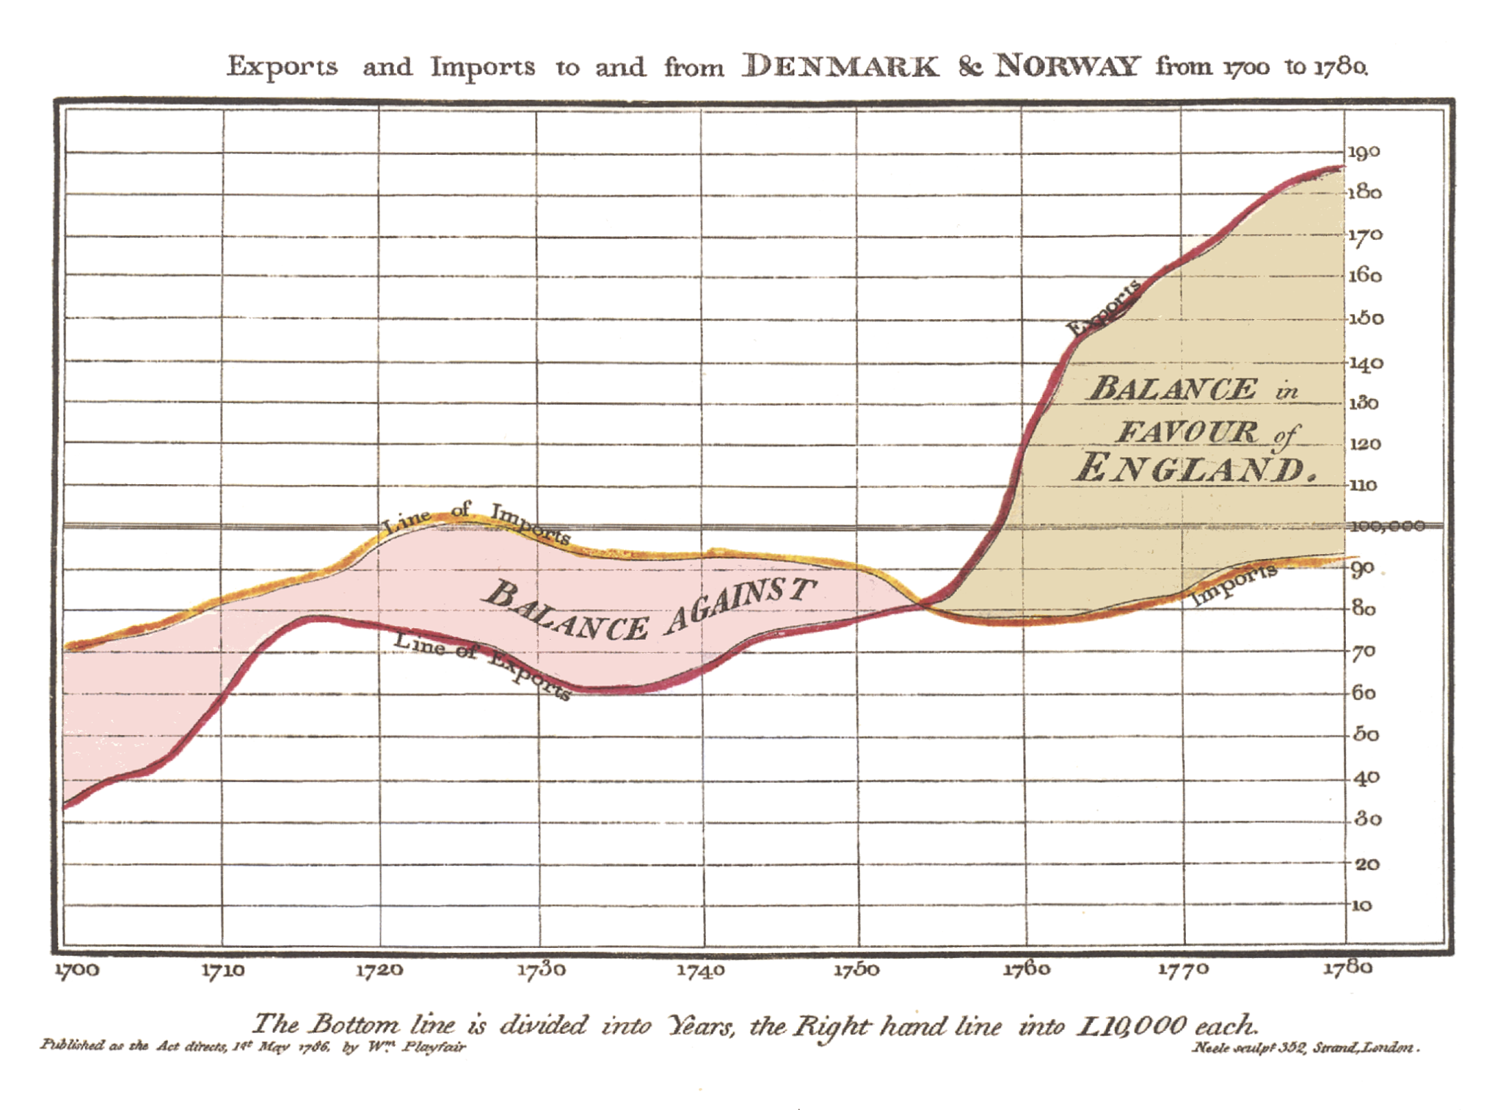
William
Playfair
(1780s)
Notes:
http://www.branchcollective.org/?ps_articles=jonathan-sachs-17861801-william-playfair-statistical-graphics-and-the-meaning-of-an-event
https://priceonomics.com/when-did-charts-become-popular/

Slide 9
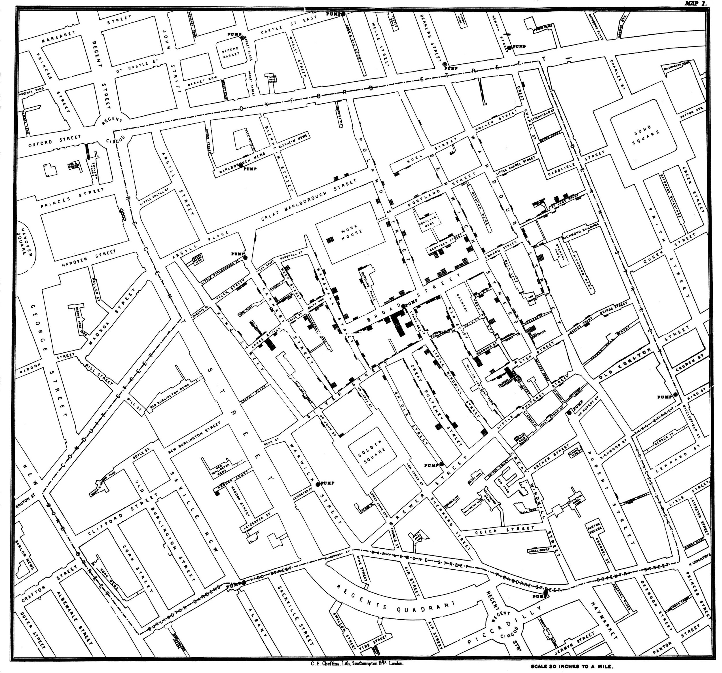
John Snow (1854)
Notes:
https://simonrogers.net/2013/03/15/john-snow-data-journalist/

Slide 10
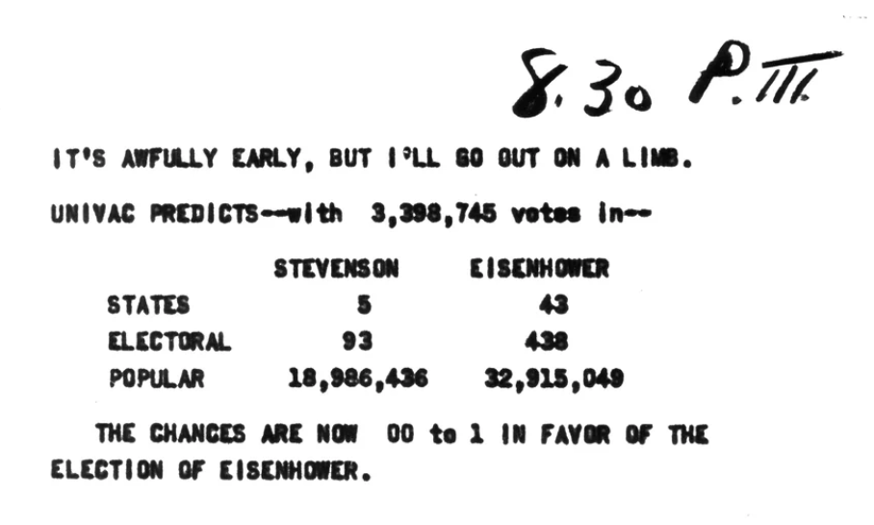
UNIVAC (1952)
Notes:
https://www.npr.org/sections/alltechconsidered/2012/10/31/163951263/the-night-a-computer-predicted-the-next-president

Slide 11
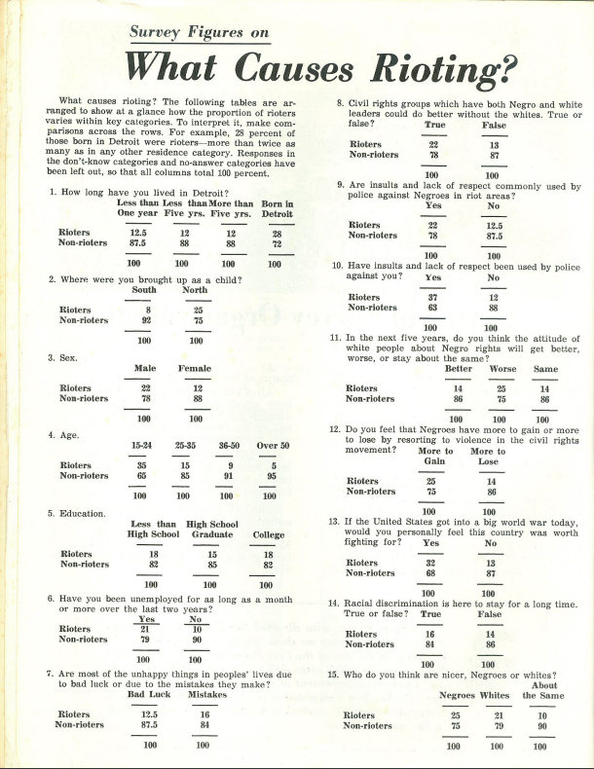
Philip Meyer (1967)
Notes:
https://s3.amazonaws.com/s3.documentcloud.org/documents/2070181/detroit1967.pdf
https://isr.umich.edu/news-events/insights-newsletter/article/revealing-the-roots-of-a-riot/

Slide 12
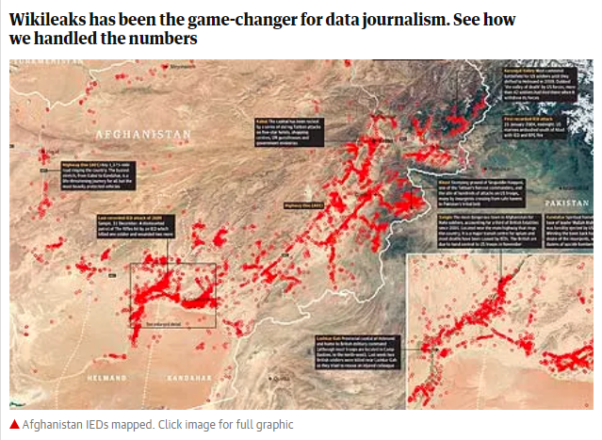
WikiLeaks (2010)
Notes:
https://wardiaries.wikileaks.org/
https://web.archive.org/web/20100729141045/http://www.guardian.co.uk/news/datablog%2Bworld/series/afghanistan-the-war-logs
https://www.iraqbodycount.org/analysis/numbers/warlogs/
http://jonathanstray.com/wp-content/uploads/2010/12/SIGACTS-dec-2006-hi-res2.jpg

Slide 13
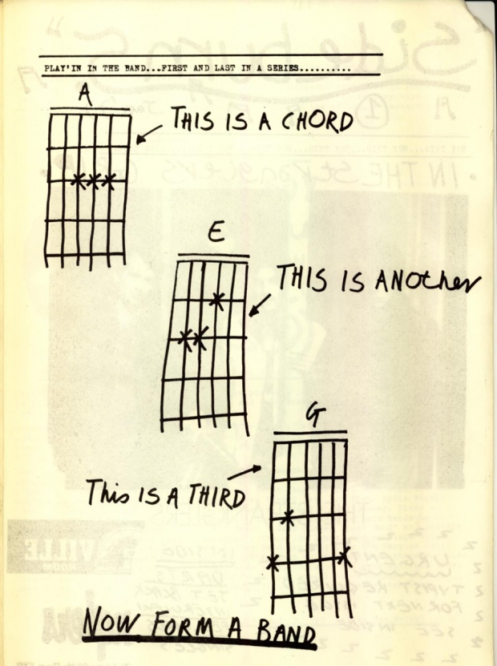
„Anyone can do it. Data jour- nalism is the new punk.“
The Guardian (2012)
Notes:
https://www.theguardian.com/news/datablog/2012/may/24/data-journalism-punk

Slide 14
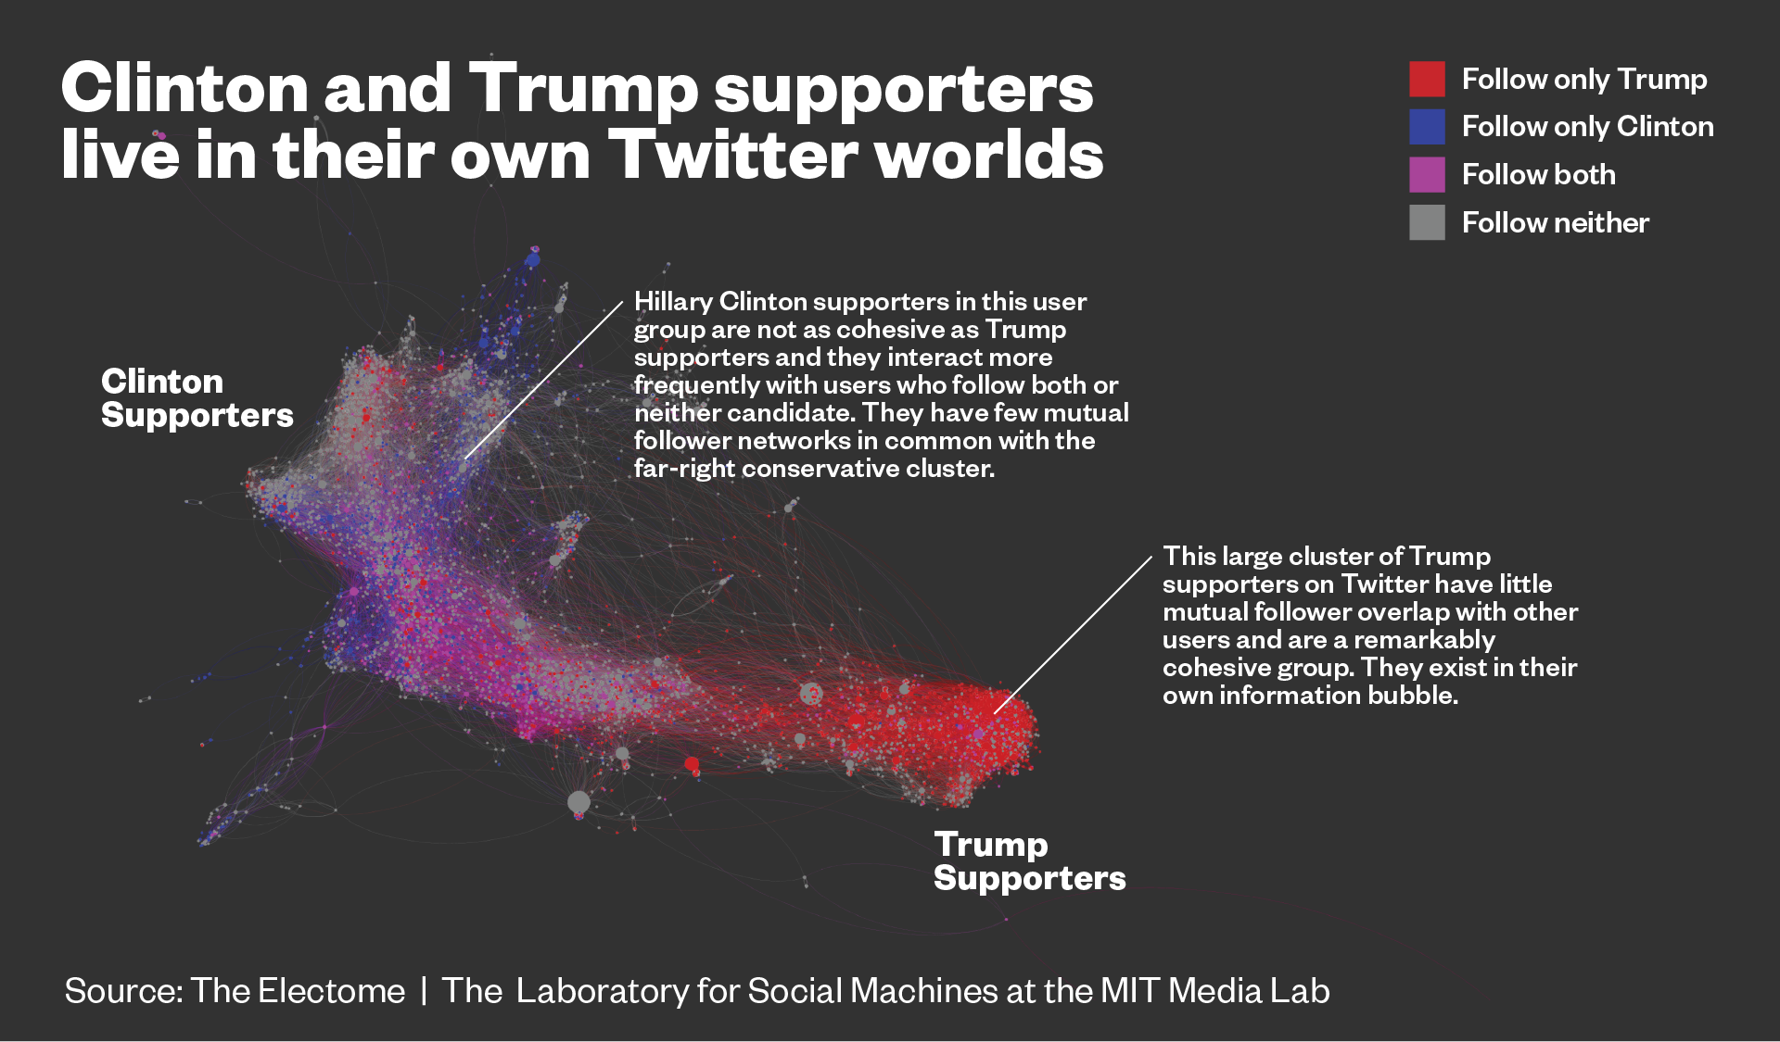
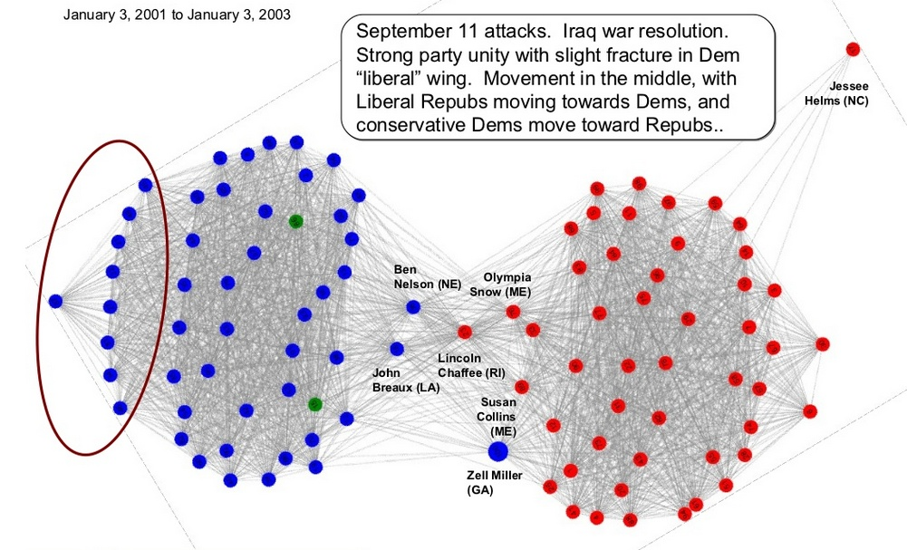
Notes:
https://sigmaawards.org/projects/
https://www.informationisbeautifulawards.com/awards/2019
https://news.vice.com/story/journalists-and-trump-voters-live-in-separate-online-bubbles-mit-analysis-shows

Slide 15
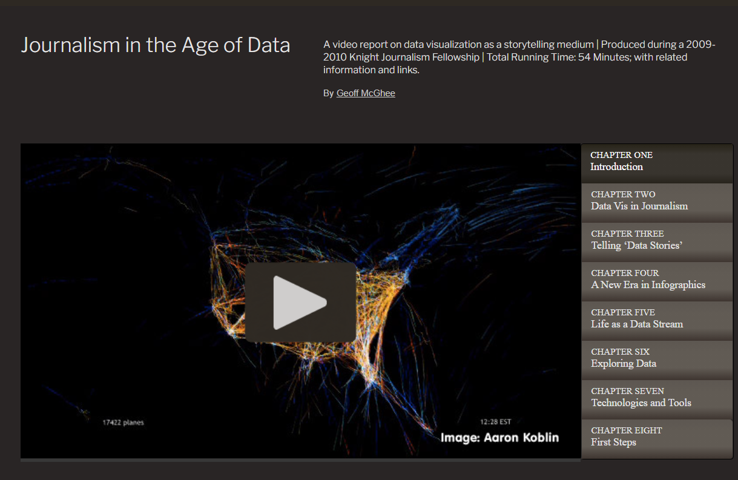
Notes:
https://datajournalism.stanford.edu/index.html

Slide 16
PROCES

Slide 17
ANALÝZA DAT
VIZUALIZACE DAT
PROGRAMOVÁNÍ
VYPRÁVĚNÍ
STATISTIKA
PRÁVO
ZNALOST TÉMATU

Slide 18
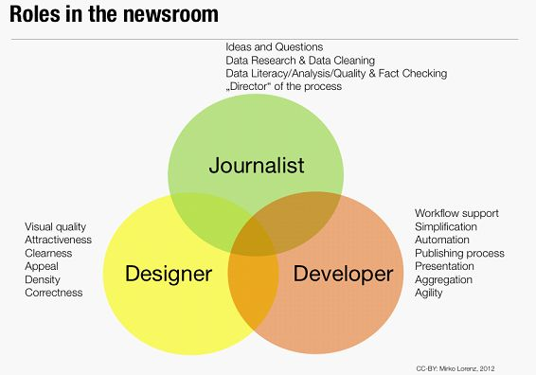
Notes:
https://www.media.ba/en/magazin-mreze-i-web/how-built-data-team-small-newsroom

Slide 19
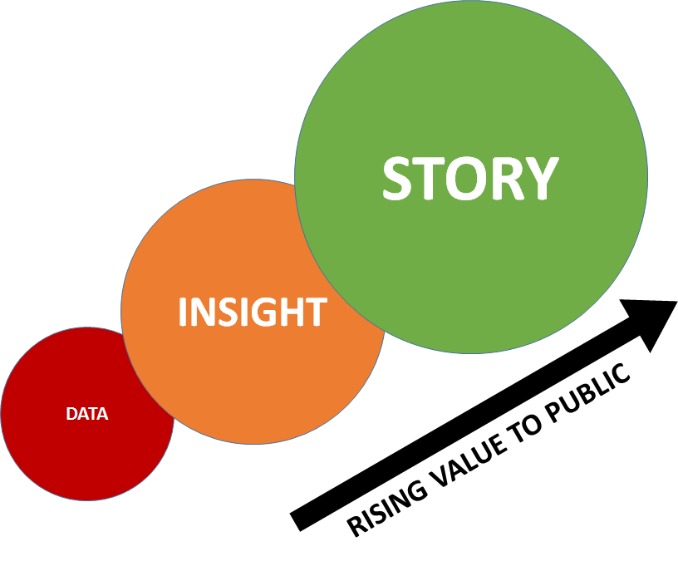

Slide 20
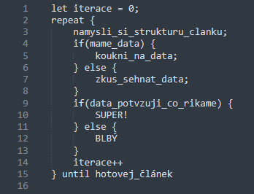

Slide 21


Slide 22
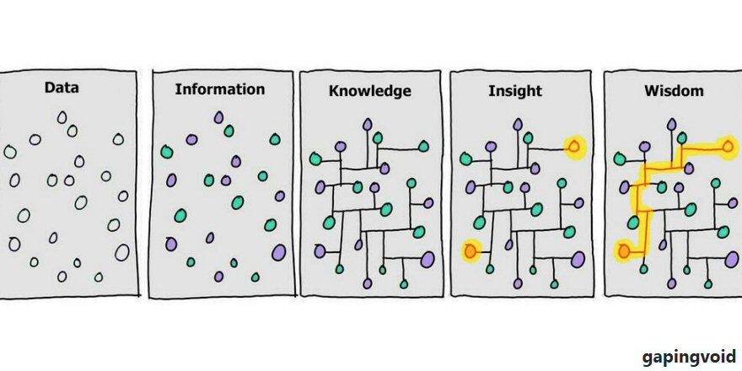

Slide 23
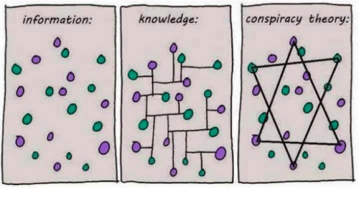

Slide 24
ŽÁNRY

Slide 25
Explainer
Notes:
https://www.nytimes.com/projects/2012/snow-fall/index.html#/?part=tunnel-creek
https://highline.huffingtonpost.com/articles/en/poor-millennials/
https://www.irozhlas.cz/zpravy-domov/covid-priciny-umrti-uzis-smrt-demografie_2101040600_jab

Slide 26
Investigace
Notes:
https://www.bellingcat.com/app/uploads/2014/11/Origin-of-the-Separatists-Buk-A-Bellingcat-Investigation1.pdf
https://www.investigace.cz/fincen-files-cesko/

Slide 27
Modelování
Notes:
https://projects.fivethirtyeight.com/2020-election-forecast/
https://www.huffpost.com/entry/pollster-predictive-perfo_b_2087862
https://www.irozhlas.cz/ekonomika/kalkulacka-socialni-davky-exekuce_1811280900_jab
https://dev.datarozhlas.cz/simulator-davek/simulator/index.htm

Slide 28
Fact-checking
Notes:
https://demagog.cz/vypis-recniku

Slide 29
Sensor journalism
Notes:
http://www.washingtonpost.com/wp-srv/special/local/dc-shot-spotter/
https://plus.rozhlas.cz/unikatni-mereni-co-se-deje-v-tele-pri-maratonu-6525665

Slide 30
Daily chart
Notes:
https://www.economist.com/graphic-detail

Slide 31
Newsgames
Notes:
https://www.google.com/search?q=filosofighters&safe=off&sxsrf=ALeKk01YLEOaCB20aRv2-aZVOla0psa13A:1602660348305&source=lnms&tbm=isch&sa=X&ved=2ahUKEwj7h4aGx7PsAhVzqHEKHYAbD_4Q_AUoAXoECAsQAw&biw=1600&bih=789
https://ig.ft.com/uber-game/

Slide 32
Data art
Notes:
https://www.google.com/search?q=nuage+vert&safe=off&sxsrf=ALeKk02nZq90EWxqSoICX0I9YYJLZN_9Hw:1602660725738&source=lnms&tbm=isch&sa=X&ved=2ahUKEwjh34K6yLPsAhX_DmMBHagyCe0Q_AUoAXoECB8QAw&biw=1600&bih=789
https://www.google.com/search?q=they+rule&safe=off&sxsrf=ALeKk00FaFcs47jQf5ZQeFu5cIq_Zo5x0Q:1602660843666&source=lnms&tbm=isch&sa=X&ved=2ahUKEwjExKDyyLPsAhVl7eAKHfLqBfsQ_AUoAXoECAsQAw&biw=1600&bih=789
https://www.google.com/search?q=lubo%C5%A1+pln%C3%BD+pup%C3%ADkov%C3%BD+den%C3%ADk&safe=off&sxsrf=ALeKk02vKmtms8BXXsPrm1EiRVeCUbTMQw:1602660937463&source=lnms&tbm=isch&sa=X&ved=2ahUKEwj0sf2eybPsAhVB2-AKHXRJAK0Q_AUoAXoECAwQAw&biw=1600&bih=789

Slide 33
„What makes it data journalism isn’t the form, it’s the starting point in a data. The result can take many forms: it might be a text article, or a data visualization, or a video, or something else entirely.“
(VOX)

Slide 34
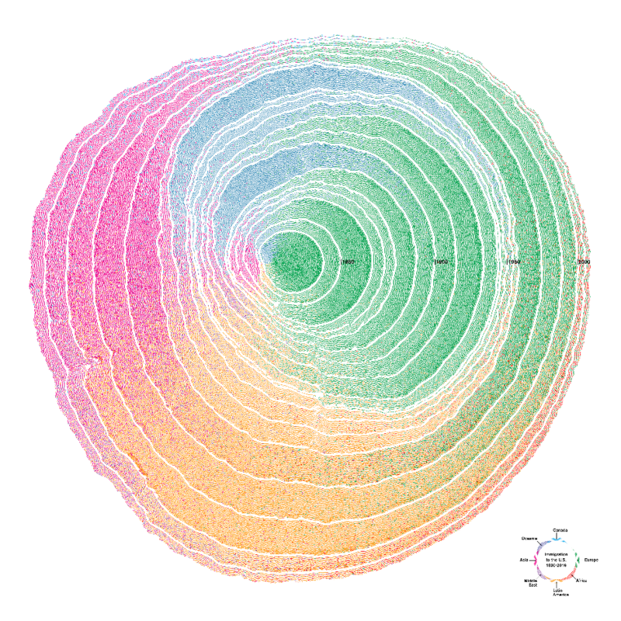
Notes:
Redakce datové žurnalistiky:
https://www.investigace.cz/tag/datove-leaky/
https://www.seznamzpravy.cz/autor/katerina-mahdalova-815
https://www.seznamzpravy.cz/autor/pavel-kasik-903
https://denikn.cz/autor/jan-tvrdon/
https://www.denik.cz/my-jsme-denik/praha/ales-vojir-3115.html
https://demagog.cz/
https://data.irozhlas.cz/
https://www.nytimes.com/section/upshot
https://www.economist.com/graphic-detail/
https://www.vox.com/
https://fivethirtyeight.com/
https://www.spiegel.de/thema/daten/
https://informationisbeautiful.net
https://www.datajournalismawards.org/
https://www.informationisbeautifulawards.com/

Slide 35
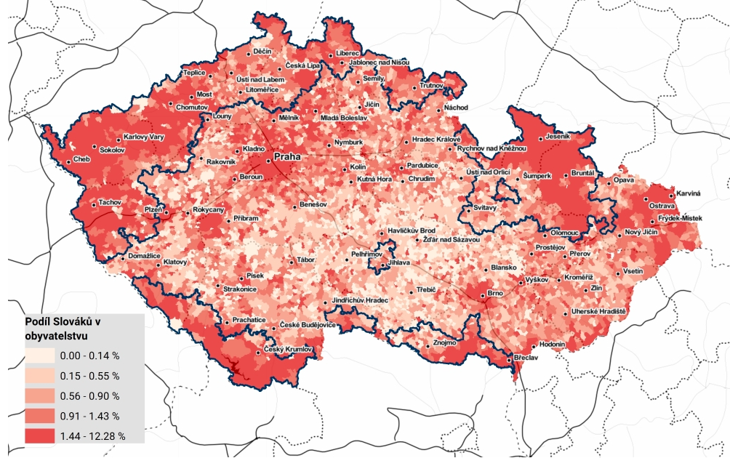
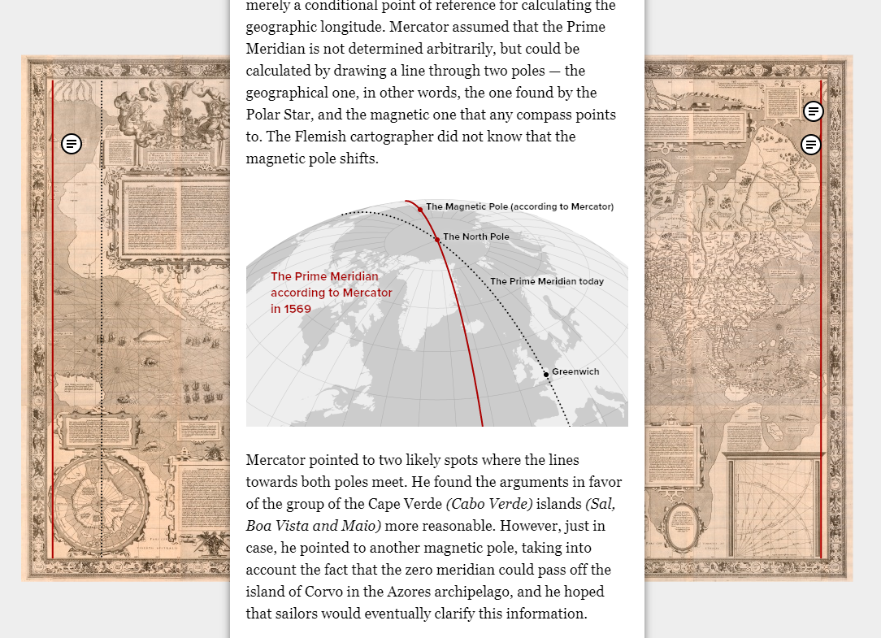
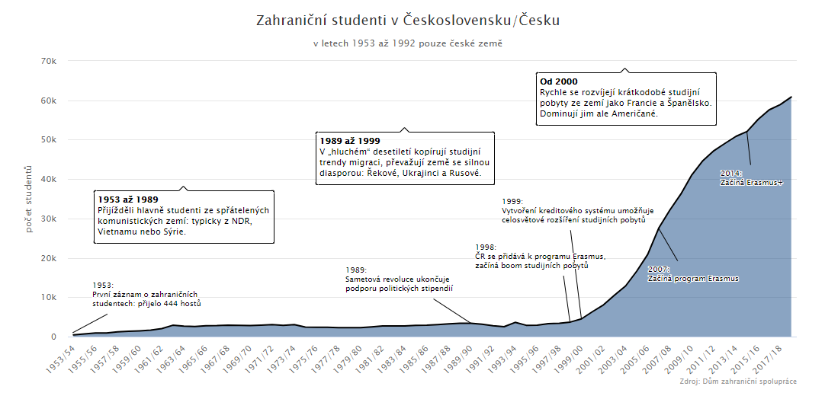
Notes:
Náhodné neutříděné články, které by vás mohly zajímat:
https://www.irozhlas.cz/zpravy-domov/slovaci-v-cesku-jsou-mladsi-a-vzdelanejsi-nez-cesi_1707180850_jab
https://www.irozhlas.cz/zpravy-domov/zahranicni-studium-erasmus-1953-archiv-studenti-vysoke-skoly-rekove-etiopie-usa_1909260600_jab
https://www.irozhlas.cz/zivotni-styl/analyza-knihovnich-vypujckek-s-poezii-koncime-po-ctyricitce_1712270900_jab
https://interaktivni.rozhlas.cz/prezidentske-projevy/
https://interaktivni.rozhlas.cz/sudety/
https://www.theguardian.com/news/datablog+media/wikileaks
http://www.slideshare.net/oreillymedia/us-senate-social-graph-1991-present?type=presentation
http://kohovolit.eu/cs/jak-hlasuji-zakonodarci-multidimenzionalni-skalovani/
https://samizdat.cz/blog/brnenska-politika-kdo-s-kym-hlasoval-v-zastupitelstvu/
https://news.vice.com/story/journalists-and-trump-voters-live-in-separate-online-bubbles-mit-analysis-shows
https://www.lidovky.cz/bubliny.aspx
https://www.abc.net.au/news/2018-12-13/how-life-has-changed-for-people-your-age/10303912#
https://www.themarshallproject.org/2018/03/30/the-myth-of-the-criminal-immigrant
https://mercator.tass.com/mercator-map
https://www.economist.com/graphic-detail/2018/11/21/imperial-borders-still-shape-politics-in-poland-and-romania
https://www.irozhlas.cz/zpravy-domov/umrtnost-data-muzi-zeny-zelezna-opona-cesko-rakousko-nemecko-ockovani_1901210600_jab
https://www.irozhlas.cz/zpravy-domov/novinar-chtel-databazi-trestnych-cinu-policie-mu-nauctovala-25-milionu_201609070630_jcibulka
https://www.irozhlas.cz/zpravy-domov/line-mapa-kriminaliy-policie-cr-hamacek_2012011517_pj
https://www.irozhlas.cz/zpravy-domov/data-univerzity-vysoke-skoly-bakalar-studijni-neuspesnost_1805290616_jab
https://www.irozhlas.cz/zpravy-svet/rusove-proti-rusum-zeme-v-nevyhlasene-obcanske-valce_1504291200_zlo
https://www.irozhlas.cz/zpravy-domov/koronavirus-model-idea-cerge-modelovani-data_2004211553_jab
https://www.irozhlas.cz/zpravy-domov/analyza-data-senat-koalice-hlasovani_2001170600_jab
https://www.irozhlas.cz/zpravy-domov/interpelace-vyznam-v-poslanecke-snemovne-na-premiera-andrej-babis-robert-plaga_2002240600_ako

