Slide 1
International security: Basic theories and concepts
International Security Policy (BSSb1105), 19/09/2022
Vendula Divišová, FSS MU
vendula.divisova@mail.muni.cz

Slide 2
Learning goals
to understand the different meanings of security and its relation to the main IR schools
to be able to specify security with respect to different elements (means, costs, time… )
to get acquainted with the notions of security policy, (security) strategy, security environment and their key elements

Slide 3
„Security matters. It is impossible to make sense of world politics without reference to it. Every day, people somewhere in the world are killed, starved, tortured, raped, impoverished, imprisoned, displaced, or denied education in the name of security.“ (Williams, 2008)

Slide 4
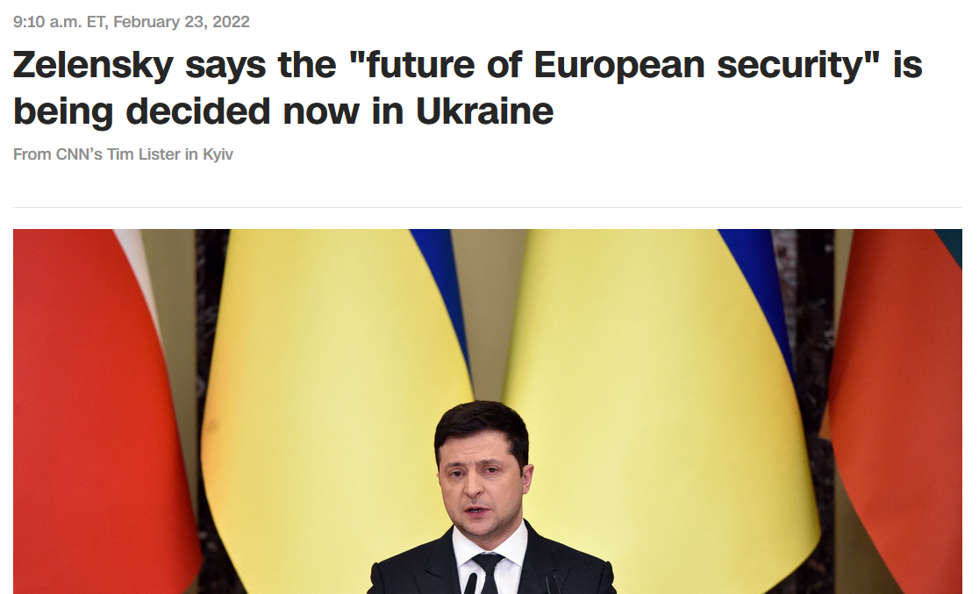

Slide 5
realism
power
security
liberalism
peace

Slide 6
Realists (and power)
international politics is anarchical (no higher power above states)
the overriding goal of states is to survive
→ by increasing their power
power as the prime motive for the behaviour of actors
security as a derivate of power (accumulation of power to ensure security)
power - primarily understood in terms of material resources to induce harm or coerce other states (power = military capabilities)
neorealism - security as the primary motivation of states

Slide 7
Liberals (and peace)
human nature as essentially good → people capable of mutual aid and collaboration
mutual benefits and international cooperation (x rejection of power politics)
war is not inevitable, its frequency can be reduced by eradicating anarchical conditions
central issues - lasting peace and cooperation in IR
the idea of an international community
security as the primary goal in state-to-state interactions

Slide 8
Security as an inherently contested concept?

Slide 9
The concept of national security
"… a nation is secure to the extent to which it is not in danger of having to sacrifice core values if it wishes to avoid war, and is able, if challenged, to maintain them by victory in such a war.“ (Walter Lippman, 1943)

Slide 10
Objective x subjective security
“… security, in an objective sense, measures the absence of threats to acquired values, in a subjective sense, the absence of fear that such values will be attacked.“ (Arnold Wolfers, 1952)

Slide 11
The concept of national security
those definitions reflect a dichotomic view of security (secure or not)
it is uncertain what are national / core values or interests?
perspective of national security and great powers
less useful for small states
ignores international security

Slide 12
Modern definition of security
“a state, under which threats to an object (usually a nation-state or an international organization) and its interests are eliminated as far as possible and this object is effectively equipped to eliminate existing and potential threats and willing to cooperate“ (Mareš, 2002)

Slide 13
Negative x positive security
“…national security includes traditional defence policy and also the non-military actions of a state to ensure its total capacity to survive as a political entity in order to exert influence and to carry out its internal and international objectives.“ (Michael H.H. Louw)

Slide 14
Specifying security
Security for whom?
Security for which values?
How much security?
From what threats?
By what means?
At what cost?
In what time period?

Slide 15
A. Security for whom?
whose values are to be secured?
traditionally, state as the dominant referent object → gradual „deepening“ of security (will be covered in Lecture 3)
individual / community
state
international system / global community

Slide 16
B. Security for which values?
the concept of national security traditionally included sovereignity, political independence and territorial integrity
values often enshrined in the constitutional order
some states also seek protection for more marginal values
the protection of values often translated into interests to be promoted
example: Security Strategy of the Czech Republic (2015)
Vital interests
Strategic interests
Other important interests

Slide 17
C. How much security?
security is a value of which a nation can have more or less / which it can aspire to have in greater or lesser measure
absolute security is unattainable → how much security is enough? (without activating security dilemma)
allocation of scarce resources among competing ends

Slide 18
D. From which threats?
threats to acquired values can arise from any sources
security traditionally equated with military threats → gradual „widening“ of security (will be covered by Lecture 2)
Military
Political
Societal
Economical
Environmental

Slide 19
E. By what means?
traditionally equated with the accumulation of military power
today - many different policies may be plausibly adopted in the pursuit of security
different elements of power (Diplomatic, Information, Military, Economic)
Security Strategy of the Czech Republic (2015) – the means differ according to the interests (vital x strategic x other)

Slide 20
F. At what cost?
the pursuit of security always involves costs (security policy compete with other values / policies)
the economic law of diminishing returns - at a certain point, the gain in security no longer compensates for the added costs of attaining it
states / citizens tend to experience efforts for security as a burden → inclined to minimise these efforts

Slide 21
G. In what time period?
most rational policies may differ greatly from short-term efforts to atain security
security policy needs to adapt to changes in strategic environment, alliances, political priorities, resources etc.
grand strategy - security policy - security strategy

Slide 22
Strategic environment and strategy
strategic (security) environment - „internal and external context, conditions, relationships, trends, issues, threats, opportunities, interactions, and effects that influence the success of the state in relation to the physical world, other states and actors, chance, and the possible futures “
strategist seeks to protect and advance the interests of the state within the SE through specific effects
strategy = ends + ways + means
strategy seeks to cause specific effects in the environment by employment of specific instruments of power (DIME)

Slide 23
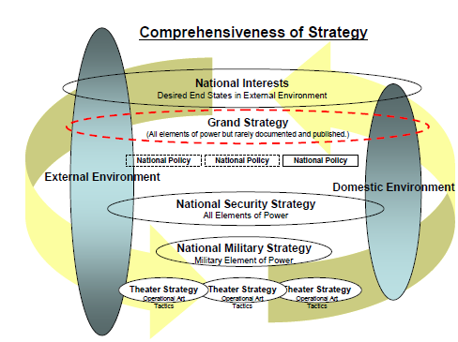

Slide 24
Security policy
(national) security policy
a general description that sets priorities and goals for security provision
how a state aims to provide for its own security and that of its population
a national understanding of the threats and risks of the security environment, and the values and principles that will guide the state in providing security
(national) security strategy
how the goals set in a national security policy can be achieved
a practical document (or set of documents) that details the necessary instruments to implement a national security policy

Slide 25
Elements of national security policy
Vision and goals
Values and principles
Strategic environment (current and future threats, risks, challenges and opportunities)
National interests and strategic objectives
International obligations

Slide 26
Summary
different approaches towards security (realism x liberalism)
security as a neglected concept
the need for specification of security (actors, values, threats, amount… )
difference between (national) security policy and security strategy
main elements of national security policy

