Slide 1
Security for Whom? From State to International to Human Security Policies
International Security Policy (BSSb1105), 10/3/2022
Vendula Divišová, FSS MU
vendula.divisova@mail.muni.cz

Slide 2
Learning goals
Understand the difference between national, international and human security and their interconnections
Learn key ideas of human security and its impact on security and defence policy

Slide 3
Outline
Deepening of security
Different levels of security
  National security
  International security
  Human security
A holistic view of security
Implications for security and defence policy

Slide 4
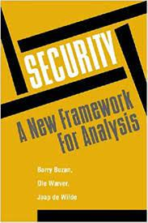
Deepening of security
Levels of analysis (Copenhaguen School)
  International systems (the entire planet)
  International subsystems (e.g., international organisations)
  Units (states, nations, transnational firms)
  Sub-units (e.g., bureaucracies, lobbies).
  Individuals

Slide 5
National security
state is given a monopoly on the use of force only insofar as it is capable of protecting its citizens
  ‘national security’ = all those public policies through which the nation state ensures its survival as a separate and sovereign community → the safety and prosperity of its citizens
security as the absence of threats to acquired values (see the next slide) / capability to deter or defeat an attack
  bias towards great powers and absolute security
  security pursued by reducing vulnerability (implies a self-help - military power)
why (absolute) national security cannot be achieved?
  security dilemma
  risk of creating a militarised and security-obsessed society

Slide 6
National security (definitions)
"… a nation is secure to the extent to which it is not in danger of having to sacrifice core values if it wishes to avoid war, and is able, if challenged, to maintain them by victory in such a war.“ (Walter Lippman, 1943)
“… security, in an objective sense, measures the absence of threats to acquired values, in a subjective sense, the absence of fear that such values will be attacked.“ (Arnold Wolfers, 1952)
“Security itself is a relative freedom from war coupled with a relatively high expectation that defeat will not be a consequence of any war that should occur.“ (Ian Bellamy)

Slide 7
International security
focus on the sources and causes of threats → aims to reduce / eliminate them
depends on the management of relations among states
agree to conduct their sovereign affairs in accordance with specified normative standards
  principles, norms, rules of behaviour → some degree of order and certainty
  international organizations and regimes
in practice IS depends on great powers
relations among states - notoriously fickle
might lead to excessive vulnerability

Slide 8
„Human security is not a concern with weapons. It is a concern with human dignity. In the last analysis, it is a child who did not die, a disease that did not spread, an ethnic tension that did not explode, a dissident who was not silenced, a human spirit that was not crushed“ (Haq 1995: 116).

Slide 9

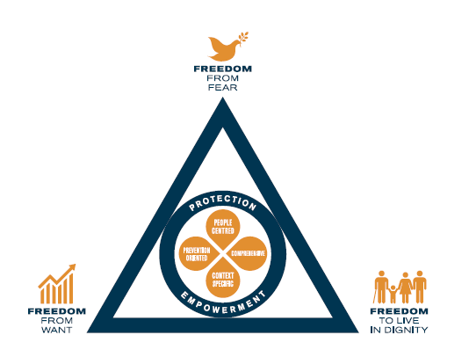
Change of paradigm? Human security
NS and IS both view states as protectors rather than oppressors of its own citizens
states might endanger their own citizens
paradigm of human security
  moral primacy to the well-being of men, women and children over and above the rights and interests of states or of international society
  different definitions - safety -> well-being, human rights
  freedom from fear + freedom from want + freedom to live in dignity

Slide 10
Dimensions of human security
Economic
Food
Health
Environmental
Personal
Community
Political
Notes:
economic security (e.g., freedom from poverty);
food security (e.g., access to food);
health security (e.g., access to health care and protection from diseases);
environmental security (e.g., protection from such dangers as environmental pollution and depletion)
personal security (e.g., physical safety from such things as torture, war, criminal attacks, domestic violence, drug use, suicide, and even trafªc accidents);
community security (e.g., survival of traditional cultures and ethnic groups as well as the physical security of these groups);
political security (e.g., enjoyment of civil and political rights, and freedom from political oppression).

Slide 11
Human Security Network
established in 1999, loose grouping of states led by Canada, Norway, Switzerland
the task of promoting the concept of human security as a feature of national and international policies
agenda for political action:
  elimination of antipersonne landmines
  stopping the use of child soldiers
  promoting respect of international humanitarian law and the work of ICC
  stop proliferation and misuse of small arms and light weapons
  protection of civilians in conflict

Slide 12
Responsibility to protect (R2P)
ICISS report (2001) - proposed the doctrine of R2P:
  „State sovereignty implies responsibility, and the primary responsibility for the protection of its people lies with the state itself.“
  „Where a population is suffering serious harm, as a result of internal war, insurgency, repression or state failure, and the state in question is unwilling or unable to halt or avert it, the principle of non-intervention yields to the international responsibility to protect.“
  applies to genocide, war crimes, crimes against humanity, ethnic cleansing
Military intervention as an exceptional measure in cases of serious and irreparable harm occurring to human beings (or imminently likely to occur)
  A. large scale loss of life as a product of deliberate state action / neglect / inability to act / failed action
  B. large scale ‘ethnic cleansing‘
Notes:
The Responsibility to Protect Report of the International Commission on Intervention and State Sovereignty

Slide 13
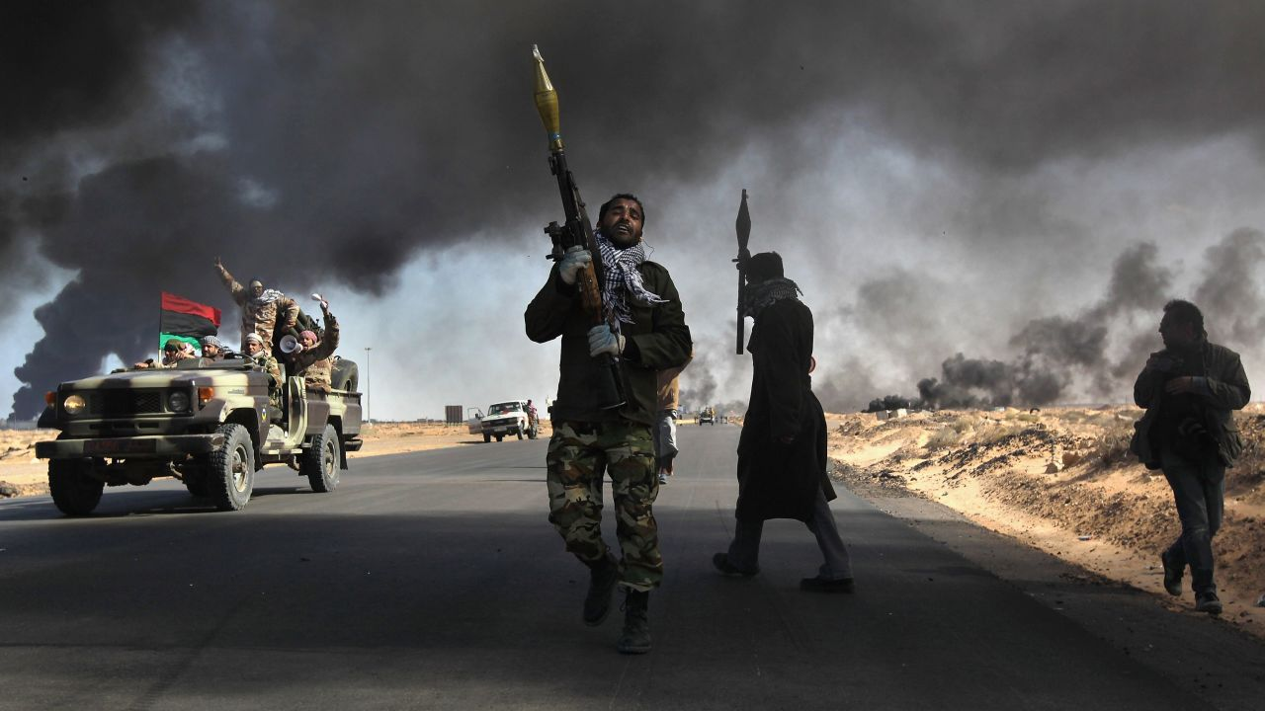
Responsibility to protect (R2P)
https://www.youtube.com/watch?v=VwPi3jK-kRw

Slide 14
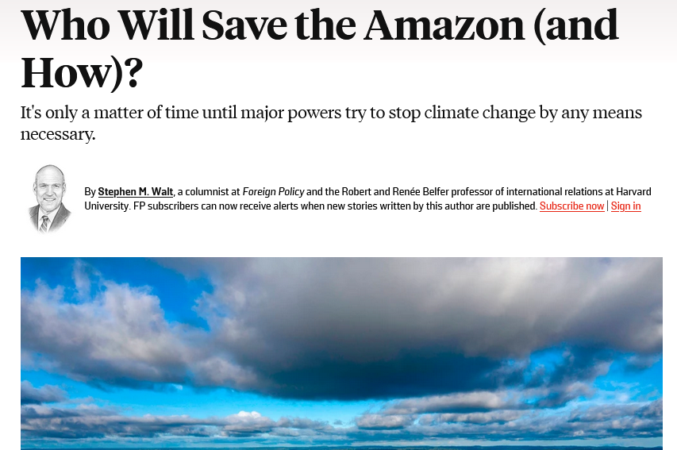
Responsibility to protect (R2P)

Slide 15
Human security in practice (NATO)
NATO - human security relates to “risks and threats to populations where NATO has operations, missions or activities, and how to mitigate and respond to them“
translated into number of policies:
  Countering Trafficking in Human Beings
  Children and Armed Conflict
  Protection of Civilians
  Preventing and Responding to Conflict-Related Sexual Violence
=> a narrow conception of human security

Slide 16

A holistic view of security
Buzan: 3 levels of security - individuals (level 1) - state (level 2) - international system (level 3)
  strong interconnections, they cannot be addressed separately!
  need for reintegration
= systemic security - interconnecting all three levels
  taking account of the vulnerabilities of other actors, threat from one‘s own state…
solution to the power-security dilemma (excessive vulnerability x excessive provocation)
stability of the system - by distributing the control as wide as possible across the levels

Slide 17
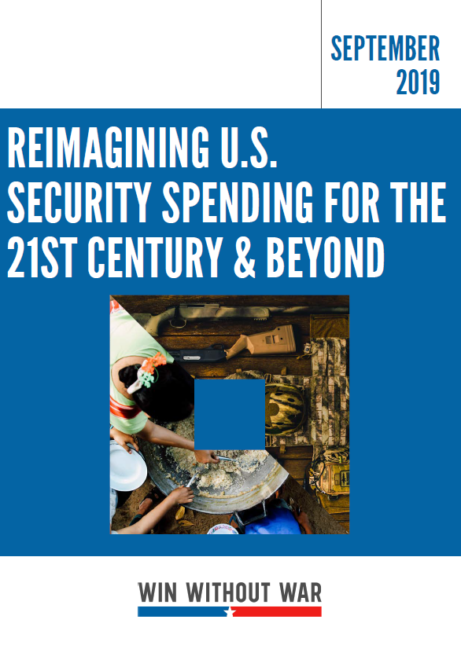
Rethinking security
Example 1: „Reimagining U.S. Security Spending for the 21st Century & Beyond“
call for reconceptualisation of US national security to be based on human security
the current existential threats do not have military solutions
the US national security cannot be separated from security of people all over the world
more focus on human security issues (authoritarianism, climate change, mass inequality, militarism)
more investment in non-military tools needed

Slide 18
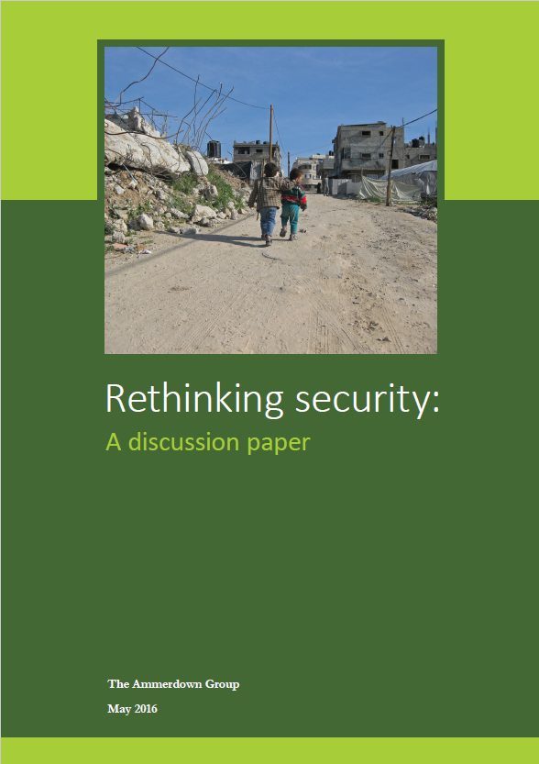
Rethinking security
Example 2: The Ammerdown Group. „Rethinking security: A discussion paper growing insecurity“
established approach - identify threats and „neutralise“ them through „capabilities“ (mostly hard power)
the military response has been ineffective and counterproductive
the goal of security must be grounded in the wellbeing of people in their social and ecological context
priority issues: scarcity and climate change, inequality, militarism, violent conflict
need for greater understanding of the adversaries

