Slide 1
Security of what?
Lucie Konečná
BSSb 1105 International Security Policy
26/9/2022

Slide 2
Brief History of SS
Sub-discipline of IR
What is security?
Agenda of SS
Periodization of the evolution of security studies:
a) Interwar period (national security, ensuring the defense of the state, first research centers)
b) the 1950s (interdisciplinarity, focus on foreign policy, expansion of the methodological base - game theory, dominant direction realism, World Politics)
c) period 1955-1965 (strategy for the use of nuclear weapons, Survival journal)
d) period 1965 -1980 (decline SS, MAD - mutual assured destruction)
e) period 1980-1989/90 (International Security journal, new approaches)
f) period after the end of bipolar confrontation (completely new topics, non- military threats)

Slide 3
The most famous SS workplaces
SIPRI – Stockholm International Peace Research Institute (https://www.sipri.org/)
PRIO - The Peace Research Institute Oslo (https://www.prio.org/)
UCDP – Uppsala Conflict Data Program (https://ucdp.uu.se/)
FFP – Fund for Peace (https://fragilestatesindex.org/)
GTD – Global Terrorism Databases (https://www.start.umd.edu/gtd/)

Slide 4
Critical Security Studies
Shift in the 90s (The first impulse - Toronto school - Strategies in Conflict: Critical Approaches to Security Studies)
Traditional security studies focused on military and state as referent object
A shift in the definition of the referent object and threats
Three main aspects of CSS according to Browning a McDonald
Mohammed Ayoob – subaltern realism
Discussion of the concept of security in the 90s - three groups
  A) group against changing the agenda (John Mearsheimer, Stephen Walt)
  B) group supporting the partial change (Schultz, Buzan?)
  C) group supporting radical reform (Ulman, Kegley)

Slide 5
The most famous SS approaches - Toronto School
1994 - small conference at the York University entitled Strategies in Conflict: Critical Approaches to Security Studies
Keith Krause and Michael C. Williams - Critical Security Studies: Concepts and Cases
They began to questioning the concept of state as the main referent object – who or what is to be secured?
Set out agenda of CSS in three points:
a) referent object
b) security more than just a military security
c) changed the way how security was studied

Slide 6
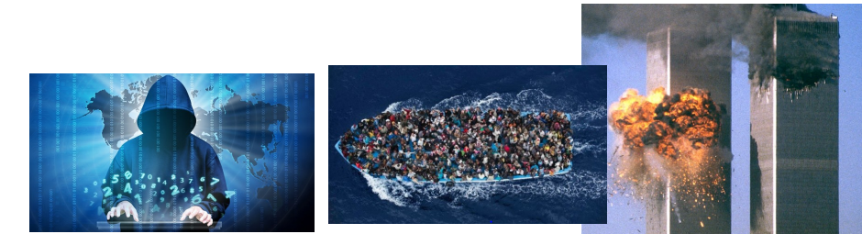



New topics and new referent objects

Slide 7
The most famous SS approaches - Copenhagen School
1995 - Barry Buzan, Ole Weaver and Jaap de Wilde published book: Security: A New Framework for Analysis
Old vs. new concept of security
Resolves its incoherence by arguing that the social production of security is sufficiently stable to be treated objectively
Concept of sectoral security - military, political, economic, societal, environmental security
Concept of analytical levels/categories (international systems, international subsystems, units, subunits and individuals).
Concept of regional security complexes (4 basic principles)
„a group of states whose major security perspectives and concerns are so intertwined that the national security issues of each cannot be adequately analyzed or addressed separately“

Slide 8
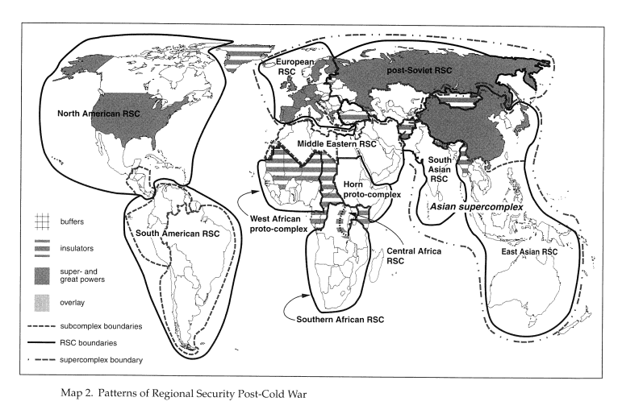
Copenhagen School – Regional Security Complexes

Slide 9
Copenhagen School - Securitization
Referential object – entity which is threatened and has legitimate right for survival
Securitisation actor – the one who securitises
Functional actor – influences the dynamic of the sector
Securitisation actor is presented by an entity which presents certain issue as security threat through speech act - 2 phases:
a) portraying a certain problem as an existential threat
b) accepting the phenomenon as a threat and subsequently taking appropriate measures
Three aspects influencing success of the securitization - the nature of the threat, the external context, the linguistic and grammatical criteria of the speech act

Slide 10
The most famous SS approaches – Welsh/Aberyswyth School
Steve Smith – Critical Security Studies and World Politics, Theory of World Security by Ken Booth.
Emancipatory realism - security is perceived in a wider context = education, economic growth, healthy environment, etc.
Focused on a normative goal = human independence
A wide range of non-military threats
The normative aspect - an academic lives in society and cannot separate himself from "values" - we select and emphasize certain facts + influences such as gender, education, class, etc... The problem is not that we do not make an "objective decision", the problem is that some options we choose to ignore

Slide 11
Sectoral analysis - Military sector
Referent objects – state or military.
Securitisation actors - ruling political elite
In practice, the military security agenda includes the ability of governments to avert internal and external threats to their existence, but also includes the use of military force to defend states or governments against non-military threats such as immigrants, competing ideologies, etc.
2 major turning points: the end of the Cold War + the collapse of the USSR and 9/11
The biggest threat - conflicts
Military sector and events of 2020/2021 - withdrawal from Afghanistan, reescalation of conflict in Nagorno Karabach, long-lasting conflicts in Syria and Jemen, increasing instability in the Sahel, etc.

Slide 12
Sectoral analysis - Political sector
Referent object - stability and sovereignty of the state
Securitisation actor – political leaders
Threats against internal legitimacy x external recognisiton/legitimacy
3 components of the state: ideas/ideology of the state, physical base and institutions.
Threats: separatist tendencies towards weak states, threats to states arising from political-ideological issues, actions of the supranational, regional integration unit and the reaction to this action, etc.
Domestic (coups, anti-government protests, delegitimization of the government), regional (tensions and instability within bilateral relations), and global level (rising tensions between the West and China/Russia).

Slide 13
Sectoral analysis - Economic sector
Referent object can be individuals, sometimes states (economic stability and prosperity) and sometimes the entire international economy
Securitisation actor - state authorities, IGOs and sometimes companies
Threats: economic losses, eventual collapse of the entire economy, economic declines, etc.
Economic regionalism – EU, ASEAN, NAFTA/USMCA, etc.
A financial crisis is any of a broad variety of situations in which some financial assets suddenly lose a large part of their nominal value. Example: banking crisis, currency crisis, international finances crisis.

Slide 14
Sectoral analysis - Societal sector
Referent object – national security, society/community
Societal security = identity security
Securitisation actor – Leaders (political, spiritual, tribal etc.).
Identity threats : a) Migration
b) Horizontal Competition
c) Vertical Competition
d) Massive population decline
The way in which identity is constructed is important, examples: Separation, Numerical superiority, Language, Cultural customs, Melting pot, Integration of groups with their own history, etc.

Slide 15
Sectoral analysis - Environmental sector
Referent object - the environment or some of its strategic components, the preservation of the current level of civilization
Securitisation actors - governments, government agencies and intergovernmental org. – governments establish rules to the actors, enforce their compliance
According to Buzzan 6 topics of the environmental agenda:
1. Disruption of ecosystems (climate change, loss of biodiversity, desertification)
2. Energy problems (depletion of natural resources, various forms of pollution)
3. Population problems (population growth and consumption exceeding the capacity of the Earth)
4. Food problems (poverty, famine)
5. Economic problems (protection of long-term unsustainable methods of production, social instability due to the growth imperative)
6. Civil disputes (damage to NE due to conflicts + violent conflicts resulting from NE degradation)

Slide 16
Sectoral analysis - Environmental sector
Three types of threats:
a) Threats to human civilization that arose from the natural environment and not caused by human activity.
b) Threats caused by human activity and affecting the natural system (present an existential threat)
c) Threats caused by human activity and affecting the natural system (do not represent an existential threat)
Think globally, act locally
The United Nations Conference on Environment and Development (UNCED), The United Nations Conference on Sustainable Development (UNCSD)
https://sustainabledevelopment.un.org/content/documents/Agenda21.pdf

Slide 17
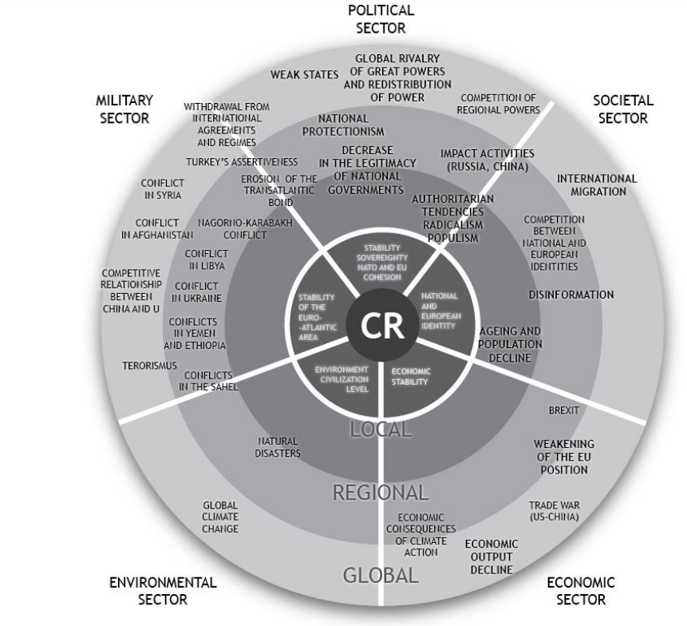
Sectoral analysis

Slide 18
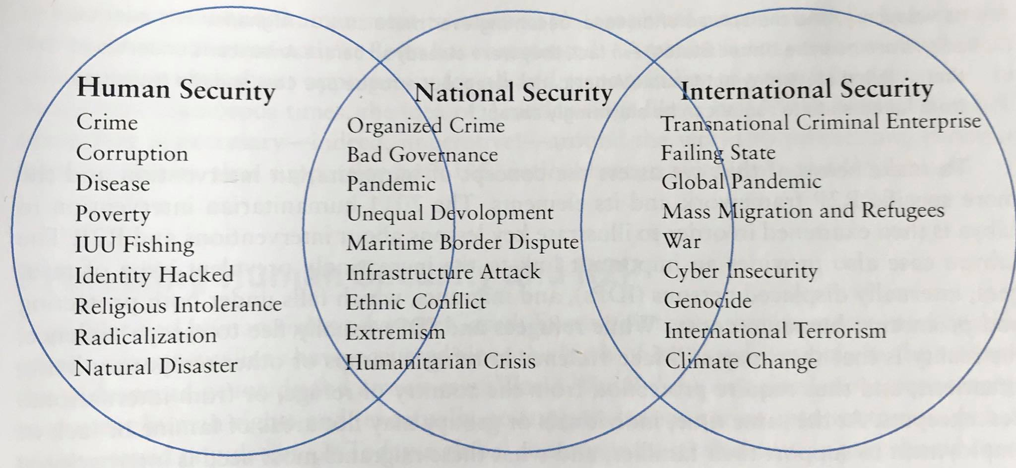
Security according to Reveron and Mahoney-Norris
Derek S. Reveron, Kathleen A. Mahoney-Norris - Human and National Security Understanding Transnational Challenges

Slide 19
Thank you for your attention

