Slide 1
New Security Challenges
Lucie Konečná
BSSb 1105 International Security Policy
17/10/2022

Slide 2
Old vs. New Security
Barry Buzan, Ole Weaver and Jaap de Wilde – Old vs. new security
Discussion of the concept of security in the 90s - three groups
  A) group against changing the agenda (John Mearsheimer, Stephen Walt)
  B) group supporting the partial change (Schultz, Buzan?)
  C) group supporting radical reform (Ulman, Kegley)
Traditional/old security - primarily the military sector and military threats that come primarily from states, regionalism
New security - new types of security, threats from non-state actors, decline of regionalism

Slide 3
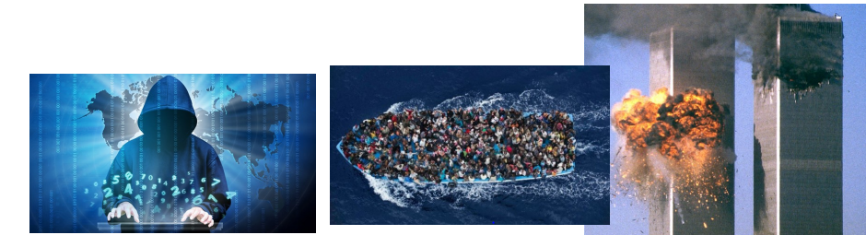

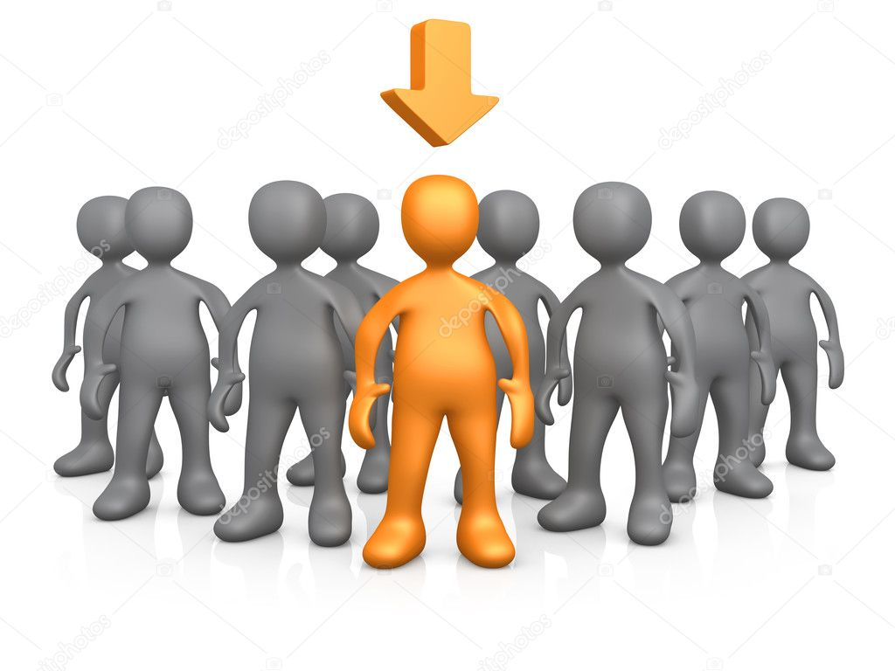

New topics and new referent objects

Slide 4
Traditional Threats - the Position of States in the International System
The state as a person of international law should possess the following qualifications:
  a ) a permanent population;
  b ) a defined territory;
  c ) government;
  d) capacity to enter into relations with the other states
(Convention on Rights and Duties of States 1933)
Typology of states:
1. Superpowers
2. (Regional) Powers
3. „Normal“ states
4. Microstates
5. Dependent states and territories
6. Failed states (https://fragilestatesindex.org/global-data/)

Slide 5
Traditional Threats - the Position of States in the International System/Polarity
Polarity expresses the number of autonomous centers of power and is a function of the distribution of power among only the most important actors
1. Unipolarity
2. Bipolarity
3. Tripolarity
4. Multipolarity
5. Hyperpolarity (total symmetric desintegration of power)
6. „Zero-polarity“ (total cooperation)

Slide 6
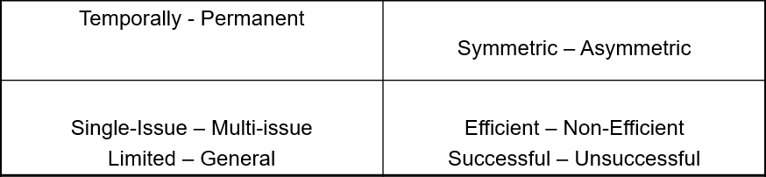
Position of States in the International System/Alliance
Security alliance is „formal agreement between two or more actors (usually states) to cooperate together on perceived mutual security issues. By allying themselves together it is anticipated that security will be increased in one, some or all of the following dimensions:
By joining an alliance system of deterrence will be established or strengthened;
By joining an alliance a defence pact will operate in the event of war;
By joining an alliance some or all the actors will be precluded from joining other alliances“ (Evans, Newnham 1998: 15).

Slide 7

Position of States in the International System/ Balancing and Bandwagoning
Balancing is more common than bandwagoning.
The stronger the state, the greater its tendency to balance. Weak state will balance against other weak states but may bandwagon when threatened by great powers.
The greater the probability of allied support, the greater the tendency to balance. When adequate allied support is certain, however, the tendency for free-riding or buck-passing increases.
The more unalterably aggressive a state is perceived to be, the greater the tendency for other to balance against it.
In wartime, the closer one side is to victory, the greater the tendency for other to bandwagon with it (Walt 2009: 102)

Slide 8

The Next 100 Years: A Forecast for the 21st Century
George Friedman
Russia - creation of buffer zones, confrontation with the US, internal collapse
USA - 21st century - the American century, Islamic Jihad, control of the American continent and oceans
China - decline in economic performance - beginning of instability

Slide 9
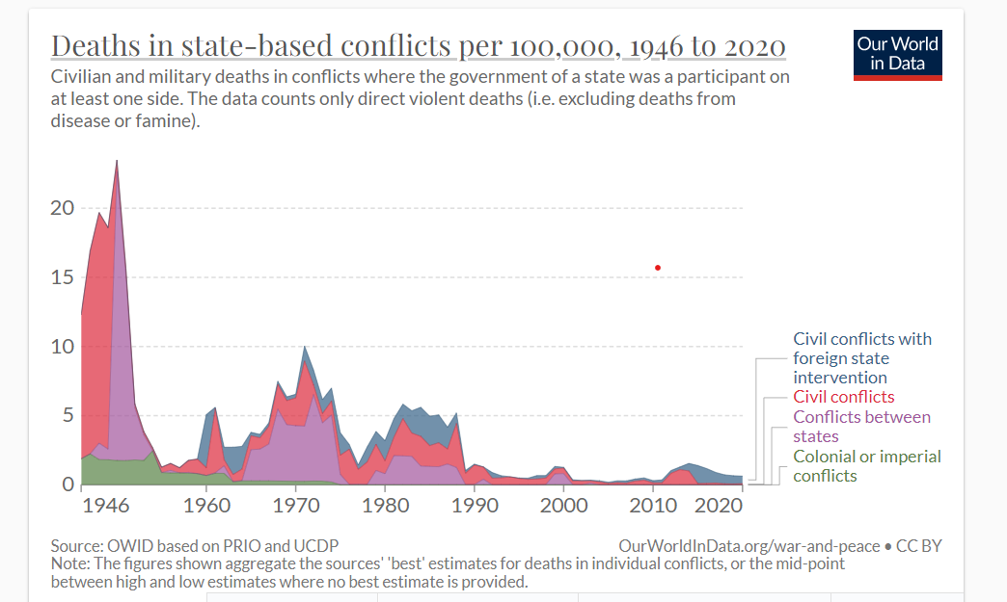
Conflicts – Traditional or New Threat?
Conflict vs. War
Low, medium and high intensity conflict
Civil war

Slide 10
Conflicts – Traditional or New Threat?
The bloodiest conflicts of the 21st century
DRC (1998 – 2003) | 2,5 – 5 mil
Afghanistan (2001-2014) | 110 00
Iraq (2003-2011) | 200 000 - 1,2 mil
Syria (2011 -) | 500 000
Yemen (2015 -) | 500 000
Darfur (2003 -) | 400 000
Nigeria (2009 -) | 200 000
Somalia (1991 - ) | 500 000

Slide 11
Violent Non-State Actors (VNSA)
Interstate, intrastate and substate/nonstate conflicts
Types of VNSA – partisans/guerilla and insurgency, terrorist groups, warlords, militia, paramilitary units , PSC/PMC, mercenaries, organized crime groups
Distinctive characteristics:
  a) motivation
  b) role of violence
  c) power/teritoriality
  d) financing
  e) organizational structure
  f) relationship between VNSA and the state
  g) relationship between VNSA and population

Slide 12
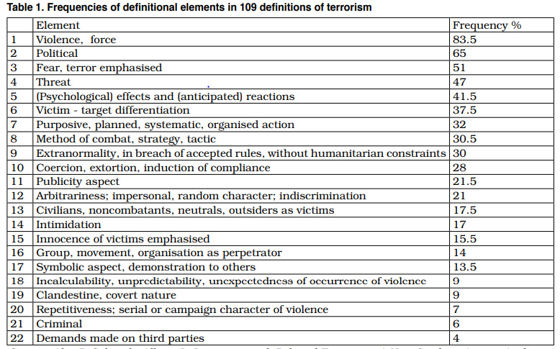
Terrorism

Slide 13
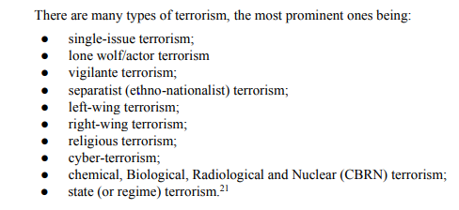
Terrorism
According to Schmid (2020)

Slide 14
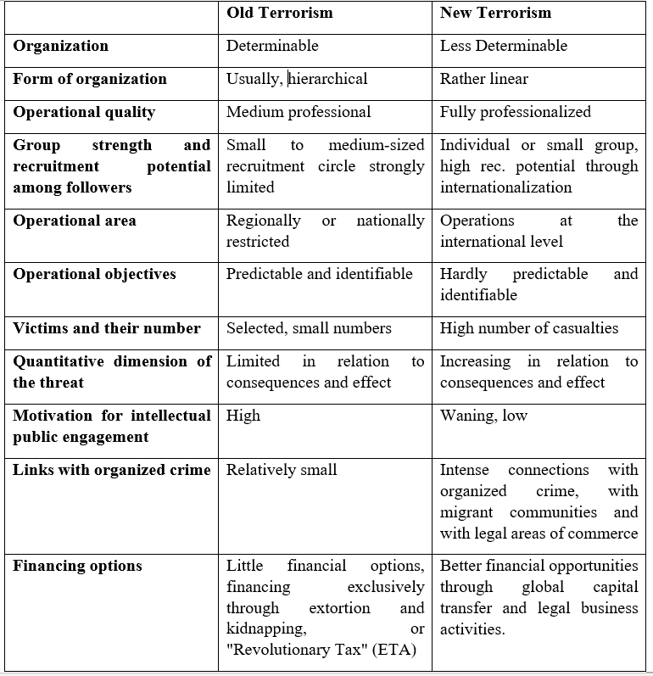
Terrorism – Old vs. New

Slide 15
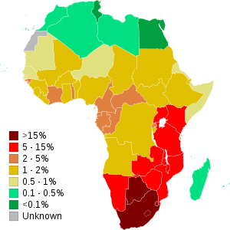
HIV/AIDS
Bushmeat theory – Cameroon.
71% of the total HIV population lives in Sub-Africa.
Desmond Tutu HIV Foundation .
UNAIDS - Joint United Nations Programme on HIV/AIDS.
Causes of expansion in Africa: behavioral factors, lack of money, natural disasters and conflicts, health industry, medical suspicion, circumcision?, religious factors, educational level, poverty.

Slide 16
Migration
Around 281 million international migrants in the world in 2020
At the end of 2021, the total number of people worldwide who were forced to flee their homes due to conflicts, violence, fear of persecution and human rights violations was 89.3 million.
Migrant vs. refugee
Negative Impacts of Refugeeism:
  Economical impacts – influence on food prices, influence on the reduction of wages of local residents, Influence on the rise in housing and rental prices and direct state expenditure on refugees.
  Social impacts – internal displacement of persons, social inequalities between refugees and local people, ethnic tension.
  Environmental impacts – increase in the slums, pollution or depletion of water, deforestation, soil degradation.
  Political-security impacts - increase in terrorism, increase in trafficking and crime, bilateral tensions between neighboring countries.

Slide 17
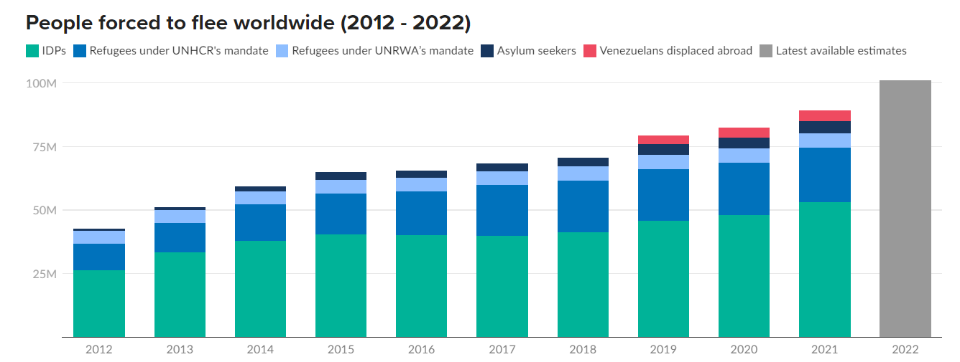
Migration

Slide 18
Migration – Refugee Related Political Violance
a) Attacks between sending state and refugees (The violence occurs between refugees and government of sending state)
b) Attacks between receiving state and refugees (The violence occurs between refugees and government of receiving state)
c) Ethnic or factual violence among refugees (The violence occurs between groups of refugees)
d) Internal violence within receiving state (The violence occurs between refugees and local population of receiving state)
e) Interstate war or unilateral intervention (Refugees and the government of more than one state are involved in violence)
f) Attacks between refugees and transnational VNSA (The violence occurs between refugees and transnational VNSA (( non-state armed groups operating across several countries))

Slide 19
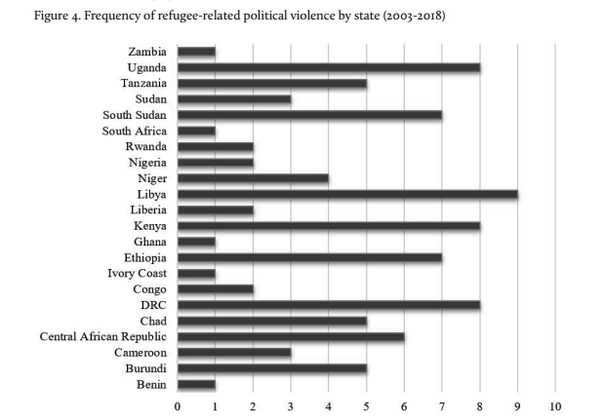
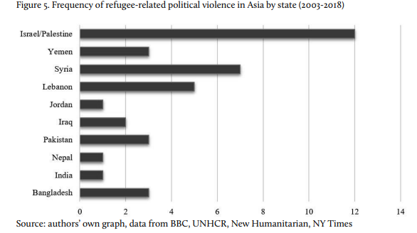
Migration – Refugee Related Political Violance

Slide 20
Cybersecurity
Types of threats:
  Organized crime
  Cyber terrorism and information propaganda
  Attack on critical infrastructure
  Industrial and military espionage
  Hacking activity (in order to prove one's abilities, or politically motivated)
  Malicious activity by someone "from within the system„
Types of means:
  Phishing
  Virus
  Worms
  Trojan Horse
  Botnet
  DOS
  Logical Timed Bomb

Slide 21
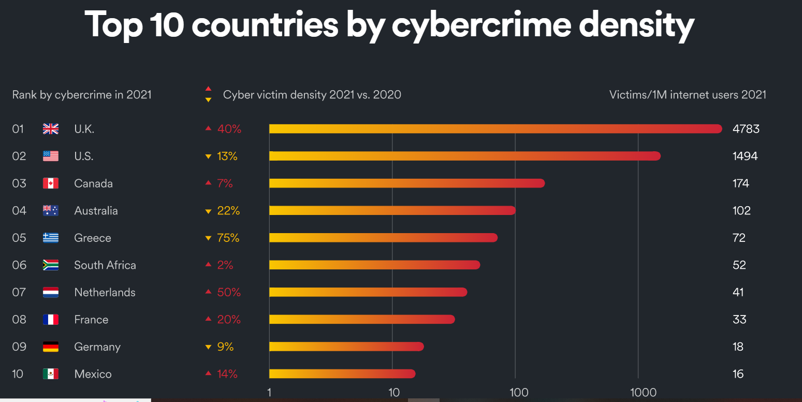
Cybersecurity

Slide 22
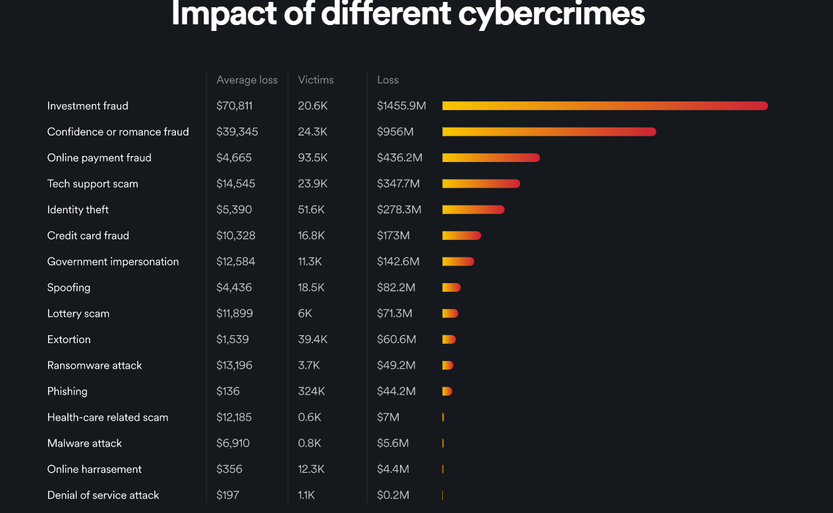
Cybersecurity

Slide 23
Thank you for your attention

