Slide 1
Politics & Security of Serbia
Balkan Politics
Věra Stojarová
stojarova@fss.muni.cz

Slide 2
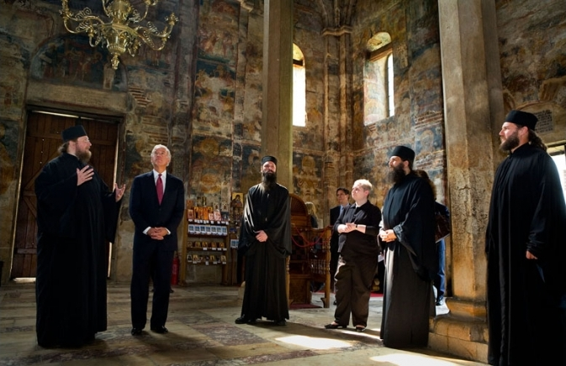
History of Serbia
1878-1918 Kingdom of Serbia
1918-41 SHS
1928 Kingdom of Yugoslavia
WWII
1945- 1992 Federal unit of Yugoslavia
1992 – 2006 together with Montenegro Federal Republic of Yugoslavia
2006 republic of Serbia
Srbija do Tokia
Serbia is like a Nokia, its getting smaller and smaller

Slide 3
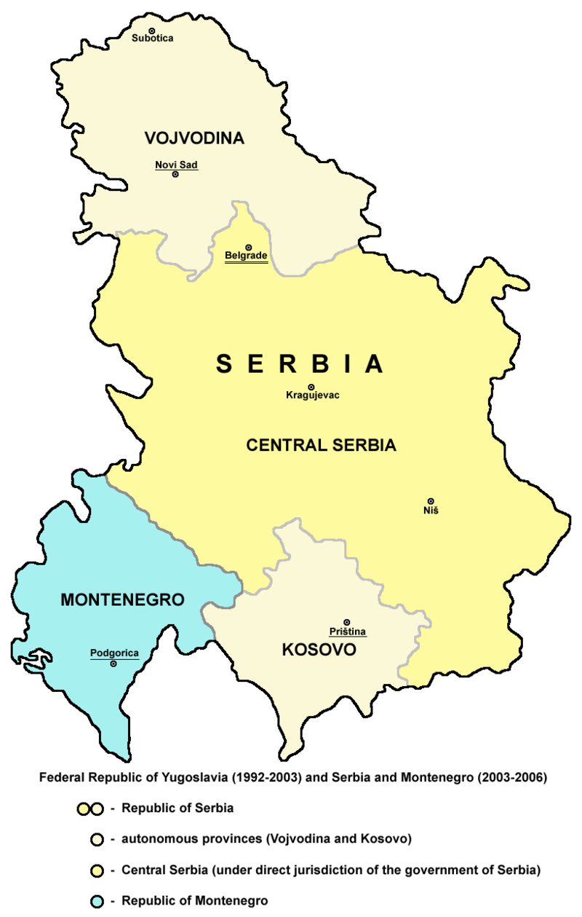
Federal Republic of Yugoslavia
1992 -2006
2006 Belgrade agrement – Serbia and Montenegro
Kosovo, Vojvodina?

Slide 4
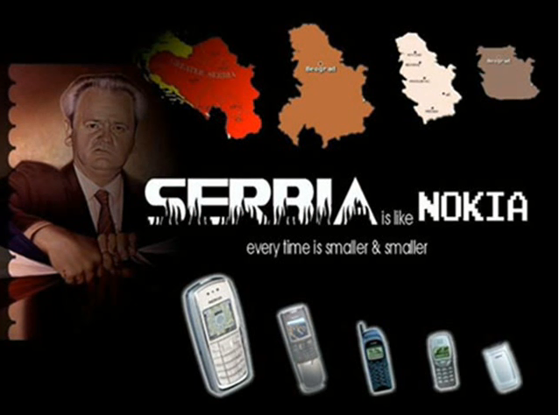
Serbia in wars
Slovenia
Croatia
BiH
Kosovo
Preševo, Medvedja Bujanovac uprising

Slide 5
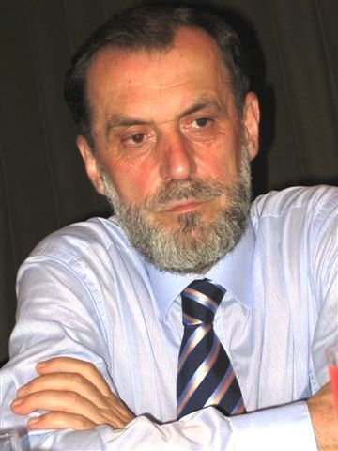
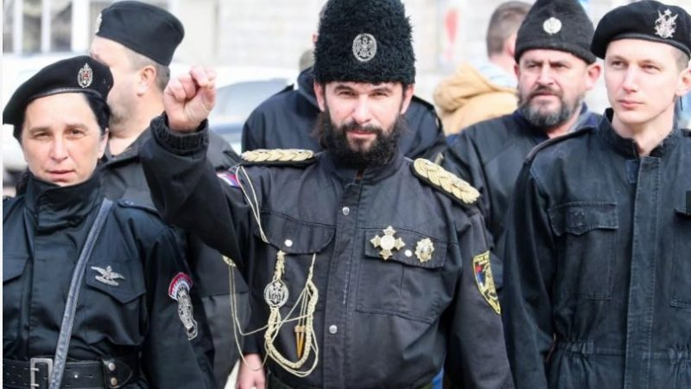
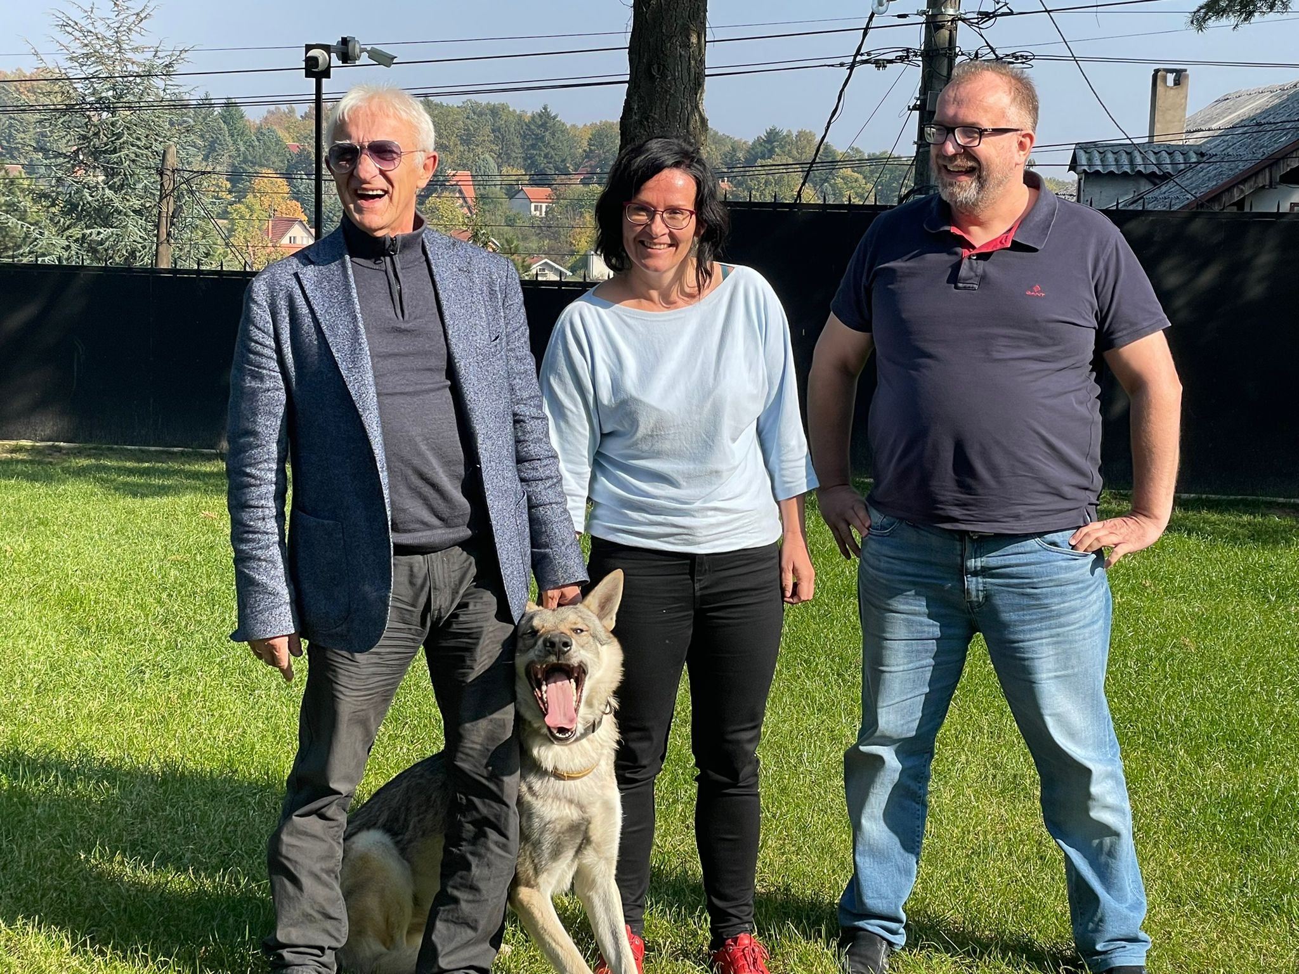
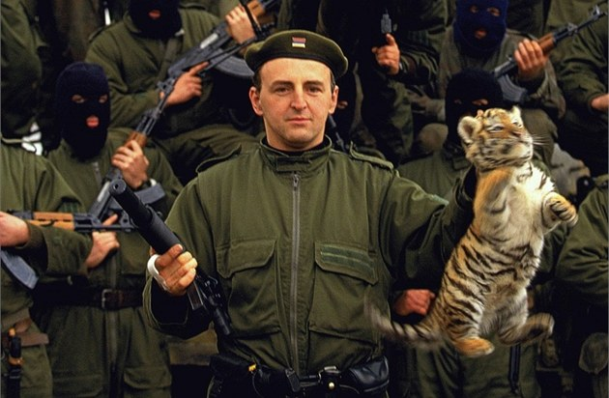
Serbian paramilitaries
Arkanovi tigrovi
Šešelj White Eagles
Captain Dragan
Vuk Drašković and chetnics

Slide 6
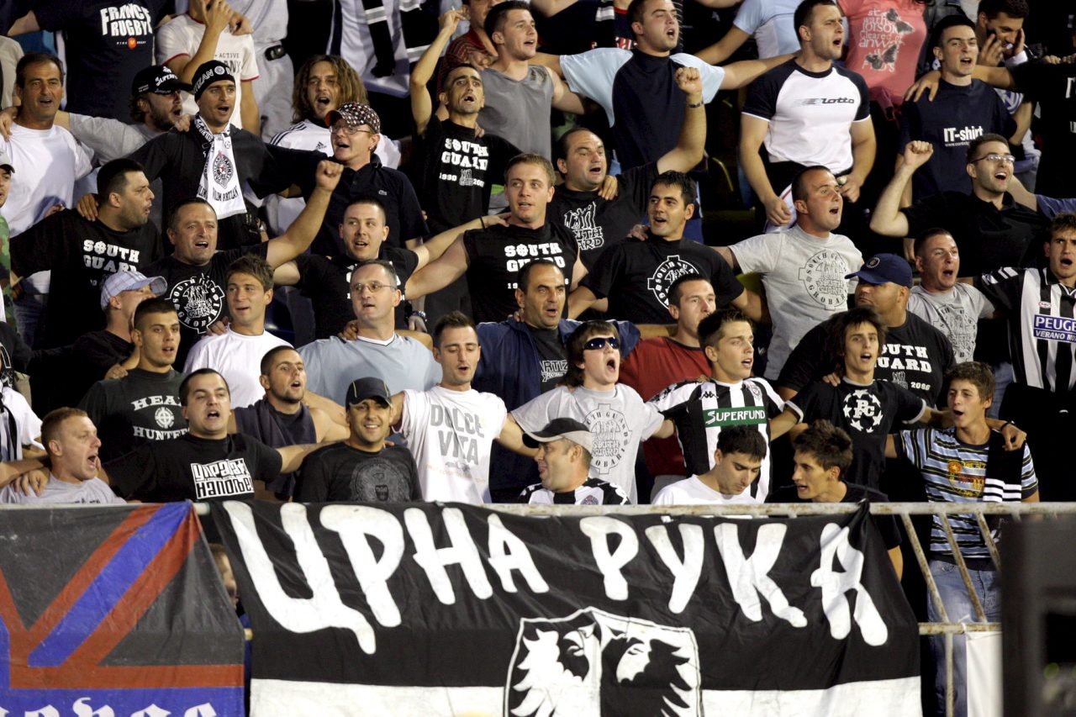
Football hooligans
Recruited by Arkan
Crvena zvezda- Delije
Played important role in 2000 toppling of Milosevic
Against pride marches
Working relationship with government
Kill, kill kill the Albanians
2014 drone with Albanian flag of greater albania
Nož, žica, srebrenica

Slide 7
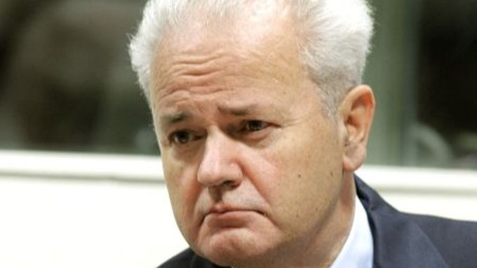
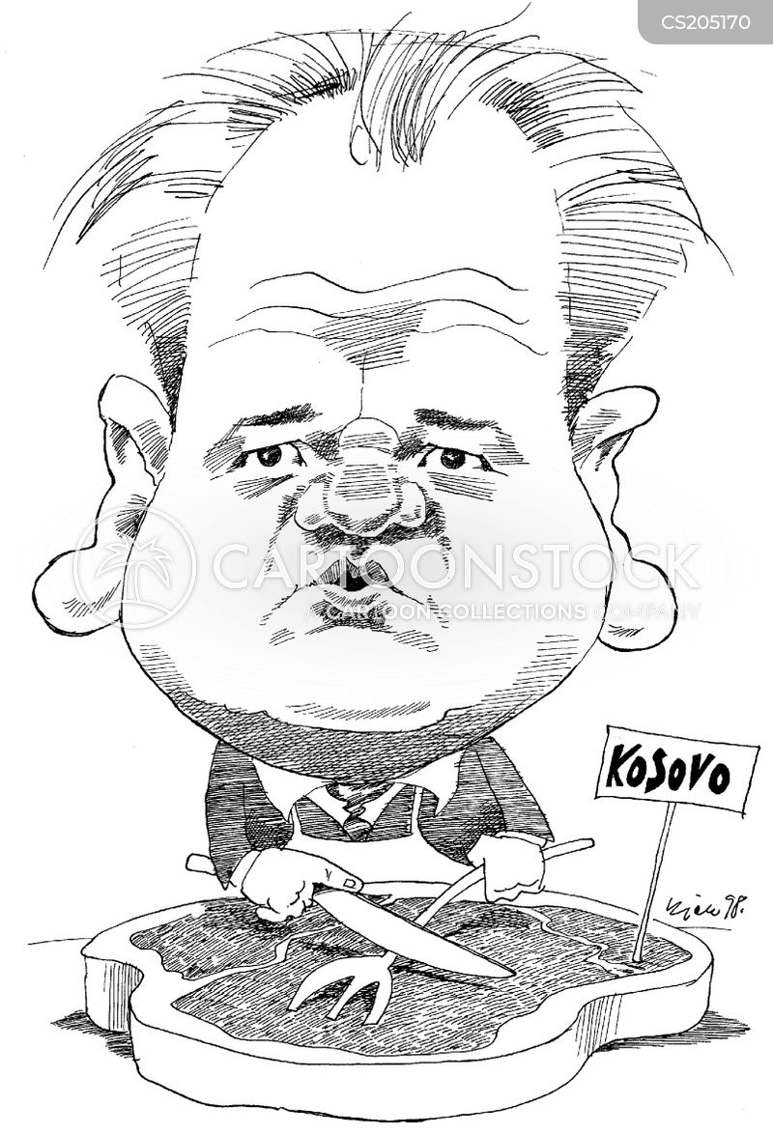
Slobodan Milošević
High ranking communist
Leader of Socialist party of Serbia
President of Serbia 1989-1997
President of federal republic of yugoslavia 1997-2000
Communism to nationalism
Authoritarian rule, police brutality
Guilty for the wars
Meetings with Tudjman to divide BiH
ICTY, ICJ, war crimes, crimes against humanity and genocide
called for political change to reduce the autonomy, protect minority Serb rights, and initiate a strong crackdown on separatism in Kosovo.
Extradited to ICTY in 2001
2006 found dead in the cell

Slide 8
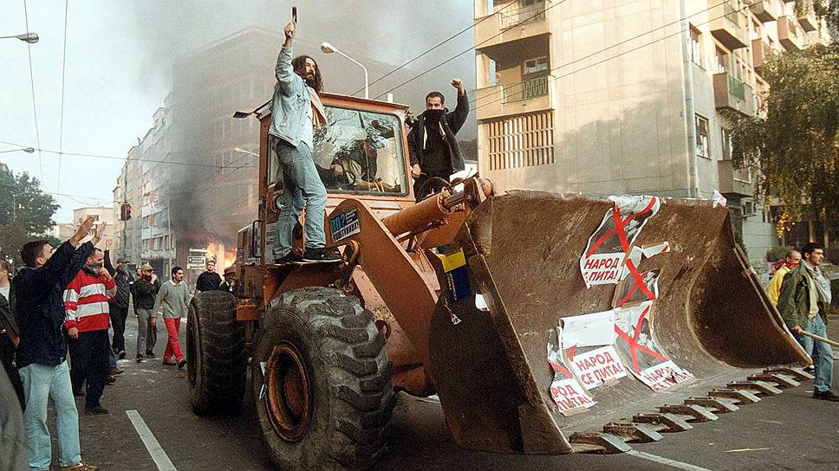
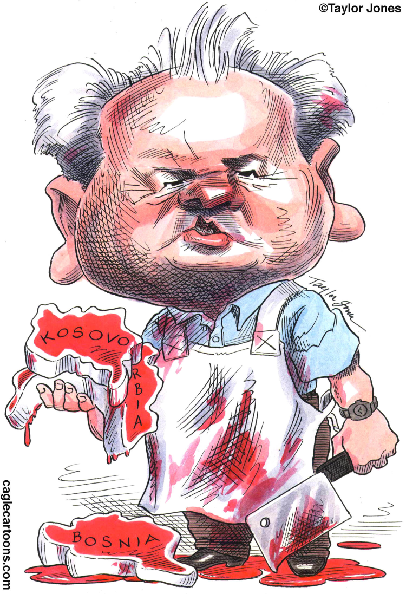
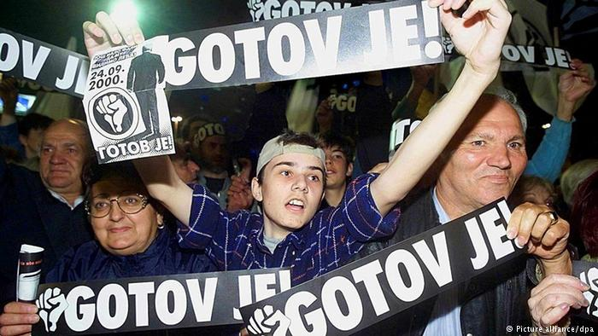
5 October 2000 overthrow of Milošević (Buldozzer revolution)
25 August execution of former mentor and political ally Ivan Stambolic – competitor, initiated by Milosevic?
OTPOR
GOTOV JE
US funded opposition campaign for the elections
24 September 2000 elections
Accusation of electoral fraud, discreppancies
Protests, no police crackdown
Due to the pressure milosevic resigned

Slide 9
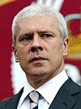
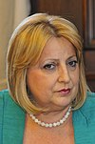
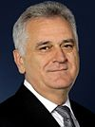
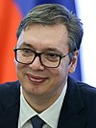
Presidents of Serbia
2006-2012 Boris Tadic DS
2012 Slavica Dejanovic SPS
2012 -2017 Tomislav Nikolic SNS
2017-2022 Alexandar Vucic SNS
Directly elected, 5 years, 2 round system, max 2 turns

Slide 10
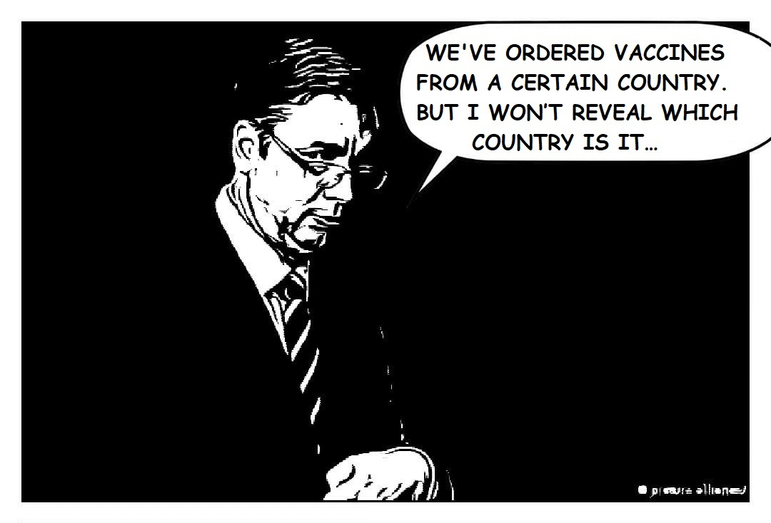
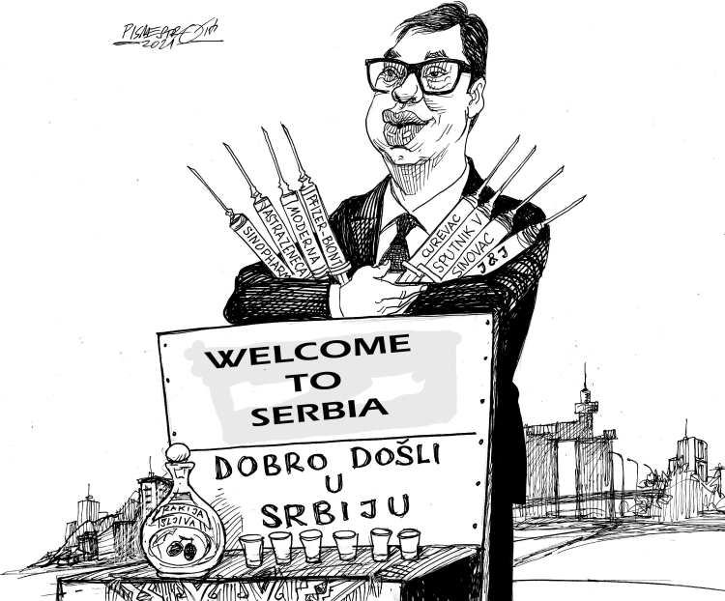
Aleksandar Vucic
Minister of Information under Milosevic
SRS (Serbian Radical Party, SRS)
Serbian Progressive Party (Srpska Napredna Stranka, SNS) – no longer supports greater Serbian ideology
Conservative, chameleonic, populist
Illiberal democratic régime
Frequently in popular tv shows

Slide 11
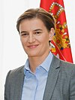
Prime ministers of Serbia
2006- 2008 Vojislav Koštunica DSS
2008-12 Mirko Cvetkovic grand coalition under DS
2012-14 Ivica Dacic SPS
2014- 2017 Alexandar Vucic
2017 Ivica Dacic SPS
2017 Ana Brnabic

Slide 12
Ana Brnabic
Female
Openly LGBT head goverment
head of government with extensive political dependence on a leader of the governing party
Puppet of Vucic

Slide 13
Political parties in Serbia
SNS
Fragmented opposition (far right, liberal, green, socialist)
National Assembly of Serbia has 250 members elected for a four-year term. A party must receive at least 3% of the votes in the entire country to qualify for any seats, except for national minorities' parties, who only have to reach 0.4%.

Slide 14
Serbian Progressive Party SNS
Split from SRS in 2008
National conservative, populist

Slide 15
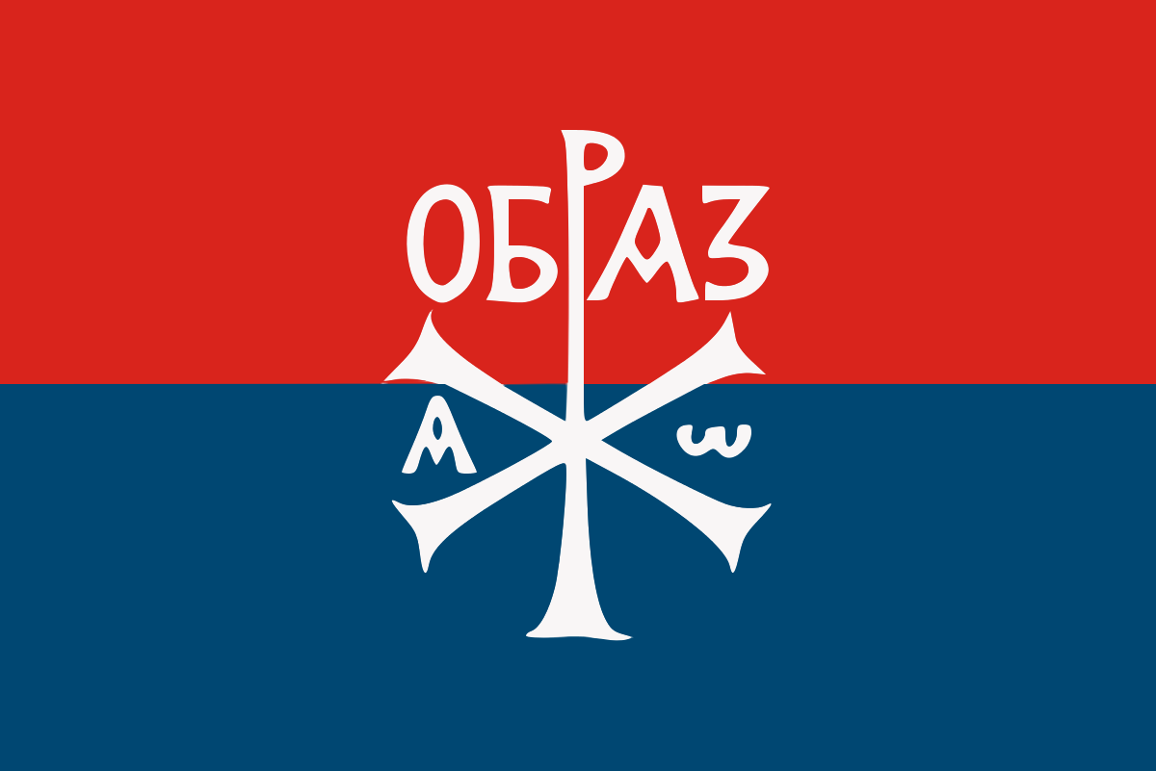
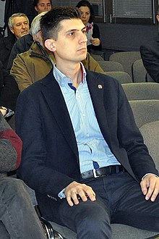
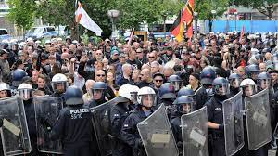
Far right politics in Serbia
Obraz
Dveri
Leviathan
Serbian Party Oathkeepers
Party of Serbian unity
Serbian right
Serbian Radical party

Slide 16
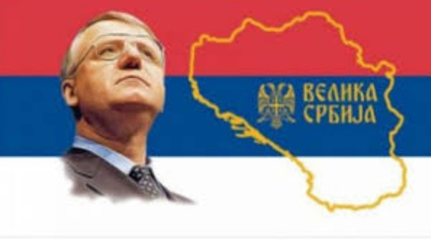
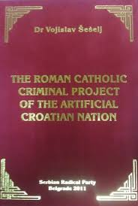
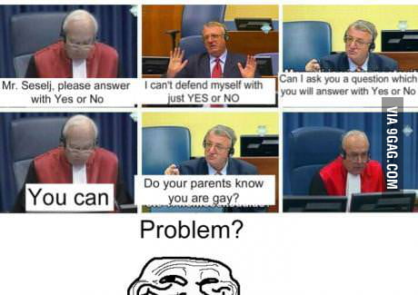
Serbian radical party
Vojislav Šešelj
advocating Greater Serbia – Vojislav Šešelj
During the 1990s supported the Socialist Party
Most successfull far right party in Europe along with fPO
Eurosceptic, russophilic, anti-western, traditionalist, far right, nationalism
Šešejl voluntarily surrended to ICTY
After almost 12 years temporarily released for health reasons, final decision guilty for crimes against humanity, got 10 years which he had already spent
White Eagles paramilitaries –Šešejlovci
https://www.youtube.com/watch?v=ilOSN4nBB7M
https://www.youtube.com/watch?v=-uZPIDGzTkQ

Slide 17
Far right organisations - ties to the regime
Blood & Honour
Combat 18
I live for Serbia
Nacionalni stroj
National Serb Front
Nomokanon
Obraz
People's Patrol
Rasonalisti
SNP 1389
SNP Naši
Serbian Action
Serbian Honour
Sveti Justin Filozof

Slide 18
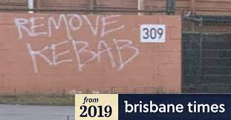
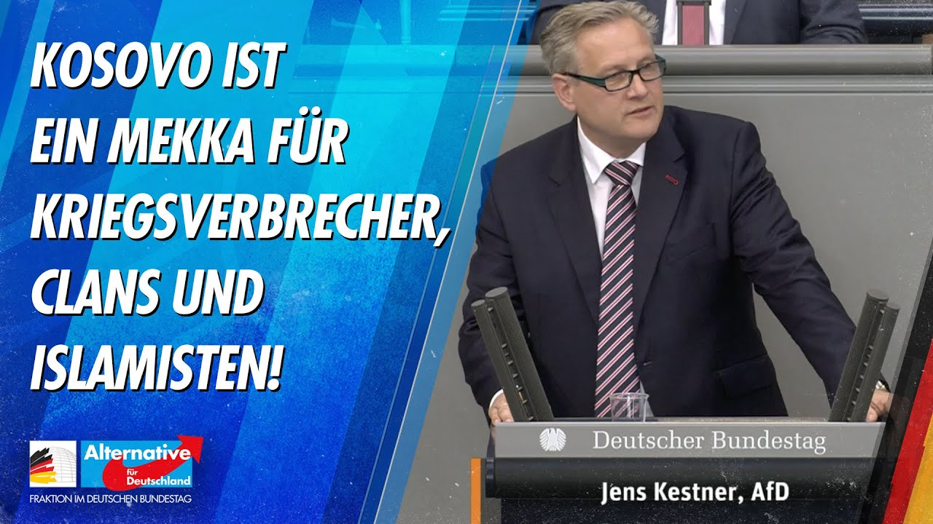
Serbian far right and the world
Anders Breivik – 2011
Brenton Harrison Tarrant - Christchurch attack on mosques 2019
Inspirations from Christchurch: (2019 mass shooting at a Walmart in Texas , 2019 opened fire at a mosque in Bærum Norway, 2021 arrest of Protestant Indian youth in Singapore plotting to attack Mosques at the anniversary of Christchurch attack)
Serb nationalists enjoy cult status among many far-right groups in Europe where they are admired for their militancy, extreme Islamophobia and – most importantly – for having put words into action in the 1990s, when Serb nationalist paramilitaries killed thousands of Muslims in Bosnia and Kosovo.
AFD, NPD

Slide 19
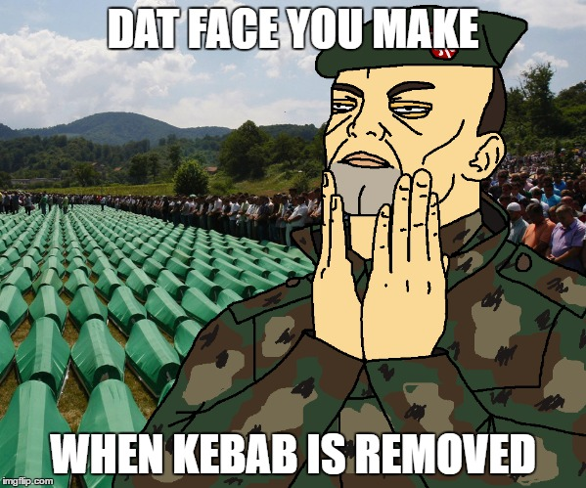
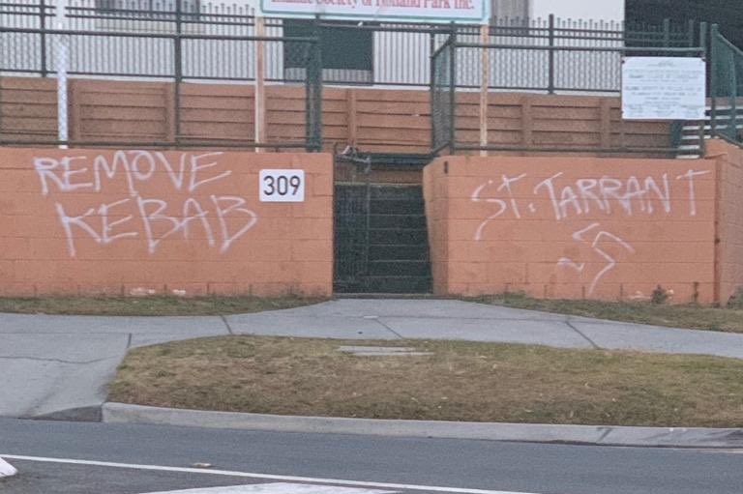
Paris- Berlin-Belgrade- Moscow
Belgrade as a bridge between east and west
Identitarian movement
Great replacement theory, white genocide, day x, narratives focus on white race not on particular nation
New right in the old packaging – far right without hackenkreuz
The far right shares information across borders, knowhow, resources, finances and means to network.
„Bosnian Serbs and Croats “could support each other in these efforts to get rid of the Sarajevo influence and Islamism.”
NPD vice-president Thorsten Heise, a prominent German neo-Nazi, “If we bring together European comrades who didn’t speak to each other before, we have laid the foundations for future networking.”
Götz Kubitschek – 2017 presentation at Matica Srpska
Paradox: - although United in Deutschland - Formation of paramilitary units on both sides of the conflict in Ukraine (Azov/Russian Imperial Movement)

Slide 20
East European Organisations as Sources of Inspiration for various attacks
In Breivik’s own words: “the so-called Bosniaks and Albanians had waged deliberate demographic warfare (indirect genocide) against Serbs for decades. This type of warfare is one of the most destructive forms of Jihad and is quite similar to what we are experiencing now in Western Europe.”[2]
https://www.youtube.com/watch?v=qHMValDKMT4 Remove kebab
https://www.youtube.com/watch?v=gknTJKgQqW4 serbia is strong

Slide 21
Oppositional political parties
Socialist Party of Serbia
Fragmented spectrum, marginal political parties
https://en.wikipedia.org/wiki/List_of_political_parties_in_Serbia

Slide 22
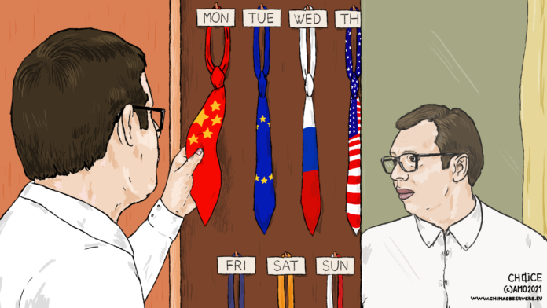
Serbia´s foreign relations
EU
Not NATO
Russia
China
Turkey

Slide 23
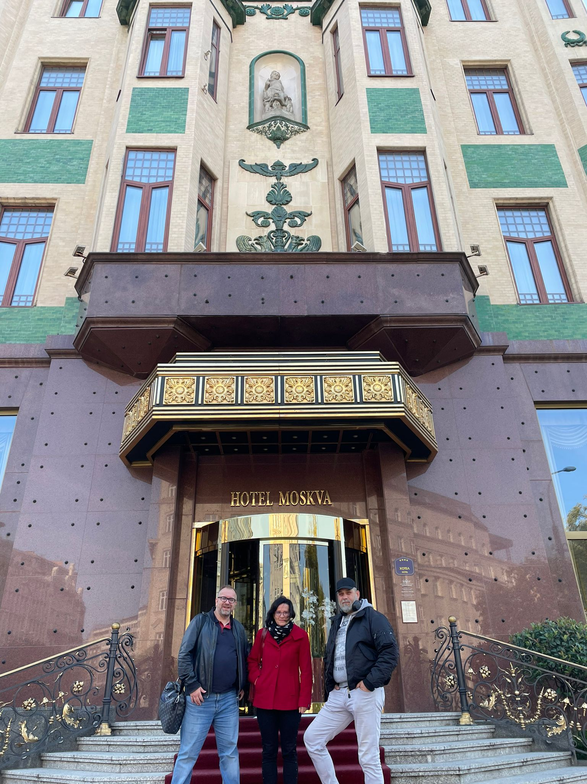
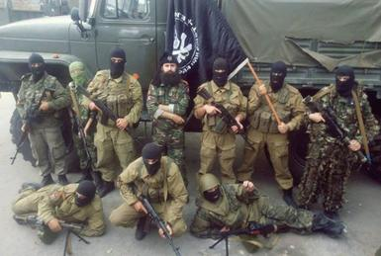
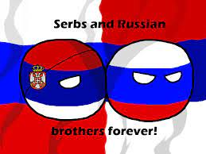
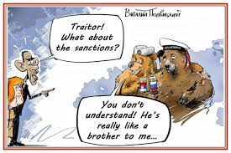
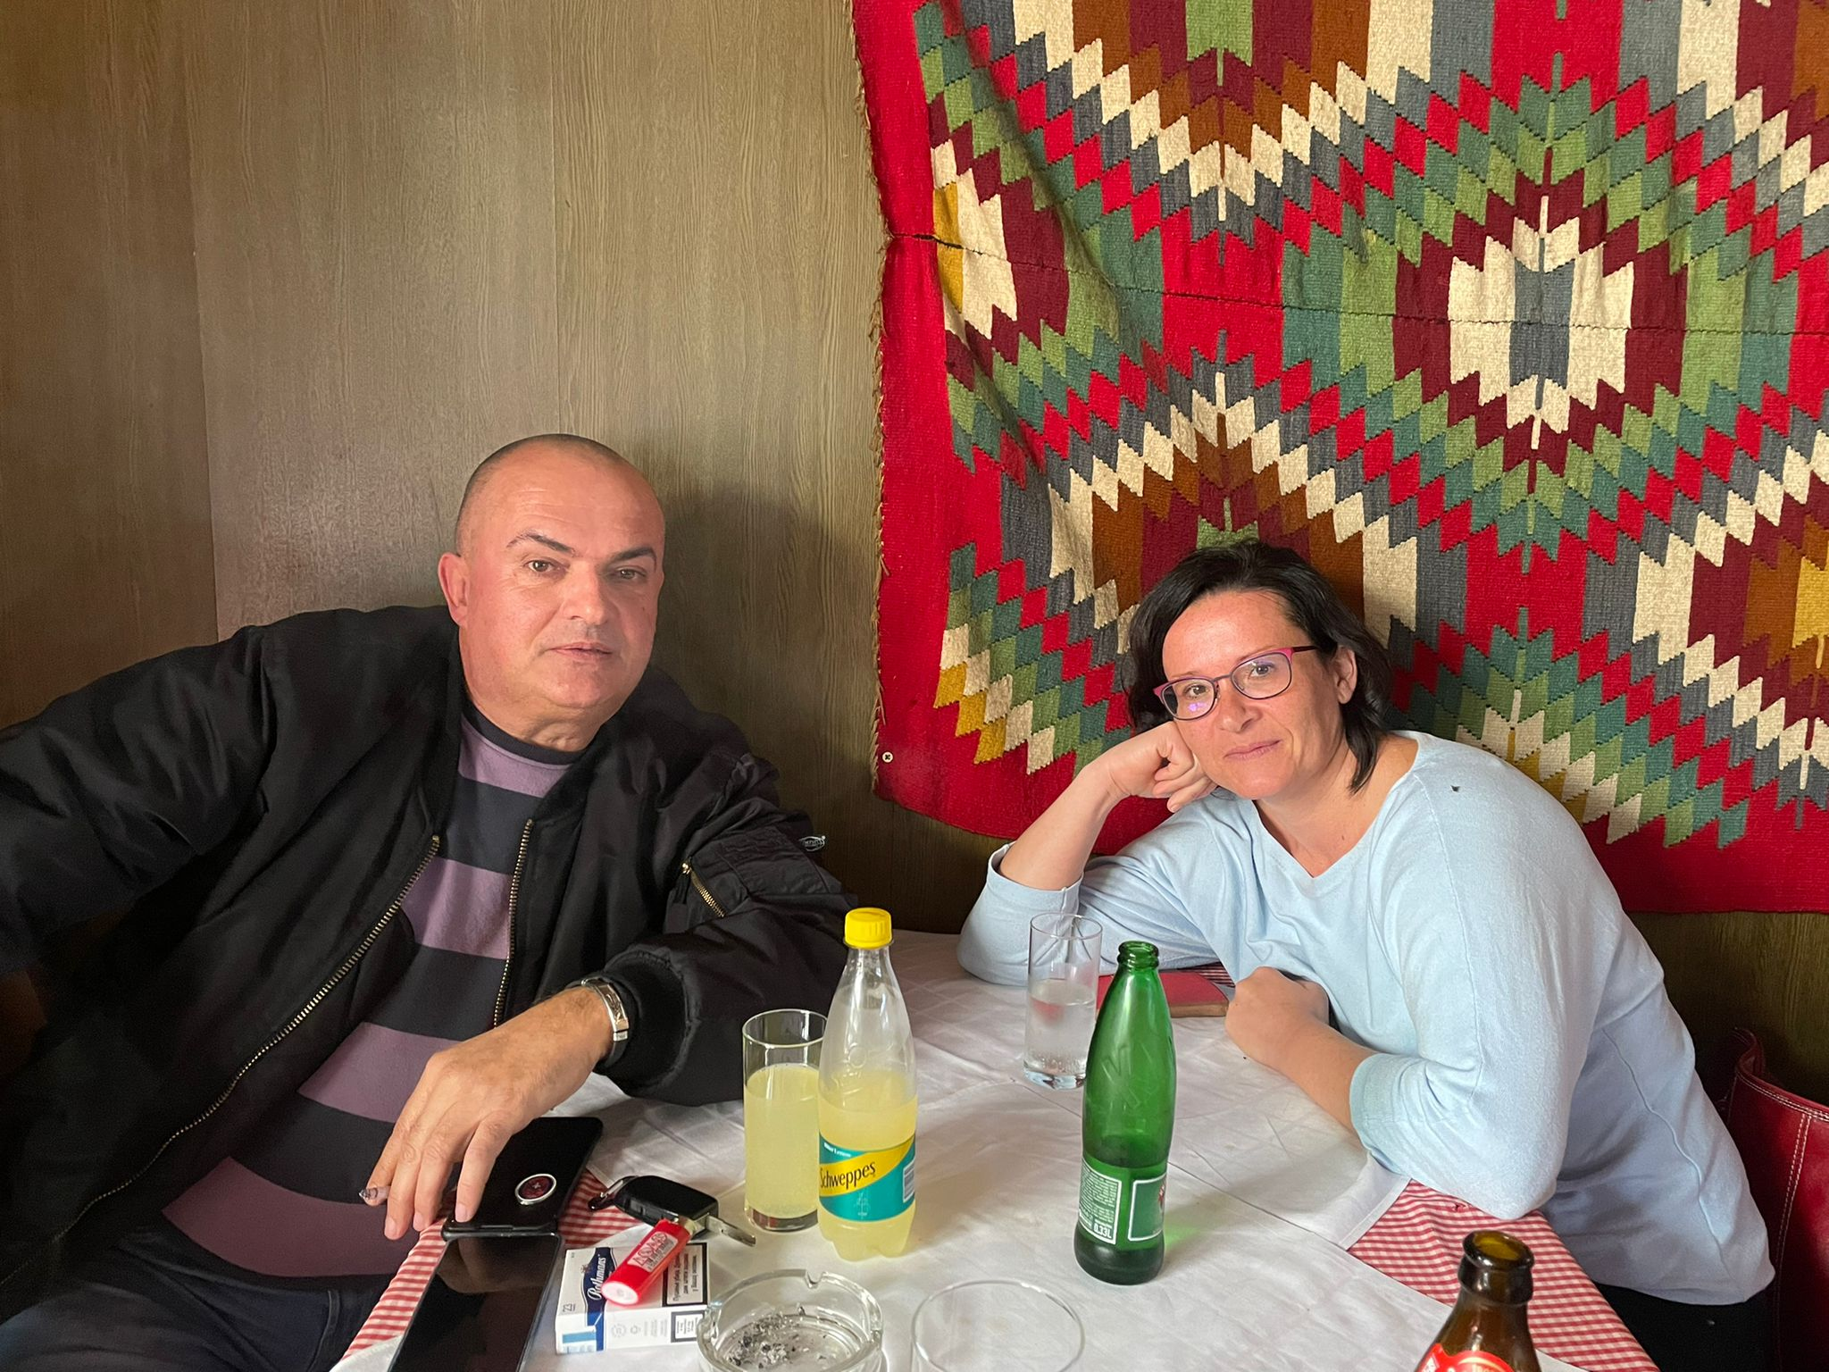
Ukraine
Vucic as stability
supporting the UN resolutions condemning Russia´s actions, nonetheless refused to join sanctions against Russia
Chetnics in Ukraine

Slide 24
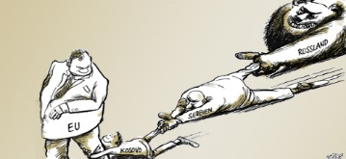
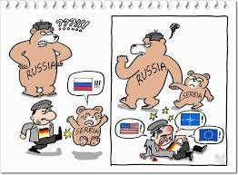
Russia in the Balkans
BiH, Serbia, North Macedonia, Montenegro
Soft power
Orthodox church, Big Slavic brother - history
Economic influence, Gas
Military Cooperation with Serbia
Far right with direct ties to Russia
Foreign fighters in Ukraine
Pro-Russian demonstrations in Serbia
Kosovo – justification for Crimea anexation
Montenegrin failed coup 2016
Disinformation campaign about war in Ukraine- selling own version – Ukraine genocide in Eastern Ukraine, denazifikation of Ukraine

Slide 25
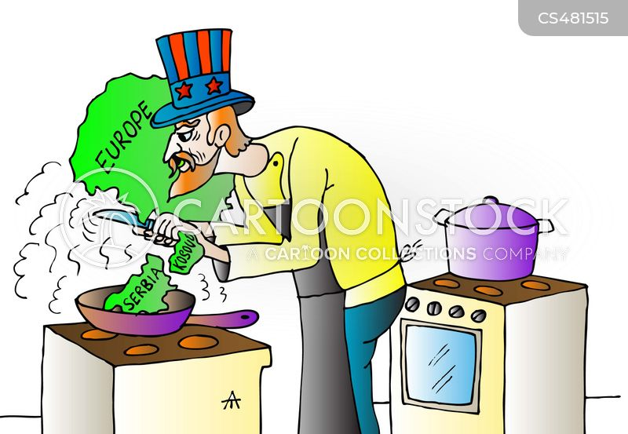
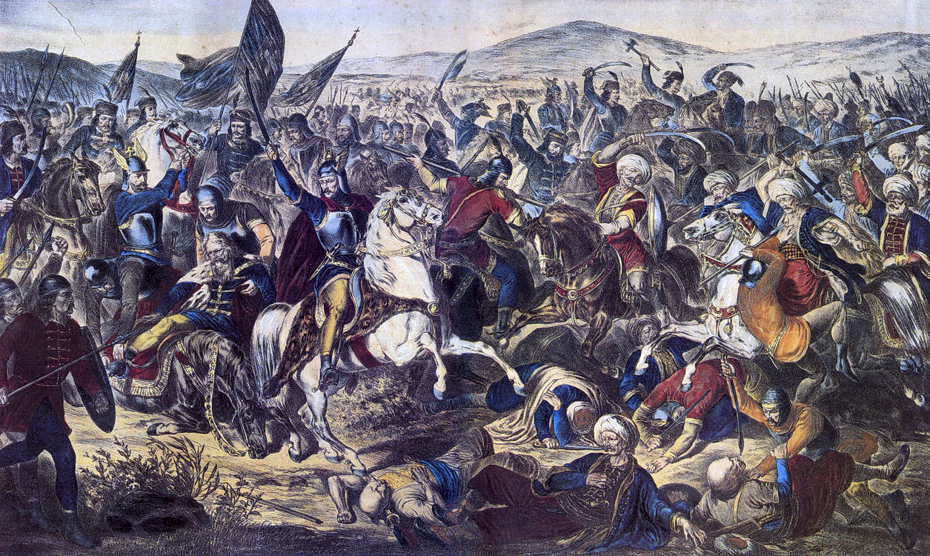
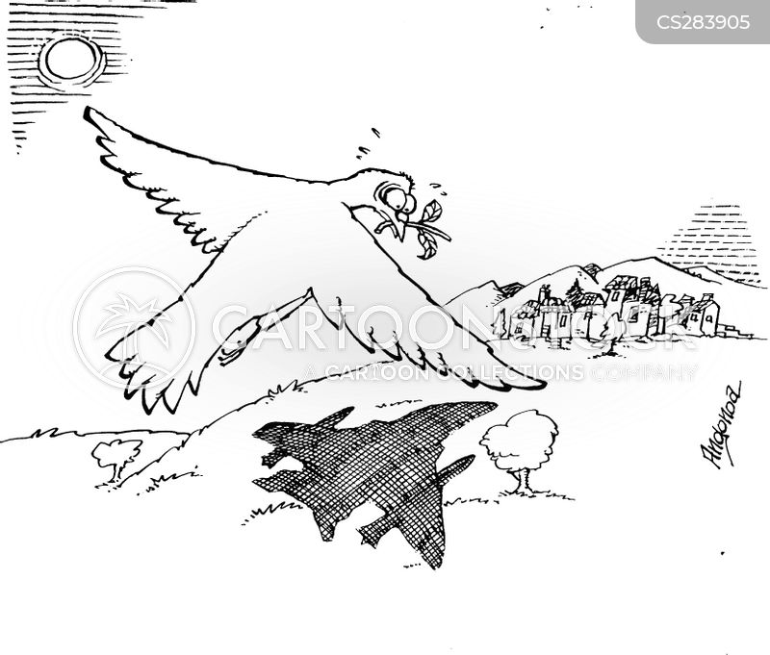
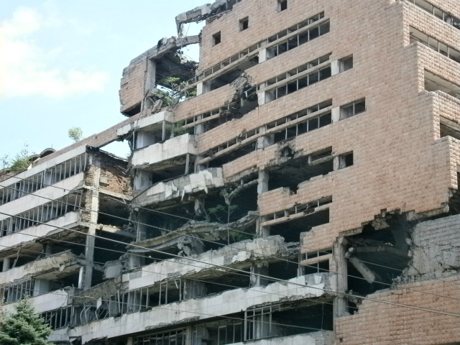
Kosovo
Recogniton of Kosovo – political suicide for any politician
Redrawing of borders and formal recognition so both countries can go on the path towards the EU

Slide 26
Other sources
https://recentglobe.uni-leipzig.de/zentrum/detailansicht/artikel/blog-from-norway-to-new-zealand-how-a-serbian-internet-meme-inspired-radical-right-terrorists-wor

