Slide 1
MUNI
Faculty
Of Social
Studies
Building sustainable Peace and Security in Bosnia and Herzegovina:
Dancing in a Vicious circle

Slide 2
Warm-up session:
What comes first to your mind when someone says Bosnia and Herzegovina?

Slide 3
(Not that) Quick Wartime Excursus.
End of bipolarity, weakening of communism, European integration.
JBT passed away on 4. May 1980.
Crises swarming –> elites, ideology, economy.
Independence declaration –> Referendum –> War (not ethnic!).
General Framework Agreement for Peace in BiH (DPA).
”Ethnic Cleansing” in IR glossary, CRSV, propaganda & disinfo.
Complex and complicated political system.

Slide 4
Nož, Žica, Srebrenica:
Genocide Denial in the Balkans
11. – 22. July 1995.
8 372 murdered men + 25-30k transported women, elderly and children.
Prosecutor v. Krstić (ICTY 2004 + ICJ 2007),
UN and the Dutch troops.
“Crime” versus “Genocide”.
Quo vadis, Aida?

Slide 5
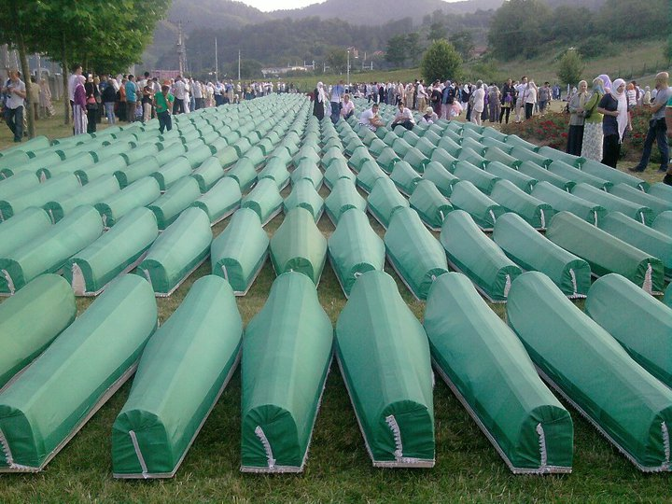
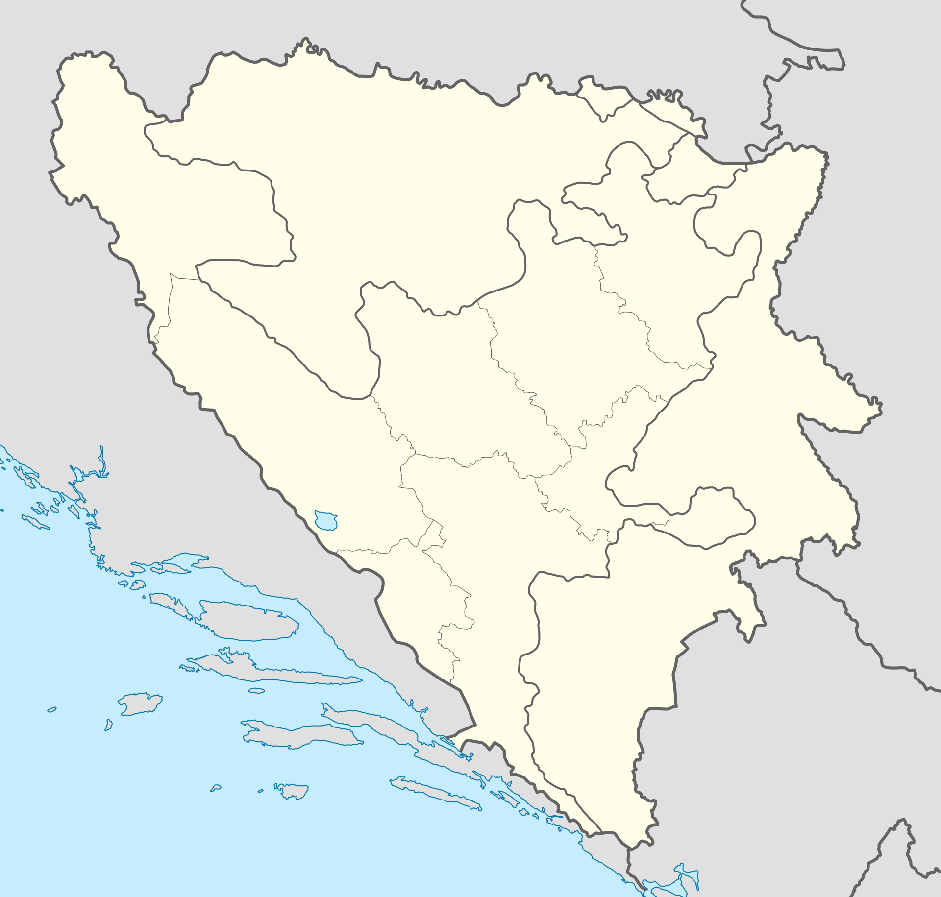
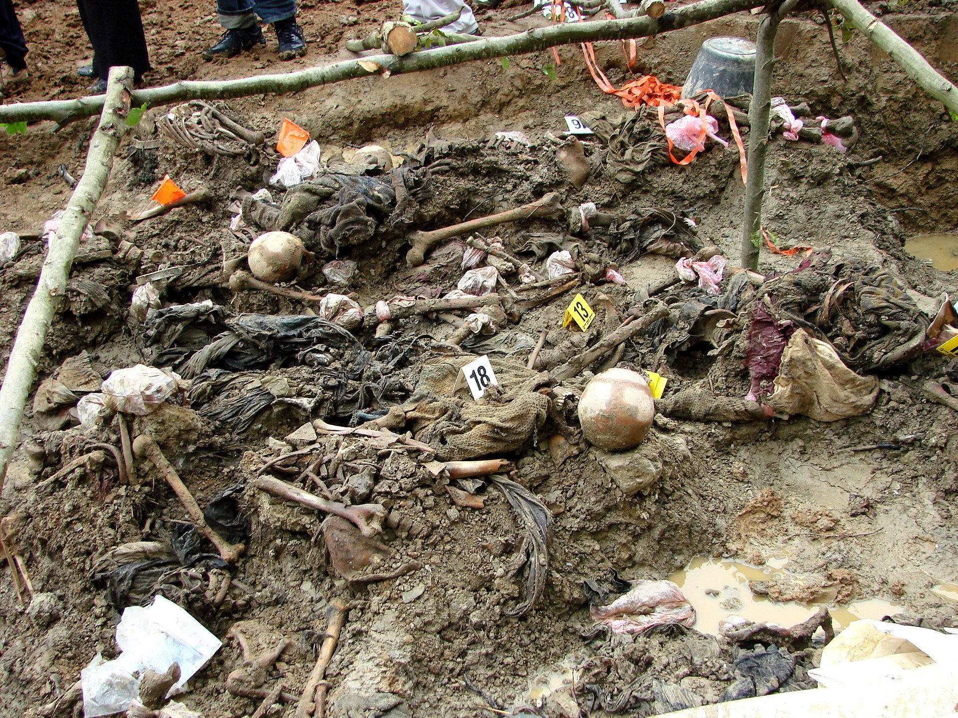
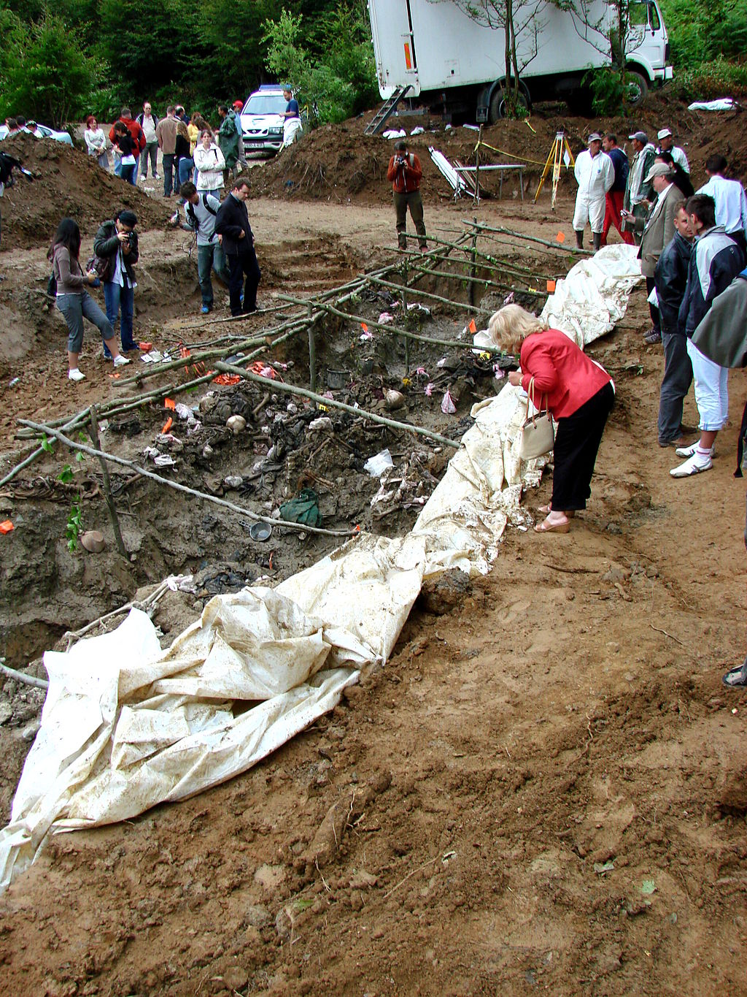

Slide 6
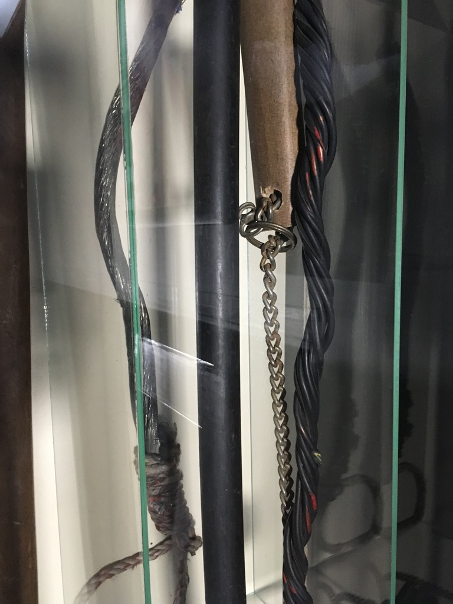
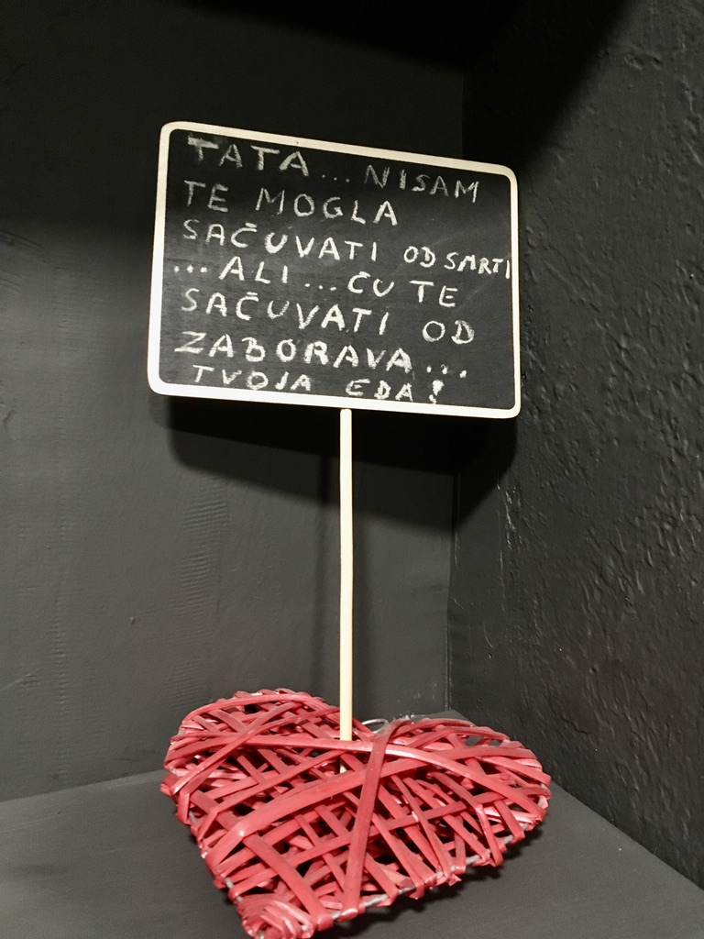
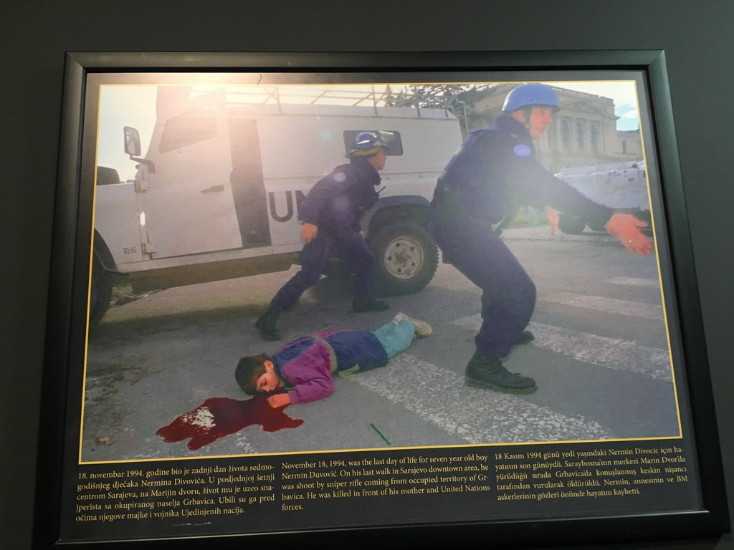
Museum of Torture and Genocide in Sarajevo

Slide 7
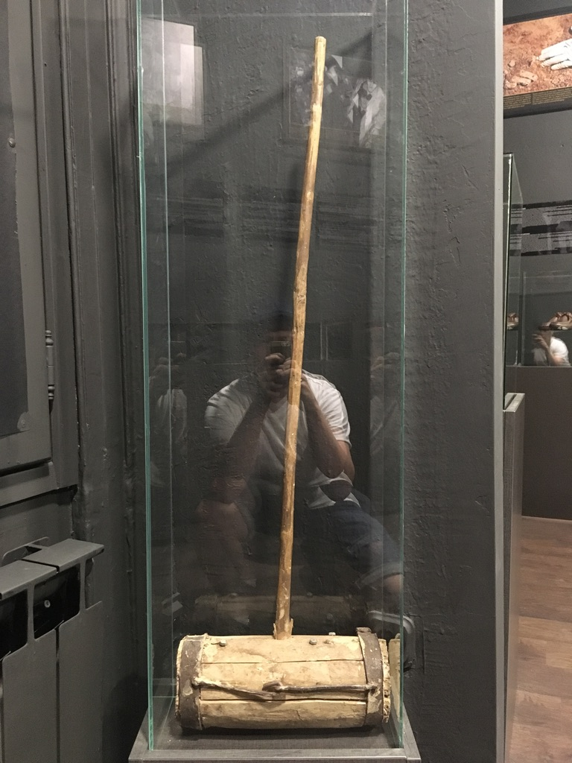
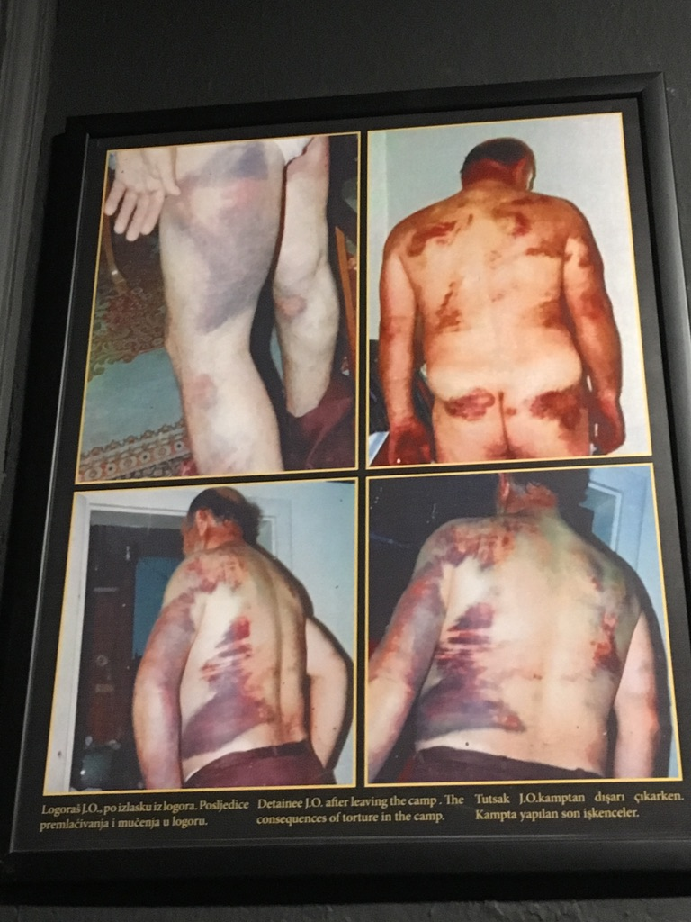
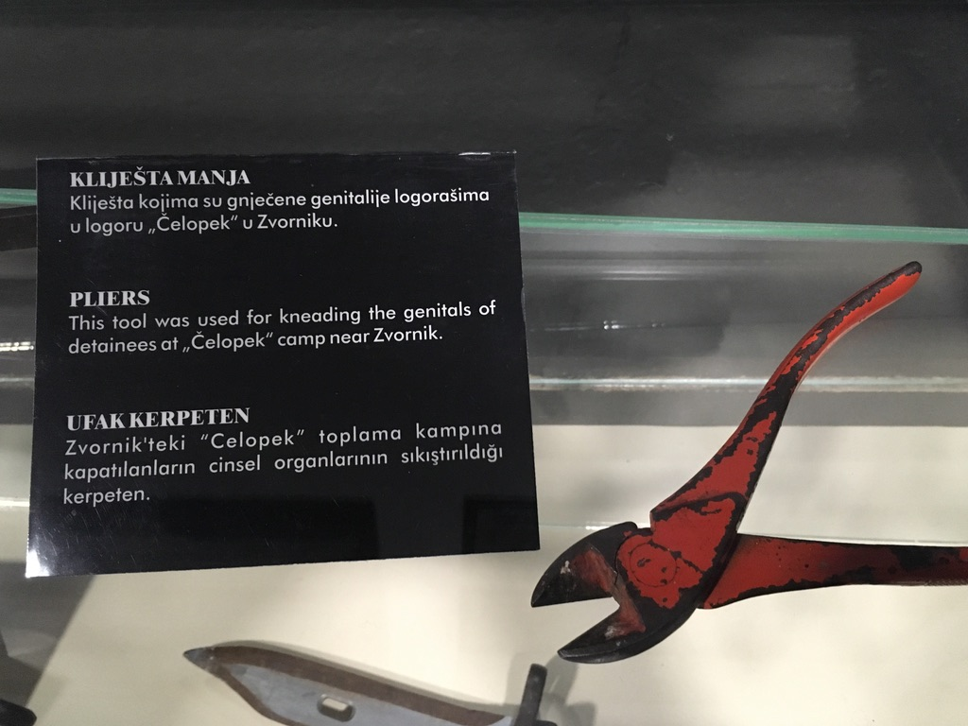
Museum of Torture and Genocide in Sarajevo

Slide 8
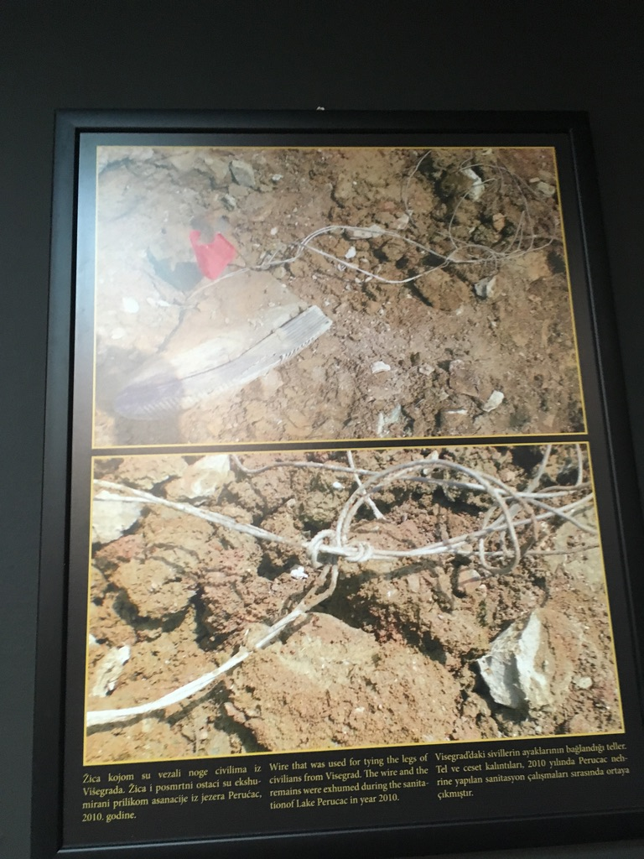
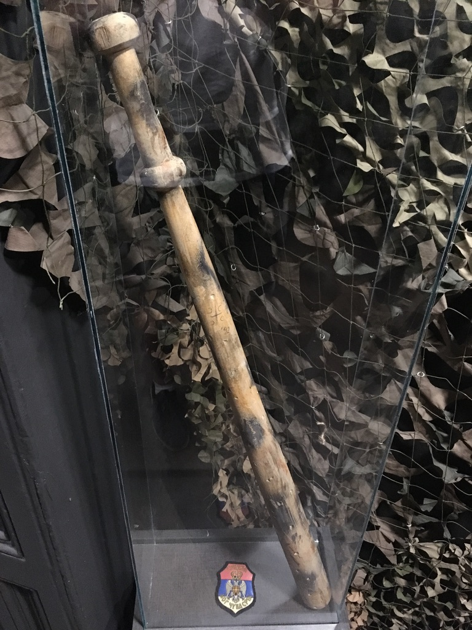
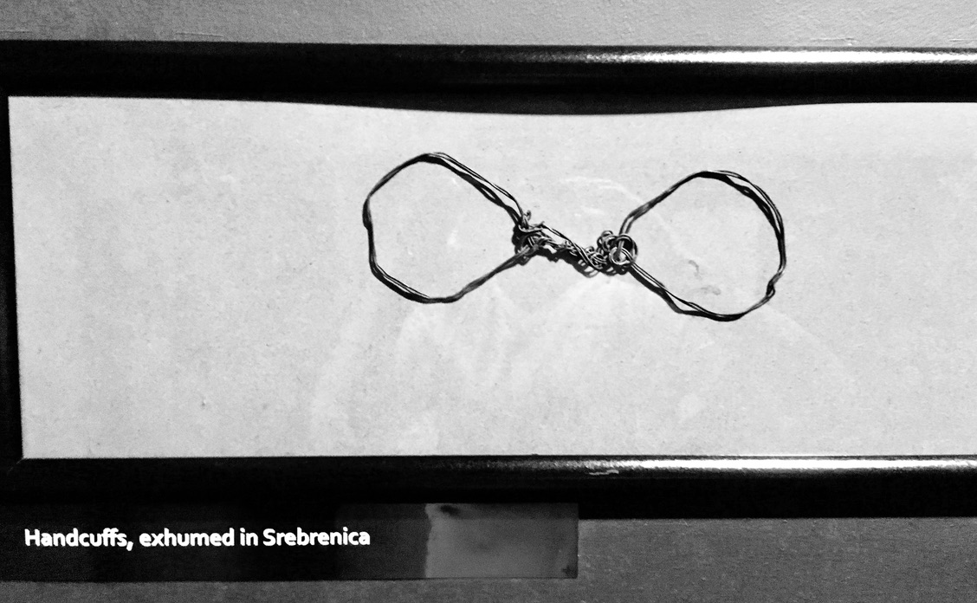
Museum of Torture and Genocide in Sarajevo

Slide 9
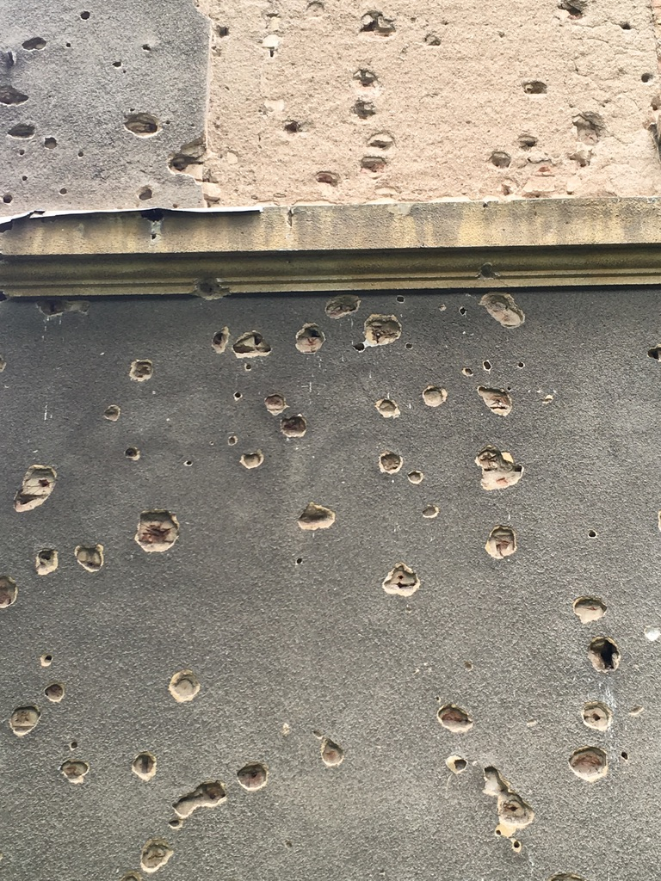
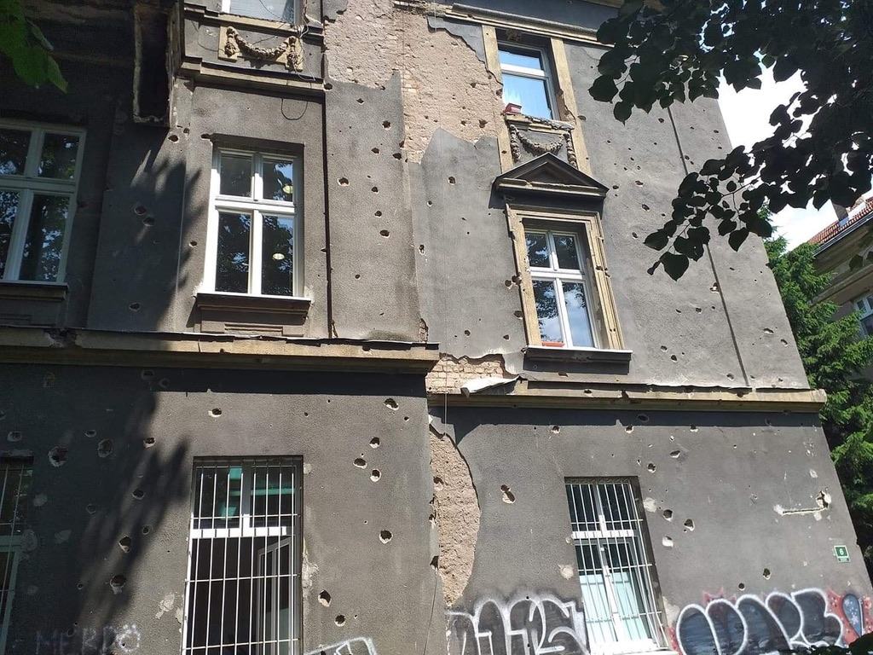
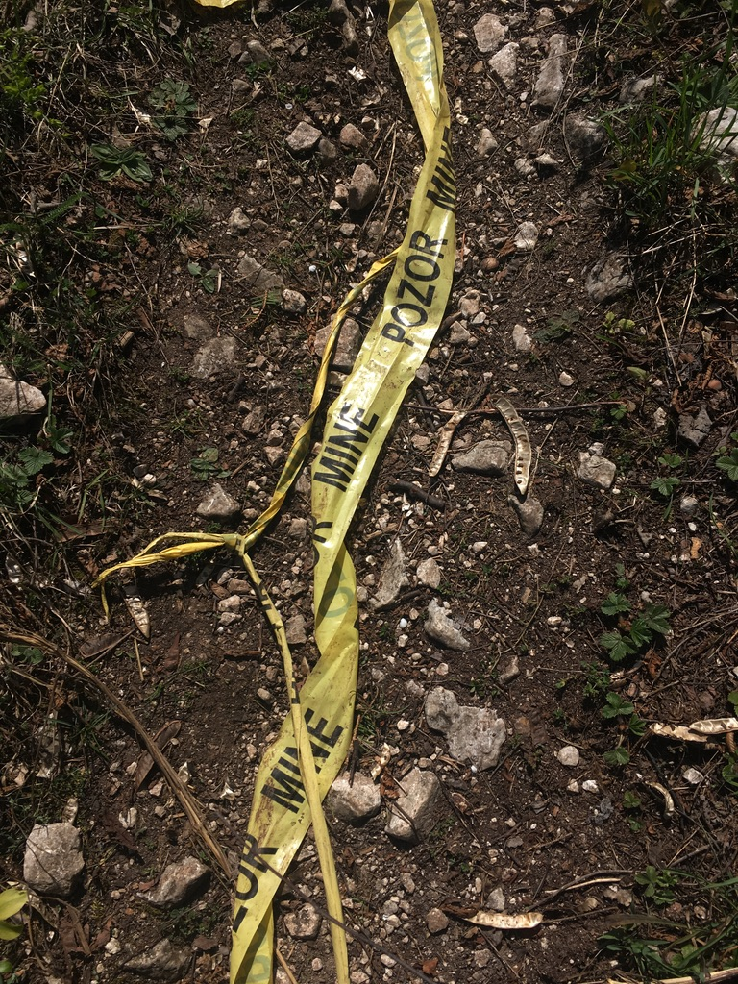
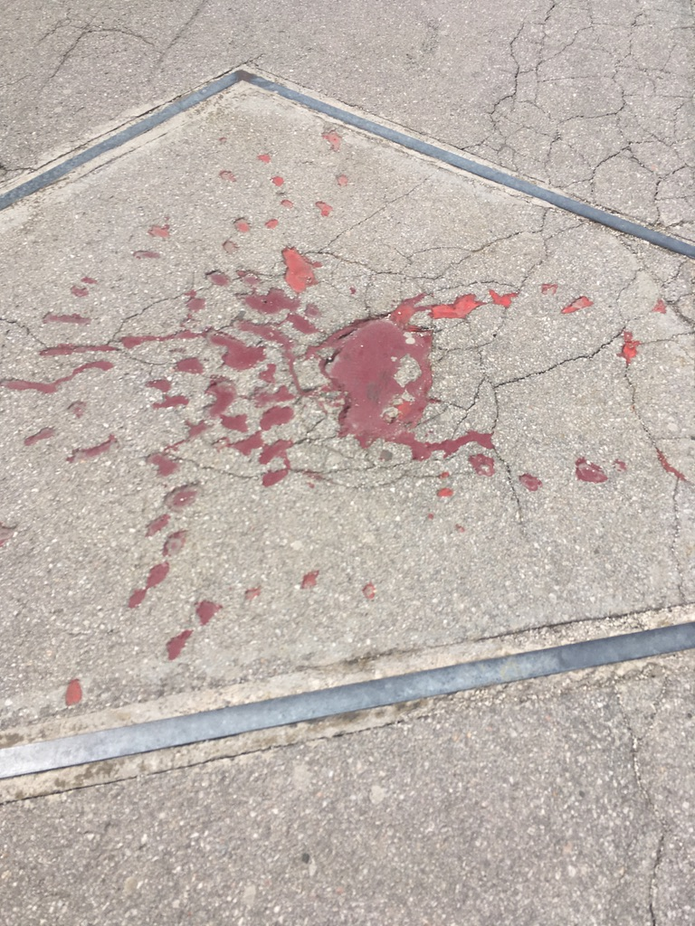
Wartime Scars of Sarajevo

Slide 10
Islamic Radicalism as a Bridge Between the Past and Present.
Under Ottoman rule both as religion and socio-political doctrine.
Concept of “European” or “secular” Islam in BiH, Naši muslimani.
Autochthonous, but not autocephalous Islam + Sufistic fractions.
War –> import of radical Islam; post-war –> export of radical Islam.
Bosniak nationalism interconnected with Islam.
WB in general both source and target of radicalisation.
Young and educated men as a specific group inclining to indoctrination.

Slide 11
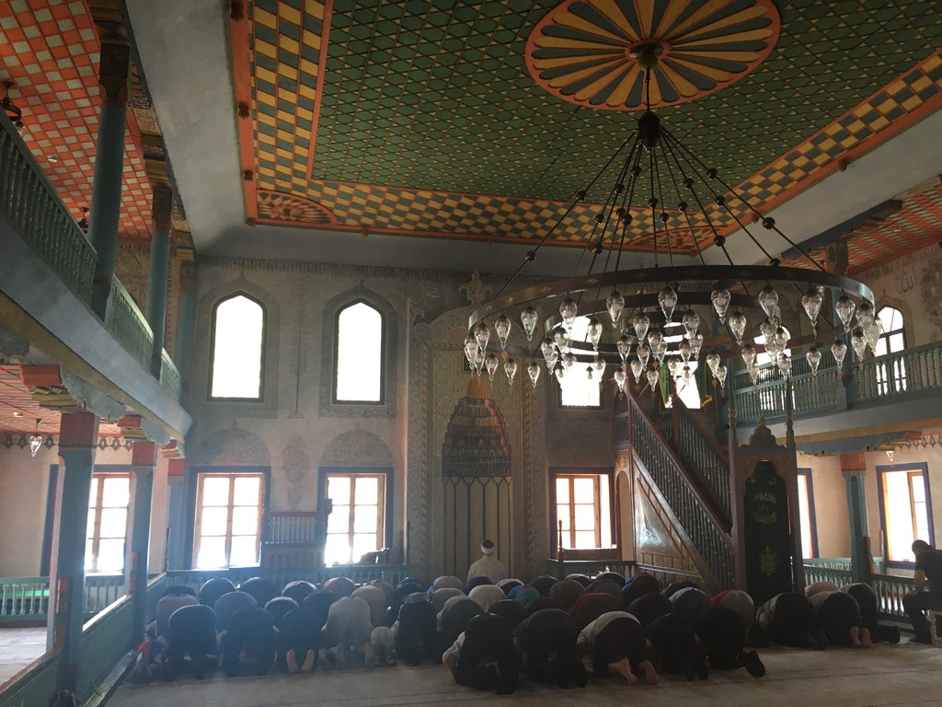
Mi smo vojska Allahova,
za Islam sa borimo.
Dati život za slobodu,
nikog se ne bojimo!
Šarena džamija, Travnik, Bosna i Hercegovina.
Foto © Jiří Němec.

Slide 12
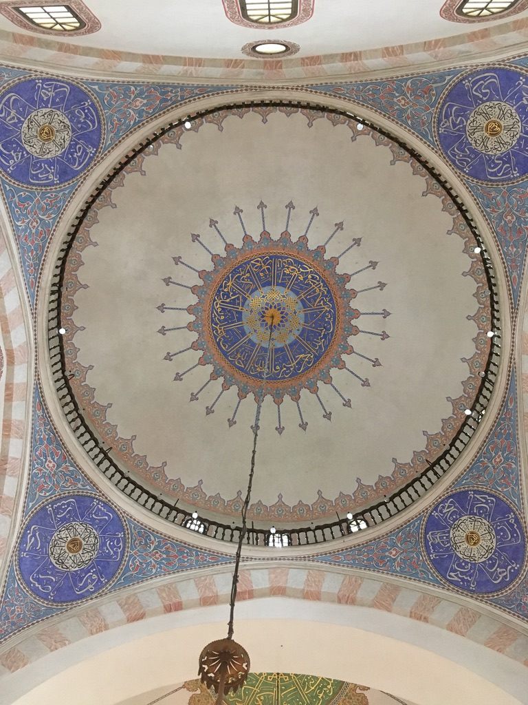
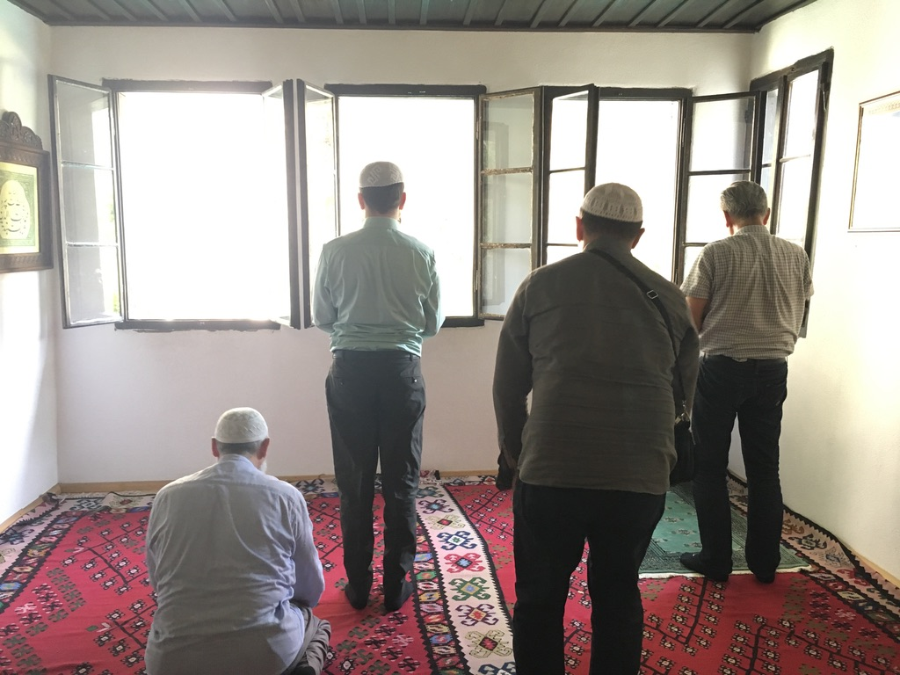
In 2015, 125 FFs per1 million inhabitants from RKS.
From BiH 85 FFs (counting).
Reintegration problems.
Weak jurisdiction.

Slide 13
Current Security Challenges for BiH:
Demining (Enviro+EconSec).
Post-war relics both traditional and “new” security issues.
Ca. 4k Km² -> 8 % of BiH’s territory.
Ca. 50 % in forests, 37 % in agricultural lands and 4 % within infrastructure.
1 700+ casualties, 600+ fatal. Ca. 80k mines still to be cleared.
Also socio-economic and environmental consequences.
BiH’s infamous “Moving Minefields”.

Slide 14
Current Security Challenges for BiH:
Environmental Security.
Recurrent floods –> landslides, moving minefields, interrupted infrastructure.
Low preparedness level, both ex ante and ex post difficulties.
2014 –> 50 % of territory, 100k displaced people.
One of the worst air pollution situations in the world (Sarajevo).
Extremely high air pollution-related mortality (3k premature deaths in 2016).
Tectonic area, but almost non-existent engineering solutions.

Slide 15
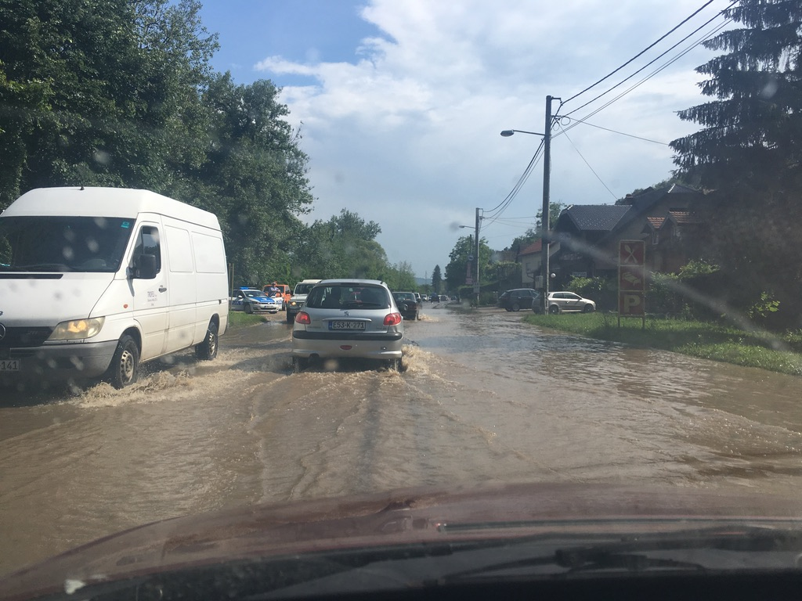
Current Security Challenges for BiH:
Environmental Security.

Slide 16
Current Security Challenges for BiH:
Energy Security.
Most energy-intense country in the Balkans.
Deteriorating infrastructure, bad maintenance, no upgrades, low efficiency.
70 % of energy is coal-generated (air pollution).
Renewables potential, but no interest and resources.
Only in the WB that can export electricity.
EU (decarbonisation), PRC (coal) and RF (oil and gas).
Foreign malign influence (elite capture, environment, critical infrastructure).

Slide 17
Current Security Challenges for BiH:
Remaining “New” Security.
EconSec: Weak, low added value, export-dependence.
High unemployment; 37 % regarding youth.
Brain drain phenomenon; 6 % of total emigration (ca. 500k ppl 2010+)
CySec: Mirrors complicated political system.
110th out of 182 in Global Cybersecurity Idex (2020), 43 of 46 in Europe.
Low awareness, no education. No comprehensive state strategy.

Slide 18
What More to Read, Watch or Listen?
Film “Quo Vadis, Aida?” on Srebrenica genocide.
Podcast series Untold Killing depicting Srebrenica genocide in detail.
Related to your presentation on FDIs, my podcast on Chinese investments in Serbia and their impact on Environmental security.
Anything from Balkan Insight’s relation on Bosnia and Herzegovina in case you want to stay up-to-date.
And of course our chapter from the book! ☺

Slide 19
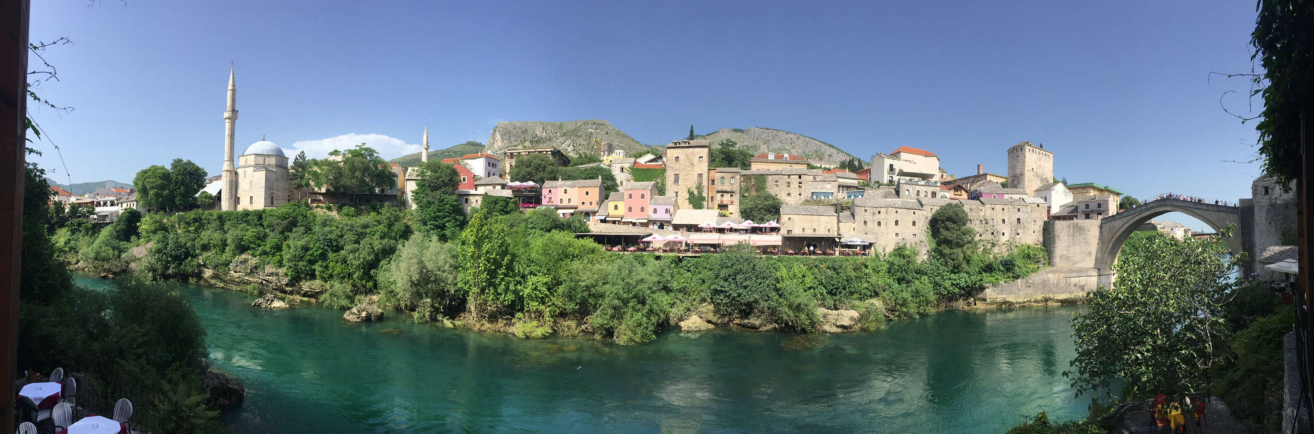
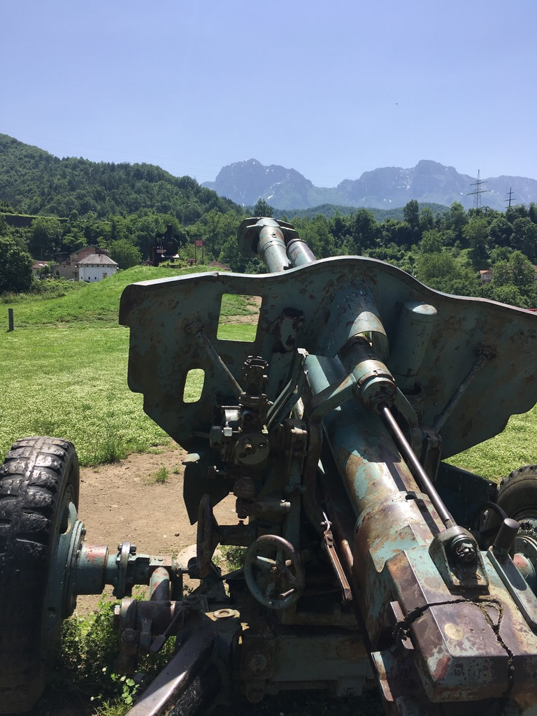
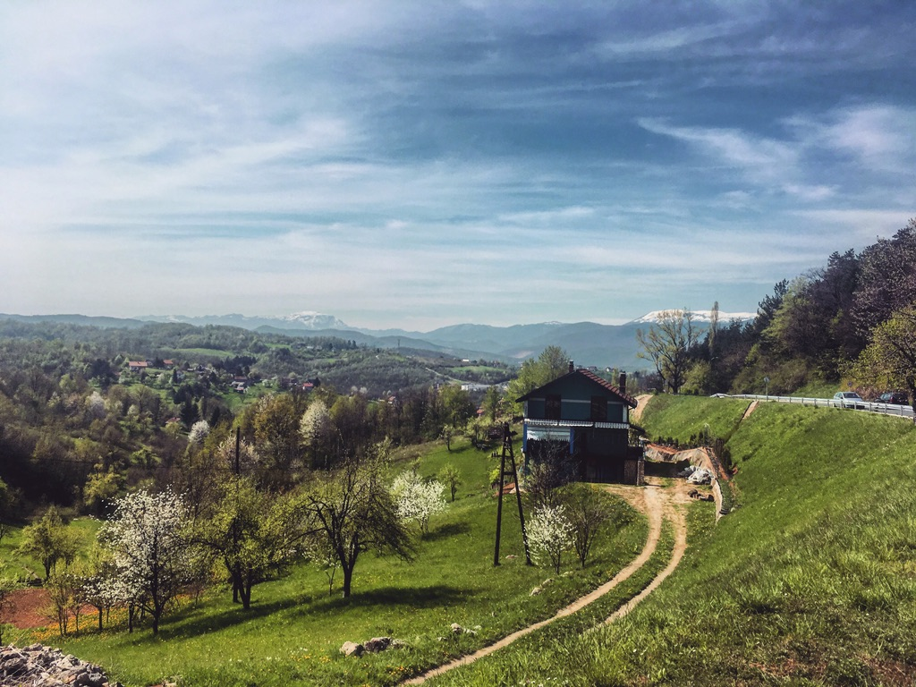
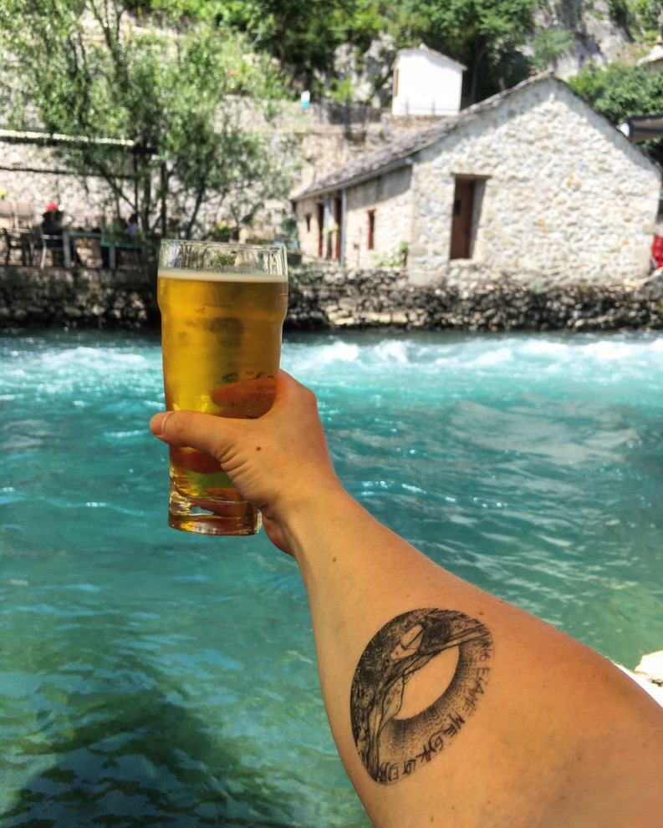

Slide 20
MUNI
Faculty
Of Social
Studies
Hvala vam na Pažnji!

