Slide 1
MUNI
Faculty
Of Social
Studies
Kosovo:
The Achilles’ Heel Of
Balkan Security

Slide 2
MUNI
Faculty
Of Social
Studies
Disclaimer
All references to Kosovo should be understood in terms of the United Nations Security Council Resolution 1244 (1999) and the International Court of Justice opinion on the Kosovo Declaration of Independence. This designation is without prejudice to the various positions on the status of this territory.
Notes:
Manoeuvre 22 , Drones, High Combat Readinnes in SRB, military concentrating on the Border.

Slide 3
MUNI
Faculty
Of Social
Studies
Trigger Warning
This presentation contains excerpts from direct testimonies of survivors of
Conflict-Related Sexual Violence from 1998–1999 Kosovo war. Although quotations do not include suggestive details, sensitive persons should skip slides 8–10.

Slide 4
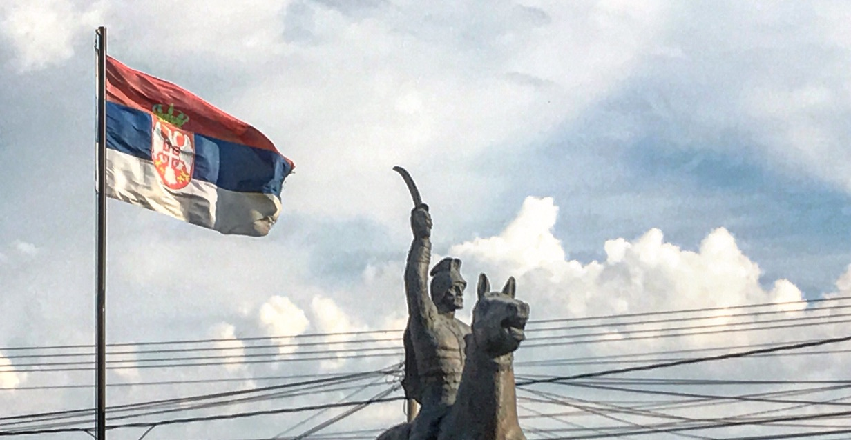
A Bit of History I.
Double-sided coin of the ”Kosovo Myth”:
  Lazar and Murad I. on Kosovo Polje/Fushë Kosovë, 1389.
  Besëlidhja e Prizrenit, 1878.
Yugoslav Constitution, 1974.
Gazimestan, 28. June 1989.

Slide 5
A Bit of History II.
Lidhja Demokratike e Kosovës.
Gándhí of the Balkans, Father of the Nation.
Ushtria Çlirimtare e Kosovës.
DPA 1995 and Albanian pyramids 1997.
28. February 1998 – 24. March 1999 – 11. June 1999.
Račak/Reçak January 1999 and the “hot phase” of war.
17. February 2008.
CRSV, paramilitaries, mass graves, IDPs and other war crimes.

Slide 6
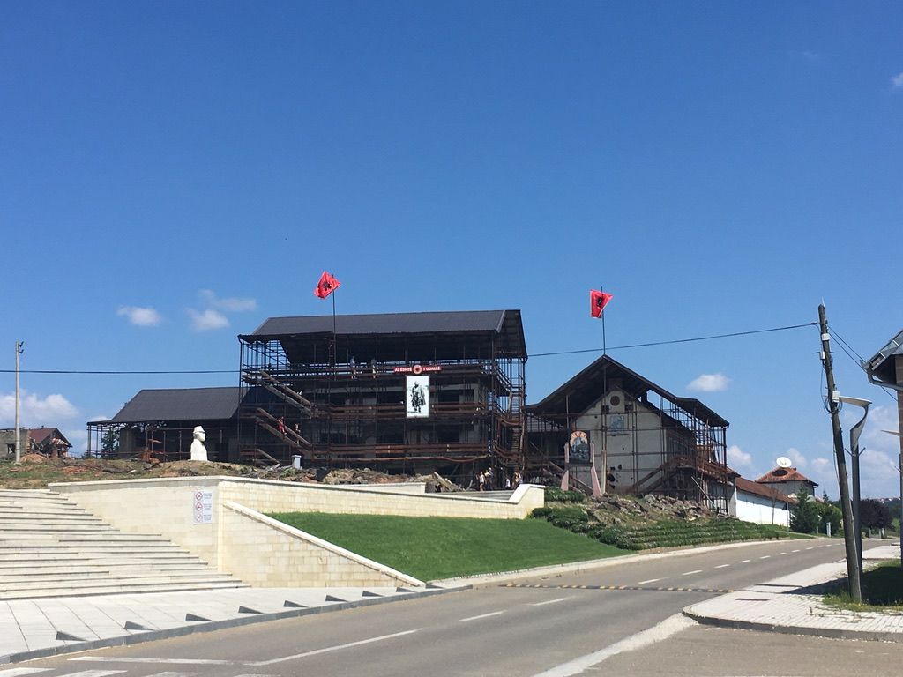
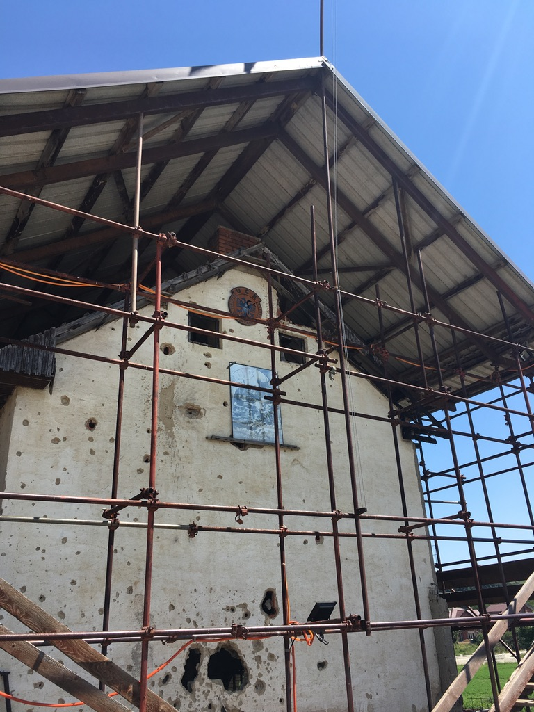
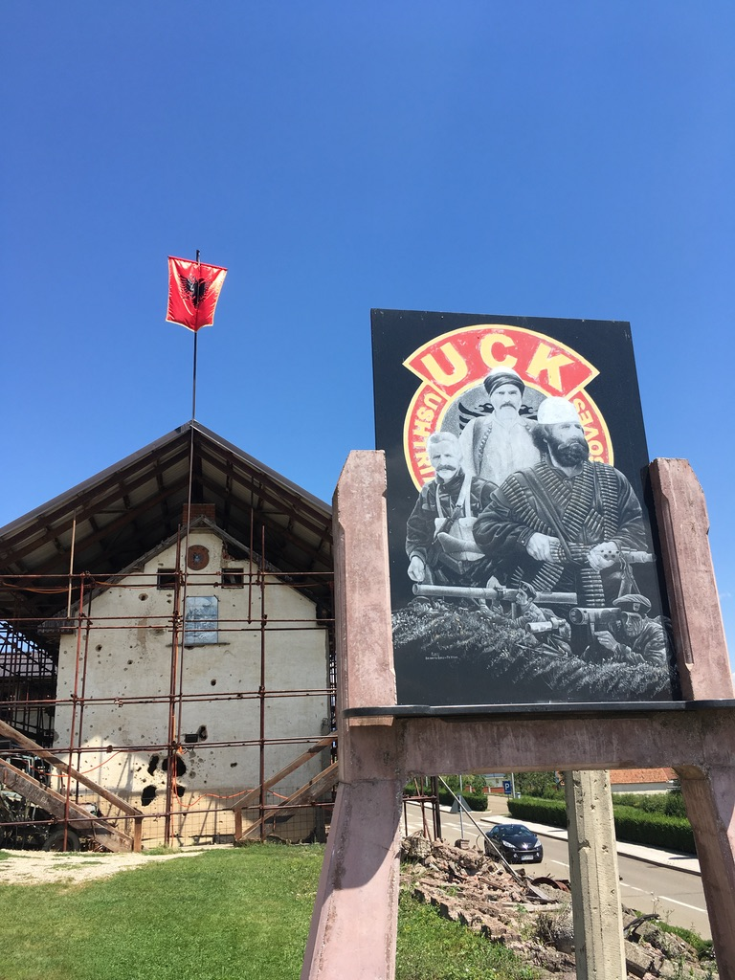
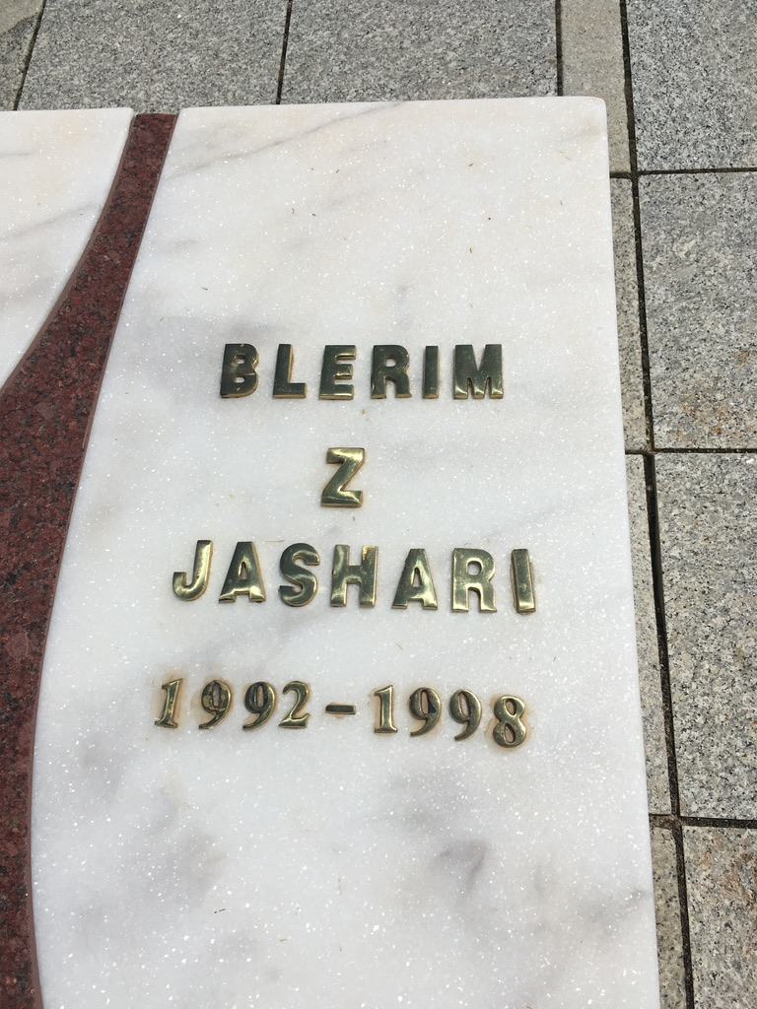

Slide 7
Conflict-Related Sexual Violence in Kosovo.
  10–20k of survivors
  Dehumanize enemy and dissolve target society => both strategic and tactical objectives.
  “Birth machine” labelling by propaganda
  Gang rapes, public rapes in front of family or community members, assaults, harassment, and sexual mutilations.
  Revenge sexual violence widely ignored by Kosovar institutions.
  TW (3 slides)!

Slide 8
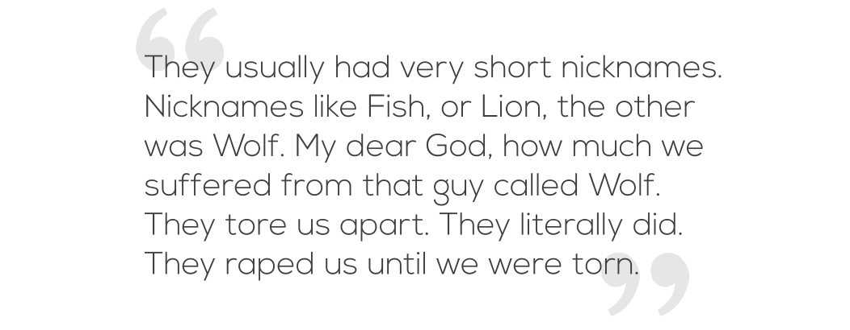

Slide 9
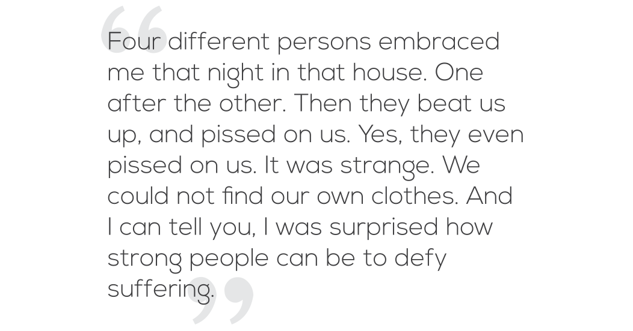

Slide 10
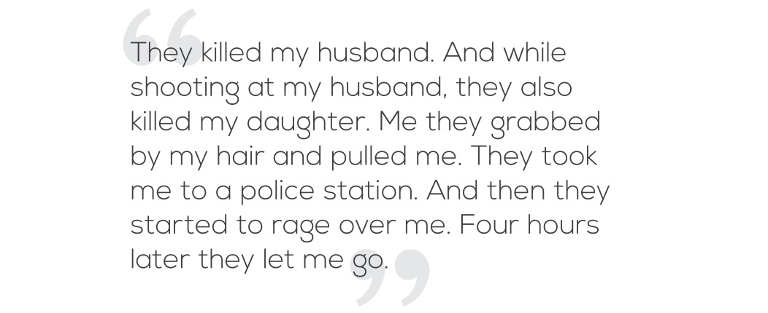

Slide 11
Kosovo’s Statehood and Territorial Integrity.
UNSCR 1244/1999, ICJ Opinion on Declaration of Independence.
UNSC: Russia and China; EU: Cyprus, Greece, Romania, Slovakia, Spain.
Republic of Kosova; Republika e Kosovës, RKS, KiM, “our southern province”.
Kosovo: 117; Serbia 92. Extensive un-recognition campaign.
Shqipëria e Madhe / Etnike, Lëvizja Vetëvendosje.
Association/Community of Serb-Majority Municipalities.
“License Plates Dispute” (Sept. ‘21), Resignation of Serb Officials (Nov. ‘22).

Slide 12
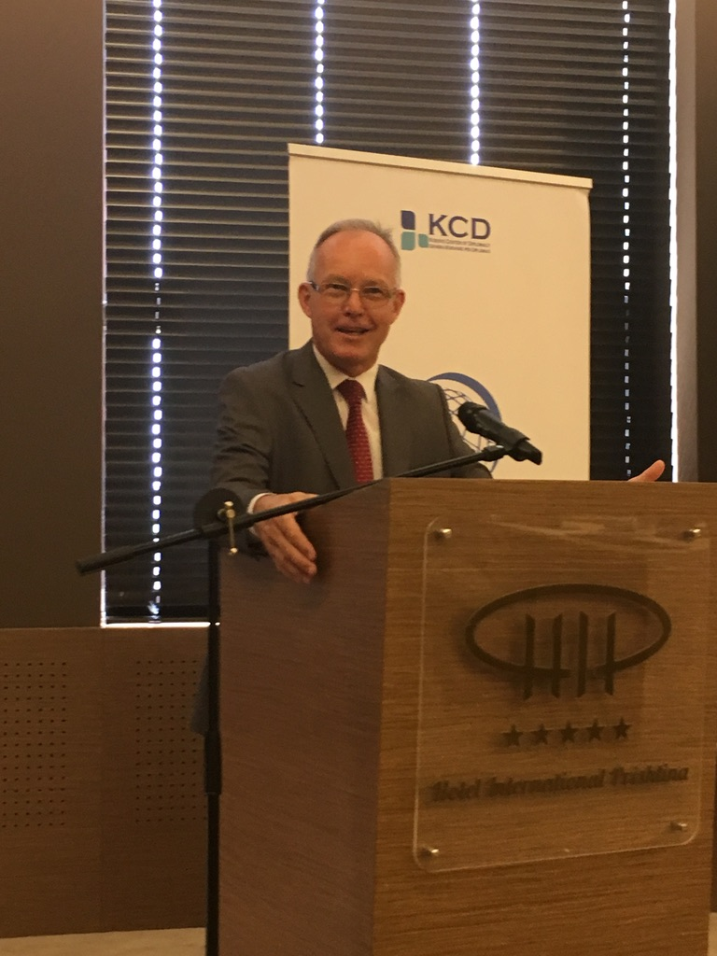
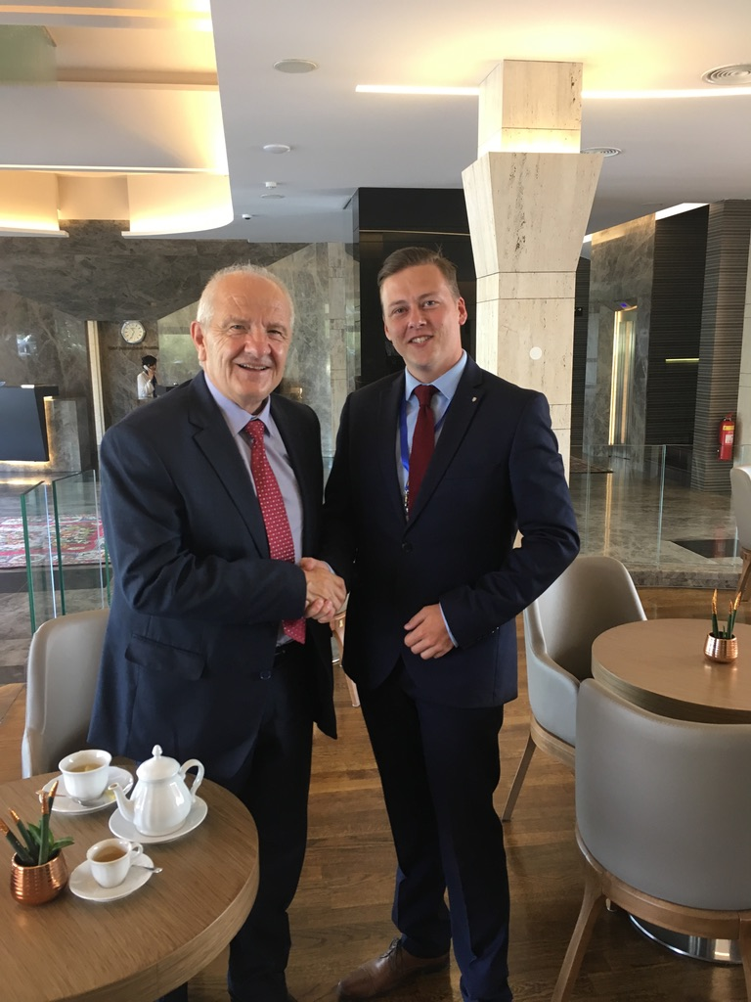
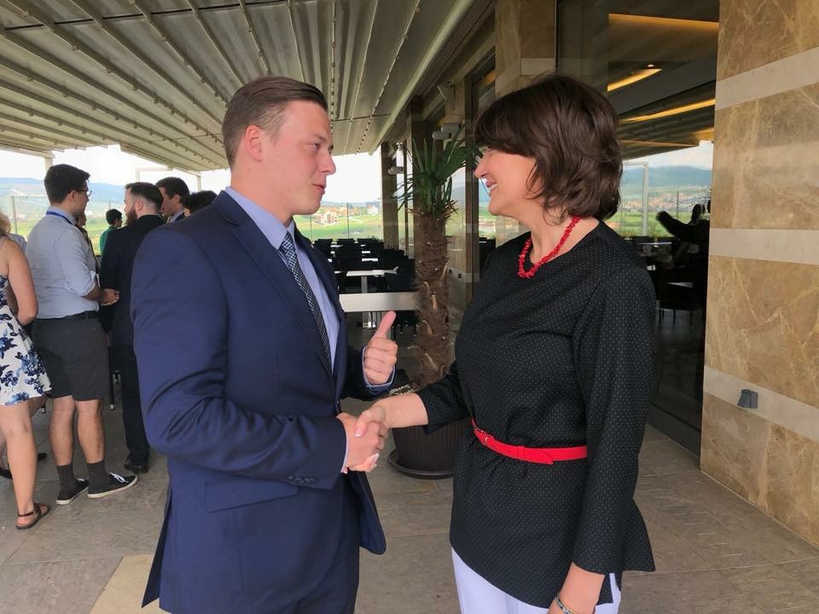

Slide 13
Current Security Challenges in Kosovo:
Cyber Security.
One of the first conflicts witnessing heavy cyber warfare.
Serbia–NATO –> China–US –> US–Serbia.
Njësia Nacionale për Siguri Kibernetike : in 2016 + NCS;
2 people KOS-CERT and 3 people KSF CERT in 2020
National Cyber Security Council: main body but no mandate.
Scant cyber threat knowledge and awareness.
Lack of legal framework for Info & Comm Tech.

Slide 14
Current Security Challenges in Kosovo:
Environmental Security.
Air pollution, land degradation, water pollution and scarcity.
Lake Gazivode/Ujmani (¹/₃ in Serbia, rest in Serb-dominated north).
¹/₃ of population supply + TPPs
Mitrovica/Mitrovicë, tradition of waste burning, open mine pits.
General similarity to pan-Balkan situation

Slide 15
Current Security Challenges in Kosovo:
Energy Security.
Interconnectedness of Enviro & Energy Security.
Lake Gazivode/Ujmani once again –> Kosovo A (1962) dhe Kosovo B (1983).
Kosova e Re …–> when? ☺
World’s 5th largest lignite reserves –> self-sufficiency.
28 % grid losses, insufficient production reserves, no flexibility.
New TPP and HPP by 2028 + smaller renewables to cover flexibility.
Energy is also an “independence issue”.

Slide 16
This Month’s Events (So Far).
“High Combat Readiness” in Serbia due to alleged drone infiltration.
Manoeuvre 22 and increased army presence along the border.
Mass Serb resignation from state institutions –> 10 MPs, 4 Mayors, judiciary and police officers (Car Plates Dispute).
Serbian rally in Mitrovica.
Today night: Arrival of Carabinieri.

Slide 17
What More to Read, Watch or Listen?
Independent investigative journalism page Kosovo 2.0, or alternatively Prishtina Insight (Balkan Insight’s Kosovo Branch) for current updates.
Němec, Jiří. 2022. “Socio-Legal Aspects of Sexual and Gender-Based Violence Survivors’ Victimization in Kosovo.” In Peace Review: Journal of Social Justice, 34: 140–150. Here (MUNI login needed).
Oxford University’s podcasts on Kosovo.
And of course our chapter from the book! ☺

Slide 18
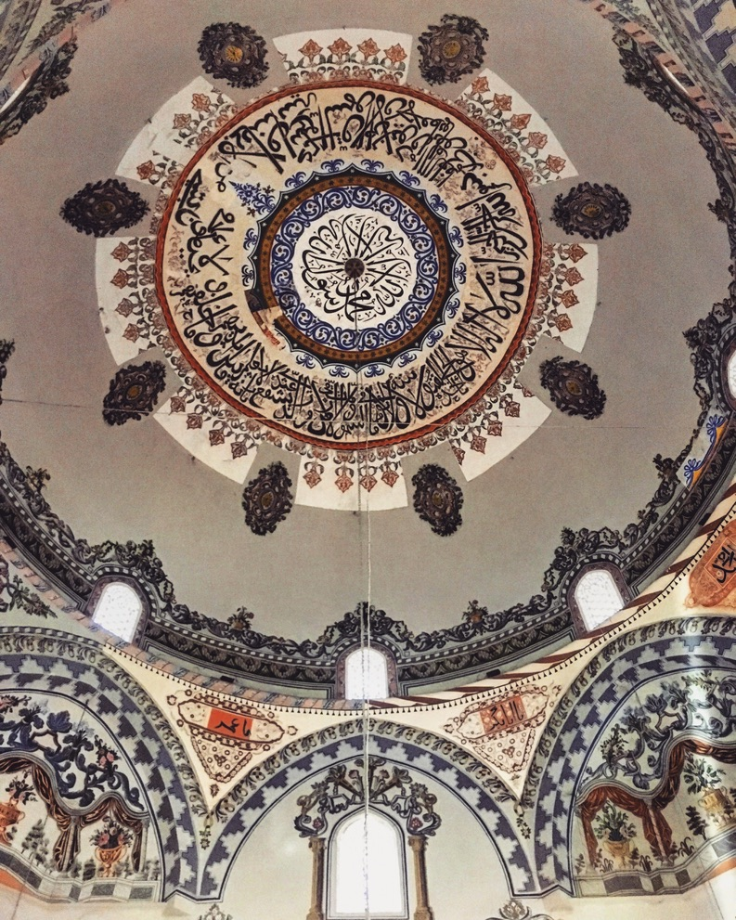
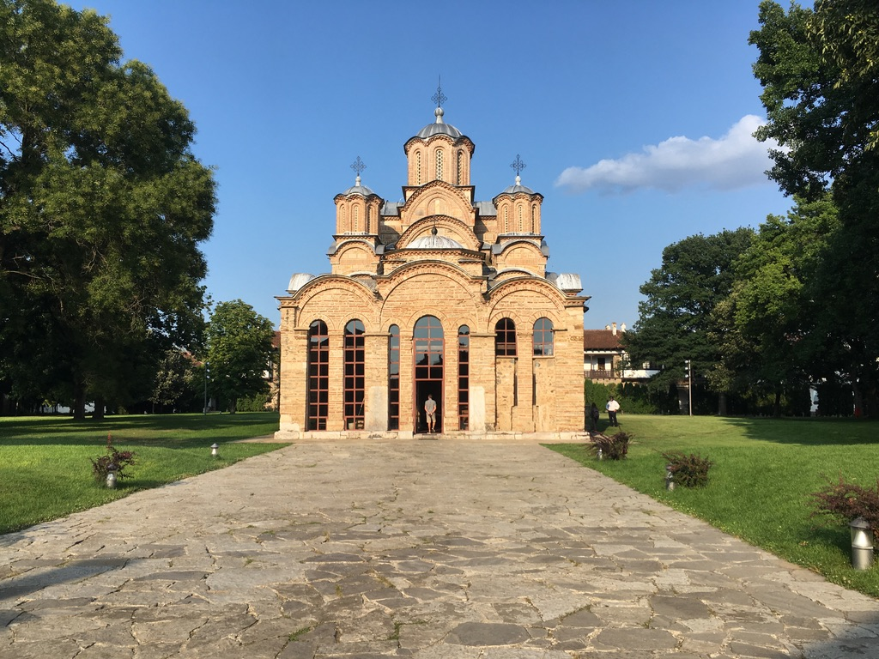
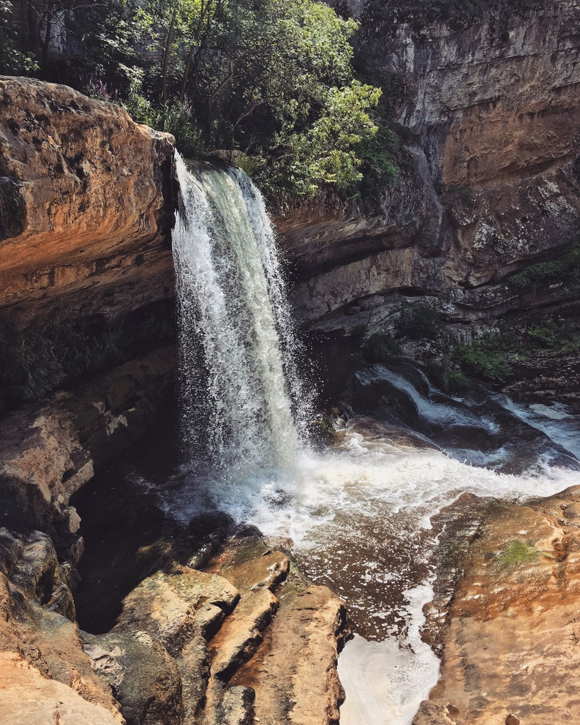
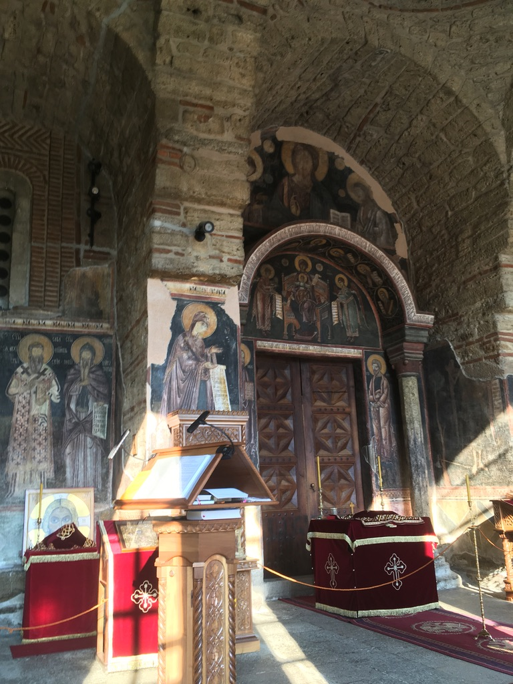
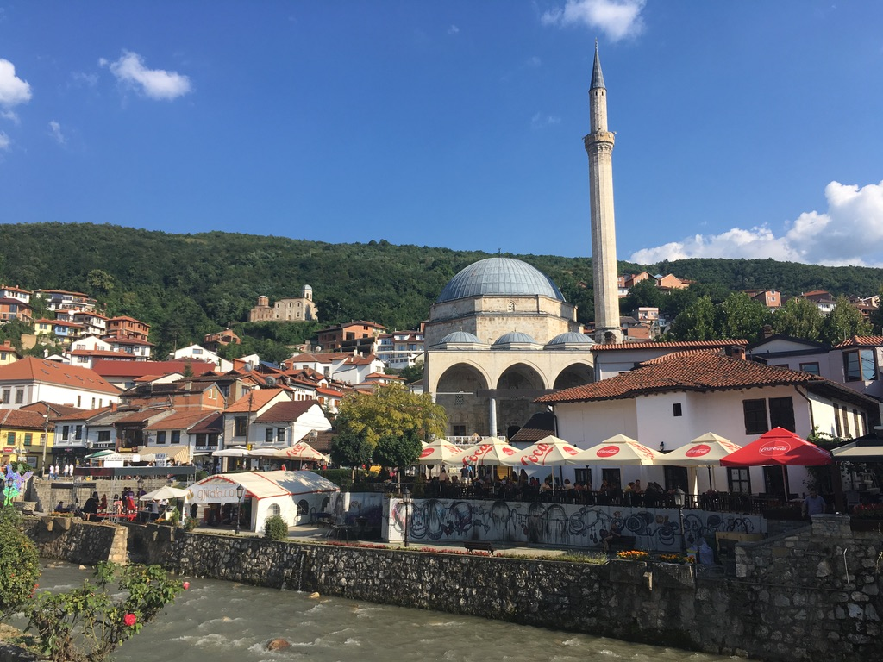

Slide 19
MUNI
Faculty
Of Social
Studies
Faleminderit shume per vemendjen tuaj
Notes:
Serbia on High

