Slide 1
Biological weapons and biotechnology
Jakub Drmola

Slide 2
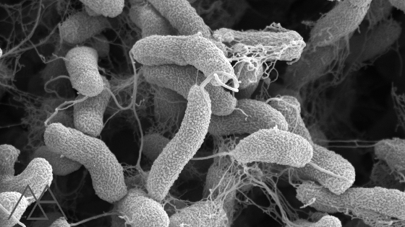
Types
bacteria
  anthrax, cholera, salmonela, tetanus, tularemia, yersinia pestis, ricketsia, typhus, Q fever, glanders
viruses
  encephalitis, smallpox, marburg virus, ebola
fungis
toxins
  botulotoxin, ricin, enterotoxin
in some cases, animals can also be considered as biological weapons (dogs, dolphins, snakes, bees, …)

Slide 3
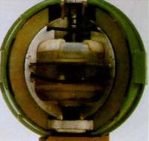
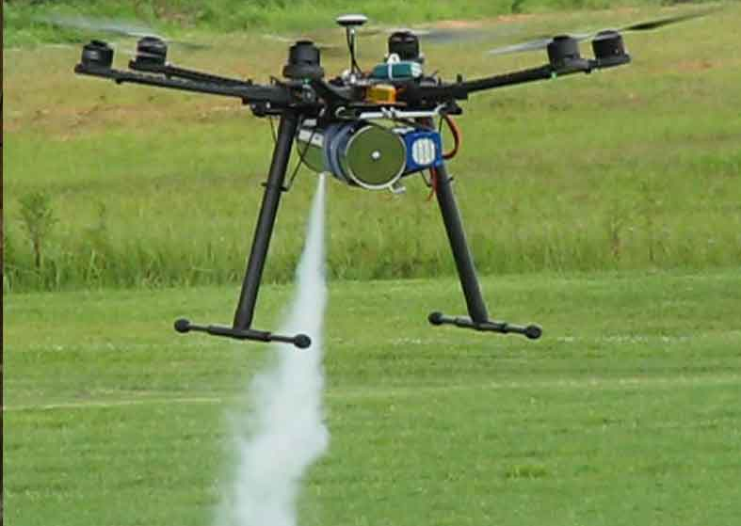
Vectors of infection
inhalation or consumption
through blood or skin
aerosol dispersal (trucks, planes, drones, missiles)
detonation (problematic)
infiltration (water, food, ventilation)
other organisms (humans, rats, flees, mosquitos, ...)

Slide 4
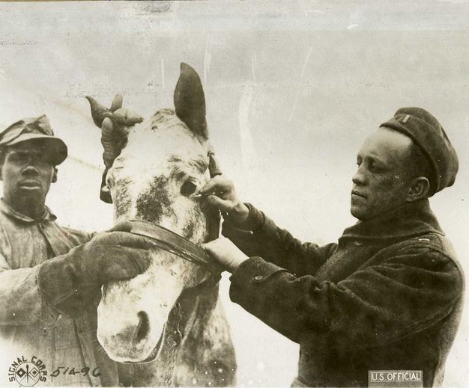
Targets
people
  to kill
  to incapacitate
animals
  as food
  as transport
plants
  as food
  against drugs

Slide 5
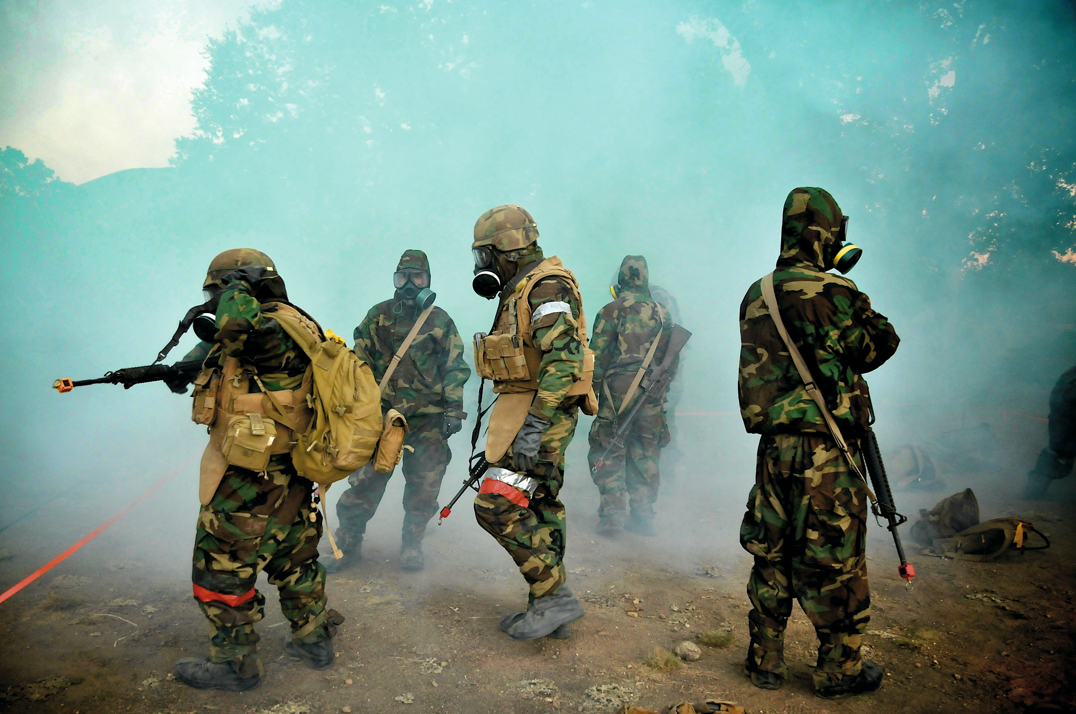
Strategic and tactical aspects
operational support
demoralize enemy
attack population
annihilation
highly dependent on weather and environmental conditions
quite unpredictable
friendly fire
latent and hard to detect

Slide 6
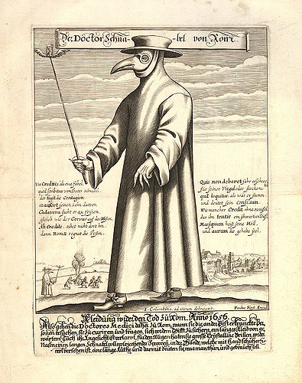
History
ancient history (poisoned arrows, wells, during sieges, use of snakes and wasps, and even plague?)
native americans decimated by smallpox
vaccination discovered 1796
deployed during WW1
  mostly against animals
deployed during WW2
  esp. by Japan in China (2-500 000 dead)
  plans to attack USA: “Cherry Blossoms at Night”
  other powers quite behind, eager to “learn”
very active development during Cold War on both sides

Slide 7
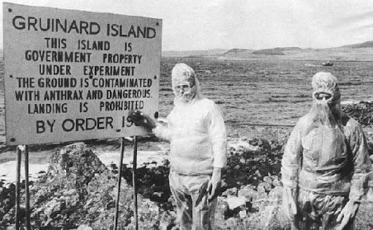

Slide 8
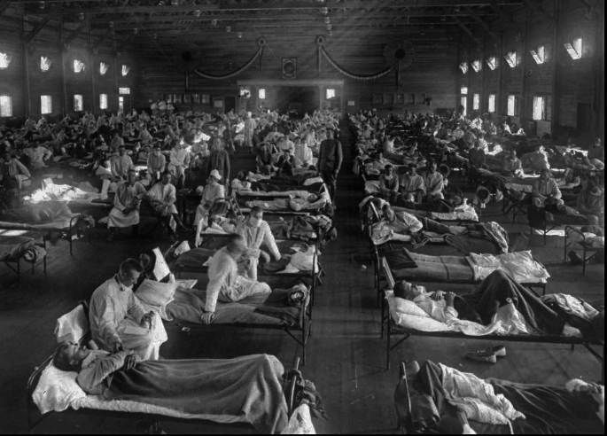
Spanish Flu
1918-1920
global population around 1,75 bil.
WW1 casualties:
  15-20 mil.
WW2 casualties:
  40-100 mil.
Spanish Flu:
  50-100 mil.
Black Death:
  75-200 mil.

Slide 9
Terrorism and assassinations and others
1978, Bulgarian dissident, Georgi Markov killed by ricin pellet
1984, Dalles, Rajneesh and salmonella
  751 infected, 45 hospitalized
  today known as Osho, still popular
1990-5, Aum Shinrikyo
  unsuccessful attempts to deploy anthrax, botulin and ebola
2001, Bruce Ivins, anthrax letters
  22 infected, 5 dead
  ended with suicide, still unclear motivation
many unfuliflled threats and plans from a number of organizations

Slide 10
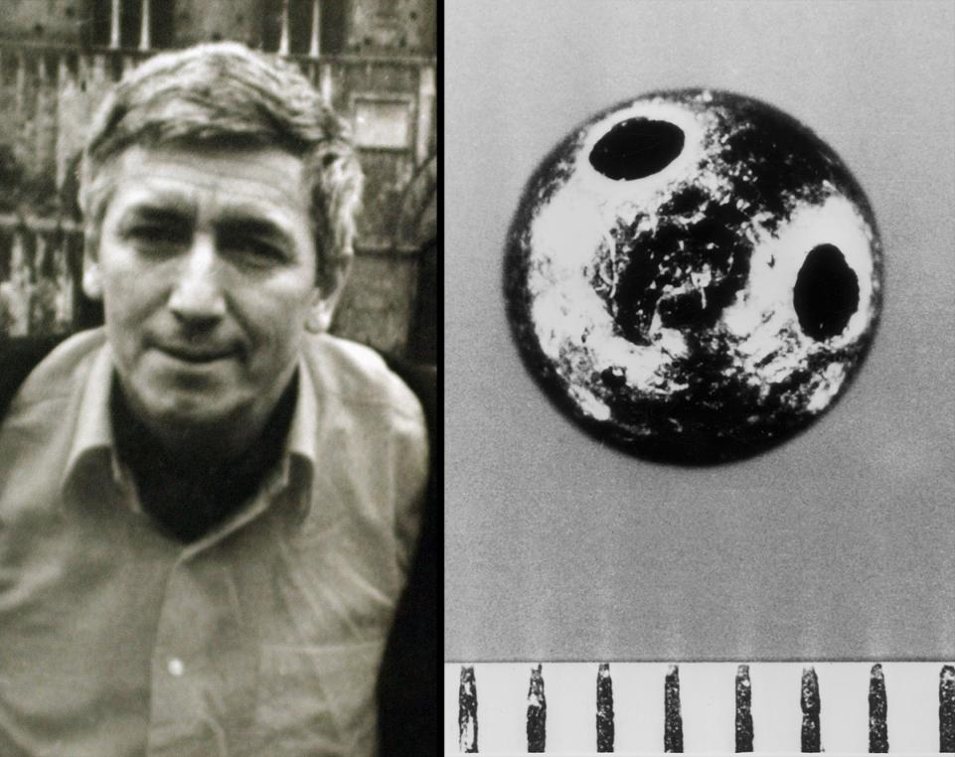

Slide 11
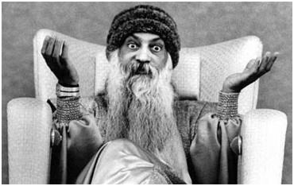

Slide 12
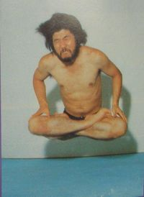

Slide 13
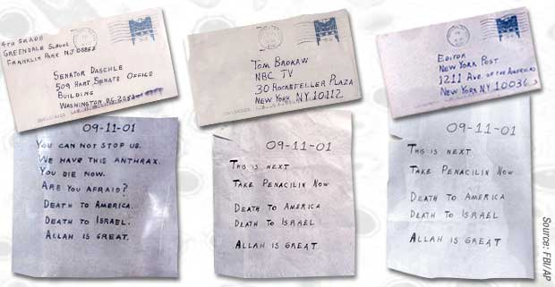

Slide 14
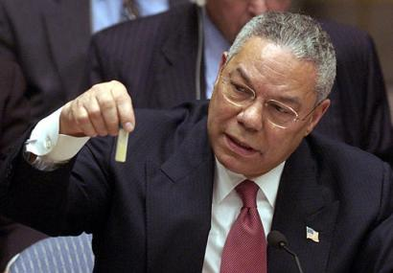

Slide 15
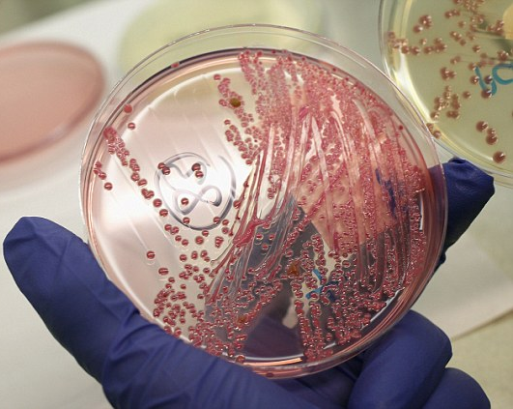
Current situation
development relatively cheap, but difficult
deployment very difficult
growing bacterial resistance
  https://www.youtube.com/watch?v=plVk4NVIUh8
can be directly gentically modified now
  chimeras, deimunization, genetic targeting
can accidentally leak or be acquired by terrorists
engineered anti-material bioweapons possible

Slide 16
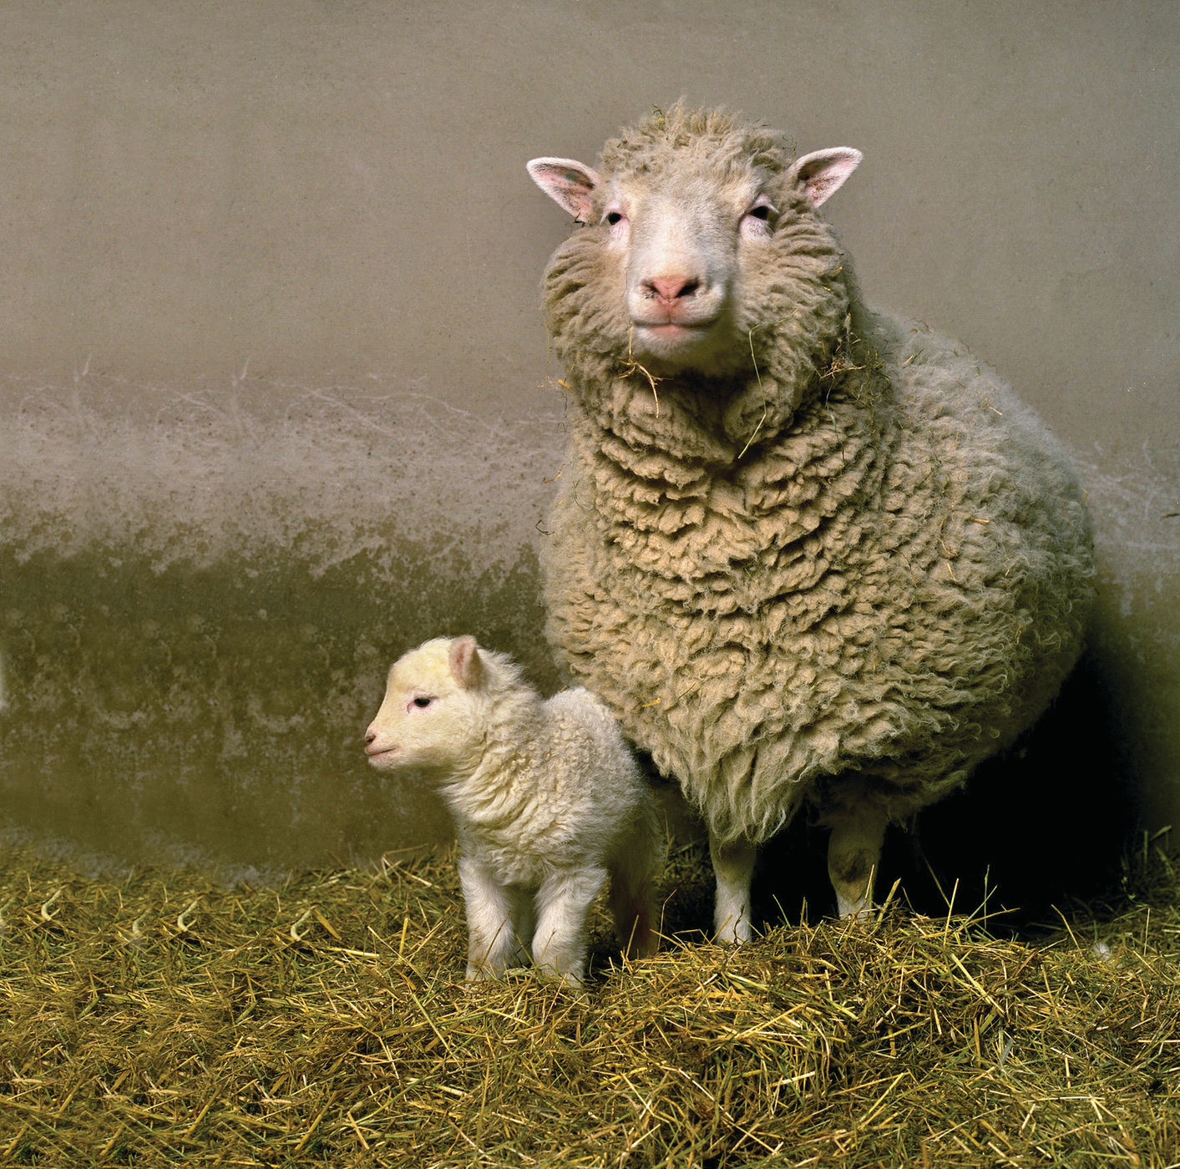
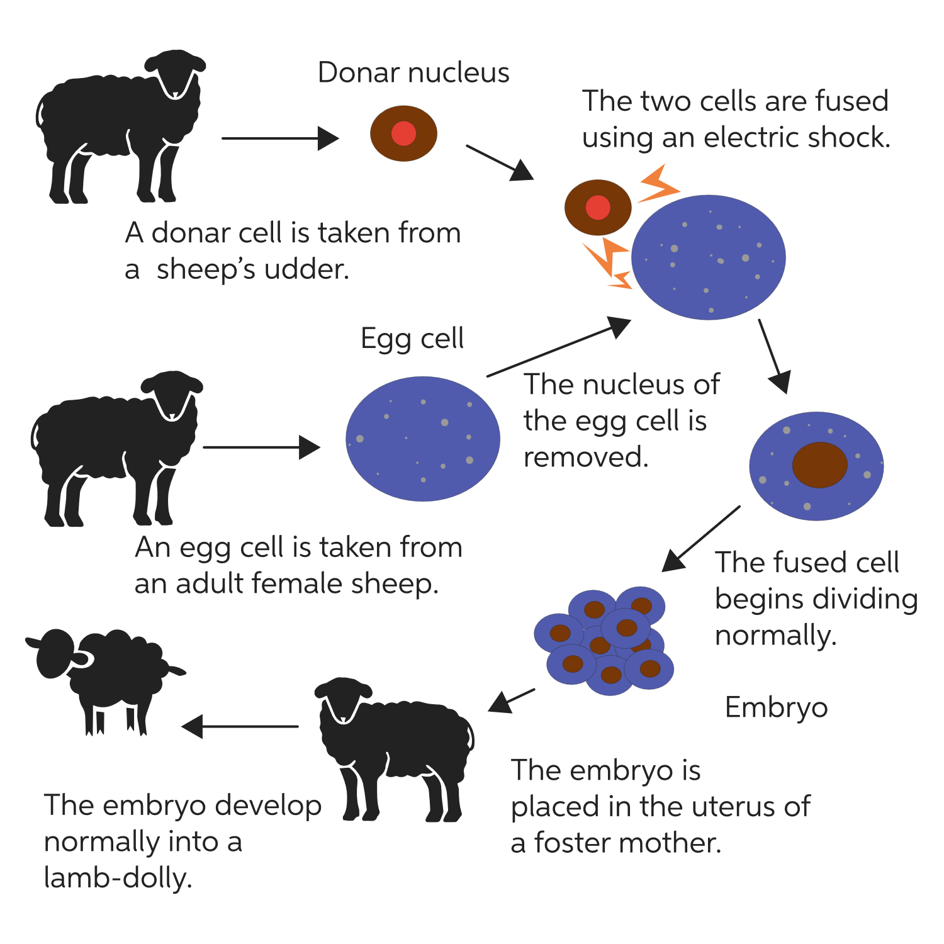

Slide 17
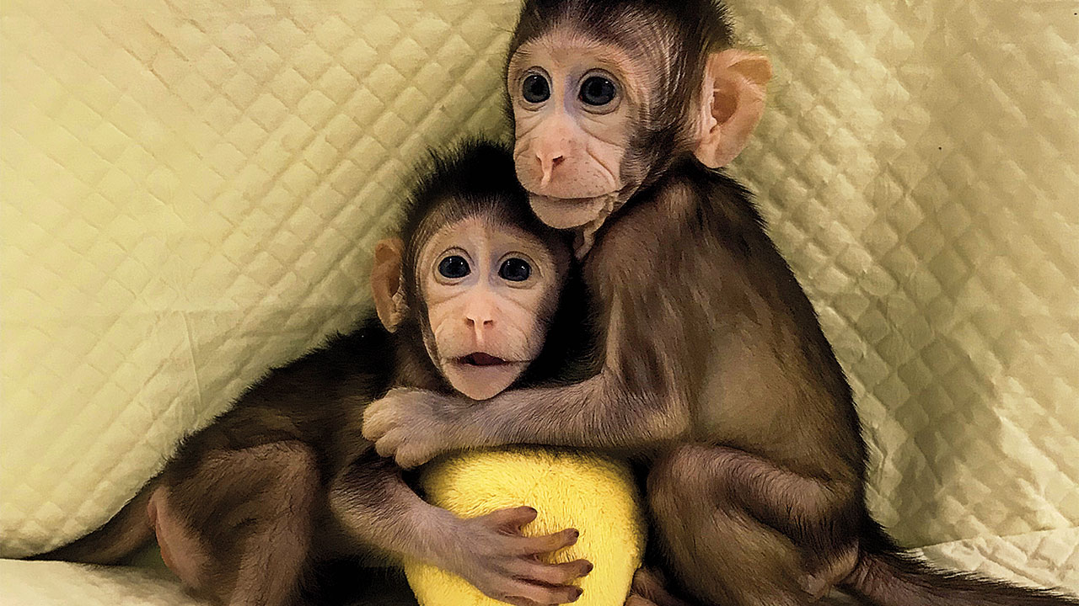

Slide 18
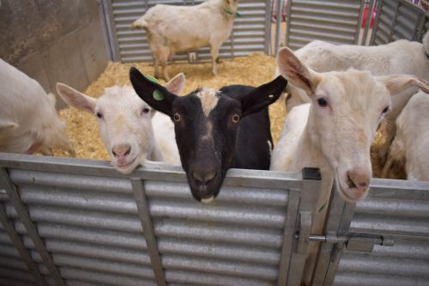

Slide 19
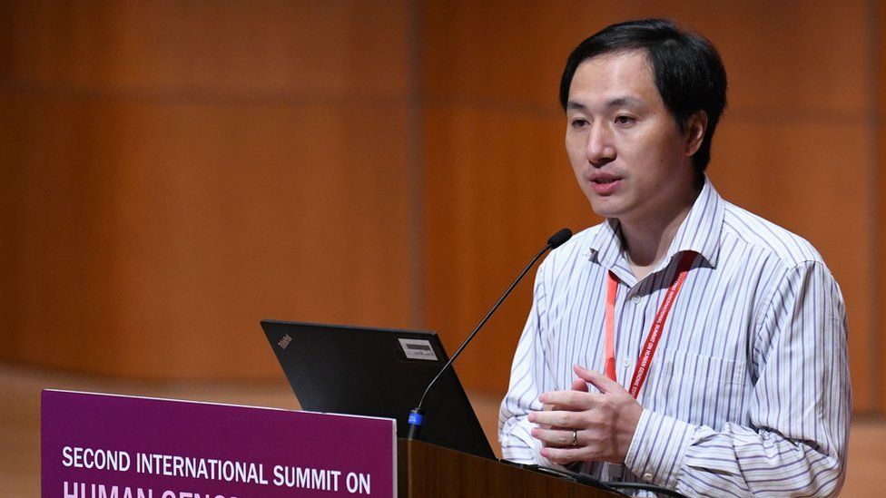

Slide 20
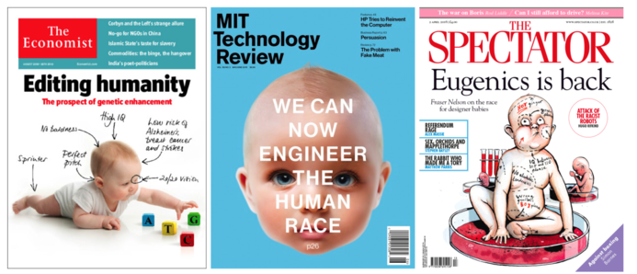

Slide 21
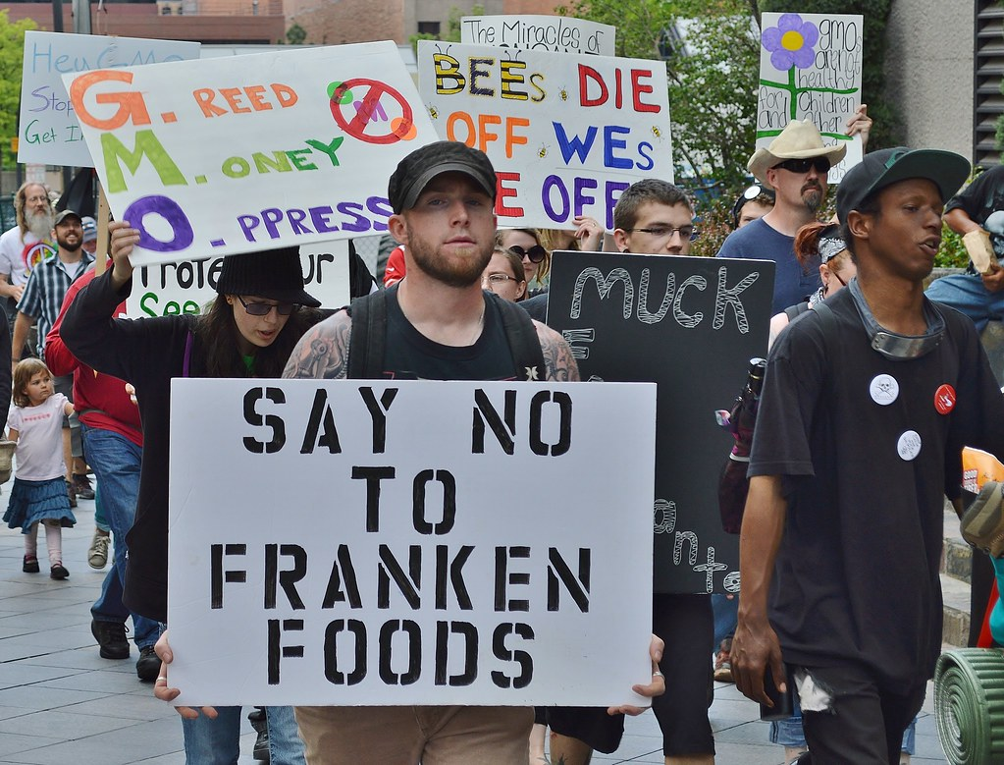

Slide 22
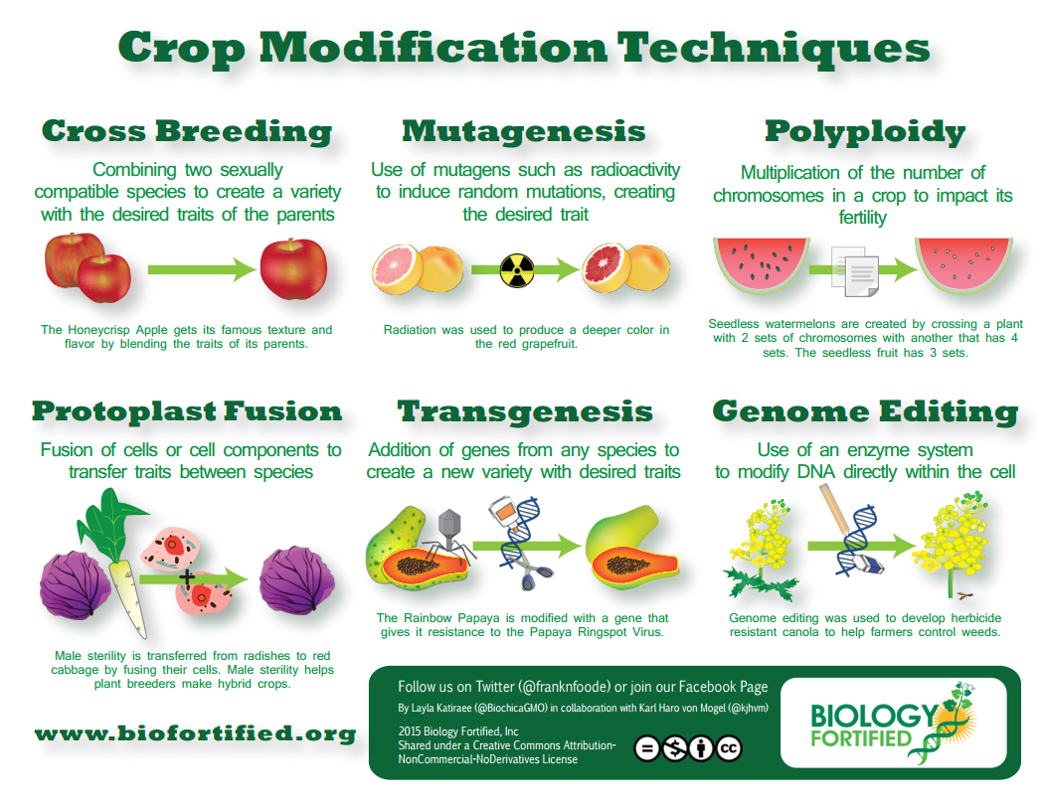

Slide 23
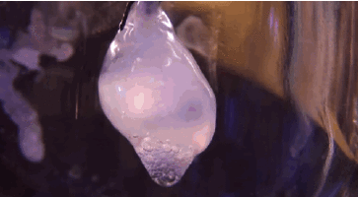
Other controversies
designer babies
artificial organs
synthetic organisms
gene editing
gene drives

