Slide 1
Modern Technologies and Conflicts
Weapons of Mass Destruction
Jakub Drmola

Slide 2
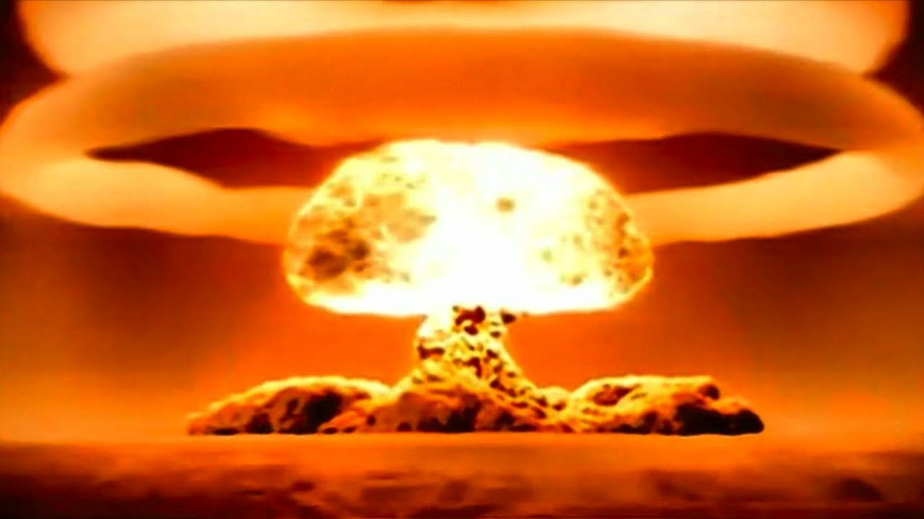

Slide 3
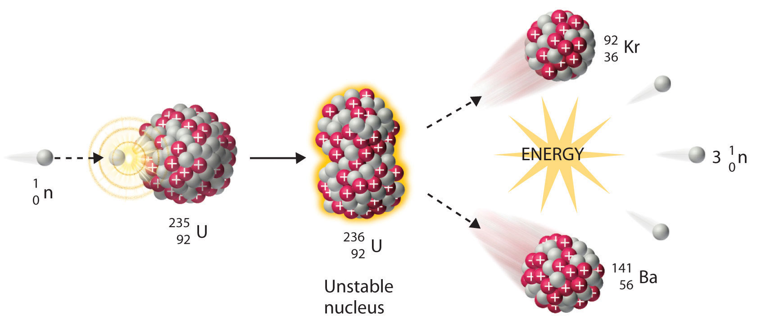
Basic fission

Slide 4
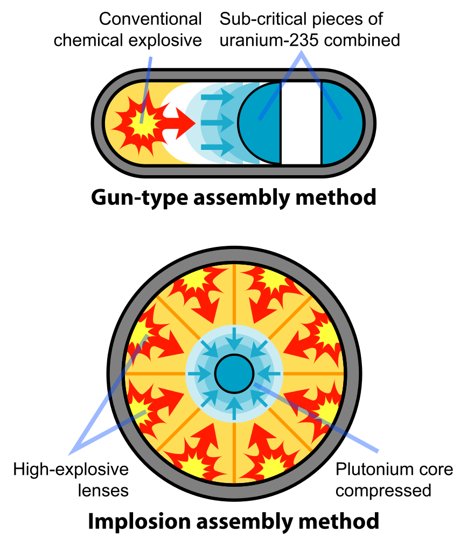
Types
gun-type
  first, less efficient and simpler design
  assembly of 2 subcritical parts
  Little Boy (Nagasaki, 6.8. 1945)
implosion
  newer, more efficient design
  concentional explosion compresses the core
  Trinity test (Nevada, 16.7. 1945)
  Fat Man (Hirošima, 9.8. 1945)

Slide 5
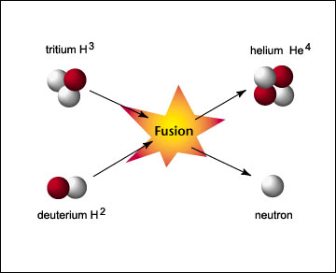
Nuclear fusion
boosted fission
  boosting yield of fission bombs by adding helium isotopes (1940s)
thermonuclear/hydrogen bombs
  hydrogen core compressed via fission bomb
  developed in 50s
  Castle Bravo, 1954, 15 MT
  Tsar Bomb, 1961, 50 MT
  roughly 1000x stronger than WW2 bombs
  commonly used today on ballistic missiles

Slide 6
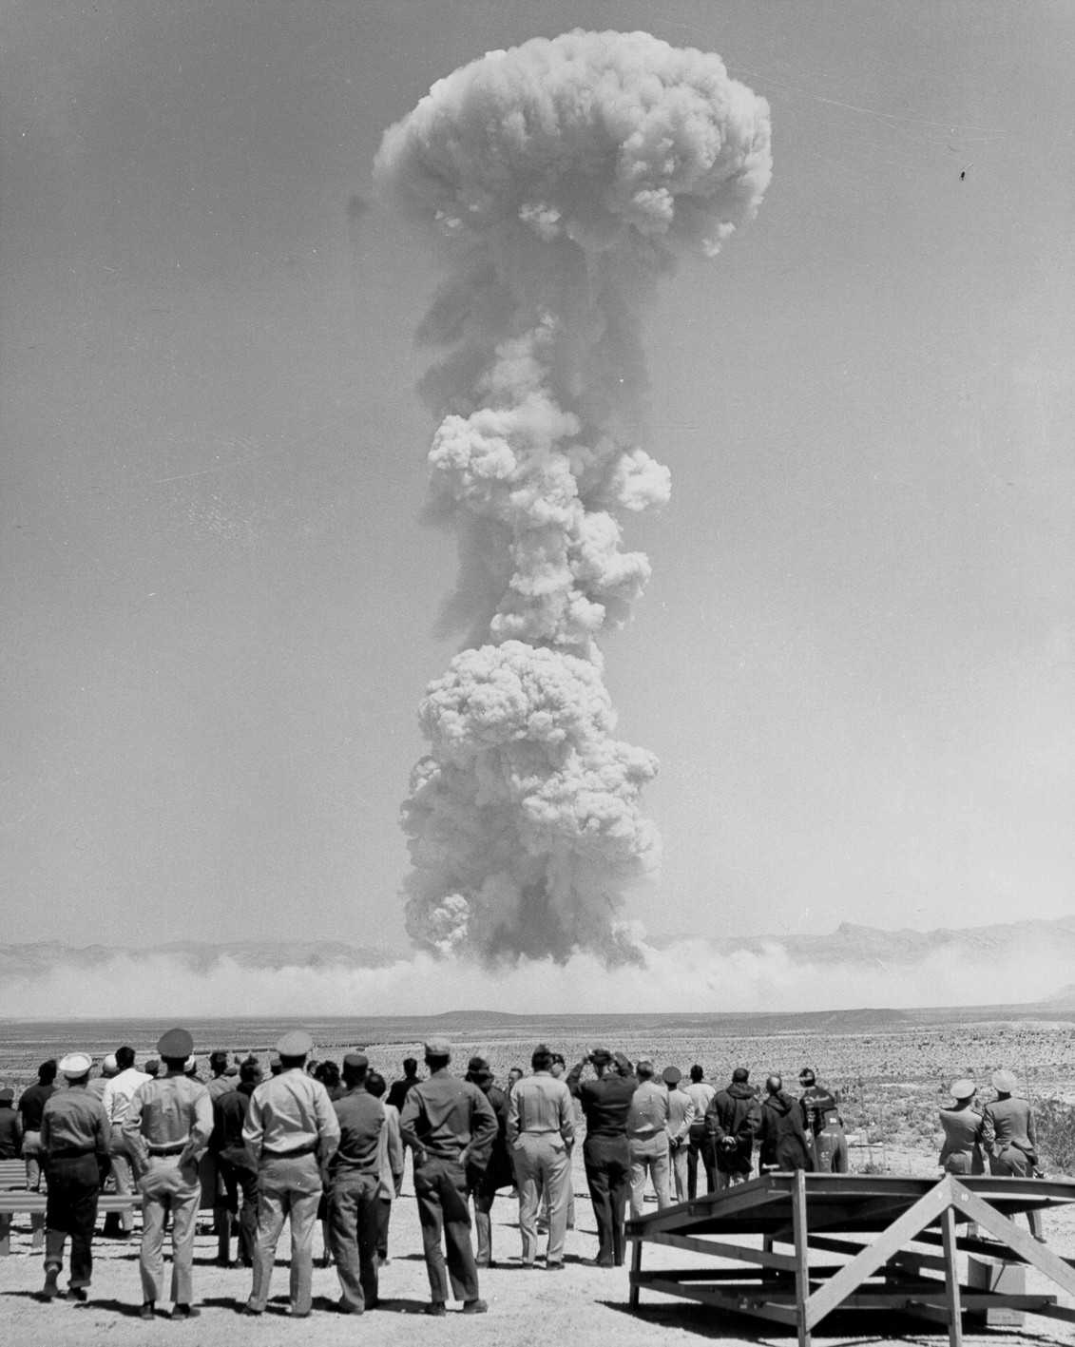
Other types
Enhanced Radiation Weapon
  optimized for neutron radiation
  minimal physical destruction
  “kills people, leaves buildings standing”
  can be used on tactical or ABM missiles
Electromagnetic Pulse
  optimized for gamma and x-ray radiation
  overloads and destroys electronics
  non-nuclear variant also exist

Slide 7
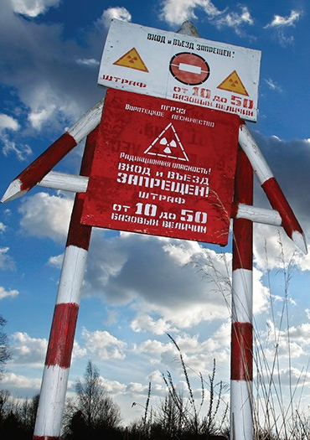
Radiological weapons
so called “dirty bomb”
spreading radiation through conventional explosion
tested as Denial-of-Access weapon
possibly attractive for terrorists
sounds scary but quite impractical
  radiation too weak, temporary and can be cleaned up
  primary threat is panic, not direct deaths
2006, Litviněnko assassination

Slide 8
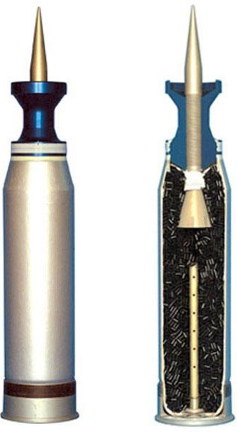
Depleted uranium
by-product from uranium enrichment
50% heavier than lead, similar to tungsten
  but cheaper and pyrophoric
used in munitions, armoud, shielding, counterweights…
lasting controversy regarding its effect on health and environment
no nuclear reaction taking place
minimal level of radioactivity (comparable to banana)
but can be quite toxic (similar to other heavy metals)

Slide 9
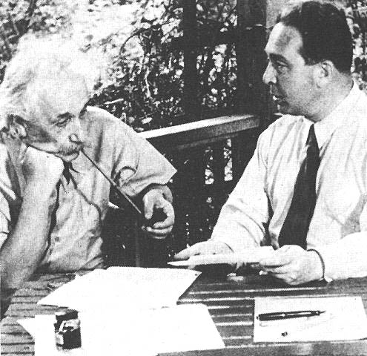
History
nucleus and radioactivity discovered before WW1 (Rutherford, Currie)
first principles developed in 30s (Leo Szilard, Otto Hahn)
1942 project Manhattan started
  UK lacked the industrial capacity
  Germany focused on rocketry
1945 end of WW2
USSR (1949), UK (1952), France (1960), China (1964), Israel (196?), India (1974), Pakistan (1998), DPRK (2016?)

Slide 10
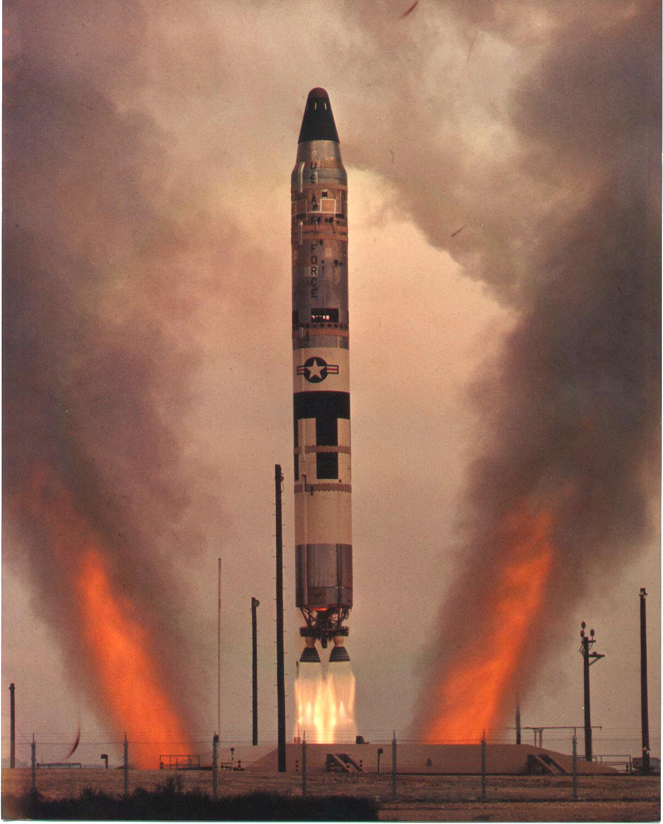
Current arsenals
permanent members of UN SC
plus India, Pakistan and Israel
ongoing efforts by DPRK and Iran
issue of post-soviet countries
former programs in Libya, Iraq, Syria, South Africa, Brazil, Taiwan, Sout Korea, Yugoslavia, ...
https://www.ctbto.org/nuclear-testing/

Slide 11
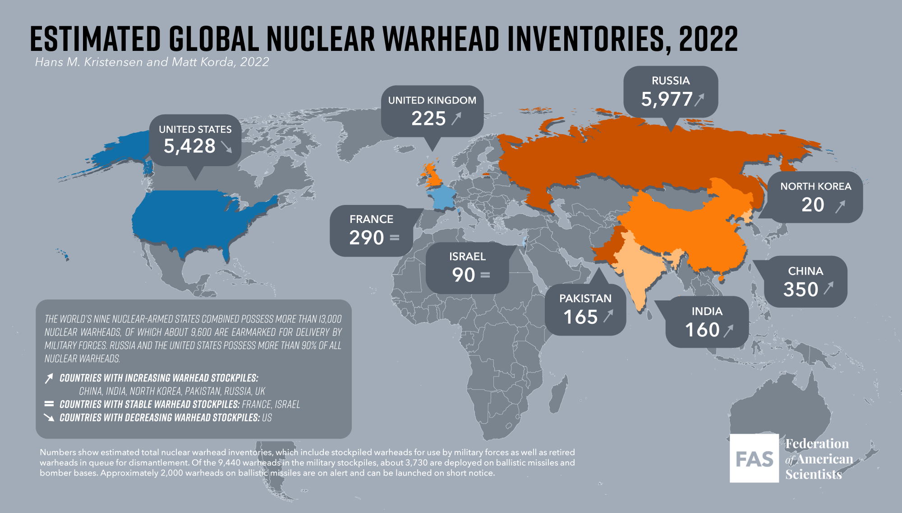

Slide 12

Terrorism
ongoing speculations
  esp. after collapse of USSR and 9/11
regular news about efforts of terrorist groups to procure nuclear weapons or dirty bombs, so far without confirmation or results
building a nuclear weapon from scratch impossible
might steal it, buy it or attack a nuclear facility
building dirty bomb is trivial, could be used to spread fear

Slide 13
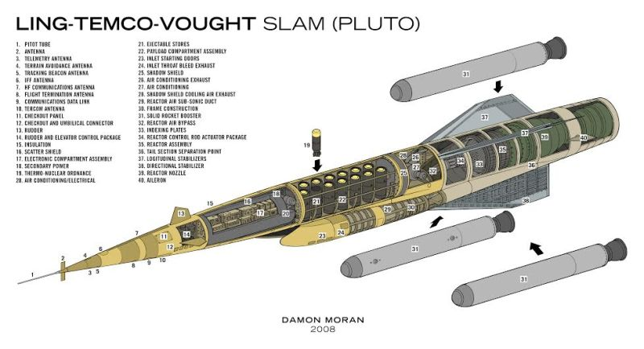
Some notable weapon systems
- SLAM (1955-1964)
doomsday weapon

Slide 14
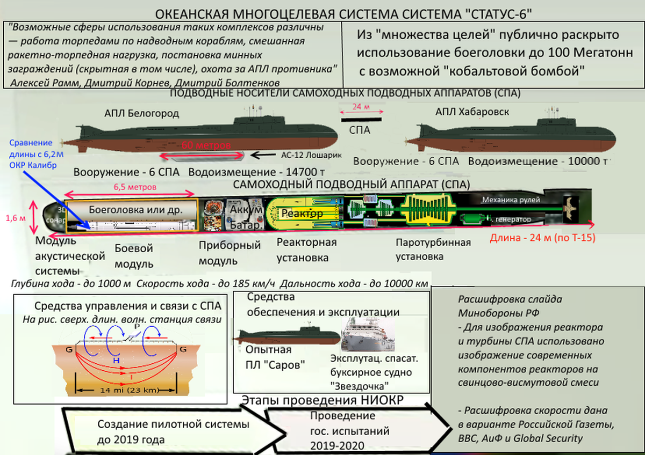

Slide 15
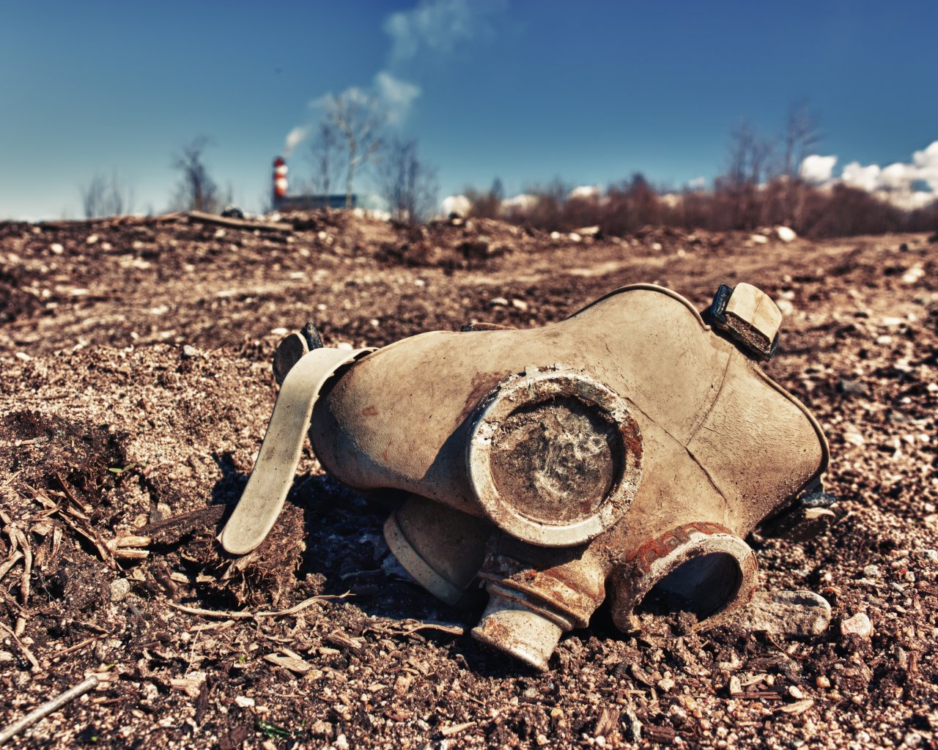

Slide 16
Types of chemical weapons I.
Nerve agents
  block nerve signals > convulsions, paralysis of muscles > asphyxiation or heart failure
  sarin, soman, tabun, VX, novichok
Blood agents
  absorbed into blood by inhalation or consumption > block oxygen
  cyanide, arsenic, oxygen monoxide
Choking agents
  stings and destroys cells in lungs and membranes > lungs flood with liquid > asphyxiation
  phosgene, chlorine

Slide 17
Types of chemical weapons II.
Blistering agents
  up to 24 hours after contact, chemical burns for days, extremely painful, necrotic
  yperite (mustard gas), lewisite
Psychoactive
  temporary loss of consciousness, confusion, hallucinations
  LSD-25, BZ, Kolokol-1
Incapacitating
  cause vomiting, burning in eyes, coughing, tears
  chloracetophenon, CS, CR, adamsite

Slide 18
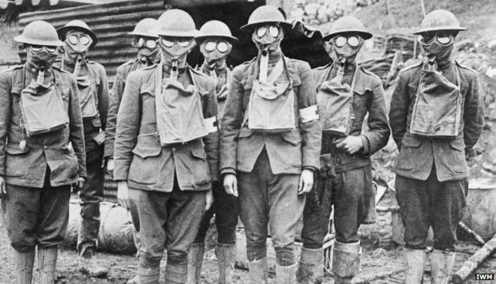

Slide 19
History I.
use of smoke since time immemorial
da Vinci’s proposal for chemical grenade
boom of chemistry since 19th century
largest use in history during First World War
  1914 – tear gas, first use by France, unsuccessful
  1915 - chlorine, phosgene
  1917 - yperite (mustard gas)
  over 1 million soldiers impacted, 100 thousand killed (primarily by phosgene)
  all major powers used chemical weapons
nerve gases discovered in Germanny in 1930s

Slide 20
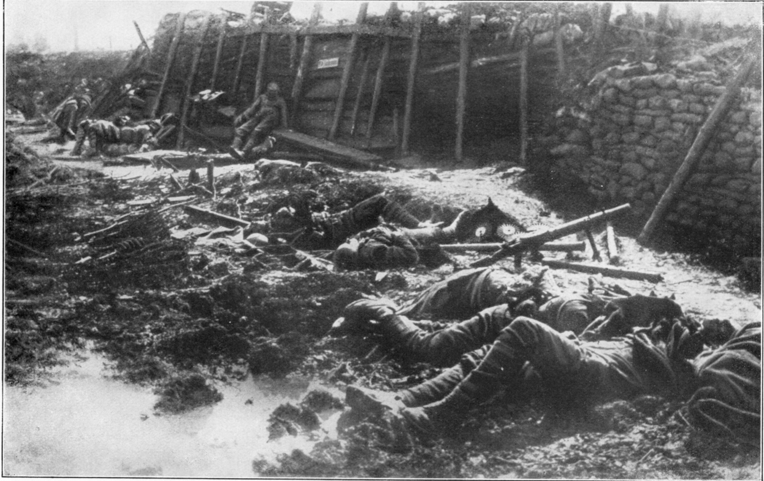

Slide 21
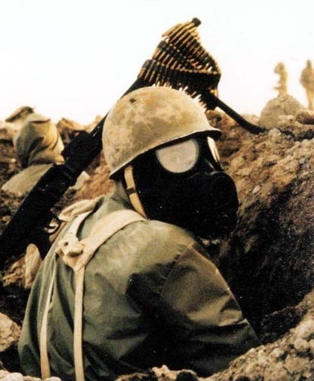
History II.
very limited combat use during WW2 – why?
  Germany did not know nobody else discovered nerve gas, worried about escalation
  used a lot by Japan
  planned use for defense of Great Britain
  Zyklon B in extermination camps
“gas race” during Cold War
used in smaller conflicts in Middle East, Africa, etc.

Slide 22
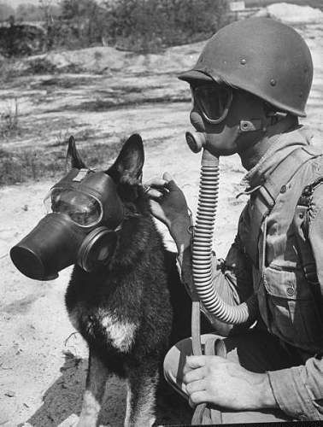
Technology used
methods of dispersion
  wind, artillery, air bombs, spraying, binary munitions
methods of protection
  detection by sight and smells, damp cloth over face
  later gas masks, continually improved, full suits
  neutralizing chemical agents, antidotes, electronic detection

Slide 23
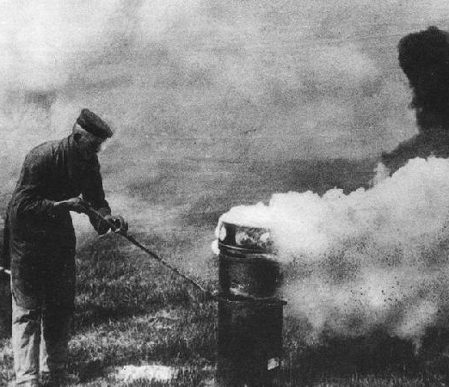
Strategic and tactical aspect
highly dependent on weather
  temperature, wind and humidity can limit the effect or even hit friendly forces
contamination
quite cheap and simple to produce
very bad for PR
not very effective when the armies are protected
can escalate quickly

Slide 24
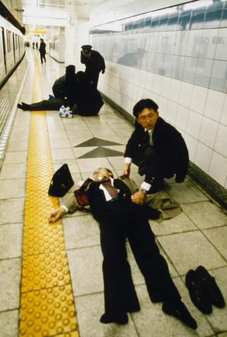
Terrorism etc.
chemical weapons are relatively easily procurable
sometimes used to enhance conventional attacks
  not effective
Aum Shinrikyo
  1990-5: 10 attempts for chemical attack
    (4x sarin, 4x VX, 1x phosgene and cyanide)
  2x successful, 14 killed, 4000 injured
Moscow theater siege, kolokol-1 used by police, 2002
attacks on chlorine tanks in Iraq, 2007
use in Syria since 2012, multiple sides
  (chlorine, sarin, yperite, tear gas)
assassination of Kim Jong Nam, 13/2/2017, VX
Sainsbury attack on Skripals, 04/04/2018, novichok

Slide 25
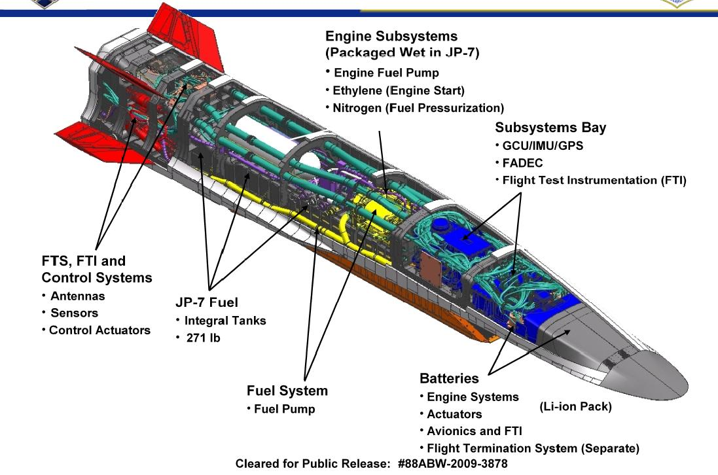
Some notable weapon systems
- scramjet
- goal is fastest possible reaction when ballistic missiles cannot be used and cruise missiles are too slow
- hypersonic (mach5+)
- flight across pacific in 1-2h
- theoretical basics known since WW2
- mixed success in tests

Slide 26
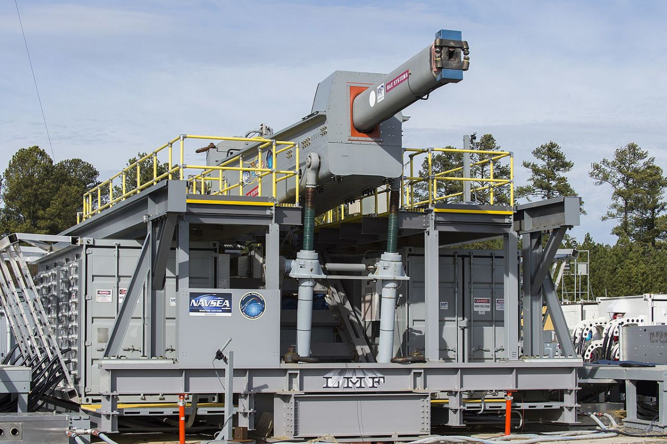
Some notable weapon systems
- Mach7+, range up to 200 km
- electromagnetic force instead of chemical combustion
- small “cheap” munition, less risky to store
- purely kinetic energy kill
- 11 kilograms @ Mach7 ≈ 87t @ 100 km/h (locomotive)
- targets at land, sea and air
- first deployments “soon”
https://www.youtube.com/watch?v=O2QqOvFMG_A&feature=youtu.be&t=8s
- problems:
  gun wear and durability
  power demands

