Slide 1
Descriptives, Crosstabs, Correlation
Methodology of Conflict and Democracy Studies
November 28

Slide 2
Aim of this lecture
How to obtain basic information about your data
Control of the assumptions
Association of two variables:
Crosstabs (Contingency tables)
Correlation

Slide 3
Descriptive Statistics
Basic measures to summarize the characteristics of your data
Various types:
Central tendencies – mean, median
Dispersion – variance, minimum, maximum
Not all descriptives are suitable for all types of variables
We use them to describe and explore your data

Slide 4
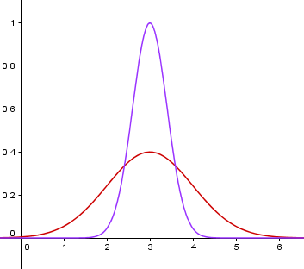

Slide 5
How to Obtain Descriptives in SPSS
Analyze > Descriptive Statistics > Frequencies
Move variables of interest to the right
In ‘Statistics’ choose all measures you require

Slide 6
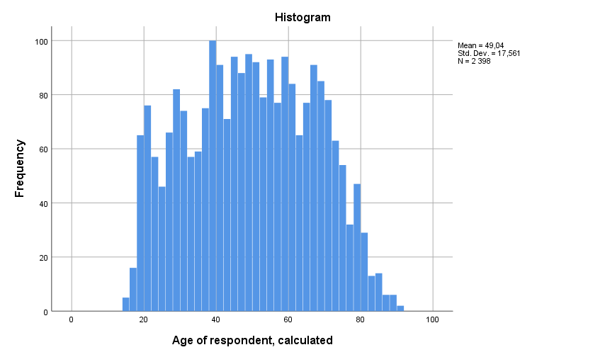
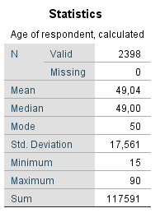

Slide 7
Assumptions of Data
Not all data are suitable for all statistical tests
Parametric and Non-parametric tests
Parametric tests as a preference v. higher requests on data

Slide 8
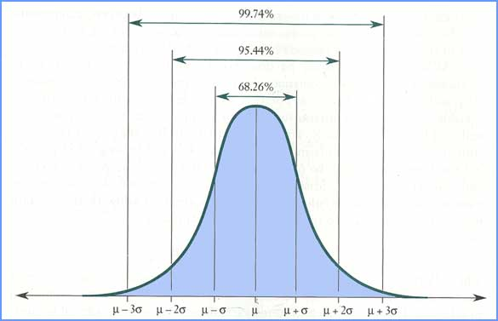
Normal Distribution

Slide 9
How to Check the Distribution
1) Visual control – Histogram
2) Statistical tests:
Kolmogorov-Smirnov
Shapiro-Wilk

Slide 10
1) Histogram
Analyze > Descriptive Statistics > Frequencies
In ‘Charts’ choose ‘Histogram’
Select ‘Show normal curve on histogram’ to draw a line corresponding to normal distribution

Slide 11
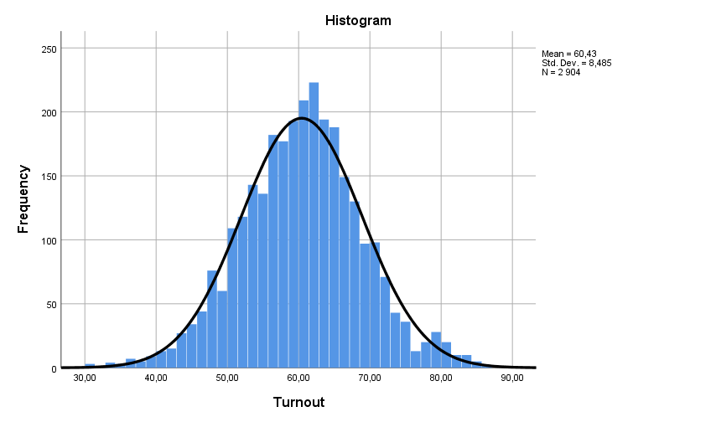

Slide 12
2) Statistical Tests
Kolmogorov-Smirnov (Shapiro-Wilk)
Both test the null hypothesis that your data are normally distributed
Results:
Significant (p <= 0.05) – we reject the null hypothesis
Not significant (p > 0.05) – we keep the null hypothesis
With large samples the tests tend to lead to significant results without meaningful reason → use histogram instead

Slide 13
How to read the significance in SPSS outputs
SPSS output | Significance
,900 | 10 %
,750 | 25 %
,500 | 50 %
,200 | 80 %
,100 | 90 %
,050 | 95 %
,010 | 99 %
,001 | 99.9 %
,000 | > 99.9 %
= (1 – SPSS output) * 100
Example: (1 – 0.234) * 100 = 0.766 * 100 = 76.6 %

Slide 14
2) Statistical Tests
Analyze > Descriptive Statistics > Explore
Place variable of your interest into ‘Dependent List’
In ‘Plots’ select ‘Normality plots with tests’

Slide 16
Association of Two Variables
Depends on types of variables
Crosstabs:
Suitable for two categorical variables
Low amount of categories in your variables (but at least two per variable)
Correlation:
Two scale variables, scale and ordinal, two ordinal variables
Specific case – scale and binary variable

Slide 17
Crosstabs
Contingency tables
Describe interaction of two categorical variables
Age groups of people v. turnout in election (yes/no)
Allow generalization to population

Slide 18
Crosstabs
Analyze > Descriptive statistics > Crosstabs
Select variables for Columns and Rows
Features:
Cells – counts, percentages, residuals
Statistics – Chi-square, Cramer’s V
Try not to fill your crosstab with too many features

Slide 19
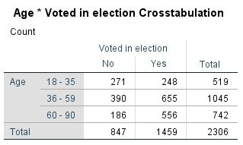
Counts: Observed

Slide 20
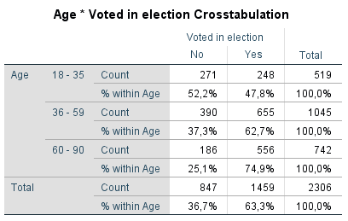
Counts: Observed Percentages: Row

Slide 21
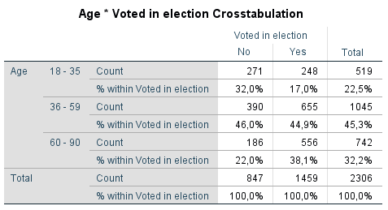
Counts: Observed Percentages: Column

Slide 22
Counts: Observed Percentages: Row
Younger people do not vote to the same extent than older people
But can we apply this to the whole population?

Slide 23
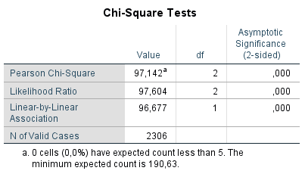
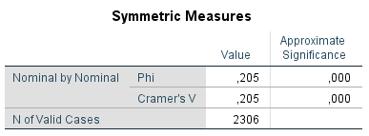
Chi-square, Cramer’s V
There is a relationship between age and turnout, and it applies to the population
But is it okay to end the analysis at this point? Can we find out more?

Slide 24
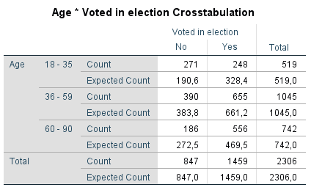
Counts: Observed + Expected

Slide 25
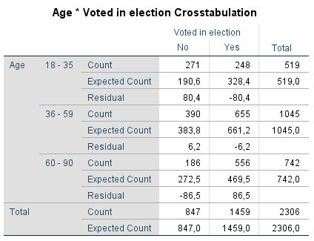
Counts: Observed + Expected Residuals: Unstandardized

Slide 26
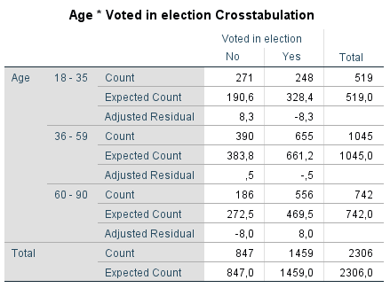
Counts: Observed + Expected Residuals: Adjusted standardized

Slide 27
Counts: Observed + Expected Residuals: Adjusted standardized Chi-square, Cramer’s V

Slide 28
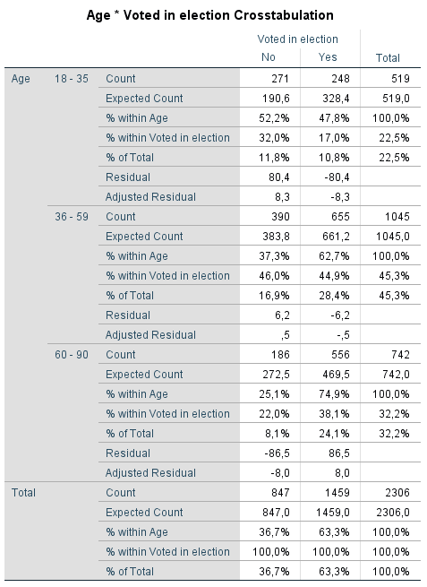
Why Not Make It Too Complicated?

Slide 29
Correlation
Association between two variables (for other cases than crosstabs)
Examples: two scale variables, scale and ordinal, two ordinal variables
Three coefficients:
Pearson
Spearman
Kendall

Slide 30
Correlation
Results vary on a scale between -1 and 1
Interpretation:
Zero means no association between the variables
Rising distance from zero shows rising association (regardless the direction – negative or positive)
-1: perfect negative association
1: perfect positive association
Beware of false absence of association
Always good to visualize data before calculating correlations

Slide 31
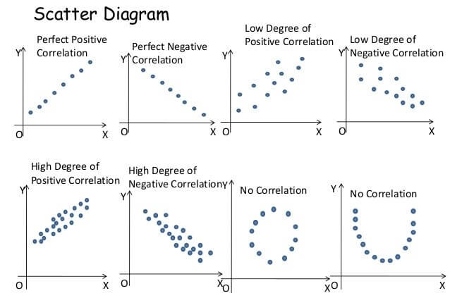

Slide 32
Pearson’s Correlation Coefficient
Parametric operation
Requirements:
Scale data (exemption – scale and binary)
If we aim to apply the findings to the population, we need normally distributed data (or a large sample)
Sensitive to outliers

Slide 33
Pearson’s Correlation Coefficient
Visualize the data
Graphs > Chart Builder
Select Scatter/Dot a variables of your interest
Correlation
Analyze > Correlate > Bivariate
Select variables and the proper coefficient (PCC is set by default)
For significance select ‘Flag significant correlations’

Slide 34
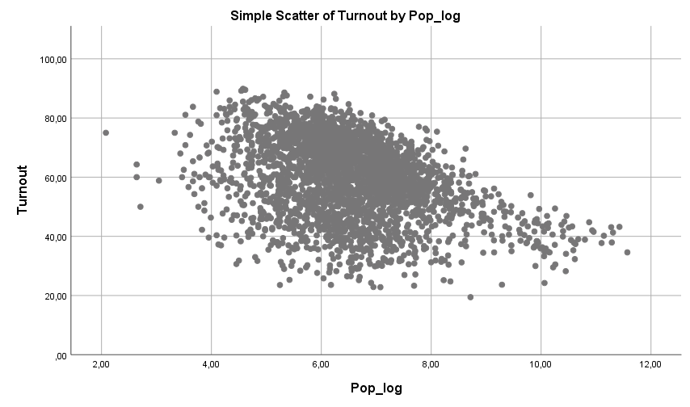

Slide 35
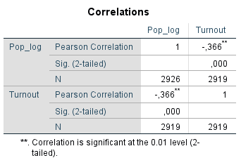

Slide 36
Pearson’s Correlation Coefficient
Scale variable and binary variable
Works the same as for two scale variables
Beware of coding of the binary variable (be sure what values the codes represent)

Slide 37
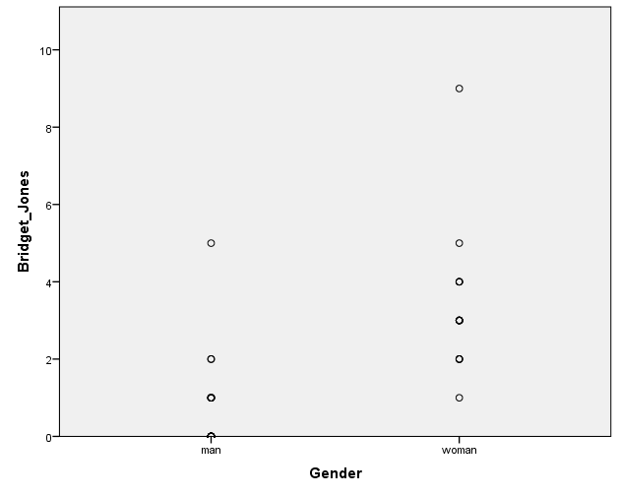
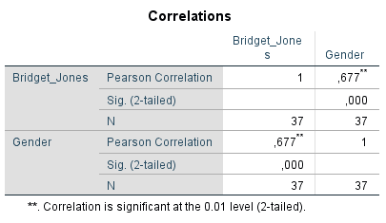

Slide 38
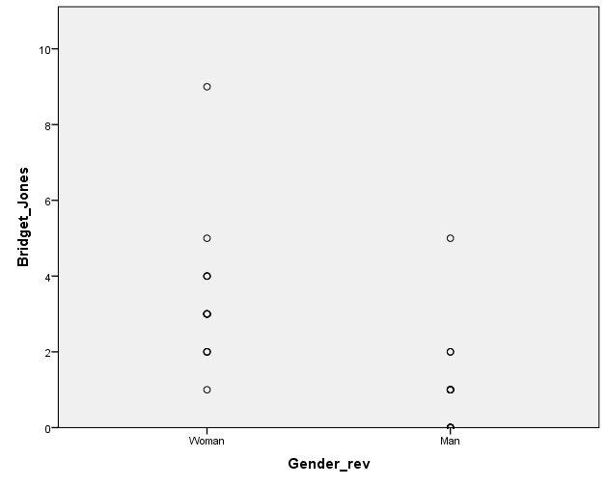
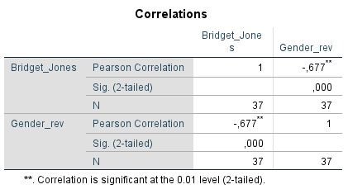

Slide 39
Non-Parametric Correlation
Spearman’s Rho and Kendall’s Tau
Correlation for other cases than two scale variables (or scale and binary)
Same interpretation as in Pearson’s CC
Preference of Kendall’s Tau if variables contain less categories and for smaller samples
Analyze > Correlate > Bivariate
Select variables and Spearman/Kendall
For significance select ‘Flag significant correlations’

Slide 40
Interpretation
Correlation does not imply causality
No control of other variables
No independent and dependent variable
You cannot tell that one variable affects the other even in cases when such relationship seems to be meaningful and logical
Keep the interpretation of effects of IVs on DV for the regression analysis

Slide 41
