Slide 1
Cybersecurity
Part 1 – overview and state activities
Jakub Drmola

Slide 2
Cybersecurity is hard

Slide 3
Characteristics to note when attack occurs
actors involved
    who did it? who is the target? states/companies/teenagers in basement?
methods used
  how did they do it? what type of attack? what was really lost or damaged?
motivation
  why did they do it? what was their goal? what did they really accomplish?
which are easy/hard to know and why?

Slide 4
Actor types
ideology
hacktivism militias
cyberterrorism
espionage
sabotage
individual
state
identity theft
financial crime
profit

Slide 5
Examples
ideology
Anonymous SEA
???
PLA 61398
Equation
Group
individual
state
Russian Bussiness Network, vDOS
profit

Slide 6
Attacks
ideology
#OP Payback Estonia
2007
???
Flame
Stuxnet
individual
state
DDoS for hire
scams
ransomware
profit

Slide 7
C-I-A triad of what is actually being attacked
Confidentiality
Integrity
Availability
examples?

Slide 8
Key distinctions
attack for profit or politics?
executed/planned as covert or overt?
what is target losing/what is the attacker gaining?

Slide 9
Main problems
attribution of attacks
  and therefore deterrence
non-territoriality
  and therefore law enforcement
asymmetry
  of actors
  of defence/offense

Slide 10
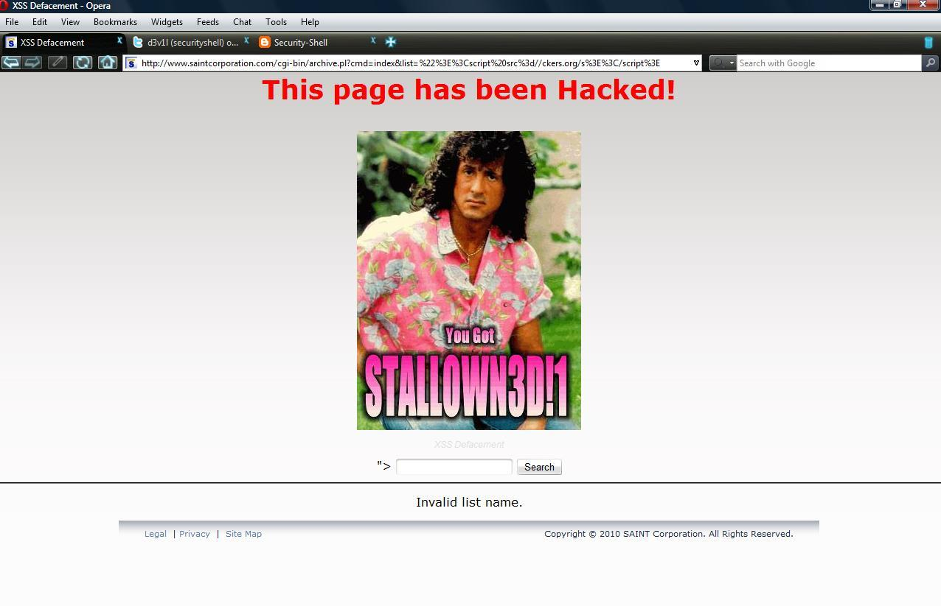

Slide 11
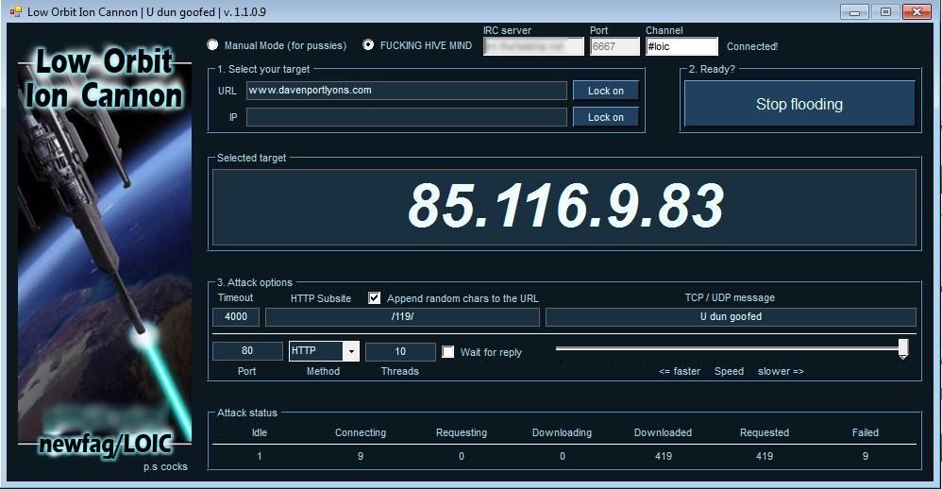

Slide 12
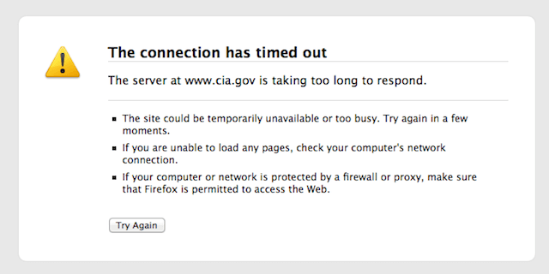

Slide 13
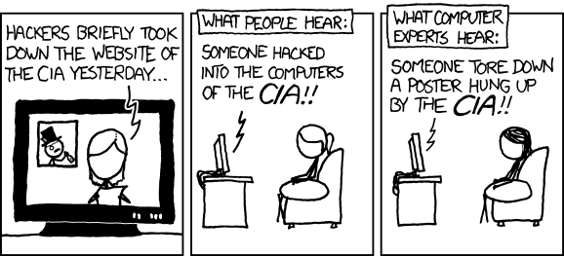

Slide 14
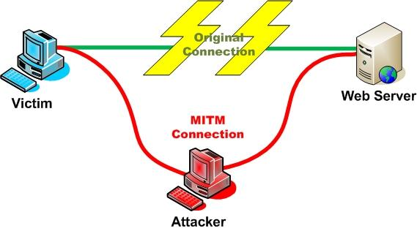

Slide 15
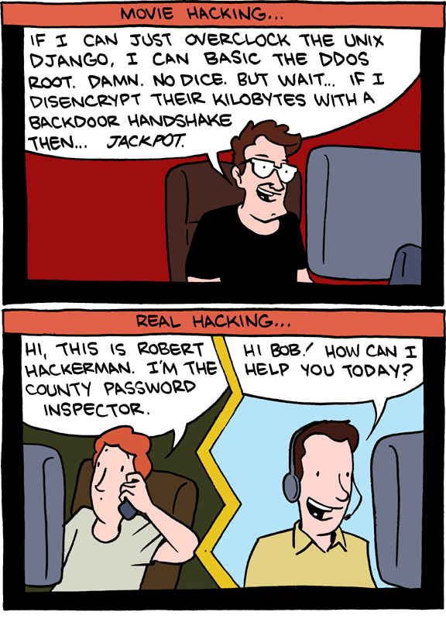

Slide 16
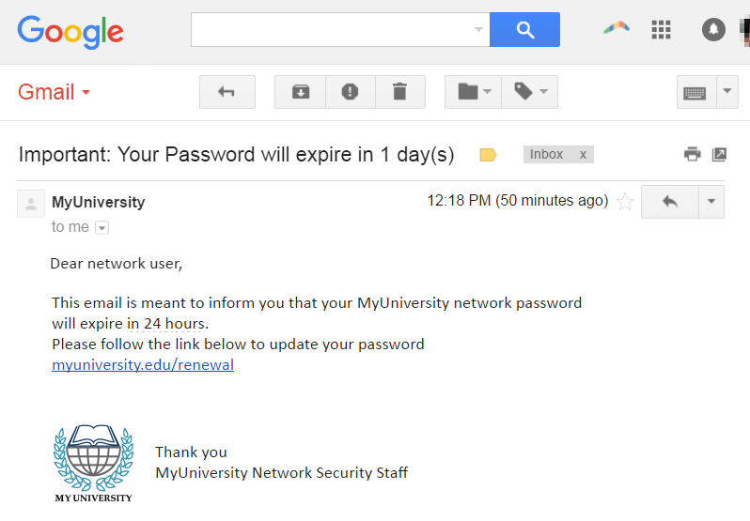

Slide 17
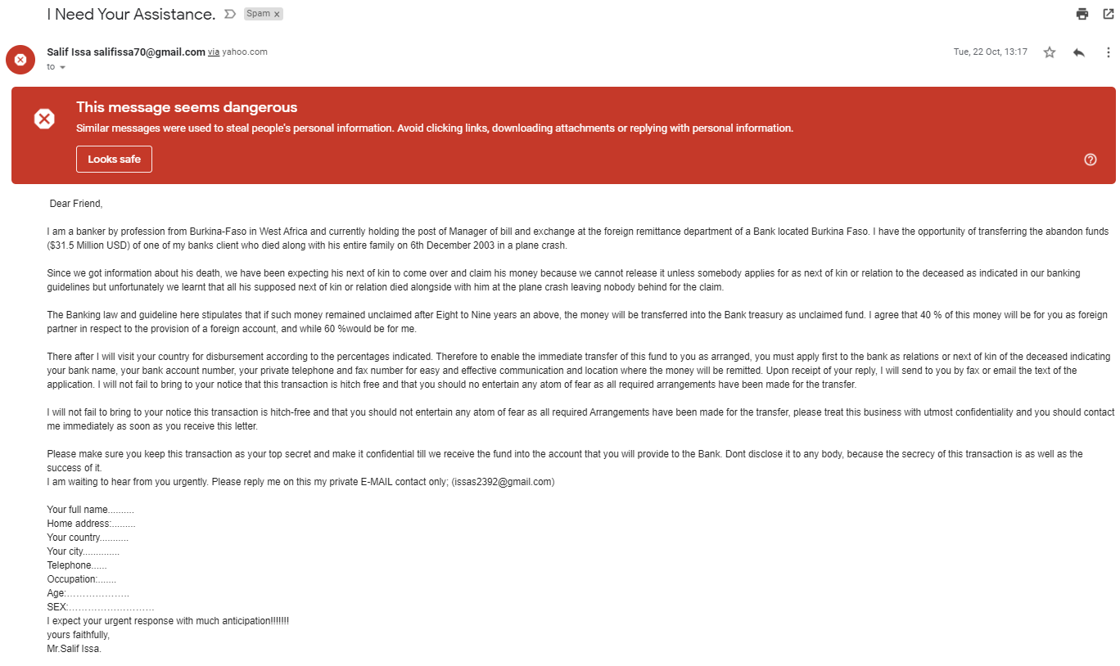

Slide 18
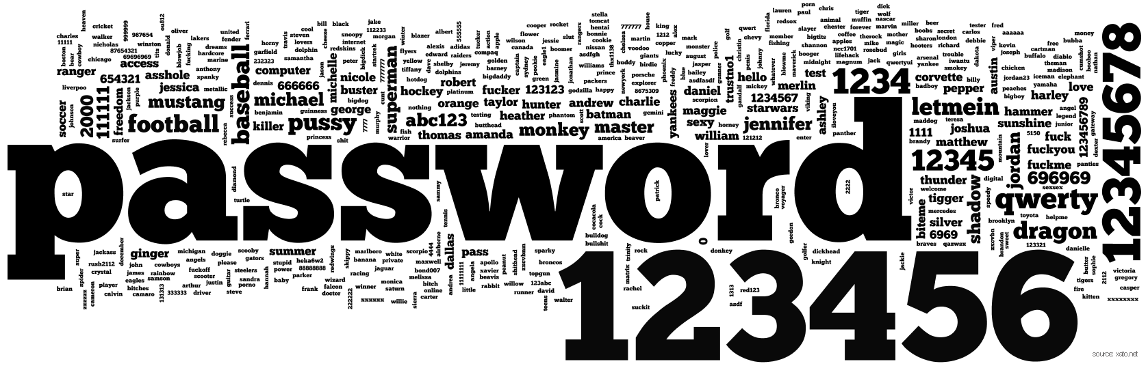

Slide 19
 | PIN | Freq
#1 | 1234 | 10.713%
#2 | 1111 | 6.016%
#3 | 0000 | 1.881%
#4 | 1212 | 1.197%
#5 | 7777 | 0.745%
#6 | 1004 | 0.616%
#7 | 2000 | 0.613%
#8 | 4444 | 0.526%
#9 | 2222 | 0.516%
#10 | 6969 | 0.512%
#11 | 9999 | 0.451%
#12 | 3333 | 0.419%
#13 | 5555 | 0.395%
#14 | 6666 | 0.391%
#15 | 1122 | 0.366%
#16 | 1313 | 0.304%
#17 | 8888 | 0.303%
#18 | 4321 | 0.293%
#19 | 2001 | 0.290%
#20 | 1010 | 0.285%

Slide 20
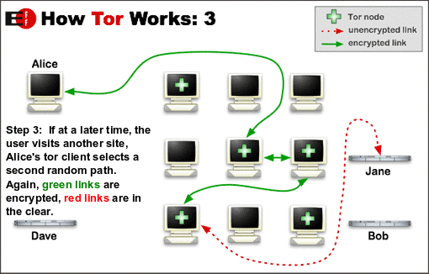

Slide 21
Cybersecurity
State activities

Slide 22
Espionage
attack on confidentiality
Flame, Red October
Purpose:
  Economic espionage
  Strategic espionage
  Tactical espionage
https://apt.securelist.com/#secondPage

Slide 23
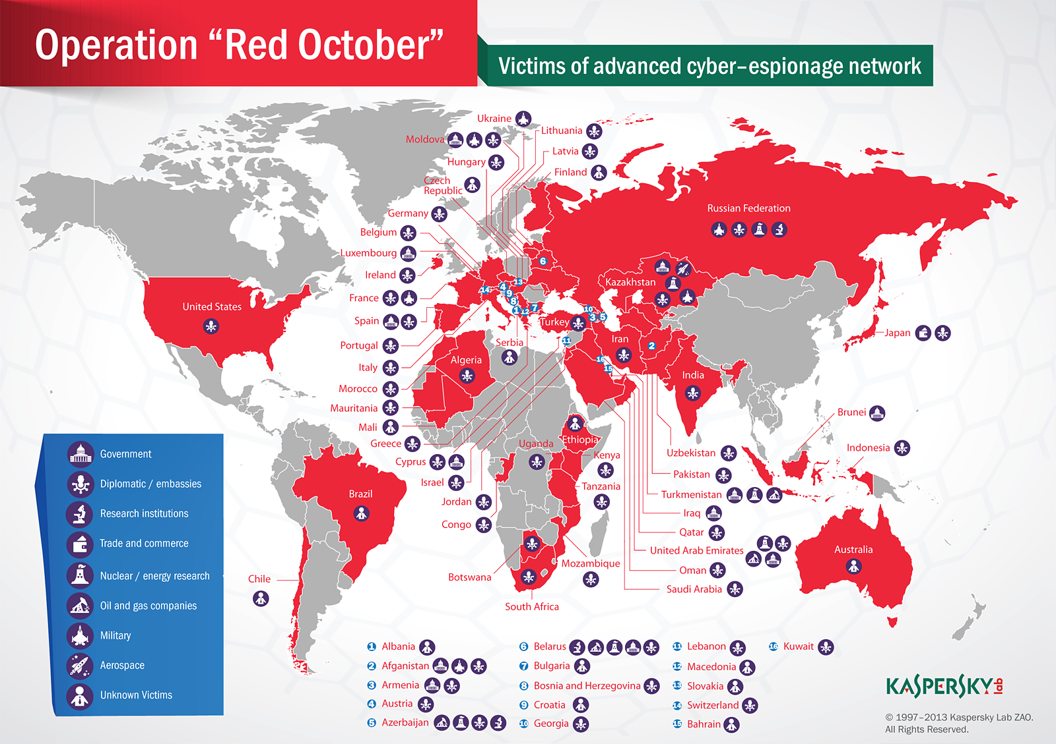

Slide 24
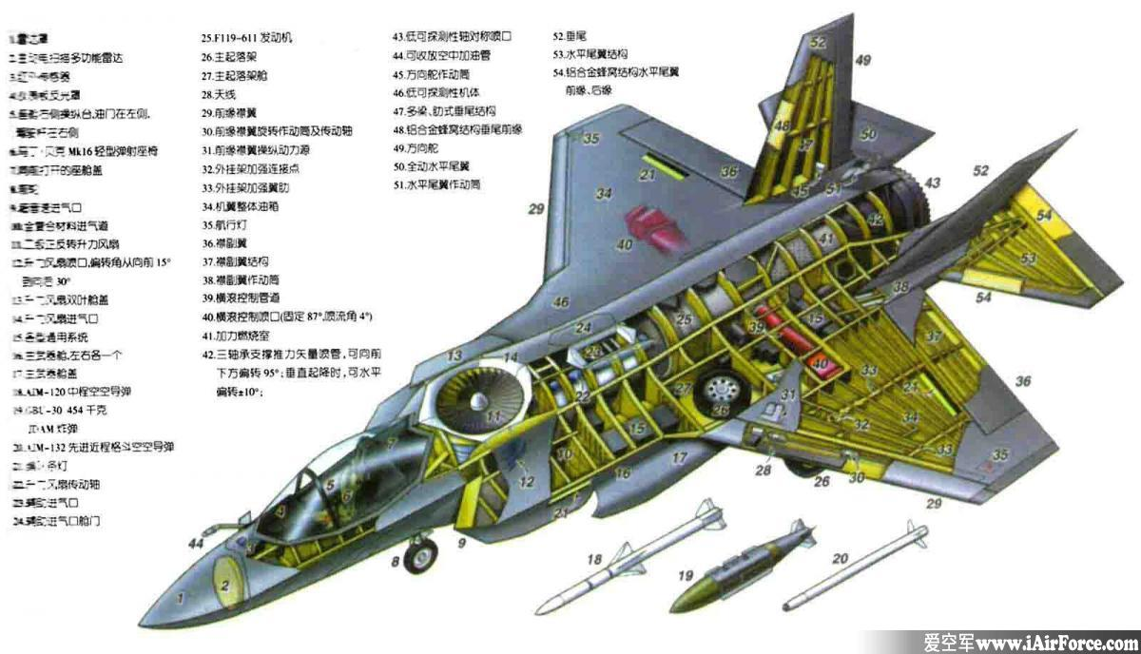

Slide 25
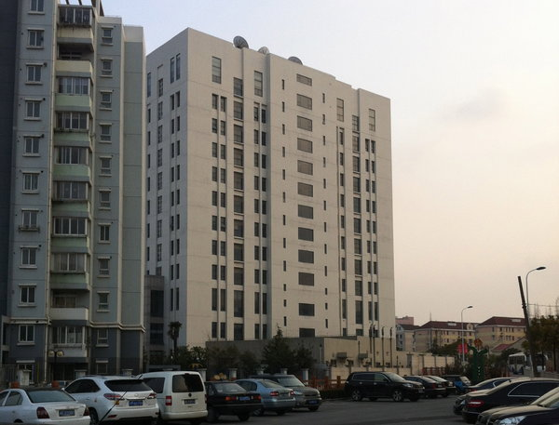

Slide 26
Domestic surveillance
also attack on confidentiality (but targeted inward)
Prism
law enforcement, population control
efforts to limit cryptography - CryptoWar

Slide 27
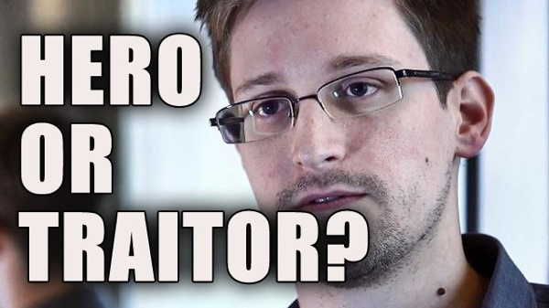

Slide 28
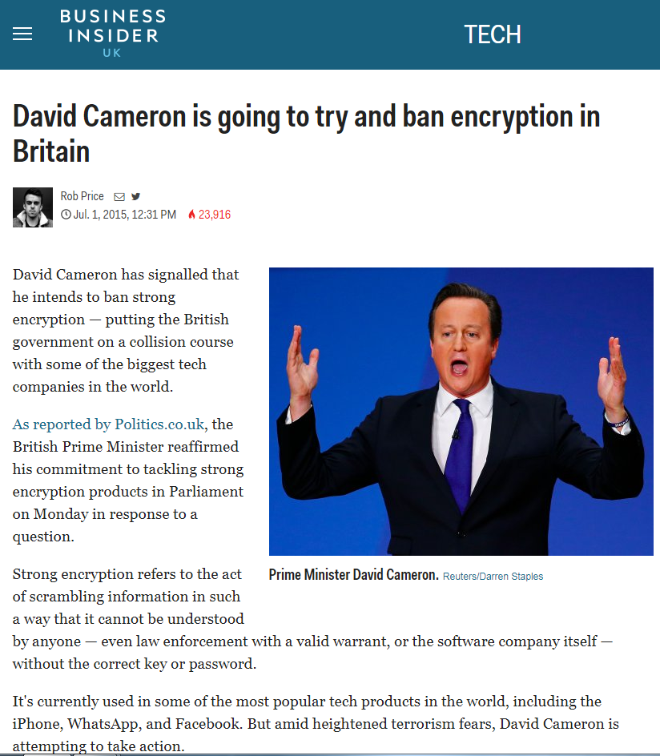
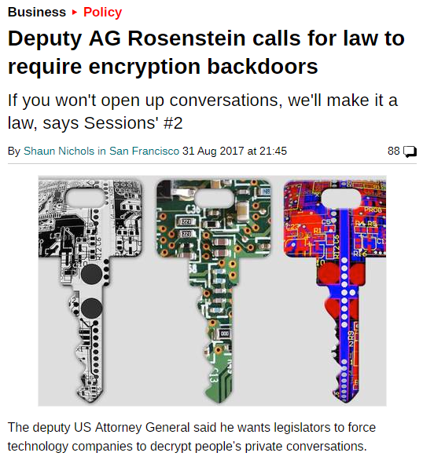

Slide 29
Censorship
attack on availability
Great Firewall of China
content control (porn? drugs? IP piracy? dissent?)
quite common, often via blacklists

Slide 30
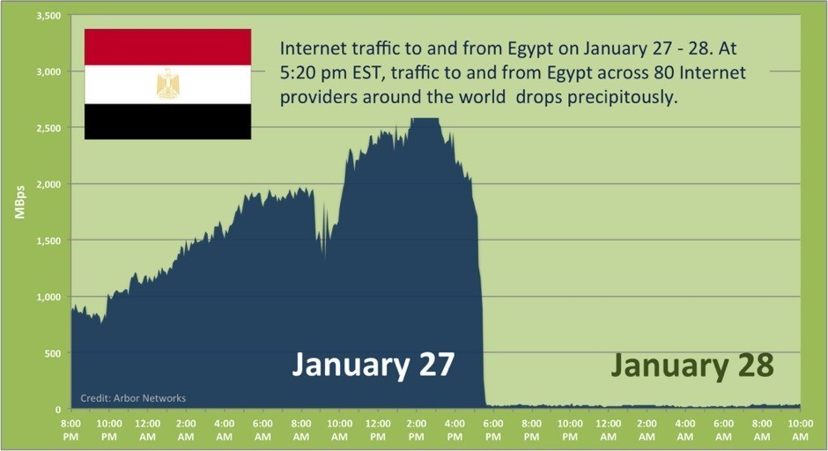

Slide 31
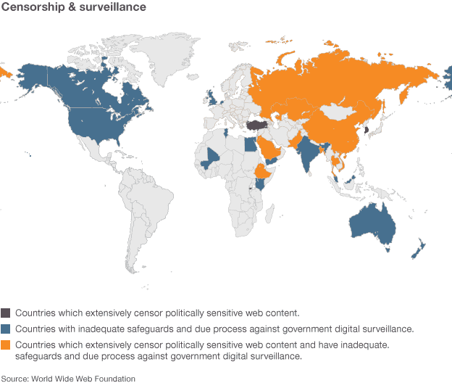

Slide 32
Sabotage
attack against data integrity
destruction of something, usually data
Stuxnet, Shamoon
still quite rare
“kinetic barrier”

Slide 33
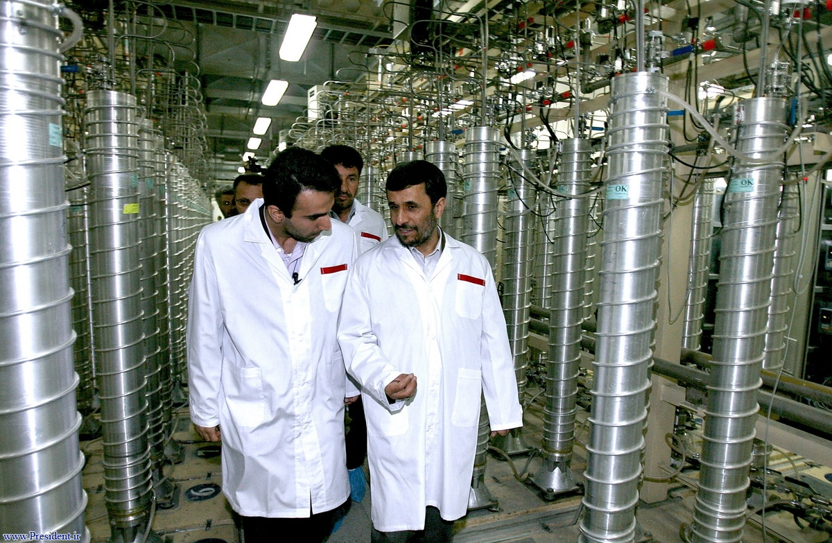

Slide 34
Operational support
various forms, not a single specific type
used to enhance or enable military operations
Orchard 2007 (integrity)
  air defence system sabotage
Georgia 2008 (availability)
  DDoS on communication channels
ISIS (confidentiality)
  intel collection for targeting

Slide 35
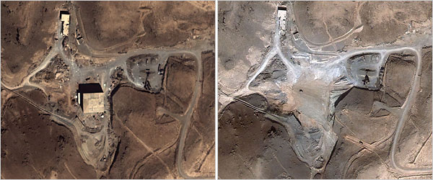
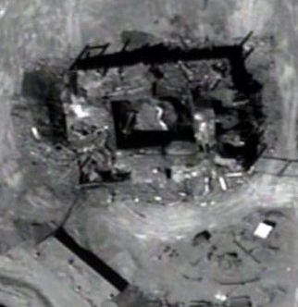

Slide 36
Other activities
Information warfare and propaganda
  not necessarily cyberattack in narrow sense, but often uses their products or tools
  influencing populations, their opinions and actions to advance ones goal
  e.g. Russian election meddling
Show of force and will
  harming another state through cyberattacks to send a message
  Estonia 2007, Ukraine right now (most often DDoS)

Slide 37
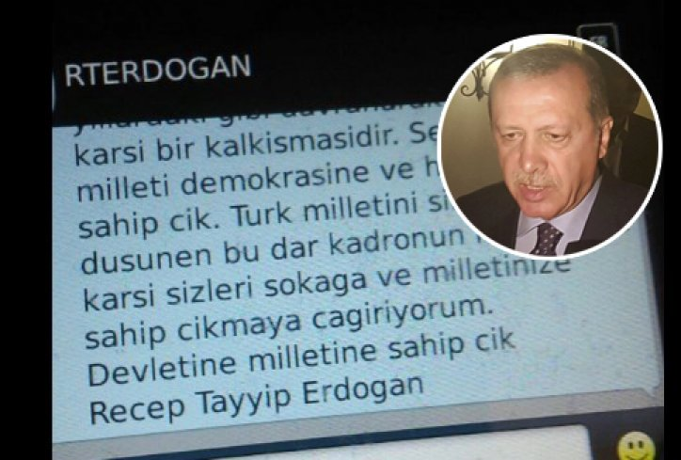

Slide 38
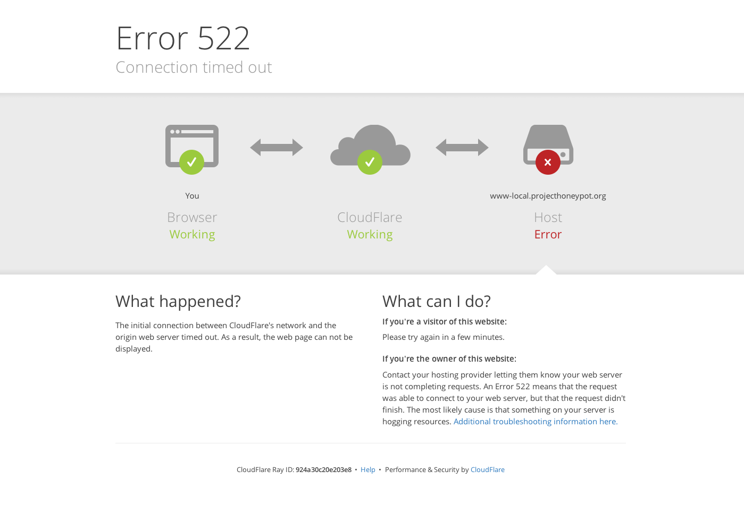

Slide 39
 | confidentiality | integrity | availability
internal | surveillance | - | censorship
external | espionage | sabotage | suppression

