Slide 1
Information Warfare
Jonáš Syrovátka
Masaryk University
Department of Political Science

Slide 2
Content
Information warfare – definition
Case studies
  US
  Russia
  Czech Republic
  War in Ukraine
Information warfare as concept – critical reflection

Slide 3
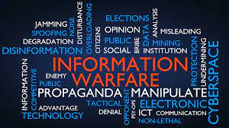
Information warfare: concept
Use of information to overpower the enemy
Information warfare is about gathering, providing, and denying information in order to improve one’s own decision-making while damaging the enemy’s.
Various techniques:
  Psychological operations
  Reconnaissance
  Disinformation
  Electronic and cyber warfare

Slide 4
Information warfare: development
Observation about importance of information is classical in thinking about conflict
Sun Tzu: What is of supreme importance in war is to attack the enemy's strategy
But in 1990s significant reshaping of information space
  Third revolution in warfare?
  Cyberspace as a new domain of conflict for NATO (2016)
Constant tension between technical (cyber) and human (psychological) aspect of IW

Slide 5

Information warfare: US tradition
Institutionalization during WWII (Office of War Information operating between 1942 and 1945)
Information operations key for success of D-Day
  Operation Fortitude
Abandoning after WWII
  Negative attitudee towards propaganda
Classical dilemma of democracy
  Aim of IW is to achieve advantage on the battlefield

Slide 6
Information warfare: US tradition
Lack of coordination
  Mainly tradition in air force experimenting with electronic warfare
Gulf war in 1991 as a triumph of deception
First military manual in 1996
  Actions taken to achieve information superiority by affecting adversary information, information-based processes, information systems and computer-based networks while defending one’s own information, information-based processes, information systems and computer-based networks.

Slide 7
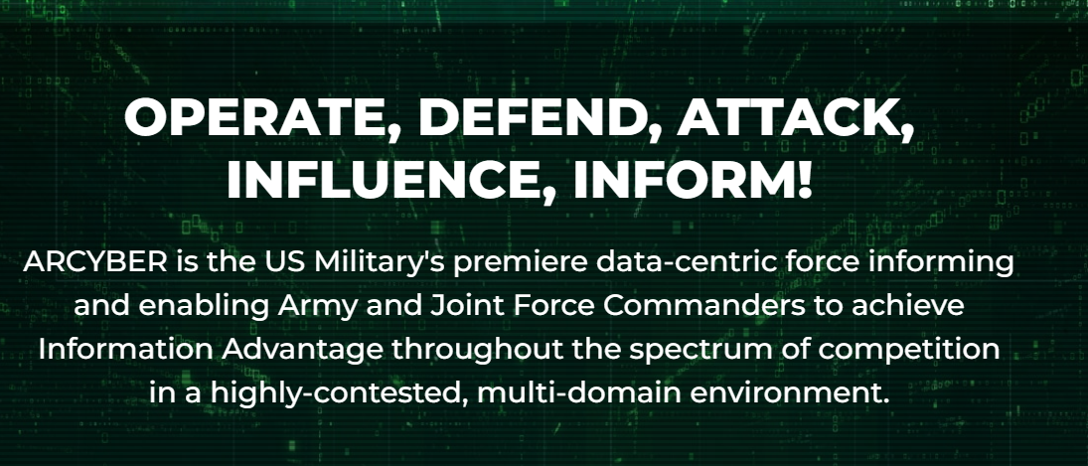
Information warfare: US tradition
According to Libicki (2017) still lack of coordination and overfocus on technical aspect
Army Cyber Command
  Change of mission in 2019

Slide 8
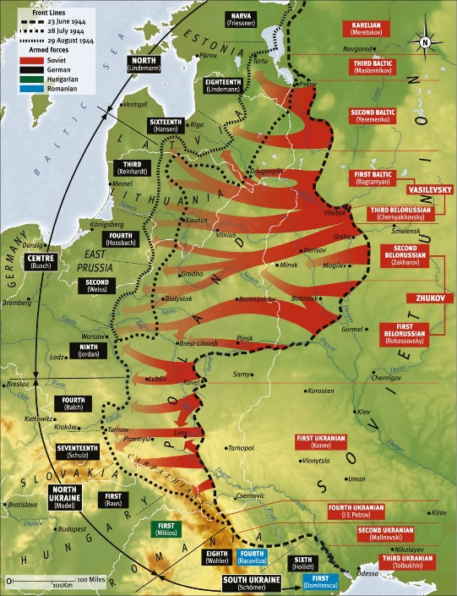
Information warfare: Russian tradition
Long-time practice
    Maskirova – art of deception during conflict developed already at the beginning of 1900s
    Field Regulations of Red Army from 1929 - Surprise has a stunning effect on the enemy. For this reason all troop operations must be accomplished with the greatest concealment and speed.
    Important part of key military operations during WWII
      Operation Bagration in 1944

Slide 9
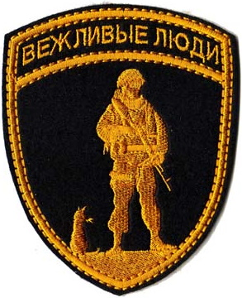
Information warfare: Russian tradition
Not limited to military affairs – 1989 perceived as result of successful Western information warfare
War/conflict as normal state of international affairs
  Aim is to achieve political objectives (military + non-military)
  Sovereignty in information space (new authoritarian regimes, law about foreign agents)
Annexation of Crimea
  „Little green man“ x „polite people“

Slide 10
Information warfare: CZ
After 2014 need to react to new security environment
  Russian propaganda present also in Czech information space but general need to update state capabilities
  Complex and messy process (Jankowicz, Eberle and Daniel)
National Security Audit (2016)
  The old - new manifestation of the influence of foreign power is then propaganda and the spread of disinformation such means of information warfare through which foreign powers attempt to influence the state in the field of governance and use of communication and information channels or technologies through which it operates public opinion.

Slide 11

Information warfare: CZ
Establishing relevant institutions
  Centre Against Terrorism and Hybrid Threats (2017)
  National Cyber and Information Security Agency (2017)
    Karel Řehka – military general and author of book Information warfare
  Cyber Forces Command (2020)
    CIW forces provide the ability to defend domestic
    parts of cyberspace, conduct infoops, infoops in
    cyberspace, PsyOps and CMI/CIMIC.

Slide 12
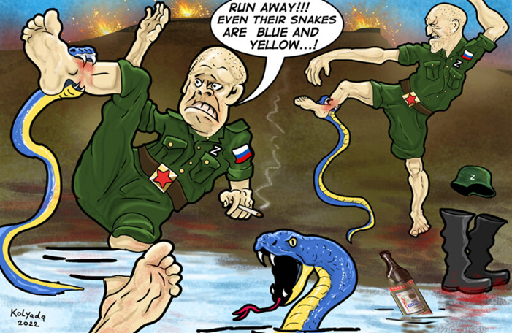
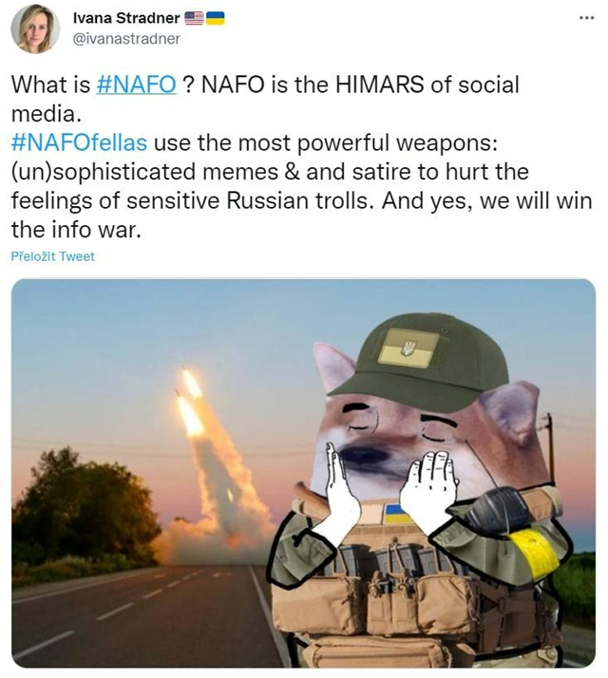
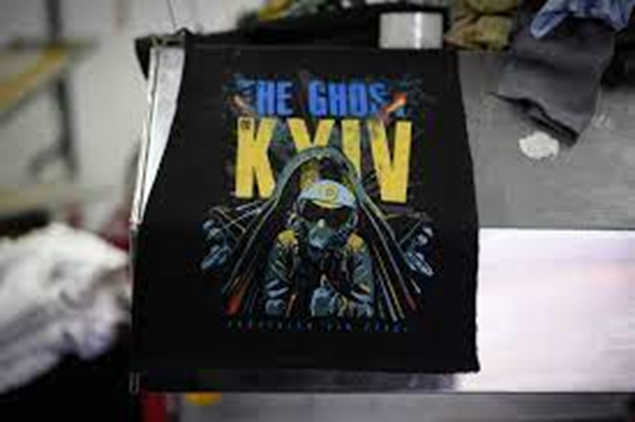
War in Ukraine
Significant information component from the start
  US information about planned invasion
  RU operation is executed in the way to maximize panic
  UK successfully applies various IW tools to counter the invasion

Slide 13

Concepts
Basic tool of science allowing research to describe phenomenon and formulate hypothesis
Name – definition – cases
Usefulness of concept
  Resonance
  Differentiation
  Strength

Slide 14
Information warfare: conceptual critique
Resonance
  Information as key aspect or cyberspace as a new domain?
Differentiation
  Was there any war/conflict without deception?
  Difference between information war, propaganda and strategic communication?
Strength
  Disinformation, intelligence gathering and destruction of computer networks under one conceptual umbrella?

Slide 15

Thank you for your attention.

