Slide 1
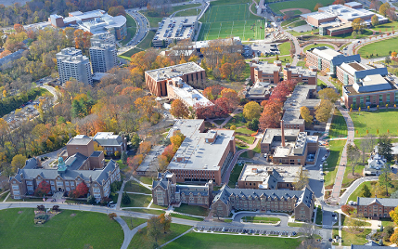
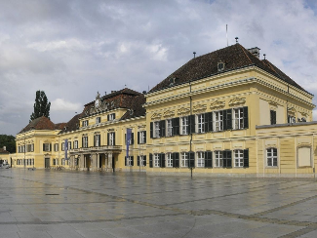
Framework for Sustainability
ENSn4673
Brian D. Fath, Ph.D. – bfath@towson.edu
Professor, Department of Biological Sciences, Towson University, Baltimore, Maryland, USA
Senior Research Scholar, International Institute for Applied Systems Analysis, Laxenburg, Austria

Slide 2
Framework for Sustainability ENSn4673 (Autumn 2022)
Course Description:
  This investigates the concept of sustainability from first principles of energetics and ecology applied to socio-economic systems. It deals with the ecological, physical, economic, social, and moral dimensions of sustainability.
Grade evaluation (points available):
  Paper (50), Exercises (50), Discussion (50), Group discussion lead (50), Final Exam (100) = Total (400)
Format:
  Each session will begin with a ~30-minute overview and summary of the topic/reading, 20-minute exercise, and 40-minute discussion. Students are expected to come to class prepared and ready to discuss with an open and curious mind.

Slide 3
Schedule
Thursday 22. 9. 14:00-17:40, room M117
Lecture 1: Introduction to sustainability and the Sustainable Development Goals.
Lecture 2: Ways of valuing the environment. Introduction of cultural theory and ecosystem services
Thursday 6. 10. 14:00-17:40, room M117
Lecture 3: Limits to Growth, planetary boundaries, Flourishing overview
Lecture 4: Foundations for Sustainability (FfS) – Chapter 1 systems thinking and win-win
Thursday 20. 10. 14:00-17:40, room M117
Lecture 5: FfS – Chapter 2 Ecologic metaphysics
Lecture 6: FfS – Chapter 3 mutualism
Thursday 3.11. 14:00-17:40, room M117
Lecture 7: FfS – Chapter 4 – origins of life
Lecture 8: FfS – Chapter 5 – reforming reductionism
Paper topic due
Thursday 24.11. 14:00–17:40, room U32
Lecture 9: FfS – Chapter 6 – networks.
Lecture 10: FfS – Chapter 7 – Rosen.
Thursday 1. 12. 14:00-17:40, room M117
Lecture 11: FfS – Chapter 8 – applications
Lecture 12: FfS – Chapter 9 – Sustainability for all
Paper due

Slide 4
Introductions

Slide 5
Framing questions
What are the most important threats to achieving global sustainability in the 21st Century?
What may be the most practical and effective ways to mitigate these threats?

Slide 6

Sustainable Development
“development that meets the needs of the present generation without compromising the ability of future generations to meet their own needs”
  Our Common Future/ United Nations Brundtland Report, 1987

Slide 7
Goal
Some of the most threatening environmental problems are caused by widespread poverty
To develop?
  Or
To sustain?
Development is often based on squandering our biological capital

Slide 8
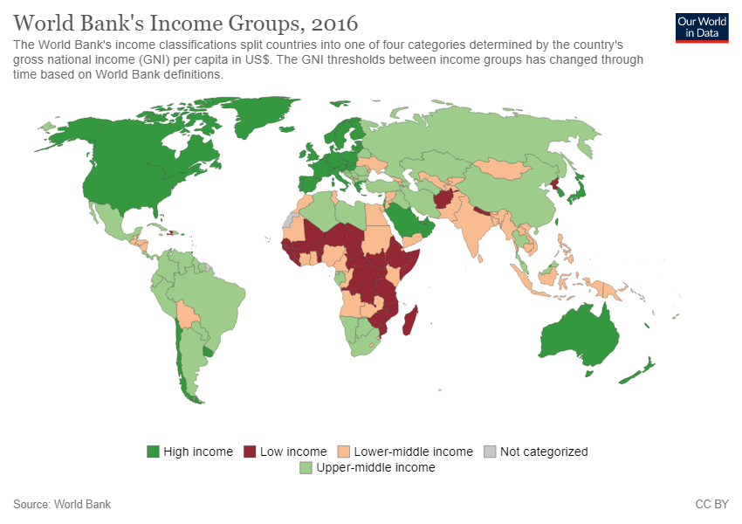

Slide 9
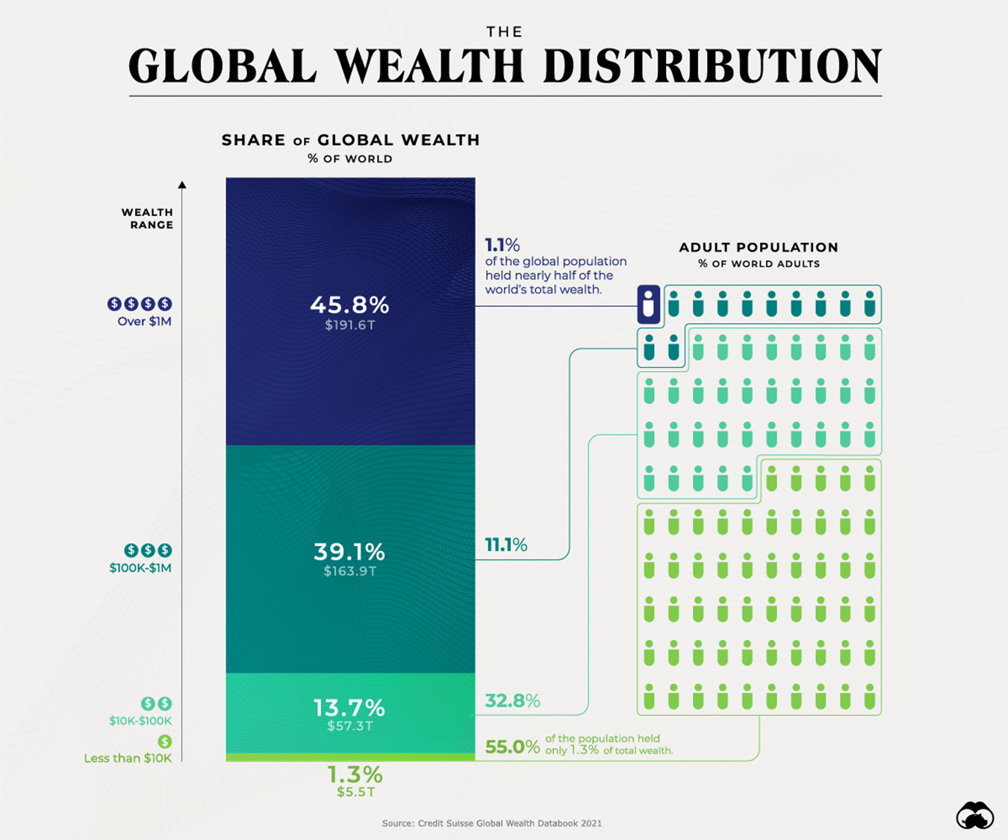

Slide 10
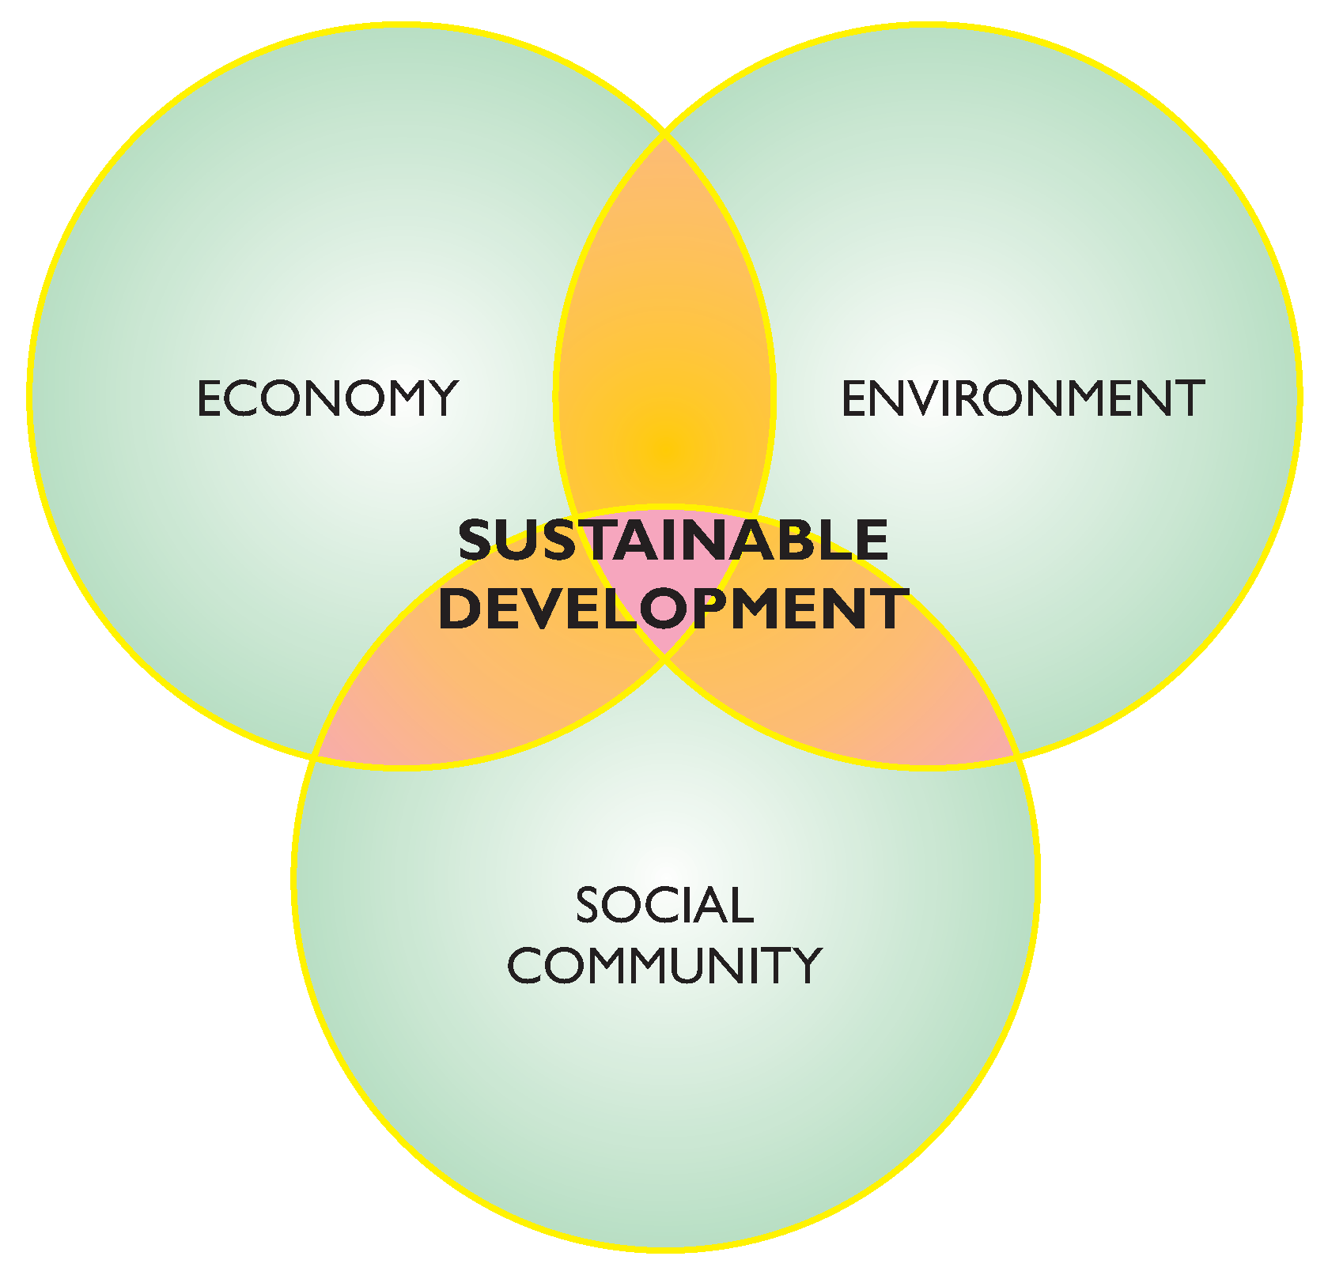
Three pillars of SD

Slide 11
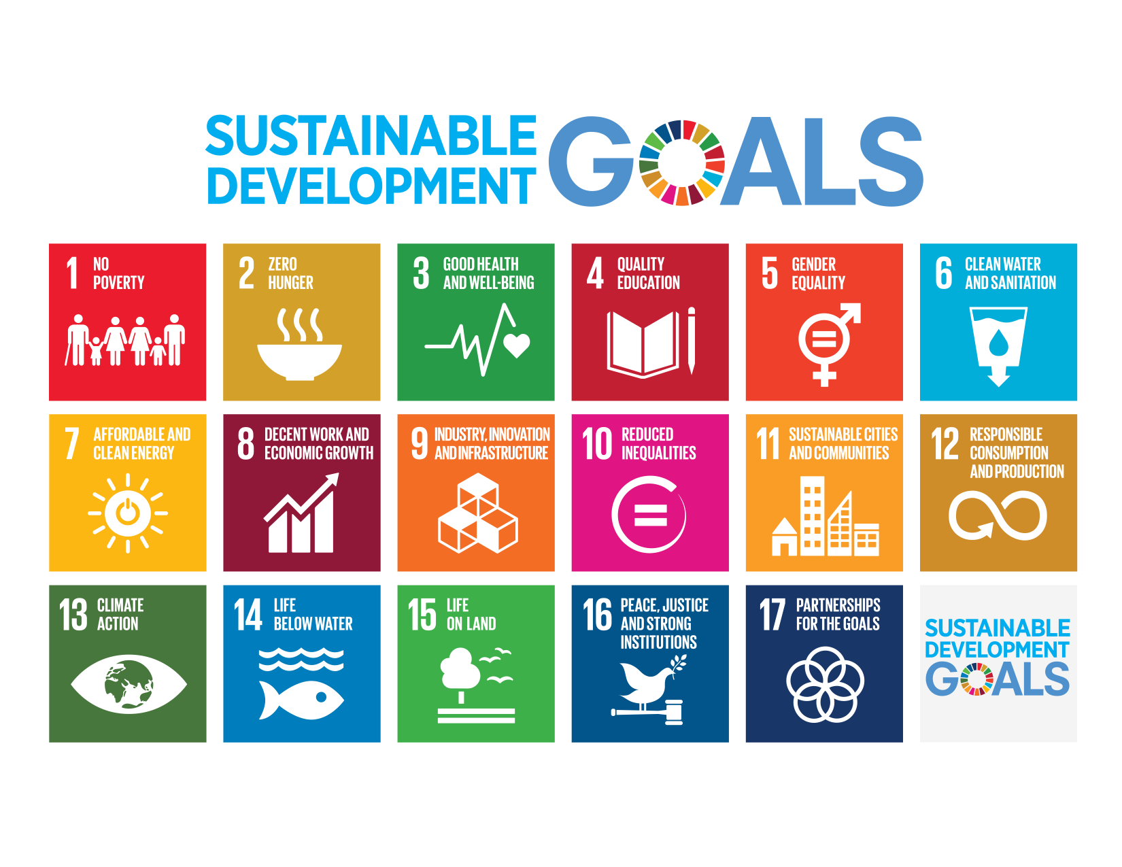
Adopted September 2015 – also called Agenda 2030

Slide 12
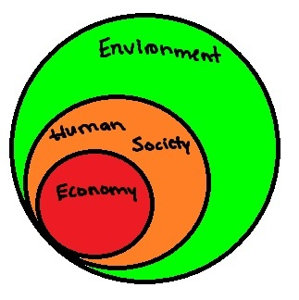
Environment is foundation for all aspects, others are subsets

Slide 13
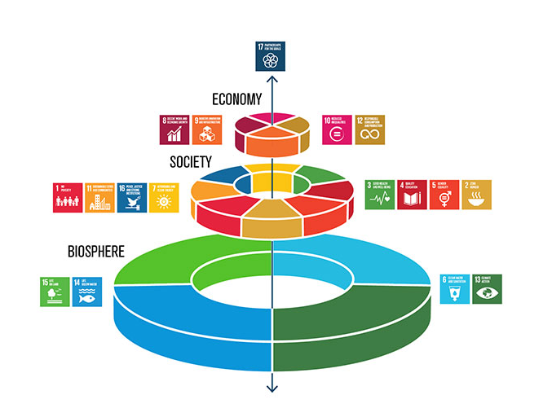

Slide 14
Sustainable Development vs Sustainability
Sustainable Development: “development that meets the needs of the present generation without compromising the ability of future generations to meet their own needs” – Our Common Future/ Brundtland Report, 1987
Sustainability: “the capacity to endure” – wikipedia
What are “our needs”?

Slide 15
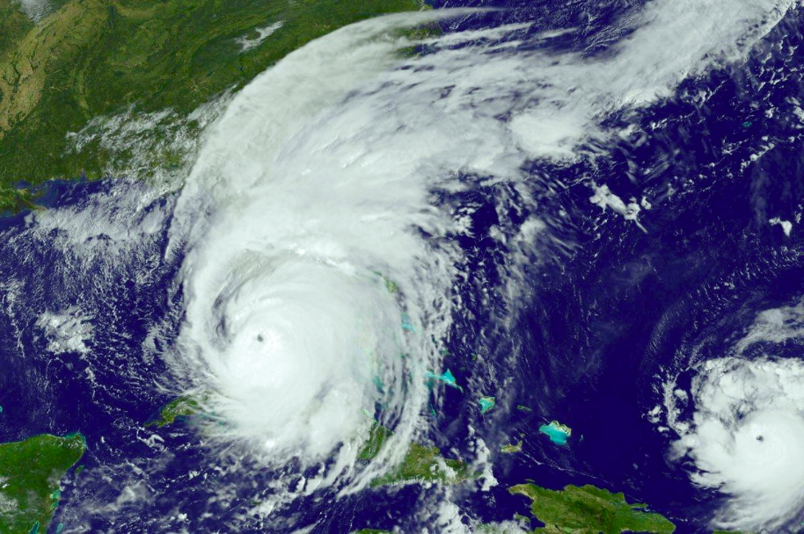
Hurricane
https://en.wikipedia.org/wiki/Hurricane_Irma

Slide 16
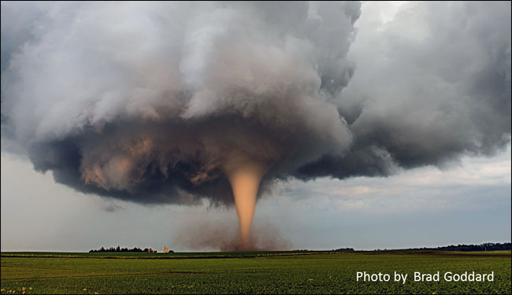
Tornado
https://www.weather.gov/safety/tornado

Slide 17
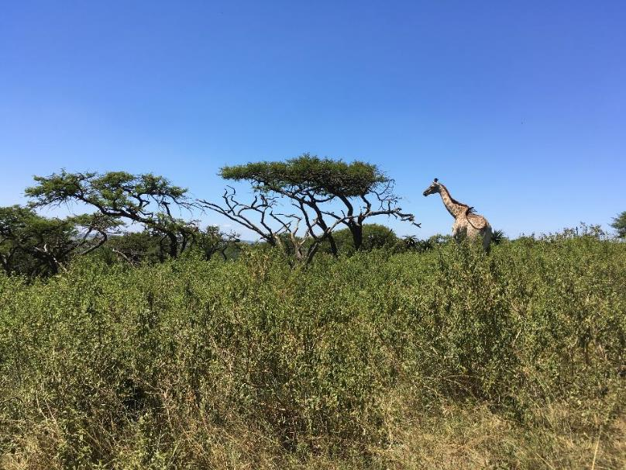
Ecosystem

Slide 18
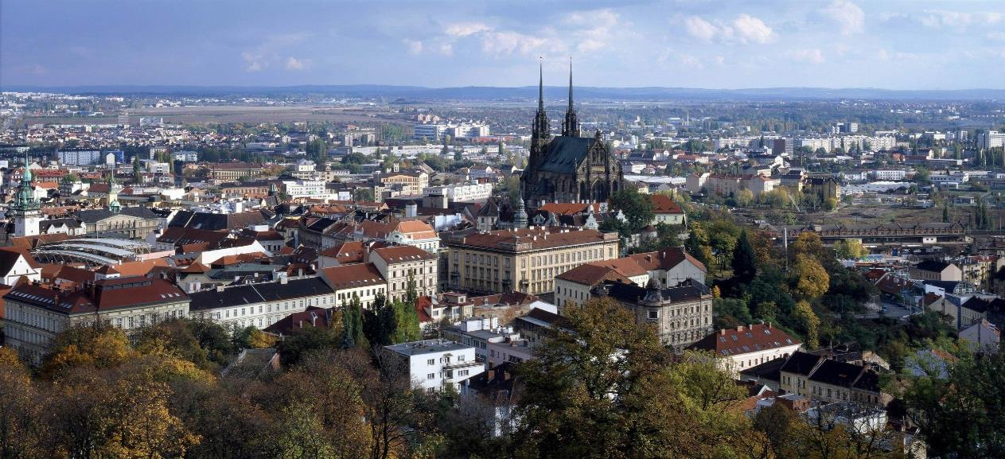
City

Slide 19
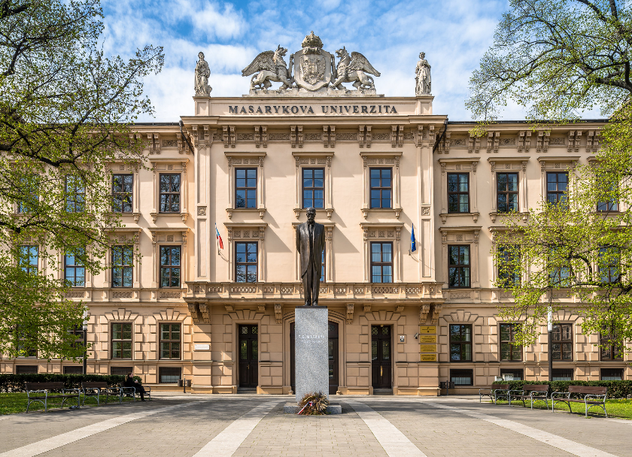
Campus

Slide 20
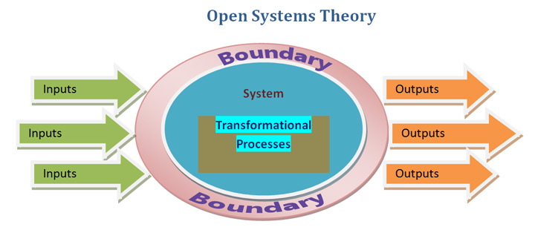
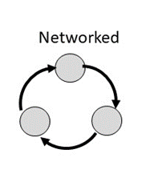
All are open systems with energy driving and maintaining the processes
All import, reuse, and export resources (water, wood, waste, minerals, metals, materials, etc.)

Slide 21
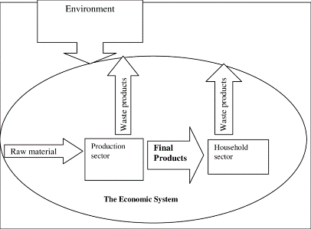
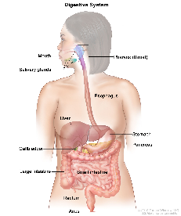

Understanding SYSTEMS!
A set of inter-relationships between components or parts that function together to act as a whole
A system is simultaneously both a system and a part of a larger system
Digestive system
Computer system
Economic system

Slide 22
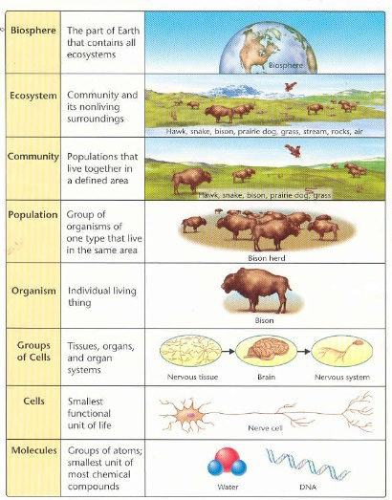
Hierarchy
A system is simultaneously both a system and a part of a larger system
Better to think in terms of processes and connections than parts

Slide 23
System Boundary – identifies the system from its external environment, but it is always part of and interacting with this environment
System
(Self,
Campus,
City,
State,
Nation)
Environment

Slide 24
Old perspective, dichotomy between system and environment
System
Environment
New perspective, system is focus of two environments
Input Environment
H
Output Environment
Where does it come from? Where does it go?

Slide 25
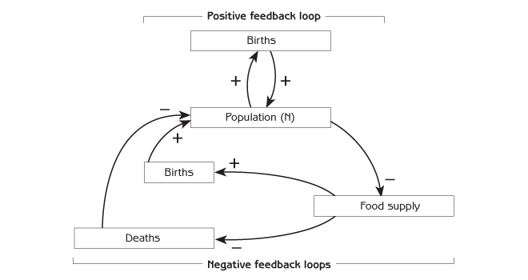
FEEDBACK as a consequence of interconnections
Systems possess capacity for
(a) self-regulation: negative feedback – balancing, stabilizing
(b) self-adaptation: positive feedback – reinforcing, destabilizing

Slide 26
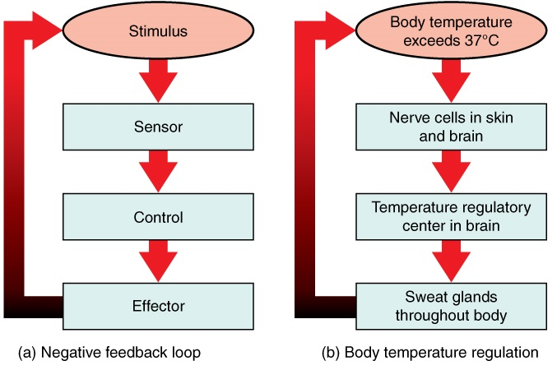
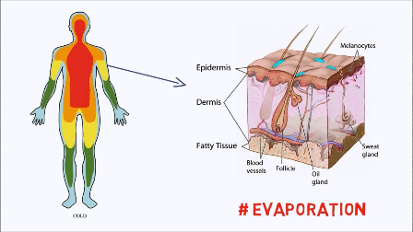
Stabilizes body temperature

Slide 27
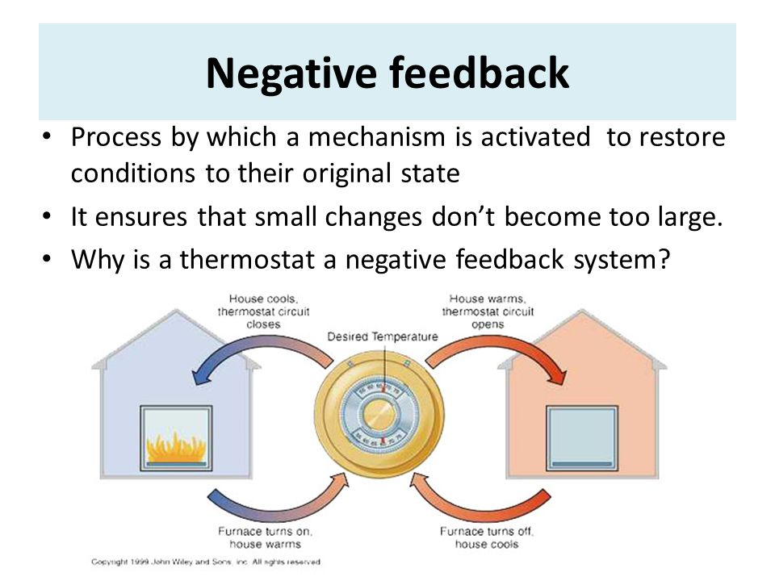

Slide 28
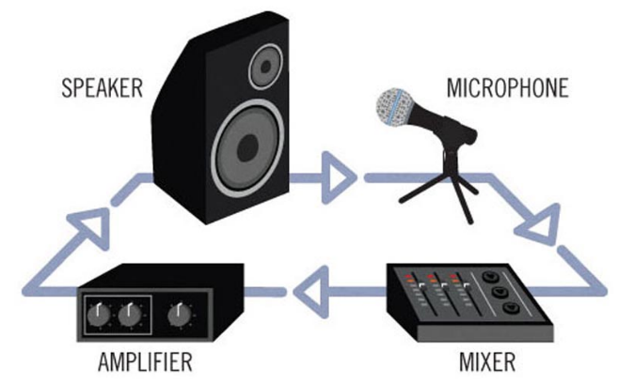

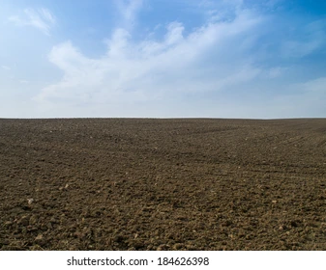
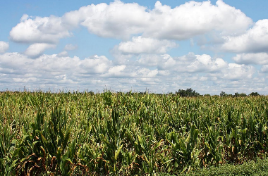
Positive feedback – when the signal is amplified and moves the system further from its original condition
Biological growth is a positive feedback
More biomass → more photosynthesis → more biomass
Sound system
→
Positive feedbacks can’t go on forever, coming up against constraints

Slide 29
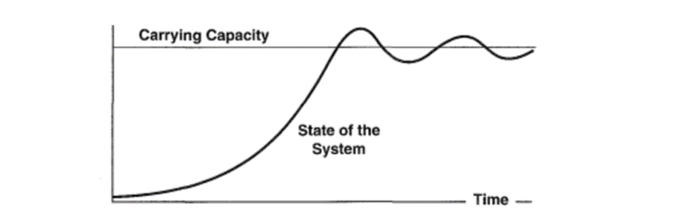
All system dynamics are an interplay of positive feedbacks that grow and change the system and negative feedbacks that stabilize and maintain the system
For example:
Negative feedback
Positive feedback

Slide 30
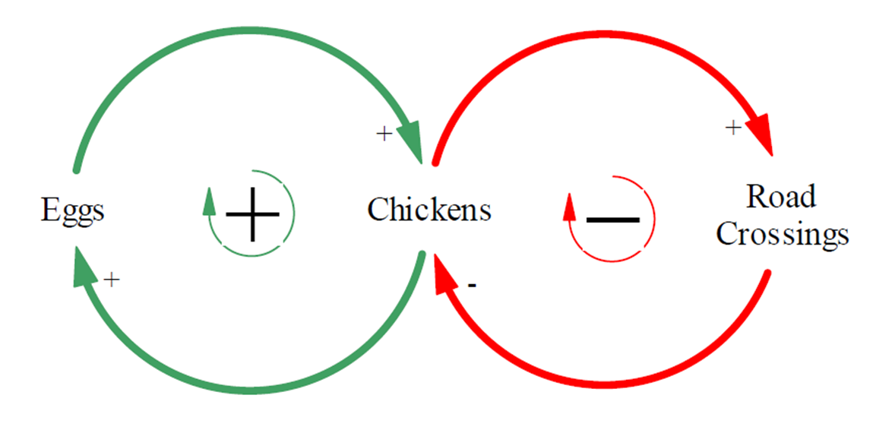
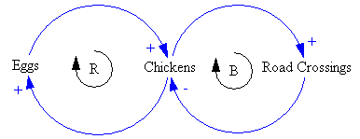
Casual Loop Diagrams (CLD)
A visual representation of interrelation between variables.
Positive causal link means that the two variables change in the same direction.
Negative causal link means that the two variables change in opposite directions.
The loop is:
reinforcing if, after going around the loop, one ends up with the same result as the initial assumption.
balancing if the result contradicts the initial assumption.

Slide 31
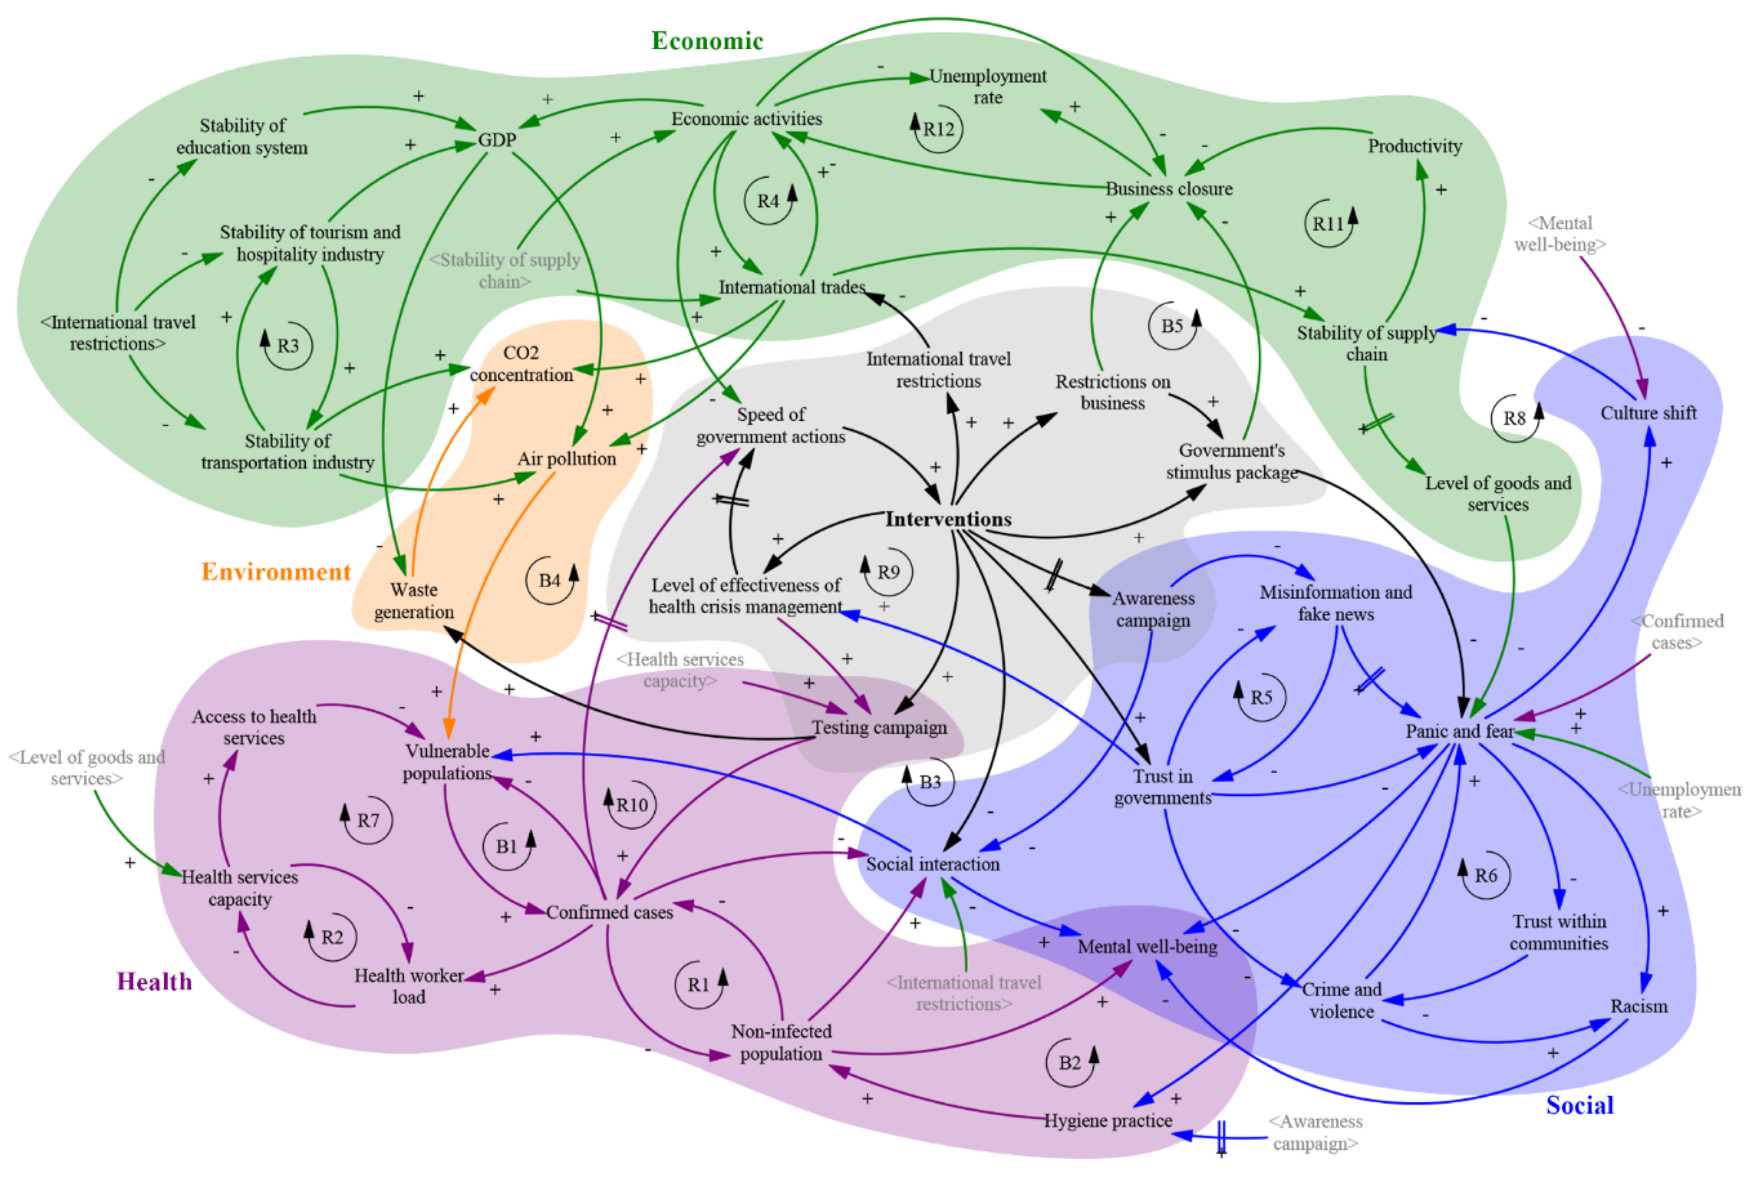
Developing a Preliminary Causal Loop Diagram for Understanding the Wicked Complexity of the COVID-19 Pandemic
www.mdpi.com/2079-8954/8/2/20/htm

Slide 33
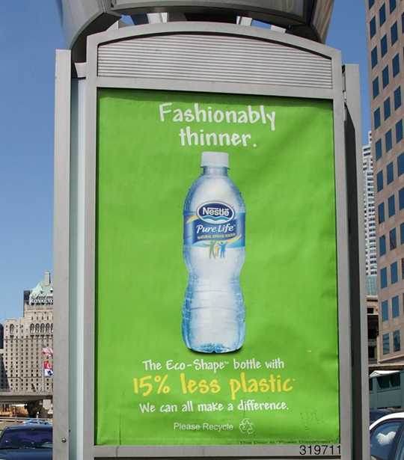
Misuse of the term sustainable
Adjective that means “green”
“A little better for the environment than the alternative”
Less bad
greenwashing

Slide 34
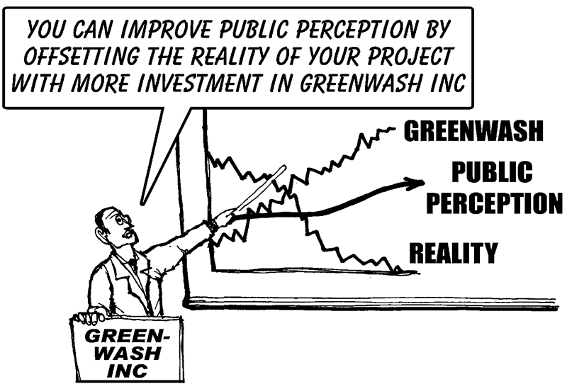

Slide 35

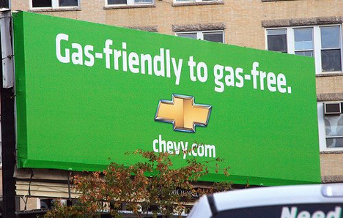

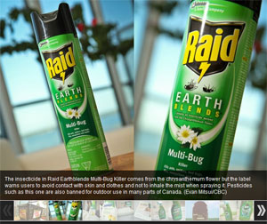
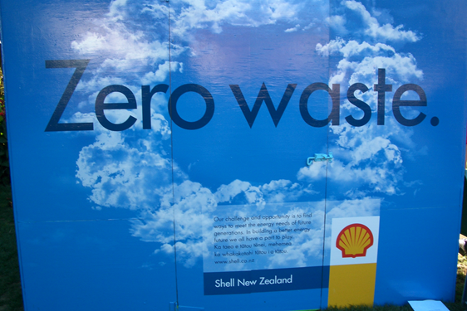

Slide 36
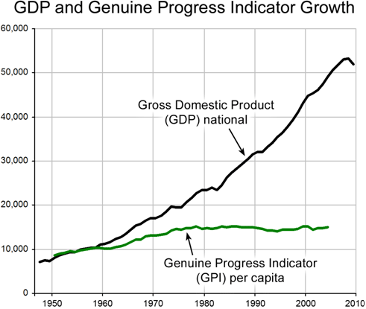
What are we tracking?
If development is not sustainable, is it development – why so many bad decisions?
Too often we focus first and only on economic indicators, namely GDP, ignoring Environmental & Social factors

Slide 37
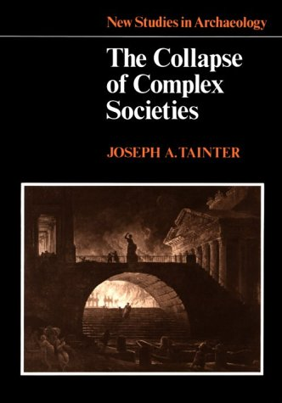
Is sustainability still possible?
“Growing human populations are eating more meat, using more carbon-based energy, shouldering aside more natural resources, and tapping into more renewable and nonrenewable commodities than ever before.”
“If humanity fails to achieve sustainability, when, and how, will unsustainable trends end?”

Slide 38
Is sustainability still possible?
Why has it proved so hard to conform human behavior to the needs of a life-supporting future?
Our political and economic institutions evolved before anyone imagined the need to restrain human behavior out of concern for the future.

Slide 39
Alternative approaches
Great Law of the Iroquois
In every deliberation, we must consider the impact on the seventh generation (~140 years into the future)
What is the purpose of expressing concern for the consequences of decision-making down to the seventh generation from their own?

Slide 40
Guidance for answers
Western insight into the needed physical and ethical transformations
Alternatively, we should look to other traditions as well: indigenous, Eastern

Slide 41
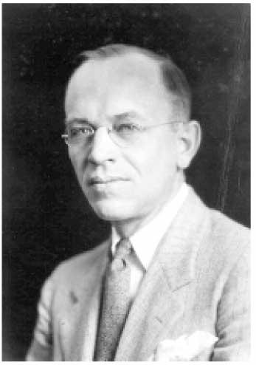
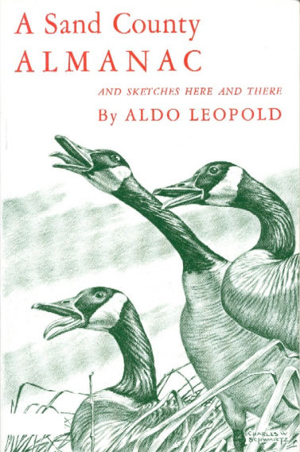
Aldo Leopold
Forest Service and Wisconsin professor, eloquent and passionate writer of our duty to protect the balance of nature:
  humans should extend to nature the same ethical sense of responsibility that we extend to each other.
A Sand County Almanac (1949) – regarded as the most influential book on conservation ever written.
“The land ethic simply enlarges the boundaries of the community to include soils, waters, plants, and animals, or collectively: the land.”

Slide 42
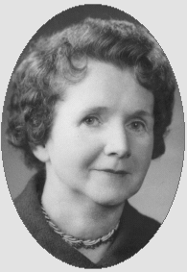
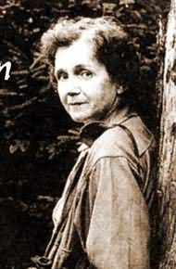
Rachel Carson
1960s – The modern environmental movement is born
1962 Silent Spring
Carson, writer and marine biologist, told how chemical use on farms, forests, and gardens, poison the environment. Insects were dying (not just the pest species) which meant no food for the birds. No birds, no bird song – a silent spring
Public awareness that humans are damaging environment

Slide 43
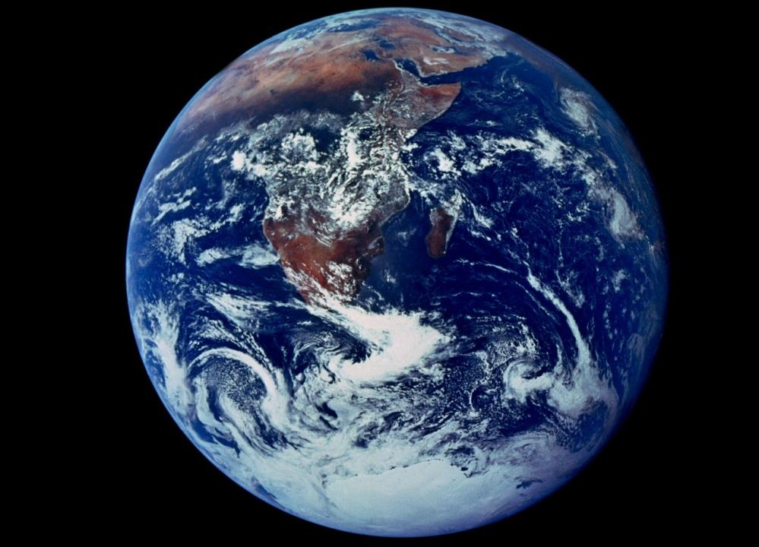
Apollo 17, Dec 1972, put world and all its people and resources into one frame

Slide 44
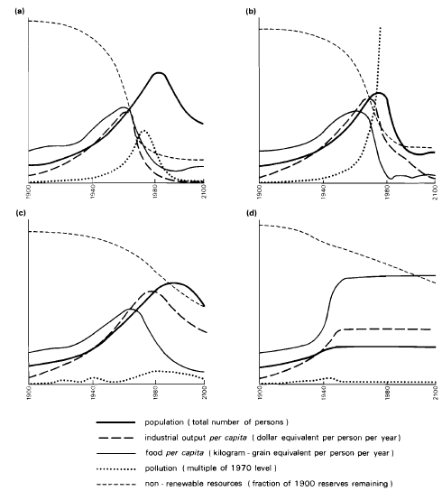
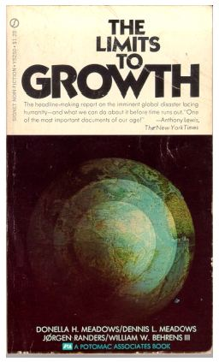
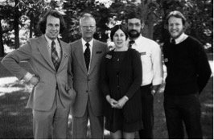
1972
Integrated global model showing that indefinite growth on a finite planet is not possible

Slide 45
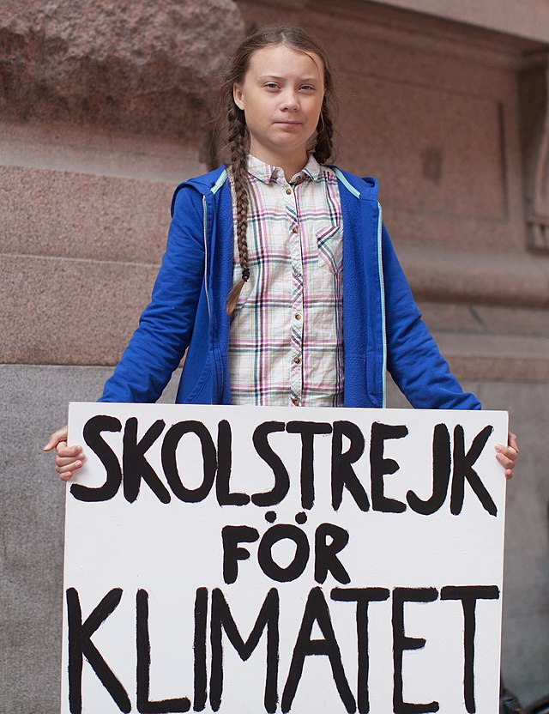
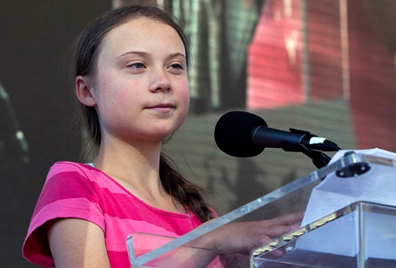
Greta Thunberg
2018 – School Strike for climate – Friday’s for Future
2019 Spoke before UN Climate conference
We will remember…

Slide 46
