Slide 1
Biophysical Limits to Growth
Brian D. Fath
Professor, Biology Dept, Towson University, USA
Senior Research Scholar, IIASA, Austria
Editor-in-Chief, Ecological Modelling
Editor-in-Chief, Current Research in Environmental Sustainability

Slide 2
Biophysical Limits to Growth
Brian D. Fath
Professor, Biology Dept, Towson University, USA
Senior Research Scholar, IIASA, Austria
Editor-in-Chief, Ecological Modelling
Editor-in-Chief, Current Research in Environmental Sustainability

Slide 3
Questions?
How does positive feedback induce system change?
How does negative feedback restrain further system change
  Give an example of positive and negative feedback
Explain hierarchy and how it plays a role in establishing a system boundary
Which solidarity type (individualist, egalitarian, hierarchist, fatalist) was most likely to use the precautionary principle? Which type believes environment is most resilient?

Slide 4
We witness unsustainable human-ecosystem interactions
How could people make such serious mistakes in the past and why does society continue to repeat such mistakes today?
Is it inevitable that the environment must be degraded to satisfy human needs?

Slide 5
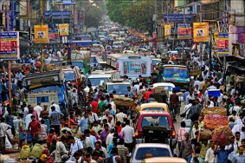
Drivers of Unsustainability
HUMAN POPULATION INCREASE
  Agriculture
  Shelter
  Mobility
  Stuff
Use Energy and
Material Resources
causes
Land use change
Habitat loss
Deforestation
Alter biogeochemical cycles
Climate Change
Eutrophication
Acid precipitation
Ozone Depletion
Smog
…
Leads to

Slide 6
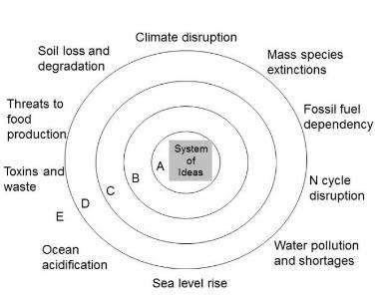


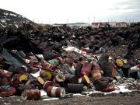

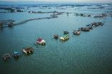
Environmental (and Social) problems are symptoms of deeper failures
Soil erosion
Toxins and waste
Water pollution
Sea level rise

Slide 7

Economics
Economics is one the main organizing forces in society
Many decisions are made based on cost-benefit analysis but true costs (direct + indirect) to individual, society, or environment are often not known

Slide 8
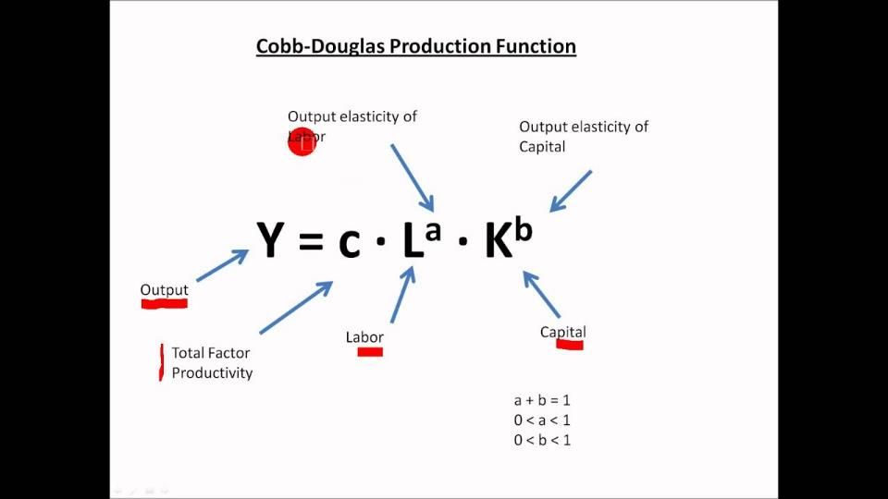
Economic Growth Models
WHERE IS ENVIRONMENT?

Slide 9
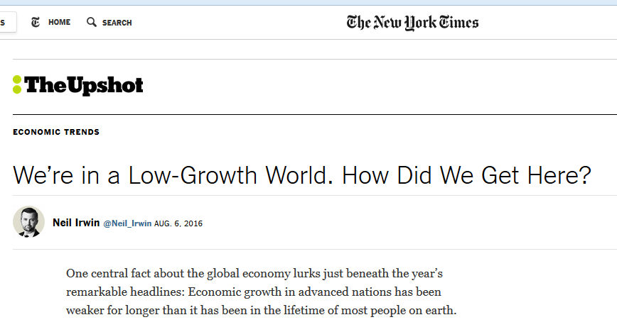
No mention of natural resources or environment
It increasingly looks as if something fundamental is broken in the global growth machine — and that the usual menu of policies, like interest rate cuts and modest fiscal stimulus, aren’t up to the task of fixing it (though some well-devised policies could help).
www.nytimes.com/2016/08/07/upshot/were-in-a-low-growth-world-how-did-we-get-here.html?hp&action=click&pgtype=Homepage&clickSource=story-heading&module=first-column-region&region=top-news&WT.nav=top-news&_r=0

Slide 10
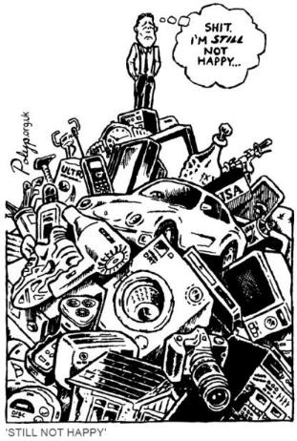
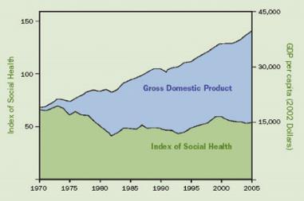
What is the purpose of growth?
We know that bigger does not always mean better, nor more happiness
Alternative well-being indicators tell a different story

Slide 11
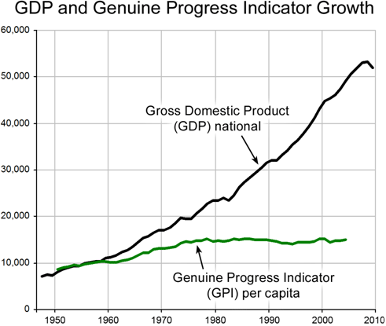
How we measure progress matters
GPI accounts for 26 indicators including economic, environmental, and social factors to determine if we are well off.
GDP measures the circulation of money
Maryland was first state to adopt GPI as official indicator

Slide 12
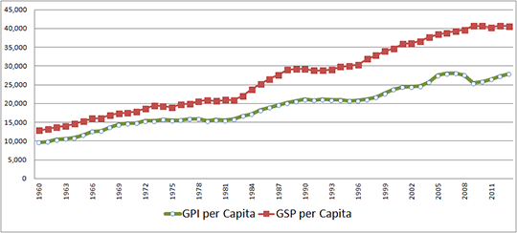
Maryland’s Genuine Progress Indicator compared with Gross State Product

Slide 13
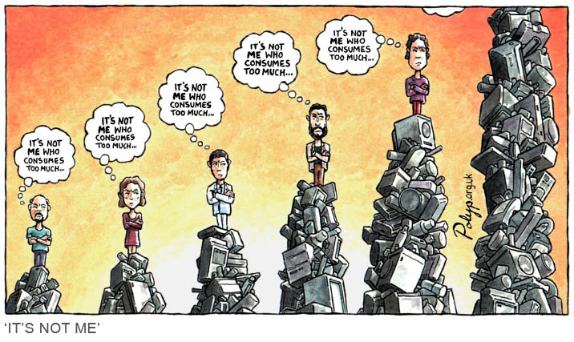
Memetic rivalries: Rene Girard
Our wants are socially constructed in competition (for status) with others.
We measure in terms of others, not absolutes

Slide 14
Sustainable Development
Sustainable Development: “development that meets the needs of the present generation without compromising the ability of future generations to meet their own needs” – Our Common Future/ Brundtland Report, 1987
What are “our needs”?

Slide 15
The challenge is “To live undestructively in an economy that is overwhelmingly destructive…” p. 20
“The responsible consumer slips out of the consumer category altogether.” P. 27
Wendell Berry, The Unsettling of America 1977

Slide 16
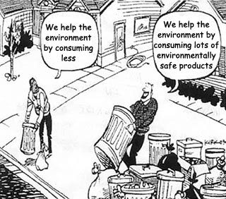

Slide 17
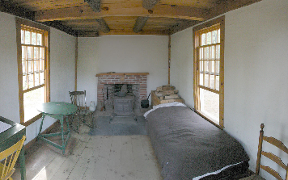
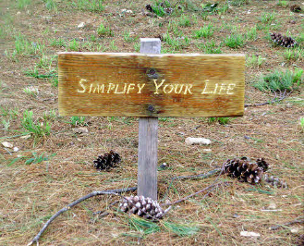
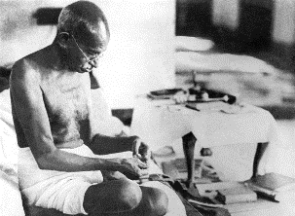
Early social customs actually blocked consumerism
Religion
Fasting
(Lent, Ramadan)
Poverty
Simple living
Limited credit
Preference for leisure time
How can we regain control over consumerism?
Thoreau’s bedroom
Gandhi spinning yarn

Slide 18
Measuring environmental impact
I=PAT
Impact = Population * Affluence * Technology
Affluence ~ consumption per person
Technology ~ impact per consumption

Slide 19
Ecological Footprint
the impact of human activities measured in terms of the area of biologically productive land and water required to produce the goods consumed and to assimilate the wastes generated.
Transportation,
Diet,
Household/lifestyle choices

Slide 20
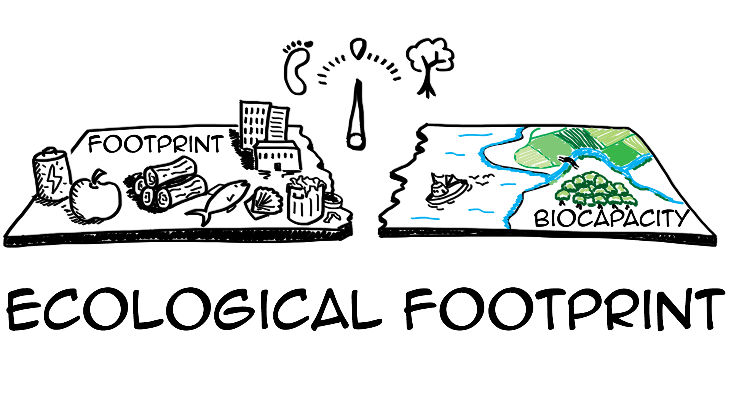
Ecological Footprint Calculator
https://www.footprintcalculator.org/
world-average ecological footprint in 2012 was 2.84 global hectares per person. world-average biocapacity of 1.73 global hectares per person

Slide 21
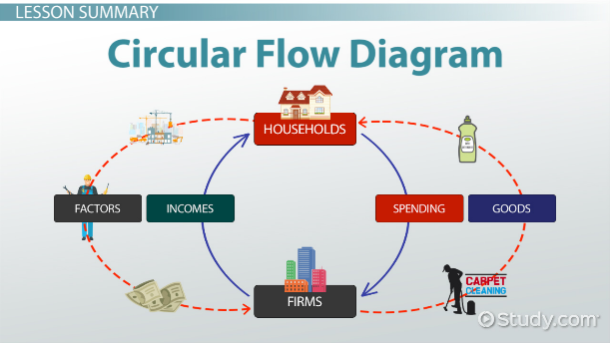
Assumption error:
Economy as an isolated system

Slide 22
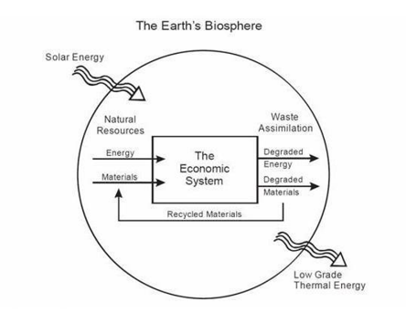
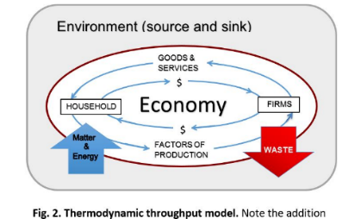

A better model:
Economy as an open system

Slide 23
A look back at the history recognizing limits

Slide 24
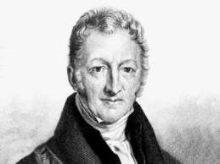
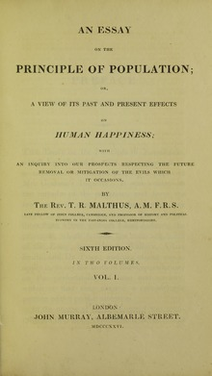
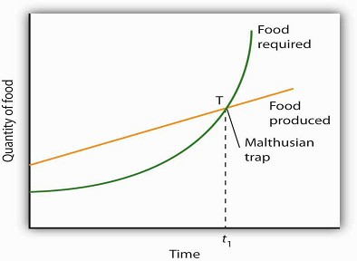
Thomas Malthus
Predicts eventually food and resources will run out as populations explode
1798

Slide 25

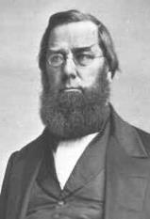
George Perkins Marsh
1864
“A certain measure of transformation of terrestrial surface, of suppression of natural, and stimulation of artificially modified productivity becomes necessary. This measure man has unfortunately exceeded.”
“The ravages committed by man subvert the relations and destroy the balance which nature has established…; and she avenges herself upon the intruder by letting loose her destructive energies…”

Slide 26
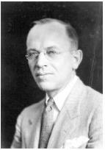

Aldo Leopold
A Sand County Almanac – regarded as the most influential book on conservation ever written.
The land ethic:
"A thing is right when it tends to preserve the integrity, stability, and beauty of the biotic community. It is wrong when it tends otherwise."
Enlarges the boundaries of the community to include soils, waters, plants, and animals, or collectively: the land.
1949

Slide 27
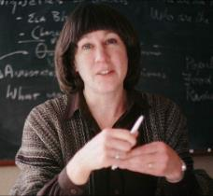
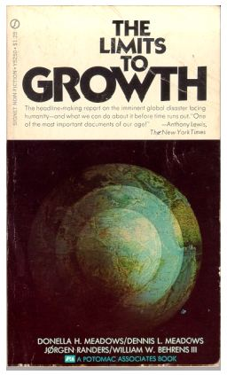
Donella Meadows and Club of Rome
1972

Slide 28
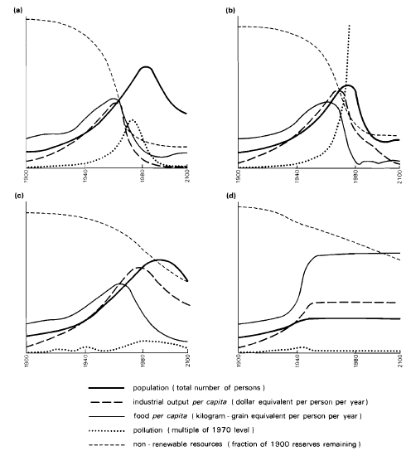
Forrester-Meadows world model
(a) A standard computer simulation based on 1970 values.
(b) Pollution-induced collapse even when known natural resource reserves are 2x.
(c) Collapse due to population growth even though resources are set as unlimited and pollution controls are assumed.
(d) Stabilized model producing a sustainable future. Assumptions: birth rate= death rate, capital investment= capital depreciation, and technological policies are implemented, e.g., resource recycling, pollution control, and restoration of eroded and infertile soils.
(After Meadows, 1971)

Slide 29
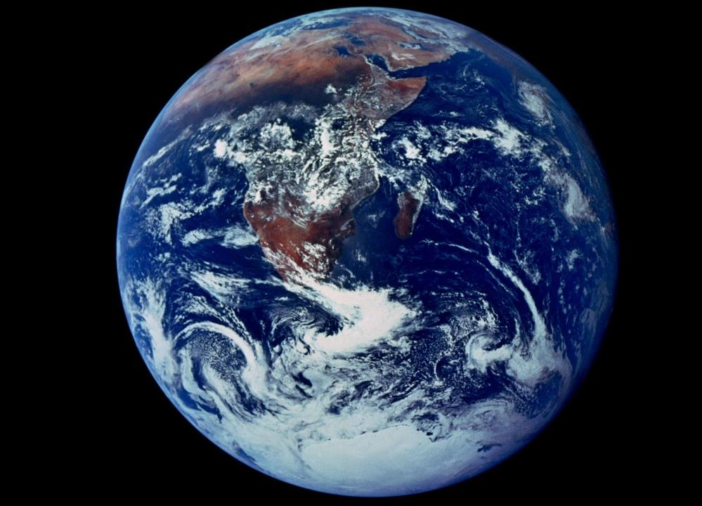

Slide 30
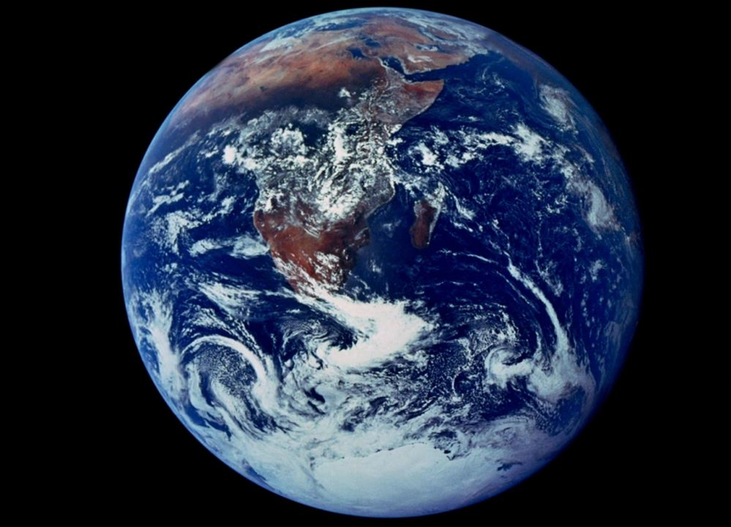
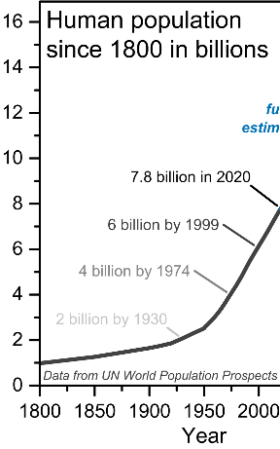
Importance of scale

Slide 31
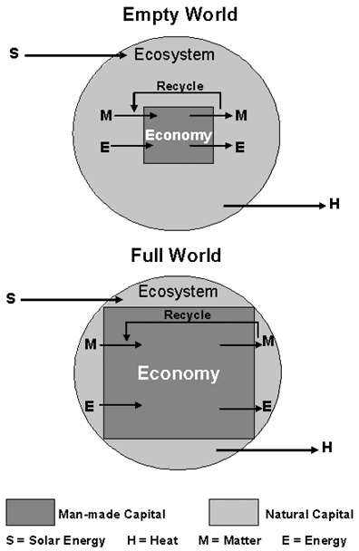
Emergence of humans, from a minor component of natural system to predominant occupant
Scale of humanity has increased greatly putting pressure on all natural resources
The changes have come so fast our customs, ethics, and religious patterns may not have adapted to them.

Slide 32
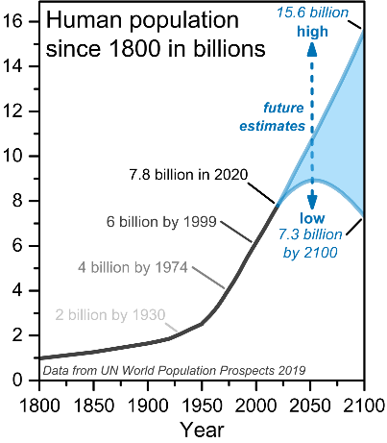
Importance of scale

Slide 33
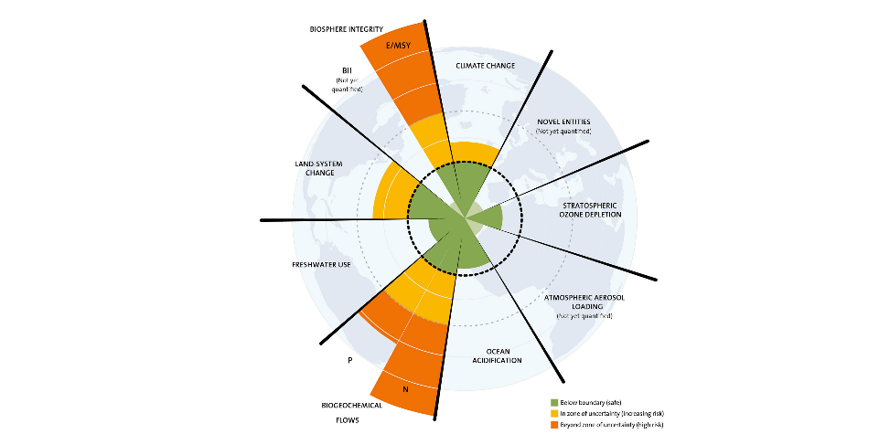
Planetary Boundaries – Stockholm Resilience Centre

Slide 34
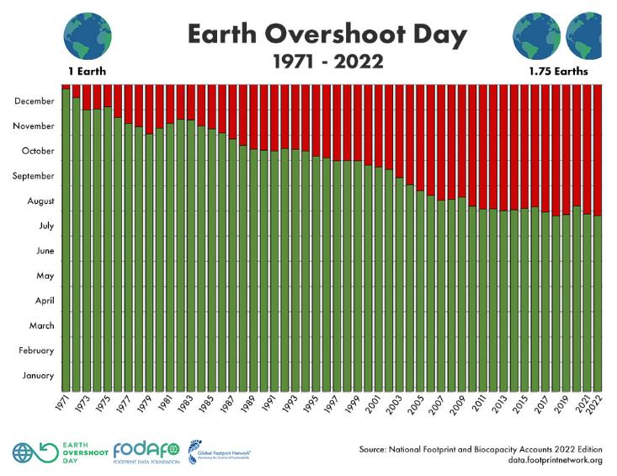
Overshooting the limits – July 28, 2022

Slide 35
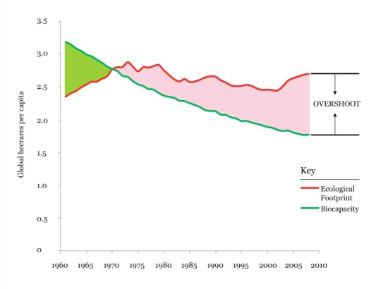
Overshoot!

Slide 36
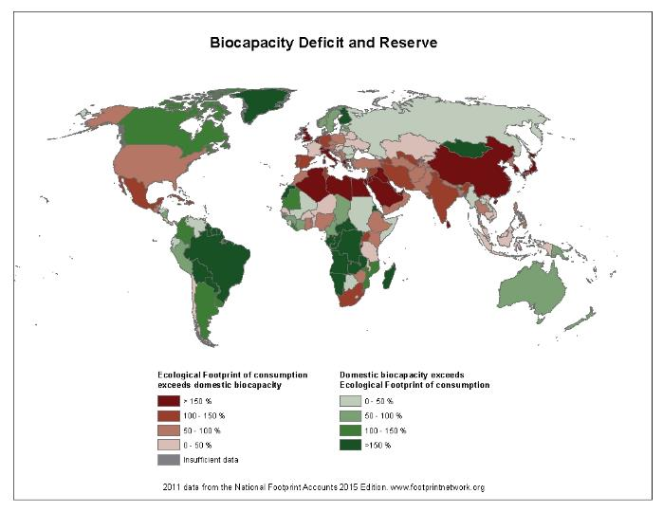

Slide 37
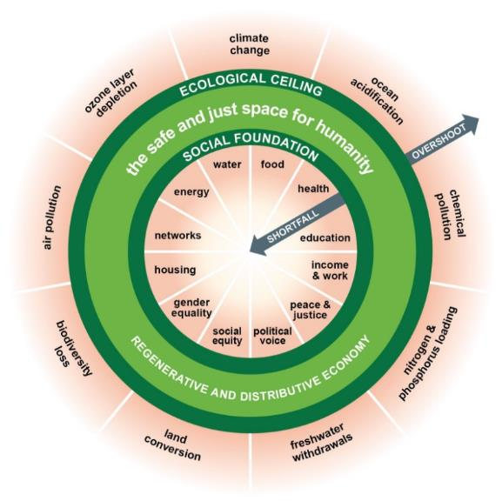
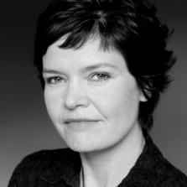
Ceilings and Floors
Donut Economics – Kate Raworth

Slide 38
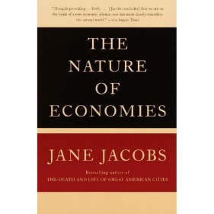
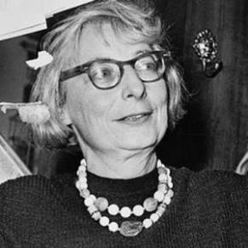
Limits to Growth
“Natural principles of chemistry, mechanics and biology are not merely limits. They’re invitations to work along with them.”
Jane Jacobs
2000

Slide 39

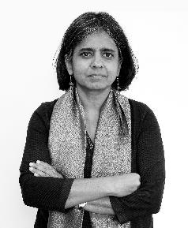

“There are limits. Let’s celebrate the limits, because we can reinvent a different future.”
Sunita Narain
This Changes Everything 2015

Slide 40
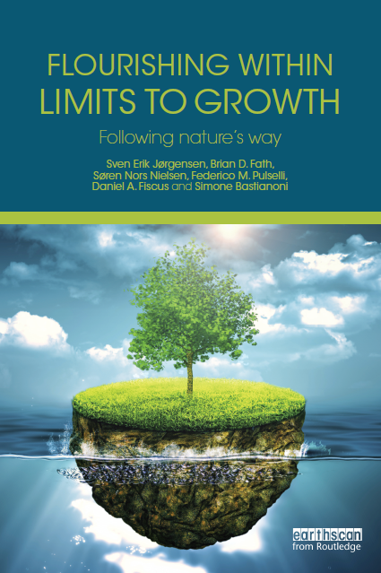
Ecosystems do quite well under constraints, let’s learn from them
2015
clubofsiena.eco-soft.dk

Slide 41
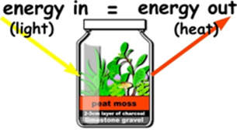
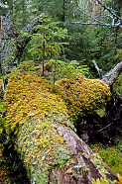
9 properties of ecosystems
Material constraints
Ecosystems conserve matter and energy – 1st law
All processes are dissipative – 2nd law
All life uses largely the same biochemical constituents and processes
Ontological properties
An ecosystem uses surplus energy to move further away from thermodynamic equilibrium (physically driven biological aspect) – centripetality
Ecosystems co-evolve and adapt to prevailing conditions (biologically driven biological aspect)
Phenomenological properties
Ecosystems have diversity of structure and function
Ecosystems work together in networks that improve the resource flow utilization
Ecosystems are emergent hierarchically
Ecosystems have an enormous amount of genetic, biochemical, and process information
Understand these and apply to socio-economic systems

Slide 42
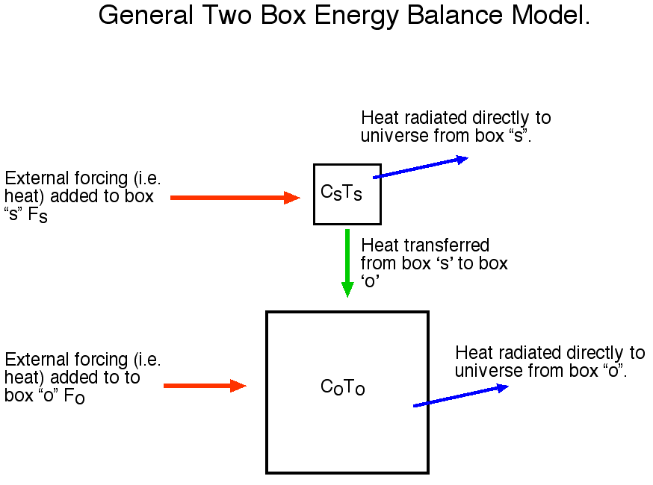
1. Ecosystems conserve matter and energy
This principle allows one to write balance equations, such as:
accumulation = input – output.

Slide 43

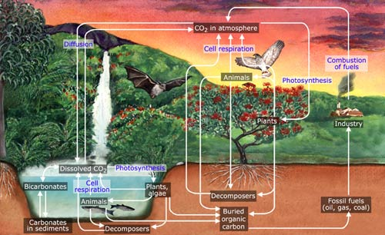
1.1. There are no trash cans in nature
Material is reused again and again through functional couplings

Slide 44
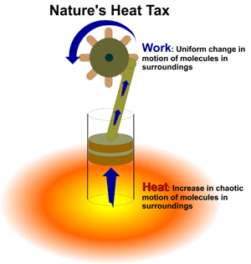
2. All processes are dissipative (irreversible)
(useful way to express the 2nd Law in ecology).

Slide 45
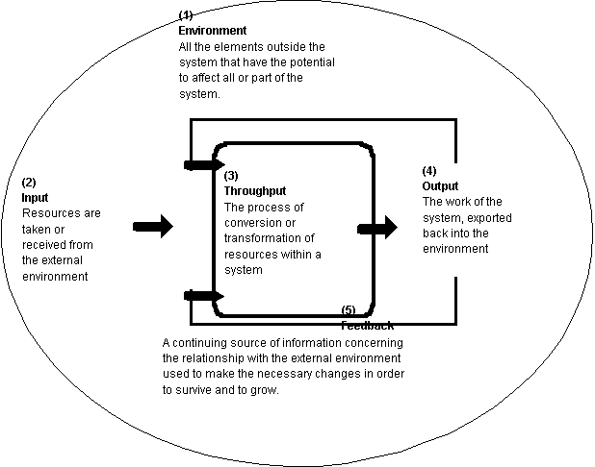
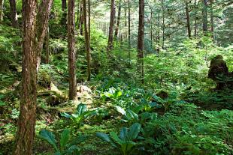
2.1. Ecosystems are open systems and require an input of work energy to maintain their function
From a thermodynamic point of view, this principle is a prerequisite for ecosystem processes. If ecosystems were isolated in the physics’ sense, then they would inevitably go to thermodynamic equilibrium without gradients and without life.

Slide 46
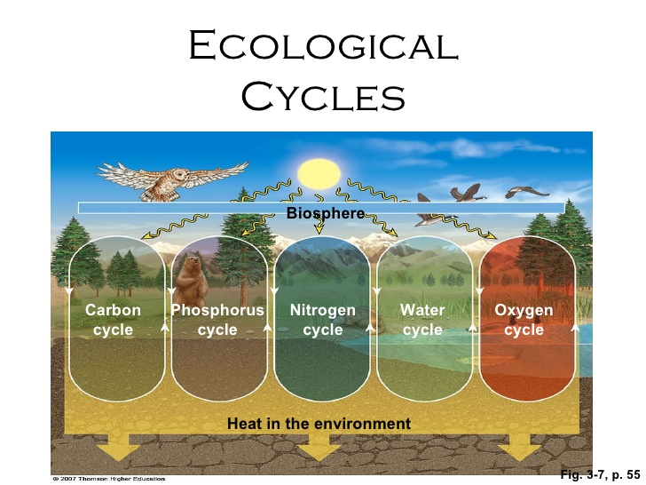

Slide 47

3. All life uses largely the same biochemical constituents and processes
  Biochemical compounds found in all living organisms are derived from about 25 elements.
Yellow Boxes = Top 5 Elements present in the human body
Green Boxes = Second 5 Top Elements present in the human body
Blue Boxes = Trace elements that are required by the human body
Violet Boxes = Elements that are deleterious to the human body.

Slide 48

4. An ecosystem uses surplus energy to move further away from thermodynamic equilibrium
This is just another way of expressing that ecosystems can grow – progressive, directional change

Slide 49

5. An ecosystem co-evolves by adapting to and modifying its environment
Evolution is a step-wise development that is based on previous configurations for survival in a changeable and very dynamic world.

Slide 50

7. Ecosystems work together in networks that improve the resource flow utilization
Connectivity is a basic property that, through transactions and relations, binds ecosystem parts together as an interacting system.

Slide 51

8. Ecosystems are emergent hierarchically
Ecosphere
Ecosystems
Communities
Populations
Organisms
Organ systems
Organs
Tissue
Cells
Molecules
Atoms

Slide 52

Ecosystem growth and development follows a logistic curve from early to late successional stages
Late stage
Biomass or complexity
Early stage

Slide 53




Ecosystem services are extracted to exploit growth phase
Human induced succession –deforestation, agriculture– moves the system back to earlier stage.

Slide 54

Bioenergetic model of succession
In early stages of succession, P>R and excess is channeled into growth and accumulation of biomass.
Increase capacity and complexity of the energy storage compartments (total biomass of all species and trophic levels) as well as the complexity of energy transfer pathways.
In late stages of succession, P=R as maintenance costs increase respiration
Negative feedback maintains steady state, with little or no change in biomass (network, feedback, cycling).

Slide 55
Four types of Ecosystem Growth and Development
0. Boundary Growth: How much energy enters the system.
I. Structural Growth: Increase in biomass quantity in the number & size of components in the ecosystem.
II. Network Development: Change in system connectivity, which results in more cycling.
III. Information Development: Qualitative change in system behavior to more energetically efficient ones.
Bigger
Better
Fath BD, Jørgensen SE, Patten BC, Straškraba M. 2004. Biosystems 77, 213–228.

Slide 56
Growth → Quantitative increase
Development → Qualitative increase
"We must realize that growth and development are two very different things. You can develop without growing and vice versa.“
Tibor Vasko, 2009, www.solon-line.de/interview-with-tibor-vasko.html

Slide 57
Alternative Economic Systems…

Slide 58


Herman Daly
Beyond Growth: the economics of sustainable development
  The first and second laws of thermodynamics must be the starting point of economics
  Neither the sources of useful inputs nor the sinks for polluting waste outputs are infinite.
1996

Slide 59


Nicolas Georgescu-Roegen
The Entropy Laws and the Economic Process (1971)
  Wealth is an open system, a structure maintained in the midst of throughput
  It begins with the depletion of useful matter/energy and ends with the return of an equal quantity of spent matter/energy back to the environment.

Slide 60

Regenerative economy
Input, Output, and System Dynamics
4.
3.
1.
2.
Fath et al. 2019. Global Transitions. 1, 15–27.

Slide 61


John Stuart Mill
British philosopher, political economist and civil servant (1806-1873)
Considered “the most influential English-speaking philosopher of the nineteenth century"
“Perpetual growth in material well-being is not possible or desirable.”
Mill argued that the logical conclusion of unlimited growth was destruction of the environment and a reduced quality of life. He concluded that a stationary state could be preferable to unending economic growth
1848
WHY HAVE WE NOT LEARNED THIS LESSON?

Slide 62


Decoupling –greater resource efficiency
Do more with less

Slide 63




degrowth
Reduce scale to fit within planetary boundaries
Do less

Slide 64
Discussion questions
Should biophysical limits be considered in economics?
  How?
Is it mostly a matter of getting the prices right – internalize extranalities?
How to differentiate between productive work and exploitative work?
How to move away from growth as a goal function?
Give an example of increased efficiency leading to increased consumption. How can we account for this in reducing environmental impacts?

Slide 65
Thank you for your attention!
2019

