Slide 1
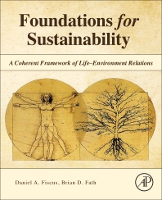
Foundations for Sustainability
Brian D. Fath & Dan Fiscus
Fulbright Distinguished Chair, Masaryk University, Brno, Czech Republic
Professor, Towson University, Maryland, USA
Senior Research Scholar, International Institute for Applied Systems Analysis, Austria

Slide 2
Chapter 5: Reforming Reductionism with six core principles
Your reaction
Is hyper-specialization an inevitable trend?
  What frictions might help retard it?
What part was most confusing or most difficult to understand?

Slide 3
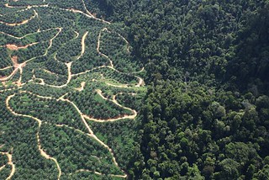
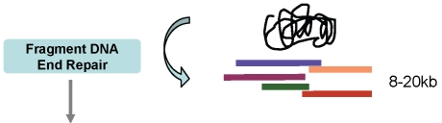
Premise: Need for science reform
Science and society do not recognize and achieve a self-enhancing, Life-environment relationship
Repair fragmentation

Slide 4
Six core principles of the new science
Is value-based centered on the value of Life;
Is anticipatory and accelerates the pace of scientific change, toward sustainable human-environment relation;
Balances and synergizes holism with reductionism;
Equally emphasizes internalist and self-referential as well as objectivist perspectives;
Is complex and is able to reconcile seeming opposites and handle multiple scales and fluid boundaries of focal entities;
Is radically empirical with constant capacity for questioning, challenging, and transforming ingrained assumptions

Slide 5
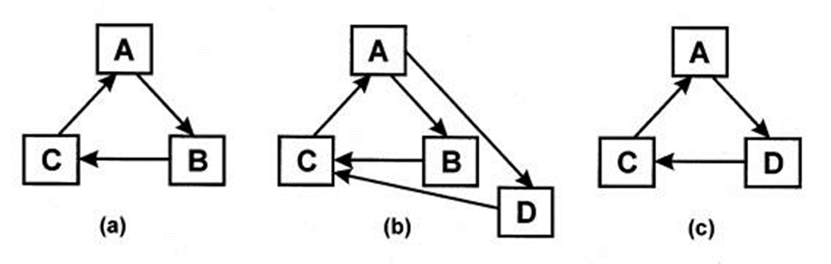

P1: Holistic science is centered on value of Life
Covered in Chapter 2
  Several of you have asked what exactly this means?
  What does it mean to you?
  Isn’t life always about winners and losers?
Value neutral
  Is it?
  Only bias is against Systemic Death

Slide 6
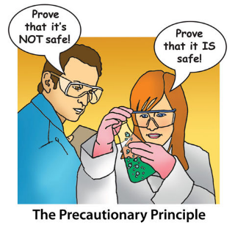
P2: Holistic science is anticipatory toward sustainability
Ecological perspective can alter how we see the rest of the world
Precautionary Principle
  Be risk averse with respect to Life
Restoration efforts cannot be “clean-ups” treating the symptoms
  Revitalize self-healing autocatalytic cycles
  The place will be home to and supportive of sustained Life
Avoid leaving messes

Slide 7
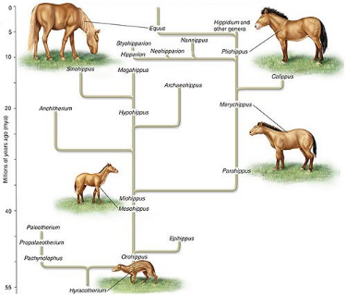
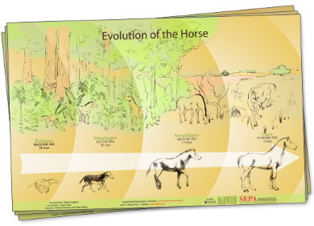
P3: Holistic science balances holism with reductionism
Back to nature:
  “Darwinian evolutionary theory contained a very great error in its identification of the unit of survival under natural selection.
  The unit of survival is not the breeding organism, or the family line, or the society.” (Bateson p. 32)
Biology texts explain evolution as a species thing
not as an ecosystem thing that it is
“The unit of survival is a flexible organism-in-its-environment.”

Slide 8
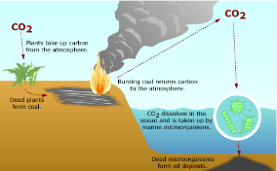
P3: Holistic science balances holism with reductionism
“a definition of a thing or event must include definition of its environment, we realize that any given thing goes with a given environment so intimately and inseparably that it is more difficult to draw a clear boundary between the thing and its surroundings.” (Watt p. 67-68)
Environmental Science/Studies, Ecology, Sustainability Sciences have built methods, habits and infrastructure to see more than isolated bits
Tracing an atom shows three material cycles are unified
  Where it comes from and where it goes?

Slide 9
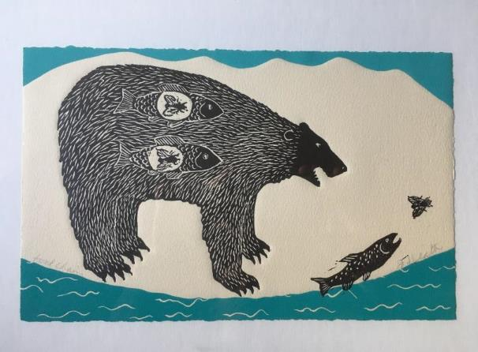
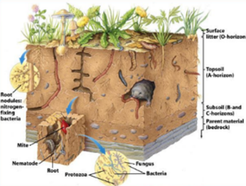
P3: Holistic science balances holism with reductionism
“We fat all creatures else to fat us, and we fat ourselves for maggots. Your fat king and your lean beggar is but variable service, two dishes, but to one table; that’s the end.” Hamlet
“Soil is the great connector of lives, the source and destination of all. … It is alive itself. It is a grave, too, of course.” Berry, 1977 p.90
Art work of Jan Heath, entitled “food chain”

Slide 10
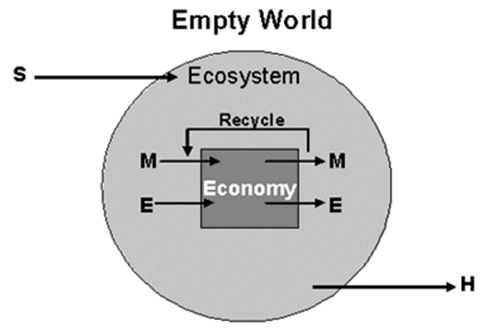
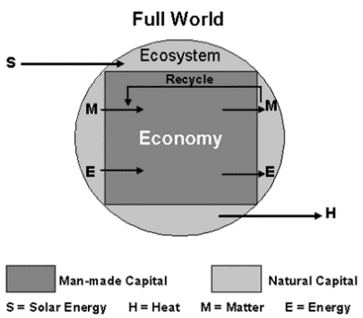
P4: Holistic science equally emphasizes internalist and externalist perspectives
Objectivity is excellent when used in moderation
Working assumptions have changed

Slide 11
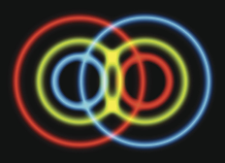
P4: Holistic science equally emphasizes internalist and externalist perspectives
Entanglement
“investigators are (and should be) not only observers, but actors in their own interests at the same time” (Salthe 2001)
“(i) we have to assume that those systems are able to interpret our interpretation, and hence (ii) our own behavior, our own choices, values and decisions have an essential place in the theory of self-organizing systems.” (van de Vijver 1998)

Slide 12

P5: Holistic science is complex
Complexity cannot be measured as an independent state variable, but rather in context with its environment
Necessity of multiple distinct modes of description and interaction
Complex systems are beyond formalization, simulability, and computability.
“self-making of the self-makers”

Slide 13
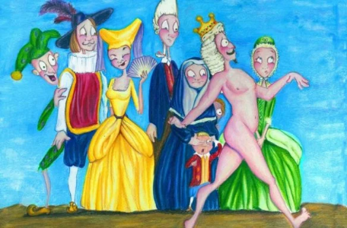
P6: Holistic science is radically empirical
resist peer pressure to conform, such as challenging questions related to sustainability;
resist pressure to continue the normal science program of “puzzle solving” (Kuhn, 1962); and
make questions and forays into “post-normal science” (Funtowicz and Ravetz, 1993)

Slide 14
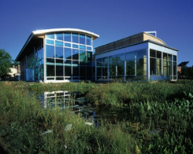
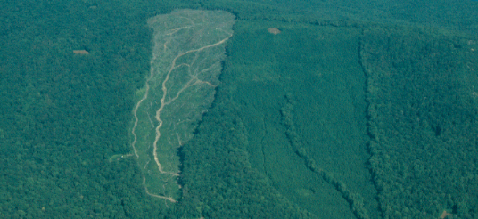
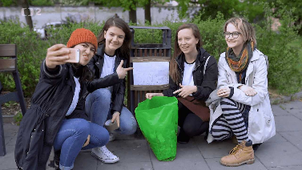
Putting into practice
hard-won lessons of the Hubbard Brook experiment were treated as for “academic purposes”
use university campuses as a laboratory and for experiments to transform our universities to sustainable operations – David Orr
Sustainable Palacky -

Slide 15
Summary of the six principles
set of science principles embodies an ethical sense that emerges from the value orientation to serve Life, from the anticipatory program to succeed in achieving sustainability, and from the other principles that promote leading by example and applying the holistic Life science to the scientific enterprise itself.

Slide 17
Discussion questions
Why is the estimated cost of restoration always wrong (the Bill Gates Chesapeake Bay example)?
Must holism end at the universe as the mode of study? – Carl Sagan quote
  How to avoid this infinite regress?
What is meant by a “second-order ecology”
Why such difficulty with internalist approaches?
  How does internalism not become shaming?

Slide 18
Discussion questions
What is the goal of the food system?
What are some ways an education in Environmental studies has broken down silos?
How to implement in place at the university?
Can these principles hold potential to enable greater scientific insight and understanding and to open new avenues for holistic action for sustainability?

