Slide 1
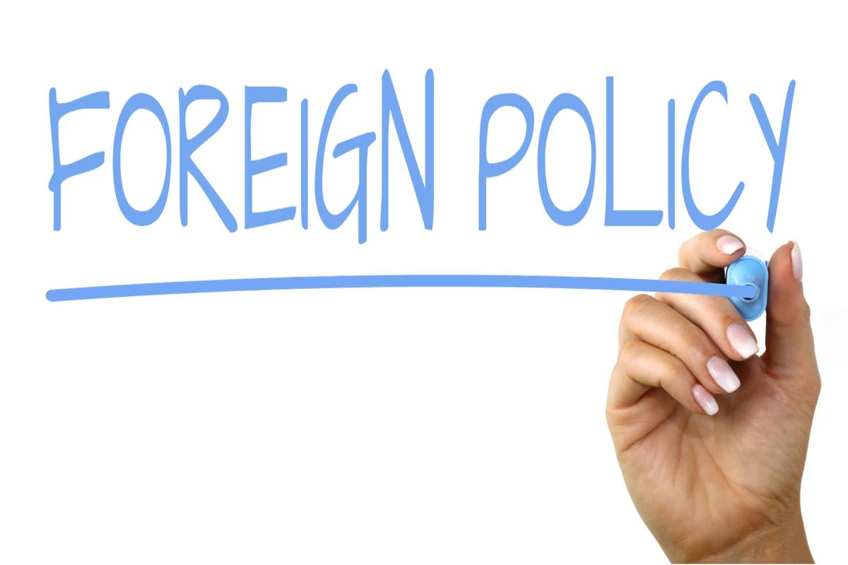
IRE1001
Kateřina Fridrichová

Slide 2
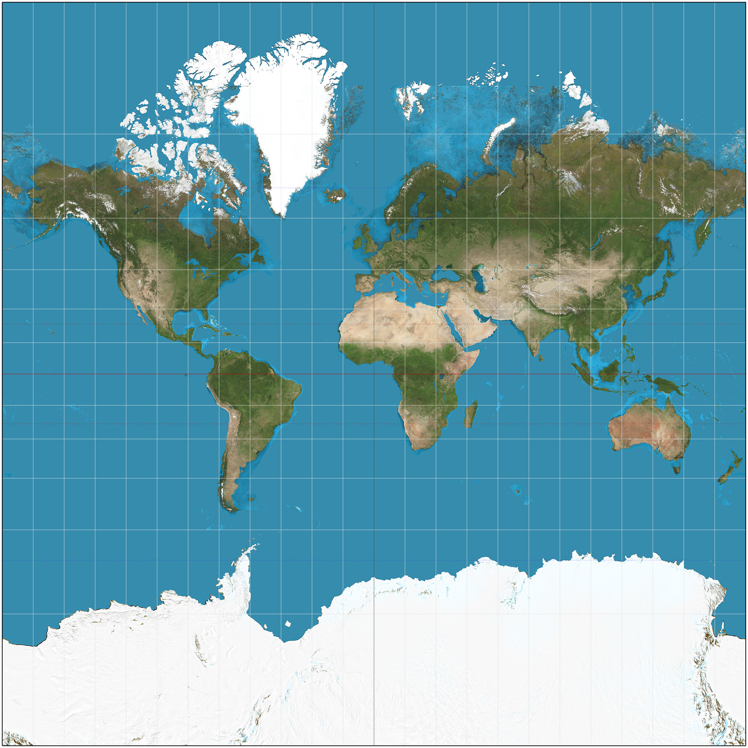
Few words on the level of analysis problem
Level of analysis question: what is the level where we do the analysis, so that it is useful for our research. The world is so complex that our models will never work exactly
International system level
  presupposes high degree of homogeneity amongst the units "black box" or "billiard ball" approach
  comprehensive and total picture of international relations
  predicts systemic behaviour
National level of analysis
  avoids inaccurate homogenization, but can lead to opposite extreme – exaggeration of the differences
  projection of individual behaviour on the state (determinism vs free will)
  question of what sort of beast is it anyways – sum of the human actors? What about rules that govern those interactions?
  richer in detail and depth but worse at the big picture
  predicts the behaviour of units
Individual level
  psychology and conditions that influence individual actor to act in a certain way

Slide 3
Foreign policy
A process of decision-making. A plan or a strategy that state adopts to deal with other states.
Problem of foreign policy analysis is that of any other complex process – the models are just approximations of how the world works – they are useful, but ultimately all wrong.
It has to take into account the level of analysis and sometimes all at the same time
Foreign Policy Analysis (FPA) then studies these goals, processes, procedures, inputs, outputs...

Slide 4
Rational decision-making model - ideal
Based on rational-choice theory
Assumes that actors are rational, informed decision-makers who maximize value and benefits to the state. Analysis on the state-level, but states perceived as more or less unitary rational actors.
Rationality is a fraught term, lack of information pervasive and so is time-constraint...
Assessment of situation
Knowing the context
Goals setting
Clarification of goals
Ordering of goals according to priority
Determination of policy options
Possible alternatives for achieveing the goals
Choosing an alternative

Slide 5
Organizational Process Model
Decisions are made in strict confines of bureaucracy, there is a "proper" way how to do things, chains of command, respecting established processes and so-called standard operating procedures (SOP).
  Outcomes then are predictable to certain extent, lacking in imagination and decrease flexibility of an organization.
  Does not replace rational decision-making model, more like explains where there are constraints during the formation of options

Slide 6
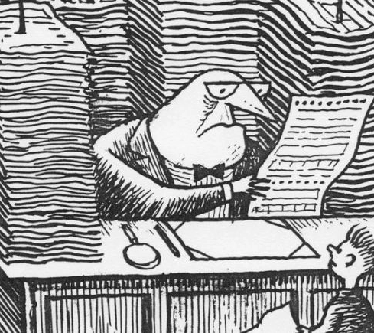
Bureaucratic Politics Model (government bargaining)
Opens the "black box" - outcomes are created by infighting and bargaining amongst various actors in decision-making process.
Many factors come to play: the salience of the issue, the relative strength of stakeholders in the situation, and their perception of what is the desirable outcome.

Slide 7
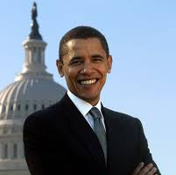
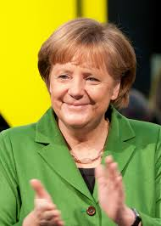
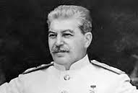
Individual decision makers
If rational model for states as well as for actors was true, it wouldn't matter who sits on the top, the outcomes of decision-making would be the same.
Values and beliefs of actors, as well as their personal idiosyncracies come to play.
  Tool: Operational code theory
    Seeks to answer the question how they percieve the world around them, how they perceive themselves and their role in the world
    - Hitler in WWI, Churchill
  Personality types that reach the top are usually of one kind
    Calculating brain
    Lower on empathy

Slide 8

Individual decision makers – limited rationality
Misperception and selective perception – filtering of information - too much data problem
Affective bias – positive or negative (emotions, likes, dislikes)
Cognitive biases - based on heuristics (on how the brain works) - the brain is attempting to create cognitive balance, reduce coginitive dissonance and make the theory in your head logically consistent
    Justification of effort – or the sunk cost argument
    Wishful thinking – overestimation of probability of the desired outcome (or event with low probability is not expected to happen)
    Mirror image of an opponent – thinking that he thinks like I do
    Historical analogies – Munich, Vietnam

Slide 9
Alternatives to rational decision-making
Bounded rationality – recognition that the information processing is not perfect and actors are satisficing instead of optimizing (they arrive at good enough solution, not the optimal one). It is a result of limited information and time to process.
Prospect theory (Khaneman and Tversky) – descriptive rather than prescriptive – describes how people assess probability of something happening
  Editing phase – outcomes which are equivalent and then the perceived are considered a loss and those that are better are considered gain
    Lossess hurt more than perceived gains feel good (risk aversion)
  Evaluation phase – computation of value based on outcomes and respective probabilities of those outcomes

Slide 10
Groupthink (part of psychology of group decision-making) symptoms
Unlike individuals groups tend to be more optimistic about the chance of success
Close-mindedness
Rationalizing warnings
Stereotyping those who are opposed to the group
Pressures towards uniformity
Individual tend not to raise controversial issues or alternative solution
Illusions of unanimity
Direct pressure
Overestimation
Members overestimate the morality of the group

Slide 11
Group-think conditions
Homogeneiety of the group (socioeconomical, educational, gender, etc.)
Type of leadership (too authoritarian)
Situational context

Slide 12
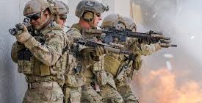
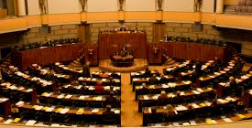

Influential actors in policy-making process
Bureaucracy – various govermental branches with vested interests
Interest groups - lobbying
Military – industrial complex – army and strong industries in cooperation
Public opinion – press, attentive public, body bag effect, "rally round the flag"effect, referendum
Legislatures

