Slide 1
Wrap up session
IREn5019 No war, no Peace: Frozen Conflicts in the Caucasus
7.12.2022.

Slide 2
Otline
Between Geopolitics and Transformation
The impact of invasion in Ukraine on Armenia
Azerbaijan
Georgia
Scenarios

Slide 3
Between Geopolitics and Transformation
Today the EaP faces a double challenge:
1) The transformation it was meant to bring about has largely failed to materialize, whereas a conflict with Russia for which it was not designed has come to the fore. As a consequence, the EaP region has become more instead of less divided.
2) The EU’s agenda has been increasingly overshadowed and contradicted by a largely geopolitical concern: competition with Russia.
It did not contain instruments for supporting its partners against Russian reprisals.
The EU’s strength tends to lie more in its transformational powers than in a capacity to act strategically.
the EU usually has difficulties setting and following coherent objectives, to say nothing of responding flexibly to the interactive nature of strategy.
In times of crisis, this condemns the EU to a reactive rather than pro-active role.

Slide 4
Between Geopolitics and Transformation
Russia, following a “realist” understanding of international relations, views the conflict as a zero-sum game for power and influence and expects its interests to be respected.
For the EU, the EaP is more about promoting development than about geopolitical interests. Consequently, the EU rejected the EaP as a reason for conflict. Russia, for its part, likely misread EU communication on the EaP as assurances that EU interference in the post-Soviet neighborhood would be limited.
On a fundamental level, the EU’s strategic culture is built on rejecting the hierarchical relationships of traditional power politics and spheres of influence. Instead, it aims for cooperation that seeks common gains in terms of liberal values. This culture is what led EU politicians to deny the legitimacy of Russian interference or even its objections to the EaP.
A major weakness of the EaP is thus that it was ill-equipped from the start for what turned out to be unavoidable competition and eventual conflict with its largest neighbor to the east.

Slide 5
Between Geopolitics and Transformation
Russia, however, can provide not only considerable short-term benefits – such as reduced energy prices and loans – to those same countries but also short-term disincentives. These include imposing trade sanctions, limiting access to migrant workers, negative propaganda by influential Russian media, sponsoring domestic opposition, and, not least, raising tensions in separatist regions, supporting armed insurgents, and sponsoring outside intervention.
Russia dismisses EU values as a mere pretext for advancing geopolitical ambitions, while the EU dismisses Russia’s objections as illegitimate.
The form of the current conflict, like its causes, has been asymmetrical. Exploiting EU weaknesses, Russia responded to EU soft power with instruments of hard power. At the same time it developed and employed its own soft power in the form of effective propaganda while the EU was distracted by crises over the euro, refugees, and, finally, the Brexit referendum.
Overall, Russia’s policies look more reactive than strategic.

Slide 6
Between Geopolitics and Transformation
Russia, moreover, has been no more successful than the EU in achieving its objectives. Only in the case of Armenia did it manage to turn the country away from European integration and toward Eurasian integration.
The most important impact of Russia’s opposition to the EaP is less direct: that the “Russian factor” has strengthened the leverage of vested interests within EaP countries, helping these deadlock the reform process, particularly in Ukraine and Moldova.
Geopolitical competition with Russia has pushed the EU into supporting pro-EU governments regardless of their real reform records.

Slide 7
Between Geopolitics and Transformation
The security deficit and fragile peace arraignment in the South Caucasus underlines the need for internationalization of conflict resolution efforts.
The interaction between the EU-led security community, the regional powers in its Eastern neighbourhood, the USA, and the pan-European institutions is a complex affair. There are clear dynamics reinforcing the spread of the European security community, namely through the promotion of a common understanding of peace and stability, rooted in liberal democratic norms, human rights, and the rule of law, and on the centrality of cooperative security, diplomacy, predictability and mutual responsiveness.
The OSCE has become a site of con-testation and for exerting unilateral power, either through the vetoing of the organisation’s work or through its gradual marginalisation.
NATO expansion has failed to deliver on its role as the main security provider.
EU member states, the lack of clarity as to the nature of its engagement with the region. The EU will need to provide clear answers to these anxieties, whereas the countries in the South Caucasus acknowledge the EU’s approach as systemic shift in their approaches to peace and security.
The EU has a new momentum and can contribute to revival of multilateral security enggements in this region: creation of multidimensional and coherent approach may keep the conflicts from escalating to “hot” wars.

Slide 8
The impact of invasion in Ukraine on Armenia
Amrenian policy priorities:
avoiding recognition of the so called Donetsk People’s Republic and Luhansk People’s Republic;
avoiding military support for Russia and, consequently, international isolation and sanctions;
avoiding any direct involvement in the sanctions imposed on Russia;
securing a continuous supply of grain and other staple foods from Russia.
Redeployment of some Russian troops from its 102nd military base in Gyumri to Ukraine.
Armenia supplied four Su-30SM fighter aircraft (acquired in 2020) to Russia for deployment against Ukraine.
Armenia sent approximately 100 troops to Kazakhstan in January 2022 as part of a CSTO mission.

Slide 9
The impact of invasion in Ukraine on Armenia
Azerbaijan’s recent incursion into Armenia in terms of Russia’s weakness? —resulting from its unsuccessful military engagement in Ukraine.
Increased scepticism towards CSTO membership and Russia’s security guarantees in Armenian public.
Prime Minister Pashinyan’s statements: “it was even said that the CSTO was concerned that it might lose Armenia. To which I replied that there is the opposite concern in Armenia — that Armenia will lose the CSTO. Or when they say that Armenia will leave the CSTO, in Armenia there is the opposite concern — that the CSTO will leave Armenia. And this is not a play on words. We expect a clear political assessment of the situation”.

Slide 10
The impact of invasion in Ukraine on Armenia
While not a substitute for security guarantees that Armenia has recently been lacking, such activities increase the possibility of a peaceful settlement, which would eventually improve economic and social perspectives.
While abrupt moves perceived hostile by Russia would create additional security risks, maintaining the long-term dependence on Russian security guarantees, as well as economic dependence, may multiply the risks in the longer term.

Slide 11
The impact of invasion in Ukraine on Azerbaijan
The Ukrainian war has put the country in an uneasy condition, in which Baku needs to balance with Moscow on the issue of Karabakh and work closely with the West in ensuring its energy security.
Moreover, the continued standoff between Russia and the EU/USA limits Azerbaijan’s field for manoeuvring, and it has taken criticism from both sides.
It seems obvious that Azerbaijan will continue its policy of “silent diplomacy” that stipulates to not irritate the powerful centres as well as its policy of restoration of territorial integrity and keeping its independence as a country through small steps and actions.

Slide 12
The impact of invasion in Ukraine on Azerbaijan
the war in Ukraine has not led to the fractions or division between political elites and society in Azerbaijan.
President Aliyev strongly supported Ukraine, calling on Ukraine to not accept the occupation of its territories.
AZ pursuing a balanced approach to the war in Ukraine since its start on February 24. Azerbaijan helps Ukraine by sending humanitarian aid; oil companies provide cheap oil to emergency vehicles, etc.
different shades of security dilemmas
Three possible scenarios: a) intensified rivalry between the West and Russia over including the South Caucasus (SC) under different spheres of influence, b) weakening Russia’s position in the SC, and c) withdrawing the West from the SC and intensifying Russia’s position here.

Slide 13
The impact of invasion in Ukraine on Azerbaijan
Baku fears that the active involvement of Brussels and Washington in the Karabakh conflict (although Baku denies the existence of conflict) will make Moscow see the region as the new front line. Thus, the conflict will not be resolved, and Russian peacekeepers will become the protectors of separatists.
The Ukrainian crisis will determine whether one of two scenarios will take place in Karabakh (more broadly in the Caucasus region): 1) preservation of Russia-centred configurations, particularly in Karabakh, or 2) replacement of these configurations with European-centred configurations.
On the one hand, we see how Western countries and institutions have reactivated their engagement in the issue after almost a decade of Russian dominance. Baku and Yerevan, as well, seem enthusiastic to explore new, alternative platforms for their bilateral relations and the Karabakh issue, one being Brussels. The real outcome and impact can be seen and evaluated after the Ukraine war: we have yet to see whether Russia will emerge from the conflict stronger or weaker.

Slide 14
The impact of invasion in Ukraine on Georgia
While the Black Sea area remains of paramount importance to Georgia, the Russia–Ukraine war made Georgia’s security more vulnerable to risks and threats emanating from the region.
Furthermore, the Ukrainian war deepened the political and societal polarization in Georgia and exacerbated the schism between Georgia’s mostly pro-Western foreign policy expert community and the government’s balanced foreign policy.
The war added a cleavage to the country’s already highly polarized domestic politics and triggered a severe political crisis. It sparkled mass protests, and the opposition demanded the resignation of the government.
While supporting the pro-Ukraine resolutions in international organizations, the Georgian government did not join sanctions against Russia and half-heartedly supported Kyiv politically and diplomatically.
The war provided an opportunity for candidacy in the EU.
a politically immature zero-sum game of polarization, radicalization, and political infighting. Overall, decoupling from Ukraine and Moldova seems to be a geopolitical loss for Georgia.

Slide 15
The impact of invasion in Ukraine on Georgia
Three direct impact on security:
1. First, direct threats to Georgia’s security and stability have further increased. In the case of renewed fighting, Georgia will be very vulnerable to Russia’s military machine.
2. the war in Ukraine has also affected the occupied zones in Georgia: withdrawal of Russian troops from the Abkhazia and South Ossetia.
3. open new economic opportunities for Georgia as a South Caucasus and Black Sea transit country.

Slide 16
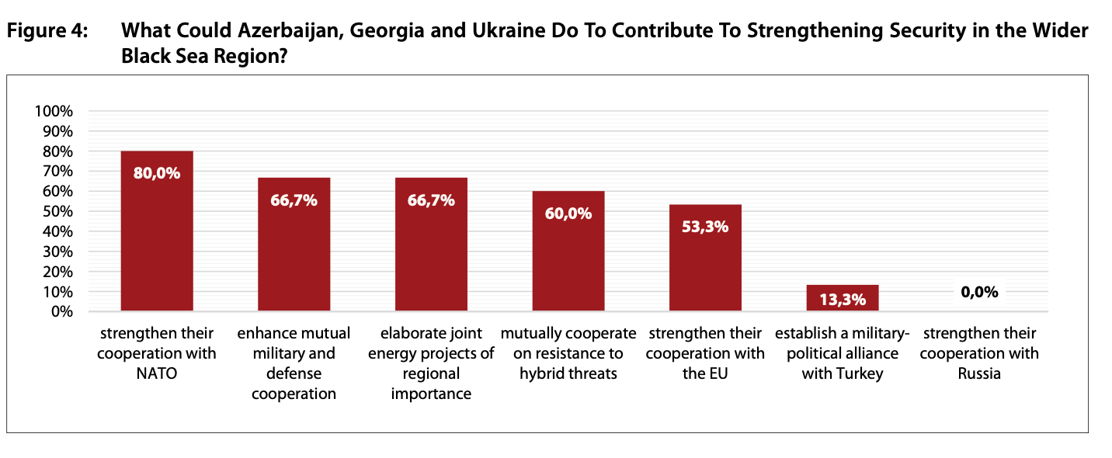

Slide 17
Scenarios
Scenario 1: A Georgian geopolitical dream
Russian defeat in Ukraine, opportunity to become EU member.
Scenario 2: Georgia’s nightmare
Russian victory- dilemma for Georgia: fight or become a Russian satellite state. Recognition of Abkhazia and South Ossetia? Social unrest and instabilities, massive emigration and brain drain.
Scenario 3: Kremlin’s geopolitical aim: Ukraine “recognizing new realities”
Frozen conflict - “recognize new realities” i.e. independence of Donetsk and Lugansk as well as annexation of Crimea. These territories will provide Moscow with persistent leverage to influence Ukrainian politics and sabotage the country’s pro-Western foreign policy.”
Scenario 4: NATO-Russia conflict

Slide 18
Q & A

