Slide 1
CUBAN MISSILE CRISIS

Slide 2
Introductions
James Richter
  1. Education
  2. Employment
  3. Research Interests
  4. Other Interests
B. Course Objectives
  1. Cuban Missile Crisis
    Why did it occur?
    How were decisions made?
    What was legacy?
  2. Writing
    How to construct an argument
    How to support your argument
    How to find your voice
Course Requirements
  Attendance
  Four Response Papers of less than 200 words
  1000 word paper (3-4 pages)
    Rough Draft: Due November 4
    Final Draft, Due November 25

Slide 3
Introductions: Who are you?
Where are you from?
Do you have any questions about what’s going on in the United States?

Slide 4
Why the Cuban Missile Crisis?
Historic Significance: A Moment Close to Nuclear Destruction
  A Turning Point in Cold War History
A Case Study in Crisis Bargaining
  How do we get into crises?
  International and Domestic Reasons
  Decision-Making Procedures. How do governments make decisions for foreign policy?
  Crisis Bargaining:
    How do governments manipulate risk to get what they want?
    How are crises resolved?
    How do governments learn?
Comparison with nuclear
politics today

Slide 5
Three Elements in Each Class
Theoretical discussion:
  International politics and the causes of war
  Domestic politics and foreign policy, decision-making
  Crisis Bargaining
  How governments “learn”
The History of the Cuban Missile Crisis
  Background: The International Situation in 1962
  Moving towards the crisis: Why Khrushchev put missiles in Cuba and why Kennedy responded
  The Crisis Itself
  The Impact
  The effect years afterward

Slide 6
C. Writing
  Introduction to what writing does, constructing an argument
  Constructing an argument
  The importance of the paragraph
  Editing
  Putting it all together.

Slide 7
PART 1: Background to the Crisis
Some Basic Assumptions
The Cold War
Nuclear Politics
Decolonization
The United States and Cuba
Cuba, Castro and the United States
The Soviet Union in the Early 1960s
The Military Balance in the Early 1960s

Slide 8
Background to the Cold War: Realist Theory
The BIG Question, if we assume that:
Most states prefer not to fight wars
Most people would prefer not to spend money on arms
WHY ARE THEIR WARS?
The Anarchy of the Sovereign State System:
No legal means to ensure another will behave
The need to ensure one’s own interest

Slide 9
Background to the Cold War:
The Security Dilemma
Assume two states, neither want war, neither want to increase spending, but both share a particular interest, and neither has any particular reason to trust the other:
If one starts to build an army, what is the other one to do?
Then what does the first one do?
Now assume that weapon technologies are more efficient for defense than offense. What happens then? What happens if weapons technologies favor offense?

Slide 10
When are wars more likely?
Miscalculation—Lack of Information
  Capabilities
  Intentions, Resolve
Shift in Relations in Power
  Revisionism: A country growing in power wants to change the rules to reflect new power relations
  *Prevention*: A country fears it is losing in the balance of power, and will strike when it can still win
When leaders believe the first strike will be decisive
  Pre-emptive war

Slide 11
Complicating Realism
Security and Power Remain Important
But how do you define what interests are?
  How do you define what constitutes a threat
Constructivism
  The Role of National Identity
  The concept of ”ontological security”

Slide 12
The Cold War: Realism
Realism: Contest Between Two Great Powers in a Bipolar World
Security dilemma in Europe
Knowledge that very difficult to defeat the other one
USSR had clear conventional superiority in Europe
US had clear naval and air superiority, and nuclear
weapons

Slide 13
Cold War: Ideology
Ideology: Superpowers legitimated selves by universal, mutually exclusive ideologies; both regarded selves as exceptional and the existence of the other as a threat, and this vision institutionalized in domestic politics
United States: Liberal Democracy
Individual Political Rights
Individual Property Rights
US Exceptionalism: “City on a Hill”
Truman Doctrine
USSR: Marxism-Leninism
Inevitable successor to capitalism
The Leading Role of the Party
Society, Economy subordinated to Party’s mission
Surrounded by enemies
RUSSIAN NATIONAL IDENTITY
Both societies to large extent organized by this competition,
Especially Soviet Union
But United States as well
Powerful institutions had stake in seeing other as enemy

Slide 14
Nuclear Politics
Nuclear weapons: cannot easily defend, so must dissuade
Deterrence: persuading a potential opponent that there is nothing to gain from an attack
The ability to retaliate: survivability
The credibility to retaliate
When is instability in a crisis most likely:
When either side (or both sides) believe they can win with a first strike
When there is a rapid shift in the balance of power

Slide 15
Volatile Balance of Power During the Cuban Missile Crisis
Rapid Shifts in Perception of Nuclear Balance
1945-1957: US had nuclear weapons and could deliver them
USSR could destroy Europe, but not the United States
1957: Sputnik and Soviet ICBMs, Khrushchev’s boasting
1961: Kennedy increases US arsenal
October, 1962: US had over 300 intercontinental nuclear missiles
USSR may have had 75
After 1966, both sides had essential equivalence

Slide 16
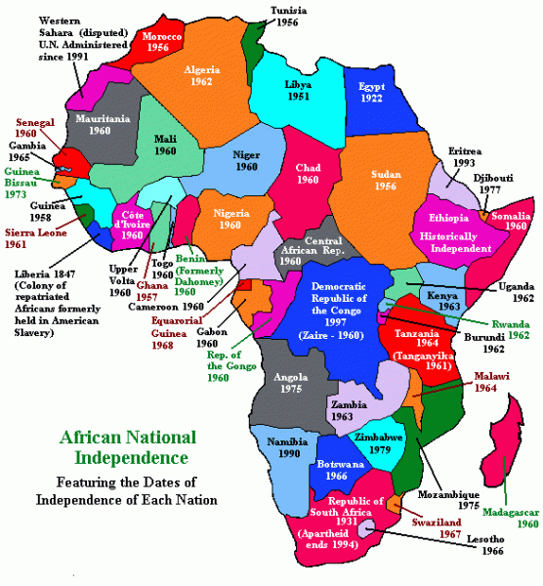
Competition in the so-called “Third World”
1945-1950: Mostly in industrial world or areas contiguous with US
1950s: US, then USSR extends out to other countries outside Eurasia
Decolonization gives rise to national liberation movements
USSR sees as opportunity
US sees as threat: Domino Theory
Role of China

Slide 17
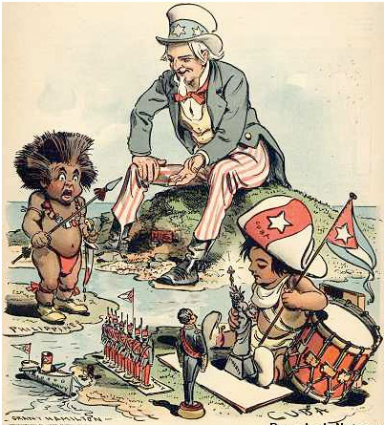
US-CUBA: Now will you be good?
Caption: ”See what I do for a good little boy?”
https://ashp.cuny.edu/news/featured-document-%E2%80%9Cnow-will-you-be-good%E2%80%9D

Slide 18
US-CUBA RELATIONS BEFORE THE COLD WAR
CUBA was part of US Sphere of Influence, but Cuba’s symbolic role for the US went much deeper
John Quincy Adams (1823): “if an apple severed by the tempest from its native tree cannot choose but fall to the ground, Cuba... can gravitate only towards the North American Union which by the same law of nature cannot cast her off from its bosom.”
Efforts to annex Cuba to expand slavery in the United States in 1850s
The Spanish-American War, the Platt Amendment, and the Second Occupation
Fulgencio Batista—1952-1959
US Financial Interests controlled much of Cuban economy: Mining(90%), utilities
(80%), sugar(40%)

Slide 19
US and Castro
Communism and Cuba
  Castro’s Revolution. Against Batista
  Eisenhower: Tepid support, tolerance at first
    Cuba receives oil from Khrushchev, Eisenhower reduces sugar quotas, Cuba appropriates property, Eisenhower declares boycott
    Plans Bay of Pigs
  Kennedy: Agrees to Bay of Pigs, which fails
    Clear plans for removing Cuba

Slide 20
Soviet Interests in Cuba
Seeking to gain national liberation movements
Cuba in the US sphere of influence
Castro was an authentic revolutionary
  Reinvigorates Soviet ideas
  Strengthens against China

Slide 21
BREAK
DOCUMENTARY: COLD WAR
  https://www.youtube.com/watch?v=yOxeZt217uw&list=PL3H6z037pboGWTxs3xGP7HRGrQ5dOQdGc&index=10
QUESTION FOR BRIEF WRITING
  To what extent could the cold war be characterized as simply a contest between two great powers? To what extent did the two superpowers' ideology make the conflict worse?

Slide 22
Emphasis on Voice, Argument and Audience
VOICE: What is your question?
Have something to say
ARGUMENT: Communicating what you think
Communicating why you think that:
Organization
Logic
Evidence
AUDIENCE: What groups do you want to hear
What are the norms for that kind of group
Academic audiences
EDIT: Discard words and sentences you don’t need
Add precision when necessary

Slide 23
WRITING WORKSHOP
Why writing?
Entering a conversation
Important to have something to say
What am I going to emphasize in this week?
What do I hope to accomplish?

Slide 24
Reading Efficiently
Why are you reading?
  To get facts
  To get ideas
What is the question?
What is the argument?
What are the main concepts?
What are the relations between these concepts?
  Is it causation?

Slide 25
Efficient Reading
Look at the title
Read the introduction and conclusion carefully
  Should have the question, the relevant audience and
  If there’s a roadmap, pay attention
Examine the section headings
Actively think about what you are reading

