Slide 1
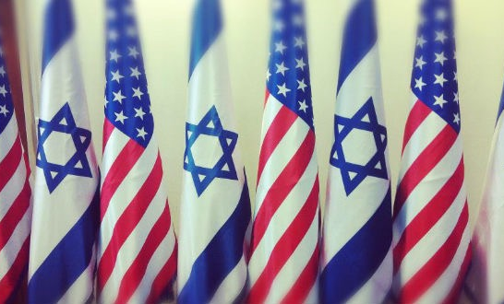
MVZn5009
The Politics of Decision-making: American Presidents, and Israeli Prime Ministers in Crisis

Slide 2
Course Overview
This course will focus on the connections between
  the dynamics of foreign policy decisions and
  the substance of specific foreign policy crisis.
We will learn the relationships among the various decision types,
How they are and how they were chosen,
The constraints that work for or against effective decisions, the environmental influences affecting said decisions, and
The substance of actual, historical foreign policy decisions.

Slide 3
Course Overview
There will be case studies.
Each case study is a crisis.
Those that have been chosen have been done either for their decision type and how the leader with or without other policymakers concluded the crisis.
While some case studies are well known others may not be.

Slide 4
Course Objectives
The understanding of decision types and how political, psychological, cultural, social, and organizational factors influence said decision during crisis.
  Providing comprehension on various themes, historical events, and personalities of American and Israeli leaders.

Slide 5
Learning Objectives
Describe the development of both the American presidency and Israeli premiership to evaluate the consequences and outcomes of the decision making process during crisis;
Explain the formal and informal mechanisms that leaders can use to achieve objectives in a crisis when interacting with other branches of government, the bureaucracy, and the public;
Identify institutional and political constraints that limit the leaders ability to achieve decision making;
Analyze the major factors affecting the successful outcome of crisis
Evaluate the strengths and weaknesses of different decision making type approaches.

Slide 6
Course Requirements
assigned readings;
class attendance and appropriate contributions to section discussions;
two short-essay analysis papers;
a final examination or research paper.

Slide 7
Structure of class
Overview of topic
Case study
Review and commentary

Slide 8
Expectations
Arrive prepared and ready to participate
  weekly readings
  awake
  not preoccupied
Ask questions
Respect to classmates and instructor

Slide 9
Exam Schedule
White paper topic choice (Week 2)
  email to instructor choice (Name_choice)
White paper topic #1 (Week 4)
  (Name_WP1)
White paper #2 (Week 9)
  (Name_WP2)
Final exam (Week 12)
  ALL DUE On Thursdays at midnight

Slide 10
Grading
20 percent on participation.
40 percent for two short papers.
40 percent on the final examination.

Slide 11
Readings
Links are in syllabus to websites and PDF files.
  Instructor will decide from readings
  Not all readings listed will be used
Uploaded to IS are chapters to read

Slide 12
Decision-Making
Models
  rational actor
  bounded rationality cybernetic
  poliheuristic
  prospect
  bureaucratic

Slide 13
Theme: Executive power
Nature of Executive power
  Constitution of U.S.
Generally speaking, the role of the president as a true decision-maker in foreign policy and decision making regarding crisis has found in Article II.
  Tradition in Israel
Generally speaking, the role of the full cabinet as a true decision-making body has declined,
    a marked tendency towards centralizing decision-making in the prime minister office.
Israel is a good example where the full cabinet has rarely been the true center of decision-making.
  there is a “kitchen cabinet” which enjoys constitutional authority to make final decisions in lieu of the full cabinet on security issues.

Slide 14
Executive power
The chief executive's position within the executive branch and in relation to parties and other political players in the wider political process has been upgraded as a result of the effects of the modern mass media, which favor a high degree of personalization of politics.
In addition to the legal and institutional structures, the personal style also affects executive power.
  static
  innovative

Slide 15
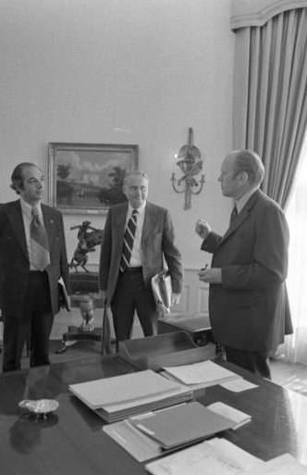
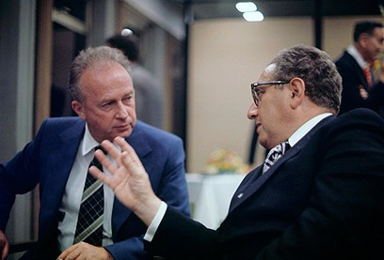
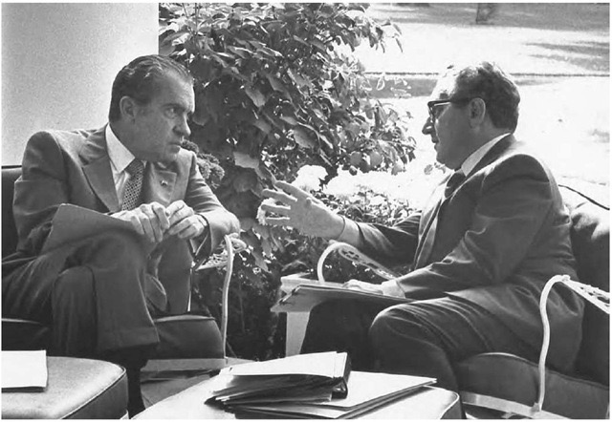

Slide 16
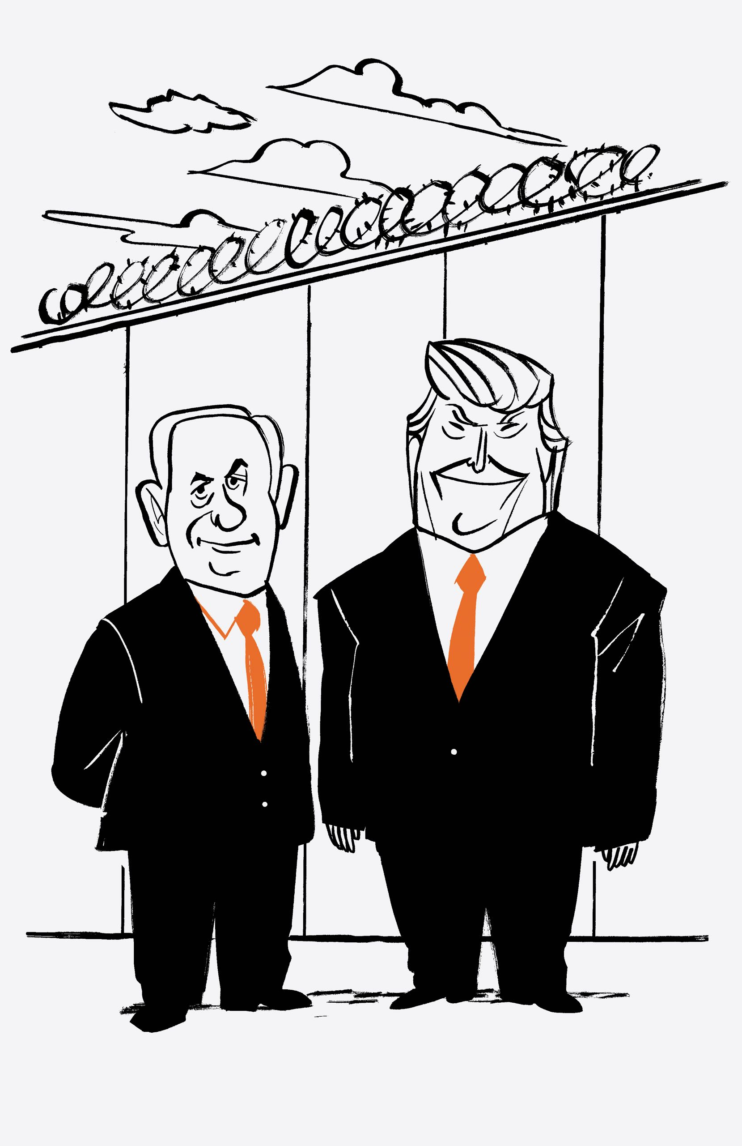
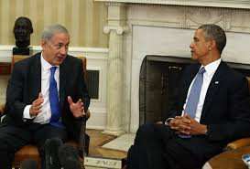
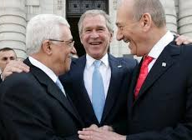

Slide 17
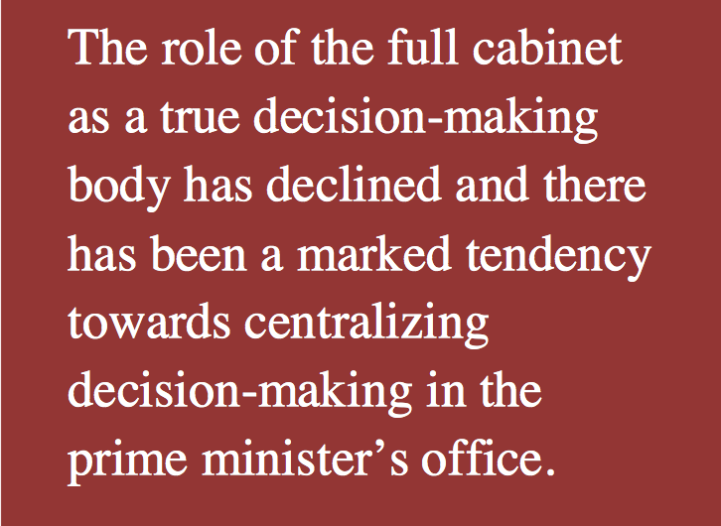
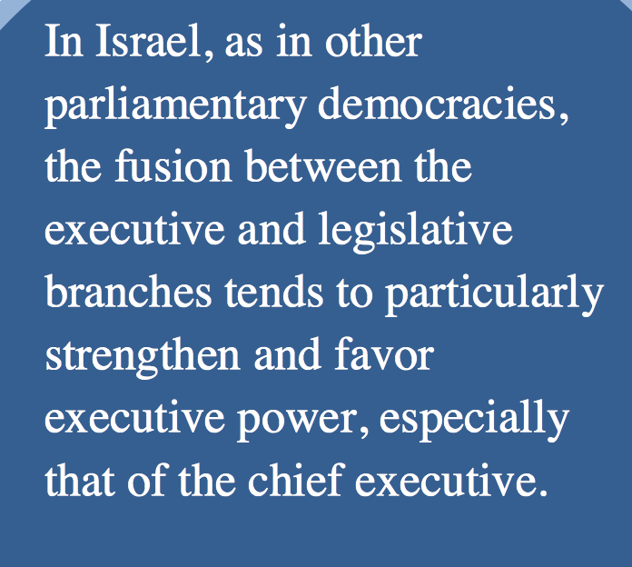

Slide 18
Sources
Dan Korn: “The Presidentialization of Politics: the Power and Constraints of the Israeli Prime Minister”

