Slide 1
Data and measurement
Populist political communication

Slide 2
Based on the ideational approach to populism + a specific communication style
Populism is “a thin-centered ideology that considers society to be ultimately separated into two homogeneous and antagonistic camps, “the pure people” versus “the corrupt elite”, and which argues that politics should be an expression of the volonté générale (general will) of the people.”
(Mudde 2004: 543).

Slide 3
Ideational approach to populism
Three core components of populism
People-centrism
Anti-elitisim
Sovereignty

Slide 4
Populist communication style
E.g. Engesser, De Vreese…
Negativity
Emotionality
Sociability
Register

Slide 5
Content analysis
Content/ textual analysis:
ideas of political actors are measured through messages that they produce (speeches, party manifestos, social media communication etc.)
Communication sources (various texts, pictures, etc.) as „true“ representatives of what politicians say are plan to do

Slide 6
Content analysis
Types of content analysis:
Mancoded/handmade
Computerised/automatized
Note: Classical content analysis can be combined with computerised content analysis (semi-automated content analysis).
- Usually follow the deductive, concept/theory rooted approach
Notes:
There are two main types…

Slide 7
Content analysis
Classical content analysis:
a codebook is defined
coders systematically analyse text by means of a codebook (human-coded approach)
Notes:
In a classical content analysis researchers first create a codebook, in which they specify what they mean by populism, how they want to measure/ code it.
This codebook is then used by coders to analyse populism in texts of political actors – speeches of presidents, party manifestos etc.
People do the analysis – referred to as human-coded approach.

Slide 8
Content analysis
Computerised content analysis:
dictionary of populist terms defined (indicators of populism)
computer counts the proportion of words that we consider to be indicators of populism
Mostly doable in English (some tools in other languages, possibility to use Google Translate)
Fully automatized, AI assisted (machine learning) – not in this class
Notes:
In computerised content analysis researchers first create dictionary containing words/ phrases which are indicators of populism.
Computer is then given both the texts of political actors in which populism should be measured and the dictionary.
Output is the proportions of populist words in those texts.

Slide 9


Content analysis: units of analysis
Notes:
…election manifestos, speeches…

Slide 10
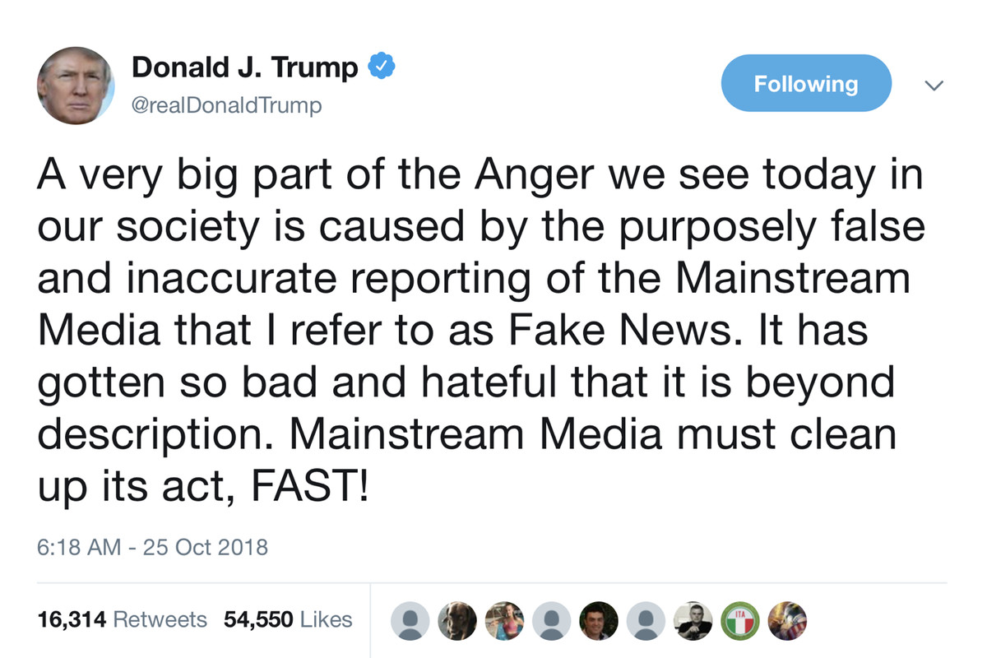
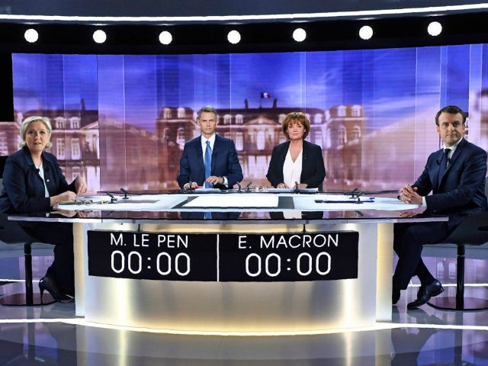
Content analysis: units of analysis
Notes:
…debates, newspaper articles, but also Tweets or Facebook posts.

Slide 11
Content analysis
units of analysis ≠ units of measurement
Notes:
Chunks of these texts are then units of our analysis.

Slide 12

Content analysis: units of measurement
Donald Trump inauguration speech transcript
1
2
3
4
Notes:
These can be paragraphs…

Slide 13
Content analysis: units of measurement
Donald Trump inauguration speech transcript
Notes:
…words…

Slide 14
Content analysis: units of measurement
Donald Trump inauguration speech transcript
1
Notes:
…entire texts (common in case of speeches).
In such case we talk about holistic grading approach in content analysis.

Slide 15
Content analysis in practise
Rooduijn , M. & Pauwels, T. 2011. “Measuring Populism: Comparing Two Methods of Content Analysis.” West European Politics 34(6), 1272–1283, online https://www.tandfonline.com/doi/abs/10.1080/01402382.2011.616665
Notes:
Lets have a look at the article on content analysis you have been asked to read before the class

Slide 16
Content analysis in practise
Rooduijn & Pauwels 2011
authors use both classical and computerised content analysis to measure and compare the degree of populism of political parties in the UK, the Netherlands, Germany and Italy
units of analysis: election manifestos
core components of populism: people-centrism, anti-elitism
Notes:
In their research,…
They measure populism in election manifestos of political parties in these countries.
And they try to identify people-centrism and anti-elitism in these party manifestos.

Slide 17
Content analysis in practise
Rooduijn & Pauwels 2011
Classical content analysis
units of measurement: paragraph
  → comparison of the degree of populism among parties based on % of populist paragraphs in their manifestos
  paragraphs in which both people-centrism and anti-elitism were present selected as populist
Notes:
In classical content analysis they look at individual paragraphs in election manifestos.
Only if both people-centrism and anti-elitism are identified in a paragraph, that paragraph is coded as populist.
Therefore, the comparison of the degree of populism….

Slide 18
Content analysis in practise
Rooduijn & Pauwels 2011
Classical content analysis: operationalisation of the core components of populism
people-centrism: “Do the authors of the manifesto refer to the people?”
  examination of every possible reference to the people (citizens, our country, society, we the people, etc.)
    list of words and combinations of words that could refer to the people: people, citizen(s), community, society, public, population, nation(al), all of us, each of us, everyone, our, we, voter(s), electorate, referenda, direct democracy, public opinion, country, specific country (depending of course on the country under analysis
  interpretation of the broader context
Notes:
By people-centrism authors mean reference to the people.
Coders provided with the list of words and combinations of words that may refer to the people, such as….
Coders also asked to take into account the context – word we may not refer to the people but to the party.

Slide 19
Content analysis in practise
Rooduijn & Pauwels 2011
Classical content analysis: operationalisation of the core components of populism
anti-elitism: “Do the authors of the manifesto criticise elites?”
  focus on criticism concerning the elite in general (critique on a specific party/ politician not coded)
  interpretation of the broader context
Notes:
By anti-elitism authors mean ciriticsm concerning the elite in general, not ciriticism of specific party or polician.
Again, coders asked to take into account the context.

Slide 20
Content analysis in practise
Rooduijn & Pauwels 2011
Computerised content analysis
units of measurement: words
  → comparison of the degree of populism among parties based on % of populist words (words considered populism)
Notes:
In computerised content analysis authors look at individual words in party manifestos.
Therefore, comparison of the degree of populism is based… in those manifestos.

Slide 21
Content analysis in practise
Rooduijn & Pauwels 2011
Computerised content analysis: operationalisation of the core components of populism
focus only on words that refer to anti-elitism
  measurement of people-centrism by means of individual words is nearly impossible (words we and our often mentioned not in reference to the people, but to the political party)
selection of words into dictionary based on both empirical and theoretical reasoning
  election manifestos of populist parties not analysed in this study used to make list of words that such parties have used to express their negativity towards elites
Notes:
Authors developed their own dictionary.
Contains only words that refer to anti-elitism.
They used party manifestos of populist parties not included in the analysis to identify those words.

Slide 22
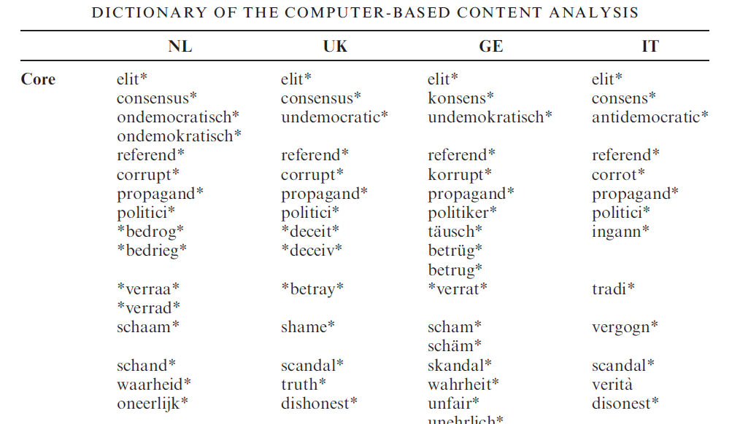
Content analysis in practise
Rooduijn & Pauwels 2011
Notes:
Here you can see what a dictionary used in a computerised content analysis can look like.
Star symbols next to each chunk.
Means that such chunk can be followed or preceded by any letters.
Why is it useful?

Slide 23
Content analysis in practise
Rooduijn & Pauwels 2011
Notes:
Example: chunk corrupt* -> not only word corrupt but also corruption, corrupted counted as indicator of populism in a text

Slide 24
Content analysis in practise
Gründl 2020
Dictionary based approach
Automated content analysis
Words in context
Broader dictionary
Parameters of a dictionary: recall (avoid false negatives) and precision (avoid false positives)
Different units of measurement (sentences and posts on FB and Twitter)

Slide 25
Content analysis
Harvard Dataverse – Global Populism Database: https://dataverse.harvard.edu/dataset.xhtml?persistentId=doi:10.7910/DVN/LFTQEZ
measurement of the level of populist discourse in the speeches of 215 chief executives (presidents and prime ministers) from 66 countries across all continents, mostly between 2000 and 2018
holistic grading
Notes:
For this course, Global populism Database more usufl
Dataset contains data on measurement …..
Holistic grading used – entire text – speech – one unit of analysis.
Example of codebook.

Slide 26
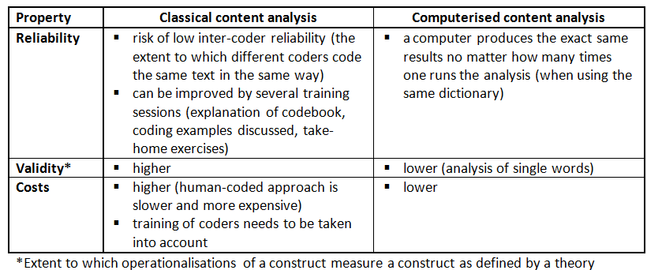
Advantages & Drawbacks of different types of content analysis

Slide 27
Visual materials as a political content
Basic assumption on the importance of visual materials – affecting our attitudes, values and also perception of politics
What are visual materials: pictures, movies, sculptures (anything you can see)
Different ways of analysis (similar to text analysis) – both qualitative and quantitative

Slide 28
Quantitative approach
Similar to other quantitative analysis – theoretical assumptions, ideally formulation of theoretically driven hypotheses (BUT explorative approach possible as well)
Definition of variables of interest (objects /leader, other members of the leadership, other parties/, environment /e.g. mingling with the people/, clothing, policy areas, types of pictures /e.g. Selfies/)
Usually comparative hypotheses (are populist visual materials more people-centric than materials of other political parties?) – otherwise how would you know that something is more or less?
Possible questions:
In which circustances are leaders of populist parties presented?
How are other political parties presented in visual materials of different political actors?
Challenge (not much has been done so far): How to measure populism in visual communication?

Slide 29
Types of questions (Bell)
Try to think of these types of questions in relation to populist communication

Slide 30
Data in quantitative analysis
Similar principles as in textual analysis
Definition of the corpus (data) – which pictures/movies should I analyze?
  Driven by research questions
  Possibilities – election period, representative sample, related to a specific topic, different time periods, etc.
units of analysis – pictures, frames, parts of pictures such as politicians, environement, tonality… (dependent on the question)
Values – the same as the text analysis (remember: mutually exclusive and ideally exhaustive categories – see Krippendorf)
Interpretation – prevalent characteristic, comparison…
Reliability – not that so much of our concern in the course but values/categories should be defined as clearly as possible

Slide 31
Qualitative approach
Deeper understanding of the content
Visual materials are not translated into numbers or quantifiable categories
Interpretation, effort to find a context for interpretation
Meaning instead of numbers

Slide 32
Example I: Doerr
Qualitative approach
„visual posters and symbols constructed and circulated transnationally by various political actors to mobilize contentious politics on the issues of immigration and citizenship“
Transnational spillover
Comparison of ideologically different political actors
„how did the SVP and EuroMayday campaigns portray the relationship between immigrants and citizens in order to reach out and mobilize supporters in distinct national contexts and transnationally?“

Slide 33
Data, method and results
SVP, NPD and LN
analysis of the black sheep campaign, the sample includes relevant visuals found on web pages and blogs by the groups associated with the cases studied (98 visuals, blacksheep related)
Discoursive analysis, visual iconography, contextualization (you do need to follow the method in details, instead concentrate on the qualitative nature of the analysis)
Comparison of the ways of transnational spillover and adaptation of communication related to immigration

Slide 34
Example II: Wodak, Forchtner
Analysis of a specific visual materials – Sagas from Vienna
Qualitative approach – discourse-historical approach
„calculated ambivalence“ – blurring the line between fiction and reality
Politics of memory
Contextual analysis of discoursive practices
What is important here is the conceptual and analytical background suited to the research questions – remember: research design follows your questions

Slide 35
Conclusion
You can meaure level of populism by collecting new data or by using existing data sources
An economic way how to assess policy positions of parties or compare them accross countries or time
In same cases not necessary to know the language, althouhg the numbers needs to be explained

