Slide 1
History of Social Anthropology (Course Code: SANb 2032)
FSS, Masaryk Univ. Brno
When: Winter/Spring 2022, Thurs from 16:00 to 17:40 (CET). Where: U43
Course convenor: Dr Patirck LAVIOLETTE
246133@mail.muni.cz / patrick.laviolette@fss.muni.cz
Office Hours: Tuesdays 14:00 16:00 (or Zoom appointment)
Office: Room 3.48, Joštova 218/10. 602 00 Brno
Phone: +420 549 49 49 04
Or by Zoom appointment:
Notes:
1

Slide 2

AJEC 2022, 31 (1): i-117
30 year retrospective of
the relationship between
(auto) biography and anthro.
https://www.berghahnjournals.com/view/journals/ajec/31/1/ajec.31.issue-1.xml

Slide 3
Autobiog associated with Western individualism.
Connected to study of the familiar
i.e.
Jackson, A. (ed). Anthropology at Home (ASA series)
London: Tavistock
The personal is political (influence of feminism
in the 60s 70s).
The personal is theoretical.
Texts as products of Multiple voice; bodies as memory.

Slide 4
French speaking genealogy ‘anthropologie et sociologie’
Émile Durkheim [1858-1917]
(Sorbonne)
Marcel Mauss [1872-1950] Lucien Lévi-Bruhl [1857-1939]
(Collège de France) (Sorbonne, misc)
Lévi-Strauss [1908-2009] Marcel Griaule [1898-1956] Germaine Dieterlen [1903-99] Luis Dumont [1911-98]
(Sorb. São Paulo, (Sorbonne ) (Sorb, CRNS, Musée de l'Homme) (Paris EHESS)
Collège de France)
Pierre Bourdieu [1930-2002] Jean Rouch [1917-2004] Luc de Heusch [1927-2012]
(Lille, EHESS, (misc., film-maker ) (Free Univ Brussels / film-maker)
Collège de France)

Slide 5
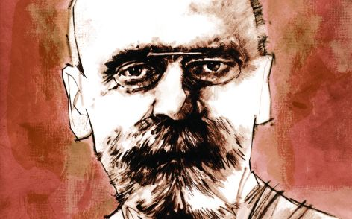
D. Emile Durkheim

Slide 6
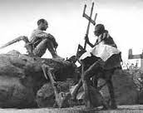
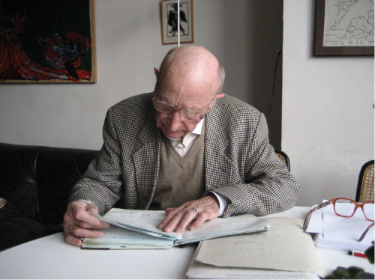
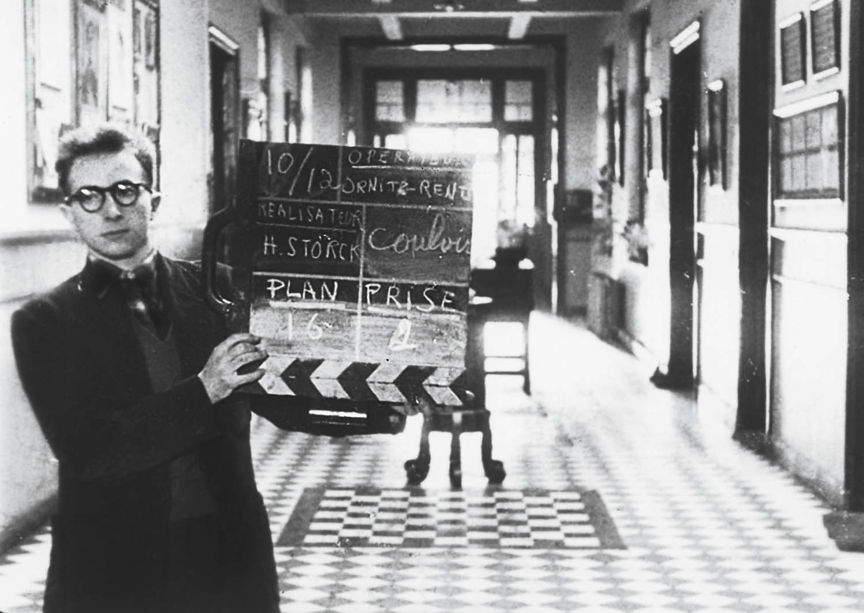
Germaine Dieterlen,
Edgar Morin, Jean Rouch
Marcel Griaule amongst the Dogon of West Africa
Screening of Luc de Heusch (1983) Tracing the Pale Fox

Slide 7


Slide 8
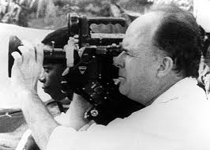
Jean Rouch

Slide 9
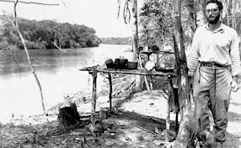
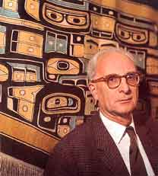
Claude Levi-Strauss

Slide 10


Slide 11
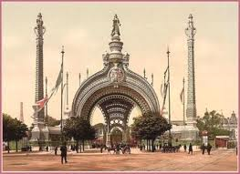
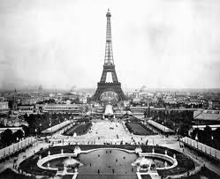
exposition 1889
Entrance to 1900, exposition, Paris
Les expositions nationales et universelles; 1844, 1855, 1867, 1889, 1900

Slide 12
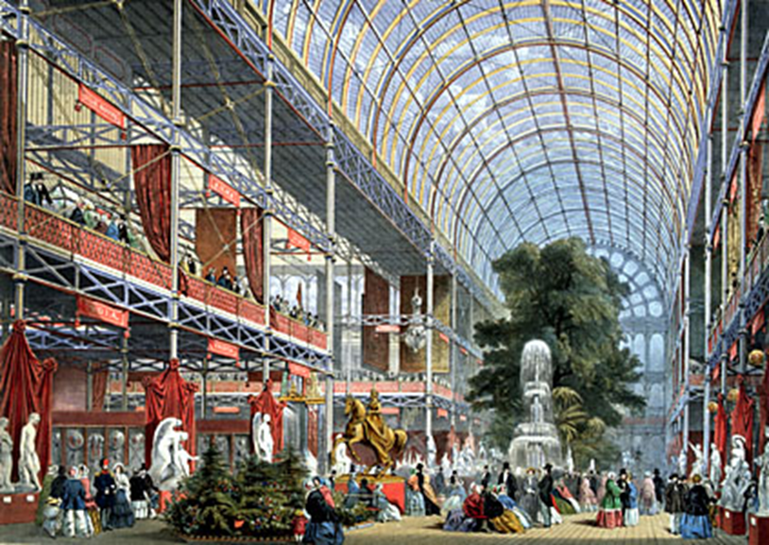
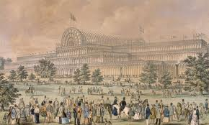
Crystal Palace London
great exhibition, 1851
Notes:
12

Slide 13
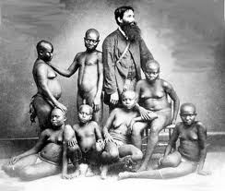
J.N. Homfray with Andaman group, 1865.
Photo shown at Paris Exposition of 1867.

Slide 14
